Slide 1
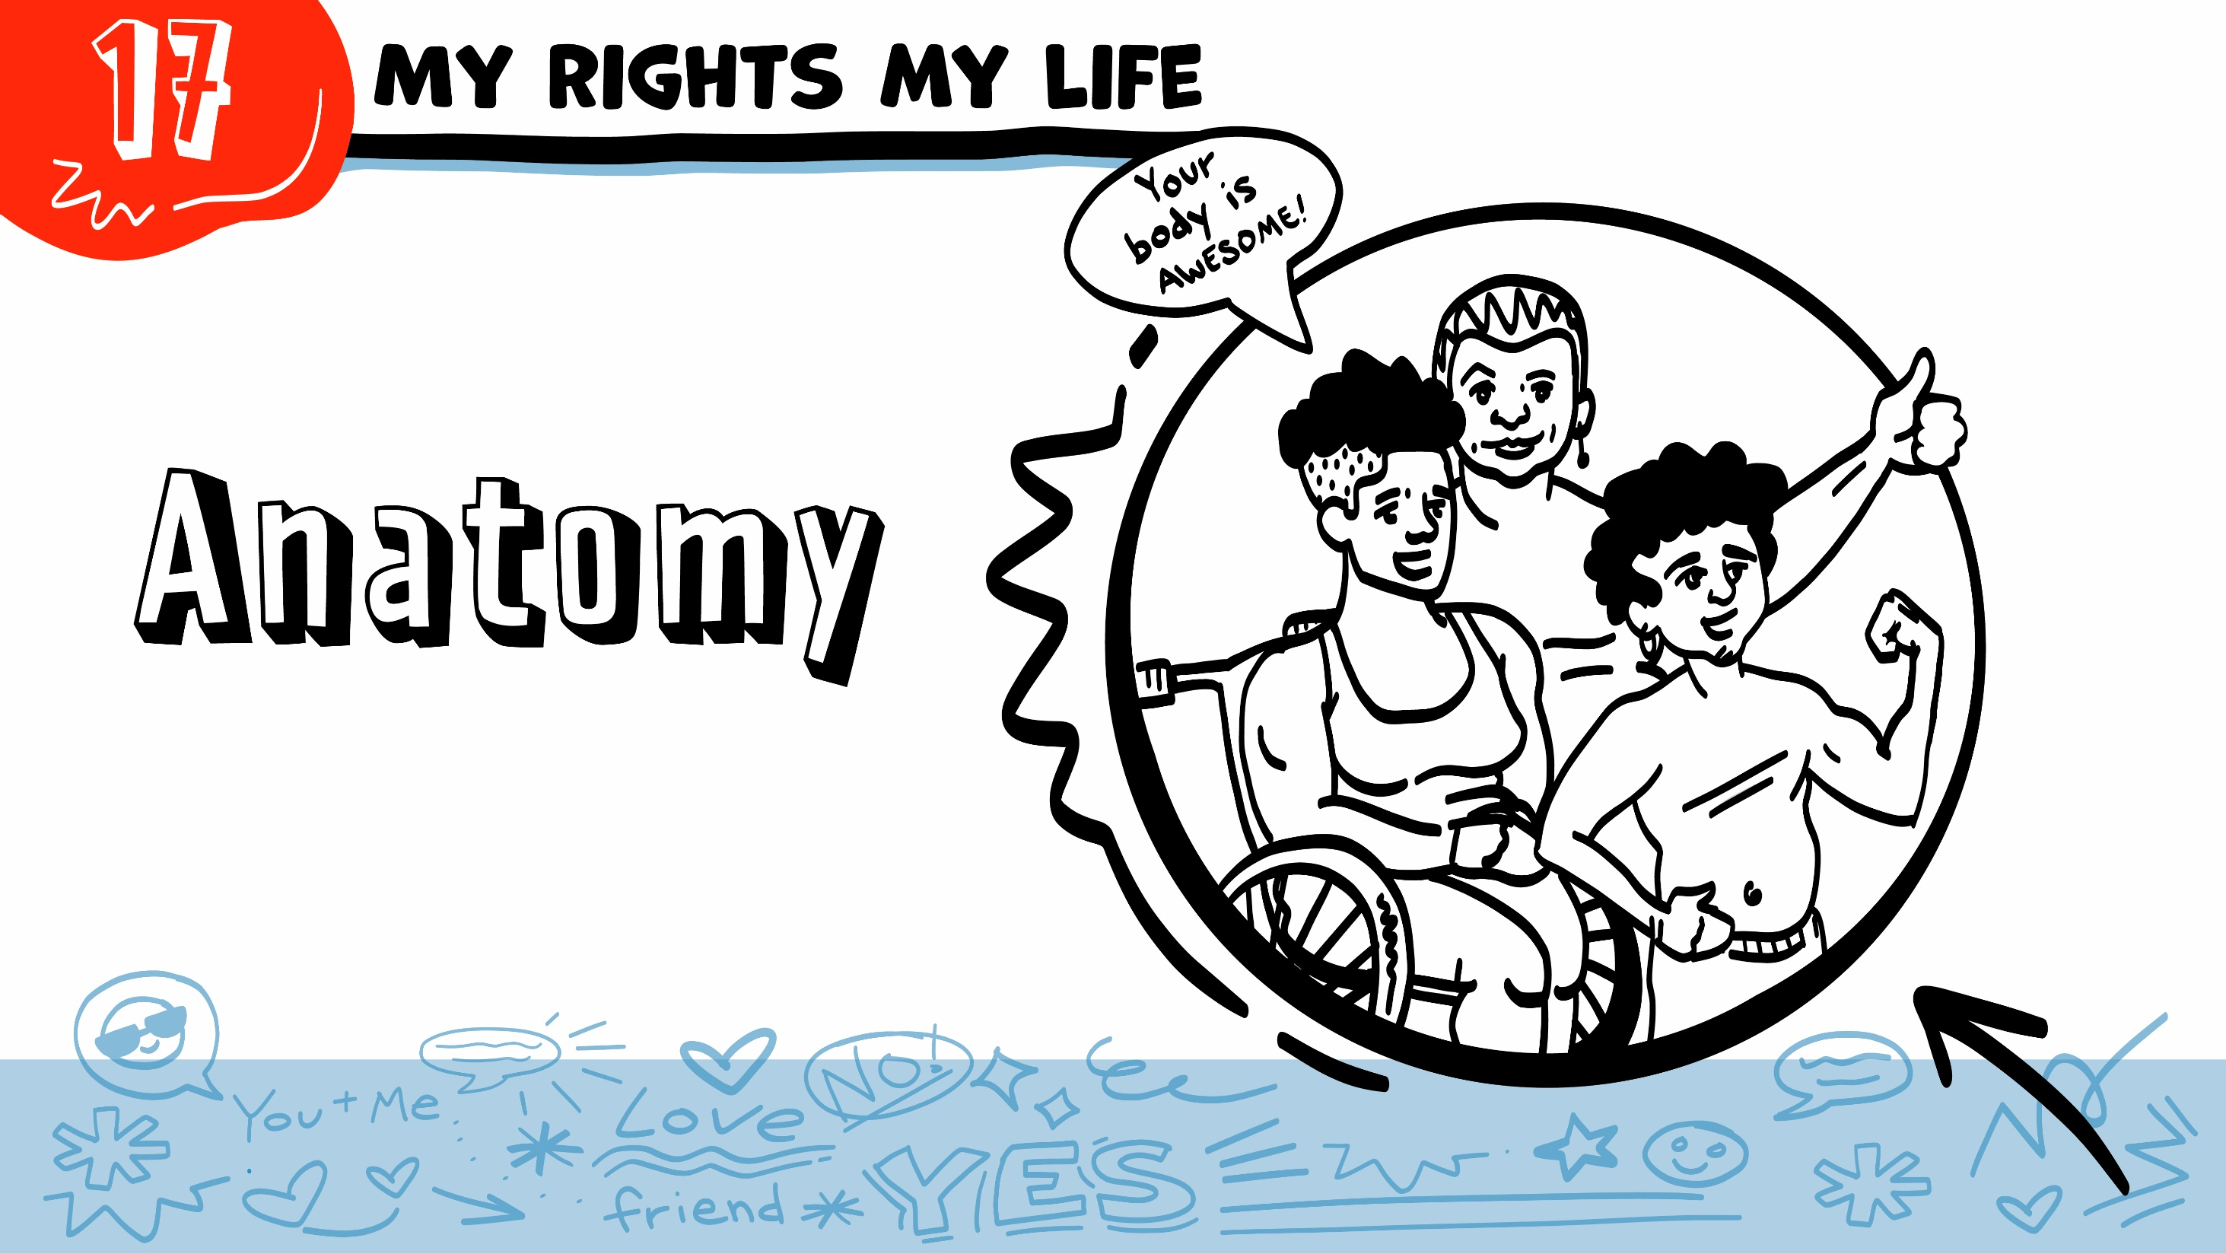
© 2022 SAFE Disability Services Program
Notes:
Repetition is beneficial for learning. Take time to review the last My Rights My Life class you taught prior to beginning this session. You can also answer any private questions students submitted on notecards during your previous class session.
Say: Today in class we will be talking about anatomy. Anatomy means body parts. We will be talking about genitals and other body parts, as well as what happens to these body parts when you are being sexual.

Slide 2
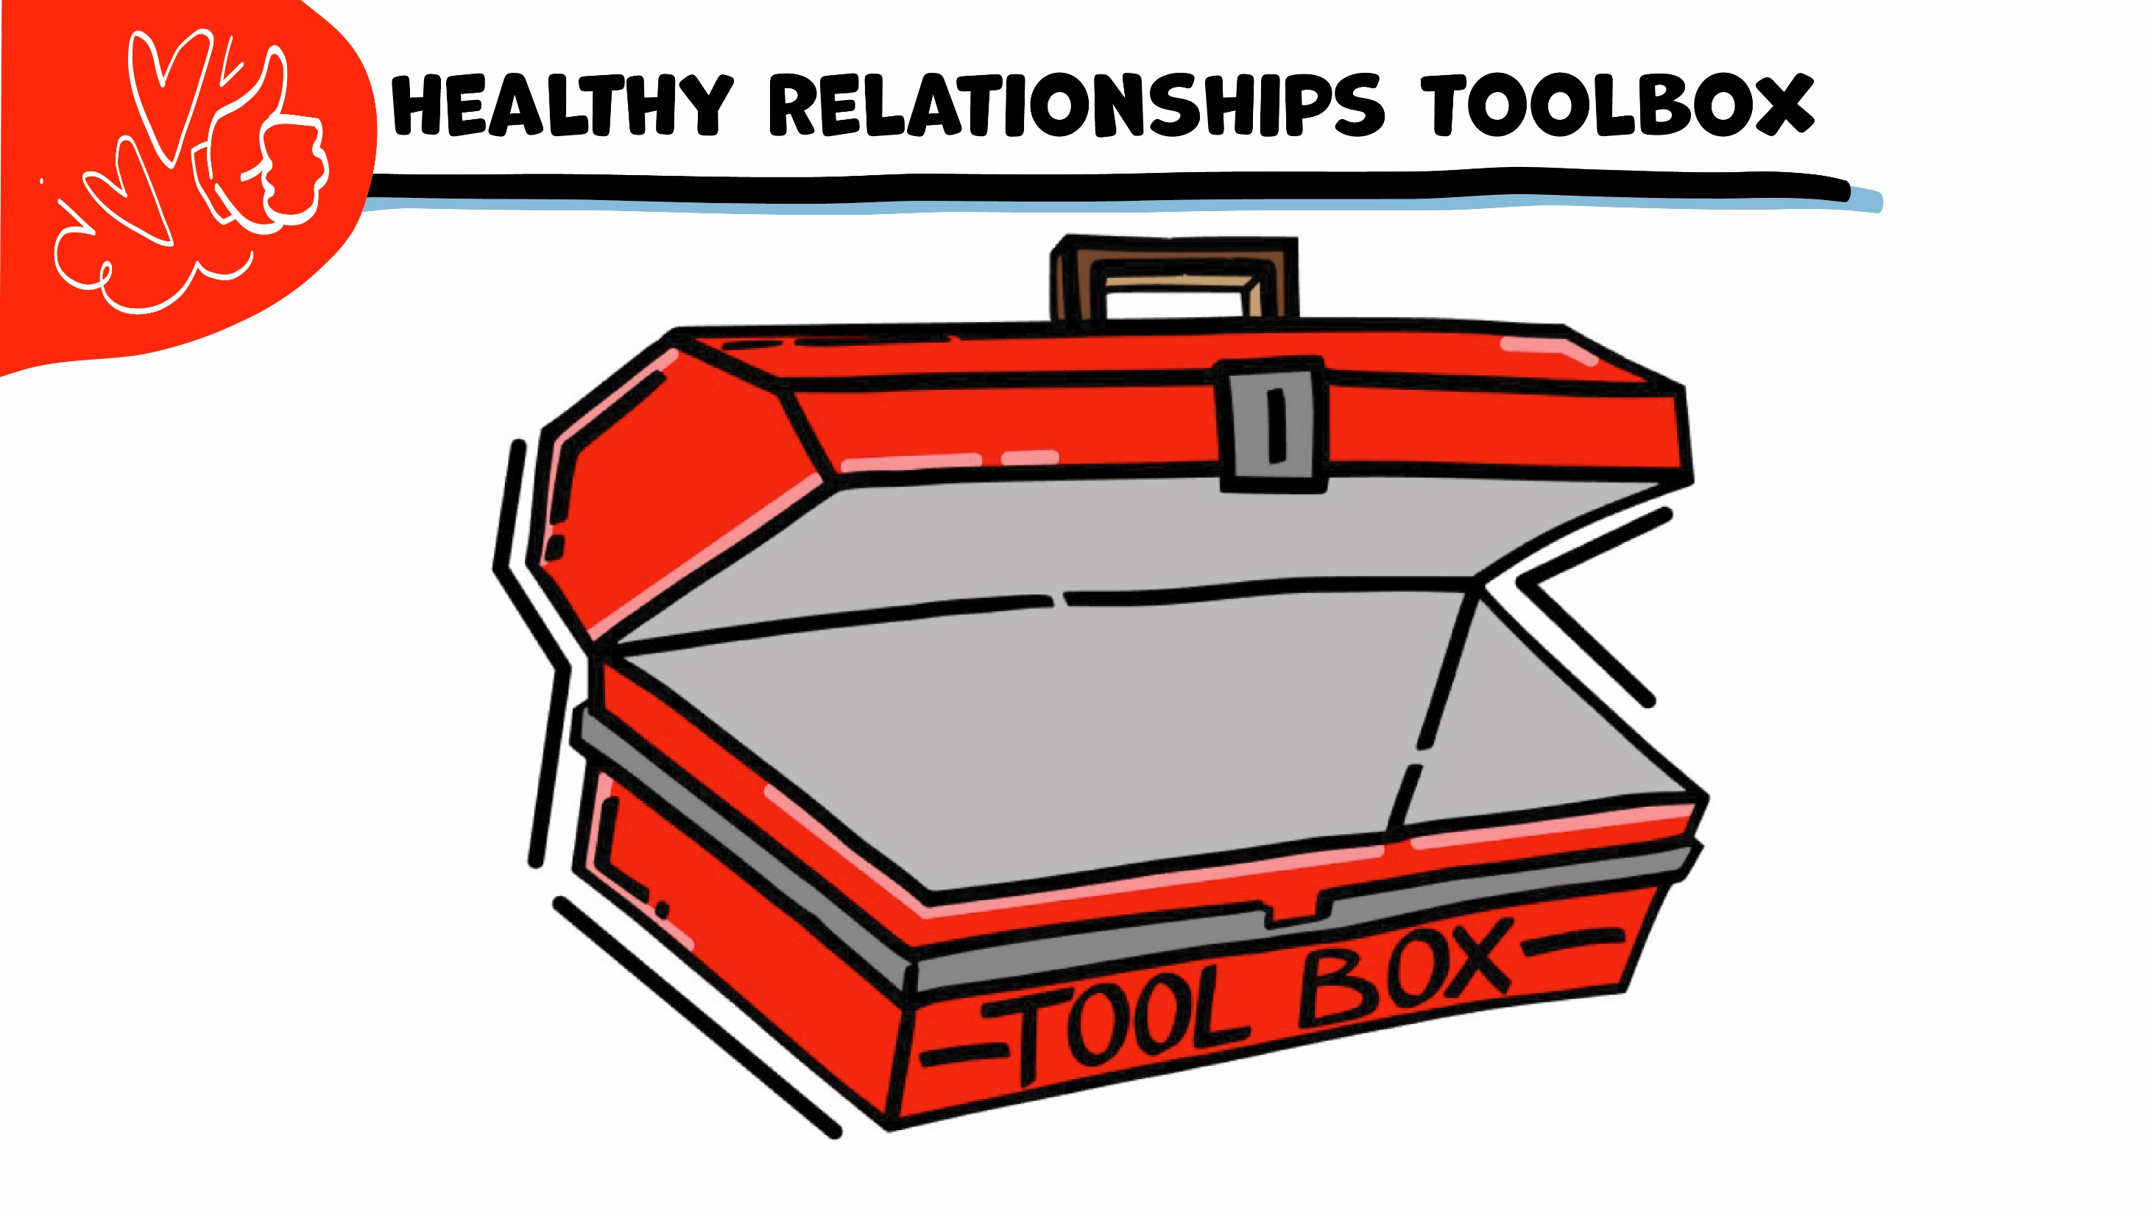
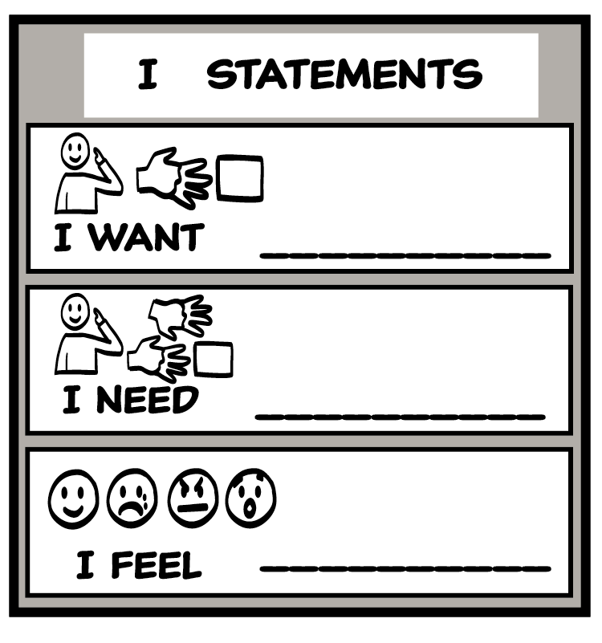
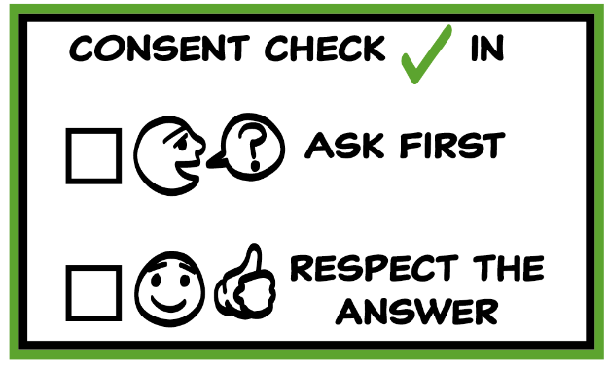
© 2022 SAFE Disability Services Program
Notes:
Use the large class Healthy Relationship Toolbox to review the Healthy Relationship Tools (I Statement, Relationship Map, NO!, and Consent Check-In). You can ask students to pull off one tool at a time and discuss what it is and how it is used. It can be particularly helpful for this review if you give students specific scenarios to think through. For example, you might ask, “If your friend lies to you, what is one I Statement you could use to tell your friend how you feel?” You may even consider using examples of situations that have recently occurred in your classroom, as long as doing so does not break student confidentiality. You can also ask students to connect the toolbox tools to their current relationships. You might say, “Can anyone volunteer and tell me about something going on in your life right now that the toolbox could help you with?”
Instructions for how to use each Healthy Relationship Tool can be found in the following classes:
I Statements: Classes 2 and 3
Relationship Map: Class 4
NO!: Class 5
Consent Check-In: Class 6

Slide 3
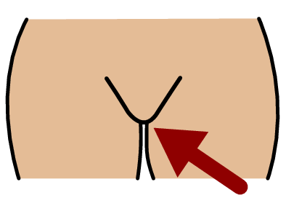
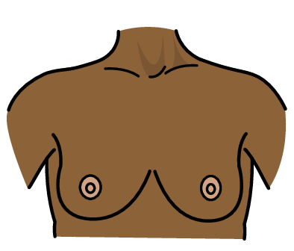
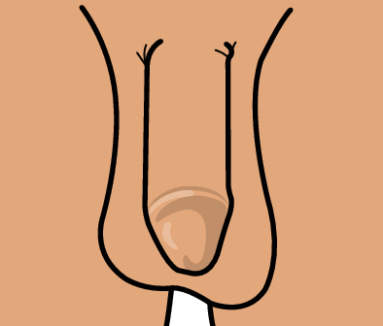
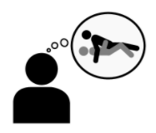
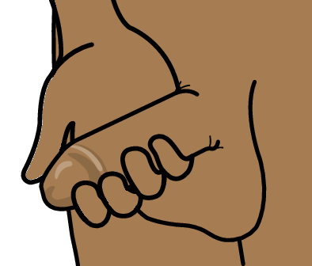
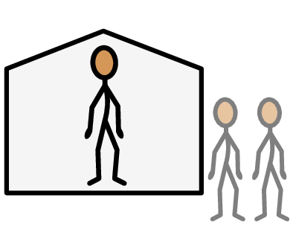
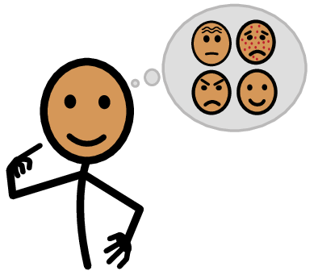
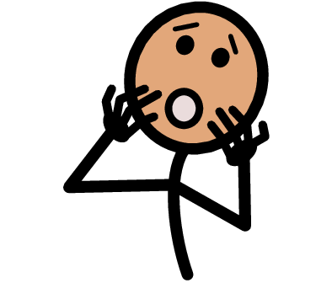
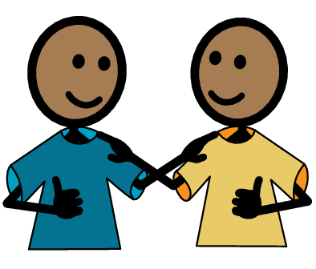
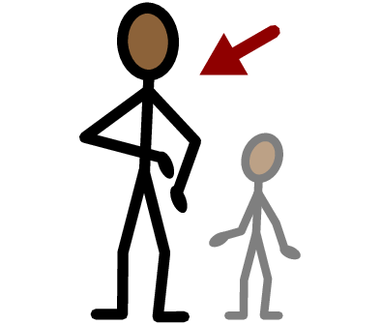
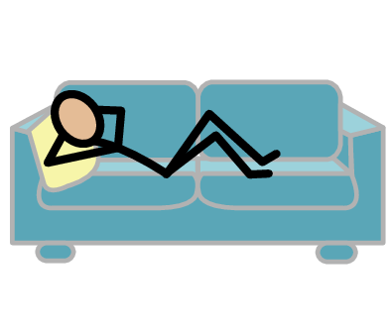
Vulva
Penis
Breasts
Sexual feelings
Yes
No
Masturbate
Public
Private
I need help
I have a question
Trust
Adult
Take a break
I feel
Happy
Sad
Mad
Scared
Copyright © 2021 SymbolStix, LLC. All rights reserved. Used with Permission.
Notes:
You can print this slide separately so each student can use the Important Words Sheet as a communication board throughout class. Review the words using the suggested definitions below. To enhance understanding, you can ask students to come up with their own definitions for vocabulary words or to provide a sentence or scenario using the new word.
Penis: a genital or private part
Vulva: a genital or private part
Breasts: a body part on the chest
Sexual feelings: when you feel attracted to someone, and want to kiss or touch them
Masturbate: when someone touches their own genitals to feel good sexually
Public: places where other people can come in and out and there are sometimes a lot of people, like a mall
Private: places where other people need your consent to come in and to leave, like your bedroom

Slide 4
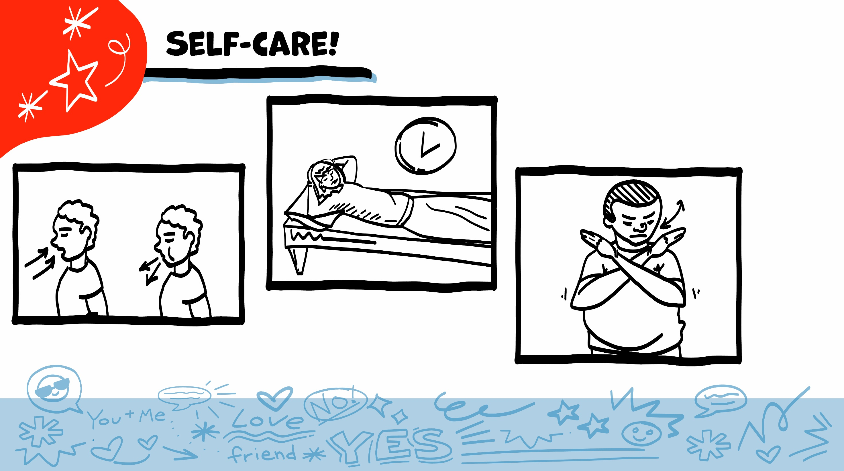
© 2022 SAFE Disability Services Program
Notes:
Say: As part of our class today, we will look at some pictures of bodies and body parts. You might feel embarrassed when we talk about this. You might not feel embarrassed. Either one is okay. Remember to check in with yourself, and to take care of yourself throughout class. If you feel overwhelmed, you can always take some deep breaths, take a break, or pass on an activity.
If your class completed the pre-teach activity, you can also encourage students to use the self-care behaviors they listed on the class flipchart paper or their individual emotion plans.

Slide 5
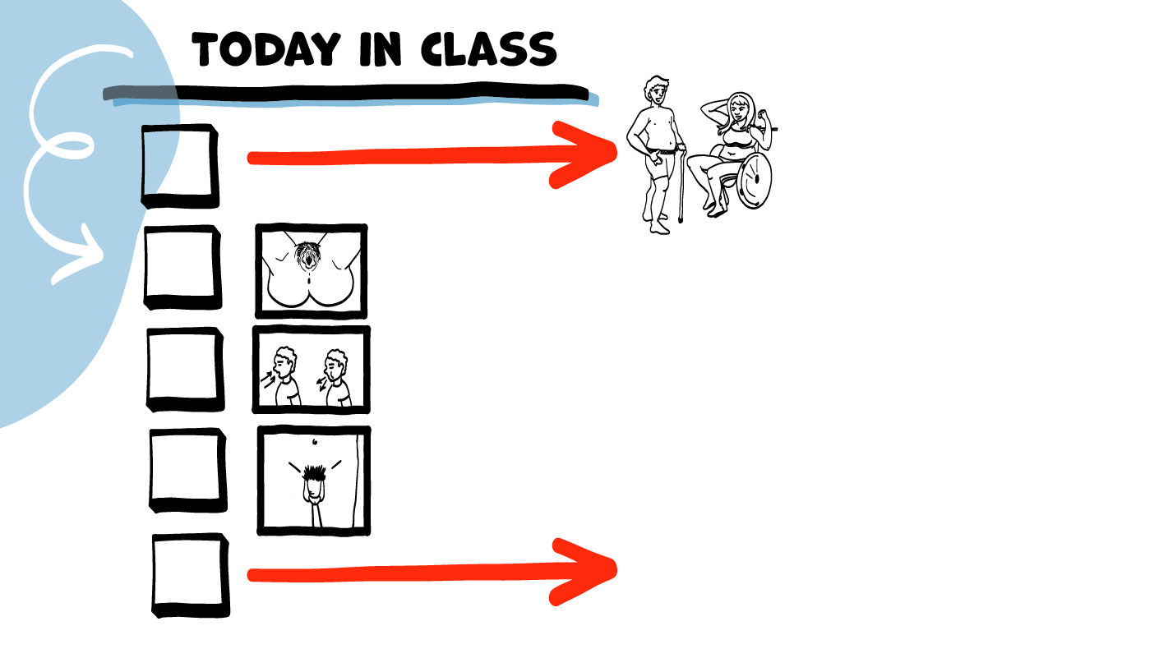
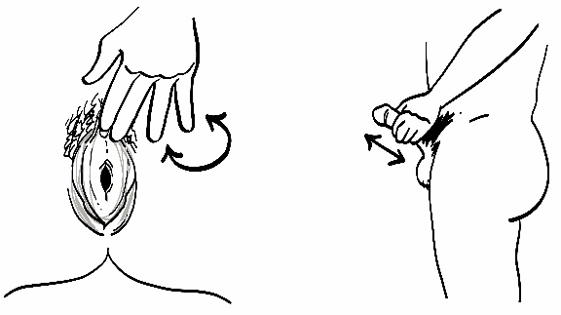
Your body is awesome!
People with vulvas and vaginas
Brain break
People with penises and testicles
Masturbation and
safety
© 2022 SAFE Disability Services Program
Notes:
Read the agenda. Alternatively, you can ask for a student volunteer to read the agenda.

Slide 6
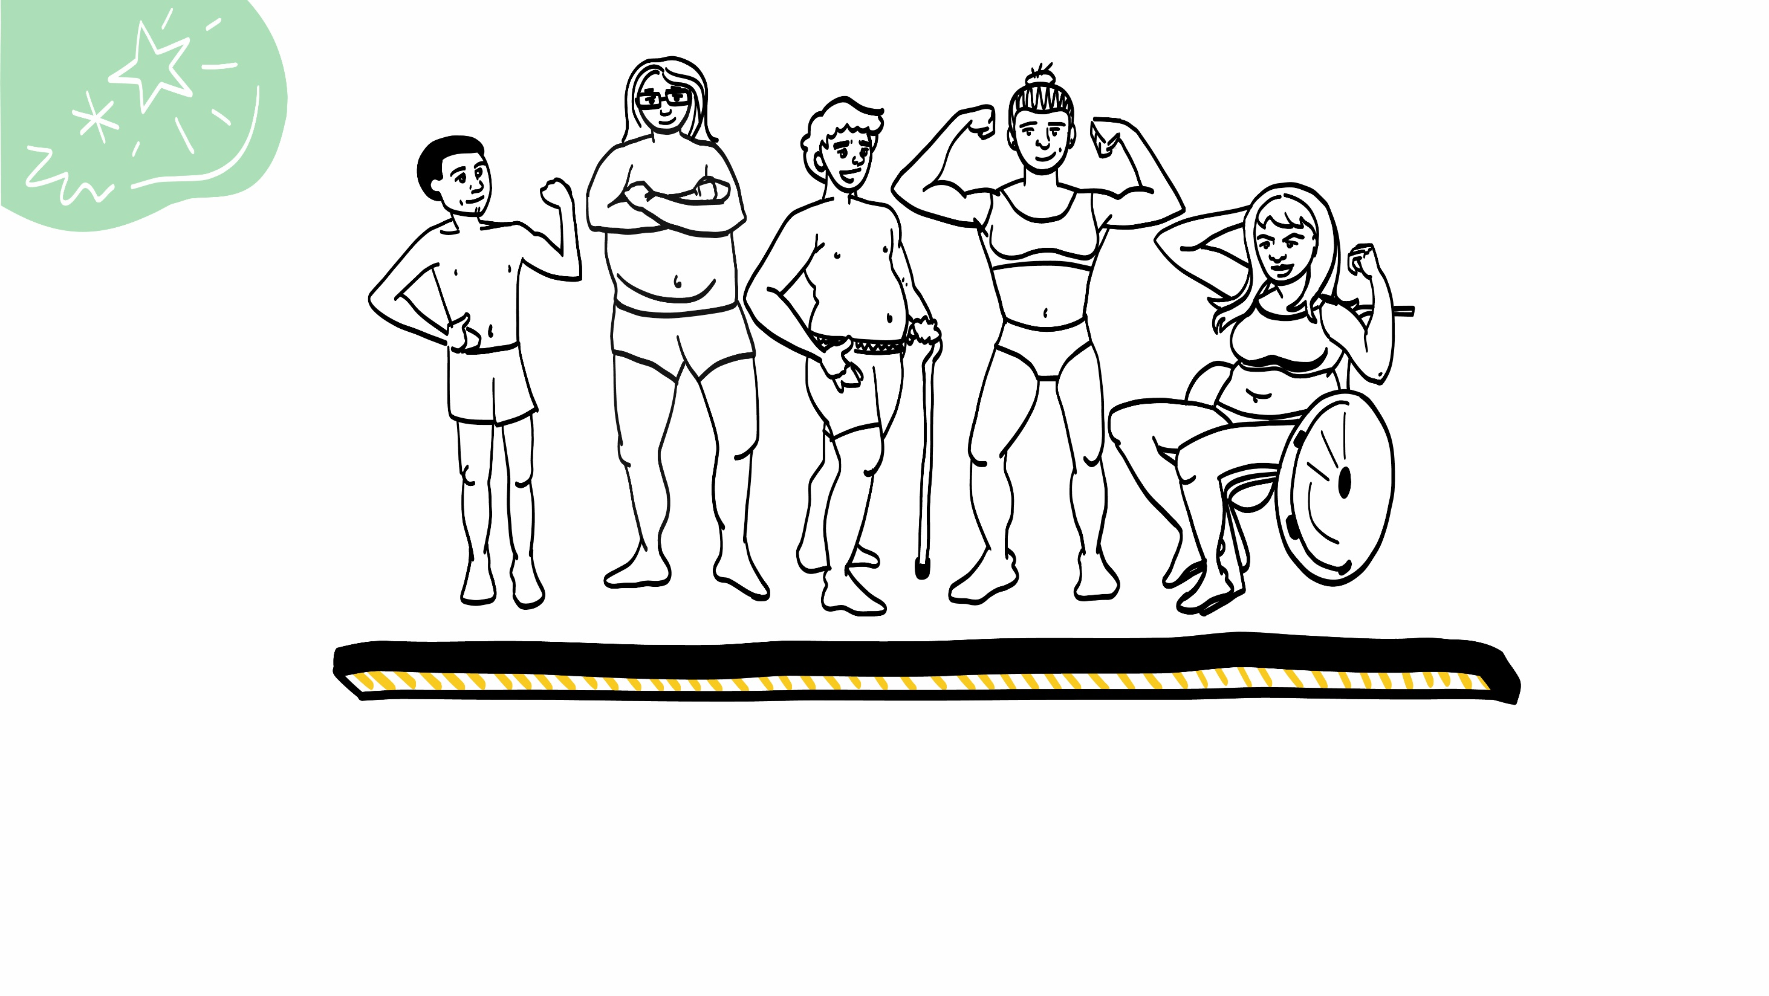
Your Body and Sex
© 2022 SAFE Disability Services Program
Notes:
Say: Over the next month and a half, we will be talking about bodies and sex. Knowing about bodies and body parts can help you stay safe and feel good when you are being sexual.
You are all adults, and this is important information for you to have so that you can be safe if and when you decide to be sexual. There is nothing inappropriate or wrong about learning about bodies and body parts. Sex is a normal part of life—it is not a bad or dirty thing to talk about. Our class is a safe place to ask questions and to learn more about your body and how to be safe when you are being sexual. You can also always ask someone in your circle of trust (green) if you have questions about bodies and sex.
There are other places that may not be okay to talk about bodies and sex. For example, it’s not okay to talk about bodies and sex when young children are around, or while you are at work. If you are ever unsure if it’s an okay time or place to talk about bodies and sex, ask someone in your circle of trust (green circle).

Slide 7
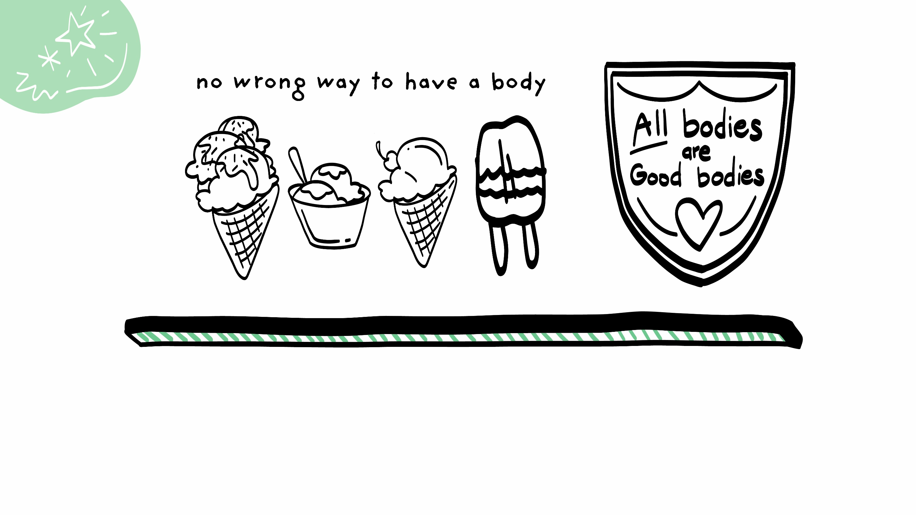
Your Body is Awesome!
© 2022 SAFE Disability Services Program
Notes:
Say: Bodies come in a million different shapes, sizes, and colors. There is NO right or wrong body. Whatever body you have is totally normal and awesome. Can I hear you all say “My body is awesome!”?

Slide 8
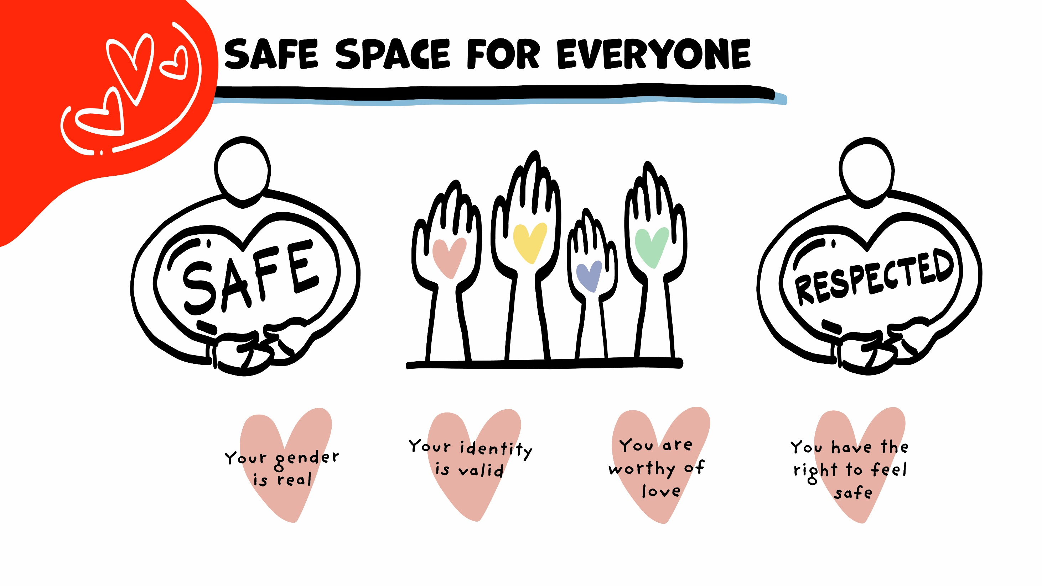
© 2022 SAFE Disability Services Program
Notes:
Say: Today in class we are going to talk about different body parts and identities. It is so important that everyone feels safe and respected in our class. It would not be respectful to say things like “ew” or “gross” as we look at pictures. We don’t want anyone to feel bad about how their body looks. Give me a thumbs up if you agree to be respectful today in class.

Slide 9
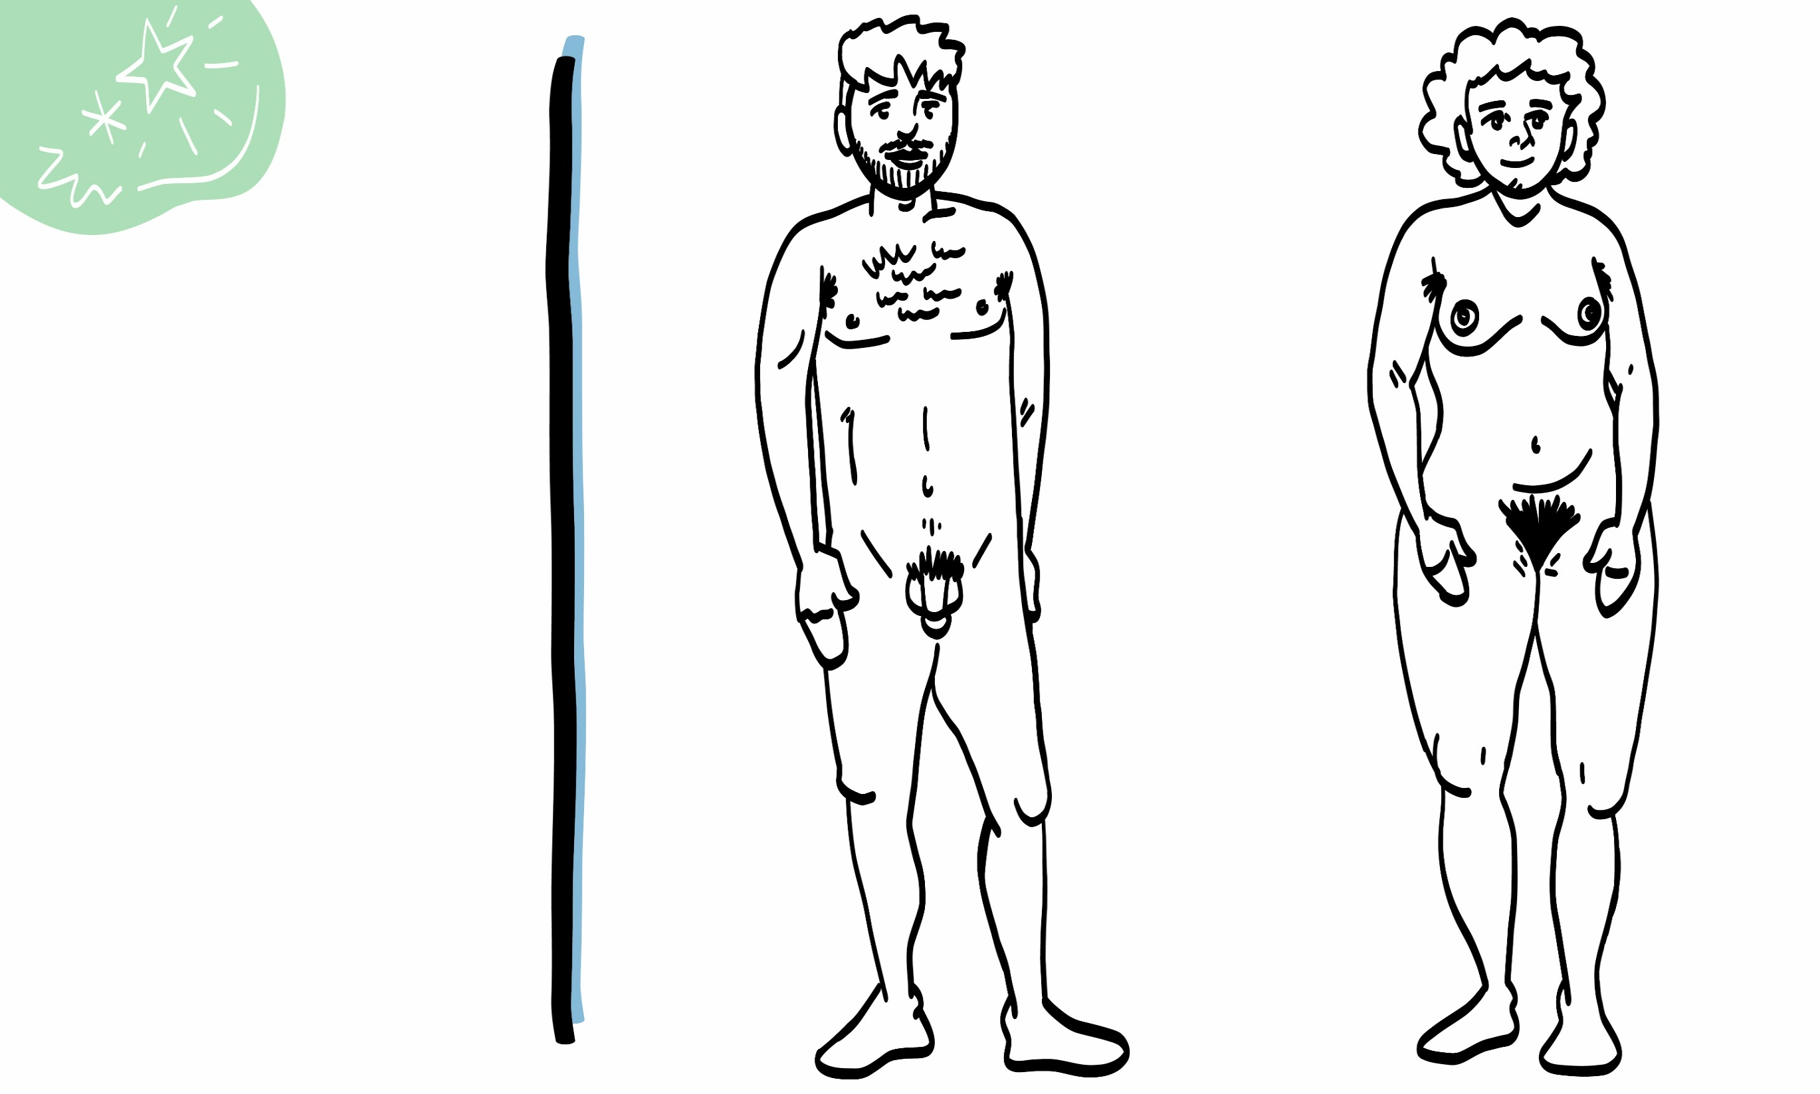
Puberty and How your Body Changes
© 2022 SAFE Disability Services Program
Person with a penis
Person with a vulva
Notes:
Say: In our classes on gender, we talked about how all people get to tell other people what their gender is. No matter what body parts you have, you get to tell us what your gender is. Today in class, we won’t talk about “women’s bodies” or “men’s bodies.” Instead, we’ll talk about the bodies of people with vulvas and vaginas, and the bodies of people with penises and testicles. We are doing this because some people with penises do not identify as men, and some people with vulvas and vaginas do not identify as women. Vulva may be a new word for you. We’ll talk a little later in class all about what that word means.
But first, let’s start by thinking about puberty and the way it changes the body. Does anyone remember what puberty is?
Give students enough time to process the question and make their decisions.
When people are young, usually in middle school, they start to go through puberty. Puberty is when the body changes to get ready for adulthood. During puberty, many people start to have sexual feelings and notice that their sexual body parts, or genitals, are changing. This happens at different times for everyone. It may happen earlier in elementary school or later in high school, but whatever time it happened for you is healthy and normal.
Let’s look at the picture on the left side of the screen. What changes happen to the body of a person with a penis during puberty?
Give students enough time to process the question and make their decisions. After students are done sharing, you can fill in any information they missed from the list below:
Grow taller and gain weight
Muscles get larger.
Shoulders get wider.
Body hair on arms, legs, chest, and back may get thicker.
Hair begins to grow on the armpits.
Pubic hair, the hair at the beginning of the penis, begins to grow.
Facial hair, such as mustaches and beards, begins to grow.
The penis and the testicles get larger.
The voice gets deeper.
People may sweat more or start to have acne. Some people start to wear deodorant.
Now let’s look at the picture on the right side of the screen. What changes do you all think happen to the body of a person with a vulva and vagina during puberty?
Give students enough time to process the question and make their decisions. After students are done sharing, you can fill in any information they missed from the list below:
Grow taller and gain weight
Breasts get larger. Some people start to wear bras.
Hips get wider.
Body hair on arms and legs may get thicker.
Hair begins to grow on the armpits.
Pubic hair, the hair on the vulva, begins to grow.
First menstruation. Menstruation is also called a “period” or “the time of the month.” This is when blood and other fluids come out of the vagina. Menstruation will be discussed more later in class.
The vagina will begin to produce a white discharge, or fluid.
People may sweat more or start to have acne. Some people start to wear deodorant.

Slide 10
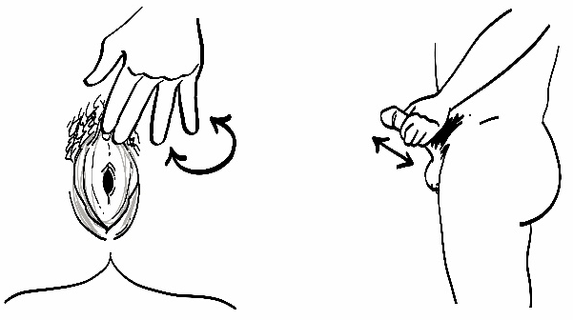
Your body is awesome!
People with vulvas and vaginas
Brain break
People with penises and testicles
Masturbation and
safety
© 2022 SAFE Disability Services Program
Notes:
Say: Now that we have talked about how all bodies are amazing, we are next going to look at some specific body parts. We will start by talking about the bodies of people with vulvas and vaginas.

Slide 11
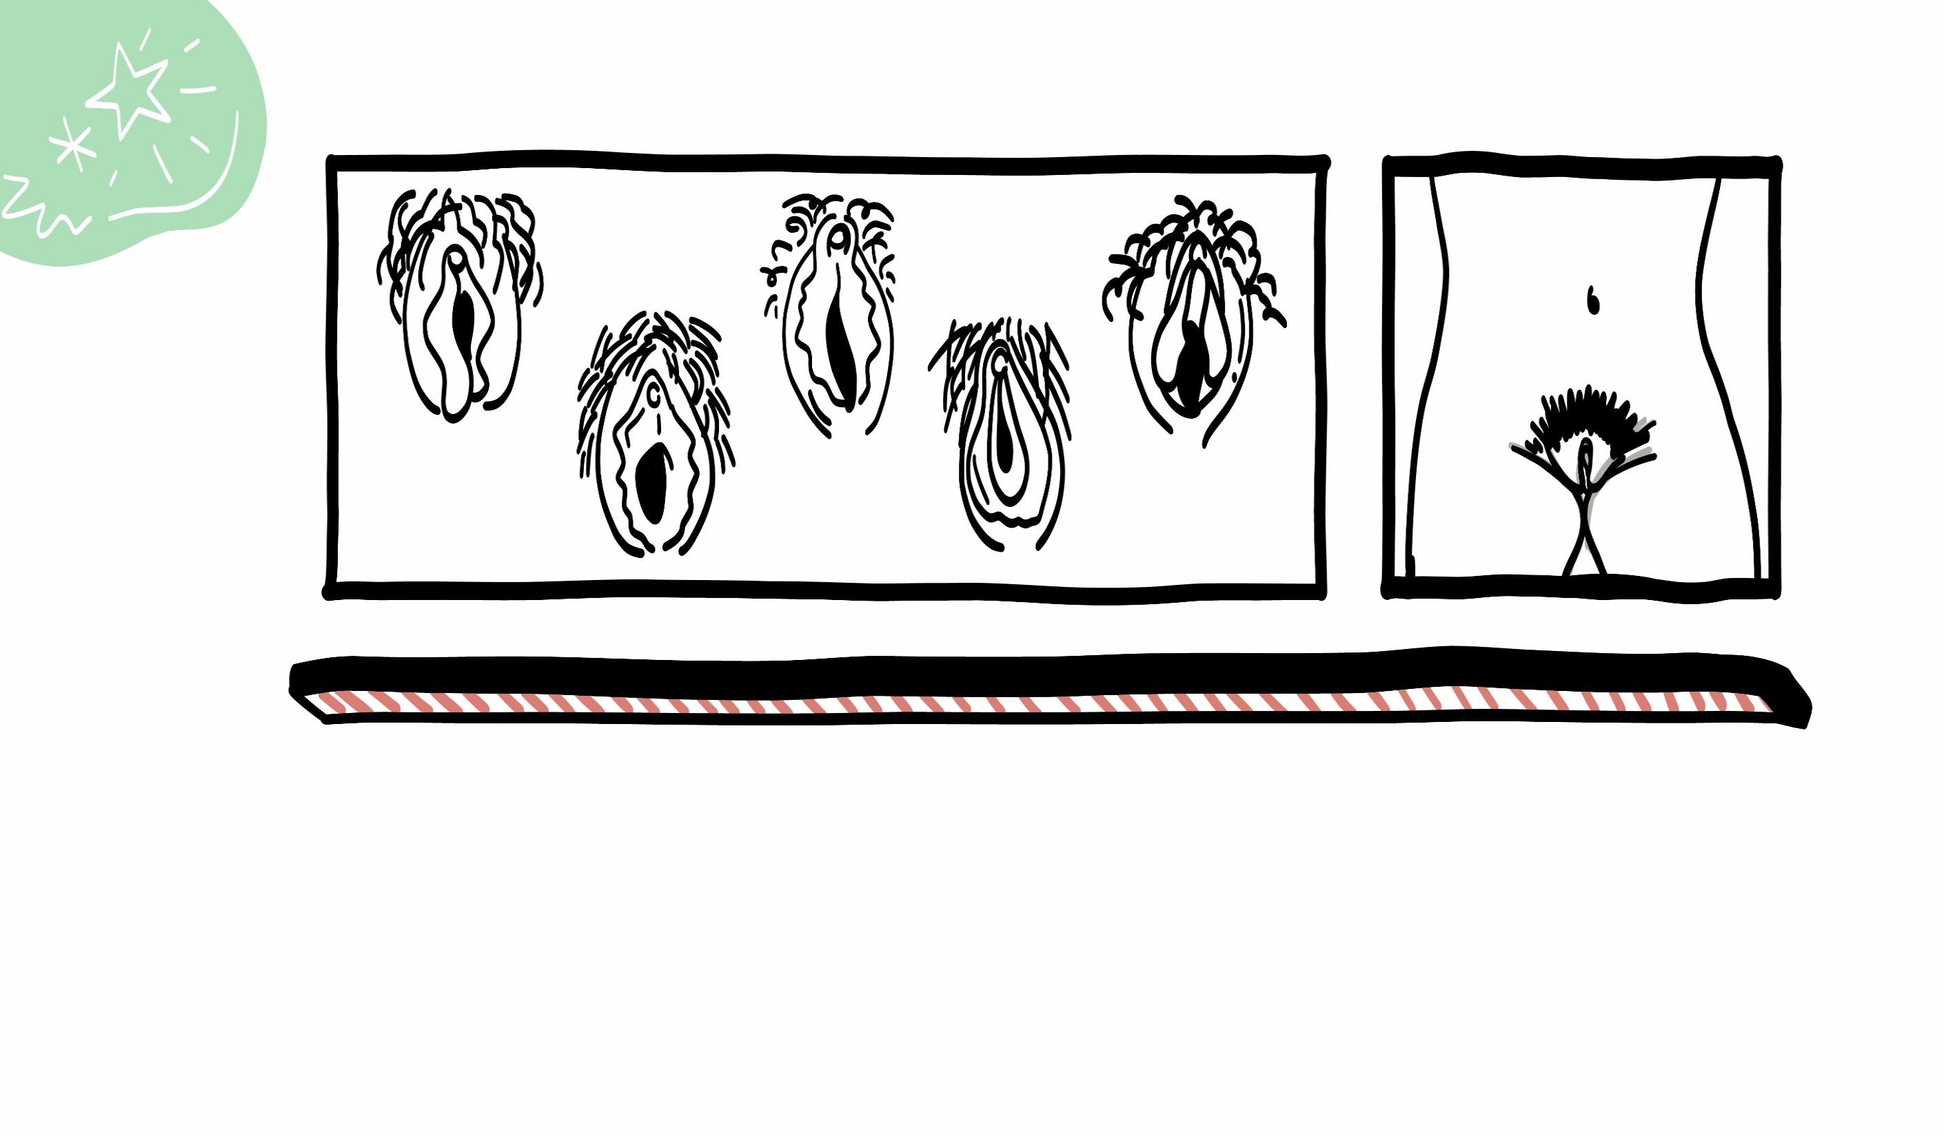
Vulvas and Vaginas
© 2022 SAFE Disability Services Program
Notes:
Say: Some people have vulvas and vaginas. The vulva is the outside part of the genitals, and the vagina is one of the inside parts. Vulvas come in a million different shapes, sizes, and colors. All are normal and healthy.
Remember, some people with vulvas and vaginas identify as women, and others do not.
Has anyone ever heard any other words to refer to vulvas and vaginas?
It can be helpful to acknowledge slang terms, since it is likely that students will hear these from their peers, or in traditional and social media. It’s also really important that students understand the correct terminology for these body parts.

Slide 12
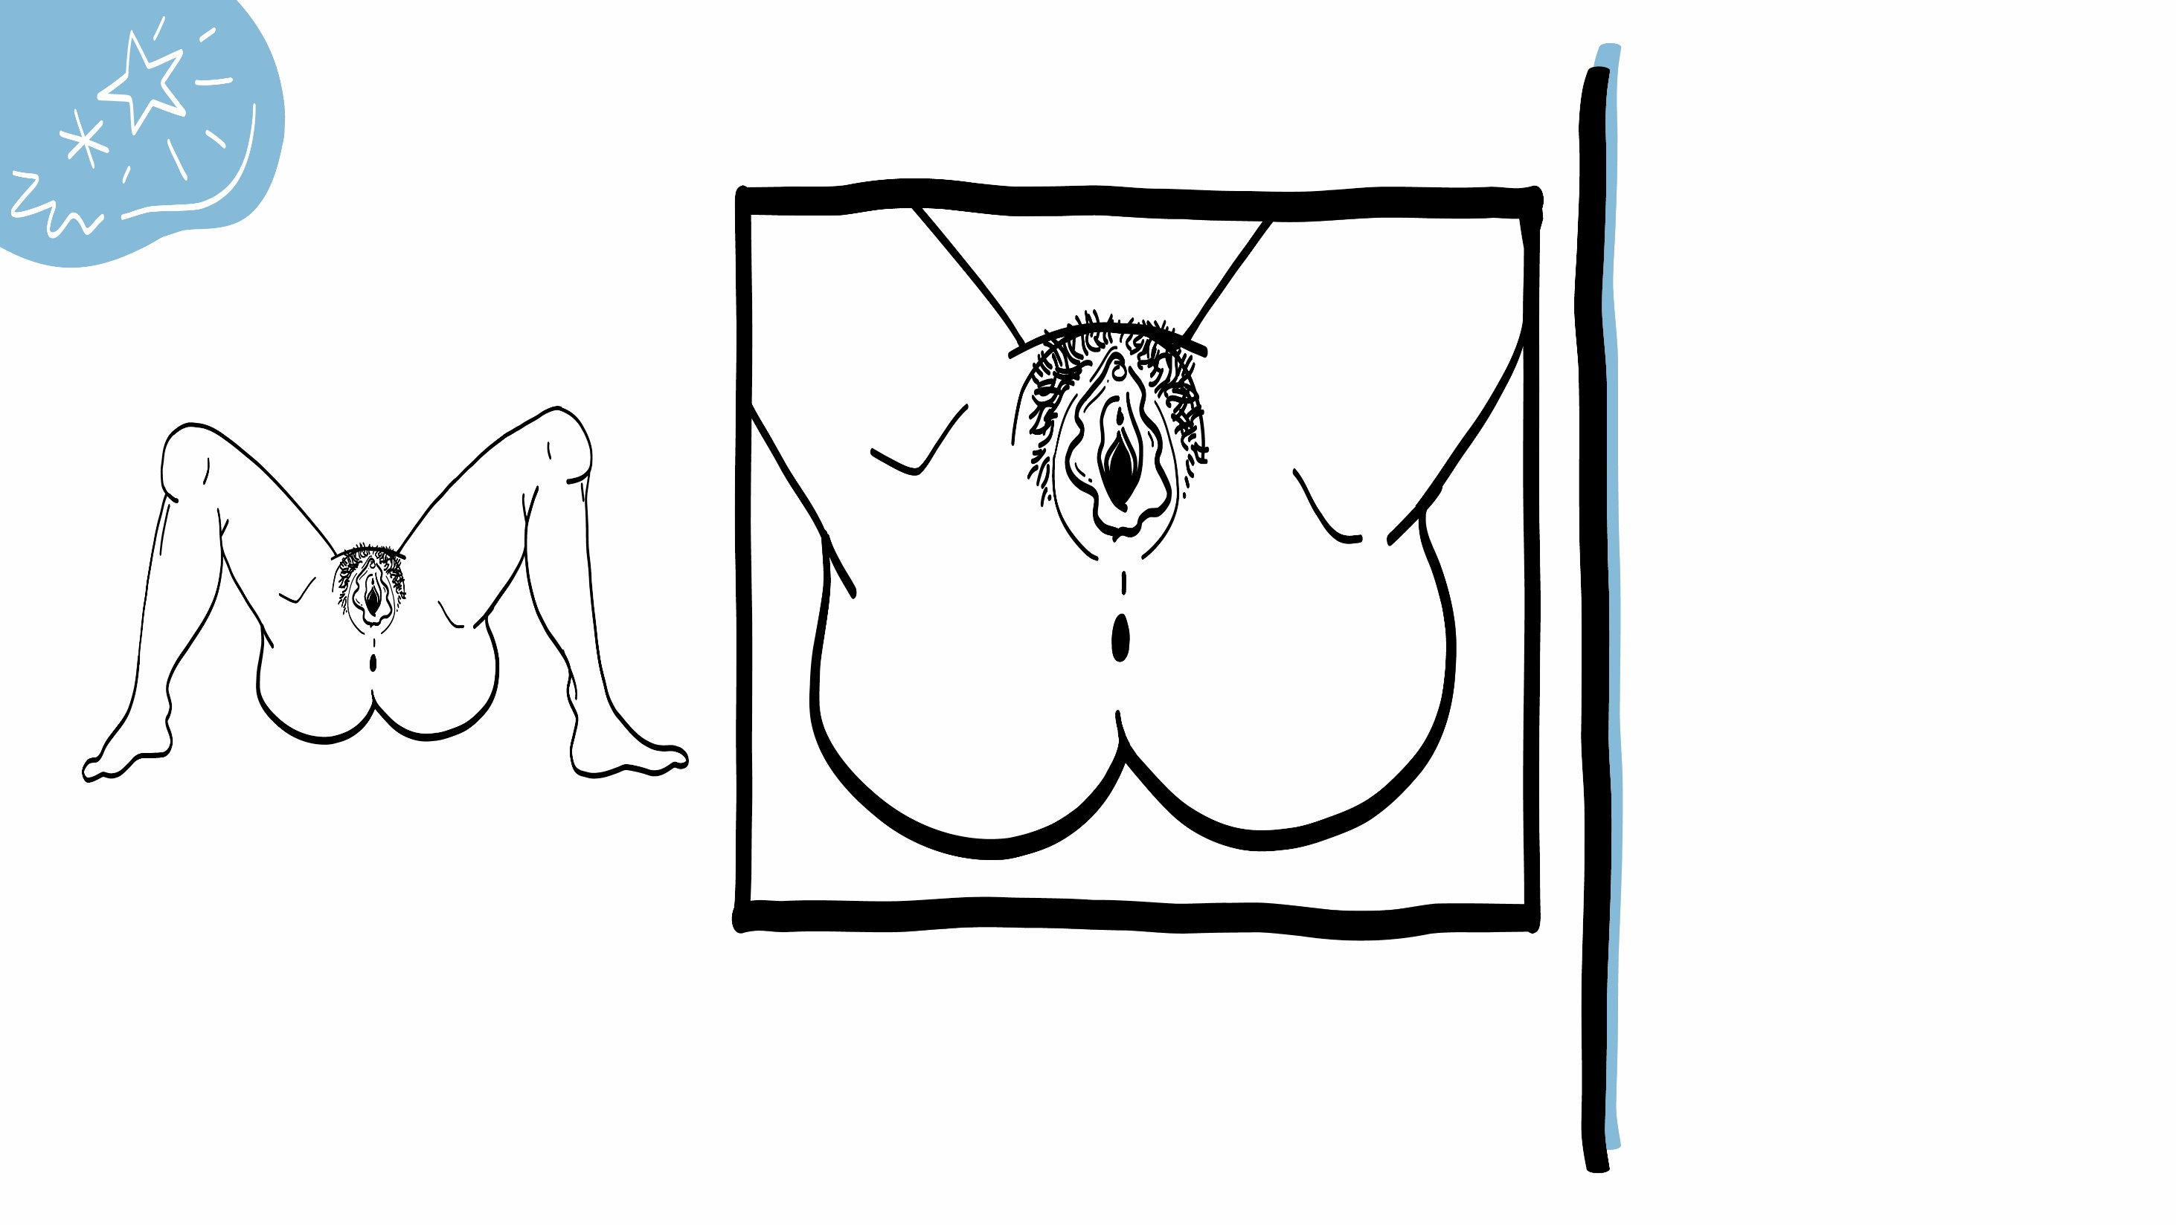
Labia
The outer part of the vulva is called the labia.
The anus is the hole in your bottom.
Anus
© 2022 SAFE Disability Services Program
Notes:
Say: The outer part of the vulva is called the labia. The labia is the skin that is around the vaginal opening. These are sometimes called the “lips.” There are outer lips and inner lips.
The anus is the opening or hole in your butt where your poop (stool) comes out. Has anyone every heard any other words to refer to the anus?
Students may say asshole or butthole or some other word. It can be helpful to acknowledge slang terms, since it is likely that students will hear these from their peers, or in traditional and social media.
It’s also really important that students understand the correct anatomical terminology for these body parts.

Slide 13
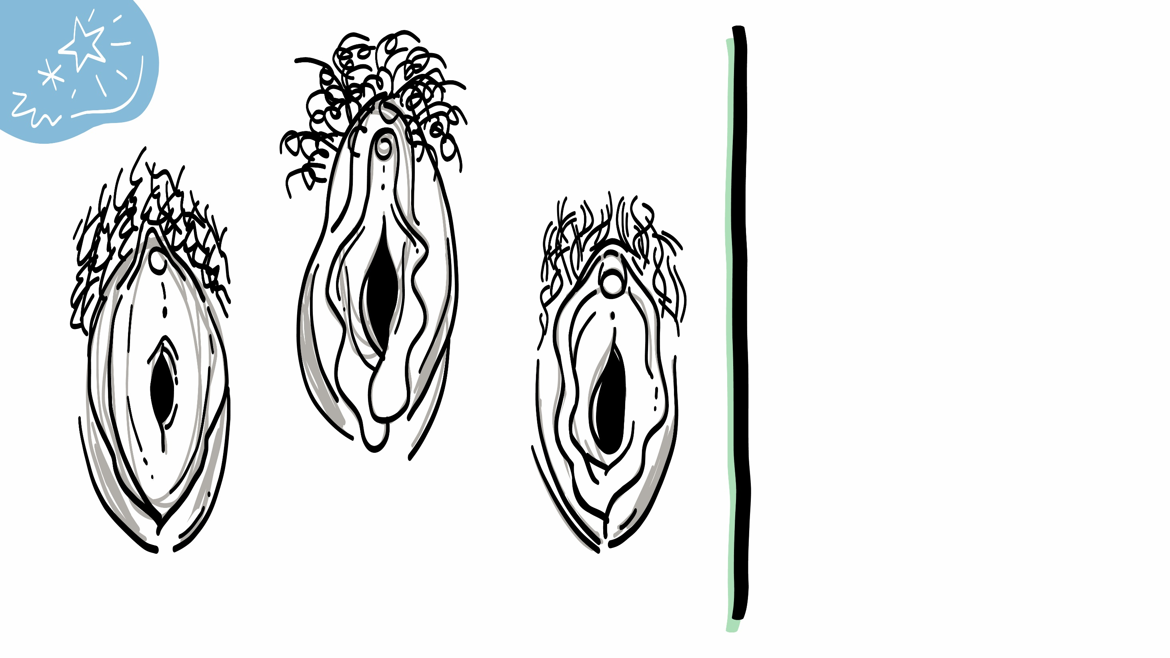
Clitoris
The vulva has two openings.
The small opening is the urethra.
The large opening is the vagina.
Urethra
Vagina
© 2022 SAFE Disability Services Program
Notes:
Say: There are two openings in the vulva. The vagina is the large opening. The vagina is where babies come out. The vagina is also where blood and other fluid comes out during menstruation, also known as a period or “the time of the month.” Menstrual Periods (most often just called ‘periods’) usually happen about once a month and last 2 to 8 days. Periods are normal and healthy. There is nothing gross about a person being on their period. Within the blood and fluids is something called an egg. This is one part of what you need to make a baby. We’ll talk about this more in another class. Someone might use tampons, pads, menstrual cups, or other things to catch the blood and other fluid as it comes out of the body. A person on their period might have other symptoms, such as cramps, where the part of the body below the stomach hurts. A person can have sex during their period; this is safe and normal.
The other opening in the vulva is called the urethra. The urethra is where pee (urine) comes out. The urethra is much smaller and is above the vagina.
Above the urethra is the clitoris. We’ll talk more about the clitoris on the next slide.

Slide 14
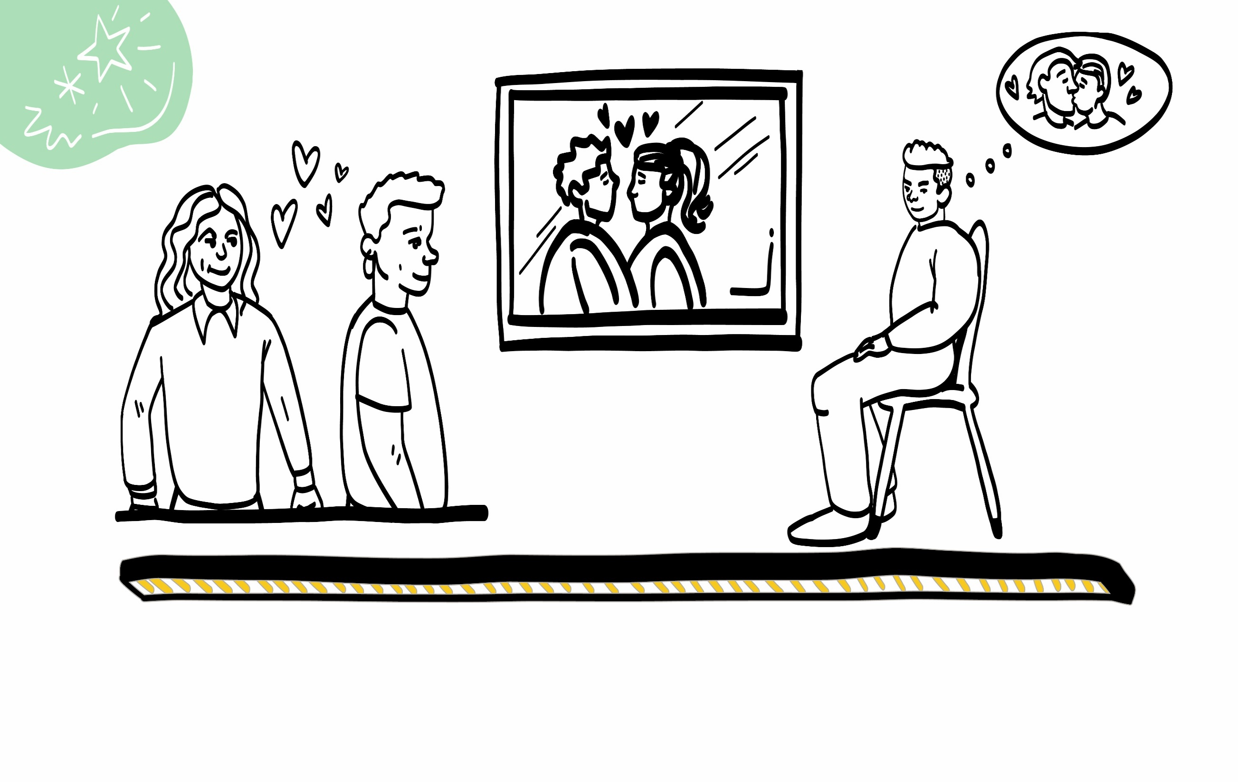
Sexual Feelings
© 2022 SAFE Disability Services Program
Notes:
Say: After a person has gone through puberty, it is normal for them to have sexual feelings. Sexual feelings are when you see someone and you think they are super cute. You may start thinking about kissing or touching them. Your vulva or penis may also change when you see them. We’ll talk about this more in today’s class.
Sexual feelings are really normal, and you don’t have to feel bad for having them. It’s also really normal if you don’t have sexual feelings.

Slide 15
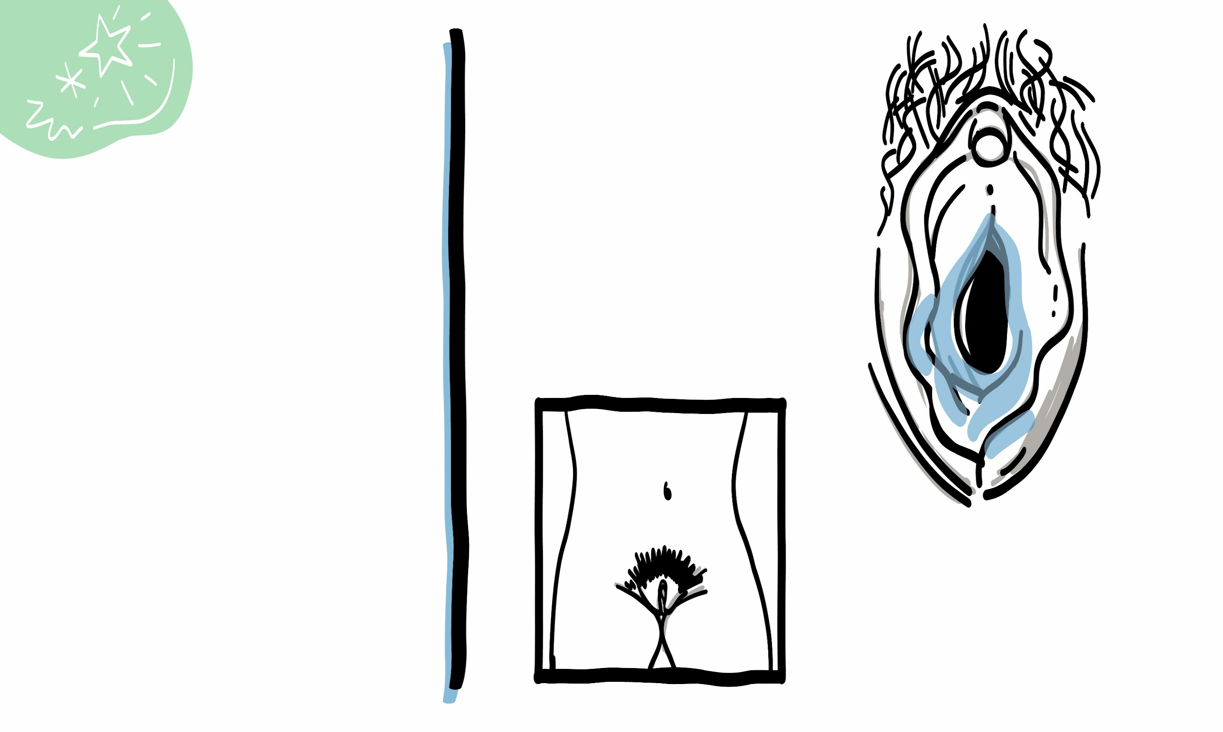
Clitoris
The clitoris is above the urethra.
When someone has sexual feelings:
The clitoris may feel tingly and warm.
The vagina may feel wet.
Vaginal fluid
© 2022 SAFE Disability Services Program
Notes:
Say: When someone with a vulva becomes sexually excited, their vulva may feel warm and tingly. The vagina also produces fluid and may feel more wet than usual. This fluid is normal and helps sex feel better. Sometimes a lot of fluid comes out, and that’s normal. This is also private. This means you shouldn’t tell other people who are not your romantic partner that your vagina feels wet or tingly. You can also always talk to your doctor or someone in your circle of trust (green circle) if you are worried about changes in your vulva or vagina.
The clitoris is above the vagina and the urethra. The clitoris is very sensitive. When someone with a vulva is sexually excited, they can have an orgasm by touching or rubbing their clitoris. Someone can also have an orgasm by having sex with someone else. We’ll talk about this more in a future class. An orgasm is what happens when all the sexual excitement in the body builds, and builds, and builds, and then is finally released. Usually when someone has an orgasm, the body feels really, really good and relaxed. Having an orgasm is sometimes called “cumming.”
When a person with a vulva has an orgasm, the muscles inside the vagina contract, which means they squeeze together and then release.

Slide 16
Masturbation is when you touch your vulva to feel good.
Masturbation is normal!
© 2022 SAFE Disability Services Program
Notes:
Say: When someone touches their own vulva and vagina to feel good sexually or to have an orgasm, this is called masturbation. They might touch or rub their clitoris, or put a finger inside the vagina. Masturbation is a normal part of being sexual, and it can be a great way to learn more about your body and what feels good to your body. Both people with a penis and people with a vulva masturbate.
Some people use personal lubricant, sometimes called lube for short, when masturbating. Lubrication is a clear liquid that can make it easier to move your hand on your vulva and in your vagina. You can buy lubrication at places like a grocery store, pharmacy, or online.
Masturbation should never hurt. If it is hurting, you might use more lube or rub more slowly. You can also take a break.

Slide 17
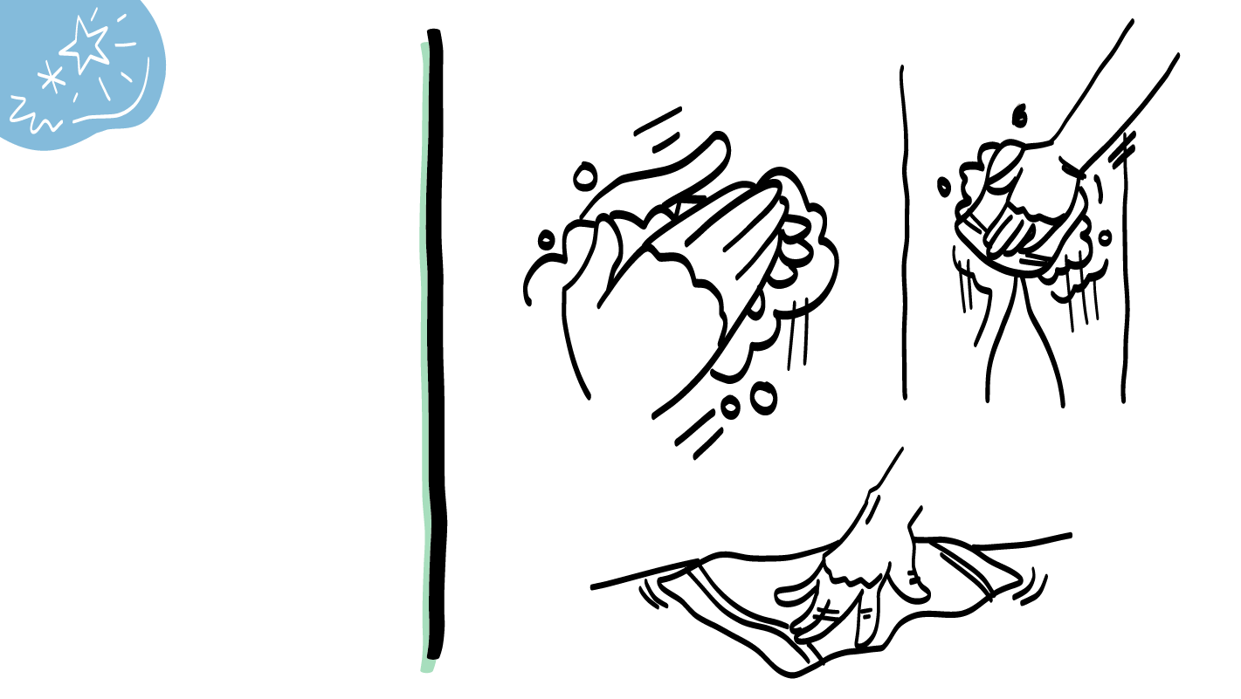
Wash your hands and vulva before and after masturbating.
After masturbating, wipe the area with a towel.
© 2022 SAFE Disability Services Program
Notes:
Say: There are a couple things you need to do to keep your body healthy when masturbating. Before masturbating, you should wash your hands and vulva. Masturbation can sometimes be a little messy. You should make sure to have a towel or something else to clean up your body and the area around you after you masturbate. It’s a good idea to wash your hands and vulva after you masturbate too. It’s okay to wash your vulva, but you shouldn’t put soap inside your vagina.

Slide 18
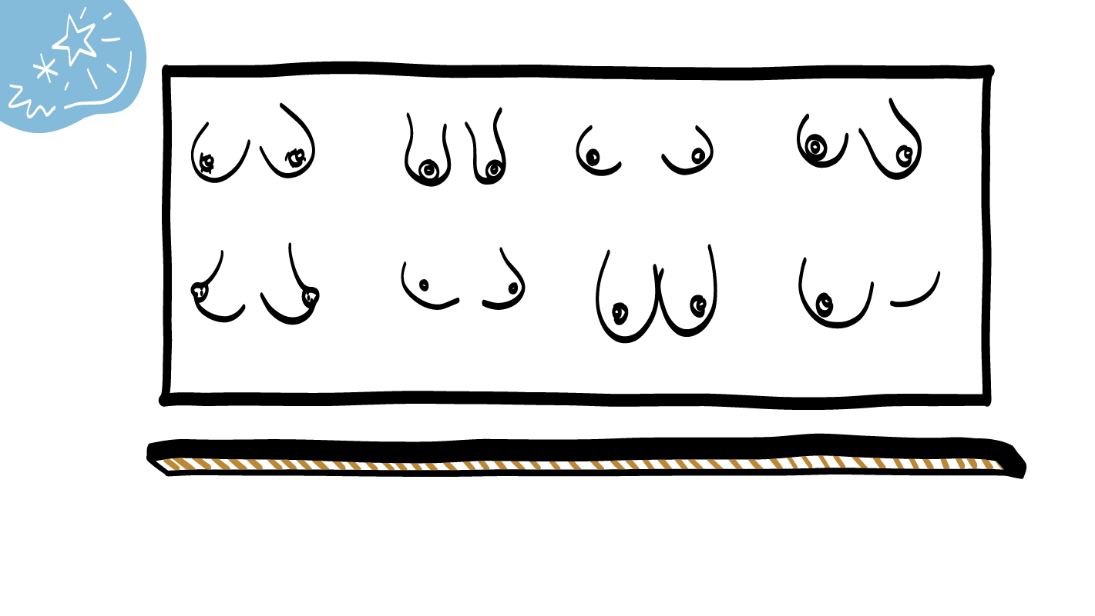
Breasts
© 2022 SAFE Disability Services Program
Notes:
Say: Some people have breasts. Breasts come in many different shapes, sizes, and colors. Some breasts are large and some breasts are small. Both are normal. It’s also normal for one breast to be bigger than the other one.
People with and without breasts have nipples. Nipples are the pointier parts at the end of the breast or in the middle of the chest. Nipples can also be a lot of different shapes, sizes, and colors. Some people have hair around their nipples and some do not. Both are normal.
A person’s breasts and nipples may become bigger when they have sexual feelings.

Slide 19
© 2022 SAFE Disability Services Program
Notes:
Say: That was a lot of information, and you all are doing an amazing job! Let’s take a quick brain break before continuing with class.
Below are three ideas to give students a quick opportunity for a brain break. You are also welcome to come up with your own ideas for brain breaks that work best for your class.
Five finger breathing
For this exercise, have all students place their hand in front of their chest with their five fingers spread out. Next, use the pointer finger of the other hand to trace up and down each of the five fingers, beginning with the thumb. As students trace up a finger, they will breathe in. As they trace down a finger, they will breath out. When students breathe out on the pinky finger, you can tell them to shake out their hands and arms. As the school year goes on, you can ask students to lead this exercise for their peers.
If this exercise is physically inaccessible for your class, you can also model the hand tracing for students while they breathe in and out.
Stretch break
Lead students through a series of basic stretches. These can be completed in a chair, or while standing up, depending on the accommodation needs of your class. Some ideas include reaching toward the ceiling, stretching one arm at a time across the chest, reaching toward toes, turning head from side to side, etc. Ask students to hold a pose while you count to ten. As the school year goes on, you can ask students to lead stretches for their peers.
Dance party
If your class likes to dance, you can put on a short song for them to dance to. This is especially effective if you are able to find a song that relates to the theme for that week’s class.

Slide 20
Your body is awesome!
People with vulvas and vaginas
Brain break
People with penises and testicles
Masturbation and
safety
© 2022 SAFE Disability Services Program
Notes:
Say: Alright, time to keep thinking about bodies. We are now going to talk about the bodies of people with penises and testicles.

Slide 21
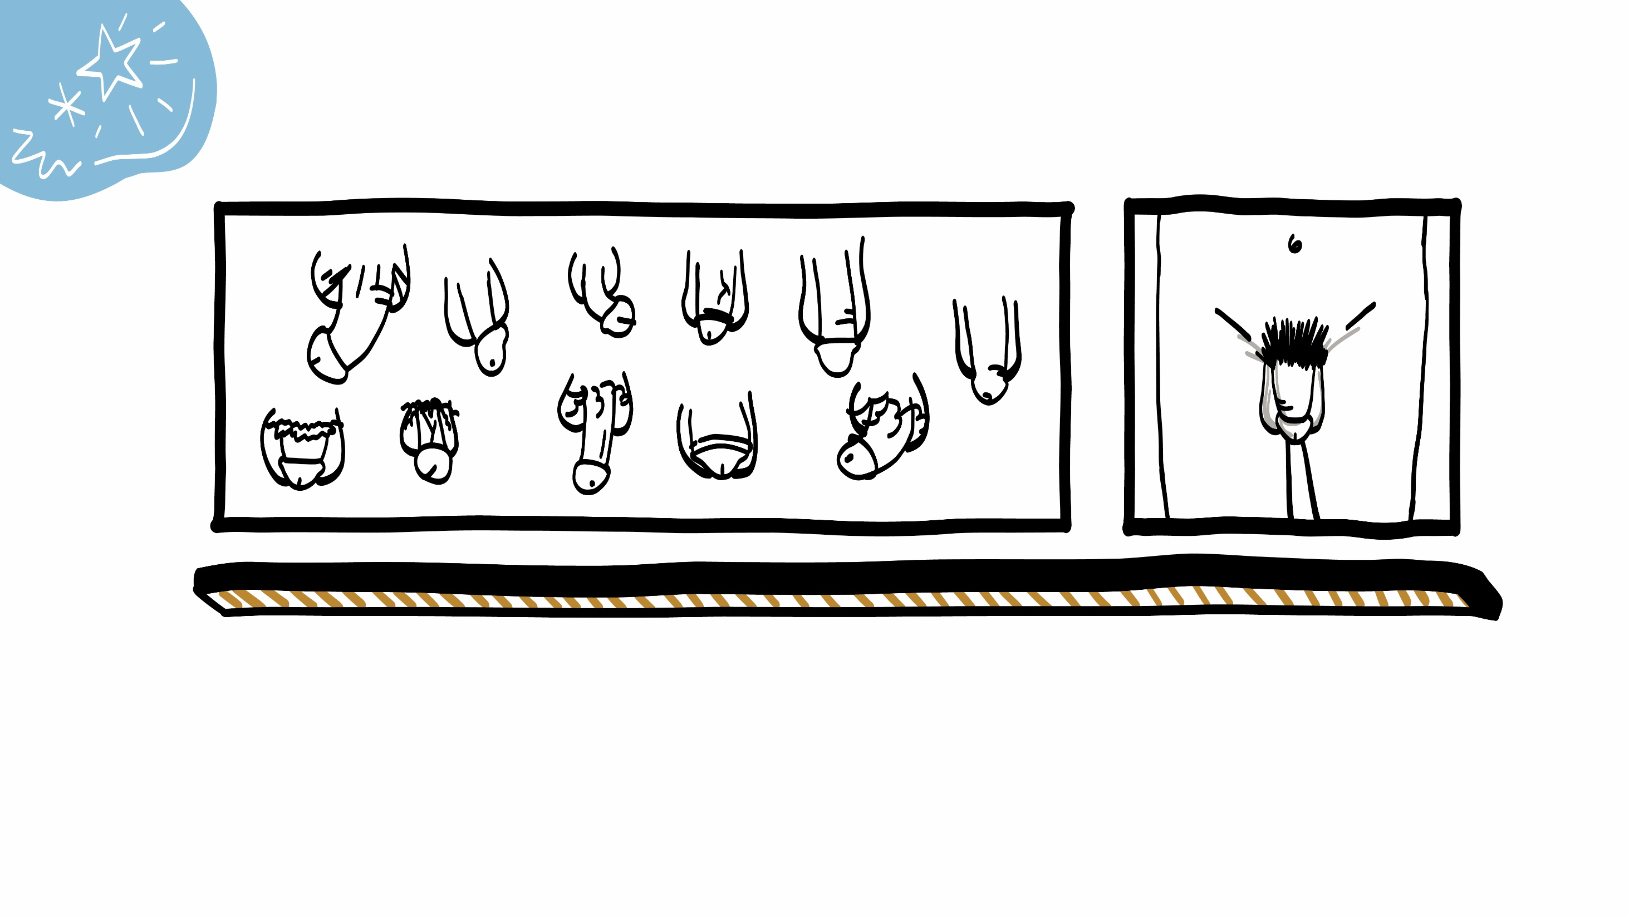
Penises and Testicles
© 2022 SAFE Disability Services Program
Notes:
Say: Some people have penises and testicles. Penises come in a million different shapes, sizes, and colors. All are normal and healthy. Sometimes people say that people of certain races have bigger penises than people of other races. That’s not true. People of all skin colors can have bigger or smaller penises. Sometimes people also say that bigger penises are better, but that’s not true either. All penis sizes are normal and good.
Remember, some people with penises and testicles identify as men, and others do not.
Has anyone ever heard any other words to refer to penises and testicles?
It can be helpful to acknowledge slang terms, since it is likely that students will hear these from their peers, or in traditional and social media. It’s also really important that students understand the correct terminology for these body parts.

Slide 22
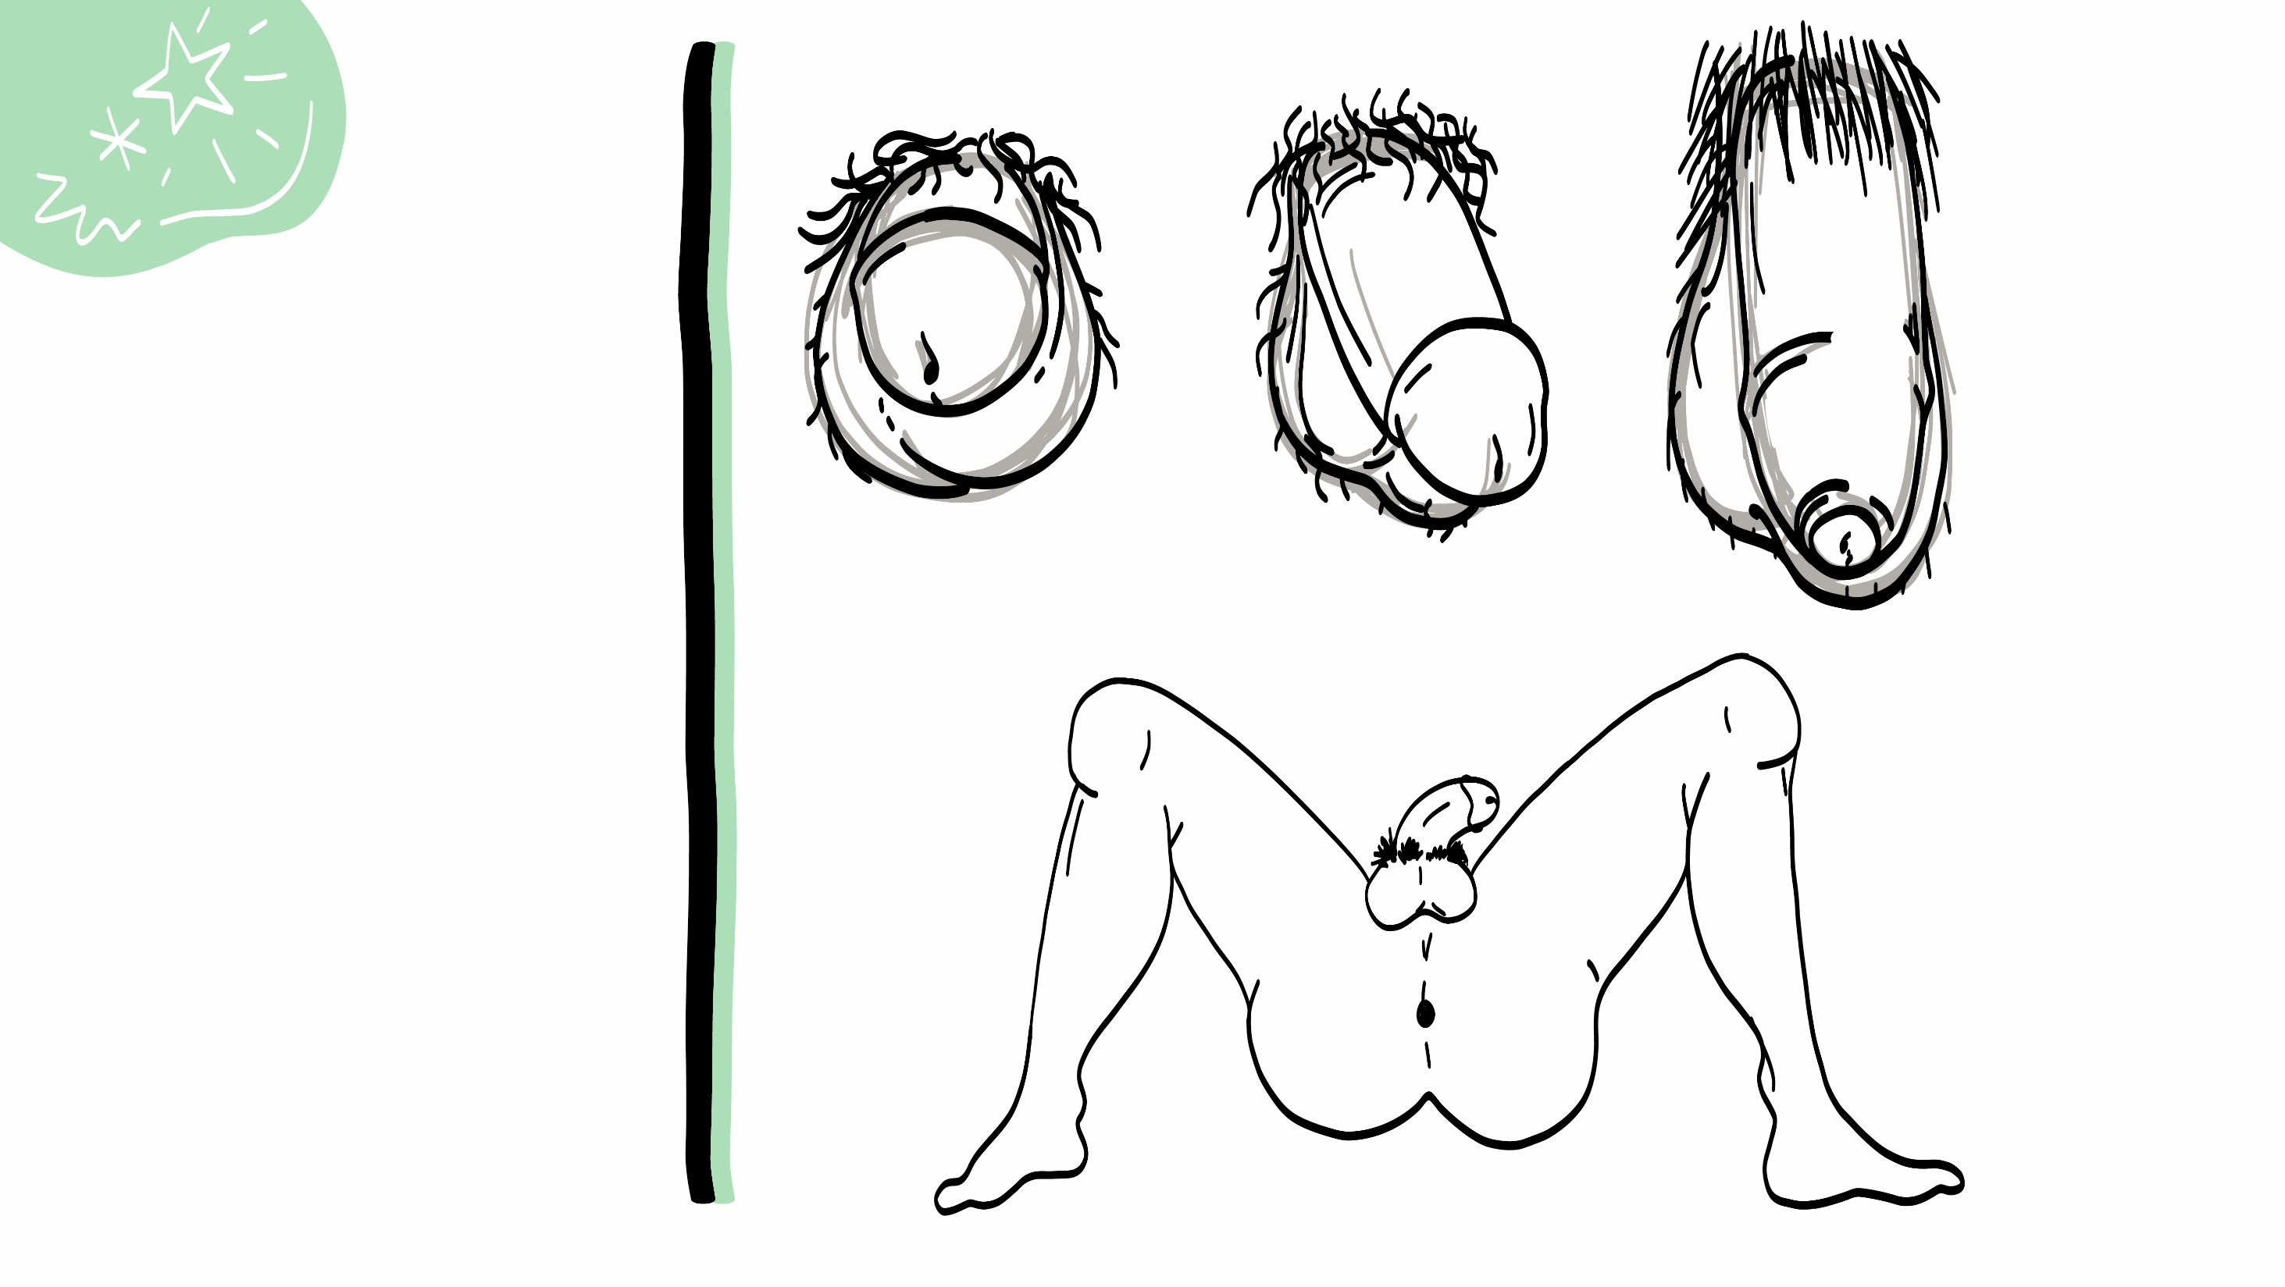
The penis has three parts.
The long part is the shaft.
The head is at the end of the shaft.
The urethra is the opening in the head of the penis.
Shaft
Urethra
Head
© 2022 SAFE Disability Services Program
Notes:
Say: The penis has 3 parts. The shaft is the long part, and the head of the penis is the part at the end of the shaft. The urethra is the opening in the head of the penis. This is where pee and something called semen comes out. We’ll talk more about semen in a minute.
Sometimes a penis is circumcised. This means that when the person was a baby, a little bit of skin, called the foreskin, was cut off of the penis. The two penises on the left of the screen are circumcised. Other people are uncircumcised. This means they still have the foreskin. The penis on the right of the screen is uncircumcised. It still has the skin that goes over the head of the penis. Both circumcised penises and uncircumcised penises are healthy and normal.

Slide 23
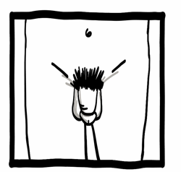
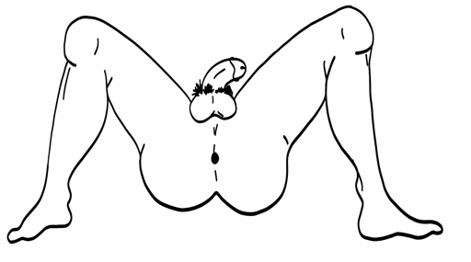
The sack under the penis is the scrotum.
The scrotum holds the testicles.
The anus (the hole in your bottom).
Scrotum with testicles
Testicles
Anus
© 2022 SAFE Disability Services Program
Notes:
Say: The sack underneath the penis is called the scrotum, and it holds the testicles. Testicles make something called semen, which has sperm in it. We’ll talk about this more in a minute. Sperm are the second part of what you need to make a baby. The first part is the egg that is inside the body of a person with a vulva and vagina.
The anus is the opening or hole in your butt where your poop (stool) comes out. Has anyone heard of other words to refer to the anus?
Students may say asshole or butthole or some other word. It can be helpful to acknowledge slang terms, since it is likely that students will be hearing these from their peers, or in traditional and social media.
It’s also really important that students understand the correct anatomical terminology for these body parts for safety purposes.

Slide 24
Sexual Feelings
© 2022 SAFE Disability Services Program
Notes:
Say: After a person has gone through puberty, it is normal for them to have sexual feelings. Sexual feelings are when you see someone and you think they are super cute. You may start thinking about kissing or touching them. Your vulva or penis may also change when you see them. We’ll talk about this more today in class.
Sexual feelings are really normal, and you don’t have to feel bad for having them. It’s also really normal if you don’t have sexual feelings.

Slide 25
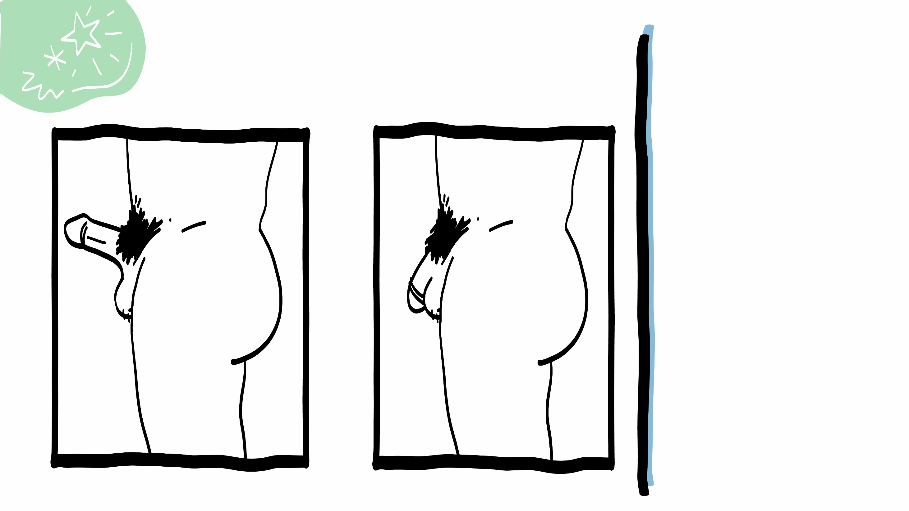
When someone has sexual feelings:
The penis gets hard and sticks out.
This is called an erection.
© 2022 SAFE Disability Services Program
Notes:
Say: When someone with a penis feels sexually excited, they may have an erection. An erection is when blood flows down to the penis, and it becomes hard and sticks out from the body.
Erections are really normal and not something to feel bad about. Erections are also private. This means erections are something for you or something just between you and your romantic partner. You shouldn’t tell people who are not your romantic partner that you have an erection, or show them your erection. If you get an erection in a public place, it can help to think about something else that is not sexy. Take some deep breaths, and try to distract yourself so your penis will get soft again. You might also use a jacket to cover your erection until it goes away. If you are ever worried about your erection or any changes to your penis or testicles, you can talk to a doctor or someone in your circle of trust (green circle).

Slide 26
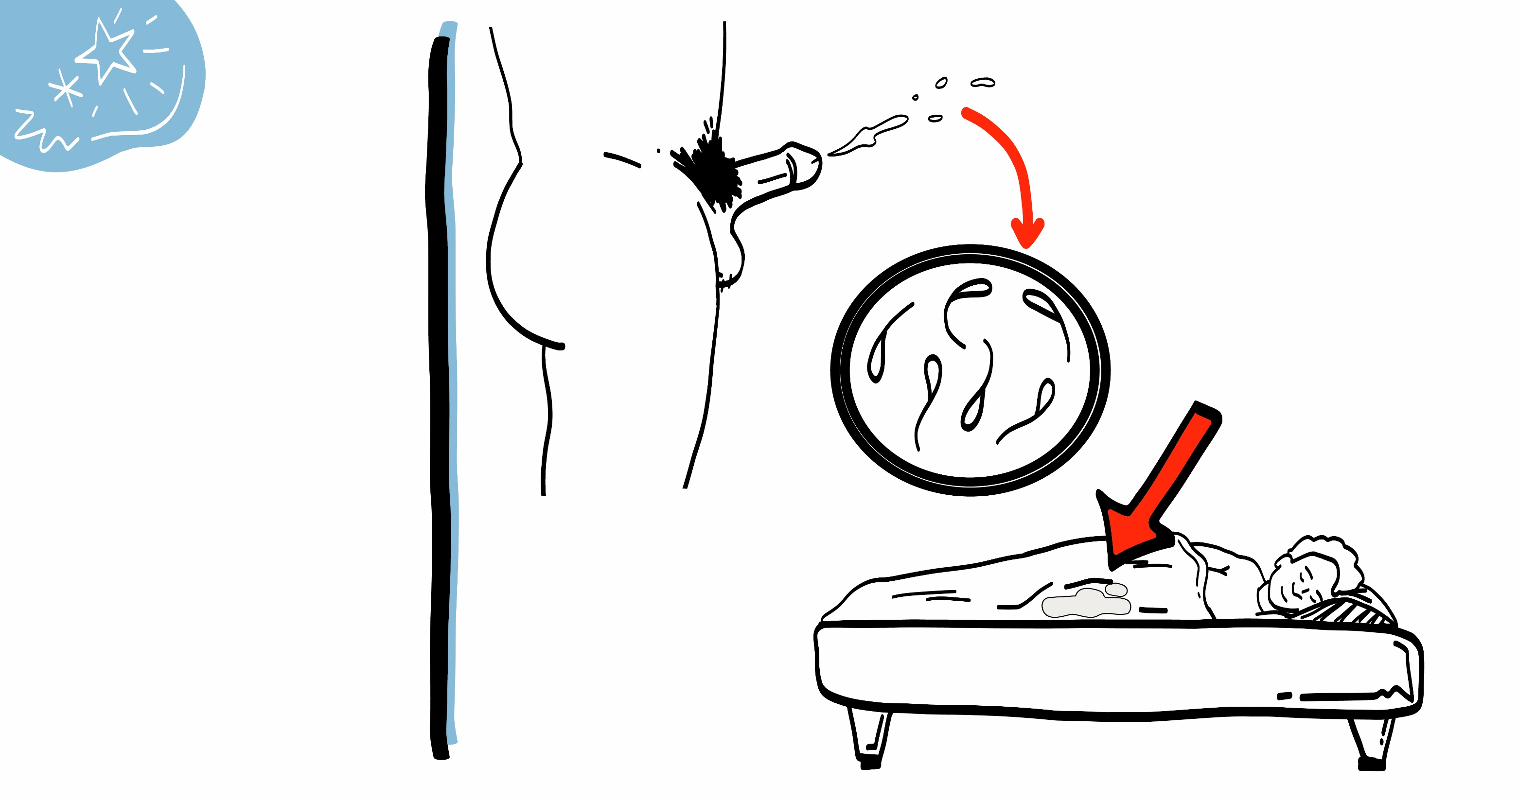
When someone has an erection they can ejaculate.
Ejaculation is when semen comes out of the penis.
If someone ejaculates while sleeping, it is called a wet dream.
© 2022 SAFE Disability Services Program
Notes:
Say: When someone with a penis is sexually excited, they can have an orgasm by touching or rubbing their erect penis and testicles and . Someone can also have an orgasm by having sex with someone else. We’ll talk about this more in a future class. Remember, an orgasm is when all the sexual excitement in the body builds, and builds, and builds, and then is finally released. Usually when someone has an ejaculation, sometimes called orgasm, the body feels really, really good.
When a person with a penis has an orgasm, they might ejaculate. Ejaculation is when a whitish fluid called semen comes out of the tip of the penis. This can only happen if the penis is hard and sticking out from the body. Semen has sperm in it, which is the second part of what is needed to make a baby.
Sometimes a person might ejaculate while they are asleep. This is called a “wet dream” and is totally normal.

Slide 27
Masturbation is when you touch your penis and testicles to feel good.
Masturbation is normal!
© 2022 SAFE Disability Services Program
Notes:
Say: Just like how people with vulvas and vaginas can masturbate, people with penises and testicles can masturbate too. Remember masturbation is when someone touches their own penis and testicles to feel good sexually or to have an orgasm. A person might rub their penis or hold their testicles. Masturbation is a normal part of being sexual, and it can be a great way to learn more about your body and what feels good to your body.
Some people use personal lubricant, sometimes called lube, when masturbating. Lubricant is a clear liquid that can make it easier to move your hand on your penis and testicles. You can buy lubricant at places like a grocery store, pharmacy, or online.
Masturbation should never hurt. If it is hurting, you might use more lubrication or rub more slowly. You can also take a break.

Slide 28
Wash your hands and penis before and after masturbating.
After masturbating wipe the area with a towel.
© 2022 SAFE Disability Services Program
Notes:
Say: There are a couple things you need to do to keep your body healthy when masturbating. Before masturbating, you should wash your hands and penis. Masturbation can sometimes be a little messy. You should make sure to have a towel or something else to clean up your body and the area around you after you masturbate. It’s a good idea to wash your hands and penis after you masturbate too.

Slide 29
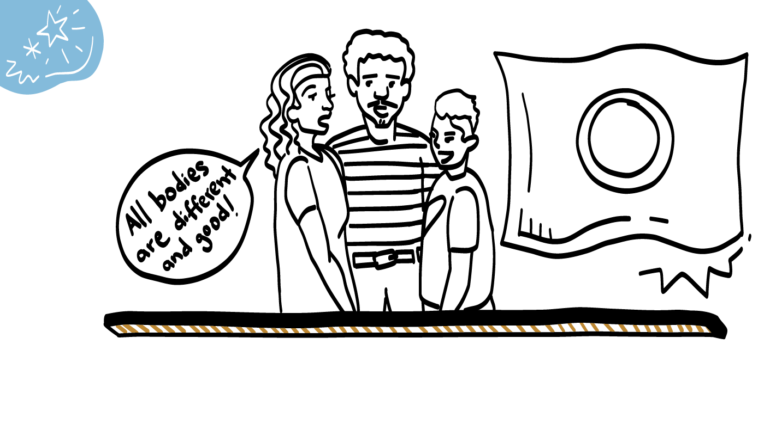
Intersex
© 2022 SAFE Disability Services Program
Notes:
Say: All bodies look different. We have talked about a lot of different body parts today—vulvas, vaginas, breasts, penises, and testicles. Some people may also have combinations of these different body parts. For example, someone might be born with both a vulva and testicles. This is totally healthy and normal too! Some people with these types of bodies call themselves “intersex.” Remember, your body is amazing just the way it is.
If you ever have questions about your body parts, you can ask a doctor, nurse, or an adult from your circle of trust (green circle).

Slide 30
Your body is awesome!
People with vulvas and vaginas
Brain break
People with penises and testicles
Masturbation and
safety
© 2022 SAFE Disability Services Program
Notes:
Say: Nice job everyone! We are done talking about body parts. For the last part of class, we are going to think through how to stay safe while masturbating.

Slide 31
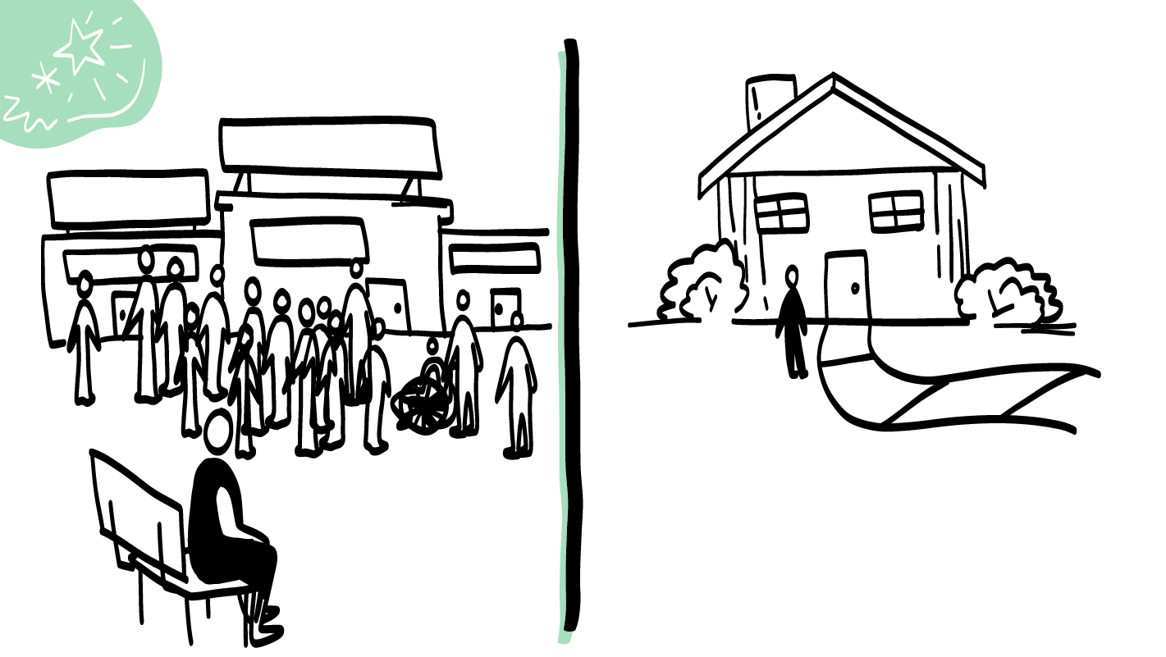
Public
Private
© 2022 SAFE Disability Services Program
Notes:
Say: You should only masturbate in a private place, and never in a public place. A public place is a place where other people can come in and out, and there are sometimes a lot of people. For example, a movie theater is a public place. Even if you are the only person in the movie theater, someone might come in late to the movie, or a movie theater employee might come in. This means it is a public place. Not only is it super awkward to masturbate in a public place, it is also against the law. This means that if you masturbate in a public place, the police might be called and you could be arrested. This is very serious.
It’s normal to have sexual feelings and to want to masturbate, but you have to make sure you’re in a private place first. Remember, a private place is a place where other people need your consent to come into. We’re going to play a game on the next few slides to help you think about safe places to masturbate. I am going to show you a picture of a place. If you think it is a safe place to masturbate, give a thumbs up. If you think it is not a safe place to masturbate, give a thumbs down.

Slide 32
Ok to masturbate?
YES
NO
© 2022 SAFE Disability Services Program
Notes:
Say: Is the grocery store a safe place to masturbate? Give a thumbs up if you think it is, and a thumbs down if you think it is not.
Give students enough time to process the question and make their decisions.
Say: A grocery store is not a safe place to masturbate. This is a public place. Even if you are in the bathroom at the grocery store, it is still a public place. Remember, it is against the law to masturbate in public places.

Slide 33
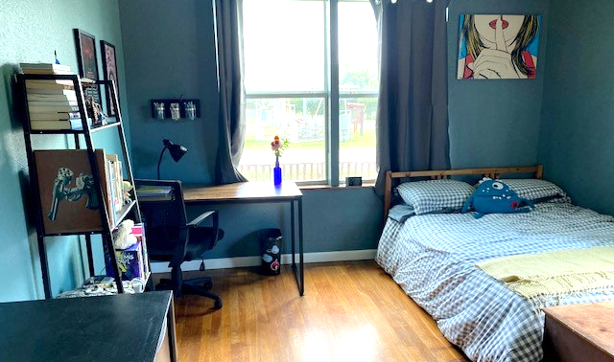
Ok to masturbate?
YES
NO
© 2022 SAFE Disability Services Program
Notes:
Say: Is your bedroom a safe place to masturbate? Give a thumbs up if you think it is, and a thumbs down if you think it is not.
Give students enough time to process the question and make their decisions.
Say: Your bedroom is a safe place to masturbate. This is a private place. Should you have the door open or closed?
Give students enough time to process the question and make their decisions.
Say: You should close your bedroom door. If you are able to, it’s a good idea to lock the door too. If you have a roommate, you may need to talk to them and figure out a schedule so you can both have private time in the room. If there are any windows in the room, you should close the blinds or curtains for privacy.

Slide 34
Ok to masturbate?
YES
NO
© 2022 SAFE Disability Services Program
Notes:
Say: Is the city bus a safe place to masturbate? Give a thumbs up if you think it is, and a thumbs down if you think it is not.
Give students enough time to process the question and make their decisions.
Say: A city bus is not a safe place to masturbate. This is a public place. Remember, it is against the law to masturbate in public places.

Slide 35
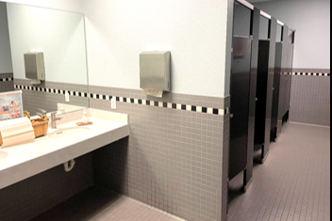
Ok to masturbate?
YES
NO
© 2022 SAFE Disability Services Program
Notes:
Ask: What does this look like a picture of?
Give students enough time to process the question and make their decisions.
Say: This is a public bathroom, like the bathroom at school. You can tell because there are multiple stalls and sinks.
Say: Is a public restroom a safe place to masturbate? Give a thumbs up if you think it is, and a thumbs down if you think it is not.
Give students enough time to process the question and make their decisions.
Say: A public restroom is not a safe place to masturbate. This is a public place. Even if you are in a stall with the door closed, it is still a public place. Remember, it is against the law to masturbate in public places.

Slide 36
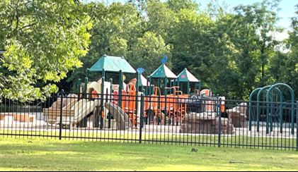
Ok to masturbate?
YES
NO
© 2022 SAFE Disability Services Program
Notes:
Say: Is the park a safe place to masturbate? Give a thumbs up if you think it is, and a thumbs down if you think it is not.
Give students enough time to process the question and make their decisions.
Say: A park is not a safe place to masturbate. This is a public place. Even if it is dark outside or you are the only one in the park, it is still a public place. Remember, it is against the law to masturbate in public places.

Slide 37
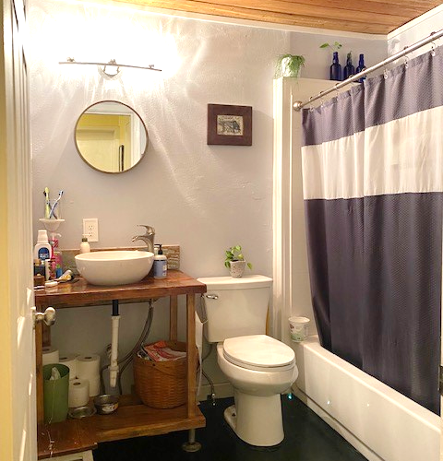
Ok to masturbate?
YES
NO
© 2022 SAFE Disability Services Program
Notes:
Ask: What does this look like a picture of?
Give students enough time to process the question and make their decisions.
Say: This is a private bathroom, in a house or apartment.
Say: Is your bathroom a safe place to masturbate? Give a thumbs up if you think it is, and a thumbs down if you think it is not.
Give students enough time to process the question and make their decisions.
Say: Your bathroom is a safe place to masturbate. This is a private place. Remember, you should close your bathroom door before masturbating. If you are able to, it’s a good idea to lock the door too. If there are any windows in the bathroom, you should close the blinds or curtains for privacy.

Slide 38
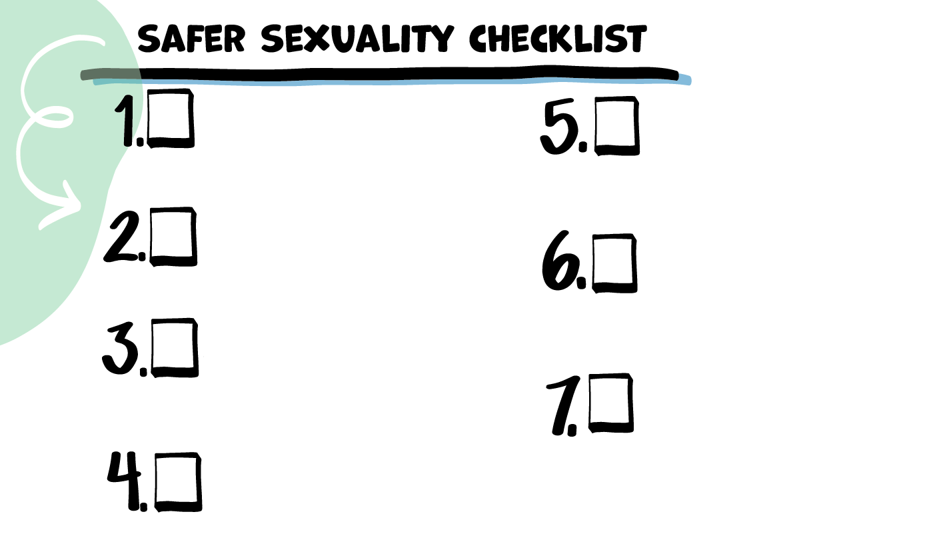
Safe and
Private Place
© 2022 SAFE Disability Services Program
Notes:
Say: We learned a lot in class today! In each of our classes about bodies and sex, we are going to add something new to our Safer Sexuality Checklist. This is a list of things that you need to make sex safer. I have a big checklist up here for the class, and I am going to give each of you your own smaller checklist. Today, we are going to add 1. Safe and Private Place to our checklist. In order to be sexual with yourself or someone else, you must first have a safe, private place to do so.
Ask for a student volunteer to attach the first checklist item manipulative onto the class checklist. Distribute student checklists, Student Safe and Private Place Graphic printouts, and glue sticks to each student. Give students time to glue the Student Safe and Private Place Graphic onto their personal checklist.

Slide 39
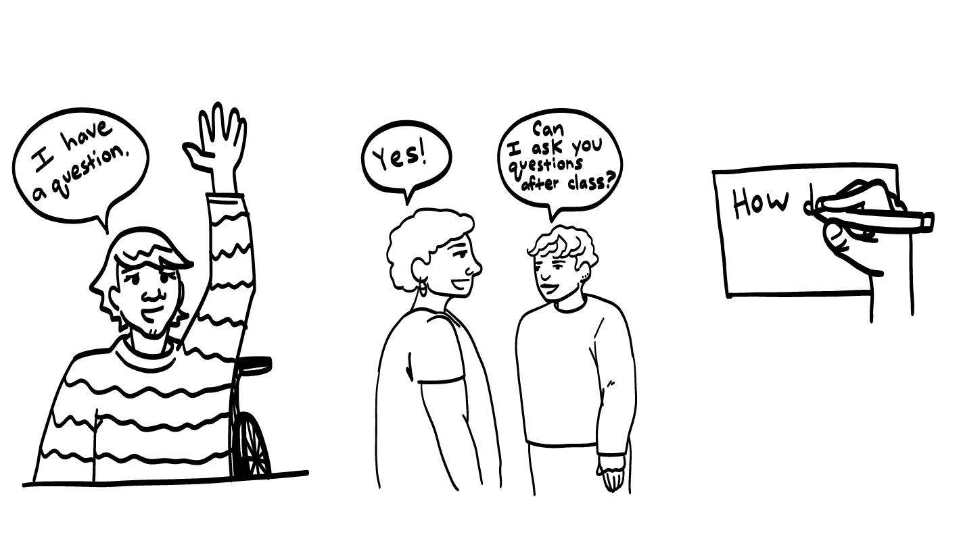
© 2022 SAFE Disability Services Program
Notes:
Say: Does anyone have any questions about today’s class? Remember, if you don’t want to ask your question out loud, you can write it on a notecard and leave it on your desk. You can also ask someone you trust to help you write your question on the notecard. I will pick up the notecards, and will answer the questions the next time we meet. When I answer a question, I won’t tell anyone who asked it.

Slide 40
Do genitals come in many different shapes, sizes, and colors?
YES
NO
© 2022 SAFE Disability Services Program
Notes:
Say: Do genitals come in many different shapes, sizes, and colors? Hold up a thumbs up for yes, and a thumbs down for no.
Give students enough time to process the question and make their decisions.
Say: That’s right. Vulvas, vaginas, breasts, penises, and testicles can all look lots of different ways. Remember, there is no right or wrong way to have a body. However your body looks is amazing!!

Slide 41
Is it normal for people to have sexual feelings after they’ve gone through puberty?
YES
NO
© 2022 SAFE Disability Services Program
Notes:
Say: Is it normal for people to have sexual feelings after they’ve gone through puberty? Hold up a thumbs up for yes, and a thumbs down for no.
Give students enough time to process the question and make their decisions.
Say: That’s right. After going through puberty, both people with vulvas and vaginas and people with penises and testicles may have sexual feelings. It’s also normal if you don’t have sexual feelings. When a person with a penis is sexually excited, the penis may get hard or ejaculate semen. When a person with a vulva is sexually excited, the vulva may feel warm and tingly, and the vagina may produce fluid and feel wet. All of this is normal.

Slide 42
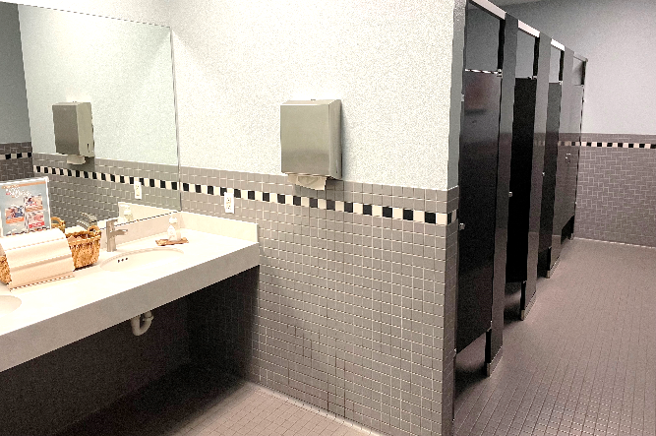
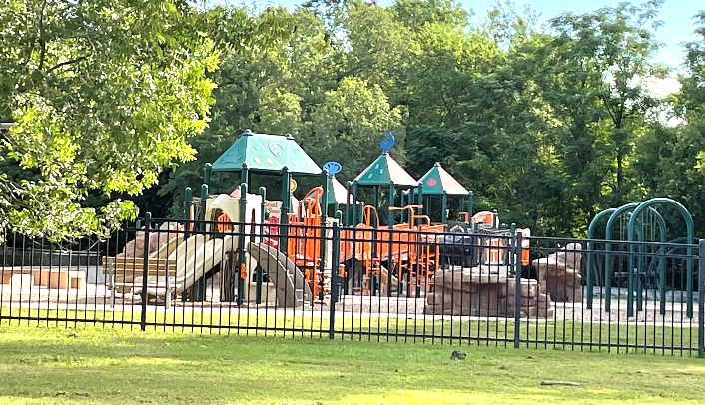
Which of these is a safe, private place to masturbate?
1
2
3
© 2022 SAFE Disability Services Program
Notes:
Say: Which of these is a safe, private place to masturbate? Hold up one finger for the bathroom at school, two fingers for a park, and three fingers for your bedroom at home.
Give students enough time to process the question and make their decisions.
Say: That’s right. Your bedroom at home is a safe, private place to masturbate. The other places are public places, where it is illegal to masturbate. It’s okay to masturbate at home in your bedroom or bathroom with the door closed and locked, and with the windows covered for privacy.

Slide 43
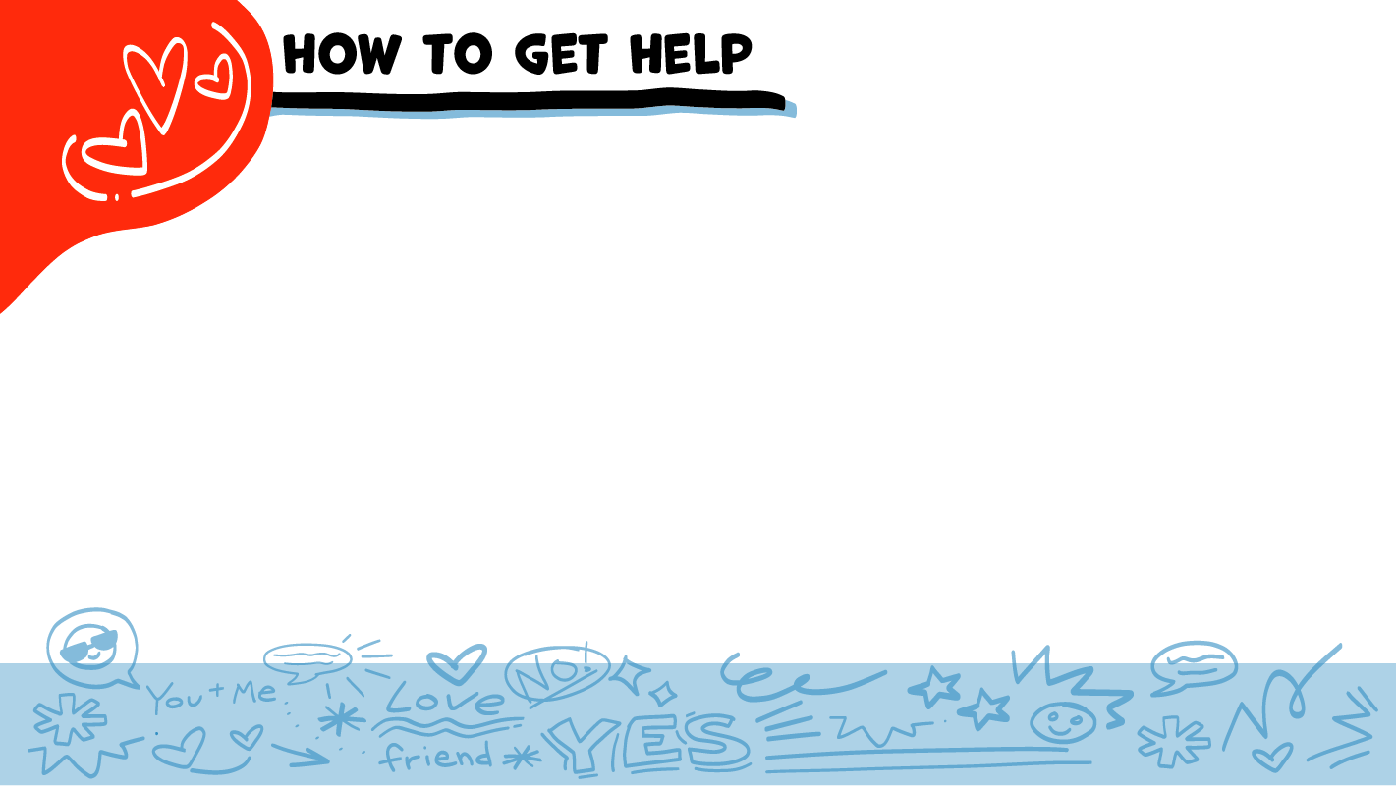
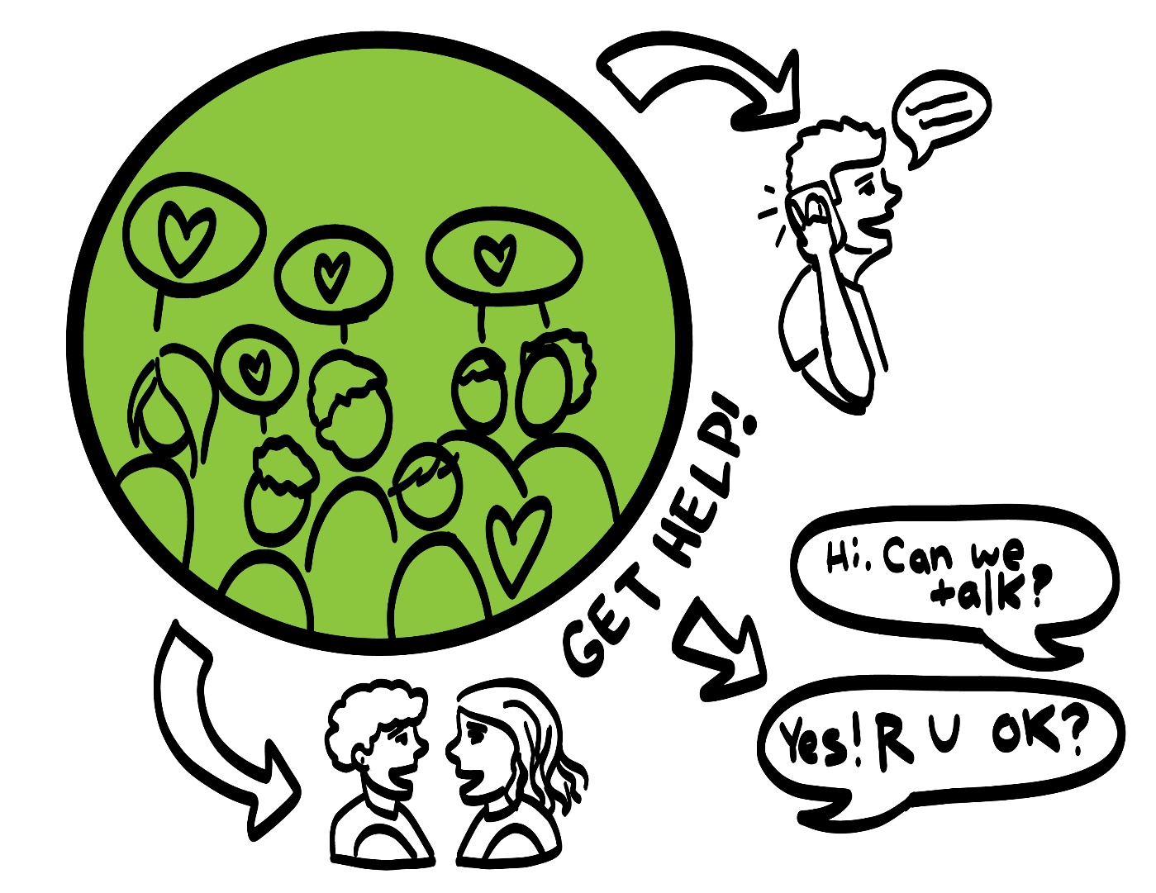
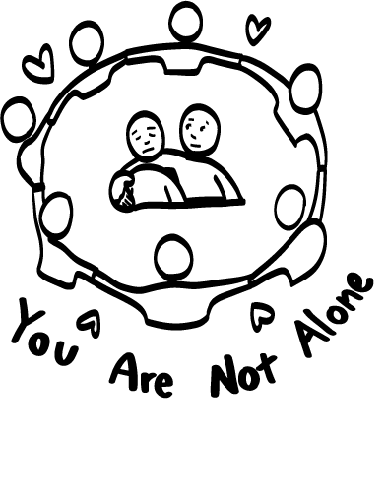
© 2022 SAFE Disability Services Program
Notes:
Say: If you are being hurt, or if someone ever touches your body in a way that you don’t like, you can get help. You did not do anything wrong, and you are not alone. You can get help by talking to an adult from your circle of trust (green circle). If someone you care about is being hurt, you can also get help by talking to an adult from your circle of trust (green). If an emergency is happening, you can always call 911. If you call 911 for help, a police officer or an ambulance might come.
If the first person you tell doesn’t believe you or doesn’t get you help, keep telling adults you trust what is going on until you get the help you need.

Slide 44
© 2022 SAFE Disability Services Program
Notes:
Say: Does anyone remember what our power statement is? Our power statement is “I know me best.” This means that each of you knows yourself better than anyone else does. Today we learned that you know your body and what your body needs better than anyone else. Let’s gather together and on the count of three, say our power statement.
Have each interested student put one hand in the middle of the circle. Ask for a student volunteer to count to three. After three, all participants say the power statement while lifting their hands into the air. Students can also stand in the circle without touching hands if they prefer.

Slide 45
© 2022 SAFE Disability Services Program
Notes:
SAFE would like to thank the Texas Council for Developmental Disabilities for the funding for this curriculum.

Slide 46
This curriculum is offered to you online at no cost. You are free to use these resources in their original format for educational purposes only. Please reference The SAFE Alliance appropriately (see citation at bottom of page).
We ask that you do not alter curriculum images, slides, or lesson plan materials. You may not use My Rights My Life curriculum (MRML) for commercial purposes that includes but is not limited to: selling workshops that you facilitate based on MRML; creating links or websites to re-distribute any of the materials associated with SAFE’s My Rights My Life curriculum.
Selling materials from My Rights My Life: A Curriculum for Safer Relationships is a direct violation of copyright law.
Westmore, M. & Lersch, H. (2022). My rights my life: A curriculum for safer relationships.
Schwartz, M. (Ed.). The SAFE Alliance: Austin, TX.
© 2022 SAFE Disability Services Program

