Slide 1
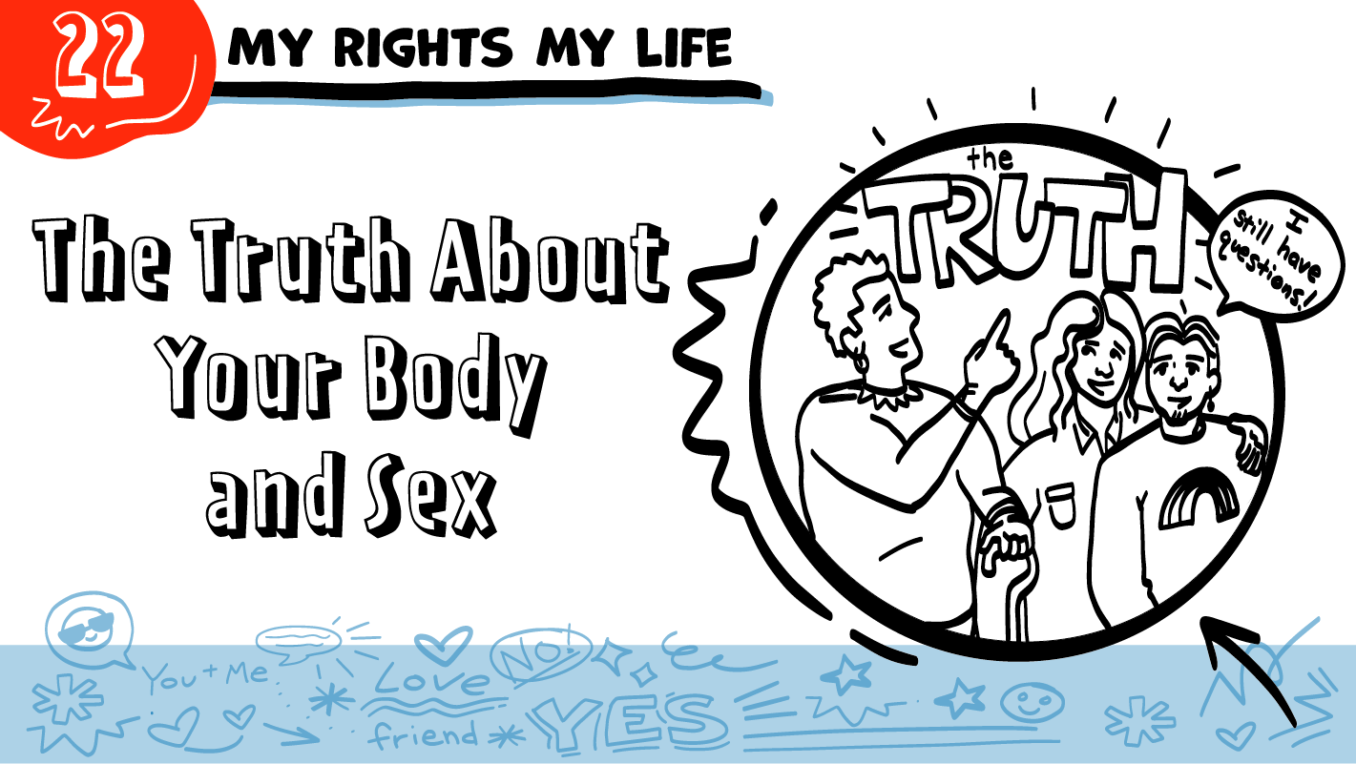
© 2022 SAFE Disability Services Program
Notes:
Repetition is beneficial for learning. Take time to review the last My Rights My Life class you taught prior to beginning this session. You can also answer any private questions students submitted on notecards during your previous class session.
Say: Today in class we will be talking about what we hear about bodies and sex, and what the truth is. We will also talk about good ways to learn more about your body and sex after our classes end. Finally, you will have an opportunity to practice speaking up for yourself.

Slide 2
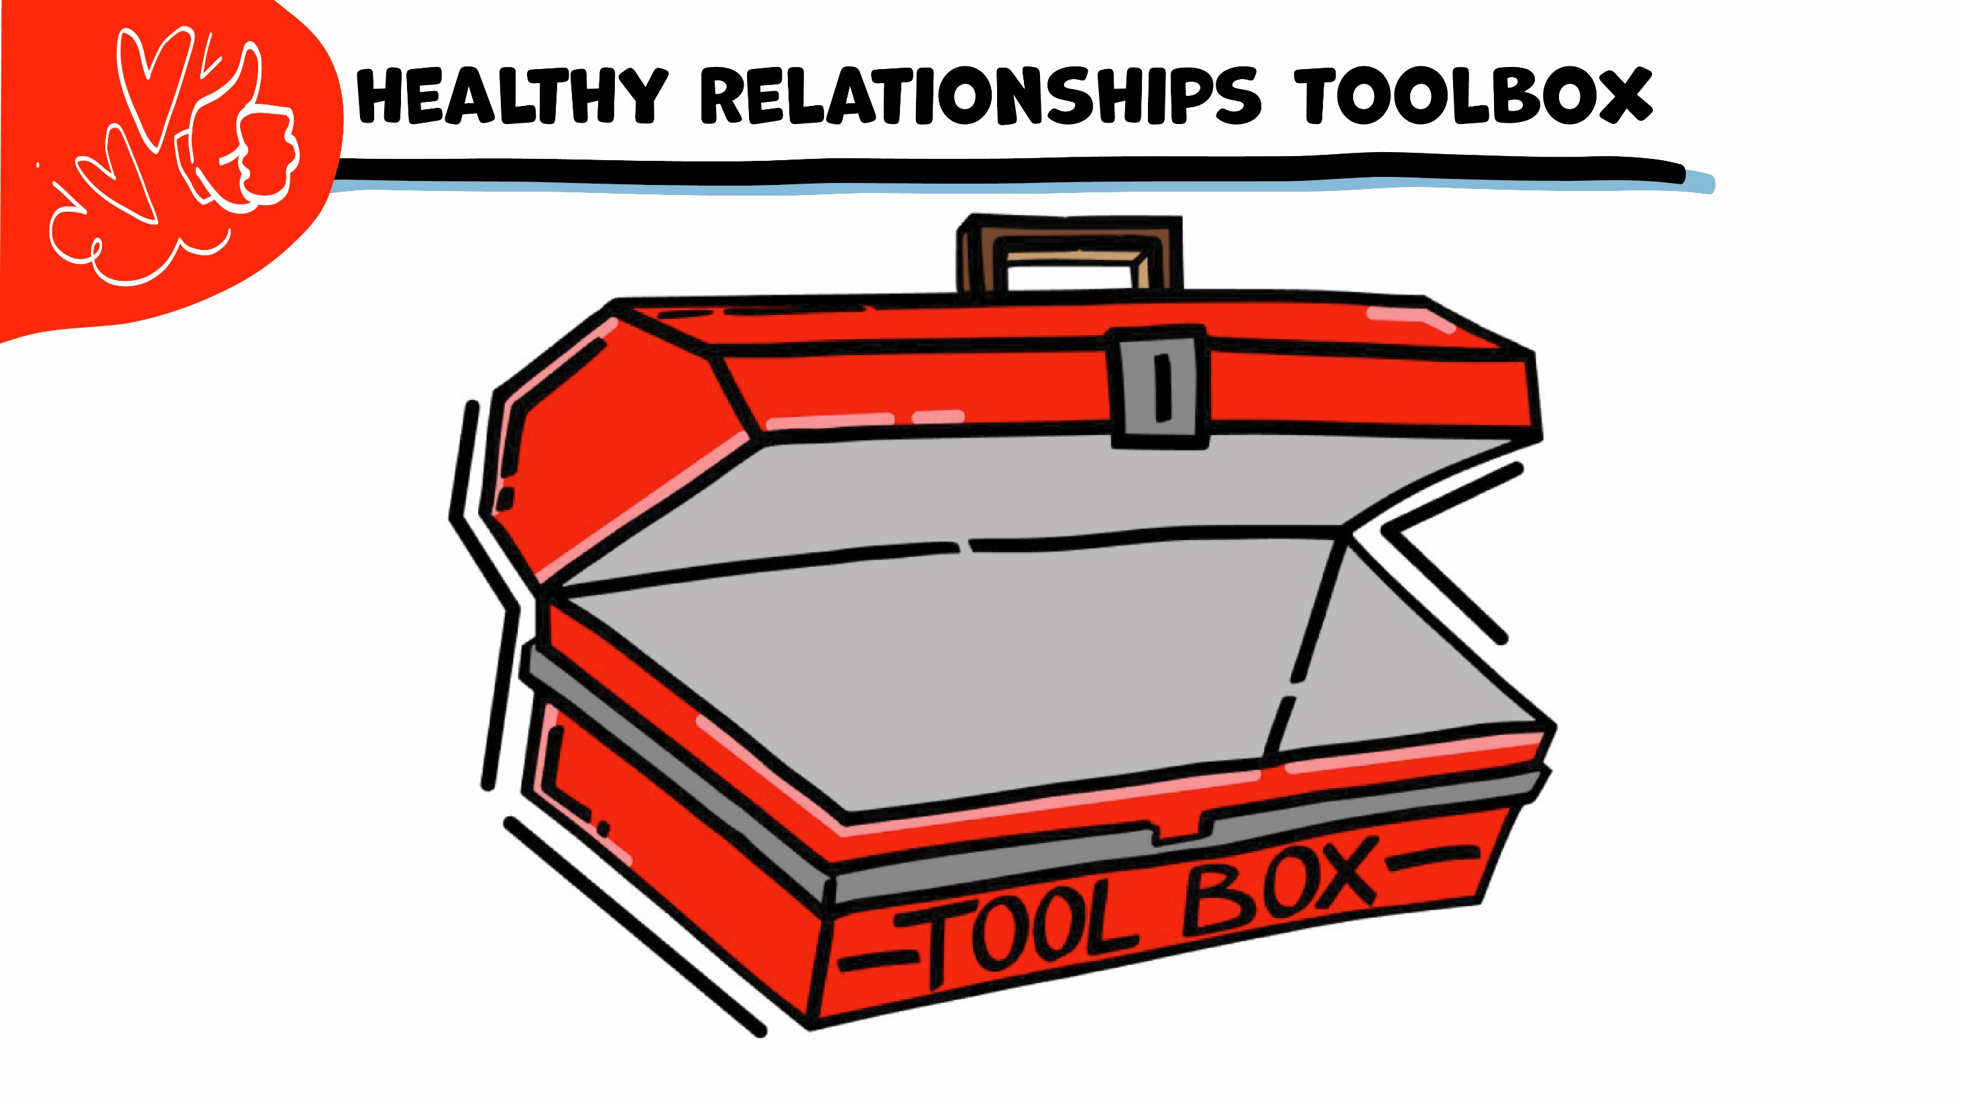
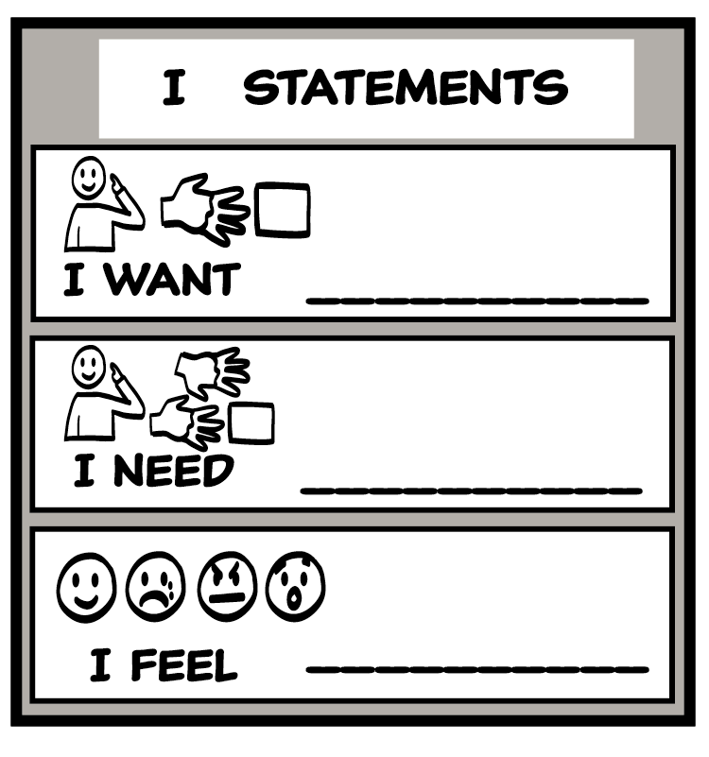
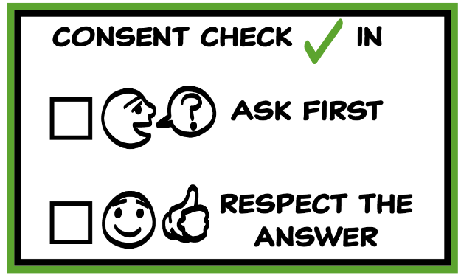
© 2022 SAFE Disability Services Program
Notes:
Use the large class Healthy Relationship Toolbox to review the Healthy Relationship Tools (I Statement, Relationship Map, NO!, and Consent Check-In). You can ask students to pull off one tool at a time and discuss what it is and how it is used. It can be particularly helpful for this review if you give students specific scenarios to think through. For example, you might ask, “If your friend lies to you, what is one I Statement you could use to tell your friend how you feel?” You may even consider using examples of situations that have recently occurred in your classroom, as long as doing so does not break student confidentiality. You can also ask students to connect the toolbox tools to their current relationships. You might say, “Can anyone volunteer and tell me about something going on in your life right now that the toolbox could help you with?”
Instructions for how to use each Healthy Relationship Tool can be found in the following classes:
I Statements: Classes 2 and 3
Relationship Map: Class 4
NO!: Class 5
Consent Check-In: Class 6

Slide 3
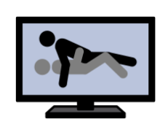
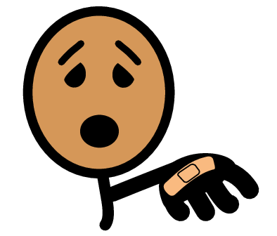
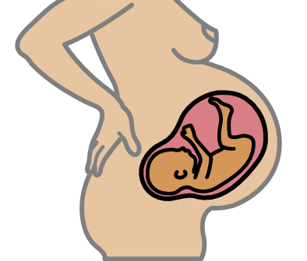
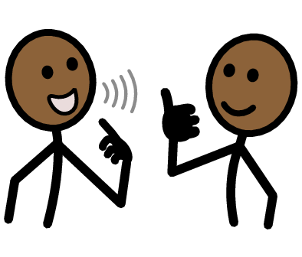
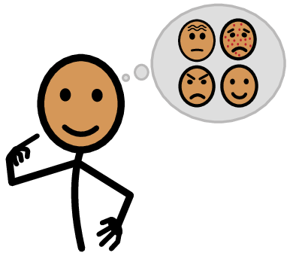
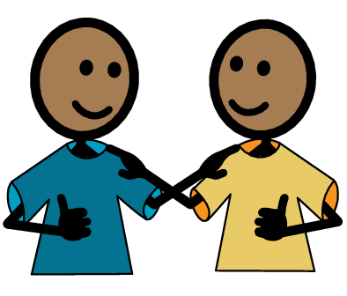
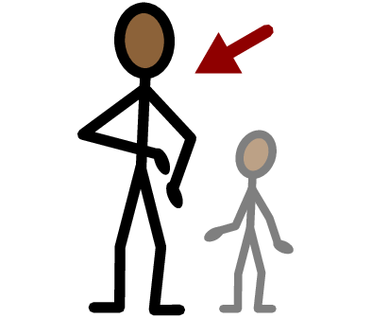
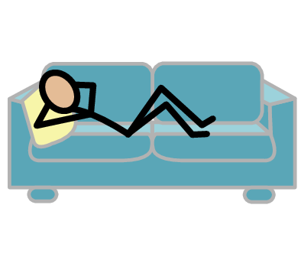
Porn
Hurt
Pregnancy
Yes
No
I need help
I have a question
Self-Advocate
Ask
Trust
Adult
Take a break
I feel
Happy
Sad
Mad
Scared
Copyright © 2021 SymbolStix, LLC. All rights reserved. Used with Permission.
Notes:
You can print this slide separately so each student can use the Important Words Sheet as a communication board throughout class. Review the words using the suggested definitions below. To enhance understanding, you can ask students to come up with their own definitions for vocabulary words or to provide a sentence or scenario using the new word.
Porn: photos or videos of people having sex
Hurt: when something does not feel good to your body
Pregnancy: when a sperm and an egg grow together in the uterus into a baby
Ask: talking to someone to get an answer
Self-Advocates: people who speak up for themselves

Slide 4
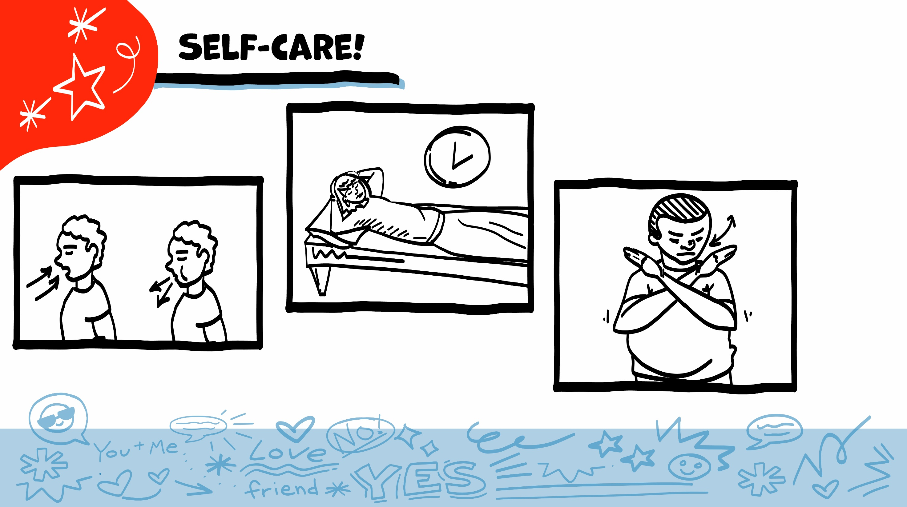
© 2022 SAFE Disability Services Program
Notes:
Say: As part of our class today, we will look at some pictures of bodies and body parts. You might feel embarrassed when we talk about this. You might not feel embarrassed. Either one is okay. Remember to check in with yourself, and to take care of yourself throughout class. If you feel overwhelmed, you can always take a break, pass on an activity, or take some deep breaths.

Slide 5
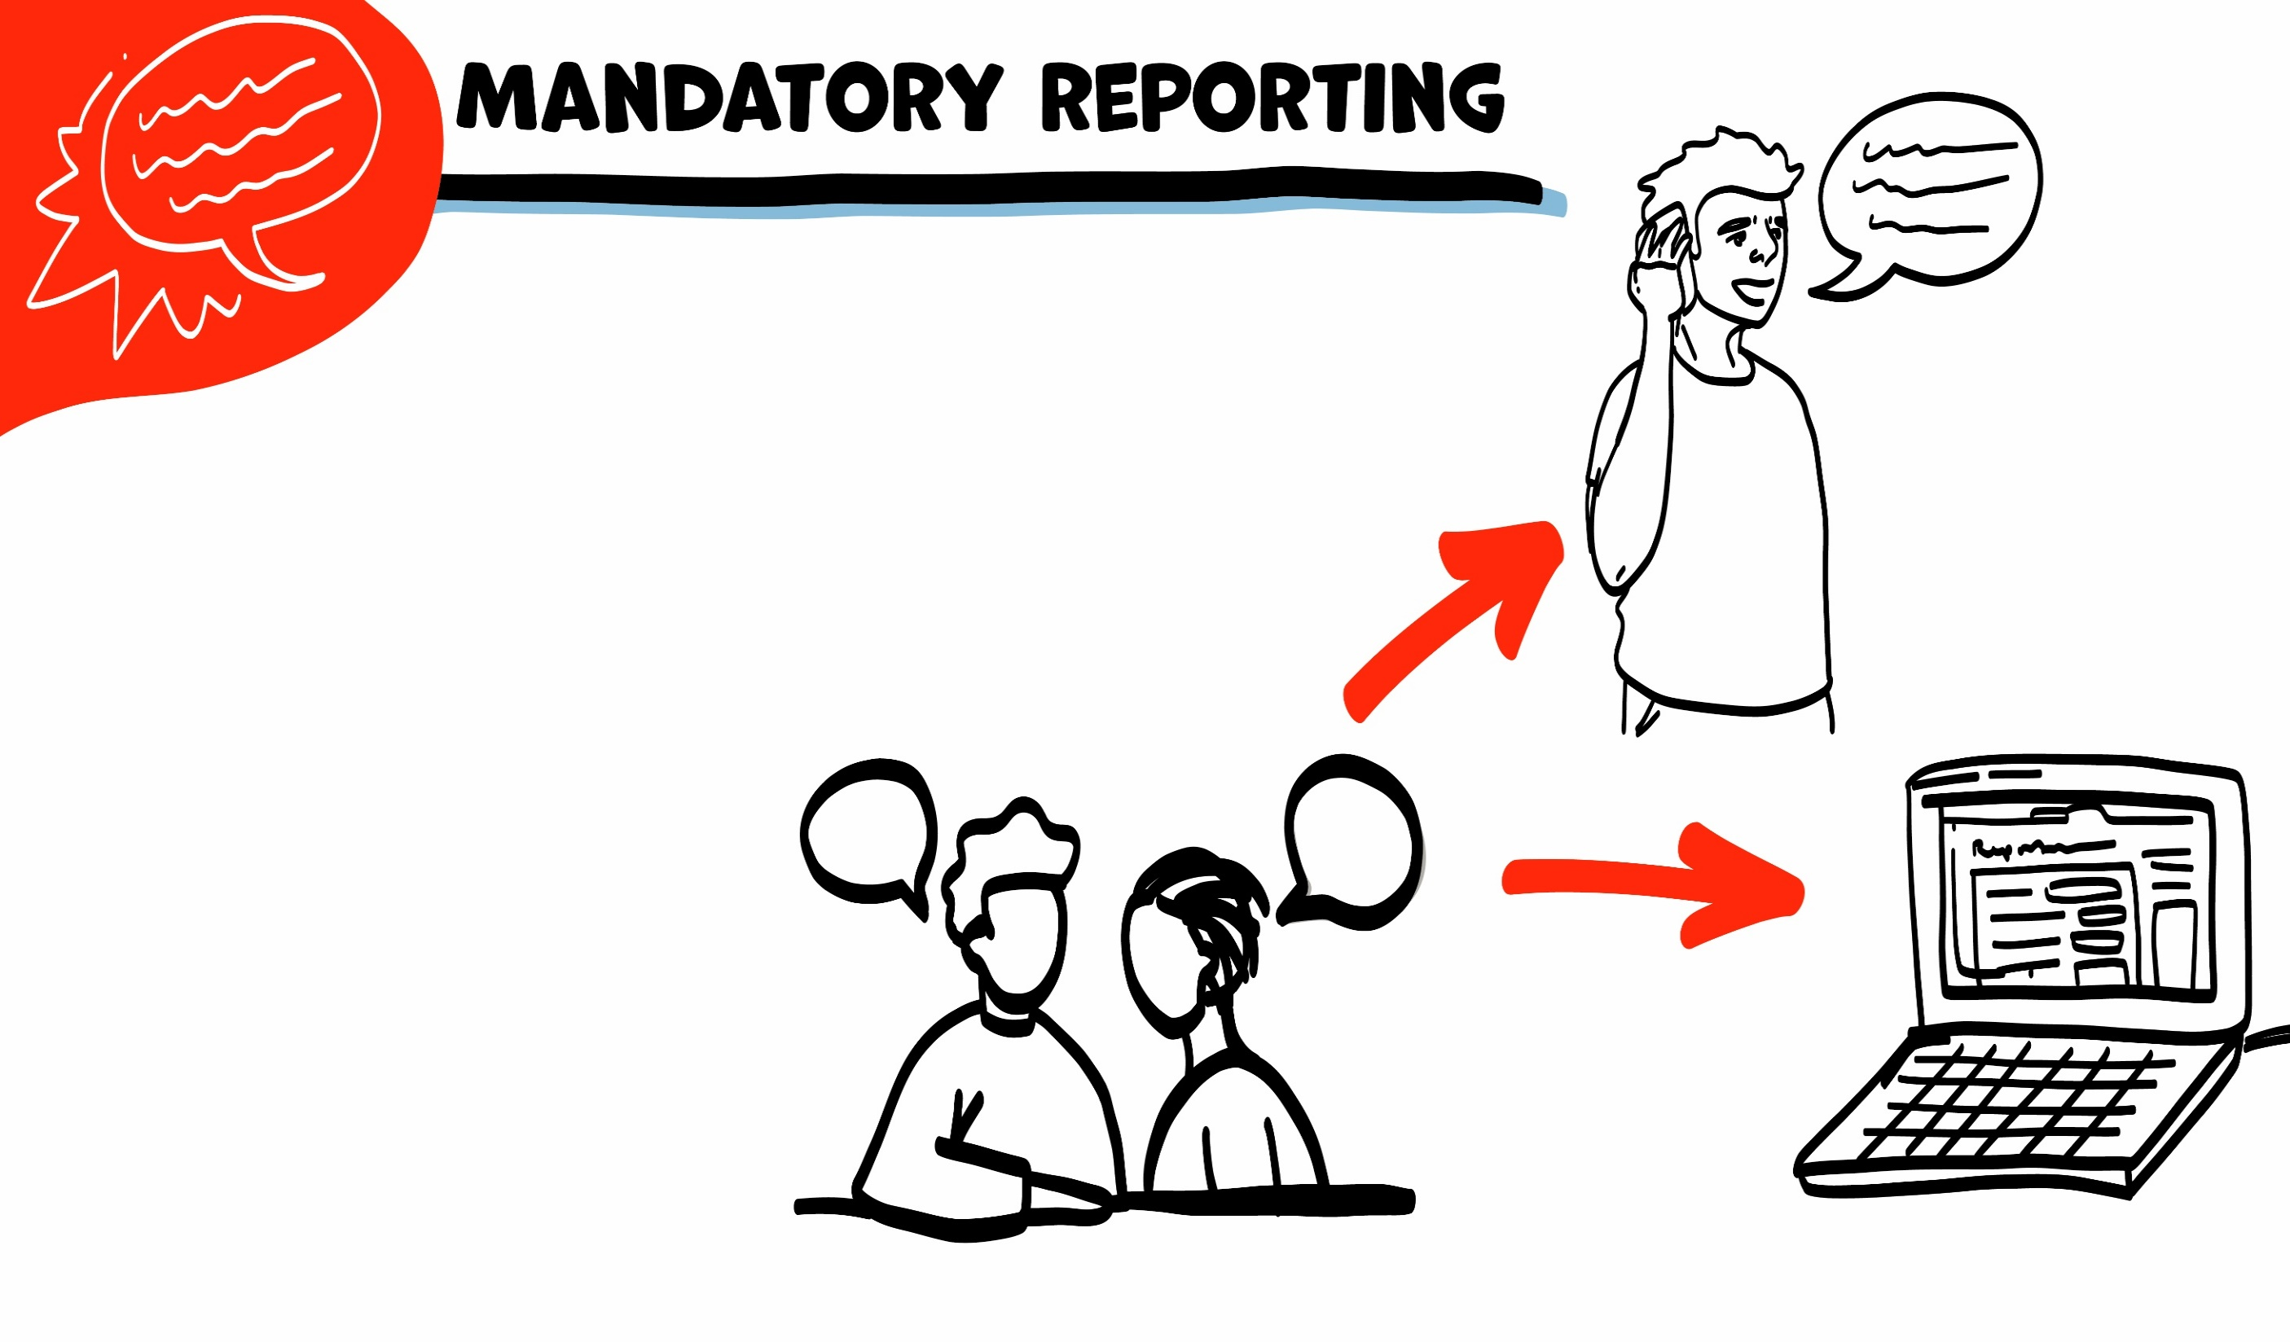
If someone is hurting you, I have to get help. I get help by telling Adult Protective Services (APS).
If I need to tell APS, I will let you know first. We can make a report together on the phone or on the computer.
© 2022 SAFE Disability Services Program
Notes:
Say: I wanted to remind everyone that I am a mandatory reporter to Adult Protective Services. Does anyone remember what that means? Normally what we talk about in class stays in class, unless I have your consent to share. This is a private, safe place to ask questions about your bodies and sex. However, if you tell me that you are being hurt, or that someone else is being hurt, I would need to let Adult Protective Services know. I would need to get you or the other person help, so no one hurts you anymore. Does anyone have any questions about that?

Slide 6
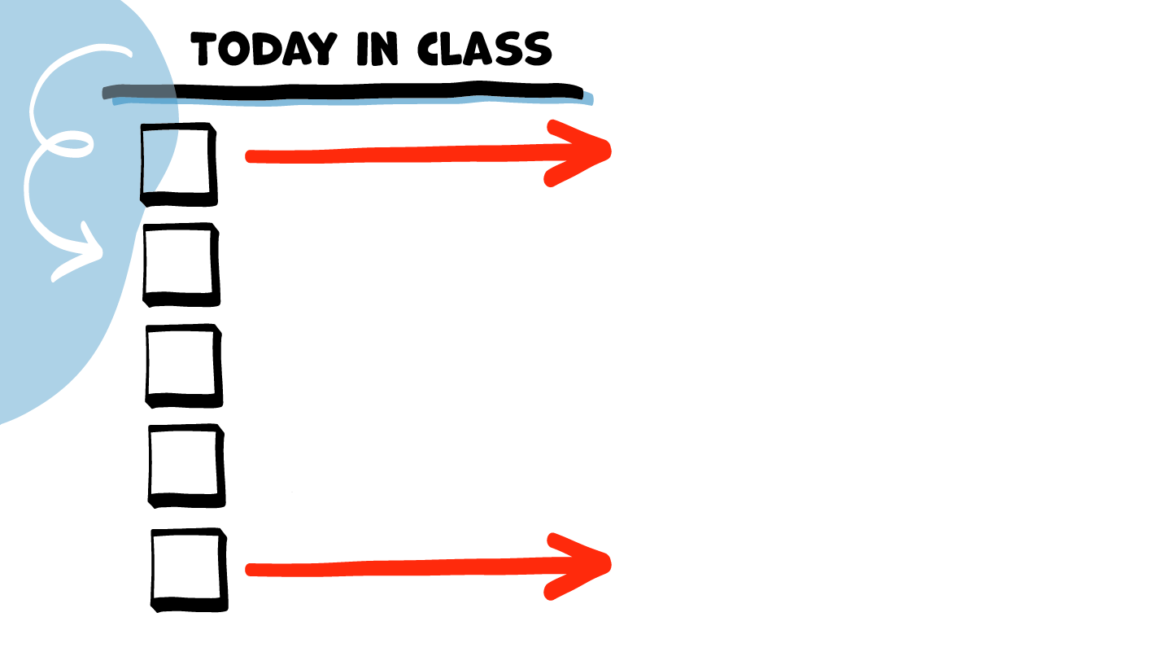
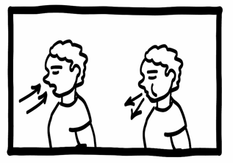
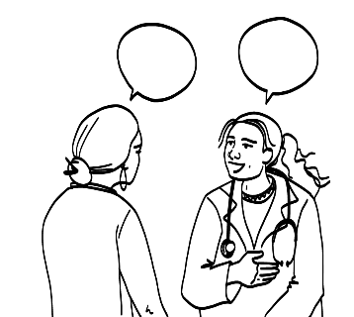
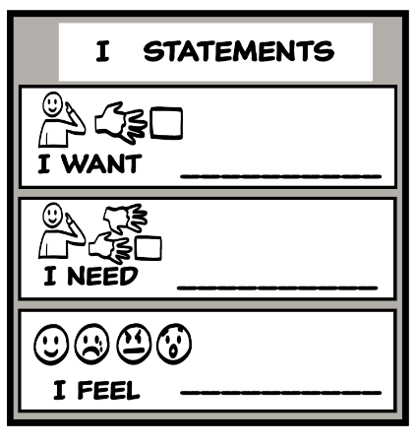
Virginity and Pornography
What We Hear about Bodies and Sex
YES
NO
Brain Break
How to Learn More
Sexual
Self-Advocacy
© 2022 SAFE Disability Services Program
Notes:
Read the agenda. Alternatively, you can ask for a student volunteer to read the agenda.

Slide 7
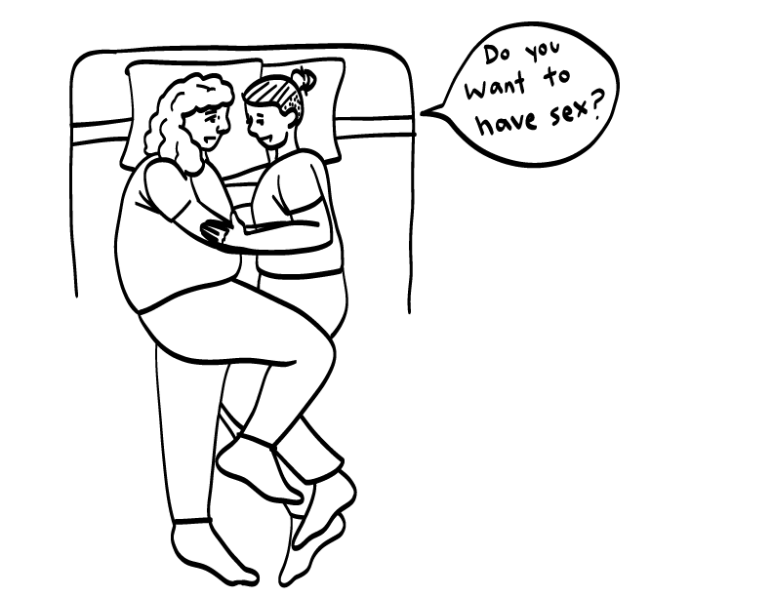
What is a Virgin?
Virgin is a word that people use to talk about someone who has never had oral, vaginal, or anal sex.
© 2022 SAFE Disability Services Program
Notes:
Say: Virgin is a word that people use to talk about someone who has never had oral, vaginal, or anal sex.

Slide 8
The Truth about Virginity
Nothing about who you are as a person changes when you have sex for the first time.
You don’t lose anything when you have sex for the first time.
What makes sex special is both people feeling safe and good.
© 2022 SAFE Disability Services Program
Notes:
Say: Sometimes when a person has sex for the first time, it is referred to as “losing their virginity.” But the truth is, when you have sex for the first time, you don’t lose anything. Having sex for the first time is like any new experience—it’s a chance to try and learn some new things. Nothing about who you are as a person changes when you have sex--you’re still you and you’re still awesome!
Sometimes people say that having sex is best when it’s someone’s first time. The truth is that virginity is not what makes sex special. What makes sex special is both people feeling safe and good. For most couples, sex will get better as they get to know each other more, and get more comfortable talking with each other about their bodies and needs. Good sex is all about good communication!
Remember, it’s never okay to make someone feel bad about having a lot of sex. It’s also not okay to make fun of someone for being a virgin. Everyone gets to decide for themselves when they are ready to have sex. Whether you have already had sex, are interested in having sex, or are not planning on having sex any time soon, you are awesome!

Slide 9
What is Pornography?
Pornography or porn is photos or videos of people having sex.
© 2022 SAFE Disability Services Program
Notes:
Say: Pornography, or porn for short, is a word people use to talk about photos or videos of people having sex. The people in porn videos are actors.

Slide 10
The Truth about Pornography
Porn does not show how sex really is. The people in porn are actors.
Porn is not a good way to learn about sex.
© 2022 SAFE Disability Services Program
Notes:
Say: Sometimes people think that porn is real and is a good way to learn about sex. The truth is that porn, like movies and television, is not a good way to learn about sex. Porn uses actors. Many times the things you see in pornography, movies, and TV are not realistic. You may see people having really violent sex, where one person is hurting the other person. Sometimes people in porn have sex for a really long time. Or you may see people who have sex without asking for consent first.
In real life, sex should never hurt either person. Always ask before touching someone’s body. In real life, sex may last a long time, or for only a couple minutes.
If you are watching porn, you need to remember that it is not real. You should not expect your partner to act the way people in porn act. Before you have sex, talk to your partner about your sexual limits, and ask about their sexual limits. Make sure you get your partner’s consent to touch their body, and that you continue to check in with them to make sure that everything feels okay.

Slide 11
Virginity and Pornography
What We Hear about Bodies and Sex
YES
NO
Brain Break
How to Learn More
Sexual
Self-Advocacy
© 2022 SAFE Disability Services Program
Notes:
Say: We’ve talked about virginity and porn. Now we’re going to talk about some other things you may have heard about sex and bodies. On the next few slides, I am going to read a statement. If you think the statement is true, gives a thumbs up. If you think the statement is false, give a thumbs down.

Slide 12
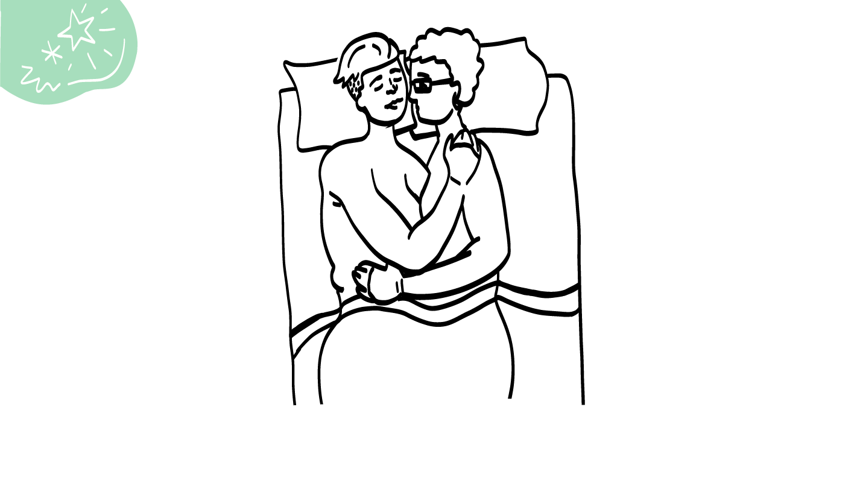
The first time you have sex it should hurt.
YES
NO
© 2022 SAFE Disability Services Program
Notes:
Say: The first time you have sex it should hurt. Is that true? Hold a thumbs up for yes or a thumbs down for no.
Give students enough time to process the question and make their decisions.

Slide 13
Sex should never hurt either person.
© 2022 SAFE Disability Services Program
Notes:
Say: No, sex should not hurt either person. Good sex is about communication. You can always say NO! or use an I Statement if something does not feel good to your body. It’s also important to check in with your partner a lot to make sure that they feel okay (use your Consent Check-In Tool). If your partner says no and asks you to stop, what should you do?
Give students enough time to process the question and make their decisions.
Say: You should stop immediately, back off, and give your partner some space.
Even if it is your first time having sex, it should not hurt. The first time you have sex, you may need to go more slowly or take breaks. Remember, you can use foreplay before you have sex to help your body get ready. You can do things like cuddling, kissing, and touching each other’s bodies. And you can use lubrication to make sure that sex feels more smooth and doesn’t hurt.
Sometimes the vagina may bleed a little bit the first time you have sex. For some people, this is normal. But remember that if anything hurts when you are having sex, slow down or take a break. If you are worried about something that happens to your body during sex, talk to a doctor or an adult in your inner circle of trust (green circle).

Slide 14
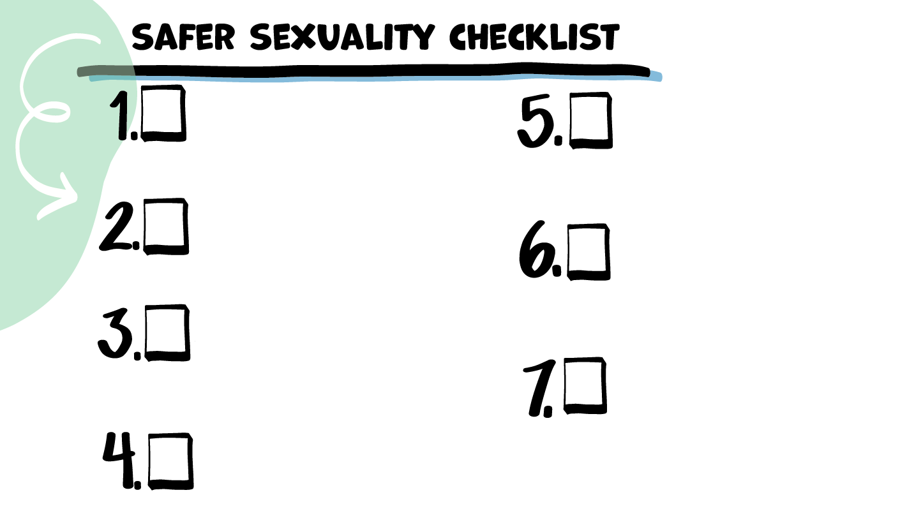
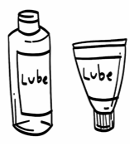
Safe and
Private Place
Birth Control Plan
Safer Sexual
Partner
STI Testing
and Protection
Sexual
Limits
Foreplay and Lubricant
Consent
© 2022 SAFE Disability Services Program
Notes:
Say: We’re going to add our final item to the Safer Sexuality Checklist. The last item is 7. Foreplay and Lube. If you have gone through all of the other items on the checklist, and you think you are ready to have sex, make sure to grab some lubricant and do some foreplay. Both of these things can help your body get warmed up for sex, and can make sex feel more smooth so it doesn’t hurt. Lubricant and foreplay can also make it less likely that a condom will tear, which helps protect your body from STIs and pregnancy.
Ask for a student volunteer to attach 7. Foreplay and Lubricant onto the class checklist. Distribute 7. Foreplay and Lubricant to each student. Give students time to glue 7. Foreplay and Lubricant item onto their personal checklist.

Slide 15
You can get pregnant the first time you have penis in vagina sex.
YES
NO
© 2022 SAFE Disability Services Program
Notes:
Say: You can get pregnant the first time you have penis in vagina sex. Is that true? Hold a thumbs up for yes or a thumbs down for no.
Give students enough time to process the question and make their decisions.

Slide 16
If you are having sex where a penis goes inside a vagina, you can get pregnant, even if it’s the first time you have sex.
© 2022 SAFE Disability Services Program
Notes:
Say: Any time you have sex where a penis goes inside a vagina, you or your partner can get pregnant. This is true even if the person with a vulva and vagina has never had sex before, or if they are on their period.

Slide 17
Having sex makes you a bad dirty person.
YES
NO
© 2022 SAFE Disability Services Program
Notes:
Say: Having sex makes you a bad, dirty person. Is that true? Hold a thumbs up for yes or a thumbs down for no.
Give students enough time to process the question and make their decisions.

Slide 18
Most people will have sex at some point in their lives.
© 2022 SAFE Disability Services Program
Notes:
Say: No, that’s not true! Most people will have sex at some point in their lives.
It is never okay to make someone feel bad for having sex, or for having a lot of sex. It is not cool to call someone names like “slut” or to make fun of them. Similarly, it’s not cool to make fun of someone for being a virgin.
Respect each person’s choice about whether or not they want to have sex. And other people need to respect your choice too!

Slide 19
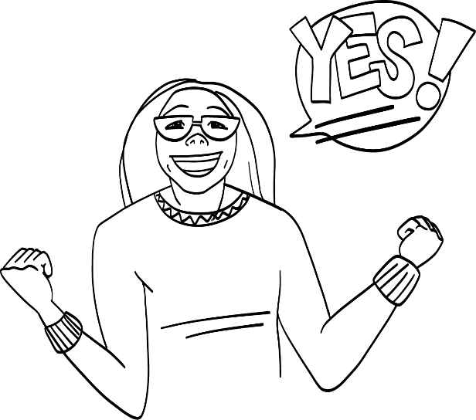
Sex should feel good for both people.
YES
NO
© 2022 SAFE Disability Services Program
Notes:
Say: Sex should feel good for both people. Is that true? Hold a thumbs up for yes or a thumbs down for no.
Give students enough time to process the question and make their decisions.

Slide 20
Sex should feel equally good for both people!
© 2022 SAFE Disability Services Program
Notes:
Say: Yes, sex should feel equally good for both people. People of all body parts can orgasm. Remember, an orgasm is when the sexual feelings build and build and then release. Usually after a person orgasms, their body feels really, really good.
You should care about your partner and check in to make sure that they are comfortable and that sex feels good to them. Your partner should check in with you, too!

Slide 21
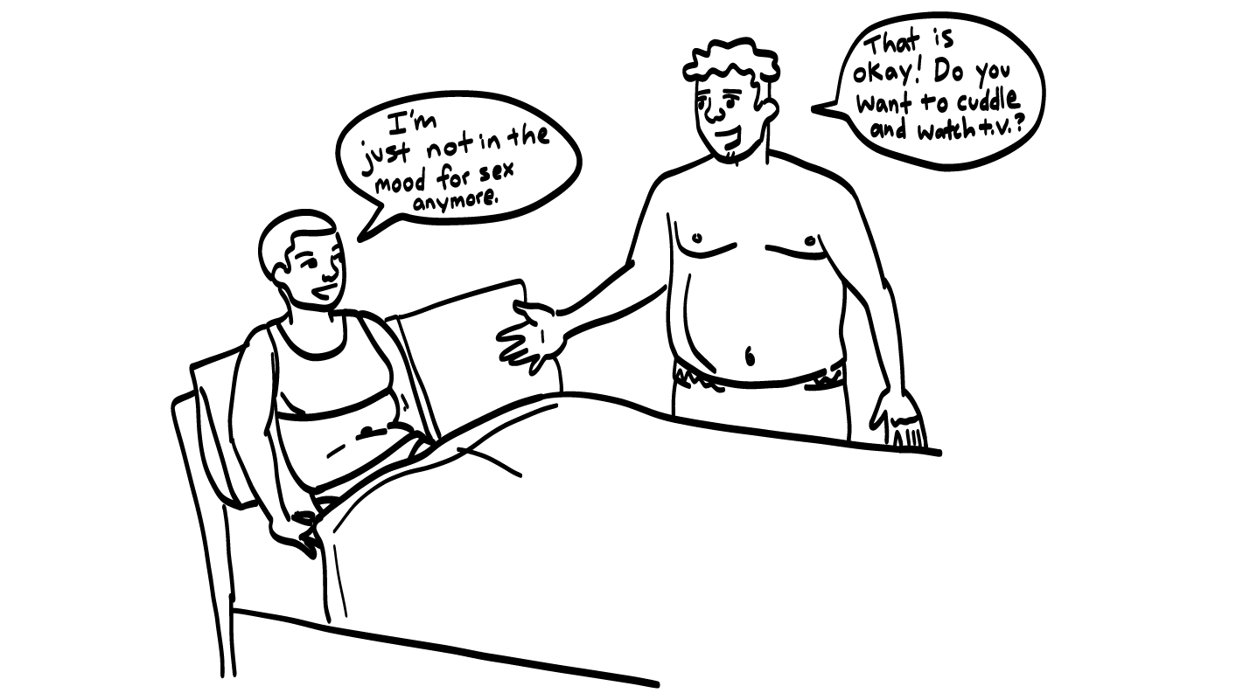
Sexual Self-Advocacy
© 2022 SAFE Disability Services Program
Notes:
Say: If sex ever doesn’t feel good to you, or is hurting you, tell your partner. You do not have to pretend that sex feels good, or pretend to have an orgasm.
What is an I Statement you could use to let your partner know that sex is not feeling good?
Give students enough time to process the question and make their decisions. You can use the large class Healthy Relationship Toolbox and I Statement Tool manipulatives to assist students as needed.
Say: Some examples include, “I want to try something else,” “I need to switch positions,” or “I feel uncomfortable. We need to stop.”
If your partner tells you that something does not feel good, it doesn’t mean that you did anything wrong, or that you are bad at sex. It just means that you need to talk to your partner more to find out what feels good to both of you!

Slide 22
Porn is a good way to learn about sex.
YES
NO
© 2022 SAFE Disability Services Program
Notes:
Say: Porn is a good way to learn about sex. Is that true? Hold a thumbs up for yes or a thumbs down for no.
Give students enough time to process the question and make their decisions.

Slide 23
Porn is not a good way to learn about sex. Porn uses actors.
© 2022 SAFE Disability Services Program
Notes:
Say: We talked earlier about how porn is not real. It has actors in it. Sex in real life is not like sex in porn.
We will talk after the brain break about better ways to learn about sex, instead of learning about it from porn.

Slide 24
© 2022 SAFE Disability Services Program
Notes:
Say: That was a lot of information, and you all are doing an amazing job! Let’s take a quick brain break before continuing with class.
Below are three ideas to give students a quick opportunity for a brain break. You are also welcome to come up with your own ideas for brain breaks that work best for your class.
Five finger breathing
For this exercise, have all students place their hand in front of their chest with their five fingers spread out. Next, use the pointer finger of the other hand to trace up and down each of the five fingers, beginning with the thumb. As students trace up a finger, they will breathe in. As they trace down a finger, they will breath out. When students breathe out on the pinky finger, you can tell them to shake out their hands and arms. As the school year goes on, you can ask students to lead this exercise for their peers.
If this exercise is physically inaccessible for your class, you can also model the hand tracing for students while they breathe in and out.
Stretch break
Lead students through a series of simple stretches. These can be completed in a chair, or while standing up, depending on the accommodation needs of your class. Some ideas include reaching toward the ceiling, stretching one arm at a time across the chest, reaching toward toes, turning head from side to side, etc. Ask students to hold a pose while you count to ten. As the school year goes on, you can ask students to lead stretches for their peers.
Dance party
If your class likes to dance, you can put on a short song for them to dance to. This is especially effective if you are able to find a song that relates to the theme for that week’s class.

Slide 25
Virginity and Pornography
What We Hear about Bodies and Sex
YES
NO
Brain Break
How to Learn More
Sexual
Self-Advocacy
© 2022 SAFE Disability Services Program
Notes:
Say: There is one more class about sex after this class. We have talked about a lot of things, and you all have learned so much! Even though you all have learned a lot, you will probably still have more questions about bodies and sex in the future. So how can you find good information about bodies and sex? Let’s talk about that next.

Slide 26
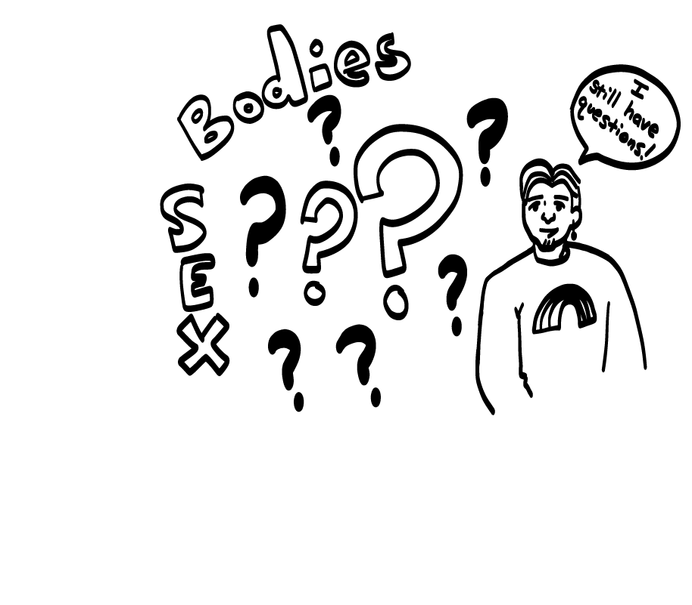
What now?
© 2022 SAFE Disability Services Program
Notes:
Say: If you still have questions about your body or sex…

Slide 27
…is work a good place to ask?
YES
NO
© 2022 SAFE Disability Services Program
Notes:
Say: …is work a good place to ask? Hold a thumbs up for yes or a thumbs down for no.
Give students enough time to process the question and make their decisions.
Say: No, work is not a good place to talk or joke about bodies and sex. In fact, you could even be fired for talking or joking about bodies and sex at work. This is something called sexual harassment, which we will talk about more in a future class. At work, you need to be professional.

Slide 28
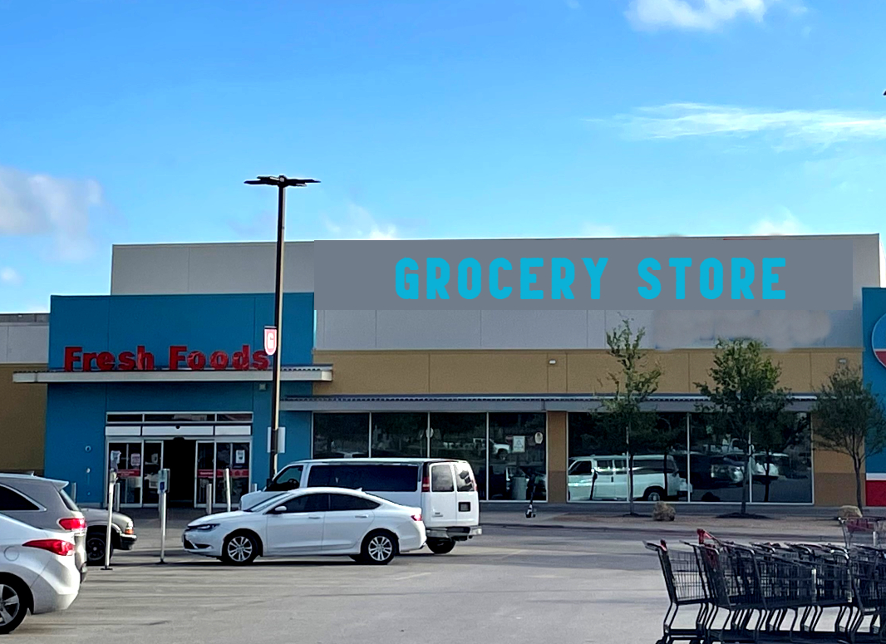
…is a grocery store a good place to ask?
YES
NO
© 2022 SAFE Disability Services Program
Notes:
Say: …is a grocery store a good place to ask questions about bodies and sex? Hold a thumbs up for yes or a thumbs down for no.
Give students enough time to process the question and make their decisions.
Say: No, a grocery store is not a good place to learn about bodies and sex. You don’t know how the people at the grocery store learned about bodies and sex themselves—it may have been from porn! Plus, grocery stores often have young children in them. It’s not okay to talk about bodies and sex around young children.

Slide 29
Is a birthday party a good place to ask?
YES
NO
© 2022 SAFE Disability Services Program
Notes:
Say: …is a birthday party a good place to ask questions about bodies and sex? Hold a thumbs up for yes or a thumbs down for no.
Give students enough time to process the question and make their decisions.
Say: No, a birthday party is not a good place to learn about bodies and sex. Just like at the grocery store, you don’t know how the people at the party learned about bodies and sex—it may have been from porn! Sex is a private topic. Ask questions only when you’re in a private place with people in your inner circle of trust (green).

Slide 30
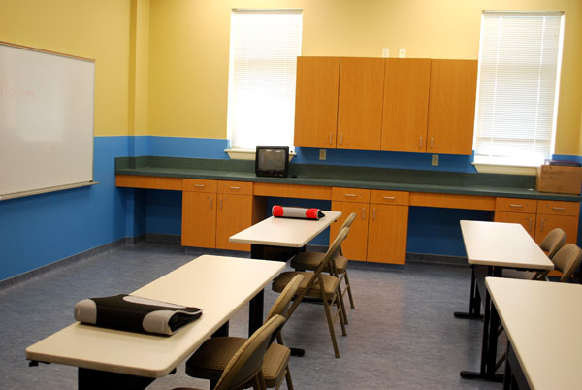
Is this class a good place to ask?
YES
NO
© 2022 SAFE Disability Services Program
Notes:
Say: …is this class a good place to ask questions about bodies and sex? Hold a thumbs up for yes or a thumbs down for no.
Give students enough time to process the question and make their decisions.
Say: Yes! My class is definitely a safe place to ask questions about bodies and sex. If you want to learn more about bodies and sex, you can ask in class. If I don’t know the answer to your question, I will find the information for you.

Slide 31
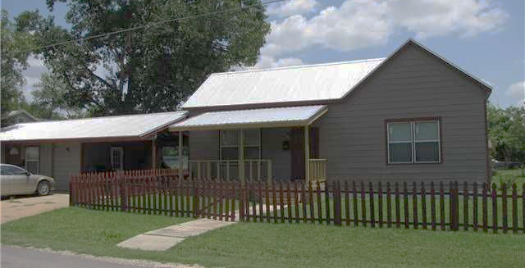
…is home a good place to ask?
YES
NO
© 2022 SAFE Disability Services Program
Notes:
Say: …is home a good place to ask questions about bodies and sex? Hold a thumbs up for yes or a thumbs down for no.
Give students enough time to process the question and make their decisions.
Say: Yes! You can ask an adult you trust at home to help you learn more about bodies and sex.

Slide 32
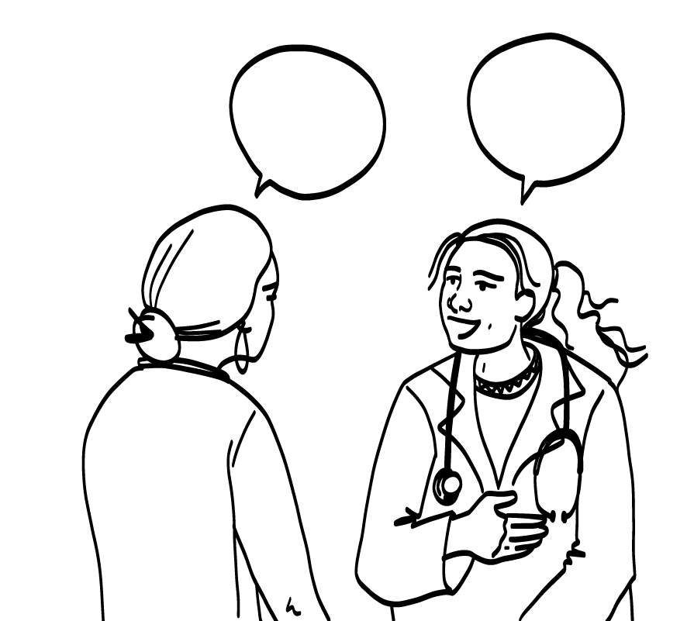
Who Could You Ask?
An adult from your inner circle of trust (green circle) can help you learn more about bodies and sex.
You can also ask a doctor or nurse.
© 2022 SAFE Disability Services Program
Notes:
Say: Who are adults you trust who could help you learn more about bodies and sex if you still have questions after this class ends?
Give students enough time to process the question and make their decisions.
Say: You can ask an adult from your inner circle of trust (green circle), like a family member or teacher. You can also ask a doctor or nurse at your doctor’s office or at a sexual health clinic.
While the internet can be a great tool to use to learn new things, not everything on the internet is true. Some websites have fake information. You can for the websites of trusted organizations.
Ask an adult from your inner circle of trust (green circle) to help you find safe websites about bodies and sex.

Slide 33
Virginity and Pornography
What We Hear about Bodies and Sex
YES
NO
Brain Break
How to Learn More
Sexual
Self-Advocacy
© 2022 SAFE Disability Services Program
Notes:
Say: The last thing we are going to talk about today is something called sexual self-advocacy.

Slide 34
Sexual Self-Advocacy
© 2022 SAFE Disability Services Program
Notes:
Say: All year you have been practicing how to be self-advocates. One part of self-advocacy is sexual self-advocacy. This means speaking up for yourself in your romantic and sexual relationships. It means saying what kinds of relationships you want to have, and what types of sex you want to have, if any. It also means being able to tell your partner and others what you want, what you need, and how you feel in your relationships.
We are going to practice using the I Statement Tool for sexual self-advocacy.

Slide 35
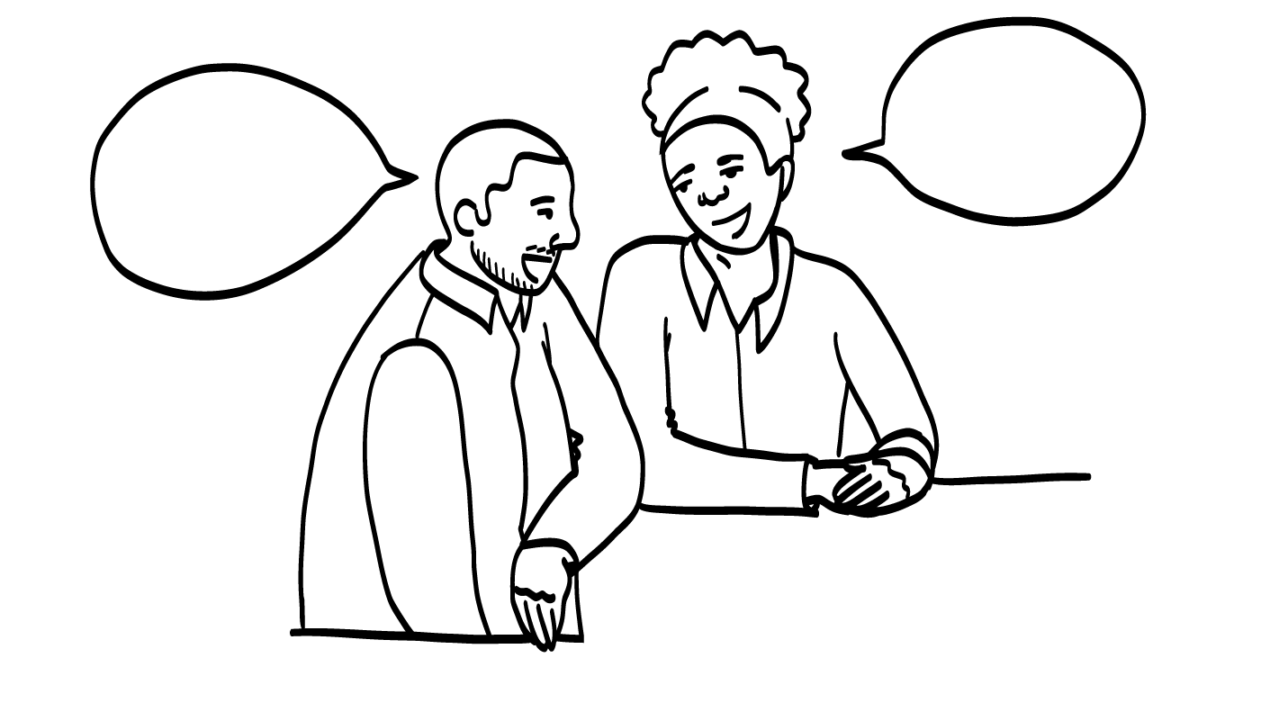
Practice
© 2022 SAFE Disability Services Program
Notes:
Your class can complete this activity together as a large group, or you can break students into smaller groups. You can use the large class Healthy Relationship Toolbox and I Statement Tool manipulatives to assist students with this activity.
Say: A minute ago, I asked you to name an adult you trust who you could go to if you have more questions about bodies and sex. What would you say to that person? How could you use an I Statement to let them know you need more information?
Give students enough time to process the question and make their decisions. Some sample answers are included below:
I want to learn more about how my body works. Can you help?
I need more information about how to be safe when I have sex.

Slide 36
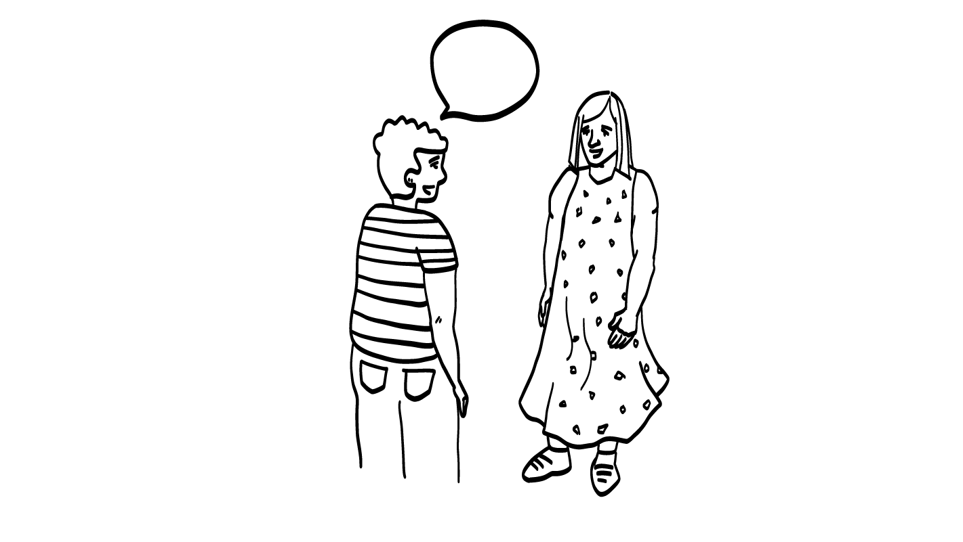
Practice
© 2022 SAFE Disability Services Program
Notes:
Your class can complete this activity together as a large group, or you can break students into smaller groups. You can use the large class Healthy Relationship Toolbox and I Statement Tool manipulatives to assist students with this activity.
Say: As an adult, you have a right to choose whether you want to date, and whether you want to have sex. Most people with disabilities, just like most people without disabilities, have sexual feelings. Sometimes people don’t believe that people with disabilities have a right to be sexual. You may have to stand up for this right with your parents, service providers, teachers, or others. What is an I Statement you could use to let someone know you are ready to have sex?
Give students enough time to process the question and make their decisions. Some sample answers are included below:
I feel ready to have sex with my partner. I am an adult.
I want you to respect my right to have sex.

Slide 37
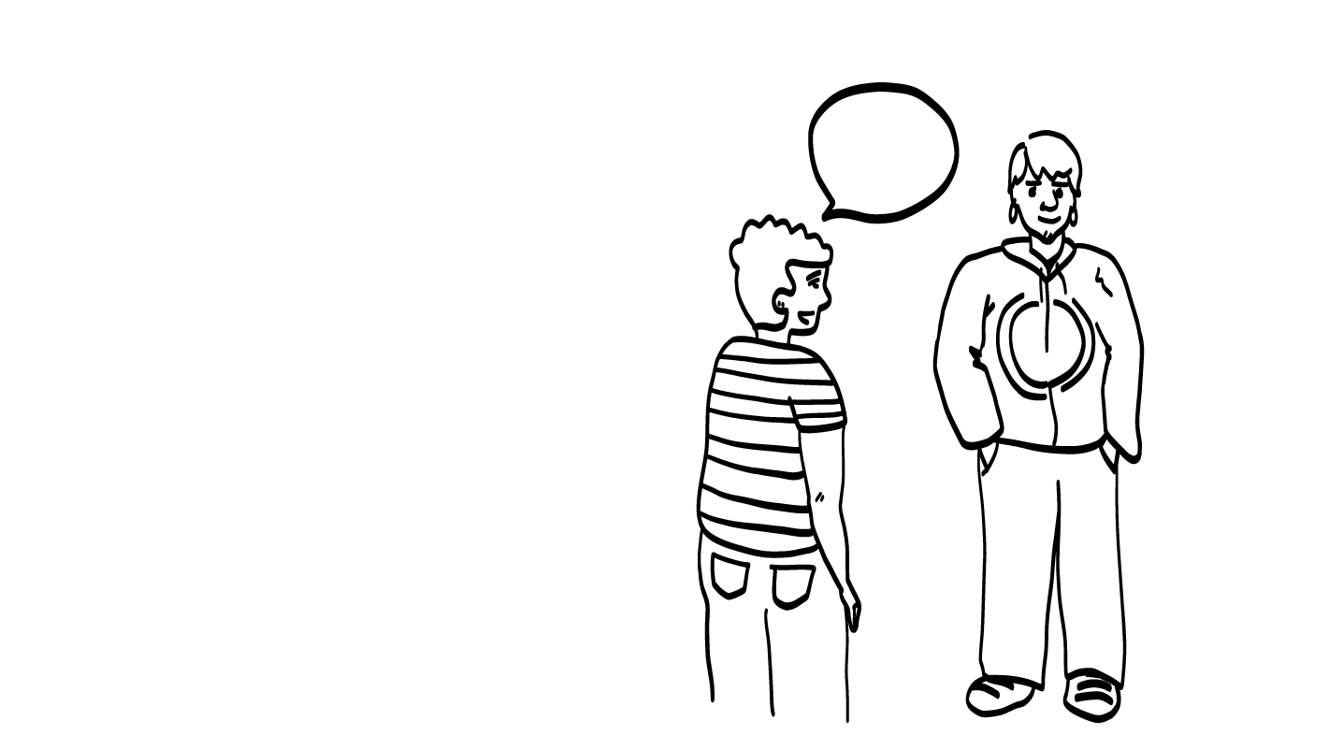
Practice
© 2022 SAFE Disability Services Program
Notes:
Your class can complete this activity together as a large group, or you can break students into smaller groups. You can use the large class Healthy Relationship Toolbox and I Statement Tool manipulatives to assist students with this activity.
Say: If you live in an apartment or house with other people, you might also have to advocate to have time alone in your room to masturbate or have sex. How could you use an I Statement to let someone know that you need alone time in your room?
Give students enough time to process the question and make their decisions. Some sample answers are included below:
I need time alone in my room with the door closed every day.
I want to have a safe place to be sexual.
I feel ready for some private time.

Slide 38
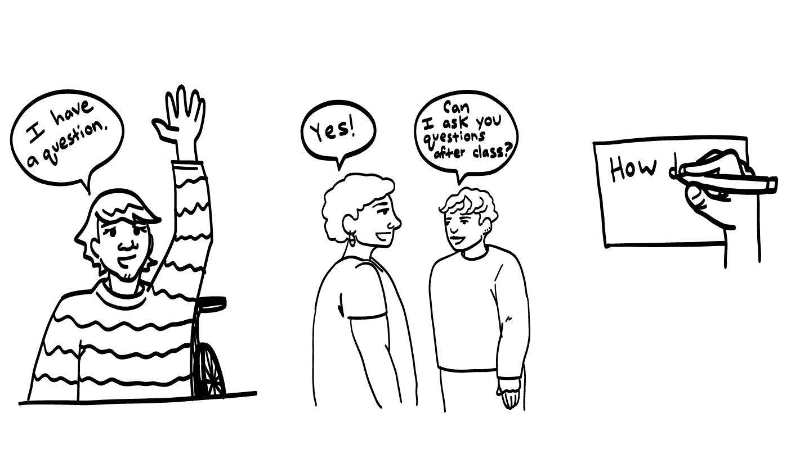
© 2022 SAFE Disability Services Program
Notes:
Say: You all did a great job in class today! Does anyone have any questions about today’s class? Remember, if you don’t want to ask your question out loud, you can write it on a notecard and leave it on your desk. You can also ask someone you trust to help you write your question on the notecard. I will pick up the notecards, and will answer the questions the next time we meet. When I answer a question, I won’t tell anyone who asked it.

Slide 39
Should sex ever hurt?
YES
NO
© 2022 SAFE Disability Services Program
Notes:
Say: Should sex ever hurt? Hold up a thumbs up for yes, and a thumbs down for no.
Give students enough time to process the question and make their decisions.
Say: No, sex should never hurt. If something does not feel good to your body, you need to tell your partner right away. There are lots of things you can try to help sex feel better. You can do more foreplay, use lubrication, switch positions, or go more slowly with your partner. Make sure to check in with your partner as well to make sure they are feeling good too!
If sex keeps hurting, you may want to talk to a doctor or someone at a health clinic about what you can do to make sure sex feels okay to your body.

Slide 40
Who is one adult you trust who you could go to if you have more questions about bodies and sex?
© 2022 SAFE Disability Services Program
Notes:
Say: Who is one adult you trust that you could go to if you have more questions about bodies and sex?
Give students enough time to process the question and make their decisions. Go around the room and ask each student to share the name of one person.

Slide 41
Is it important to speak up for what you want and need in your sexual relationships?
YES
NO
© 2022 SAFE Disability Services Program
Notes:
Say: Is it important to speak up for what you want and need in your sexual relationships? Hold a thumbs up for yes, and a thumbs down for no.
Give students enough time to process the question and make their decisions.
Say: Yes! Speaking up for yourself in your sexual relationships is called sexual self-advocacy. Remember, other people can’t read your mind. It’s really important that you tell your partner how you feel, what you want, and what you need. Good sex is about good communication. You may also have to remind your parents, service providers, teachers, and others that you are an adult with the right to choose to be sexual.

Slide 42
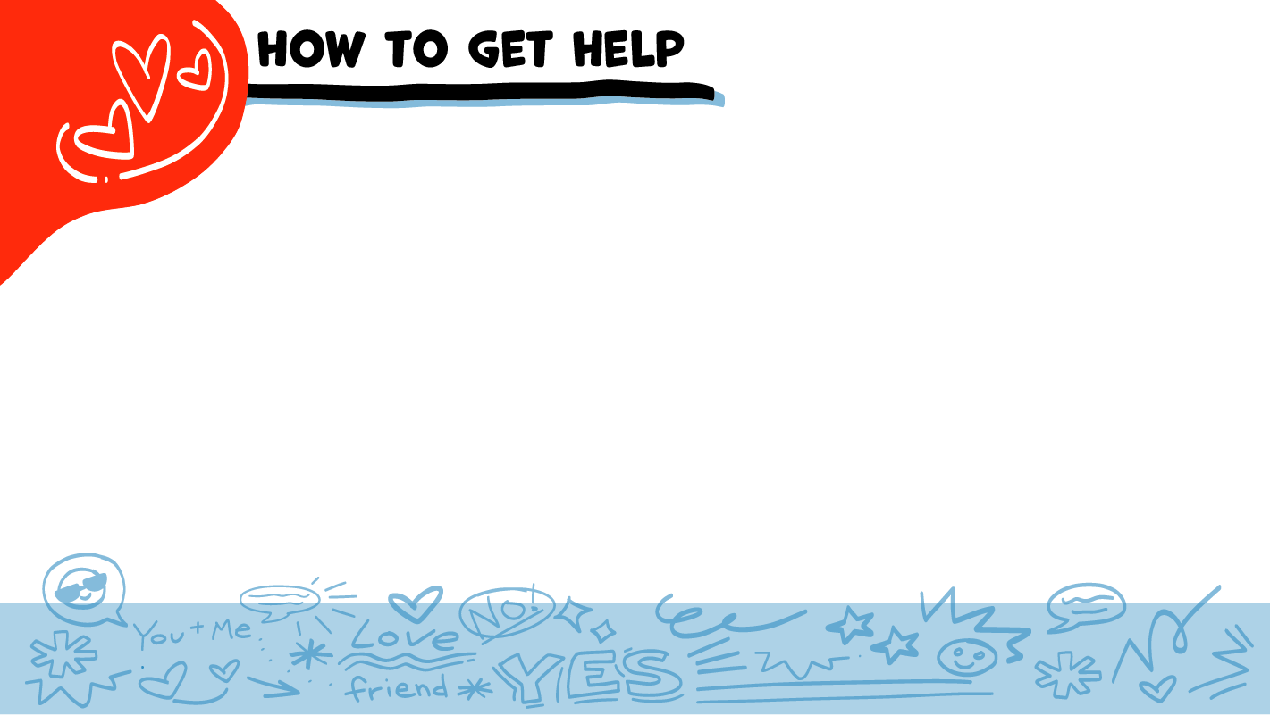
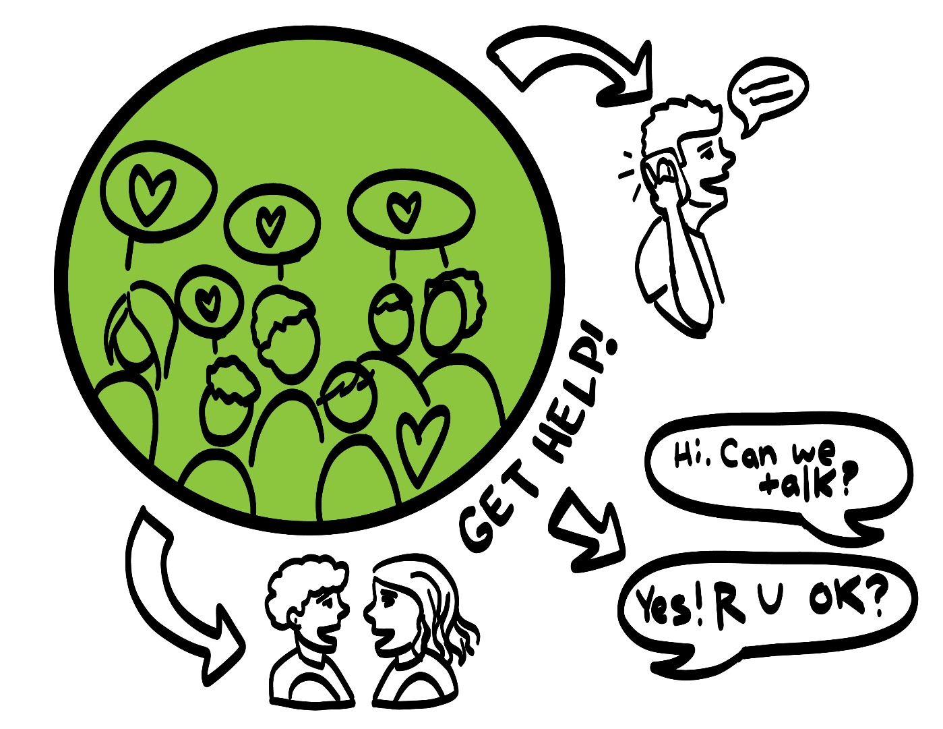
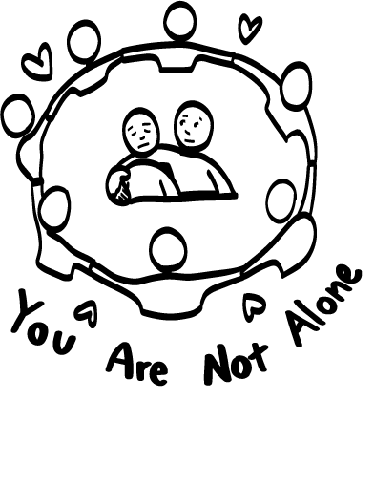
© 2022 SAFE Disability Services Program
Notes:
Say: If you are being hurt, or if someone ever touches your body in a way that you don’t like, you can get help. You did not do anything wrong, and you are not alone. You can get help by talking to an adult from your inner circle of trust (green circle) If someone you care about is being hurt, you can also get help by talking to an adult from your inner circle of trust (green circle). If an emergency is happening, you can always call 911.
If you call 911 for help, a police officer or an ambulance might come. If the first person you tell doesn’t believe you or doesn’t get you help, keep telling adults you trust what is going on until you get the help you need.

Slide 43
© 2022 SAFE Disability Services Program
Notes:
Say: Does anyone remember what our power statement is? Our power statement is “I know me best.” This means that each of you knows yourself better than anyone else does. Today you had a chance to think about the truth about bodies and sex. We also talked about safer places and people to help you learn more about bodies and sex. Let’s gather together and on the count of three, say our power statement.
Have each interested student put one hand in the middle of the circle. Ask for a student volunteer to count to three. After three, all participants say the power statement while lifting their hand into the air. Students can also stand in the circle without touching hands if they prefer.

Slide 44
© 2022 SAFE Disability Services Program
Notes:
SAFE would like to thank the Texas Council for Developmental Disabilities for the funding for this curriculum.

Slide 45
This curriculum is offered to you online at no cost. You are free to use these resources in their original format for educational purposes only. Please reference The SAFE Alliance appropriately (see citation at bottom of page).
We ask that you do not alter curriculum images, slides, or lesson plan materials. You may not use My Rights My Life curriculum (MRML) for commercial purposes that includes but is not limited to: selling workshops that you facilitate based on MRML; creating links or websites to re-distribute any of the materials associated with SAFE’s My Rights My Life curriculum.
Selling materials from My Rights My Life: A Curriculum for Safer Relationships is a direct violation of copyright law.
Westmore, M. & Lersch, H. (2022). My rights my life: A curriculum for safer relationships.
Schwartz, M. (Ed.). The SAFE Alliance: Austin, TX.
© 2022 SAFE Disability Services Program

