Slide 1
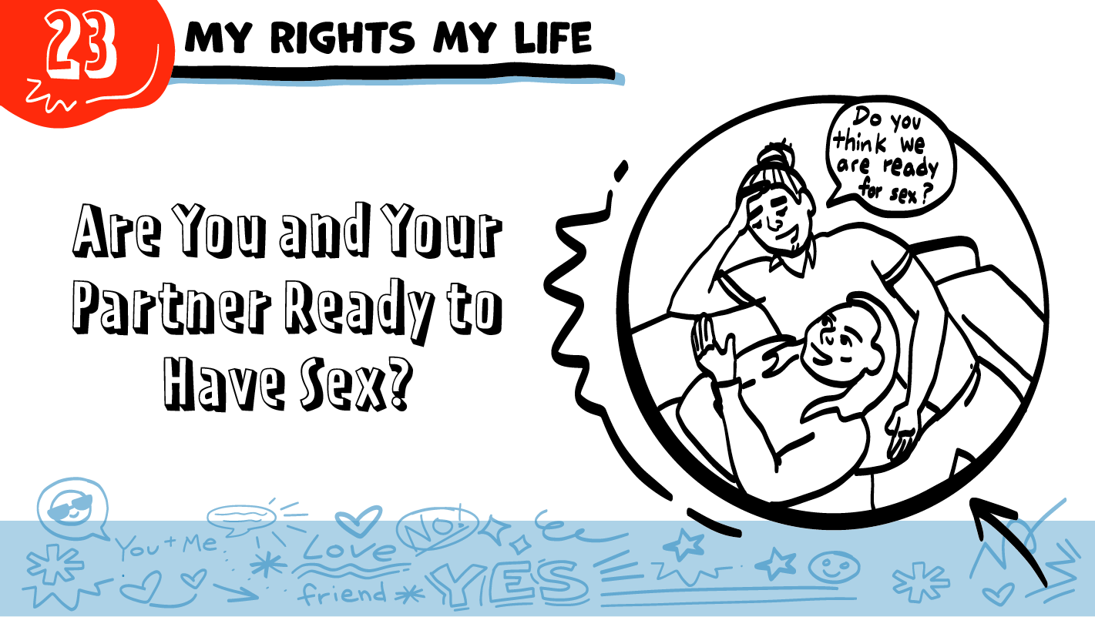
© 2022 SAFE Disability Services Program
Notes:
Repetition is beneficial for learning. Take time to review the last My Rights My Life class you taught prior to beginning this session. You can also answer any private questions students submitted on notecards during your previous class session.
Say: Today is our final class on bodies and sex! We are going to go over everything we have talked about in our Safer Sexuality Checklist.

Slide 2
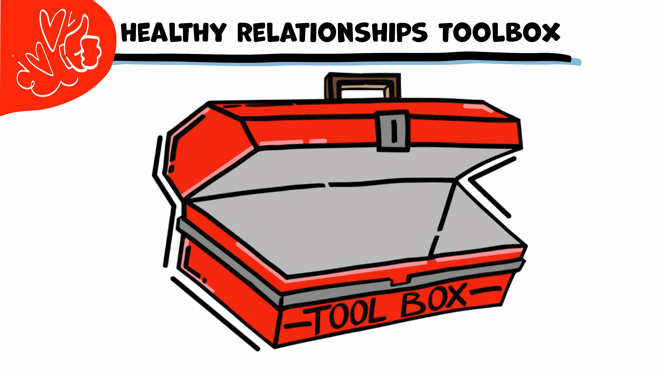
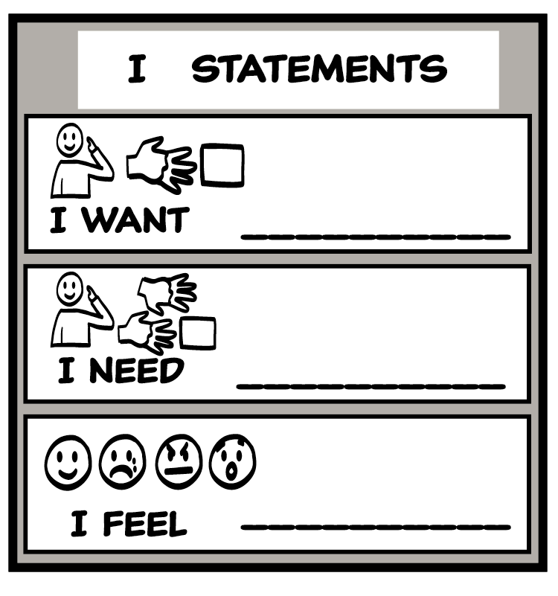
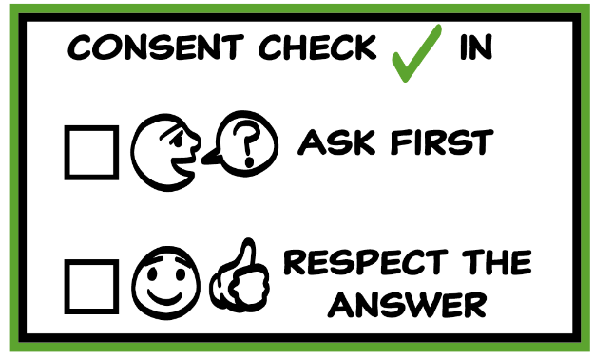
© 2022 SAFE Disability Services Program
Notes:
Use the large class Healthy Relationship Toolbox to review the Healthy Relationship Tools (I Statement, Relationship Map, NO!, and Consent Check-In). You can ask students to pull off one tool at a time and discuss what it is and how it is used. It can be particularly helpful for this review if you give students specific scenarios to think through. For example, you might ask, “If your friend lies to you, what is one I Statement you could use to tell your friend how you feel?” You may even consider using examples of situations that have recently occurred in your classroom, as long as doing so does not break student confidentiality. You can also ask students to connect the toolbox tools to their current relationships. You might say, “Can anyone volunteer and tell me about something going on in your life right now that the toolbox could help you with?”
Instructions for how to use each Healthy Relationship Tool can be found in the following classes:
I Statements: Classes 2 and 3
Relationship Map: Class 4
NO!: Class 5
Consent Check-In: Class 6

Slide 3
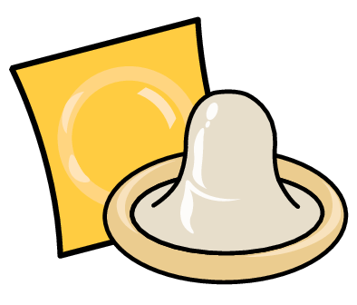
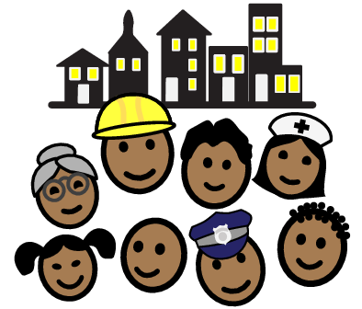
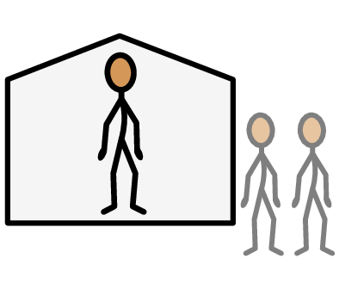
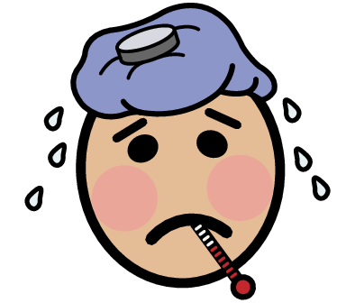
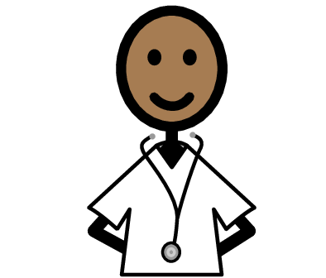
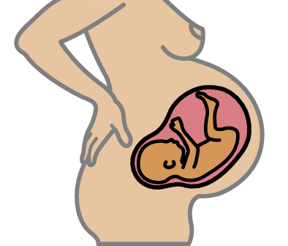
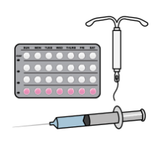
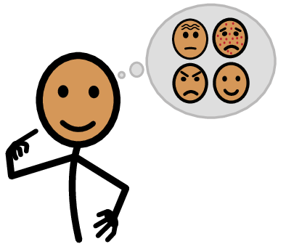
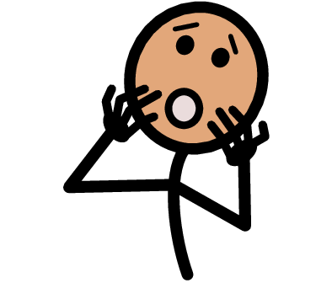
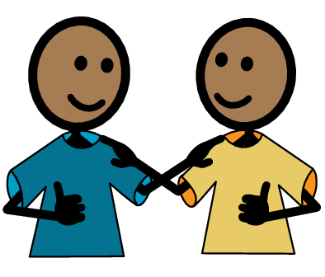
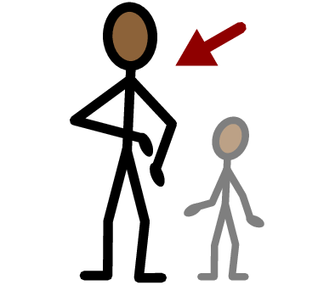
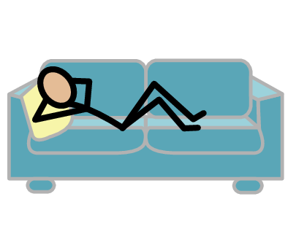
Condom
Dental dam
Sick
Public
Private
Yes
No
Foreplay
Doctor
Birth control
Pregnancy
I need help
I have a question
Ask
Trust
Adult
Take a break
I feel
Happy
Sad
Mad
Scared
Copyright © 2021 SymbolStix, LLC. All rights reserved. Used with Permission.
Notes:
You can print this slide separately so each student can use the Important Words Sheet as a communication board throughout class. Review the words using the suggested definitions below. To enhance understanding, you can ask students to come up with their own definitions for vocabulary words or to provide a sentence or scenario using the new word.
Public: places where other people can come in and out and there are sometimes a lot of people, like a mall
Private: places where other people need your consent to come in and out, like your bedroom
Ask: talking to someone to get an answer
Birth control: things that you can use to help you not make a baby if you are having penis in vagina sex
Pregnancy: when a sperm and an egg grow together in the uterus into a baby
Sick: when your body does not feel good
Condom: a piece of rubber that goes over the hard penis and catches semen
Dental dam: a piece of rubber that goes over the vulva or the anus when you have oral sex
Doctor: someone who helps keep your body healthy
Foreplay: things that people do to get their bodies ready for sex, such as kissing and touching each other’s bodies

Slide 4
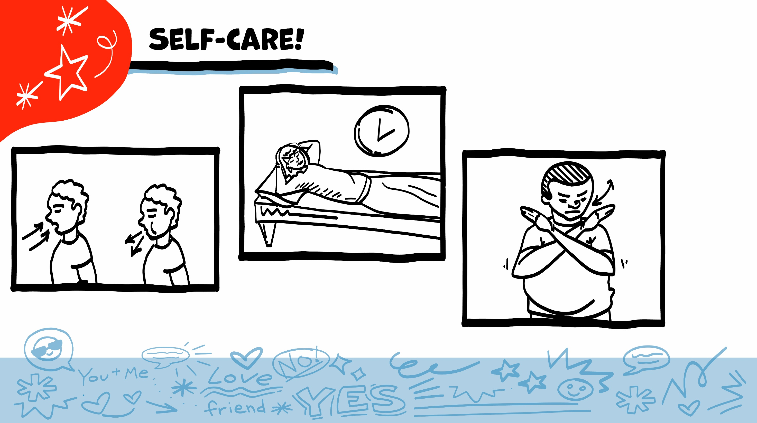
© 2022 SAFE Disability Services Program
Notes:
Say: As part of our class today, we will look at some pictures of bodies and body parts. You might feel embarrassed when we talk about this. You might not feel embarrassed. Either one is okay. Remember to check in with yourself, and to take care of yourself throughout class. If you feel overwhelmed, you can always take a break, pass on an activity, or take some deep breaths.

Slide 5
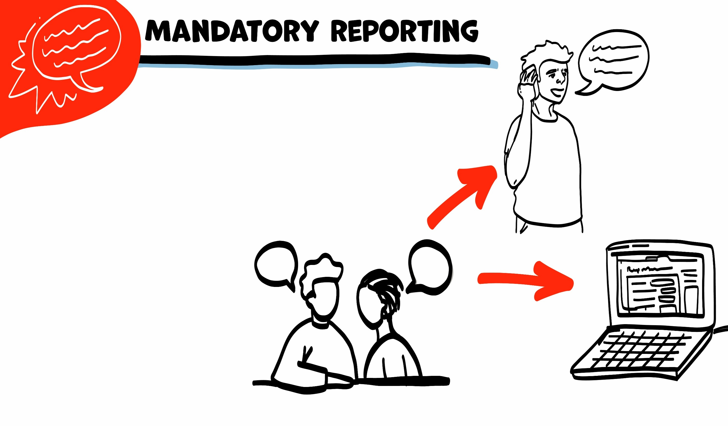
If someone is hurting you, I have to get help. I get help by telling Adult Protective Services (APS).
If I need to tell APS, I will let you know first. We can make a report together on the phone or on the computer.
© 2022 SAFE Disability Services Program
Notes:
Say: I wanted to remind everyone that I am a mandatory reporter to Adult Protective Services. Does anyone remember what that means? Normally what we talk about in class stays in class, unless I have your consent to share. This is a private, safe place to ask questions about your bodies and sex. However, if you tell me that you are being hurt, or that someone else is being hurt, I would need to let Adult Protective Services know. I would need to get you or the other person help, so no one hurts you anymore. Does anyone have any questions about that?

Slide 6
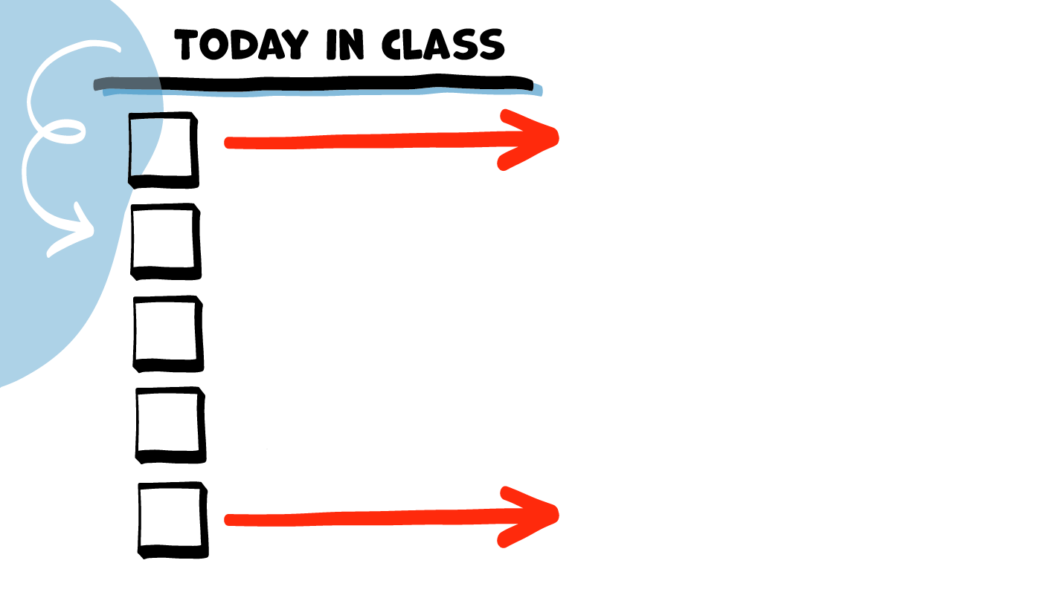
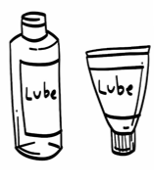
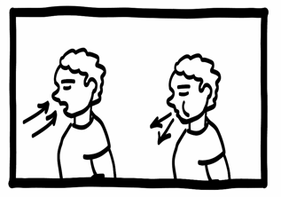
Safe and
Private Place
Birth Control Plan
Safer Sexual
Partner
STI Testing
and Protection
Sexual
Limits
Foreplay &
Lubricant
Brain break
Consent
© 2022 SAFE Disability Services Program
Notes:
Read the agenda. Alternatively, you can ask for a student volunteer to read the agenda.

Slide 7
© 2022 SAFE Disability Services Program
Notes:
Say: Today is our last class about sex and bodies. You all have done an amazing job! Today we will put everything we’ve talked about together and discuss how you can know if you and your partner are ready to have sex.

Slide 8
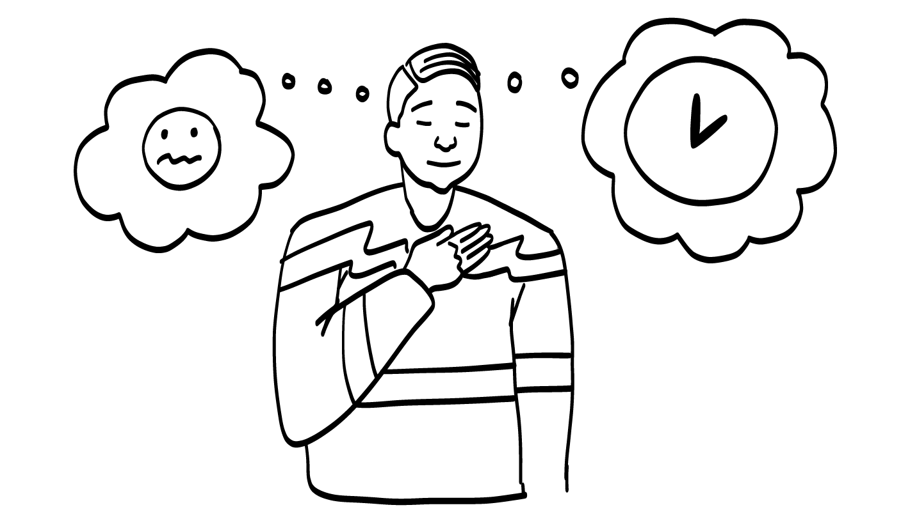
You must never feel pressure to have sex if you don’t want to. Trust your feelings!
© 2022 SAFE Disability Services Program
Notes:
Say: There are no rules about when you have to have sex. The decision is completely up to you and your partner. You must never feel pressured to have sex if you don’t want to.
If you decide that you and your partner are ready to have sex, that’s great! If you’re not ready to have sex, that’s great too! You and your partner get to decide what feels right for your relationship and your bodies. As long as you are doing what feels right for you and your partner, that is awesome!
If you and your partner decide you’re ready to have sex, you can use the Safer Sexuality Checklist to make sure you are being as safe as possible. We’ll go through the checklist step-by-step in class today.

Slide 9
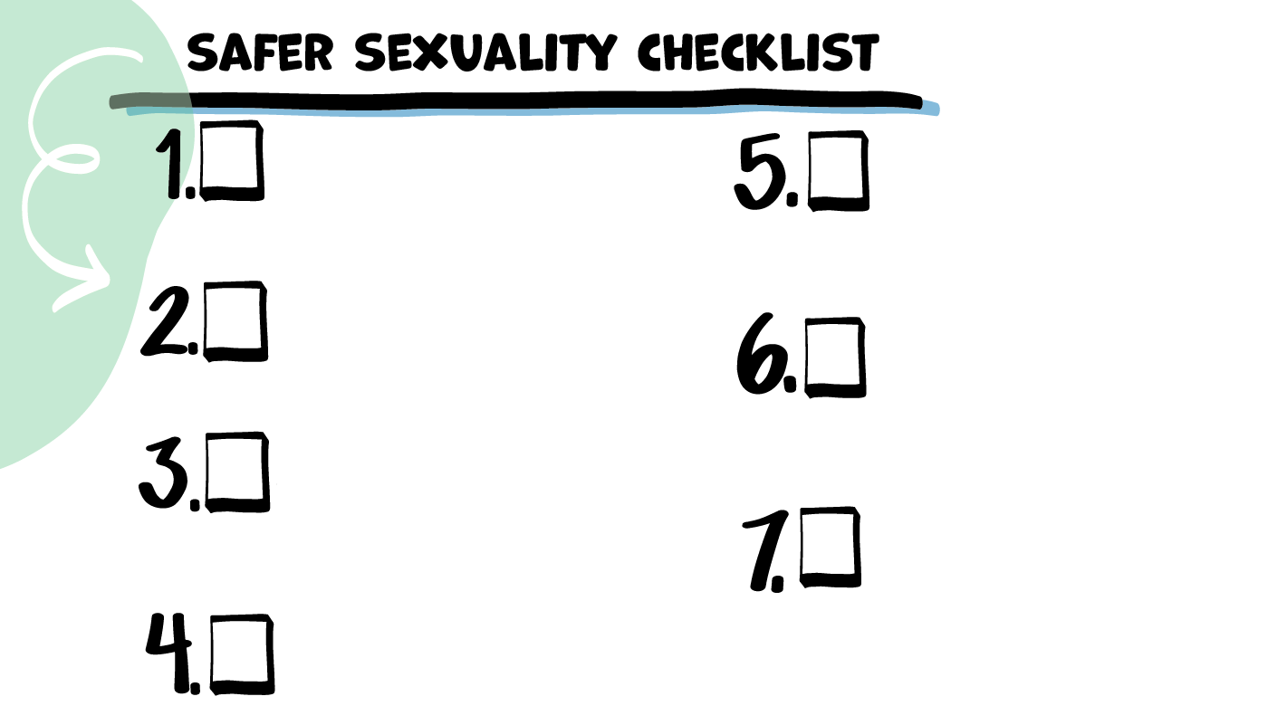
Safe and
Private Place
Birth Control Plan
Safer Sexual
Partner
STI Testing
& Protection
Sexual
Limits
Foreplay
& Lubrication
Consent
© 2022 SAFE Disability Services Program
Notes:
Say: We’ve added seven items to our Safer Sexuality Checklist! We’ll spend our class today seeing what you remember about each of these items. Going through this checklist before having sex can help you and your partner stay safer and healthier.

Slide 10
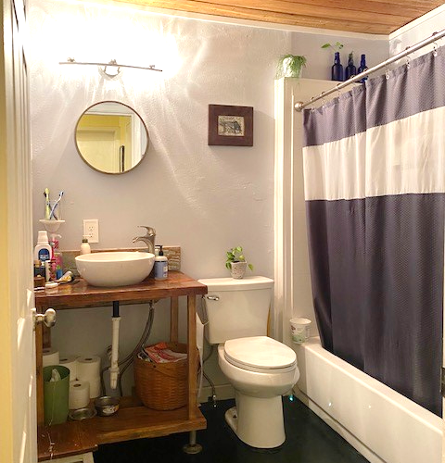
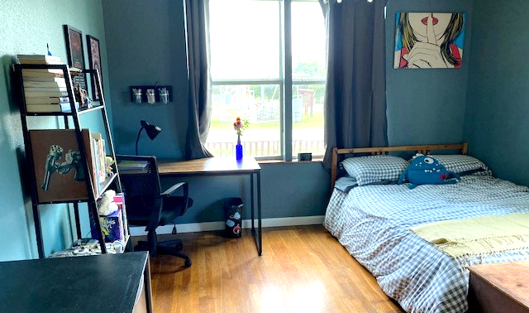
1. Safe and Private Place
© 2022 SAFE Disability Services Program
Notes:
Say: If you and your partner decide you want to have sex, the first thing you need is a safe, private place. We talked about how it is against the law to masturbate or have sex in a public place. Public places are places where other people can come in and out, such as movie theaters, parks, restaurants, and schools.
What is a safe, private place to masturbate or have sex?
Give students enough time to process the question and make their decisions.
Say: Your bedroom or bathroom at home with the door closed and the windows covered is a safe, private place to have sex.

Slide 11
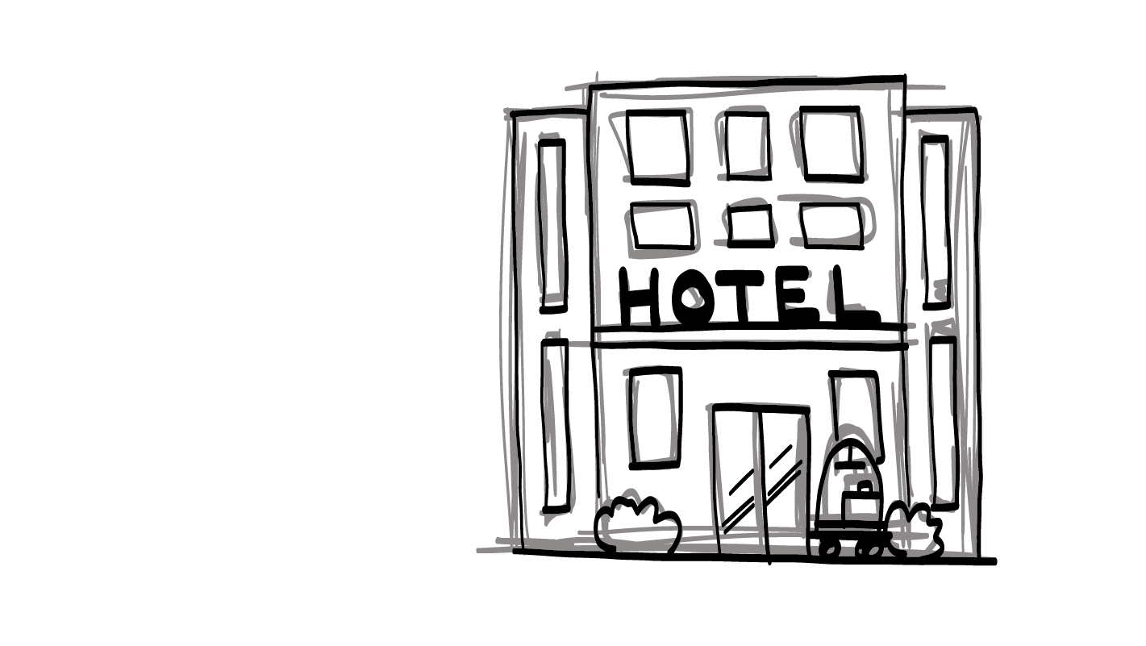
Hotels and Safety
Inner Circle of Trust (Green Circle)
© 2022 SAFE Disability Services Program
Notes:
Say: One other private place people sometimes use to have sex is hotels. You should only meet someone at a hotel if they are in your inner circle of trust (green circle). This means they are someone you have known in real life not just online for many months or years. They also need to be someone who has met other important people from your inner circle of trust (green circle), such as your parents or older siblings. If you decide to meet your romantic partner at a hotel, you need to tell people in your inner circle of trust (green circle) where you are going.

Slide 12
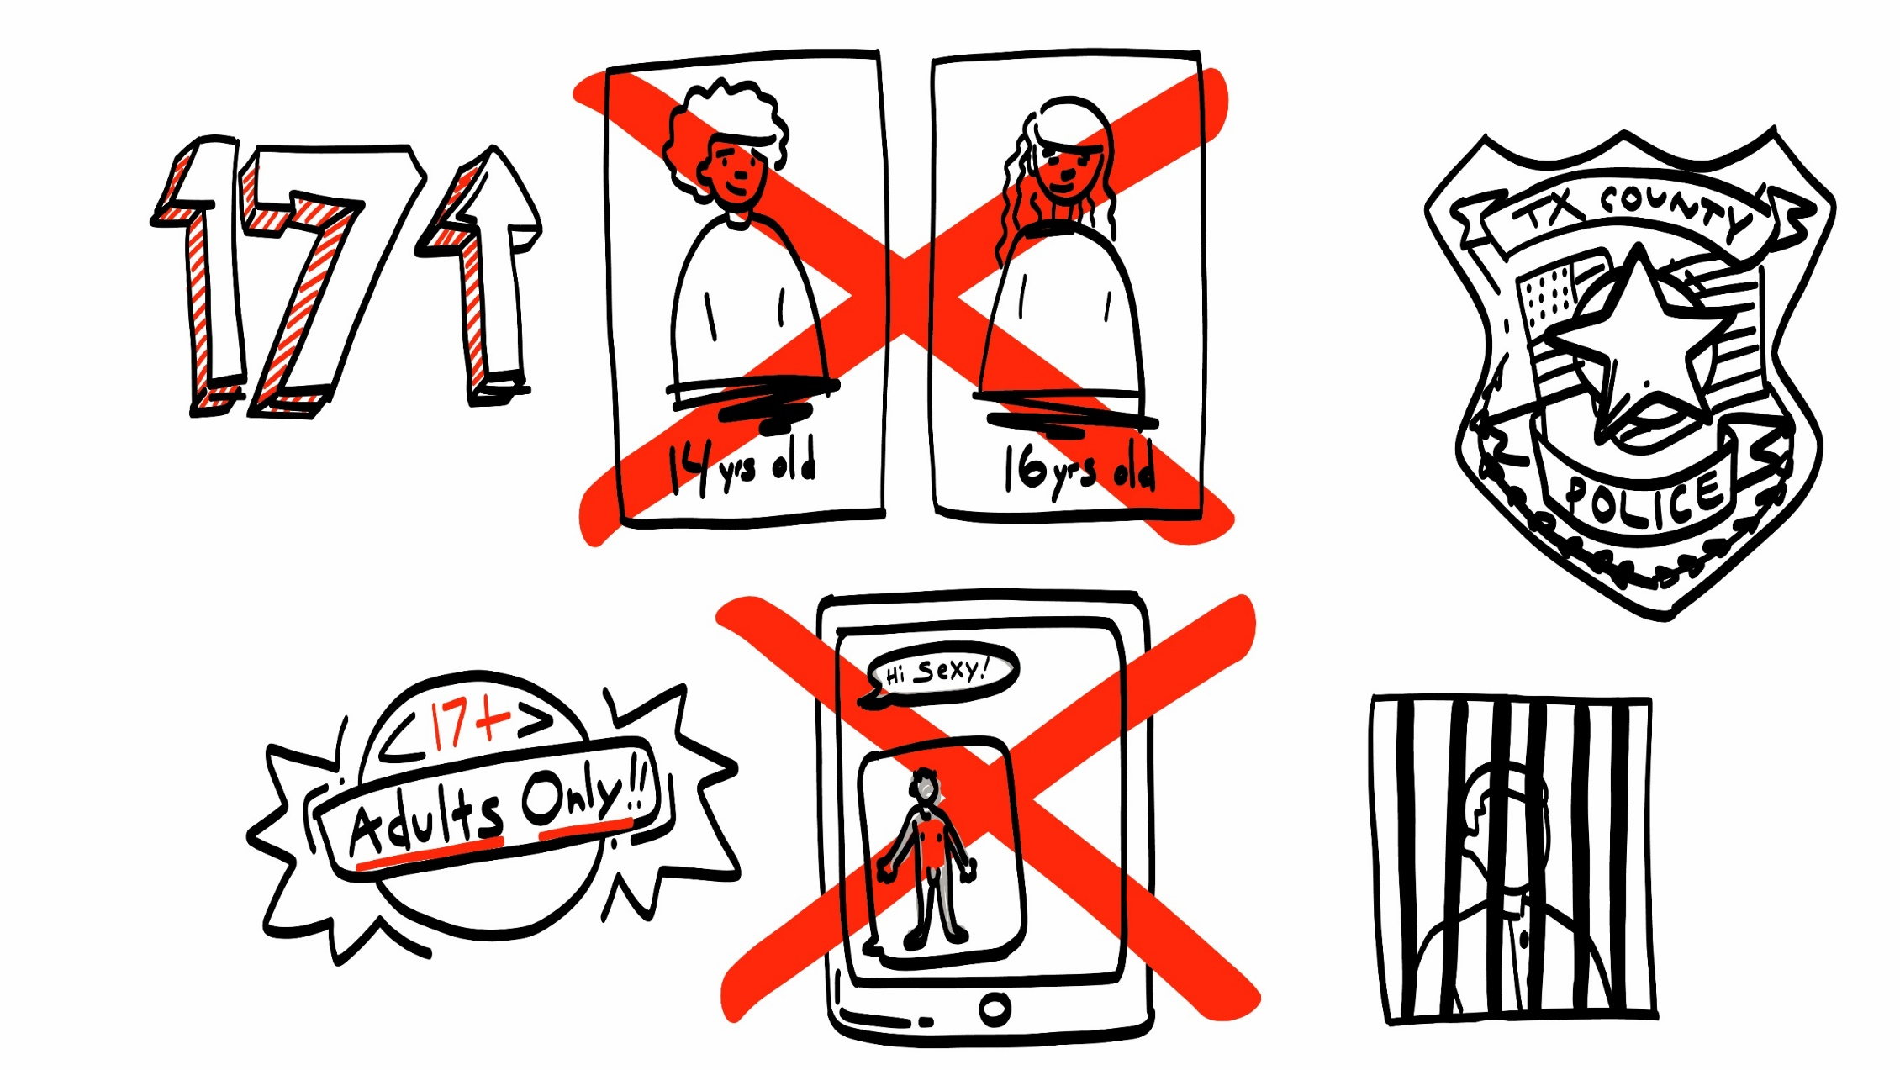
2. Safer Sexual Partner
© 2022 SAFE Disability Services Program
Notes:
Say: Next, you want to make sure you have a safer sexual partner. Does anyone remember what the age of consent is in Texas?
Give students enough time to process the question and make their decisions.
Say: The age of consent in Texas is 17. All of you are adults. This means that if you choose to have sex, you need to only have sex with other adults. If someone 16 or younger asks you to have sex you need to say no. You must only have romantic and sexual relationship with people who are 17 or older.
It is against the law to have sex with hands and fingers, oral sex, vaginal sex, or anal sex with someone who is sixteen or younger. You also shouldn’t talk about these types of sex with someone who is sixteen or younger.
In addition, you could also get in trouble for sending sexts or naked pictures to someone who is under seventeen, or for having naked pictures on your phone or computer of someone who is under seventeen. If you are talking to someone online or on the phone and things start to get sexual, you need to ask the other person how old they are.
It is your responsibility as the adult to make sure you are only being sexual with other adults.

Slide 13
Where is Your Partner on the Relationship Map?
© 2022 SAFE Disability Services Program
Notes:
Say: It’s also really important that you trust your sexual partner. Your partner needs to make you feel safe, respected, and good—before, during, and after sex.
For it to be safer, where do you need someone be on your relationship map before you have sex?
Give students enough time to process the question and make their decisions.
Say: Someone needs to be in your inner circle of trust (green circle) before you have sex for it to be safer.

Slide 14
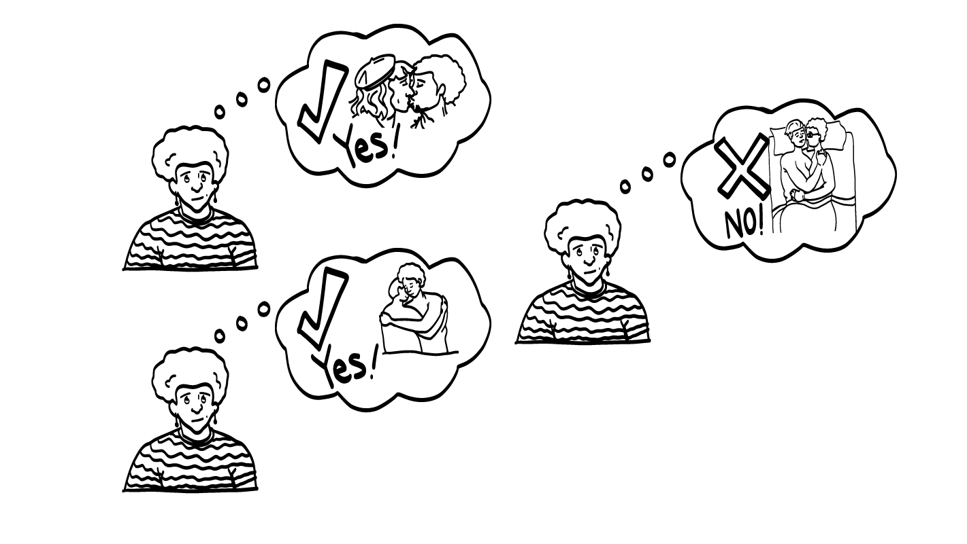
3. Sexual Limits
© 2022 SAFE Disability Services Program
Notes:
Say: The third item on the checklist is sexual limits. You need to only have sex if you really want to! Sexual limits is a word for what you are okay doing sexually, and what you are not okay doing sexually. Only you get to decide what kinds of things you do and do not want to do. It is never okay for someone else to force or pressure you into doing something sexual.
Take a minute to think about all of the types of touch we have talked about—holding hands, cuddling, kissing or making out, sex with hands and fingers, oral sex, vaginal sex, and anal sex. Think in your head about which of these things do you feel ready to do? Which of these things are you not ready for yet? These are your sexual limits.
Give students some time to quietly reflect on their sexual limits.

Slide 15
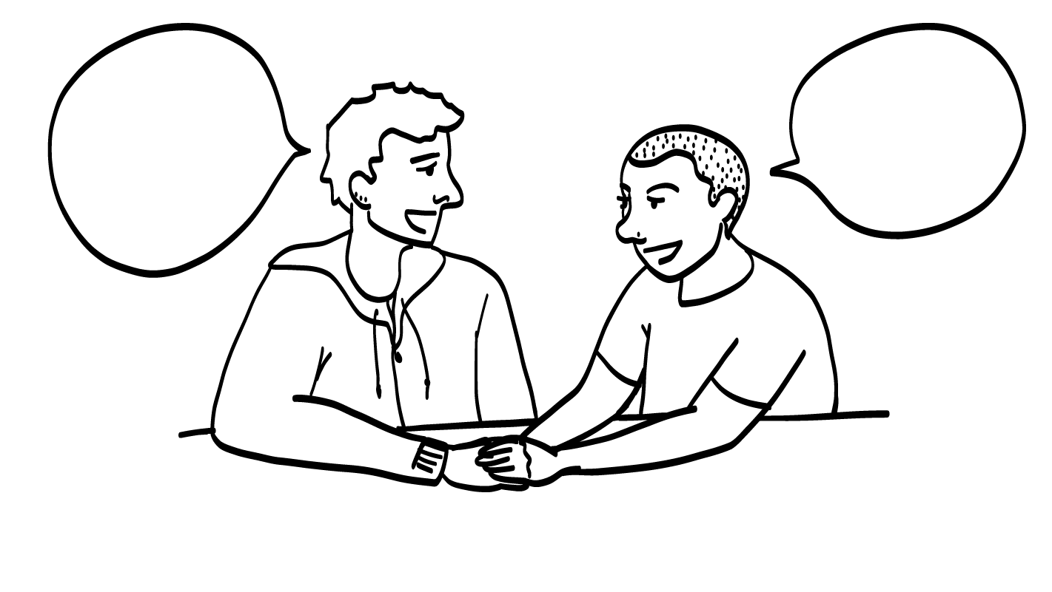
Talking about Sexual Limits
© 2022 SAFE Disability Services Program
Notes:
Say: It’s really important to know what your sexual limits are before you start to have sex. It’s also really important that you can tell your partner what your sexual limits are. You need to be able to tell your partner what you do and do not want to do. You can also let them know what feels good to your body, and what doesn’t feel good to your body.
And remember you can change your mind at any time and your partner needs to respect that.

Slide 16
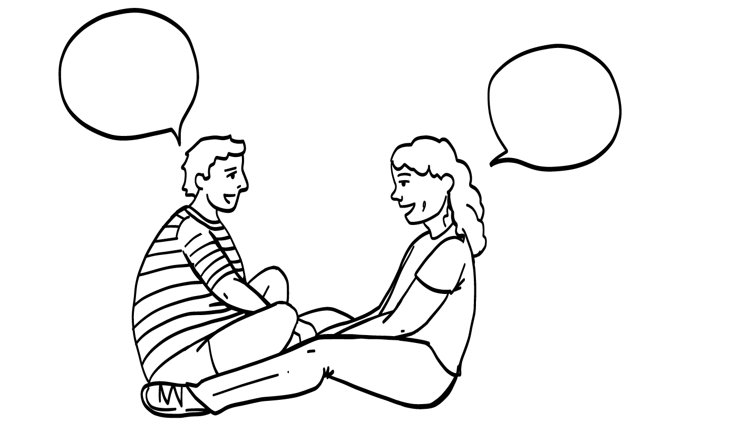
Sexual Limits Practice
© 2022 SAFE Disability Services Program
Notes:
You can complete this activity all together as a large group, or break your class into smaller groups to complete.
Say: Let’s practice! I am going to read the story on the screen. It says, “You aren’t ready to have sex yet. You just want to make out.” How you could use an I Statement to tell your partner your sexual limits in this story?
Give students enough time to process the question and make their decisions. Sample answers include:
I want to make out, but I’m not ready to have sex.
I need more time before we have sex. Can we make out?
I don’t feel ready to have sex.

Slide 17
Sexual Limits Practice
© 2022 SAFE Disability Services Program
Notes:
You can complete this activity all together as a large group, or break your class into smaller groups to complete.
Say: Let’s try another one. It says, “You are ready to have vaginal sex.” How you could use an I Statement to tell your partner your sexual limits in this story?
Give students enough time to process the question and make their decisions. Sample answers include:
I want to have vaginal sex.
I feel ready to have vaginal sex.

Slide 18
Sexual Limits Practice
© 2022 SAFE Disability Services Program
Notes:
You can complete this activity all together as a large group, or break your class into smaller groups to complete.
Say: Here’s our final story. It says, “You start to have sex and it is hurting you. You want to stop.” How you could use an I Statement to tell your partner your sexual limits in this story?
Give students enough time to process the question and make their decisions. Sample answers include:
I want to slow down. That’s hurting.
I need to take a break.
I feel like this isn’t working. Can we try something else?

Slide 19
© 2022 SAFE Disability Services Program
Notes:
Say: That was a lot of information, and you all are doing an amazing job! Let’s take a quick brain break before continuing with class.
Below are three ideas to give students a quick opportunity for a brain break. You are also welcome to come up with your own ideas for brain breaks that work best for your class.
Five finger breathing
For this exercise, have all students place their hand in front of their chest with their five fingers spread out. Next, use the pointer finger of the other hand to trace up and down each of the five fingers, beginning with the thumb. As students trace up a finger, they will breathe in. As they trace down a finger, they will breath out. When students breathe out on the pinky finger, you can tell them to shake out their hands and arms. As the school year goes on, you can ask students to lead this exercise for their peers.
If this exercise is physically inaccessible for your class, you can also model the hand tracing for students while they breathe in and out.
Stretch break
Lead students through a series of basic stretches. These can be completed in a chair, or while standing up, depending on the accommodation needs of your class. Some ideas include reaching toward the ceiling, stretching one arm at a time across the chest, reaching toward toes, turning head from side to side, etc. Ask students to hold a pose while you count to ten. As the school year goes on, you can ask students to lead stretches for their peers.
Dance party
If your class likes to dance, you can put on a short song for them to dance to. This is especially effective if you are able to find a song that relates to the theme for that week’s class.

Slide 20
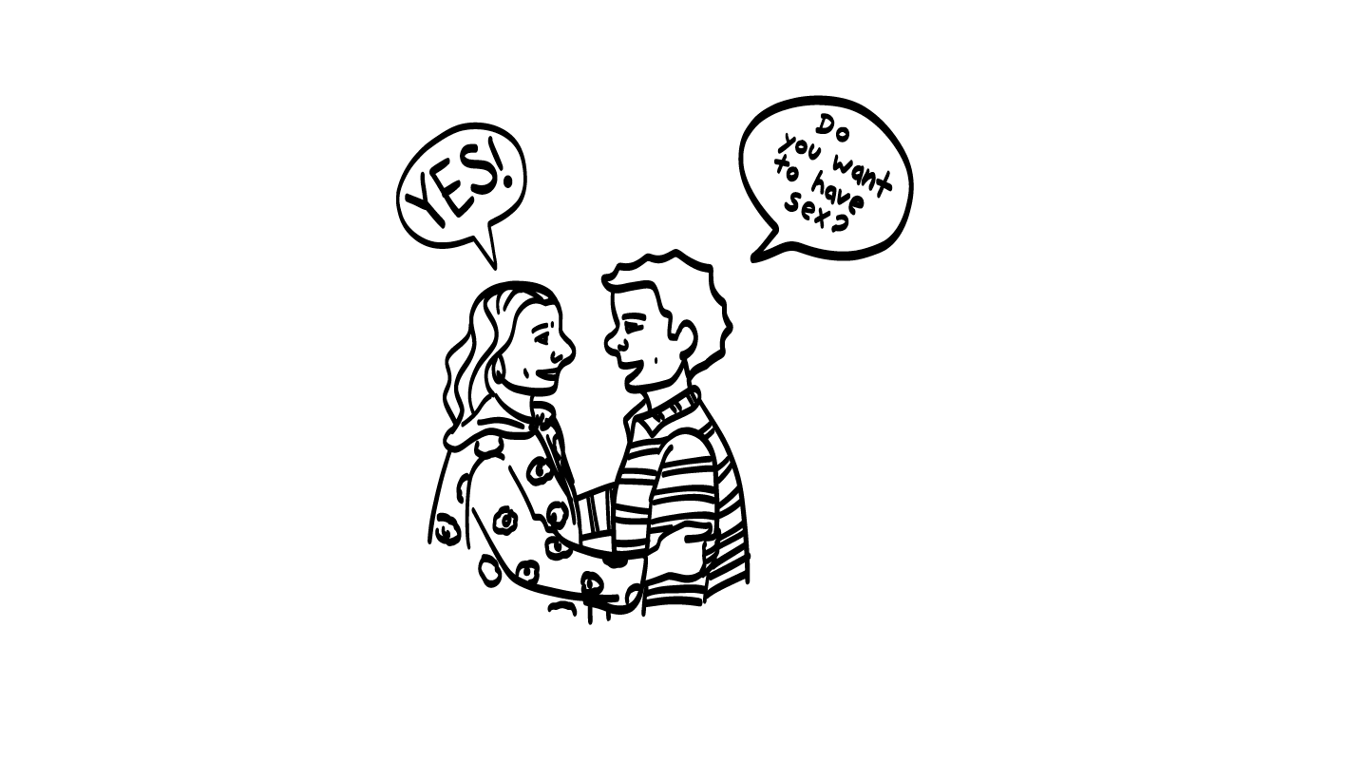
4. Consent
© 2022 SAFE Disability Services Program
Notes:
Say: The fourth part of our Safer Sexuality Checklist is consent. Does anyone remember what consent is?
Give students enough time to process the question and make their decisions.
Say: Consent is getting someone’s ok or permission to do something. Consent is when you ask, and someone says yes.
There are four parts of consent. The first, thinking clearly, means that both people are awake and sober. Neither person has been drinking a lot of alcohol or doing drugs. People have to be thinking clearly to be able to give consent.
The second part is that both people give an excited yes. What does an excited yes sound like?
Encourage students to share out loud what an excited yes sounds like (ex: YES!, yahoo!, oh yeah!, etc.).
Say: You can also say yes with your signs. Your partner needs to say yes with their words or signs, and their face and body needs to also look excited.
The third part of consent is that there is no pressure. Pressure is when someone tries to get you to do something you don’t want to do. They might pressure you to have sex by threatening you, making you feel bad, using their body to hurt you, or even offering you something nice in exchange for sex. Remember, you must only have sex if you really want to! It’s not okay for someone to pressure you to have sex. It’s also not okay for you to pressure your partner to have sex.
Finally, the last part of consent is ongoing check-ins. Consent isn’t a one-time thing. Just because someone says yes to having sex with you today, doesn’t mean that they want to have sex with you tomorrow. You need to ask each time. And as you’re having sex, you need to pay attention to your partner’s body and words to make sure they are still feeling good. If you are ever unsure, you need to stop and ask your partner if they are okay.

Slide 21
Consent Check-In
Getting Consent
Do you want to have sex?
Can I kiss you?
What do you want to do?
Where can I touch you?
Can I take your clothes off?
© 2022 SAFE Disability Services Program
Notes:
Say: So if you want to touch, kiss, or have sex with your partner, how do you ask them? What could you say?
Give students enough time to process the question and make their decisions. Some ideas are included below:
Do you want to have sex?
Can I kiss you?
What do you want to do?
Where can I touch you?
Can I take your clothes off?

Slide 22
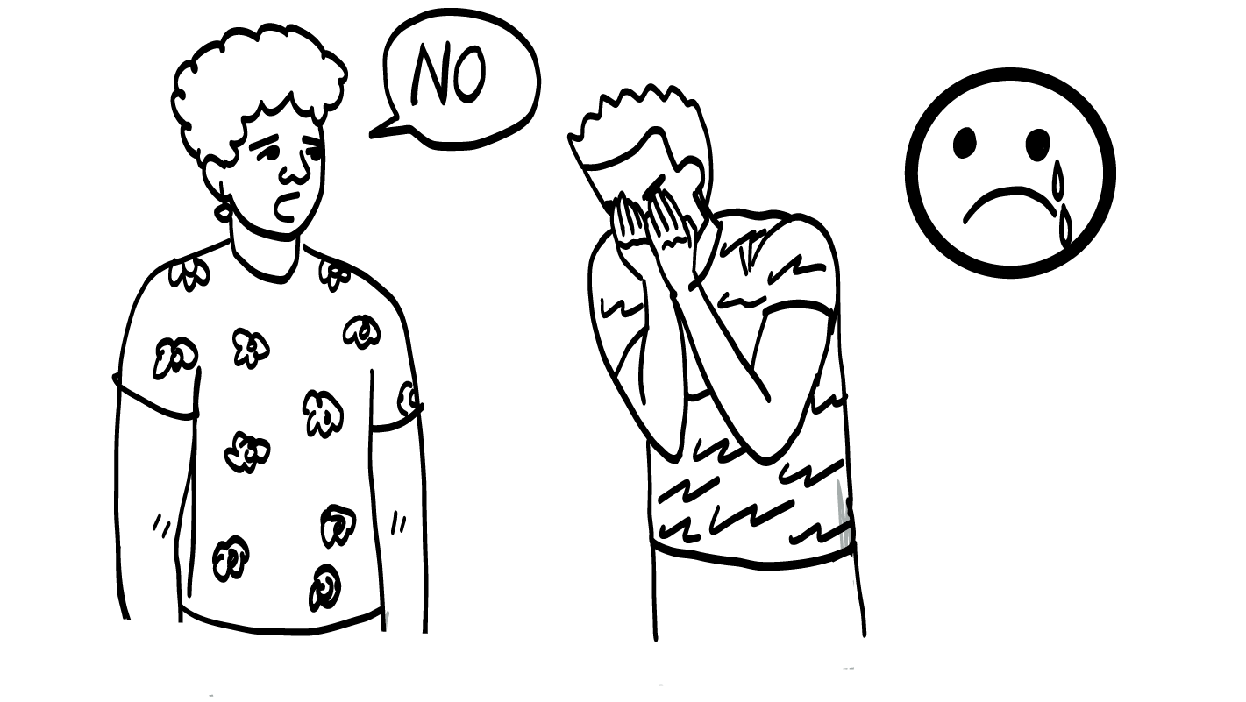
Handling Rejection
Rejection is when you ask someone to be sexual and they say no.
You always have the right to say no. Your partner also has the right to tell you no.
What can you do to feel better when you are rejected?
© 2022 SAFE Disability Services Program
Notes:
Say: Remember, you always have the right to say NO! to anyone or anything that you’re not cool with. Your partner also has the right to tell you NO! if you ask them to have sex. You might feel disappointed if you wanted to have sex and your partner says no. That’s normal. But you cannot make your partner feel bad. They have the right to say no, and you need to respect their sexual limits.
If you are feeling down because your partner said no, what could you do to feel better? What is something that makes you really happy?
Give students enough time to process the question and make their decisions. Some ideas are included below:
Go for a walk
Listen to music
Eat ice cream
Talk to a friend
Do art

Slide 23
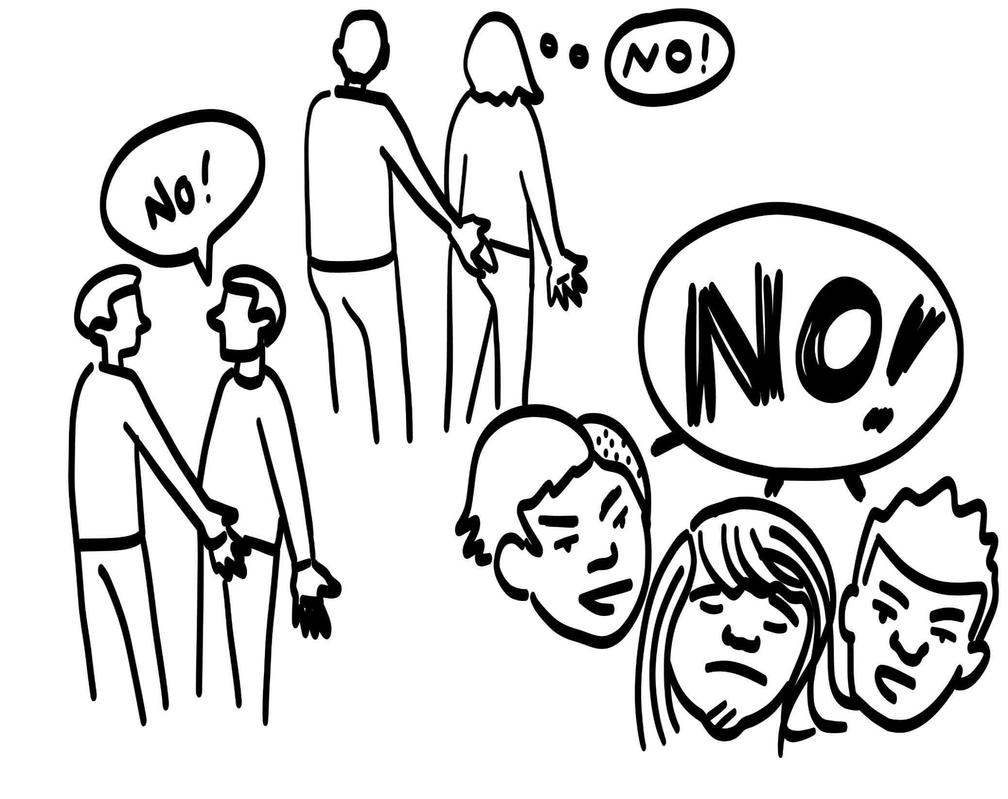
Sexual assault is when someone touches you sexually without consent.
Sex without consent is called rape.
Sexual assault and rape are wrong and illegal.
© 2022 SAFE Disability Services Program
Notes:
Say: Sexual touch without consent is called sexual assault or rape. It is against the law and it is not okay. If someone touches your breasts, genitals, or butt without your consent, this is sexual assault. If someone makes you touch their breasts, genitals, or butt without your consent, this is sexual assault too.
If anyone has ever touched you in a way you did not like, it is not your fault. You did not do anything wrong. You are not alone, and you can get help from an adult in your inner circle of trust (green circle).
I want each of you to think of one adult you could talk to if someone touches you or someone you care about in a way you don’t like. Who is one adult from your inner circle of trust (green circle) that you could talk to for help?
Give students enough time to process the question and make their decisions. Go around the classroom and ask each student to share the name of one adult they could go to for help.

Slide 24
5. Birth control plan
© 2022 SAFE Disability Services Program
Notes:
Say: Does anyone remember which type of sex is the only one that can lead to making a baby?
Give students enough time to process the question and make their decisions.
Say: Vaginal sex where a penis goes into a vagina is the only type of sex that can make a baby. When semen comes out of the penis, it has sperm in it. The sperm swims up into the vagina to meet the egg inside the body of the person with a vulva and vagina.

Slide 25
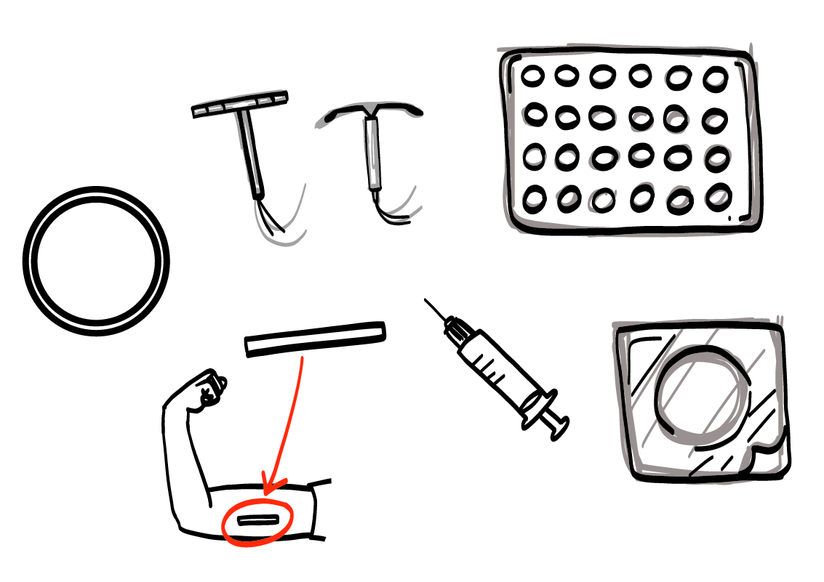
Birth Control for People with Vulvas and Vaginas
© 2022 SAFE Disability Services Program
Notes:
Say: We also talked about birth control. Birth control are things that you can use to help you not make a baby if you are having penis in vagina sex. Some people, such as gay men, lesbian women, and bisexual and pansexual people, may not have penis in vagina sex. So they may not have to worry about birth control. If you do decide to have penis in vagina sex, and you’re not ready to be a parent, you need to use birth control.
Let’s start by looking at birth control options for people with vulvas and vaginas. Can anyone name one type of birth control we talked about?
Give students enough time to process the question and make their decisions.
Say: We talked about the IUD, implant, vaginal ring, and birth control pills, shots, and patches. Where do you have to go to get this type of birth control?
Give students enough time to process the question and make their decisions.
Say: To get birth control for a person with a vulva and vagina, you need to go to a doctor’s office or reproductive health clinic.

Slide 26
Condoms
© 2022 SAFE Disability Services Program
Notes:
Say: The only type of birth control for people with penises is condoms. A condom is basically a piece of rubber that goes over the erect, or hard, penis. When a person with a penis has pre-cum or ejaculates, the condom catches the semen with sperm in it. If the sperm stay inside the condom, they can’t go meet with an egg to make a baby. Although condoms aren’t 100% effective, they do a really good job of preventing pregnancy if you use them right.
Does anyone remember where you can buy condoms?
Give students enough time to process the question and make their decisions.
Say: You can buy condoms in tons of places! Condoms are sold at grocery stores, places like Target and Walmart, pharmacies, gas stations, and online.
You need to check two things on the condom package: 1) Its expiration date. Just like food, condoms can go bad. Check the date on the condom to make sure it is still good. 2) If it has lubricant. You want to try to buy condoms that have lubricant on them. Even if your condom has lubricant on it, you can still use more. Lubrication helps keep the condom from ripping, which is really important to preventing pregnancy!
Condoms don’t work if they are ripped. If there is a hole in the condom, the semen with sperm in it might get out and go meet with an egg. You need to be really careful opening the condom package. You must never use your teeth or scissors to open the package, because it might tear the condom. Instead, gently tear open the condom package with your hands or ask your partner for help. If you have a hard time opening the condom package, you can also ask an adult from your inner circle of trust (green circle) to help you practice opening a condom package.

Slide 27
Birth control talk
You and your partner should answer the questions below to make a plan about birth control together
What kind of birth control will you use?
Where will you get birth control?
How will you pay for birth control?
© 2022 SAFE Disability Services Program
Notes:
Say: It is both your and your partner’s responsibility to get birth control. You need to talk together about your birth control plan. What kinds of birth control are you going to use? Where will you go to get them? Who is going to pay for the birth control? You and your partner need to make a plan together to make sure you have everything you need to prevent pregnancy.

Slide 28
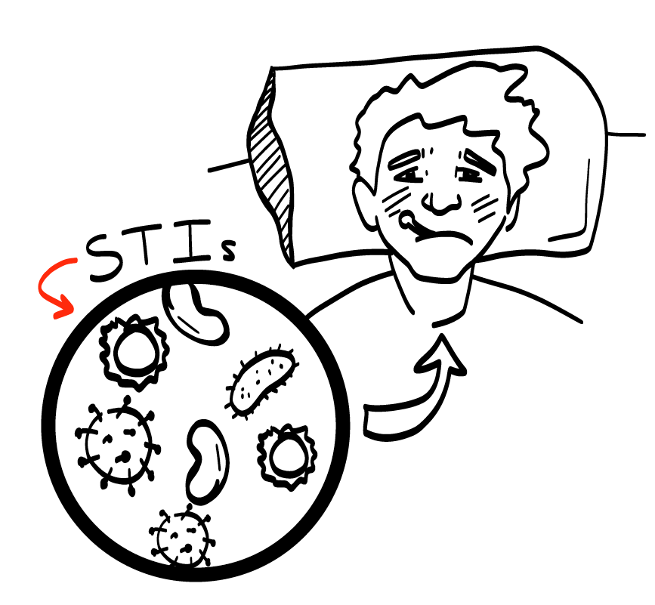
6. STI Testing and Protection
© 2022 SAFE Disability Services Program
Notes:
Say: Sexually transmitted infections, or STIs, are sicknesses that you can get from having sex. STIs are also sometimes called STDs.
People of all sexual orientations and gender identities can get STIs. If you have oral, vaginal, or anal sex with a person who has an STI, they can give you the STI. If you have never had sex before, you cannot have an STI. The only way to get an STI is to have oral, vaginal, or anal sex with someone who has an STI.
Think back on your sexual limits. If you are not ready to have oral, vaginal, or anal sex, then you don’t have to worry about STIs right now. If you are planning to have vaginal, oral, or anal sex, you need to take some steps to keep you body healthy. We’re going to review those steps now.

Slide 29
Testing and Treatment
© 2022 SAFE Disability Services Program
Notes:
Say: The only way to know for sure if you have an STI is to get tested. Both you and your partner need to get tested on a regular basis for STIs if you are having sex. Does anyone remember where you can get tested for STIs?
Give students enough time to process the question and make their decisions.
Say: You can get tested at your doctor’s office or at a sexual health clinic. Some clinics may even test you for free or for little money if you don’t have insurance.
To test for STIs, a doctor or nurse might have you pee in a cup, or they might draw some of your blood. For other tests, a doctor or nurse will swab your mouth and throat or your genitals with a Q-tip.
If your test comes back positive, that means you have an STI. Your doctor or nurse can also give you treatment for the STI. You may have to take pills or put a cream on your genitals. The treatment will help you feel better, and will help keep your body healthy.

Slide 30
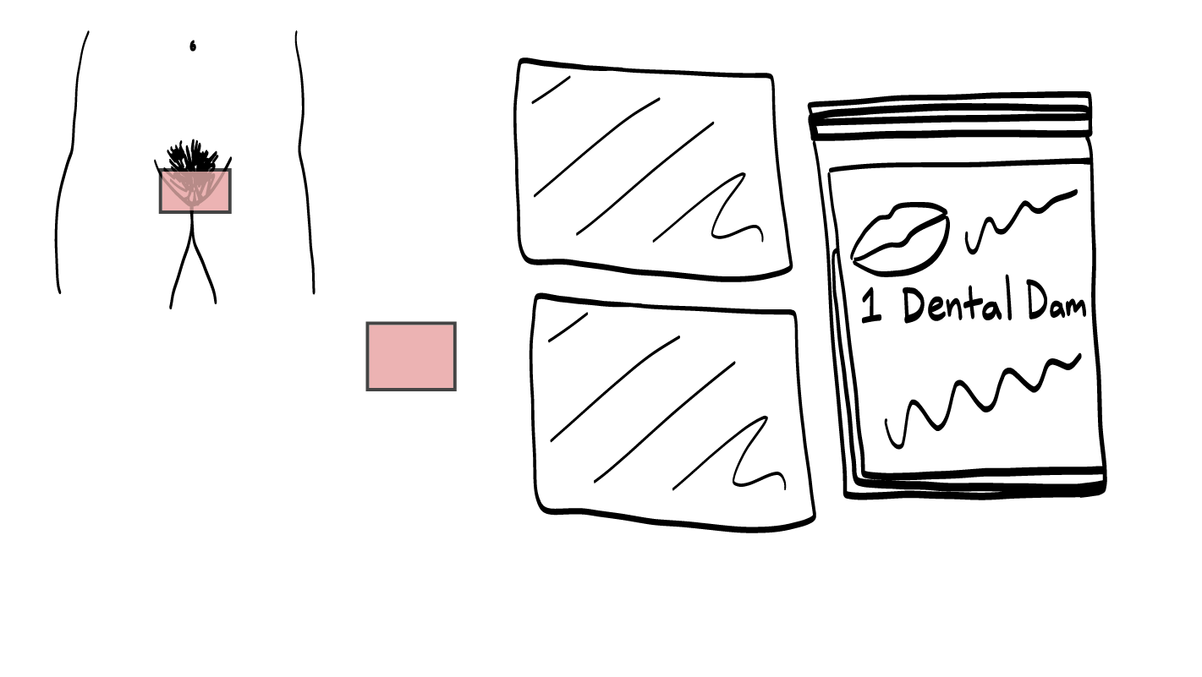
Protection
© 2022 SAFE Disability Services Program
Notes:
Say: Protection are things you can use to make it less likely that you will get an STI when you have oral, vaginal, or anal sex. Can anyone remember one type of protection we talked about?
Give students enough time to process the question and make their decisions.
Say: Dental dams are made out of rubber, just like condoms. They are put over the vulva and vagina or over the anus before someone has oral sex. The mouth, lips, and tongue go on the dental dam, instead of going directly on the other person’s body.
You can get dental dams online, or from a sexual health clinic.
The other type of protection is condoms. Remember, condoms are basically a piece of rubber that goes over the erect, or hard, penis.

Slide 31
STI Testing and Protection Practice
© 2022 SAFE Disability Services Program
Notes:
Say: If you are going to have oral, vaginal, or anal sex, you and your partner need to make a plan to get tested and use protection.
Let’s practice! Imagine that you want to get tested for STIs with your partner. What’s an I Statement you could use to let your partner know?
Give students enough time to process the question and make their decisions. Sample answers include:
I feel like we need to get tested for STIs.
I want to go together to get tested for STIs.
I need to make sure our bodies are healthy before we have sex. Let’s get tested for STIs.

Slide 32
STI Testing and Protection Practice
© 2022 SAFE Disability Services Program
Notes:
Say: Here’s another story. Imagine that you want to get condoms before having anal sex with your partner. What’s an I Statement you could use to let your partner know?
Give students enough time to process the question and make their decisions. Sample answers include:
I want to go get condoms with you.
I need us to have condoms before we have sex.
Say: You and your partner need to make a plan together for how you will get the protection. Will you buy dental dams and condoms online? Could you get condoms at a grocery store? Who is going to pay for them? These are all questions that you and your partner need to answer together.

Slide 33
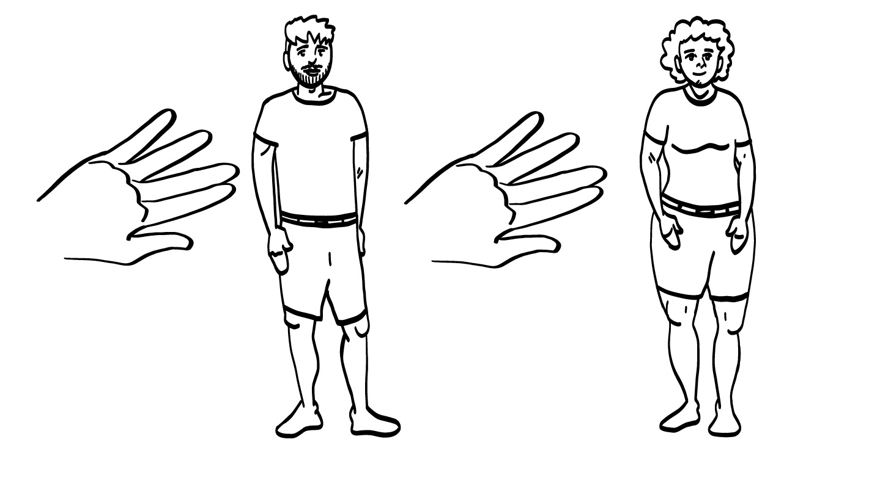
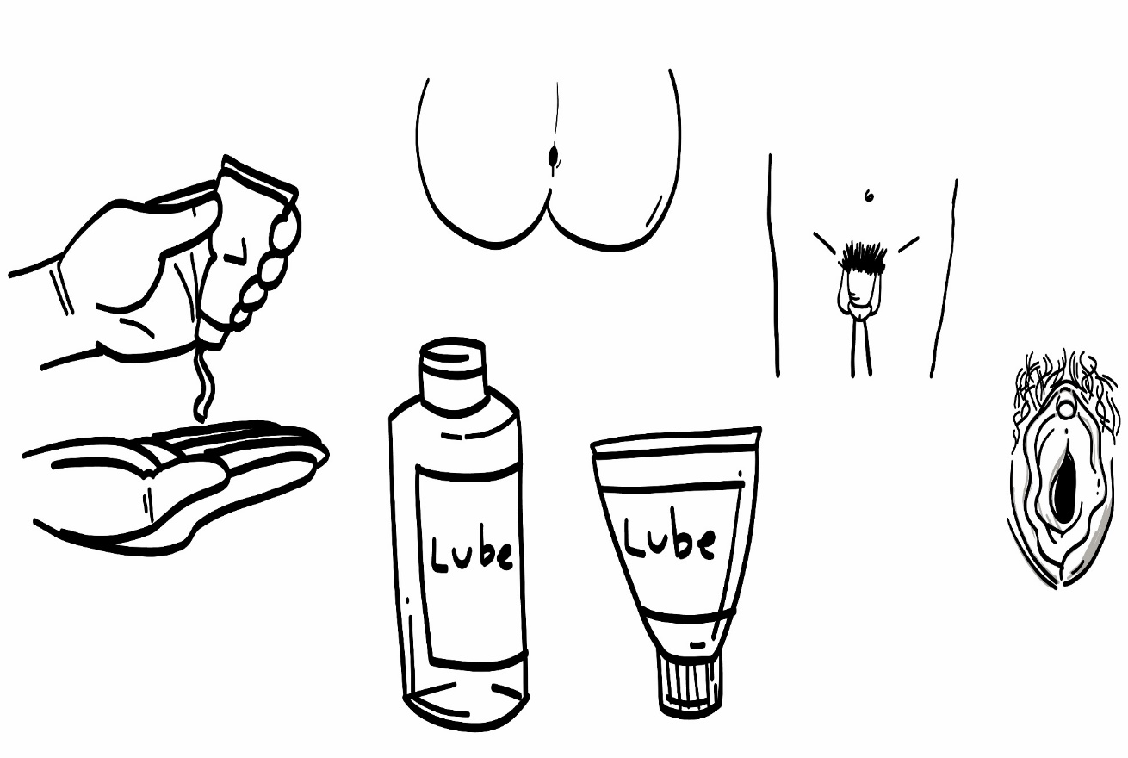
7. Lubrication and Foreplay
© 2022 SAFE Disability Services Program
Notes:
Say: The final item on our Safer Sexuality Checklist is Lubrication and Foreplay. If you have gone through all of the other items on the checklist, and you think you are ready to have sex, make sure to grab some lubricant and do some foreplay. Both of these things can help your body get warmed up for sex. Lubrication and foreplay can also make it less likely that a condom will tear, which helps protect your body from STIs and pregnancy.

Slide 34
Foreplay
© 2022 SAFE Disability Services Program
Notes:
Say: Remember foreplay is a word for things people do to get their bodies warmed up for sex. You and your partner might hold hands, hug, cuddle, kiss, make out, or touch each other’s bodies with and without clothes.
Foreplay can make the penis get hard, so you can put a condom on it. It can also make the vagina feel wet, which can make sex feel more smooth so it doesn’t hurt.
Foreplay takes a while—not just a couple minutes. Use the Consent Check-In tool to see how your partner is doing, and to make sure they are feeling good.
Foreplay can also make you feel emotionally close to your partner.

Slide 35
Lubrication
© 2022 SAFE Disability Services Program
Notes:
Say: Remember, lubricant is a clear fluid that you can use to help make sex feel better. Even if you have done foreplay and your body is creating its own fluids, lubricant can still be a great thing to use. You can put lubricant on a condom, on your fingers, or inside the vagina or anus.
Where can you buy lubrication?
Give students enough time to process the question and make their decisions.
Say: You can buy lubricants at a grocery store, pharmacy, or online.

Slide 36
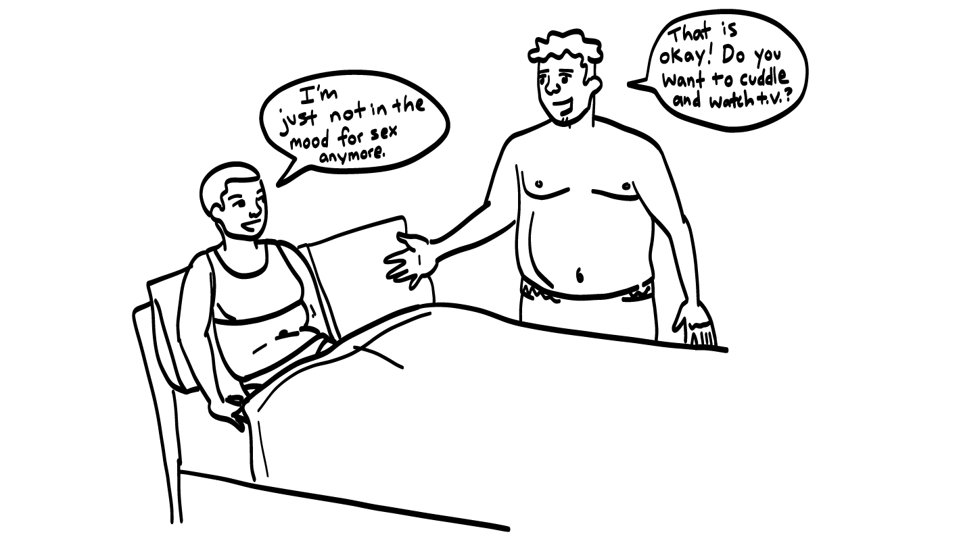
You Can Still Change Your Mind
© 2022 SAFE Disability Services Program
Notes:
Say: If you work through our Safer Sexuality Checklist, and decide that you and your partner are ready to have sex, remember that you can always change your mind. Even if you’re naked and making out, you can still change your mind. You can say NO! or use an I Statement to let your partner know that you want to stop. And remember that your partner can change their mind at any point too. If they say no at any time, you need to stop right away, back off, and give your partner some space.

Slide 37
Remember…..
Safe and
Private Place
Birth Control Plan
Safer Sexual
Partner
STI Testing
and Protection
Sexual
Limits
Lubricant
and Foreplay
Consent
© 2022 SAFE Disability Services Program
Notes:
Say: Great job in classes these past few weeks. Sex can be a really amazing part of life, but it’s also an important responsibility. Make sure that if you decide to have sex, you are taking care of yourself and your partner. If something ever doesn’t feel right, talk to your partner or an adult from your inner circle of trust (green circle).

Slide 38
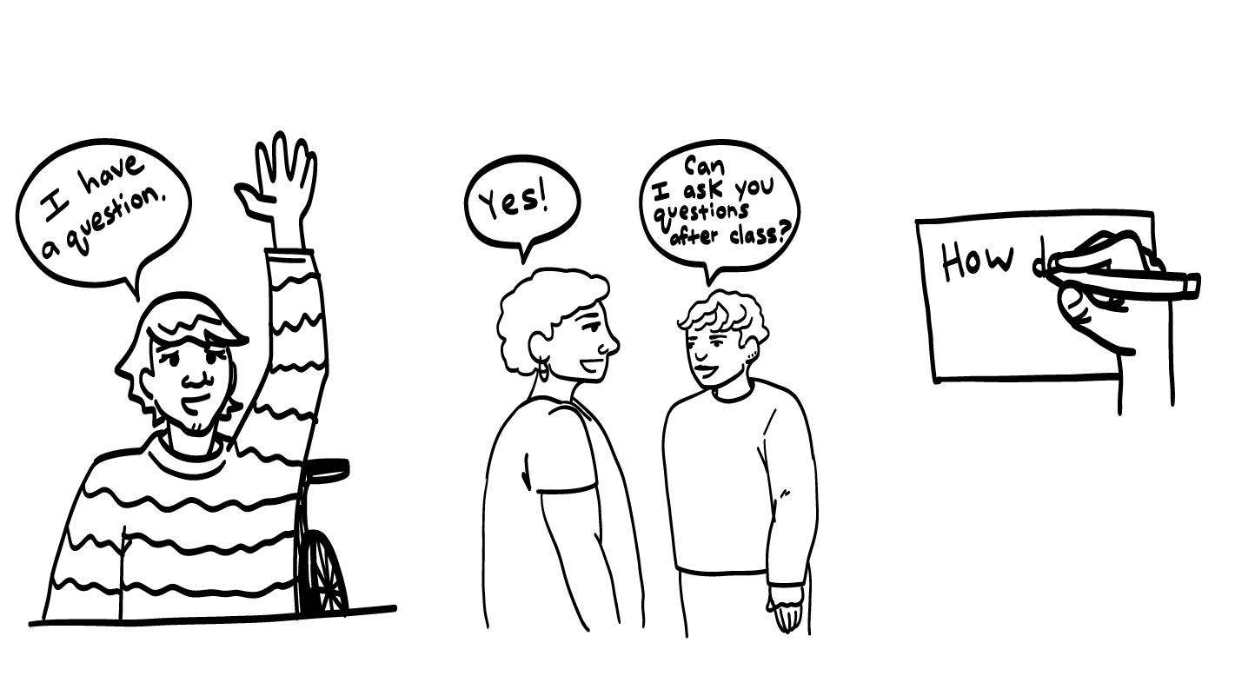
© 2022 SAFE Disability Services Program
Notes:
Say: You all did a great job in class today! This is our last class about bodies and sex. Does anyone have any questions about bodies or sex? Remember, if you don’t want to ask your question out loud, you can write it on a notecard and leave it on your desk. You can also ask someone you trust to help you write your question on the notecard. I will pick up the notecards, and will answer the questions the next time we meet. When I answer a question, I won’t tell anyone who asked it.

Slide 39
Who gets to decide when you are ready to have sex?
© 2022 SAFE Disability Services Program
Notes:
Say: Who gets to decide when you are ready to have sex? Raise your hand if you know the answer.
Give students enough time to process the question and make their decisions.
Say: Only you can decide for yourself if you are ready to have sex. Your partner gets to decide if they are ready to have sex, too.

Slide 40
Name one thing that is on our Safer Sexuality Checklist.
© 2022 SAFE Disability Services Program
Notes:
Say: Name one thing that’s on our Safer Sexuality Checklist. Raise your hand to share an answer.
Give students enough time to process the question and make their decisions. Keep calling on students until all 7 parts of the safer sexuality checklist are named.

Slide 41
Can you change your mind at any time about having sex?
YES
NO
© 2022 SAFE Disability Services Program
Notes:
Say: Can you change your mind at any time about having sex? Hold a thumbs up for yes, and a thumbs down for no.
Give students enough time to process the question and make their decisions.
Say: Yes! Even if you are naked and starting to have sex, you can still change your mind. You always have the right to say NO!

Slide 42
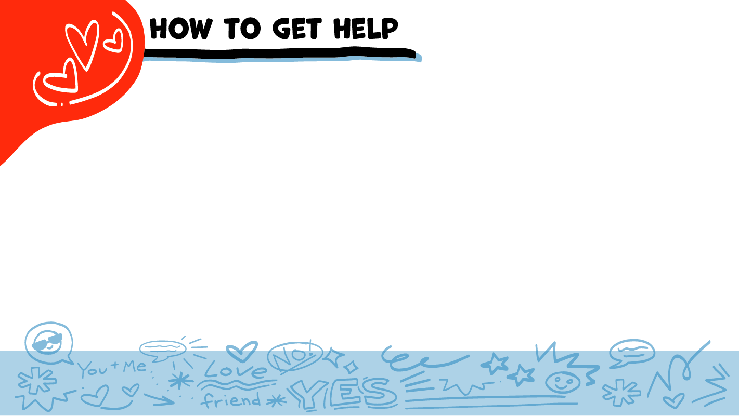
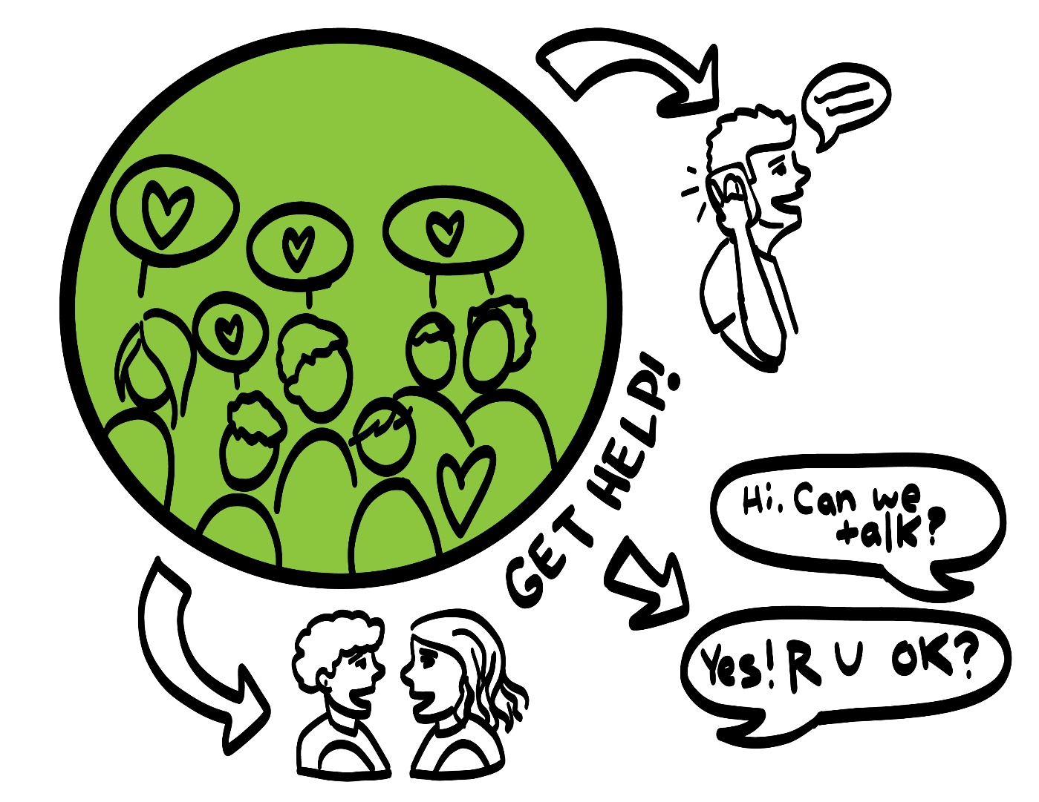
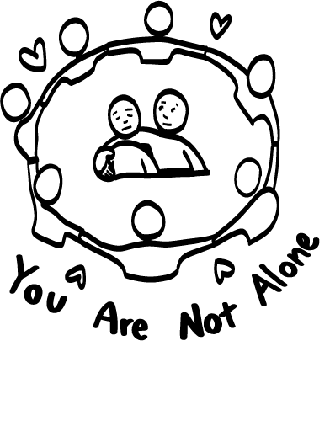
© 2022 SAFE Disability Services Program
Notes:
Say: If you are being hurt, or if someone ever touches your body in a way that you don’t like, you can get help. You did not do anything wrong, and you are not alone. You can get help by talking to an adult from your inner circle of trust (green circle). If someone you care about is being hurt, you can also get help by talking to an adult from your inner circle of trust (green circle). If an emergency is happening, you can always call 911. If you call 911 for help, a police officer or an ambulance might come.
If the first person you tell doesn’t believe you or doesn’t get you help, keep telling adults you trust what is going on until you get the help you need.

Slide 43
© 2022 SAFE Disability Services Program
Notes:
Say: Does anyone remember what our power statement is? Our power statement is “I know me best.” This means that each of you knows yourself better than anyone else does. You know best when you will feel ready to have sex. Let’s gather together and on the count of three, say our power statement.
Have each interested student put one hand in the middle of the circle. Ask for a student volunteer to count to three. After three, all participants say the power statement while lifting their hand into the air.

Slide 44
© 2022 SAFE Disability Services Program
Notes:
SAFE would like to thank the Texas Council for Developmental Disabilities for the funding for this curriculum.

Slide 45
This curriculum is offered to you online at no cost. You are free to use these resources in their original format for educational purposes only. Please reference The SAFE Alliance appropriately (see citation at bottom of page).
We ask that you do not alter curriculum images, slides, or lesson plan materials. You may not use My Rights My Life curriculum (MRML) for commercial purposes that includes but is not limited to: selling workshops that you facilitate based on MRML; creating links or websites to re-distribute any of the materials associated with SAFE’s My Rights My Life curriculum.
Selling materials from My Rights My Life: A Curriculum for Safer Relationships is a direct violation of copyright law.
Westmore, M. & Lersch, H. (2022). My rights my life: A curriculum for safer relationships.
Schwartz, M. (Ed.). The SAFE Alliance: Austin, TX.
© 2022 SAFE Disability Services Program

