Slide 1
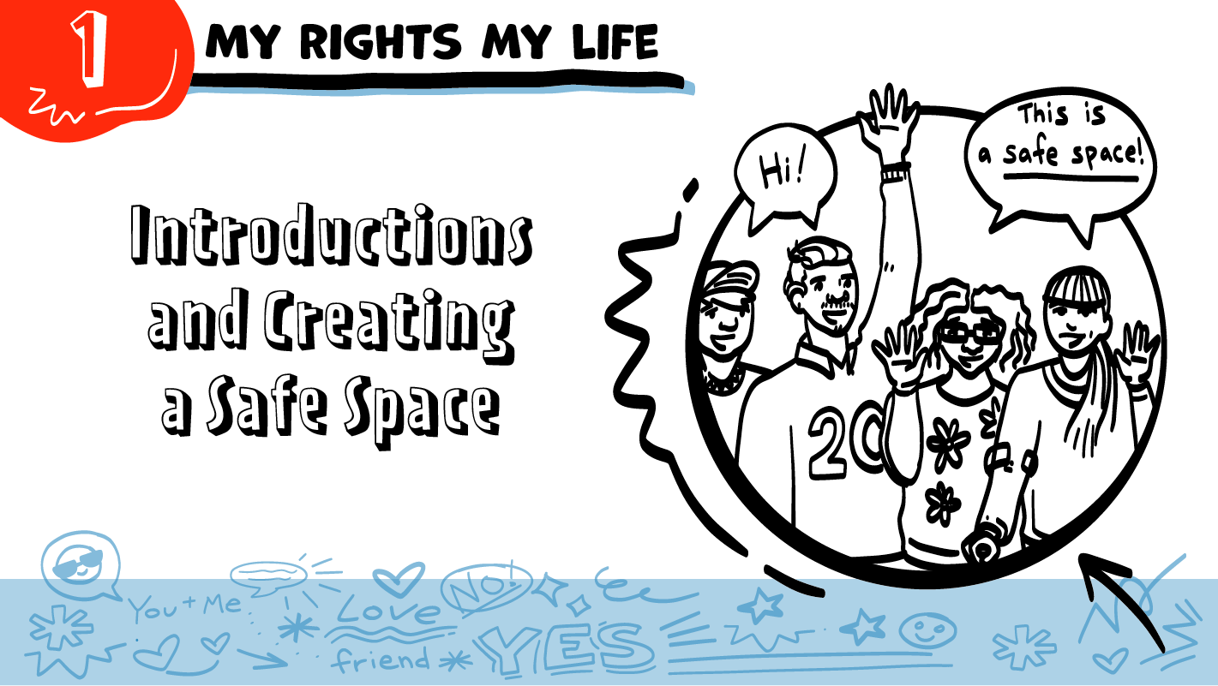

for High School Students
© 2026 SAFE Disability Services Program
Notes:
Say: Today we are starting something new. During this semester, we will be going through classes called My Rights My Life, together. In these classes, we will talk about leadership and healthy relationships. Since today’s class is our first one, we will be doing introductions. This means we will have a chance to get to know each other a little more, and to learn about the classes themselves. We’ll also talk about how to make sure our class is a safe space to talk about relationships.

Slide 2


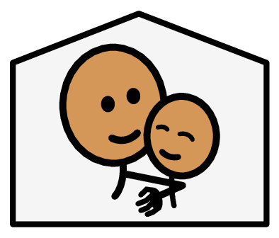
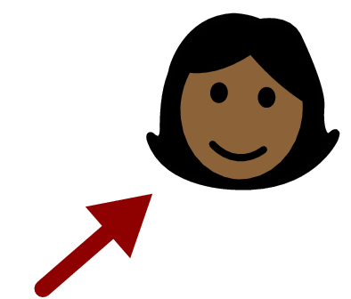
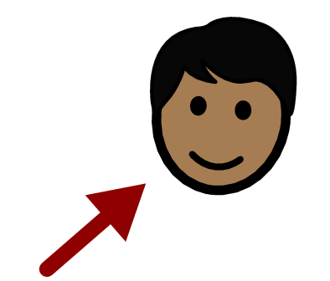



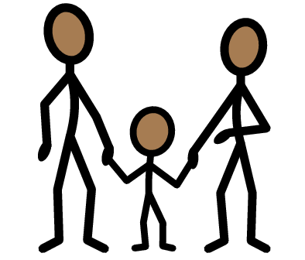
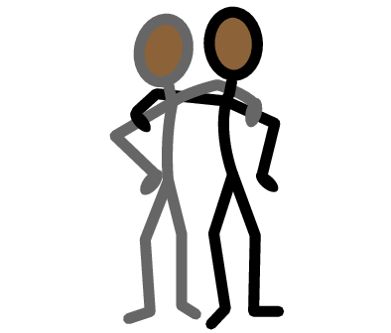



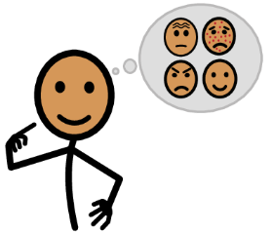



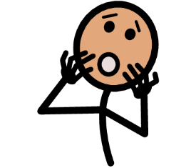
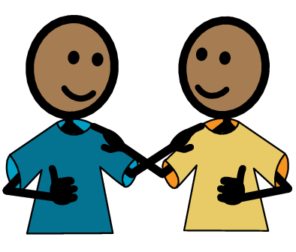
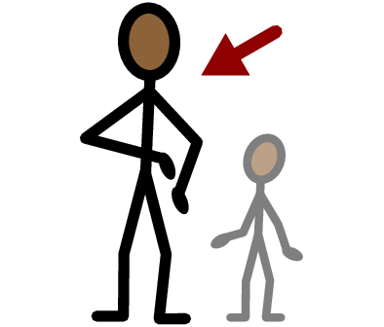
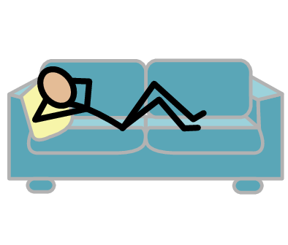
Safe space
Pronouns
Relationships
Yes
No
Family
Friend
Healthy
I need help
I have a question
Trust
Adult
Take a break
I feel
Happy
Sad
Mad
Scared
Copyright © 2021 SymbolStix, LLC. All rights reserved. Used with Permission.
Notes:
Say: Every time we have class, you will get a new Important Words Sheet. The words on the left and bottom of the screen will stay the same for every class. The words in the middle will be new each time. These new words are the vocabulary words for the class. You may know some of them, or they may all be new to you. Either one is okay!
You can use your Important Words Sheets all year in this class. For example, if you ever need help, you can point to the square on the left side of the sheet. If you need to take a break at any time, you can point to the square at the bottom of the sheet. Let’s go over all of the words on this week’s Important Words Sheet.
NOTE: You can print this slide separately so each student can use the Important Words Sheet as a communication board throughout class. Review the words using the suggested definitions below. To enhance understanding, you can ask students to come up with their own definitions for vocabulary words or to provide a sentence or scenario using the new word.
Core Board Words
Yes/No
I need help: You can point to this if you need someone to make something easier for you to do.
I have a question: You can point to this if you want to ask someone something.
Trust: Trust means you feel safe with another person, believe they will be honest and kind, want you to be okay, and you can count on them.
Adult: A person who is 18 years old or older
Take a break: You can point to this if you do not want to be in class for a short time.
I feel: How to tell other people what emotion you are having
Happy: Feeling good; people sometimes smile when they are happy.
Sad: Feeling down or not happy; people sometimes frown or cry when they are sad.
Mad: Feeling angry or upset about something; people sometimes yell when they are mad.
Scared: Feeling afraid of something; people sometimes scream or cry when they are scared.
Lesson 1 Words
Pronouns: Words people use to talk about someone, such as he, or she
Safe space: A place where people feel good and can ask questions
Healthy: When a relationship feels good to both people
Relationships: Two or more people who know each other; some types of relationships include family, friends, and coworkers
Family: The people you are related to, such as mom, dad, brother, or sister
Friend: Someone you like to spend time with

Slide 3
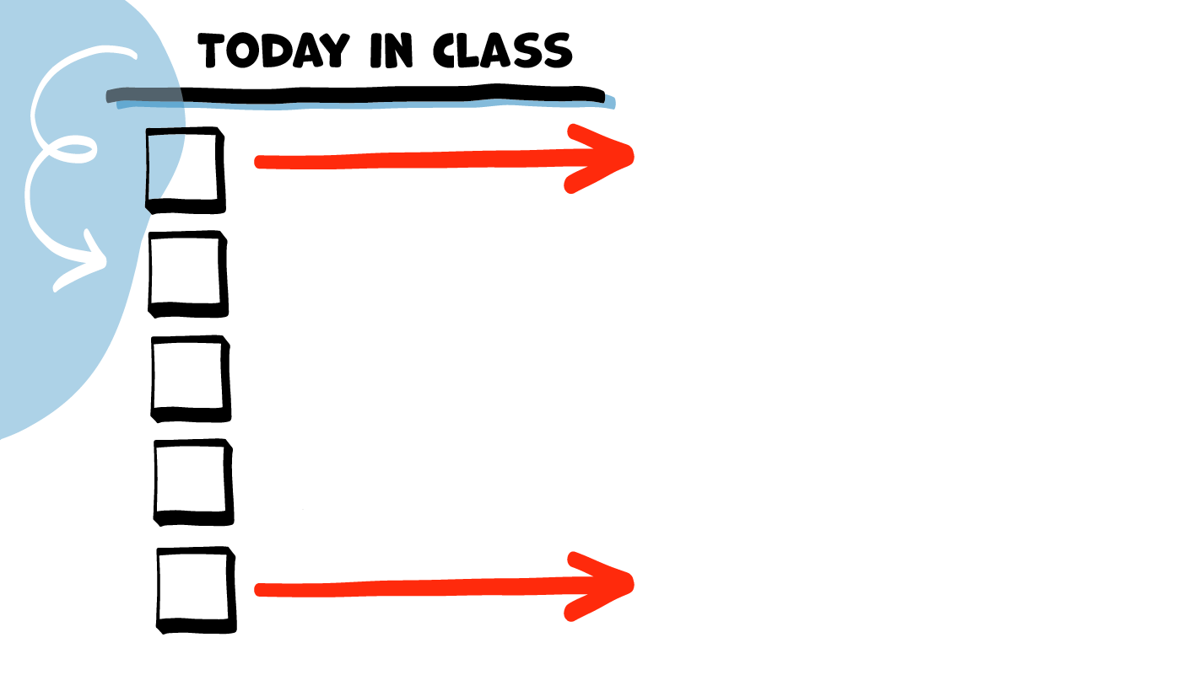
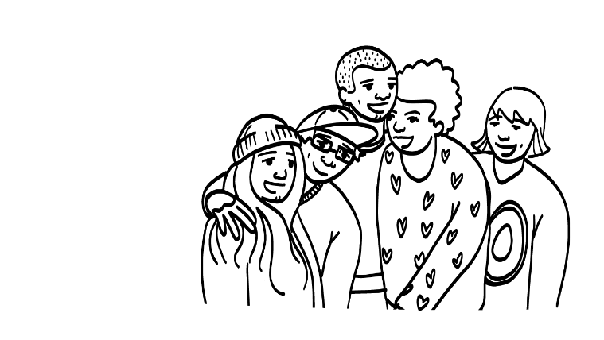
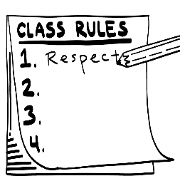
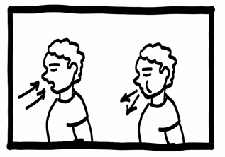
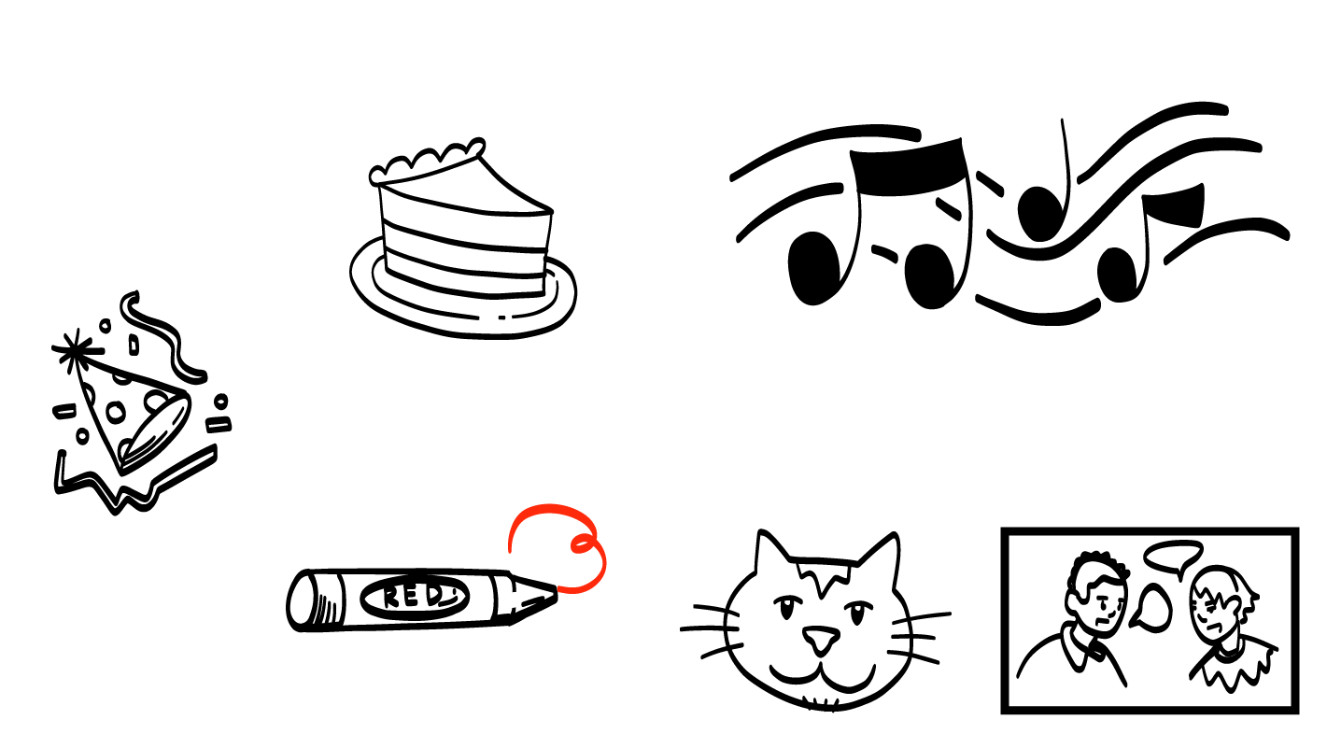
Share name
and pronouns
Talk about My Rights My Life class
Make class rules
Brain break
Getting to know you!
© 2026 SAFE Disability Services Program
Notes:
Say: At the beginning of every class we will read the class agenda. The class agenda will tell you what you are doing in class that day.
NOTE: Each week has a list of the main topics for the class. You can read the agenda out loud to your students. Alternatively, you can ask for a student volunteer to read the agenda. This visual schedule is repeated throughout the class anytime a transition is happening from one topic to the next.

Slide 4
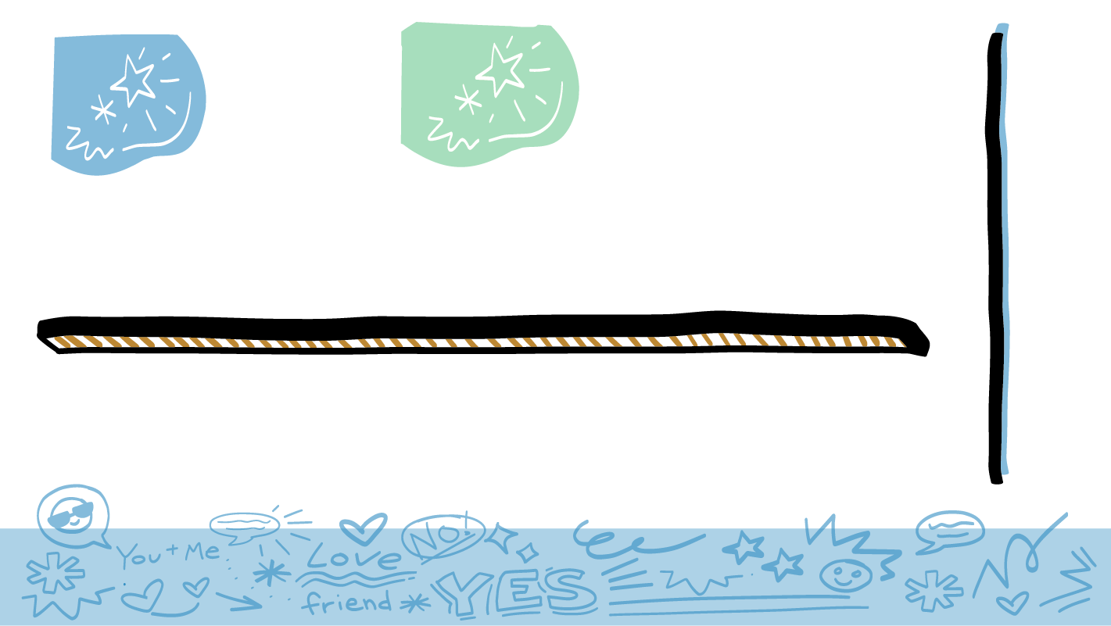
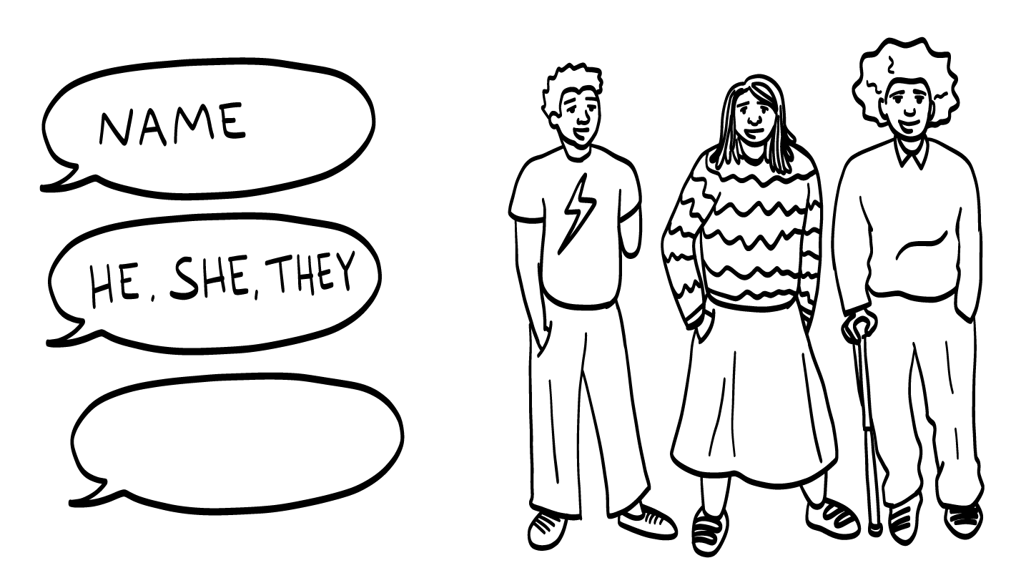
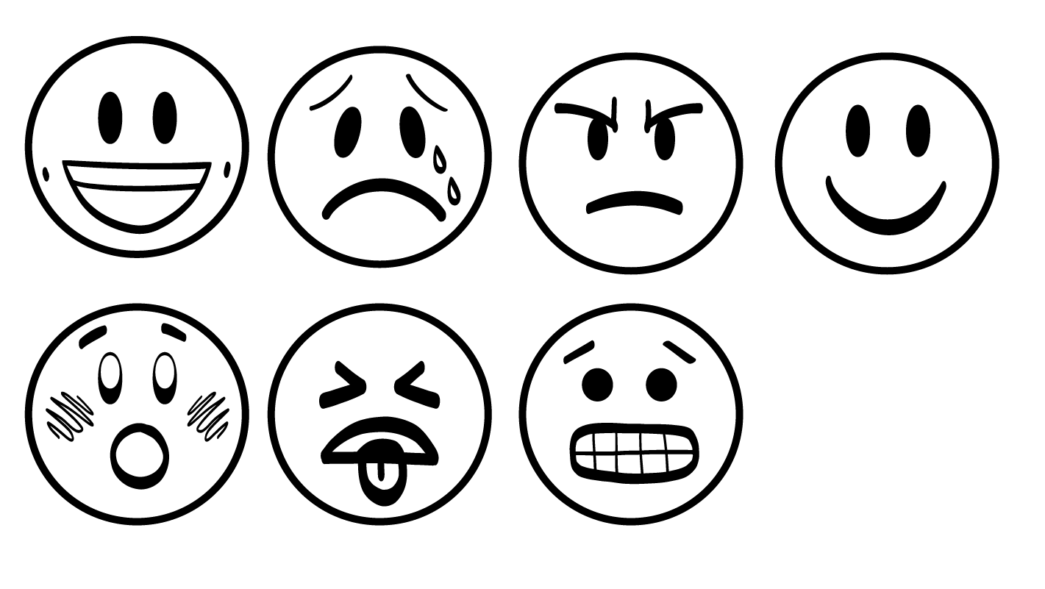
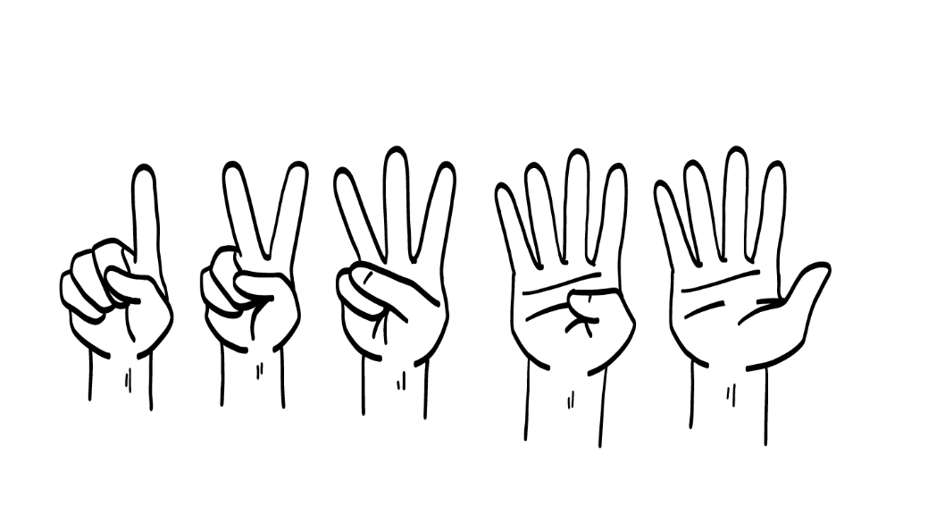
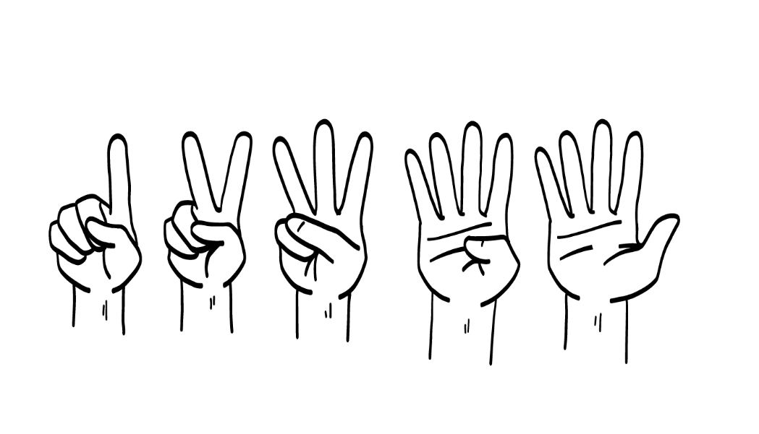
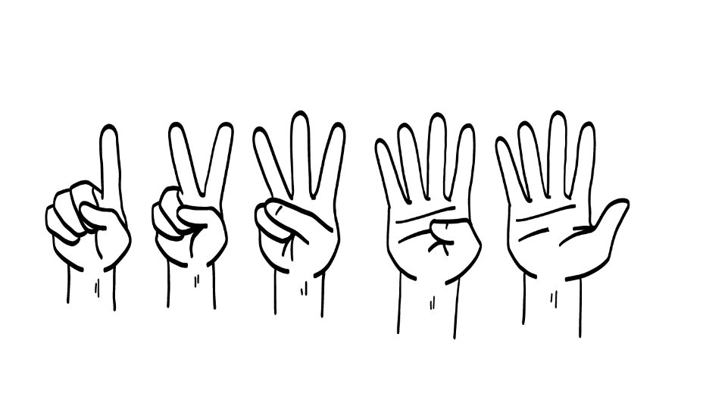
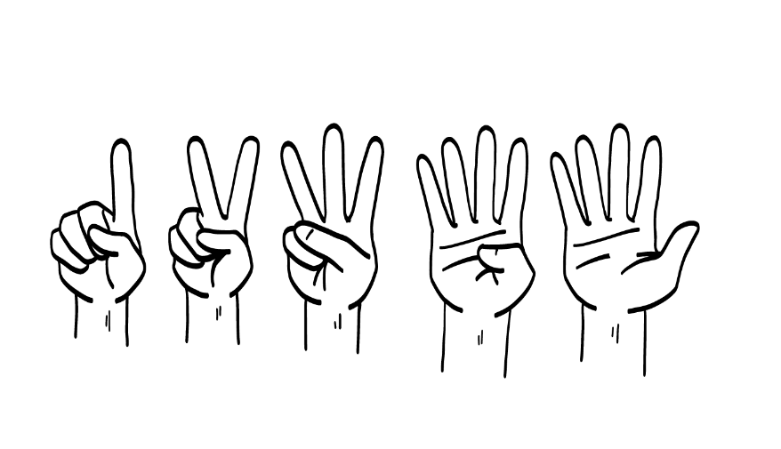
1
2
3
4
Happy
Sad
Mad
Excited
Man
He
Nonbinary
Person
They
Woman
She
© 2026 SAFE Disability Services Program
Notes:
Say: I am going to start class by asking each of you to share three things about yourself. First, I want you to say your name. Next, I want you to share your pronouns, if you feel comfortable sharing. Pronouns are words people use to talk about their gender. So, for example, if someone is a woman, we might use the pronoun “she” to talk about her. If someone is a man, we might use the pronoun “he” to talk about him. If someone is a non-binary person, we might use the pronoun “they” to talk about them. Nonbinary means someone does not identify as a man or a woman. We will talk about pronouns more later in the year. The third thing I want you to share is how you are feeling today. You can hold up one finger for happy, two fingers for sad, three fingers for mad, and four fingers for excited. I’ll go first so you can see how this works.
Introduce yourself to the class with your name, pronoun, and how you are feeling. Then ask for a volunteer to go next. Keep going until all students have had the opportunity to introduce themselves. For some students, the concept of “pronouns” may be a new one. This is okay. Students will get further opportunities to practice using pronouns later in the classes. For this first class, it’s mostly important to give all students the opportunity to share their pronouns “if” they feel comfortable doing so. This is a choice. Be sure to respect each student’s pronouns and use the correct pronoun when referring to the student.

Slide 5
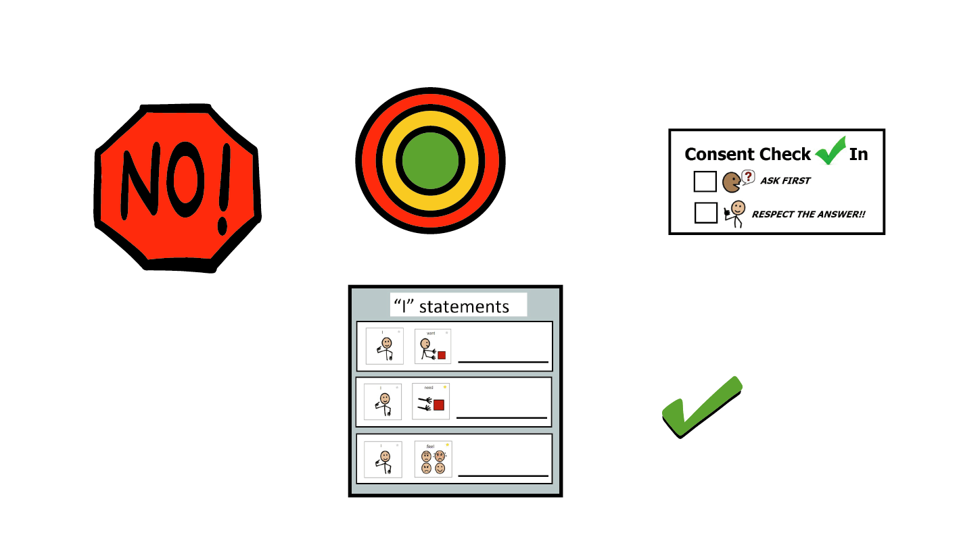
Share name
and pronouns
Talk about My Rights My Life class
Make class rules
Brain break
Getting to know you!
© 2026 SAFE Disability Services Program
Notes:
Say: Thanks for introducing yourselves! Now we are going to talk about what we will do in My Rights My Life classes.

Slide 6
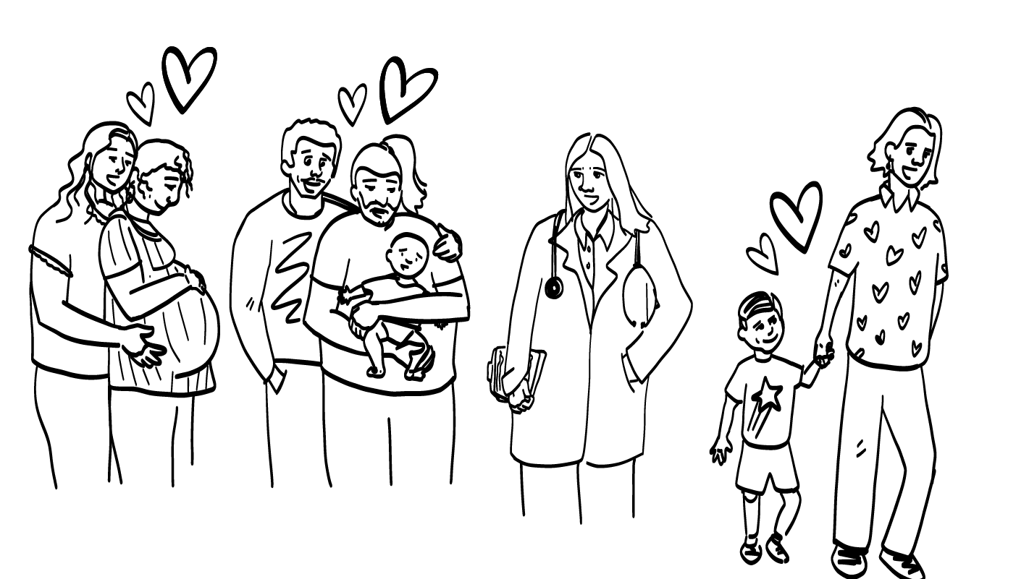
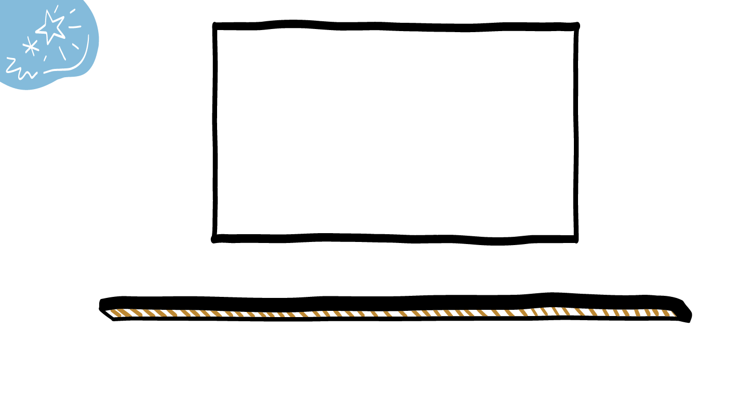
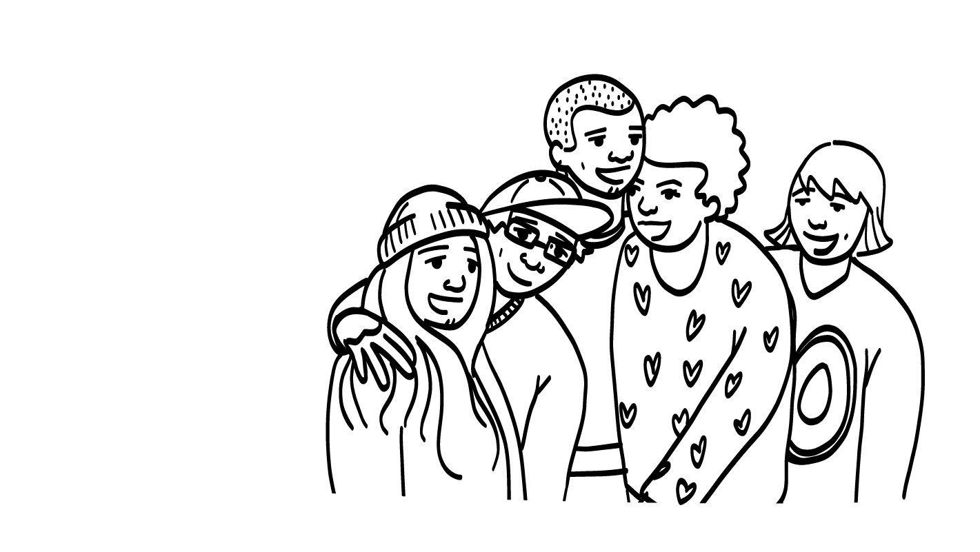
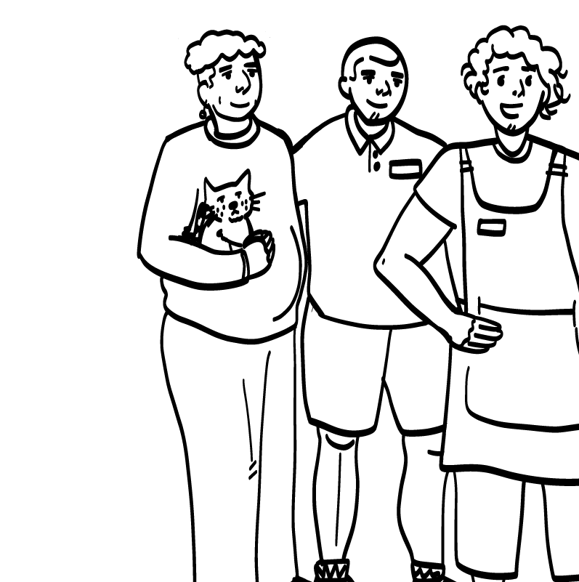
Relationships
© 2026 SAFE Disability Services Program
Notes:
Say: In our classes, we are going to talk all about different types of relationships! What do you all see in the pictures on the screen? What types of relationships are we looking at?
Give students enough time to process the question and make their decisions.
Say: The picture on the left looks like people are at work. These could be coworkers, or a boss and workers. The middle picture looks like a group of friends. The picture on the right looks like a family—there is an adult and a child. These are all examples of relationships that we will talk about in our class.

Slide 7
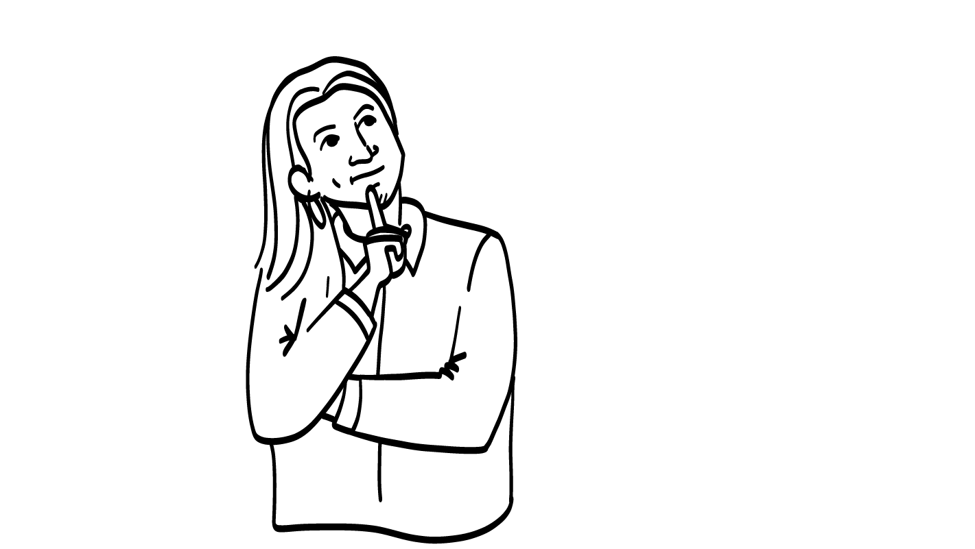
What do you
want to learn?
© 2026 SAFE Disability Services Program
Notes:
Say: Knowing that these classes will be all about relationships, is there anything that you really want to learn?
Give students enough time to process the question and make their decisions. As students share what they are interested in learning, you can confirm for them if that topic is in My Rights My Life classes and let them know approximately when the class will discuss that topic. If a student suggests a topic that is not in the curriculum, or if it is going to be a long time before the topic comes up, you can also offer to meet independently with the student to help them get the information they are looking for.

Slide 8
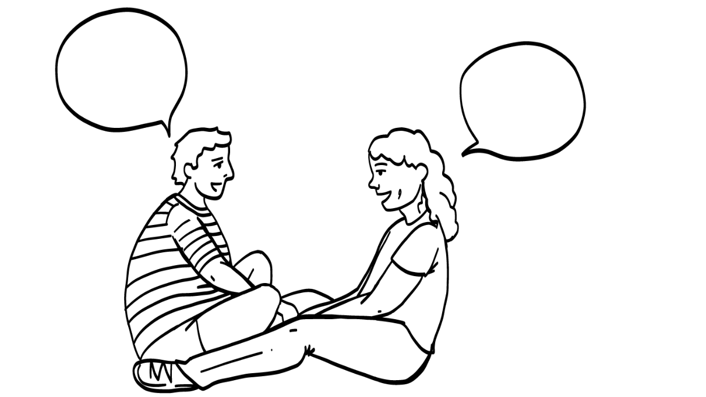
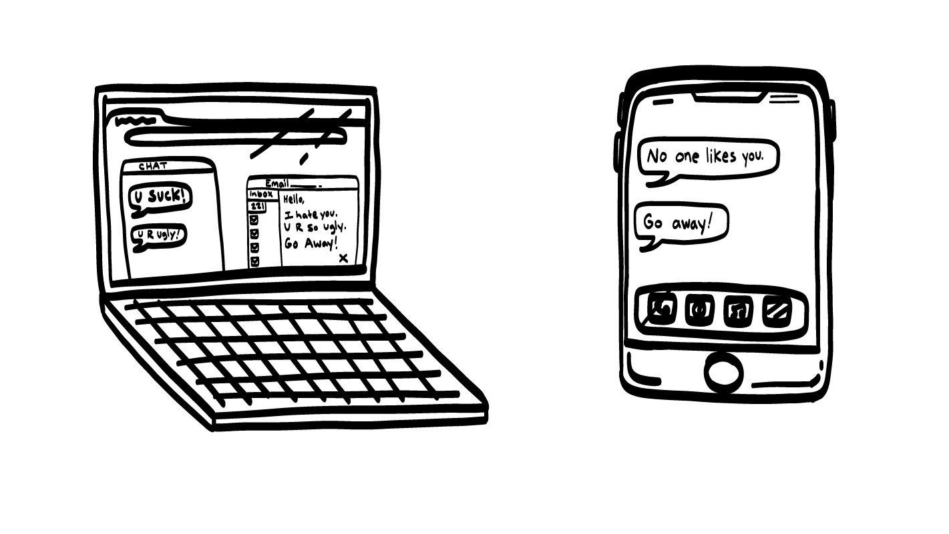
Things You Will Learn!
© 2026 SAFE Disability Services Program
Notes:
Say: You all are going to learn a whole lot in classes this year! Here are some of the things we will talk about:
Feelings, or emotions, and what to do when you have big feelings
Speaking up for yourselves and being leaders
Having relationships with friends, family, coworkers, and teachers that feel good
Telling people what you are okay with in your relationships and what you are not okay with
What consent is and why it is so important
How to be safer online and on social media
What makes relationships healthy and unhealthy

Slide 9
Share name
and pronouns
Talk about My Rights My Life class
Make class rules
Brain break
Getting to know you!
© 2026 SAFE Disability Services Program
Notes:
Say: The first thing we need to do to get ready for our classes is to make some class rules together.

Slide 10
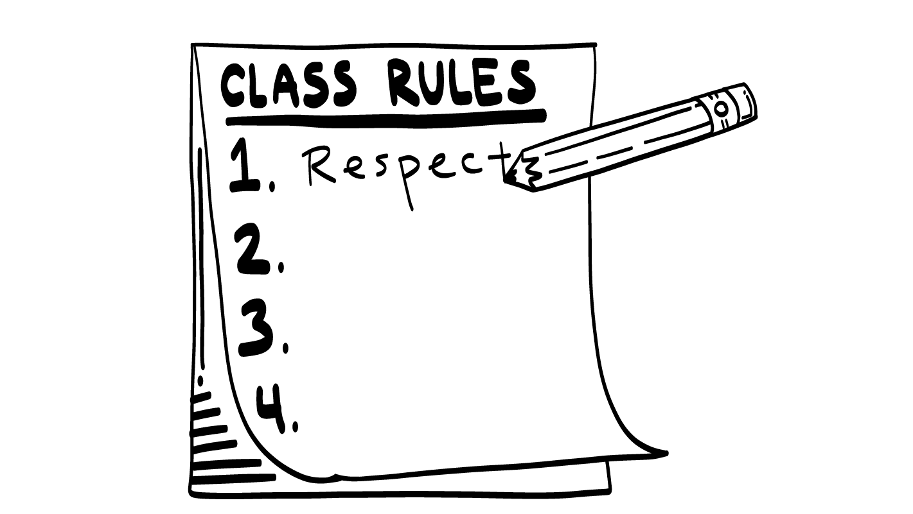
© 2026 SAFE Disability Services Program
Notes:
Say: Before we can really get started, we need to talk about making our time together feel safe for everyone. We want everyone to feel safe and good in My Rights My Life healthy relationship class! One thing we can do to make sure everyone in the class feels safe is to come up with our class rules. Throughout the semester, we will be talking about some things like personal boundaries with other people, that could be uncomfortable or hard to talk about. So, we really need to have a safe space to talk about these things. Class rules are things we all agree to follow so that everyone can talk in class and feel respected, safe, and welcomed.
For example, one rule I would like to add is “It’s okay to pass.” This means that if I ask a question and you don’t want to answer, you can say “I pass.” What do you all think? Do we want to add “It’s okay to pass” to our class rules? Give a thumbs up for yes and a thumbs down for no.
Give students enough time to process the question and make their decisions. If everyone gives a thumbs up, write “Okay to pass” on a whiteboard or chart paper. If some students give a thumbs down, ask them why they do not agree with the class rule. See if you can come up with a new rule that addresses the student’s concerns.
Say: Does anyone have ideas about other rules we should include? What do we need so we can have a safe space?
Give students enough time to process the question and make their decisions. As students suggest sample rules, continue to check-in to see if the class agrees to the rule by asking them to give a thumbs up/thumbs down. It’s important that students commit together to following these rules. Once the class agrees on a rule, write it on a white board or chart paper.
As needed, you can use some of the sample prompting questions below to promote student discussion.
What things make this a place where everyone is respected?
If somebody says something personal in here, is it okay to tell other people who aren’t in the class?
How will we make sure everyone gets to take a turn to share?
What should you do if you want to talk?
You can tell anyone what the trainers/teachers say in the class – just not something personal your classmates share. [This is important given we are not asking class members to keep ‘secrets’ just to respect what classmates share. They can tell anyone what teachers and SAFE staff say.].
Some sample agreements are included below for your reference:
We raise our hands if we want to talk.
We don’t tell others what your classmates or other students say in here, so everybody can feel comfortable sharing.
You can tell others anything that your teachers and SAFE staff say in here.
We never have to talk if we don’t want to.
If we are talking a lot, we can “step back” and let others talk.
Everyone is respected.
Say: This is a great list! I will keep this list up for all of our classes this year so we can look at it and make sure we are all following the same rules. We can also change the rules or add new ones if we need to. Does everyone agree to follow these rules so our class can be a safe space? Give a thumbs up for yes and a thumbs down for no.
Give students enough time to process the question and make their decisions. Students should commit together to following these rules. If anyone does not give a thumbs up, ask them if they’d be willing to share why they don’t agree. Pull in classmates to discuss the concerns and to build a set of rules that everyone finds acceptable.

Slide 11
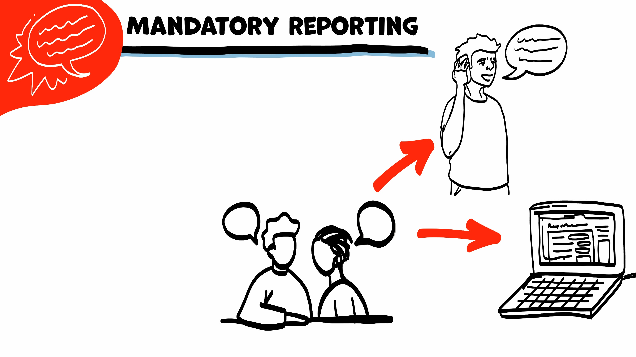
If someone is hurting you, I have to get help. I get help by telling Adult Protective Services (APS) or Child Protective Services (CPS).
If I need to tell APS or CPS,
I will let you know first. We can make a report together on the phone or on the computer.
© 2026 SAFE Disability Services Program
Notes:
Say: One thing teachers have to do to keep you safe is get help if you tell us that someone is hurting you or hurting someone you know. This is called being a mandatory reporter. The way that I get help is by calling APS or CPS. APS is Adult Protective Services and CPS is Child Protective Services. I will always tell you if I need to call APS or CPS, and I will ask you if you want to call APS or CPS yourself, if you want me to call, or if you want us to make the call together. Does anyone have any questions about that?

Slide 12
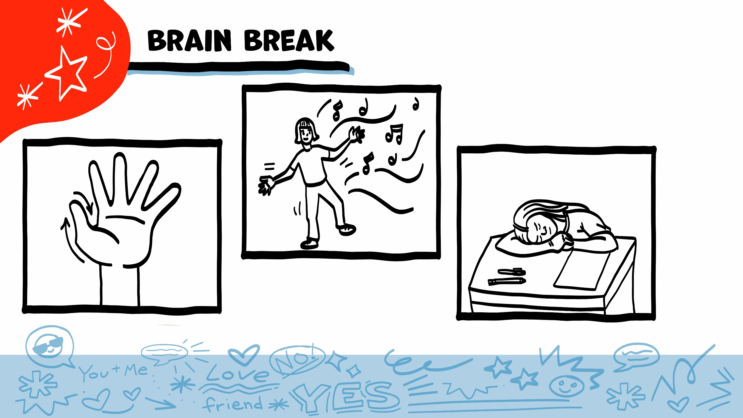
© 2026 SAFE Disability Services Program
Notes:
Say: That was a lot of information, and you all are doing an amazing job! Every week in class we will take a brain break in the middle. This is a chance to move a little and take a break from thinking!
Below are three ideas to give students a quick opportunity for a brain break. You are also welcome to come up with your own ideas for brain breaks that work best for your class.
Five finger breathing
For this exercise, have all students place their hand in front of their chest with their five fingers spread out. Next, use the pointer finger of the other hand to trace up and down each of the five fingers, beginning with the thumb. As students trace up a finger, they will breathe in. As they trace down a finger, they will breathe out. When students breathe out on the pinky finger, you can tell them to shake out their hands and arms. As the school year goes on, you can ask students to lead this exercise for their peers.
If this exercise is physically inaccessible for your class, you can also model the hand tracing for students while they breathe in and out.
Stretch break
Lead students through a series of basic stretches. These can be completed in a chair, or while standing up, depending on the accommodation needs of your class. Some ideas include reaching toward the ceiling, stretching one arm at a time across the chest, reaching toward toes, turning head from side to side, etc. Ask students to hold a pose while you count to ten. As the school year goes on, you can ask students to lead stretches for their peers.
Dance party
If your class likes to dance, you can put on a short song for them to dance to. This is especially effective if you are able to find a song that relates to the theme for that week’s class.

Slide 13
Share name
and pronouns
Talk about My Rights My Life class
Make class rules
Brain break
Getting to know you!
© 2026 SAFE Disability Services Program
Notes:
Say: The last thing we are going to do today is play a Getting to Know You game!

Slide 14
1.
2.
3.
What is your favorite food?
4.
5.
6.
What is your favorite song?
What do you like to do for fun?
What is your favorite animal?
What is your favorite color?
What is your favorite movie?
© 2026 SAFE Disability Services Program
Notes:
Say: It’s time for us to play a game! We’ll use this game to get to know each other a little bit more. In just a minute, everyone is going to get in a circle. I have a beach ball with the numbers 1 through 6 on it. We are going to take turns tossing and catching the ball. When you catch the ball, you will look to see what number your hand landed on. You will answer the question that goes along with the number. For example, if your hand lands on the number one, you will share your favorite food. After you are done sharing, you can toss the ball to someone else. Make sure to say their name before you toss so they know you are passing the ball to them! Does anyone have any questions about how to play?
Have students and teachers form a circle. Ask for a volunteer to go first. The facilitator will toss the beach ball to this volunteer. The volunteer will say what number their hand landed on as they catch the ball. The facilitator will read the question that corresponds with that number. After they’ve answered their question, they should say the name of the person they want to go next and toss the ball to them.
After answering their question, the second person says the name of a person who has not shared yet and tosses the ball to them. Keep tossing the ball until every person has had a chance to share.
Beach Ball Game Questions:
What is your favorite food?
What do you like to do for fun?
What is your favorite color?
What is your favorite song?
What is your favorite animal?
What is your favorite movie?
Accommodation: If tossing and catching the ball is a physical barrier to some students, roll or bounce the ball. Another option is to ask a student to volunteer to be the runner. The runner can walk the ball from one student to the next. (See lesson plan materials list for additional suggestions.)

Slide 15
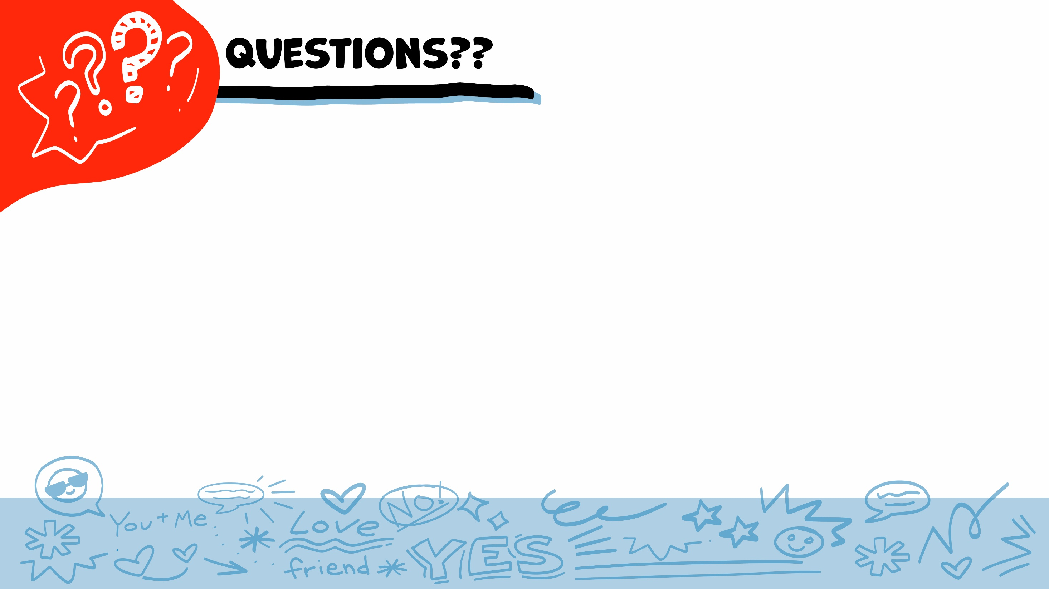
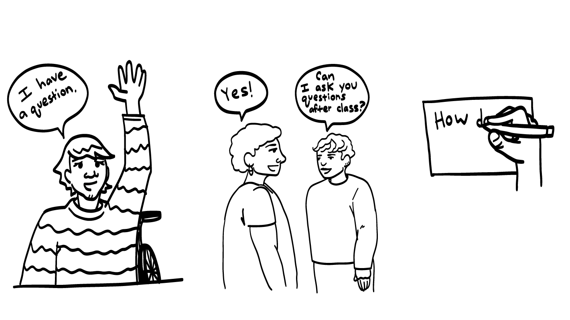
© 2026 SAFE Disability Services Program
Notes:
Say: Does anyone have any questions about today’s class?
Give students enough time to process the question and make their decisions.
Say: You can always ask questions out loud. Every time we have class, I will also give you a blank notecard. If you don’t want to ask your question out loud, you can write it on a notecard and leave it on your desk. You can also ask someone you trust to help you write your question on the notecard. I will pick up the notecards and will answer the questions the next time we meet. When I answer a question, I won’t tell anyone who asked it.

Slide 16
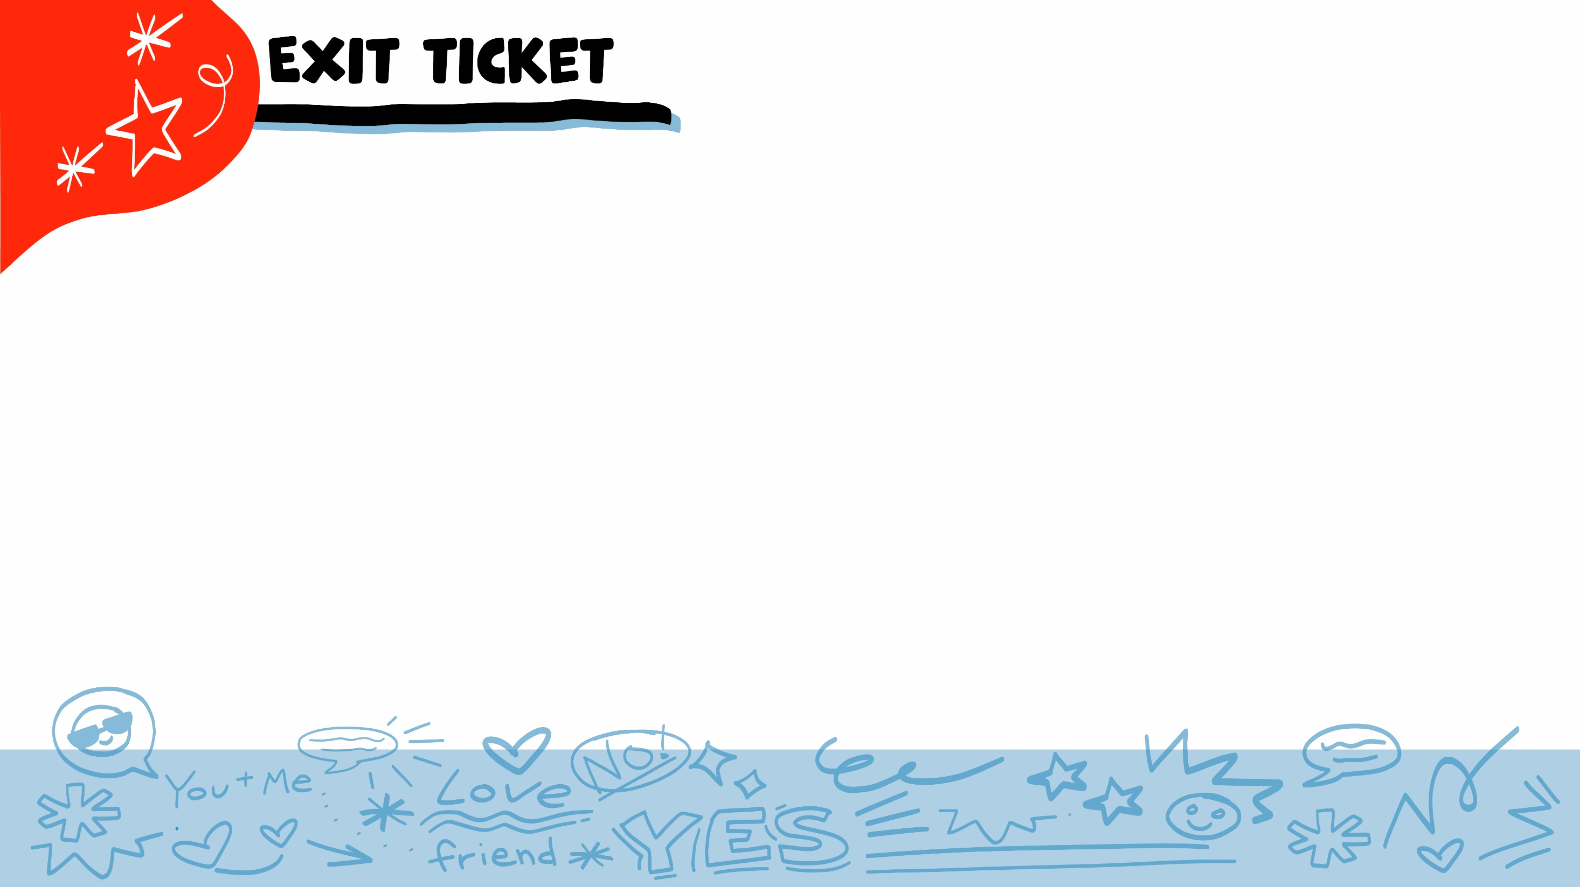
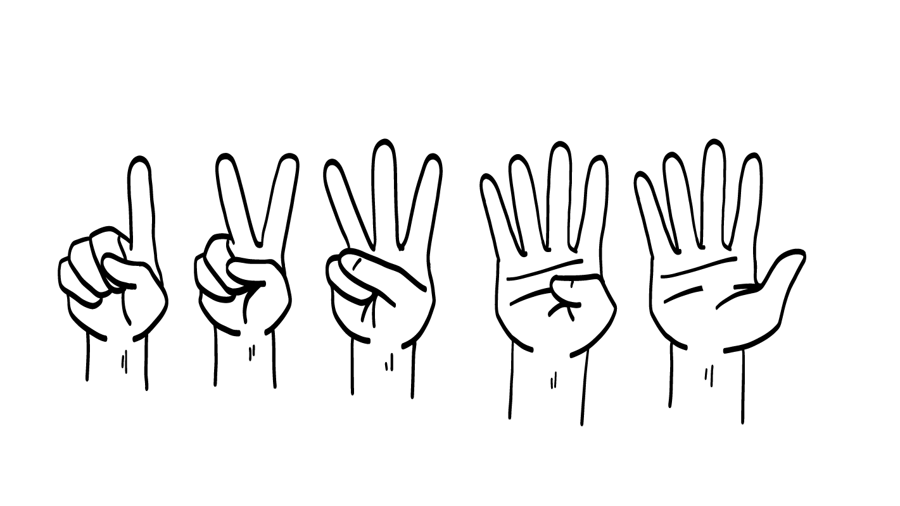
What will I do if you tell me someone is hurting you?
Get help by calling APS or CPS
Nothing
1
2
© 2026 SAFE Disability Services Program
Notes:
Say: At the end of every class I will ask you some questions to see what you learned in class. We call this an exit ticket.
What will I do if you tell me someone is hurting you? Hold up one finger for “get help by calling APS or CPS” and hold up two fingers for “nothing.”
Give students enough time to process the question and make their decisions.
Say: That’s right! If you ever tell me that you are being hurt, or that someone else is being hurt, I would need to get help. I get help by calling Adult Protective Services, or Child Protective Services.

Slide 17
What is My Rights My Life class about?
Healthy relationships
Getting a job
Cooking
1
2
3
© 2026 SAFE Disability Services Program
Notes:
Say: What is My Rights My Life class about? Hold up one finger for “healthy relationships,” two fingers for “getting a job,” and three fingers for “cooking.”
Give students enough time to process the question and make their decisions.
Say: My Rights My Life classes are all about healthy relationships. We’ll talk about the things that make your relationships with friends, family, coworkers, and teachers feel good and safe for both people.

Slide 18
What is one thing you will learn in My Rights My Life class?
© 2026 SAFE Disability Services Program
Notes:
Say: What is one thing you will learn in My Rights My Life class?
Give students enough time to process the question and make their decisions. If students do not generate any answers on their own, you can revisit slide eight.

Slide 19
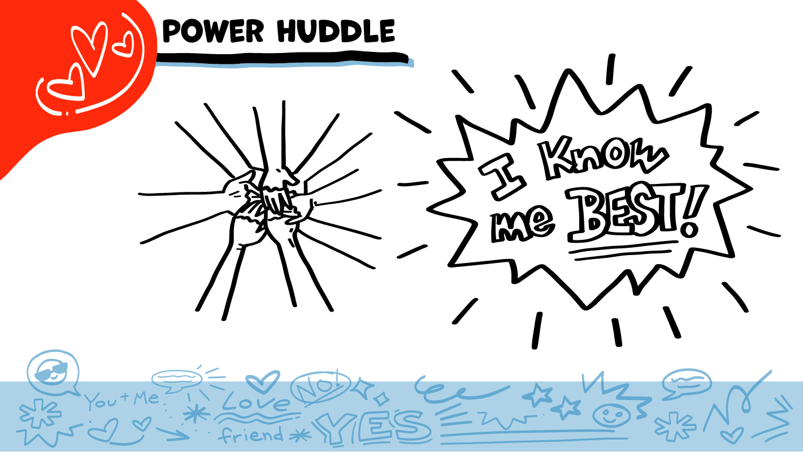
© 2026 SAFE Disability Services Program
Notes:
Say: It was awesome getting to know everybody a little bit today. We will close every class by saying our power statement, “I know me best.” This means that each of you know yourself better than anyone else does. Over the next few weeks, you’ll keep learning more about yourselves, and how to tell other people what you’re thinking and feeling. Let’s gather together and on the count of three, say our power statement
Have each interested student put one hand in the middle of the circle. Ask for a student volunteer to count to three. After three, all participants say the power statement while lifting their hands into the air. Students can also stand in the circle without touching hands if they prefer.

Slide 20

This work is supported by the Texas Council for Developmental Disabilities through a grant from the U.S. Administration for Community Living (ACL), Department of Health and Human Services (HHS), Washington, D.C. 20201 with a 100% federal funding award totaling $6,161,072. Council efforts are those of the grantee and do not necessarily represent the official views of nor are endorsed by ACL, HHS, or the U.S. government.
© 2026 SAFE Disability Services Program
Notes:
SAFE would like to thank the Texas Council for Developmental Disabilities for the funding for this curriculum.

Slide 21

This curriculum is offered online at no cost. You are free to use the resources in the original format for educational purposes only. Please reference The SAFE Alliance appropriately (citations at bottom of page).
We ask that you do not alter curriculum images/art, slides, or lesson plan materials. You may not use My Rights My Life (18+ or High School) curriculum for commercial purposes (i.e., selling workshops you facilitate based on MRML curriculum; and/or creating links/websites to re-distribute any materials associated SAFE’s My Rights My Life).
This resource, My Rights My Life: A curriculum for healthier relationships for high school students (grades 9-12) is based on the original My Rights My Life: A curriculum for safer relationships (age 18+) written by Megan Westmore, Heidi Lersch, and edited by Schwartz, M. (2022). Selling materials from MRML is a copyright violation.
Burleson, Anna Belle & Benitez, Sophie (2026) provided light modification and abbreviated the original curriculum
(Westmore & Lersch, 2022) to offer an age appropriate resource for High School Students (grades 9-12).
Schwartz, M. (Ed.). The SAFE Alliance, Austin, Texas.
Westmore, M. & Lersch, H. (2022). My rights my life: A curriculum for safer relationships.
Schwartz, M. (Ed.). The SAFE Alliance: Austin, TX.
© 2026 SAFE Disability Services Program

