Slide 1
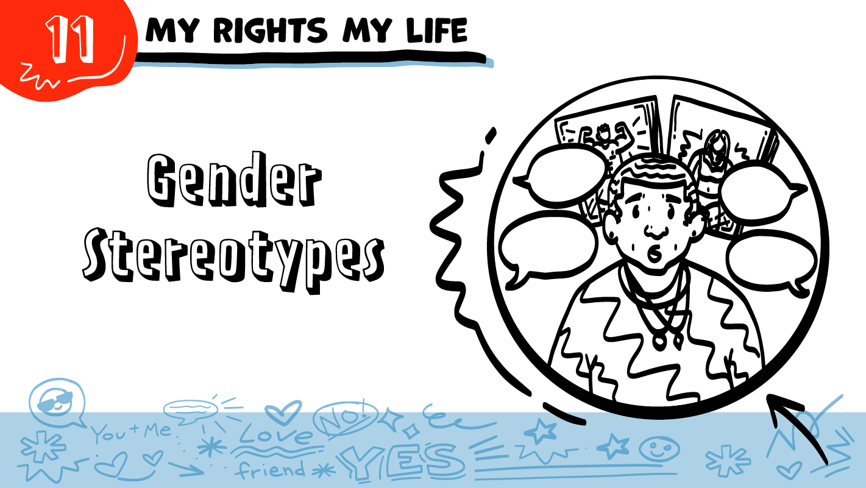


for High School Students
© 2026 SAFE Disability Services Program
Notes:
Repetition is beneficial for learning. Take time to review the last My Rights My Life class you taught prior to beginning this session. You can also answer any private questions students submitted on notecards during your previous class session.
Say: Today we are going to talk about something called gender stereotypes.

Slide 2
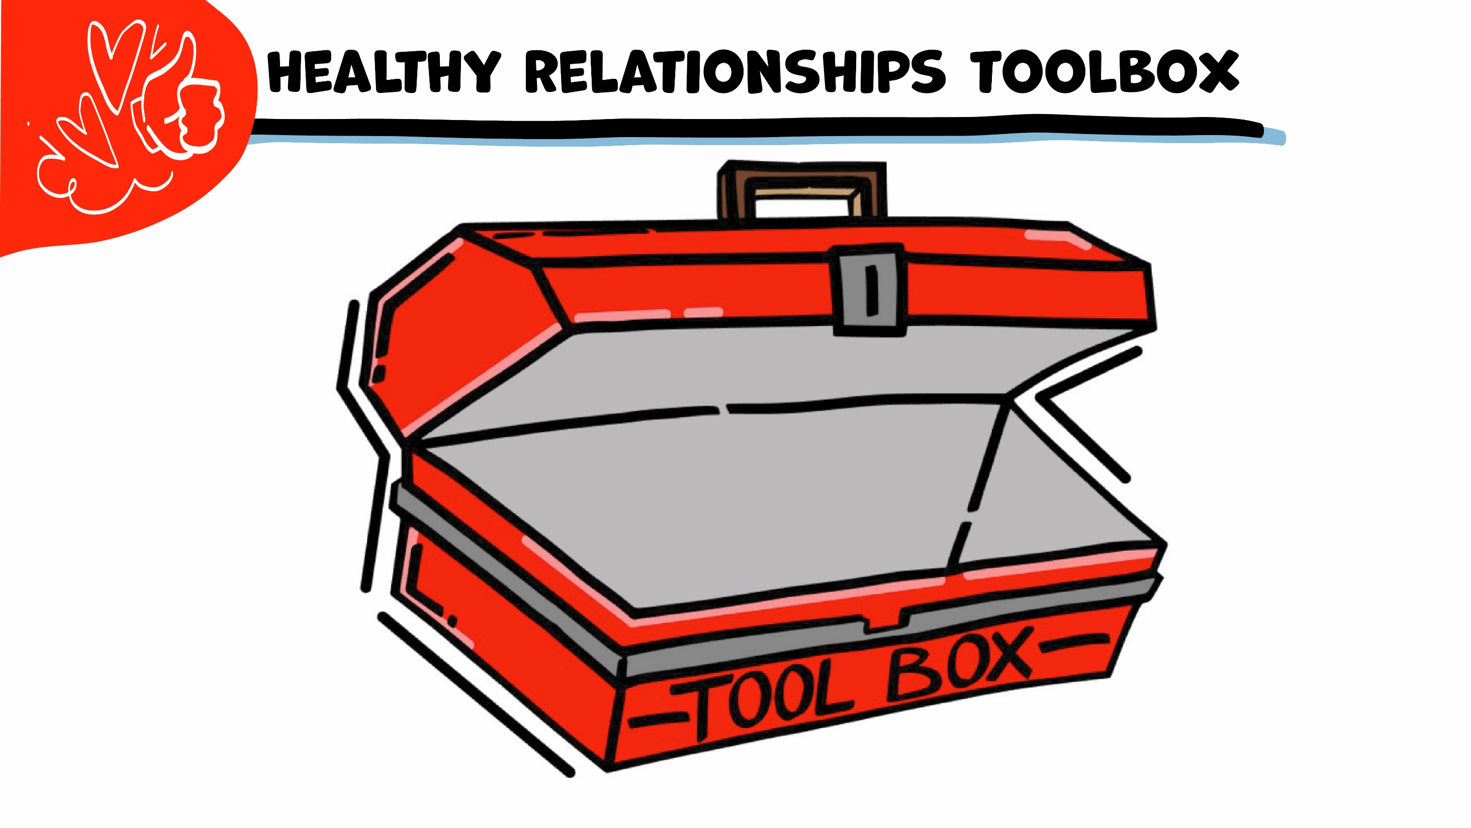
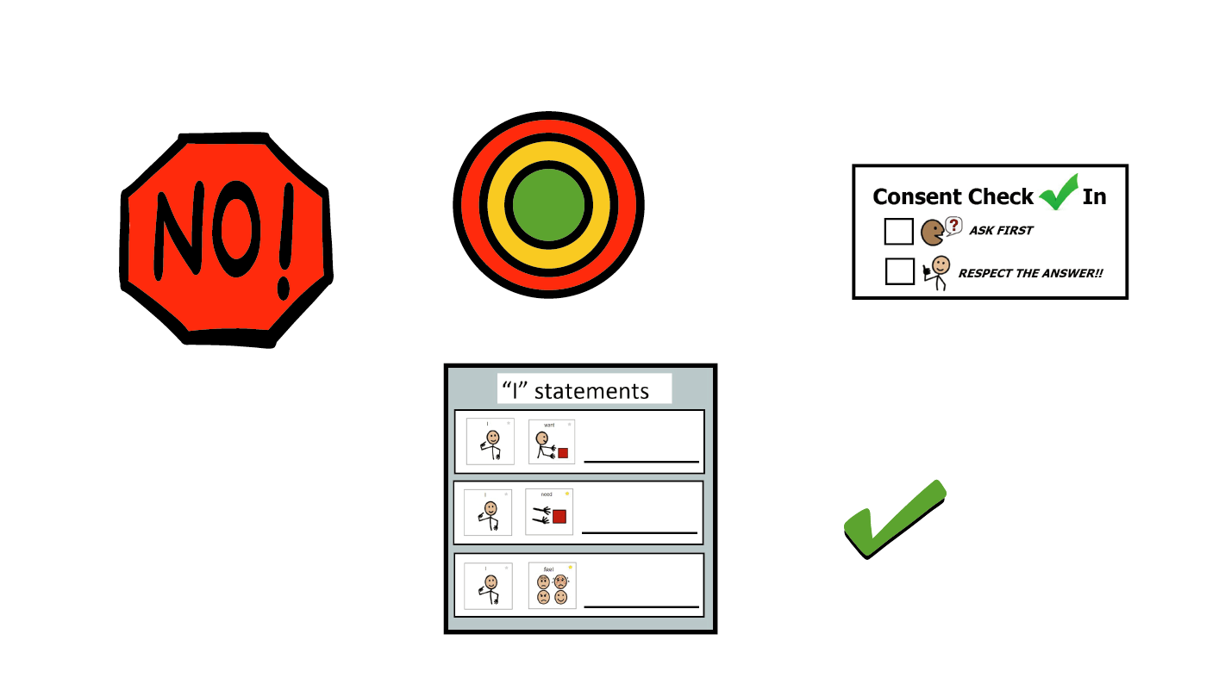
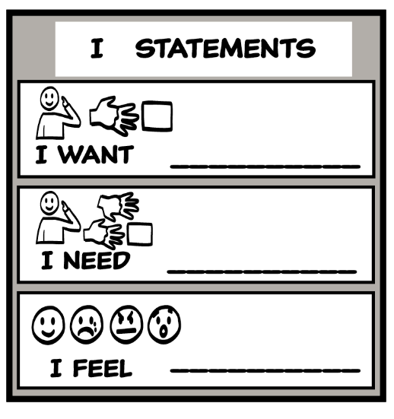
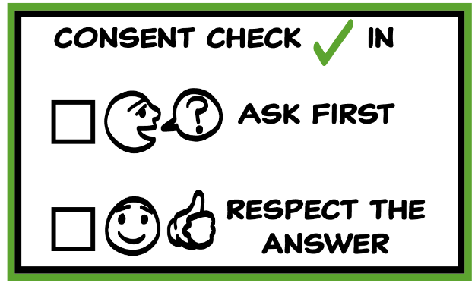
© 2026 SAFE Disability Services Program
Notes:
Use the large class Healthy Relationship Toolbox to review the Healthy Relationship Tools (I Statement, Relationship Map, NO!, and Consent Check-In). You can ask students to pull off one tool at a time and discuss what it is and how it is used. It can be particularly helpful for this review if you give students specific scenarios to think through. For example, you might ask, “If your friend lies to you, what is one I Statement you could use to tell your friend how you feel?” You may even consider using examples of situations that have recently occurred in your classroom, as long as doing so does not break student confidentiality. You can also ask students to connect the toolbox tools to their current relationships. You might say, “Can anyone volunteer and tell me about something going on in your life right now that using the toolbox could help you with?”
Instructions for how to use each Healthy Relationship Tool can be found in the following classes:
I Statements: Classes 2 and 3
Relationship Map: Class 4
NO!: Class 5
Consent Check-In: Class 6

Slide 3

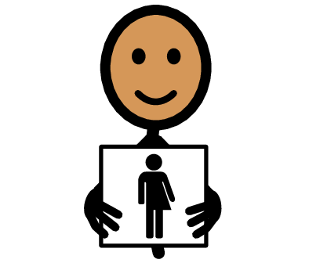
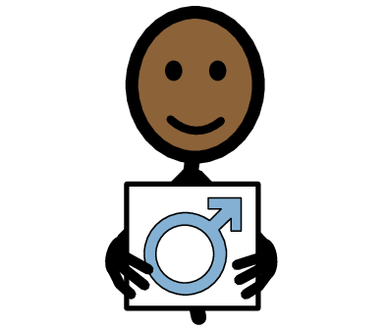
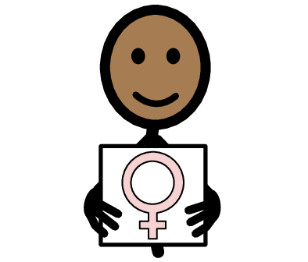
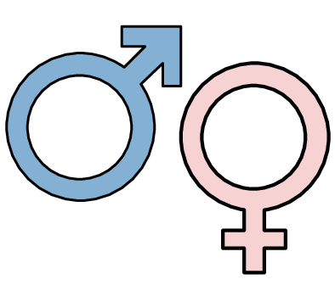


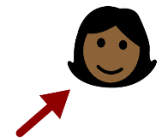
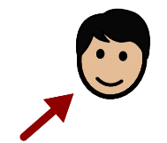
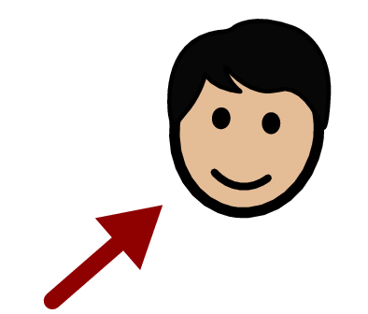
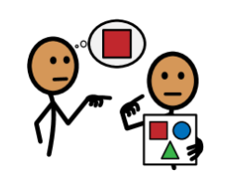

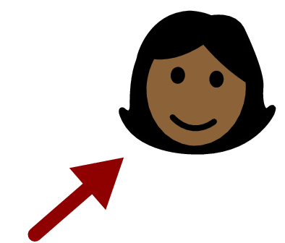



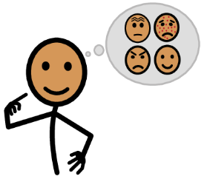




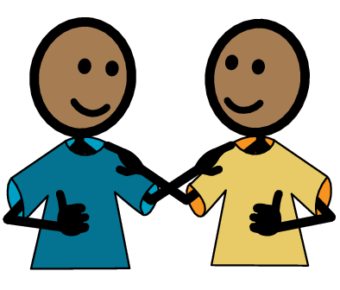
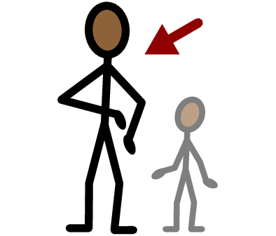
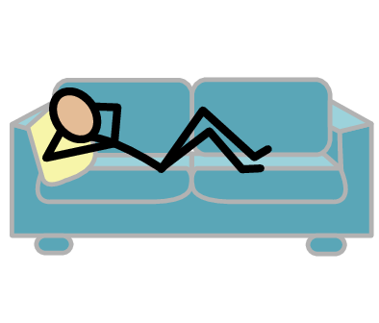
Gender
Non-binary
Man
Woman
Yes
No
Pronouns
He
She
They
Stereotype
I need help
I have a question
Trust
Adult
Take a break
I feel
Happy
Sad
Mad
Scared
Copyright © 2021 SymbolStix, LLC. All rights reserved. Used with Permission.
Notes:
You can print this slide separately so each student can use the Important Words Sheet as a communication board throughout class. Review the words using the suggested definitions below. To enhance understanding, you can ask students to come up with their own definitions for vocabulary words or to provide a sentence or scenario using the new word.
Gender: man, woman, and non-binary
Non-binary: gender that is not man or woman
Man: gender that is not non-binary or woman
Woman: gender that is not man or non-binary
Pronouns: words that talk about gender, such as he, she, and they
He: pronoun for men
She: pronoun for women
They: pronoun for non-binary people
Stereotype: things people say about a group that are not all true

Slide 4
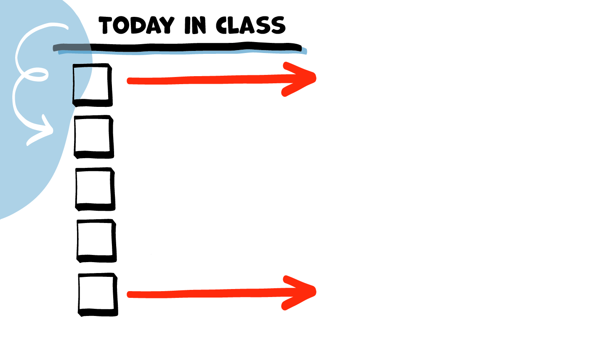
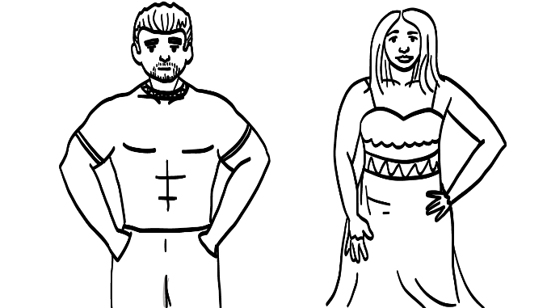
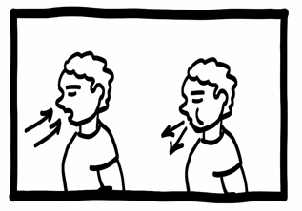
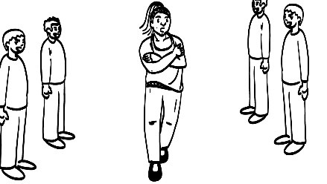


Woman
Man
Gender and Pronouns
Non-binary
Gender Stereotypes
Brain break
Gender Stereotypes and Safety
Stereotypes
Game
True
False
© 2026 SAFE Disability Services Program
Notes:
Read the agenda. Alternatively, you can ask for a student volunteer to read the agenda.

Slide 5
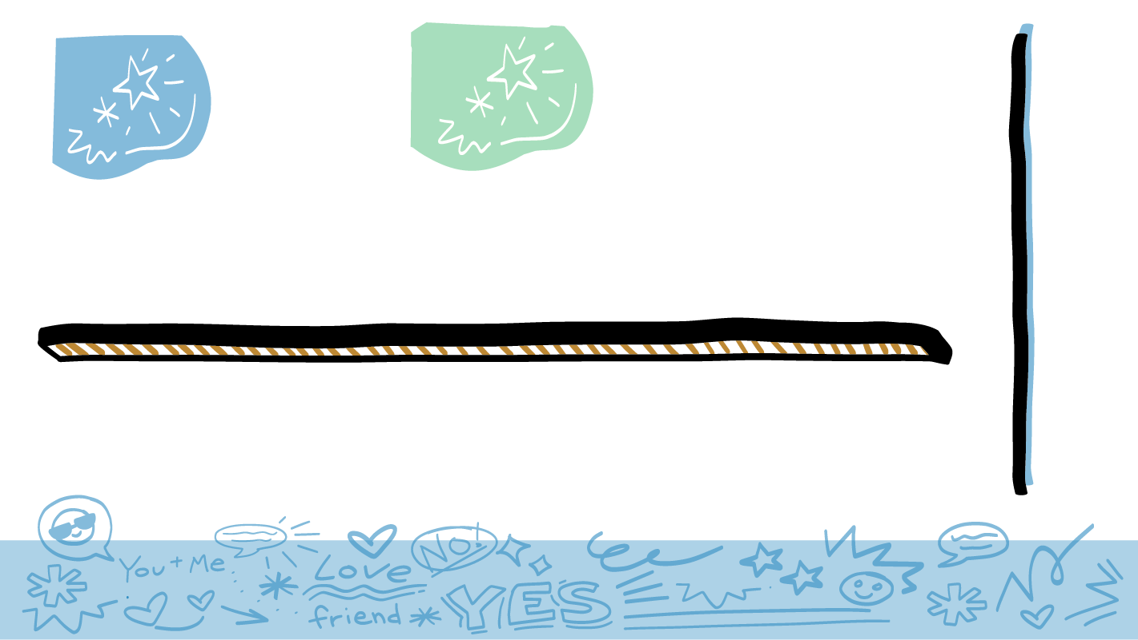
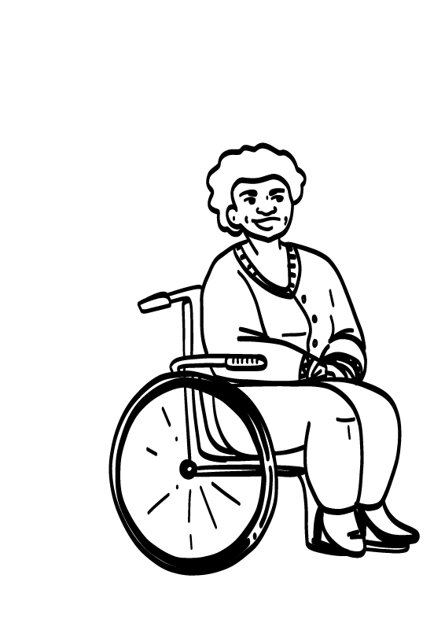
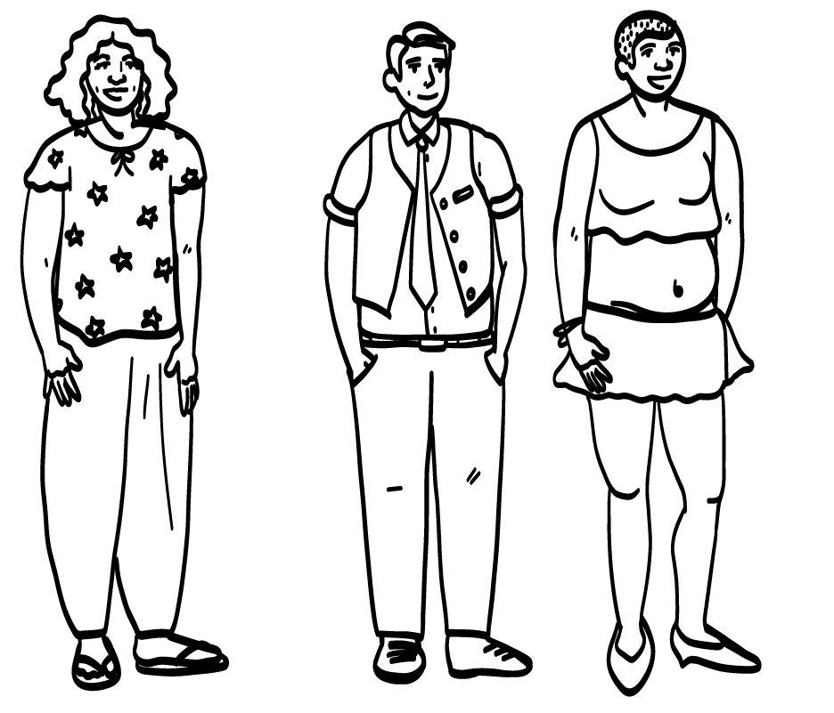
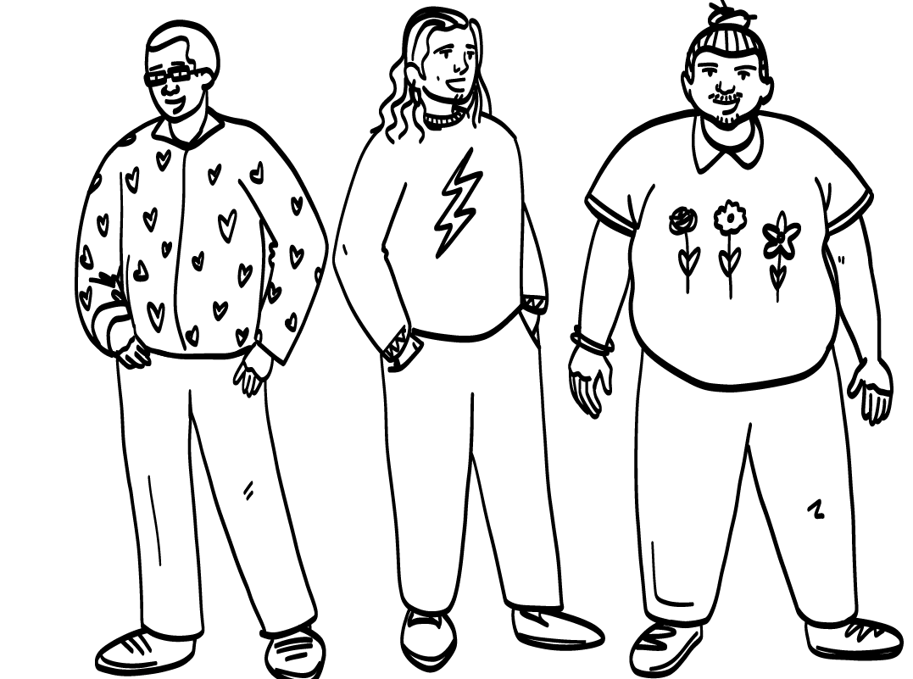
Gender
Gender is one way you can tell us who you are. If you are a man, woman, or non-binary person.
© 2026 SAFE Disability Services Program
Notes:
Say: We are going to start today’s class by talking briefly about gender and pronouns. One way people tell us about who they are is through gender. Gender is how a person can tell us if they are a man, a woman, or a non-binary person. Non-binary means someone is not identifying as man or woman. Some non-binary people say they are in between man and woman, and others say they are both man and woman.

Slide 6

What is your gender?
Only you can tell people what your gender is.
Woman
Non-binary
Man
© 2026 SAFE Disability Services Program
Notes:
Say: You get to tell us what your gender is. I cannot tell you what your gender is, and your parents cannot tell you what your gender is. Only you can tell people what your gender is.
Does anyone want to raise their hand and share what their gender is?
Give students enough time to process the question and make their decisions. Go around the room and encourage students to share their gender, if they would like to.

Slide 7
Pronouns
Woman
She
Man
He
Non-binary
They
Pronouns tell people what your gender is.
© 2026 SAFE Disability Services Program
Notes:
Say: Pronouns are words that you use to tell other people what your gender is. People use pronouns when they are talking about you. The pronoun for men is he. The pronoun for women is she. The pronoun for non-binary people is they.

Slide 8
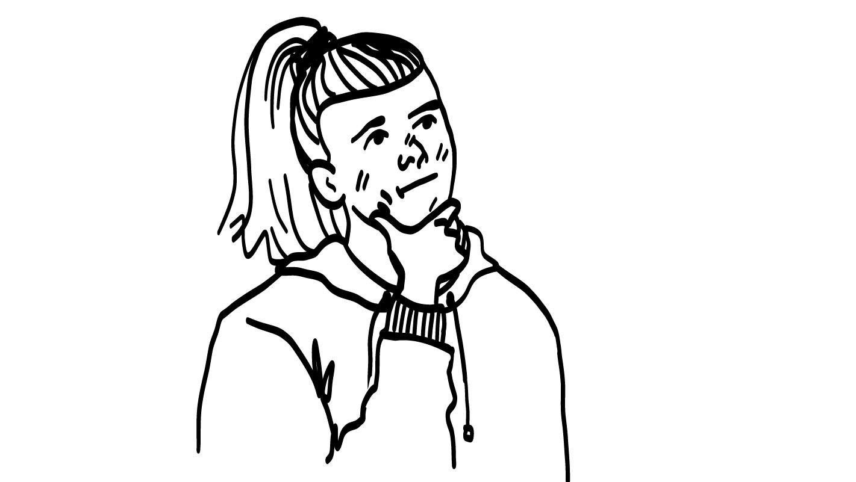
He She
???
???
They
She/They
What is your pronoun?
© 2026 SAFE Disability Services Program
Notes:
Say: Does anyone want to raise their hand and share what their pronoun is?
Give students enough time to process the question and make their decisions. Go around the room and encourage students to share their pronoun, if they would like to.

Slide 9
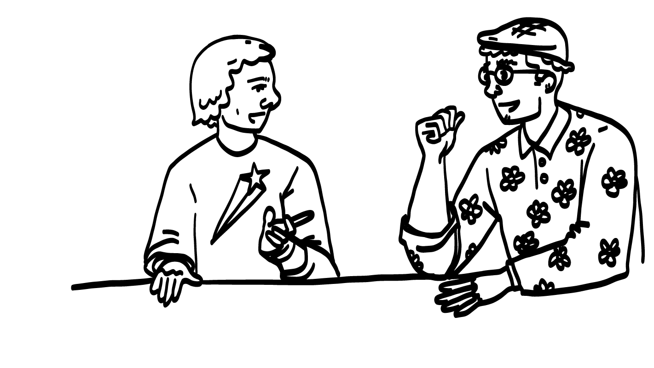
“What are your pronouns?”
A respectful way to ask about someone’s gender is to ask what pronouns they use.
© 2026 SAFE Disability Services Program
Notes:
Say: If you do not know what someone’s gender is, a respectful way to find out is to ask what pronouns they use. You can ask, “What are your pronouns?”
Sometimes, people might ask you for your pronouns! You can also introduce yourself with your pronouns to tell people what your gender is. Raise your hand if you would like to practice introducing yourself with your name and pronoun.
Give students enough time to process the question and make their decisions. Go around the room and invite students to introduce themselves with their names and pronouns, if they would like to.

Slide 10
Woman
Man
Gender and Pronouns
Non-binary
Gender Stereotypes
Brain break
Gender Stereotypes and Safety
Stereotypes
Game
True
False
© 2026 SAFE Disability Services Program
Notes:
Say: Great work on gender and pronouns! Now we are going to talk about something called gender stereotypes.

Slide 11
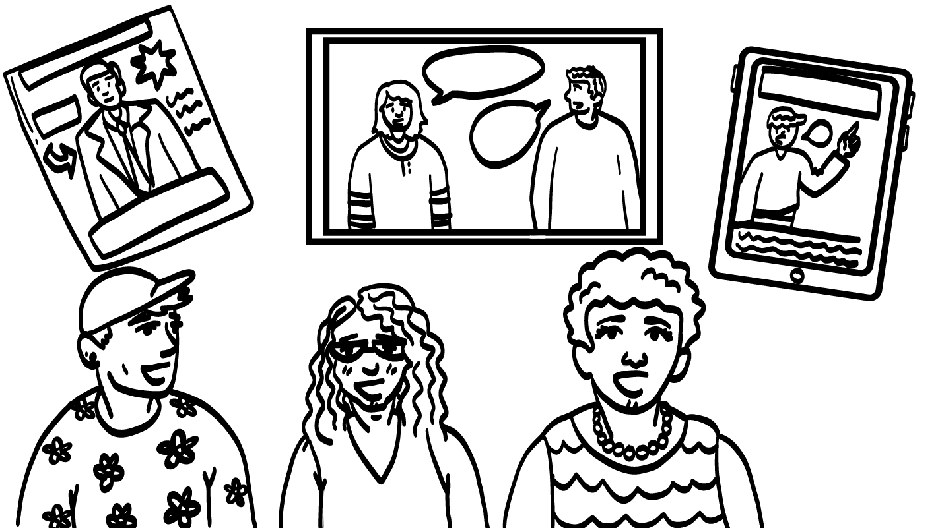
Stereotypes
Stereotypes are things you hear about a group of people that are not all true.
© 2026 SAFE Disability Services Program
Notes:
Say: Stereotypes are things you hear about a group of people that are not all true. For example, if I said that ALL people with red hair are smarter than other people, is that true? Give a thumbs up for yes and a thumbs down for no.
Give students enough time to process the question and make their decisions.
Say: No, that is not true. Or if I said that ALL people born in January are good at basketball, is that true?
Give students enough time to process the question and make their decisions.
Say: No, not ALL people born in January are good at basketball. We hear a lot of stereotypes from movies, TV, social media, and even our friends and family. Stereotype might be a new word for you, so let’s practice saying it together.

Slide 12
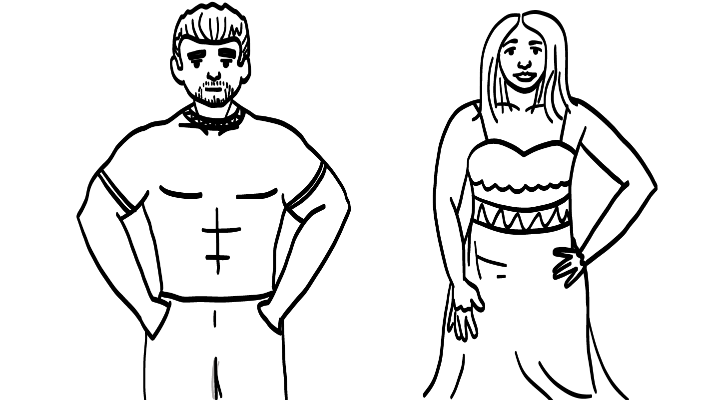
Gender Stereotypes
Gender stereotypes are things we hear about men and women that are not all true.
© 2026 SAFE Disability Services Program
Notes:
Say: There are lots of stereotypes about men and women. Sometimes people will say that something is a “man thing” or a “woman thing,” but that’s not true. Gender stereotypes can make people feel like they can only like or do some things. That isn’t cool. We want all people to feel free to do what they like to do!
We hear a lot of things about gender from movies, TV, social media, and even our friends and family. Today we are going to look at some gender stereotypes. We are also going to talk about the truth.

Slide 13
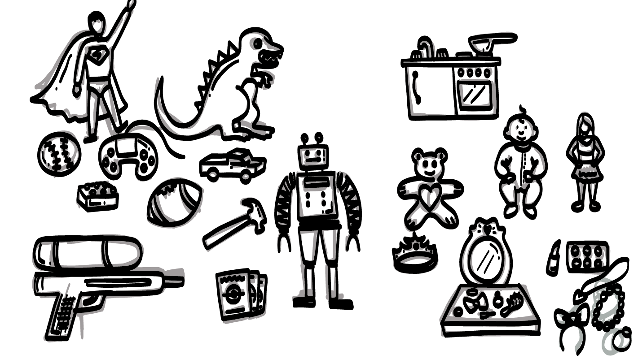
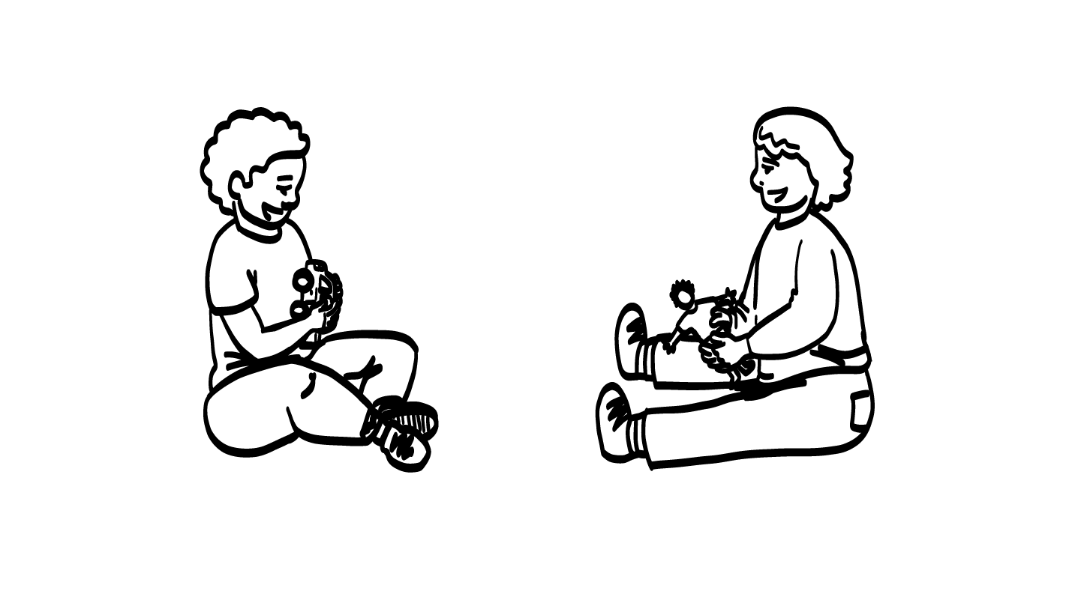
Gender and children:
What we hear.
“for boys”
“for girls”
© 2026 SAFE Disability Services Program
Notes:
Say: A lot of gender stereotypes start when people are really young! What do you all think—can only girls like the color pink? Give a thumbs up for yes and a thumbs down for no.
Give students enough time to process the question and make their decisions.
Say: No way! Lots of boys and non-binary people like pink too. What about the color blue? Can only boys like blue? Give a thumbs up for yes and a thumbs down for no.
Give students enough time to process the question and make their decisions.
Say: No! Lots of girls and non-binary people like the color blue. Saying that only girls like pink and only boys like blue is a gender stereotype.
Take a look at the other pictures on the slide. What are some gender stereotypes you hear about the toys on the screen?
Give students enough time to process the question and make their decisions. Some sample talking points are included below:
Sometimes we hear that only boys play with toy tool sets or trucks, and only girls play with dolls and toy makeup.
This isn’t true! Children of all genders can play with lots of different toys.
Can you think of any other gender stereotypes we hear about children?

Slide 14
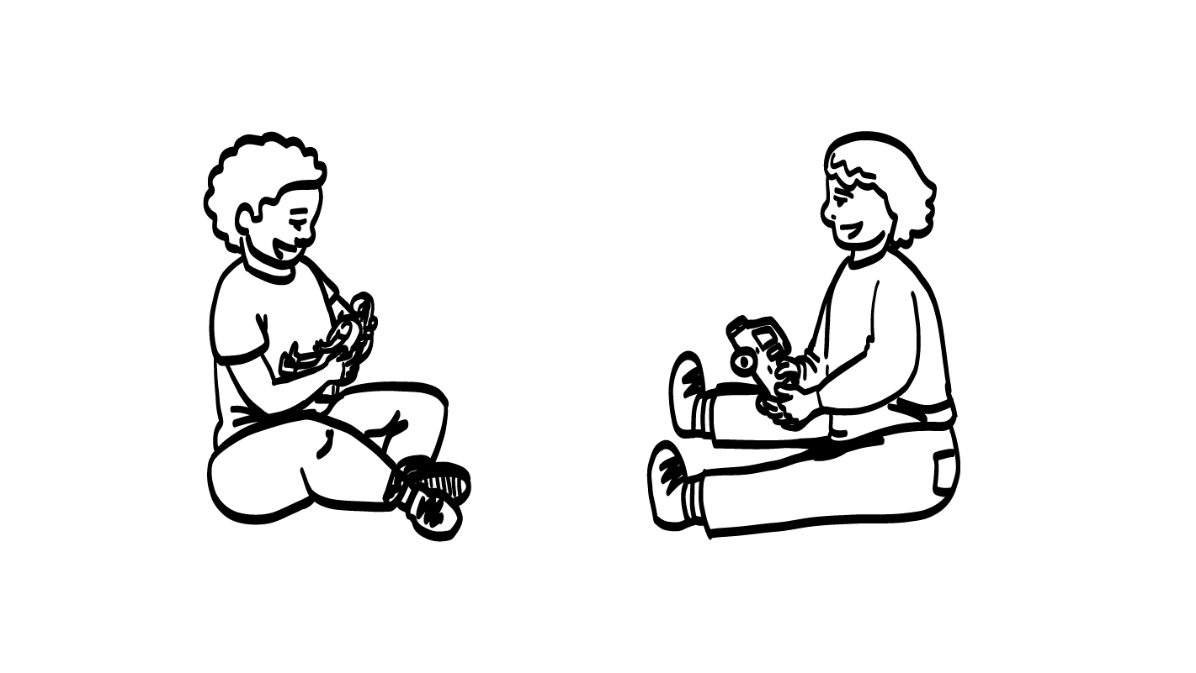
Gender and children: The truth.
© 2026 SAFE Disability Services Program
Notes:
Say: The truth is that children can like lots of different colors and toys no matter what their gender is. Some boys like to play with dolls and kitchen sets and may wear dresses. Some girls like to play with trucks and tool sets or may play sports.
Boys and girls should be able to play with the toys that they want and like to play with!

Slide 15
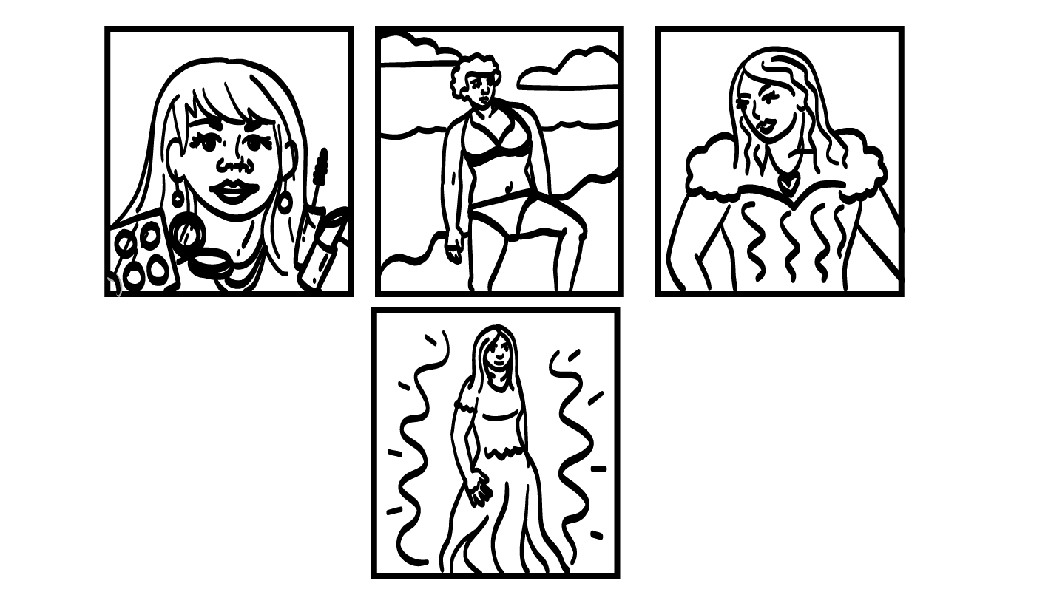
Gender and women’s bodies: What we hear.
© 2026 SAFE Disability Services Program
Notes:
Say: Now let’s talk about gender stereotypes we hear about women and their bodies. Take a look at the pictures on the screen. What do you all think? Do all women like to wear makeup? Give a thumbs up for yes and a thumbs down for no.
Give students enough time to process the question and make their decisions.
Say: Nope! Some women like to wear makeup, but other women do not. Take a look at the other pictures on the screen. What gender stereotypes have you heard about women and their bodies?
Give students enough time to process the question and make their decisions. Some sample talking points are included below:
Sometimes we hear that ALL women like to wear dresses. This isn’t true.
Sometimes we hear that women have to be really skinny, but this isn’t true either.
Can you think of any other gender stereotypes we hear about women and their bodies?

Slide 16
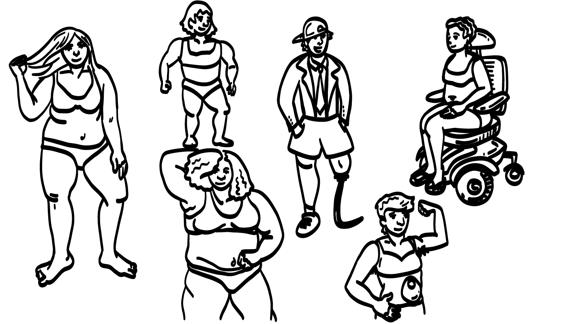
Gender and women’s bodies:
The truth.
© 2026 SAFE Disability Services Program
Notes:
Say: The truth is that women can look lots of different ways! Some women wear makeup and dresses, and others do not. Some women have lots of muscles. Some are skinny, and others have curves. Some women also have disabilities. However your body looks is normal and amazing!

Slide 17
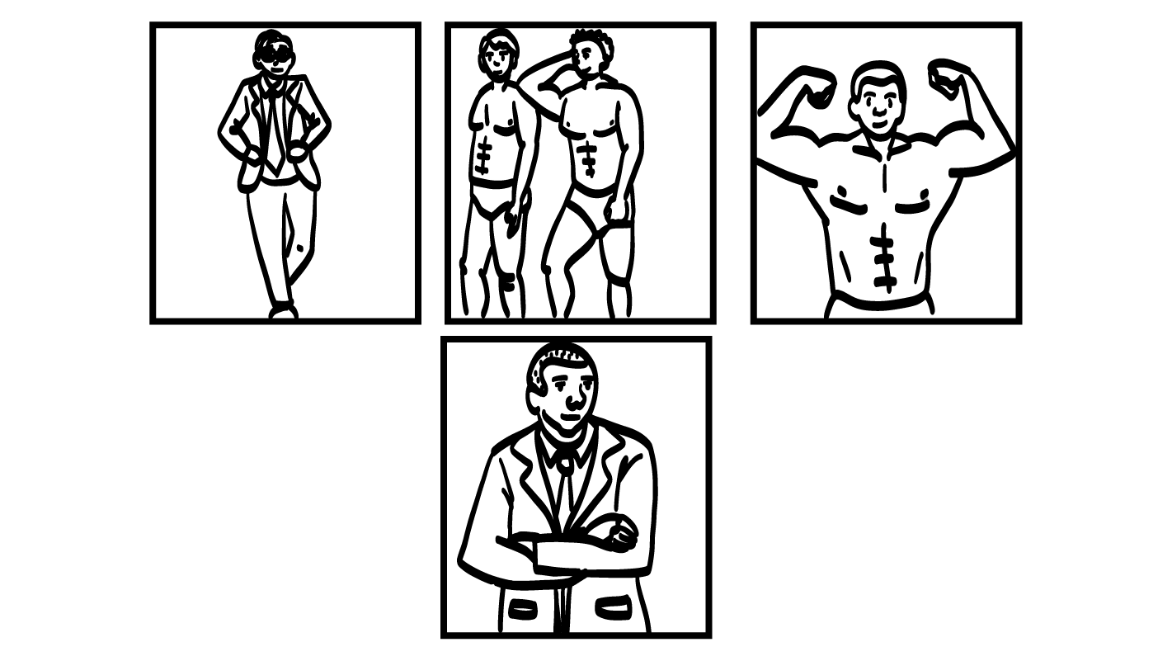
Gender and men’s bodies:
What we hear.
© 2026 SAFE Disability Services Program
Notes:
Say: Now let’s talk about gender stereotypes we hear about men and their bodies. Take a look at the pictures on the screen. What do you all think—do all men have really big muscles? Give a thumbs up for yes and a thumbs down for no.
Give students enough time to process the question and make their decisions.
Say: Nope! Some men have big muscles, and others don’t. Both are amazing! Take a look at the other pictures on the screen. What other gender stereotypes have you heard about men and their bodies?
Give students enough time to process the question and make their decisions. Some sample talking points are included below:
Sometimes we hear that ALL men like to wear suits. This isn’t true.
Sometimes we hear that all men have to be really athletic, but this isn’t true either.
Can you think of any other gender stereotypes we hear about men and their bodies?

Slide 18
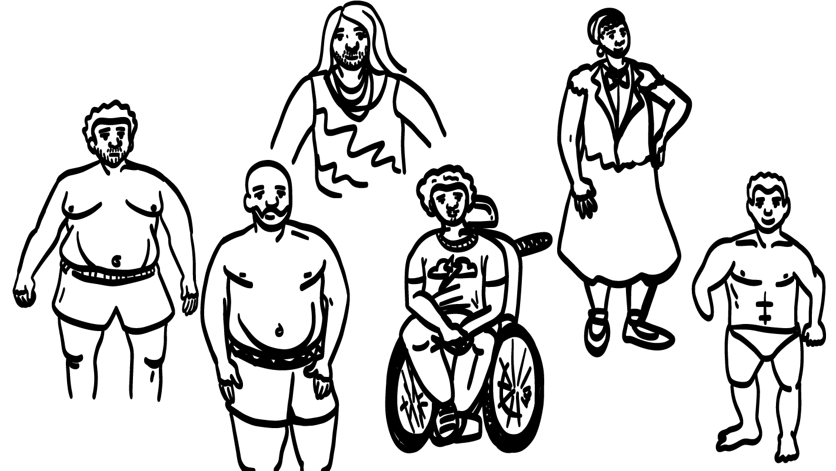
Gender and men’s bodies:
The truth.
© 2026 SAFE Disability Services Program
Notes:
Say: The truth is that men can look lots of different ways! Some men have lots of muscles, and others don’t. Some men wear makeup and dresses, and others do not. Some men are skinny, and others are bigger. Some men also have disabilities. However your body looks is normal and amazing!

Slide 19
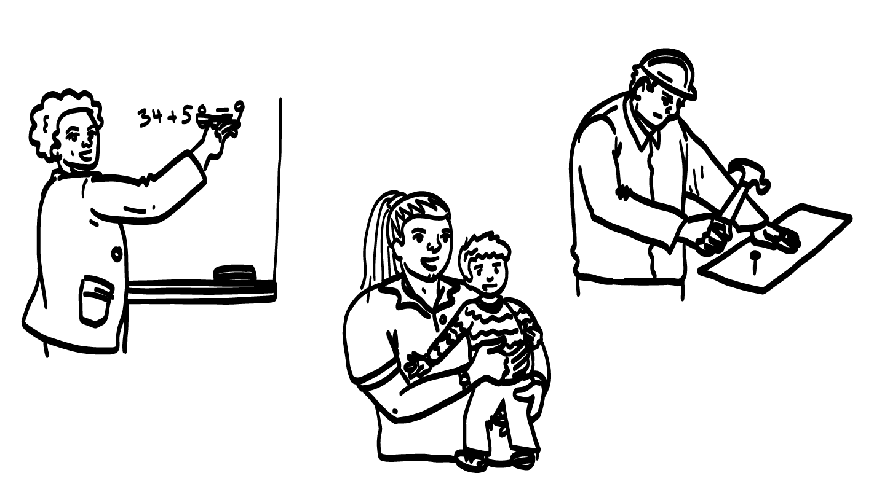
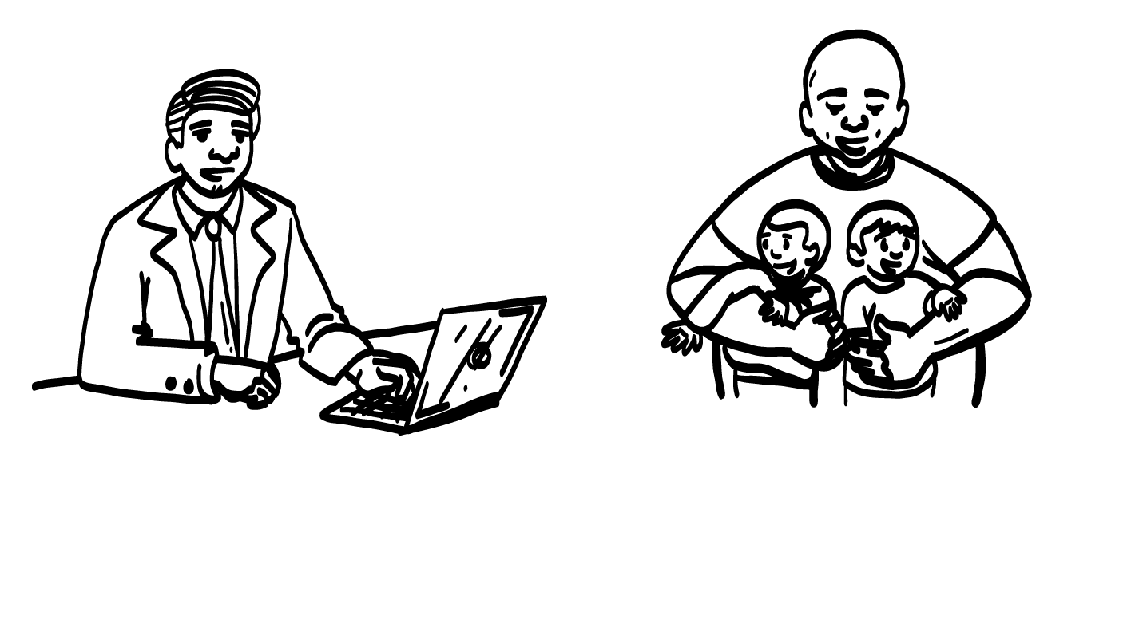
Gender and jobs: What we hear.
© 2026 SAFE Disability Services Program
Notes:
Say: We also hear a lot of stereotypes about gender and jobs. What do you all think—can only women be teachers? Give a thumbs up for yes and a thumbs down for no.
Give students enough time to process the question and make their decisions.
Say: No way! Lots of men and non-binary people are teachers too. What about construction workers? Can only men work in construction? Give a thumbs up for yes and a thumbs down for no.
Give students enough time to process the question and make their decisions.
Say: No! Lots of women and non-binary people work in construction. Saying that only women can teach and only men can work in construction is a gender stereotype.
Take a look at the other pictures on the slide. What are some gender stereotypes you hear about the jobs on the screen?
Give students enough time to process the question and make their decisions. Some sample talking points are included below:
Sometimes we hear that only women can work with children. This isn’t true.
Sometimes we hear that only men are good at technology, but this isn’t true either.
Can you think of any other gender stereotypes we hear about jobs?

Slide 20
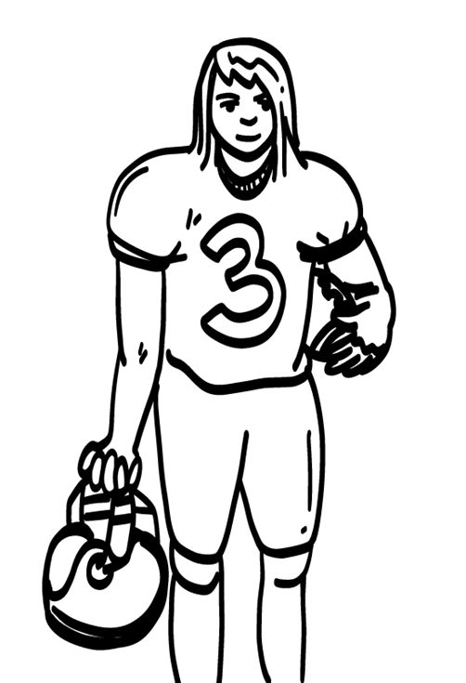
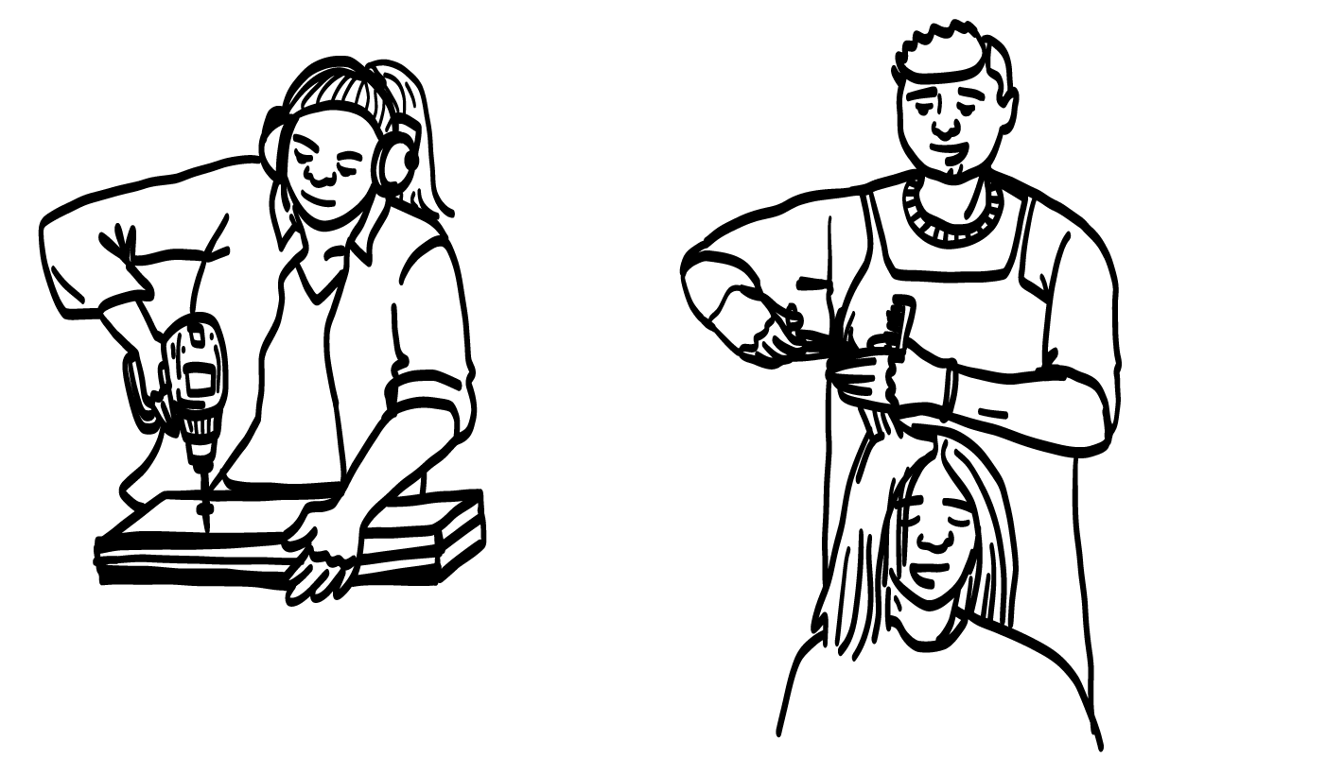
Gender and jobs: The truth.
© 2026 SAFE Disability Services Program
Notes:
Say: The truth is that people of all genders can do any job they want to do! Women might work in construction, or be plumbers, football players, or firefighters. Men might work with children or be hairstylists. It is not okay to tell someone they cannot do a job because of their gender.

Slide 21
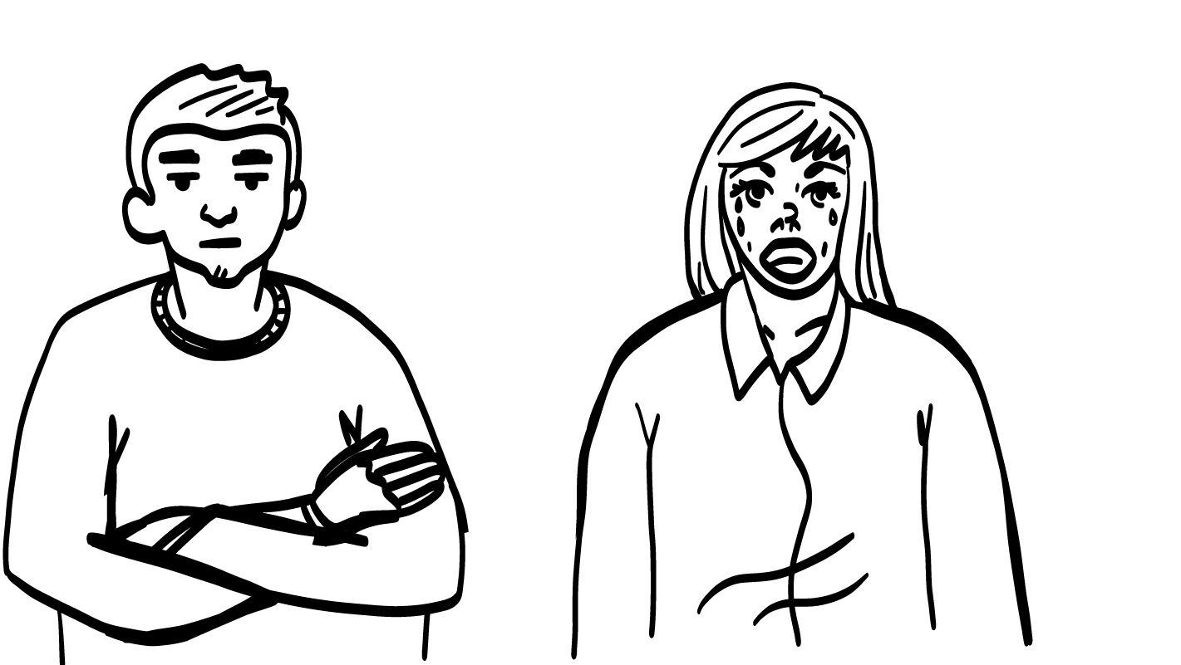
Gender and emotions:
What we hear.
© 2026 SAFE Disability Services Program
Notes:
Say: Let’s talk about one more type of stereotype before we take a break. Sometimes we also hear stereotypes about gender and emotion. Sometimes people say that women are really emotional, or that it is not okay for men to cry. What do you all think? Is this true? Give a thumbs up for yes and thumbs down for no.
Give students enough time to process the question and make their decisions. After students have weighed in, move to the next slide.

Slide 22
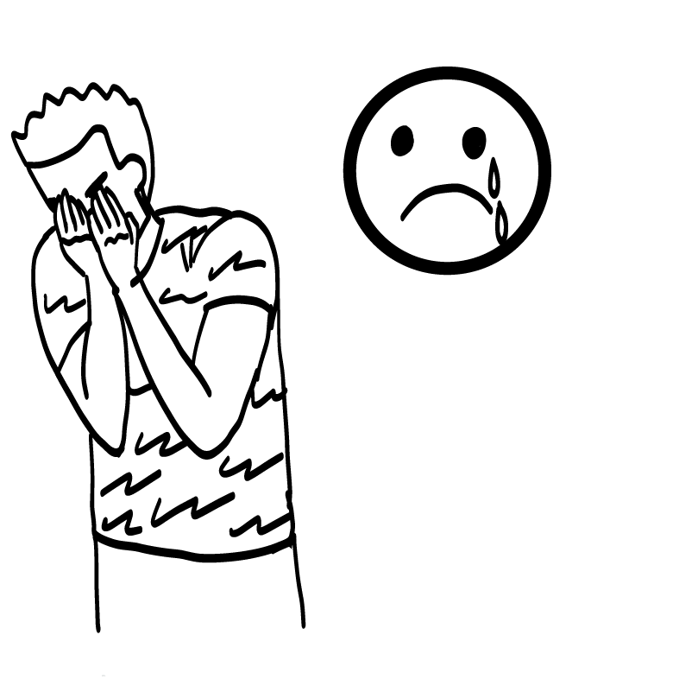

Gender and emotions: The truth.
© 2026 SAFE Disability Services Program
Notes:
Say: You’re right! That’s totally not true. Lots of women are the leaders in their countries. They are really strong and powerful. And it is totally normal and okay for men to show all emotions—including crying! People of all genders feel all emotions.

Slide 23
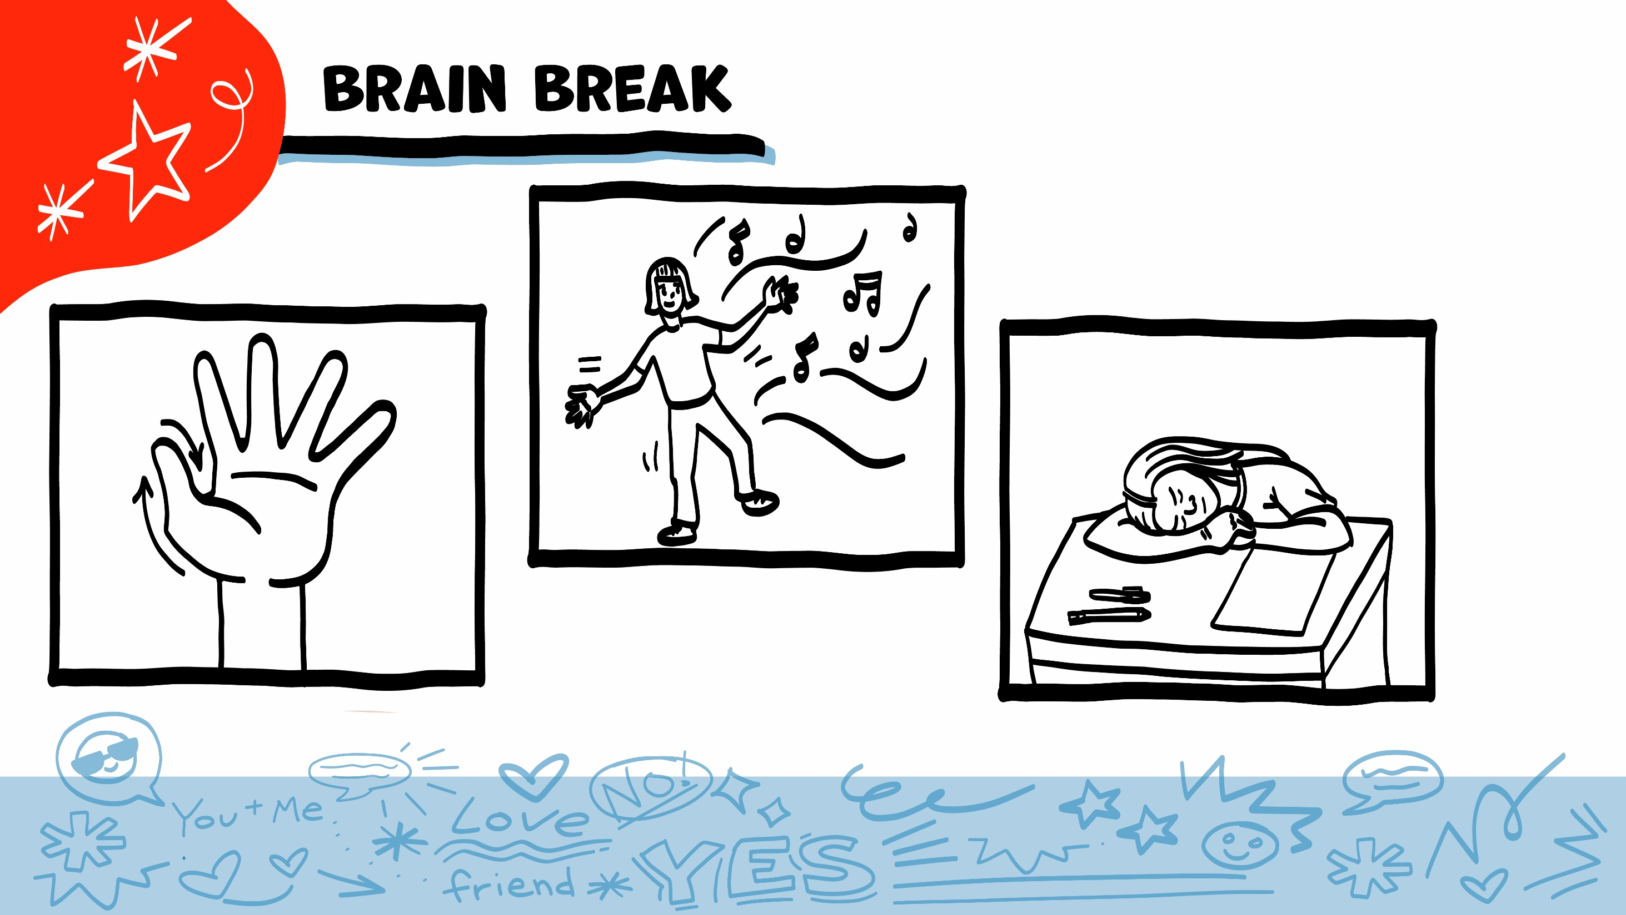
© 2026 SAFE Disability Services Program
Notes:
Say: That was a lot of information, and you all are doing an amazing job! Every week in class we will take a brain break in the middle. This is a chance to move a little and take a break from thinking!
Below are three ideas to give students a quick opportunity for a brain break. You are also welcome to come up with your own ideas for brain breaks that work best for your class.
Five finger breathing
For this exercise, have all students place their hand in front of their chest with their five fingers spread out. Next, use the pointer finger of the other hand to trace up and down each of the five fingers, beginning with the thumb. As students trace up a finger, they will breathe in. As they trace down a finger, they will breathe out. When students breathe out on the pinky finger, you can tell them to shake out their hands and arms. As the school year goes on, you can ask students to lead this exercise for their peers.
If this exercise is physically inaccessible for your class, you can also model the hand tracing for students while they breathe in and out.
Stretch break
Lead students through a series of basic stretches. These can be completed in a chair, or while standing up, depending on the accommodation needs of your class. Some ideas include reaching toward the ceiling, stretching one arm at a time across the chest, reaching toward toes, turning head from side to side, etc. Ask students to hold a pose while you count to ten. As the school year goes on, you can ask students to lead stretches for their peers.
Dance party
If your class likes to dance, you can put on a short song for them to dance to. This is especially effective if you are able to find a song that relates to the theme for that week’s class.

Slide 24
Woman
Man
Gender and Pronouns
Non-binary
Gender Stereotypes
Brain break
Gender Stereotypes and Safety
Stereotypes
Game
True
False
© 2026 SAFE Disability Services Program
Notes:
Say: We’ve talked about a lot of gender stereotypes so far in class. Now we are going to talk about how gender stereotypes impact safety.

Slide 25
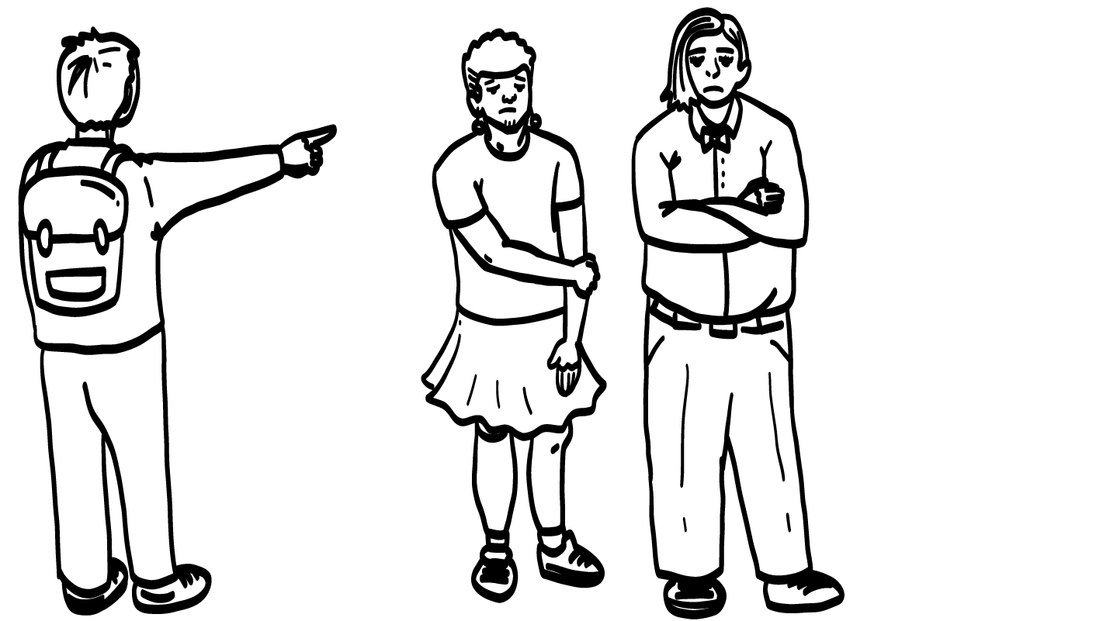
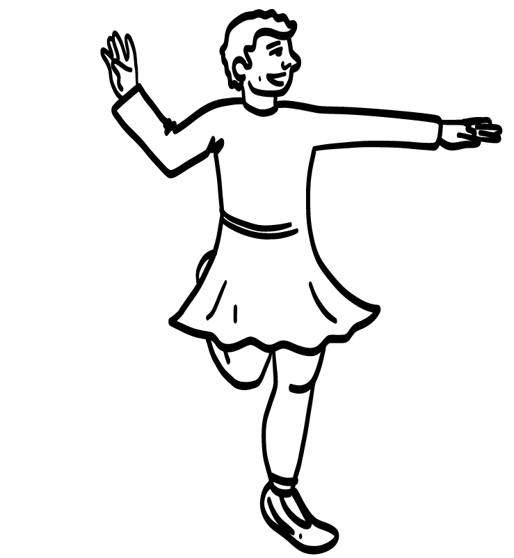
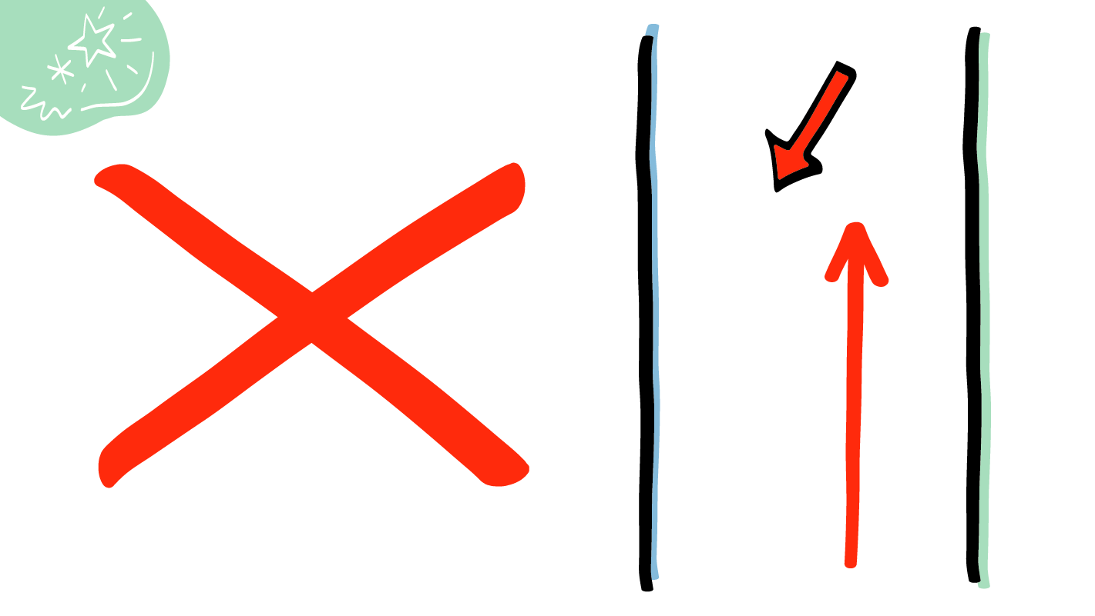
Gender Stereotypes and Bullying
Ha-ha, you are weird!
© 2026 SAFE Disability Services Program
Notes:
Say: Sometimes when people do something that is different than a gender stereotype, they get bullied. For example, if a man likes to paint his nails or do ballet, someone might make fun of him. This is not cool. It is never okay to make fun of someone or bully them.
If someone is making fun of you for doing something you love, how can you get help? Who could you talk to?
Give students enough time to process the question and make their decisions.
Say: You can talk to an adult in your inner green circle of trust.

Slide 26
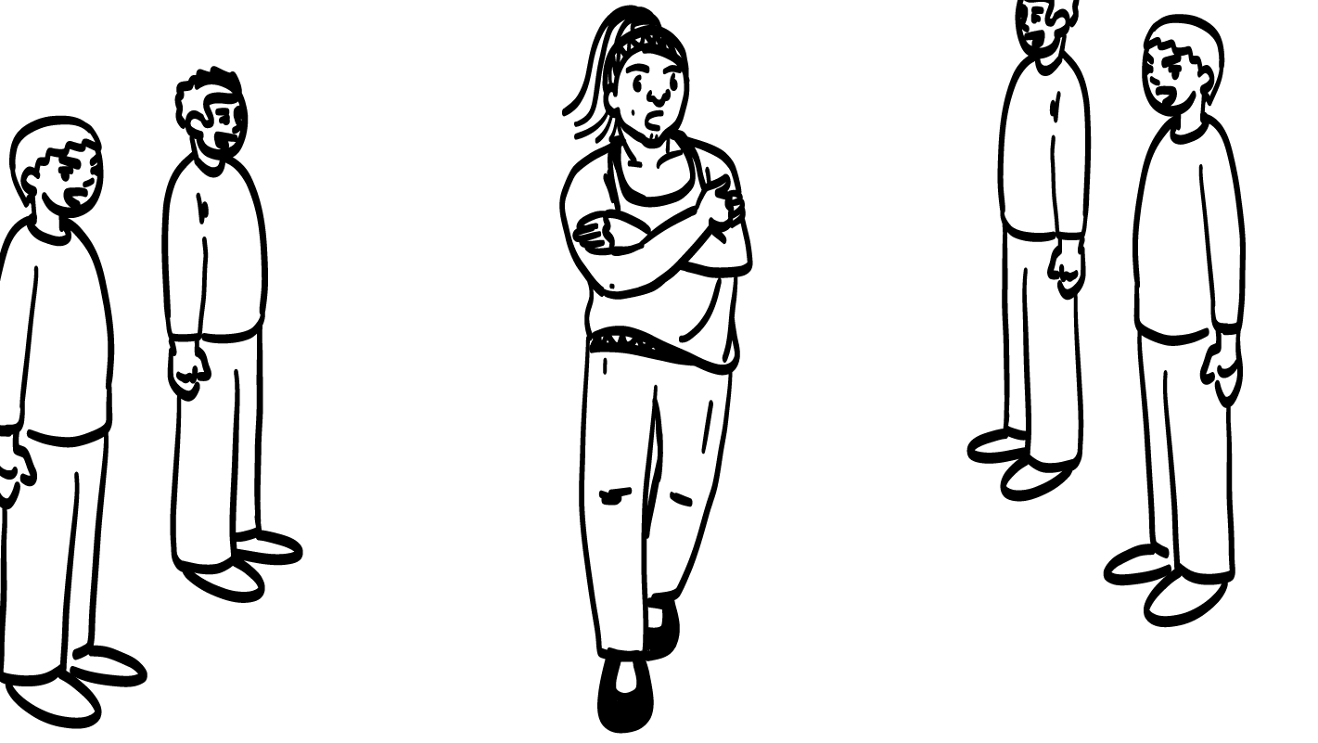
Gender stereotypes and safety: Harassment.
Hey sexy!
Nice butt!
© 2026 SAFE Disability Services Program
Notes:
Say: Gender stereotypes can also make women feel unsafe. Sometimes gender stereotypes cause men to talk about the way women’s bodies look or do something called catcalling. Catcalling is when someone yells things at a person on the street. They might yell things like, “Where you going beautiful?” or “Can you smile for me?”
Take a look at the face of the woman on the screen. How does it seem like she is feeling?
Give students enough time to process the question and make their decisions.
Say: This woman looks like she is scared and uncomfortable. Talking about a woman’s body can make her feel really unsafe. It is not okay to stare at someone’s body or to make comments about their body. This is something called sexual harassment, which we will talk about more in another class.

Slide 27
Woman
Man
Gender and Pronouns
Non-binary
Gender Stereotypes
Brain break
Gender Stereotypes and Safety
Stereotypes
Game
True
False
© 2026 SAFE Disability Services Program
Notes:
Say: Now that we’ve talked a lot about gender stereotypes, it’s time to play a game.

Slide 28
Stereotypes Game
???
???
???
© 2026 SAFE Disability Services Program
Notes:
Say: I am going to read something on each of the following slides. If you think what I read is true, give a thumbs up. If you think it is not true, give a thumbs down. This will help us think about the stereotypes we hear about men and women and dating.

Slide 29
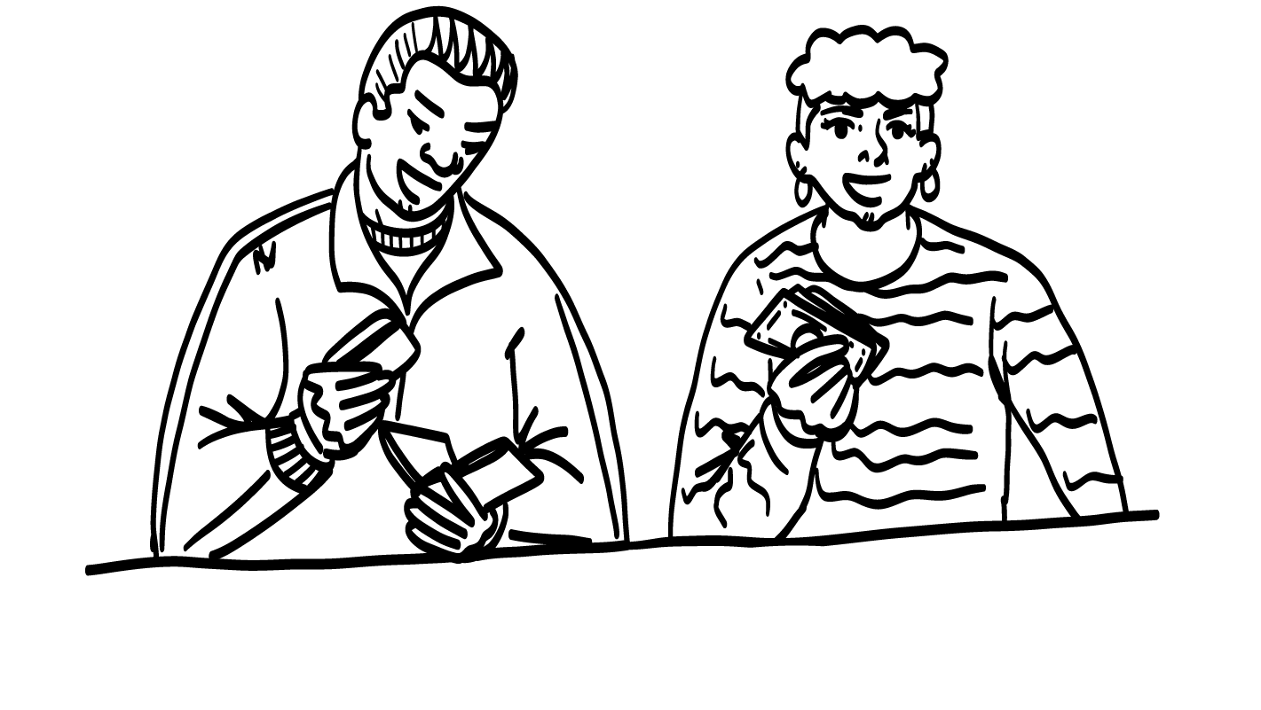


Men always have to pay for the date.
$$$$$
True
False
© 2026 SAFE Disability Services Program
Notes:
Say: In a dating relationship, men always have to pay for the date. Is that true? Give a thumbs up for yes and a thumbs down for no.
Give students enough time to process the question and make their decisions. After students have weighed in, move to the next slide.

Slide 30
Both people can pay for dates!
© 2026 SAFE Disability Services Program
Notes:
Say: This is not true! Some couples will take turns paying for dates. Others will split the cost of the date. It is not fair to always expect the man to pay for a date.

Slide 31
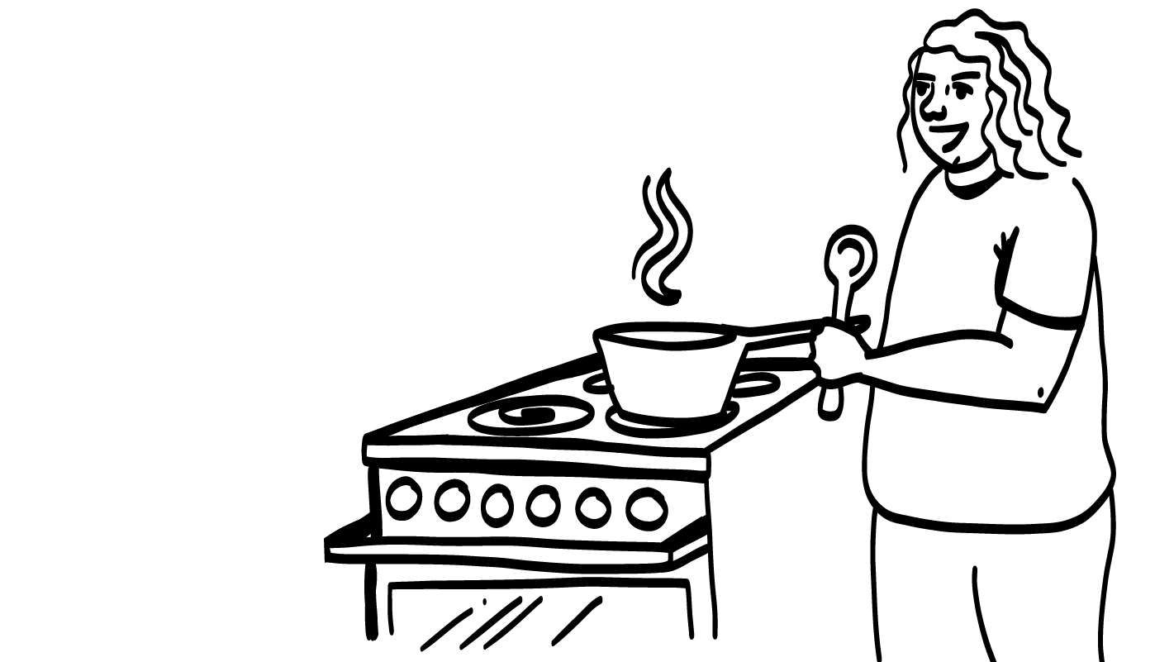
Women should do all the cooking and cleaning in a relationship.
True
False
© 2026 SAFE Disability Services Program
Notes:
Say: Women should do all the cooking and cleaning in a relationship. Is that true? Give a thumbs up for yes and a thumbs down for no.
Give students enough time to process the question and make their decisions. After students have weighed in, move to the next slide.

Slide 32

Both people should cook and clean!
© 2026 SAFE Disability Services Program
Notes:
Say: No way! This is a gender stereotype. It is not fair to expect women to do all of the cooking and cleaning in a relationship. Both people need to work together to cook and keep things clean.

Slide 33


Do what I say!
Women should listen to men in a relationship. The man is
the boss.
True
False
© 2026 SAFE Disability Services Program
Notes:
Say: Women should listen to men in a relationship. The man is the boss. Is that true? Give a thumbs up for yes and a thumbs down for no.
Give students enough time to process the question and make their decisions. After students have weighed in, move to the next slide.

Slide 34
Great idea!
Let’s do this
together!
No one is the boss in a healthy relationship!
© 2026 SAFE Disability Services Program
Notes:
Say: No! No one is the boss in a healthy relationship. Both people should listen to each other and make decisions together.

Slide 35

Only a man can mow the grass.
True
False
© 2026 SAFE Disability Services Program
Notes:
Say: Let’s do one more. Only a man can mow the grass. Is that true? Give a thumbs up for yes and a thumbs down for no.
Give students enough time to process the question and make their decisions. After students have weighed in, move to the next slide.

Slide 36


People of all genders can mow the grass!
© 2026 SAFE Disability Services Program
Notes:
Say: Nope, that’s a gender stereotype, too. People of all genders can mow the grass.

Slide 37


© 2026 SAFE Disability Services Program
Notes:
Say: Does anyone have any questions about today’s class? Remember, if you don’t want to ask your question out loud, you can write it on a notecard and leave it on your desk. You can also ask someone you trust to help you write your question on the notecard. I will pick up the notecards and will answer the questions the next time we meet. When I answer a question, I won’t tell anyone who asked it.

Slide 38



Are stereotypes things that are
true about groups of people?
YES
NO
© 2026 SAFE Disability Services Program
Notes:
Say: Are stereotypes things that are true about groups of people? Give a thumbs up for yes and a thumbs down for no.
Give students enough time to process the question and make their decisions.
Say: No. Stereotypes are things that people say about groups of people that are not all true.

Slide 39
Is it okay for men to cry?
YES
NO
© 2026 SAFE Disability Services Program
Notes:
Say: Is it okay for men to cry? Hold a thumbs up for yes and a thumbs down for no.
Give students enough time to process the question and make their decisions.
Say: Yes, it is okay for people of all genders, including men, to cry when they feel big emotions. Saying that men should not cry is a gender stereotype. It is not true.

Slide 40
Is it okay to catcall, or yell things, at a woman or man walking down the street?
YES
NO
© 2026 SAFE Disability Services Program
Notes:
Say: Is it okay to catcall, or yell things, at a woman or man walking down the street? Hold a thumbs up for yes and a thumbs down for no.
Give students enough time to process the question and make their decisions.
Say: No, this is not okay. This can makes women or men feel really unsafe.

Slide 41



© 2026 SAFE Disability Services Program
Notes:
Say: If you are being hurt, or if someone ever touches your body in a way that you don’t like, you can get help. You did not do anything wrong, and you are not alone. You can get help by talking to an adult from your inner green circle of trust. If someone you care about is being hurt, you can also get help by talking to an adult from your inner green circle of trust. If an emergency is happening, you can always call 911. If you call 911 for help, a police officer or an ambulance might come.
If the first person you tell doesn’t believe you or doesn’t get you help, keep telling adults you trust what is going on until you get the help you need.

Slide 42

© 2026 SAFE Disability Services Program
Notes:
Say: Does anyone remember what our power statement is? Our power statement is “I know me best.” This means that each of you knows yourself better than anyone else does. Today you learned the truth about gender stereotypes. Let’s gather together and on the count of three, say our power statement.
Have each interested student put one hand in the middle of the circle. Ask for a student volunteer to count to three. After three, all participants say the power statement while lifting their hands into the air. Students can also stand in the circle without touching hands if they prefer.

Slide 43

This work is supported by the Texas Council for Developmental Disabilities through a grant from the U.S. Administration for Community Living (ACL), Department of Health and Human Services (HHS), Washington, D.C. 20201 with a 100% federal funding award totaling $6,161,072. Council efforts are those of the grantee and do not necessarily represent the official views of nor are endorsed by ACL, HHS, or the U.S. government.
© 2026 SAFE Disability Services Program
Notes:
SAFE would like to thank the Texas Council for Developmental Disabilities for the funding for this curriculum.

Slide 44

This curriculum is offered online at no cost. You are free to use the resources in the original format for educational purposes only. Please reference The SAFE Alliance appropriately (citations at bottom of page).
We ask that you do not alter curriculum images/art, slides, or lesson plan materials. You may not use My Rights My Life (18+ or High School) curriculum for commercial purposes (i.e., selling workshops you facilitate based on MRML curriculum; and/or creating links/websites to re-distribute any materials associated SAFE’s My Rights My Life).
This resource, My Rights My Life: A curriculum for healthier relationships for high school students (grades 9-12) is based on the original My Rights My Life: A curriculum for safer relationships (age 18+) written by Megan Westmore, Heidi Lersch, and edited by Schwartz, M. (2022). Selling materials from MRML is a copyright violation.
Burleson, Anna Belle & Benitez, Sophie (2026) provided light modification and abbreviated the original curriculum
(Westmore & Lersch, 2022) to offer an age appropriate resource for High School Students (grades 9-12).
Schwartz, M. (Ed.). The SAFE Alliance, Austin, Texas.
Westmore, M. & Lersch, H. (2022). My rights my life: A curriculum for safer relationships.
Schwartz, M. (Ed.). The SAFE Alliance: Austin, TX.
© 2026 SAFE Disability Services Program

