Slide 1
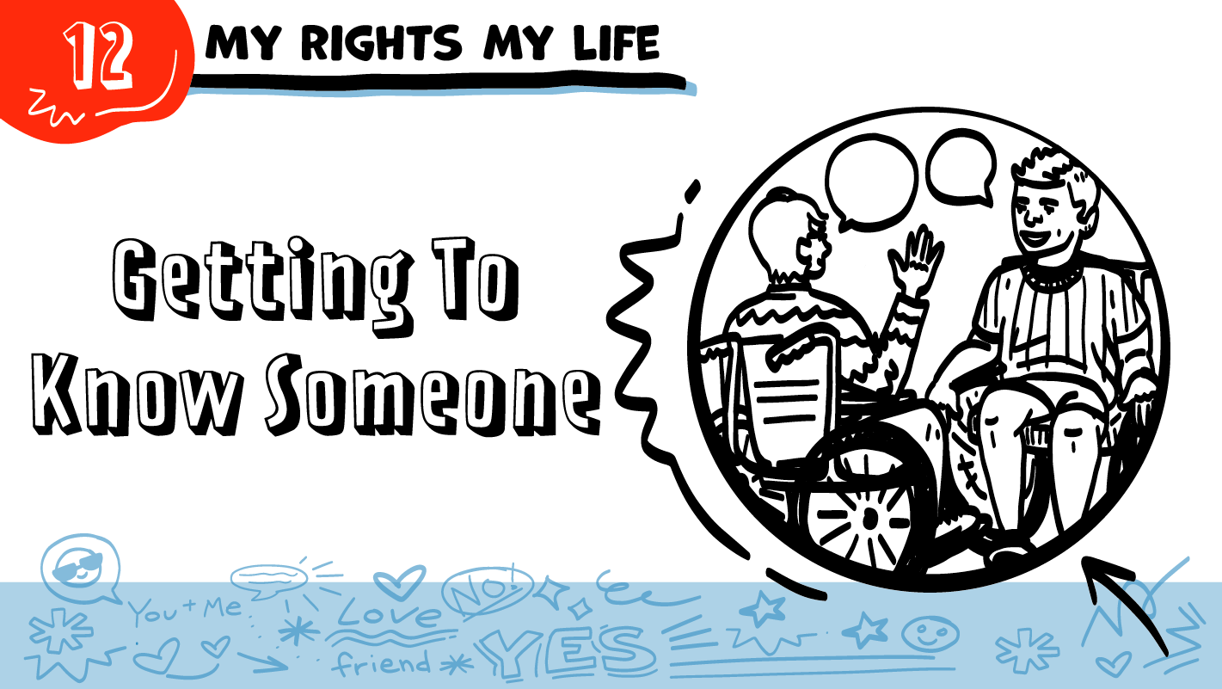


for High School Students
Hi!
Hi!
© 2026 SAFE Disability Services Program
Notes:
Repetition is beneficial for learning. Take time to review the last My Rights My Life class you taught prior to beginning this session. You can also answer any private questions students submitted on notecards during your previous class session.
Say: This class is all about relationships. To start us off, we are going to talk about how you meet new people, and safer ways to get to know someone.

Slide 2
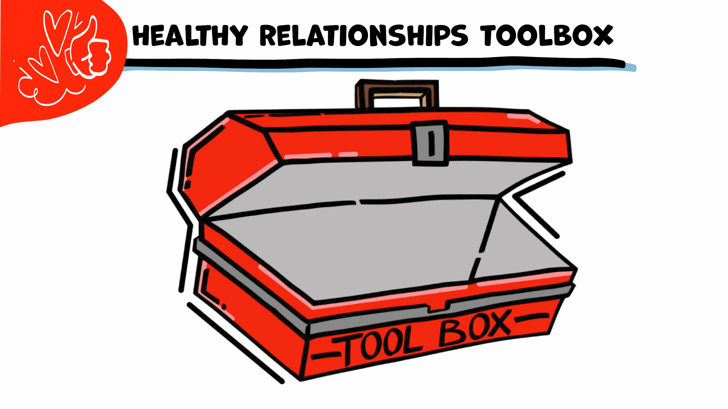
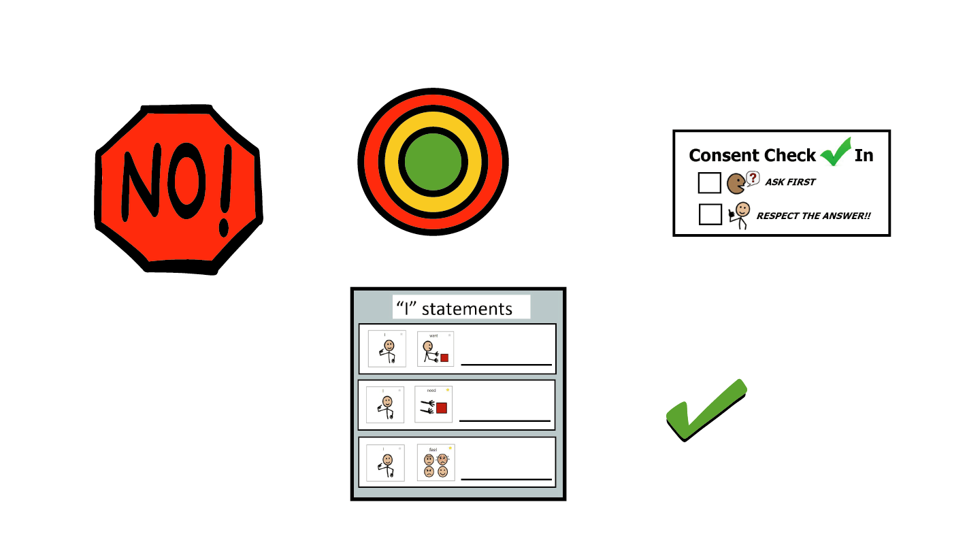
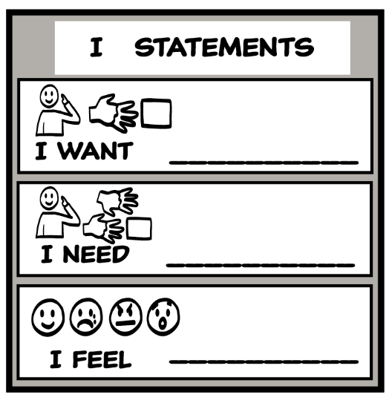
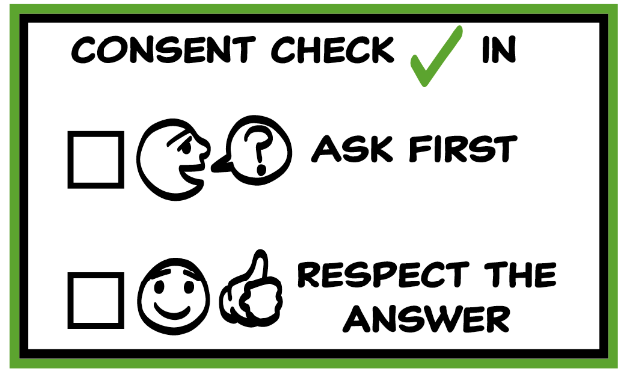
© 2026 SAFE Disability Services Program
Notes:
Use the large class Healthy Relationship Toolbox to review the Healthy Relationship Tools (I Statement, Relationship Map, NO!, and Consent Check-In). You can ask students to pull off one tool at a time and discuss what it is and how it is used. It can be particularly helpful for this review if you give students specific scenarios to think through. For example, you might ask, “If your friend lies to you, what is one I Statement you could use to tell your friend how you feel?” You may even consider using examples of situations that have recently occurred in your classroom, as long as doing so does not break student confidentiality. You can also ask students to connect the toolbox tools to their current relationships. You might say, “Can anyone volunteer and tell me about something going on in your life right now that the toolbox could help you with?”
Instructions for how to use each Healthy Relationship Tool can be found in the following classes:
I Statements: Classes 2 and 3
Relationship Map: Class 4
NO!: Class 5
Consent Check-In: Class 6

Slide 3

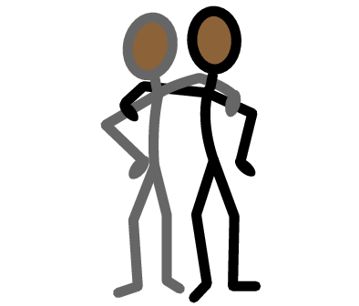



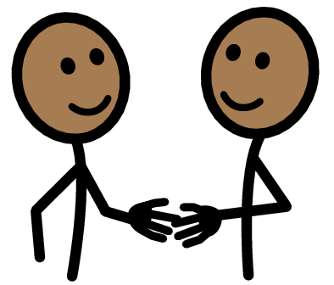


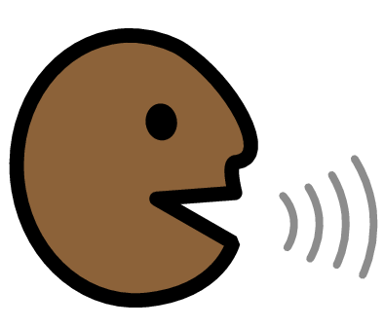


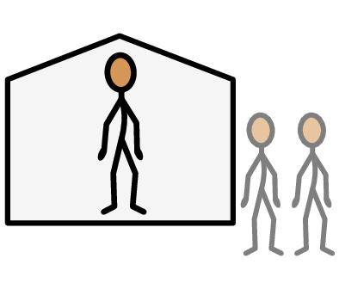


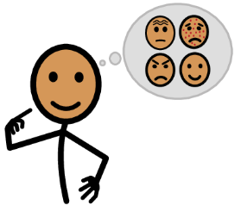




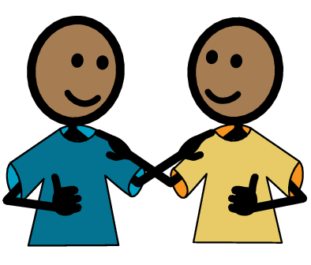
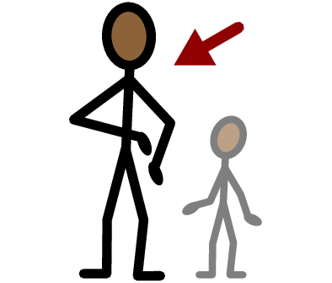
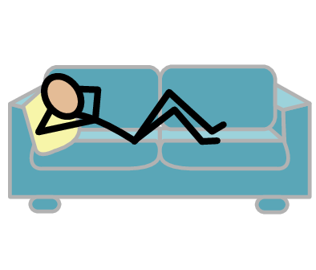
Relationship
Friend
Online
Meet
Ask
Yes
No
Talk
Stranger
Public
Private
I need help
I have a question
Trust
Adult
Take a break
I feel
Happy
Sad
Mad
Scared
Copyright © 2021 SymbolStix, LLC. All rights reserved. Used with Permission.
Notes:
You can print this slide separately so each student can use the Important Words Sheet as a communication board throughout class. Review the words using the suggested definitions below. To enhance understanding, you can ask students to come up with their own definitions for vocabulary words or to provide a sentence or scenario using the new word.
Relationship: two or more people who know each other; some types of relationships include family, friends, and coworkers
Friend: someone you like to spend time with
Stranger: a person you do not know
Meet: when you first talk to someone new
Ask: talking to someone to get an answer
Talk: when you use your words, signs, or pictures to tell someone something
Online: something that is on the internet
Public: places where other people can come in and out and there are sometimes a lot of people, like a mall; or things online that other people can see
Private: places where other people need your consent to come in and out, like your bedroom; or things online that only you can see

Slide 4
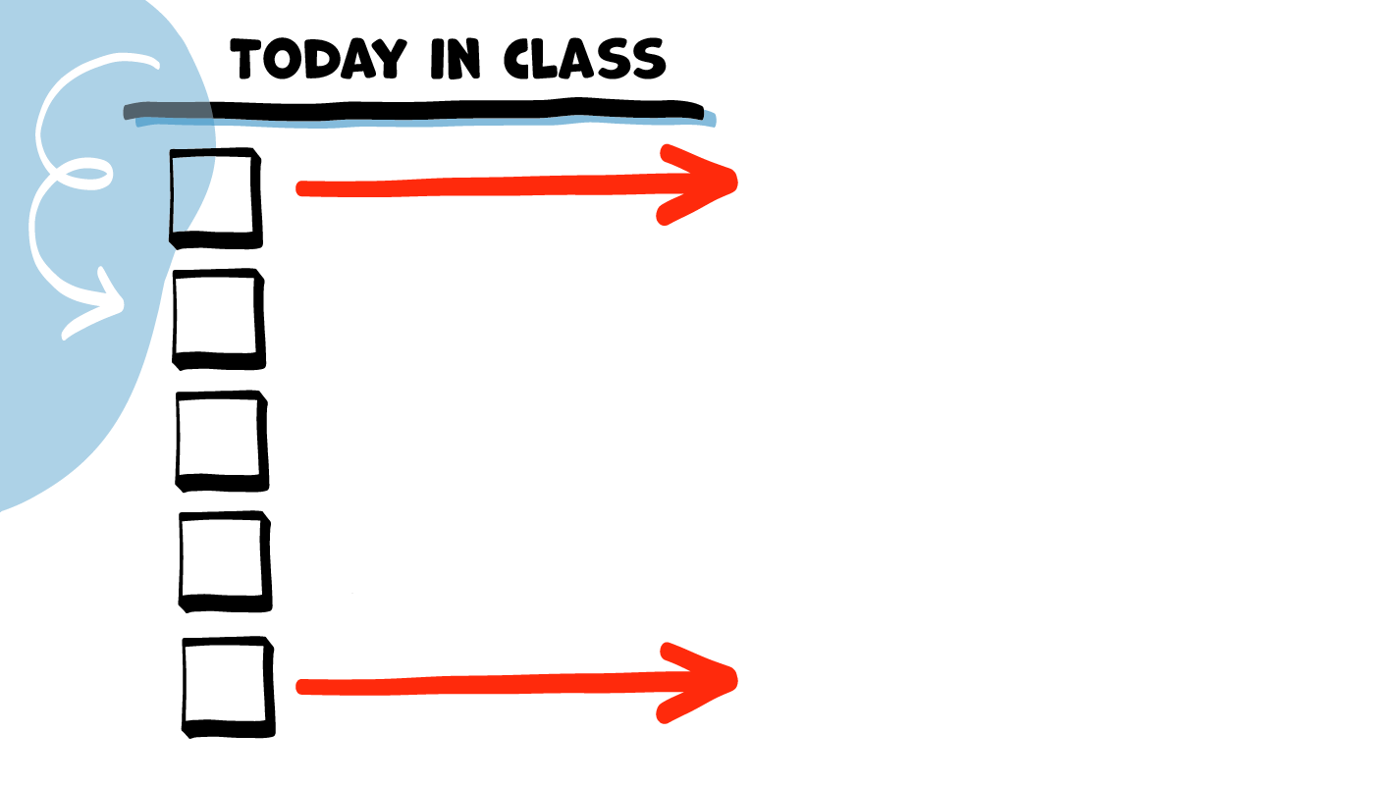
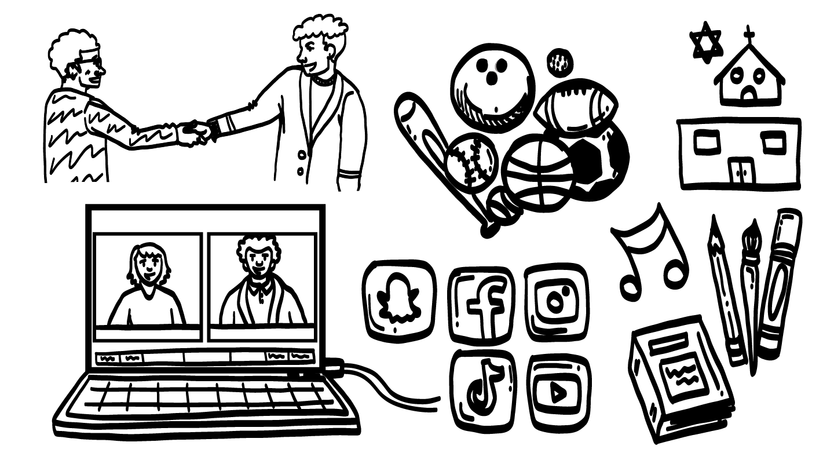
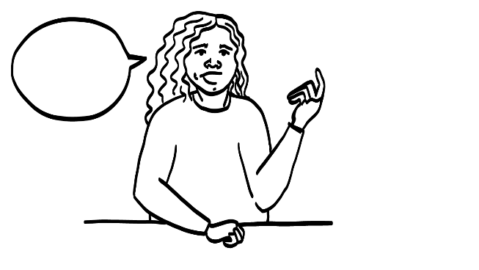
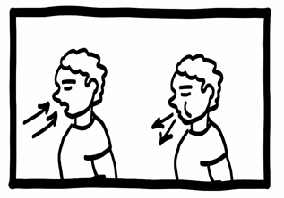
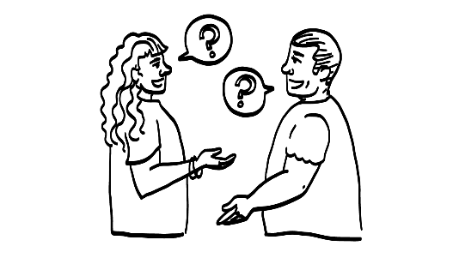

Meeting New People
Okay to Ask?
Brain break
Getting to Know Someone Practice
Moving Into Yellow
and Green Circles
© 2026 SAFE Disability Services Program
Notes:
Read the agenda. Alternatively, you can ask for a student volunteer to read the agenda.

Slide 5
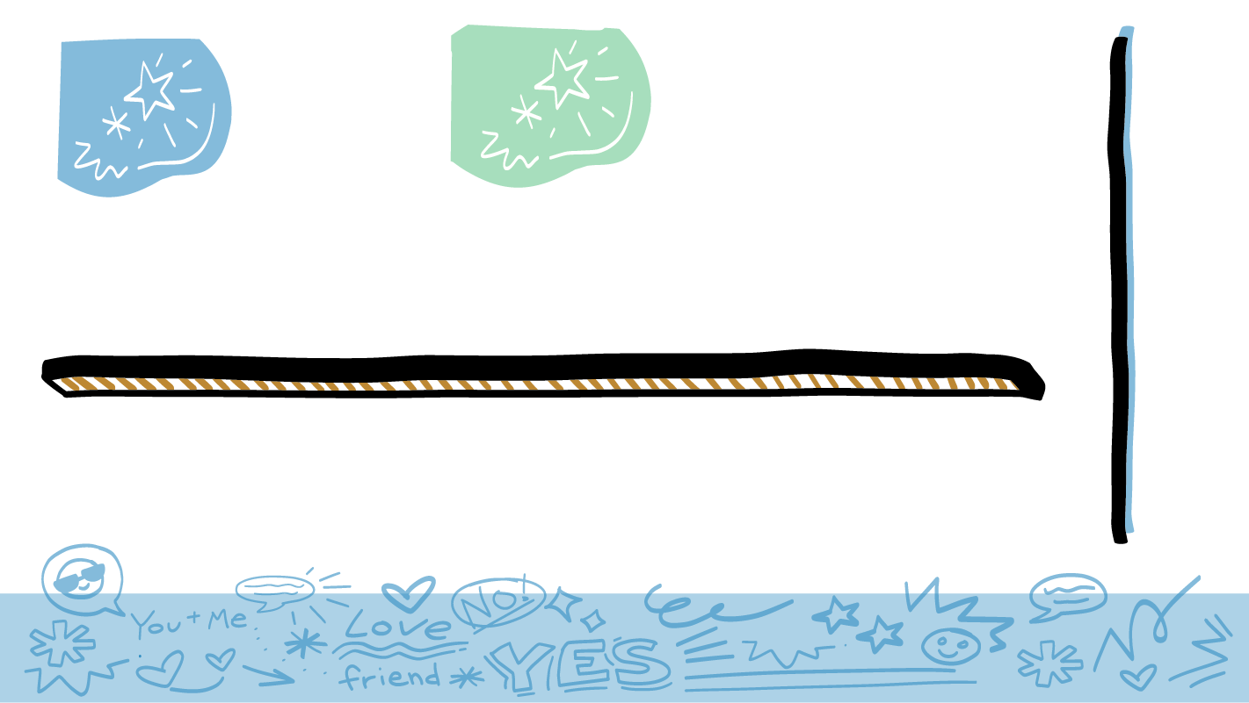
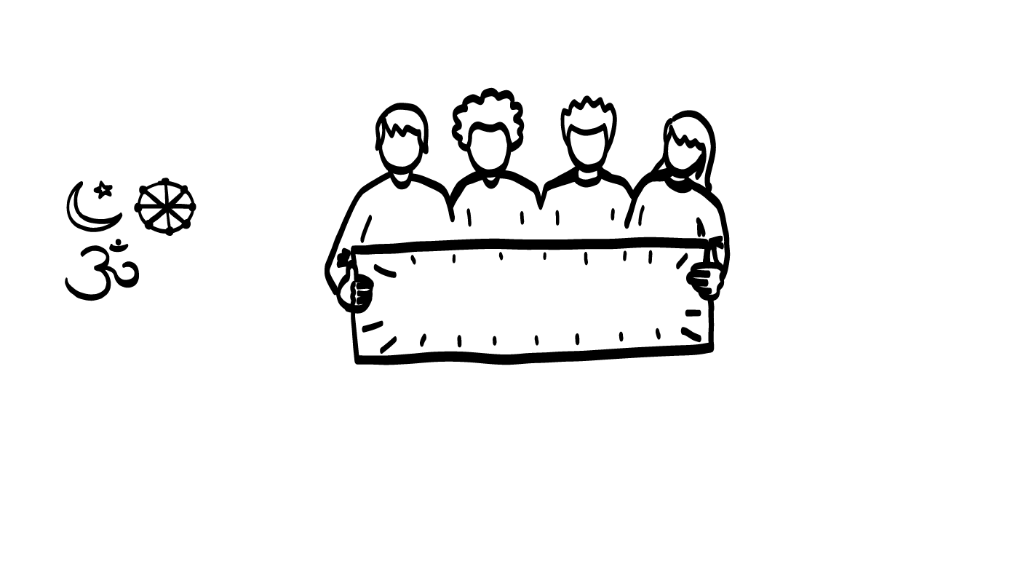
Where do you meet new people?
Self-advocacy group!
© 2026 SAFE Disability Services Program
Notes:
Say: Where do you meet new people? This could be in-person or online. Let’s make a list of places.
Give students enough time to process the question and make their decisions. As students name out places, write them on the board or a piece of chart paper. Some potential answers include book clubs, sports teams, religious organizations, social media, or self-advocacy groups.

Slide 6

Where are new people on your Relationship Map?
People you have just met go in the outer red circle on your
Relationship Map.
© 2026 SAFE Disability Services Program
Notes:
Say: When you meet someone new, where do they go on your Relationship Map?
Give students enough time to process the question and make their decisions.
Say: People you have just met go in the outer red circle on your Relationship Map. This does not automatically mean that they are dangerous. It just means that you don’t know them and can’t trust them yet. You do not know if they are a safe person or not.

Slide 7
If you have only ever talked to someone online, where are they on your Relationship Map?
People you have only talked to online and never met in person are in your can’t trust yet outer red circle.
© 2026 SAFE Disability Services Program
Notes:
Say: Sometimes people meet other people online. If you have only ever talked to someone online, where are they on your Relationship Map?
Give students enough time to process the question and make their decisions.
Say: They are in the outer red circle of people you can’t trust yet because you don’t know them. You can’t really know who someone until you have met them in-person and spent a lot of time with them. The only way to know for sure who someone you have only talked to online is, is to meet them in-person. Until you meet them in-person, they stay in your outer red circle. Even if you think they are really cool or really cute, or you’ve been talking to them for several weeks, they are still in your outer red circle.
We are going to talk next about safer ways to meet in-person with someone you met online.

Slide 8
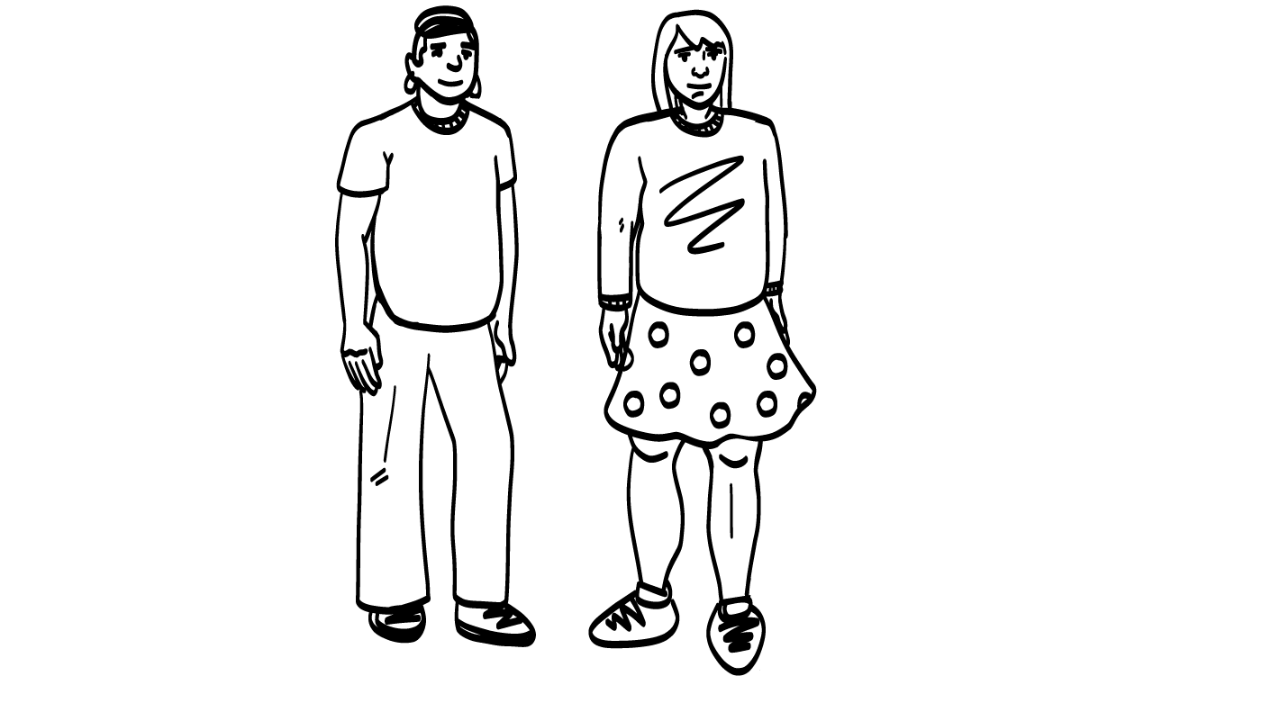

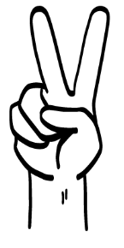
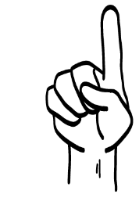
Is it safer to go by yourself or to bring an adult you trust if you are meeting someone you only know online?
Bring an adult you trust
Alone
© 2026 SAFE Disability Services Program
Notes:
Say: If you are going to meet in-person with someone you met online, is it safer to go by yourself or to bring an adult you trust with you? Hold up one finger for alone and two fingers for with an adult you trust.
Give students enough time to process the question and make their decisions.
Say: You should bring an adult you trust with you to the meeting.

Slide 9
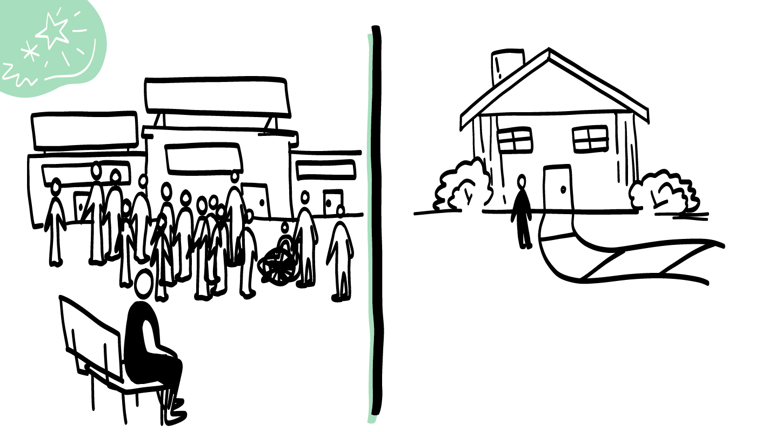
Is it safer to meet in a public place or private place when you meet someone you only know online?
Public
Private
© 2026 SAFE Disability Services Program
Notes:
Say: If you are going to meet in-person with someone you met online, is it safer to meet in a public place where there are lots of people around, or a private place where it is just the two of you?
Give students enough time to process the question and make their decisions.
Say: It is safer to meet in a public place where there are lots of other people around. Even though you are going to bring an adult you trust, you want there to be other people who you can go to if you need help. For example, if you meet at a coffee shop and things start to feel weird or unsafe, you could go to an employee and ask for help.
You should never invite someone you have only talked to online to your house. It is also not safe to go to their house. Never get in a car with someone you’ve only ever talked to online. Remember, they are in your outer red circle of people you don’t really know yet and you can’t trust yet.

Slide 10
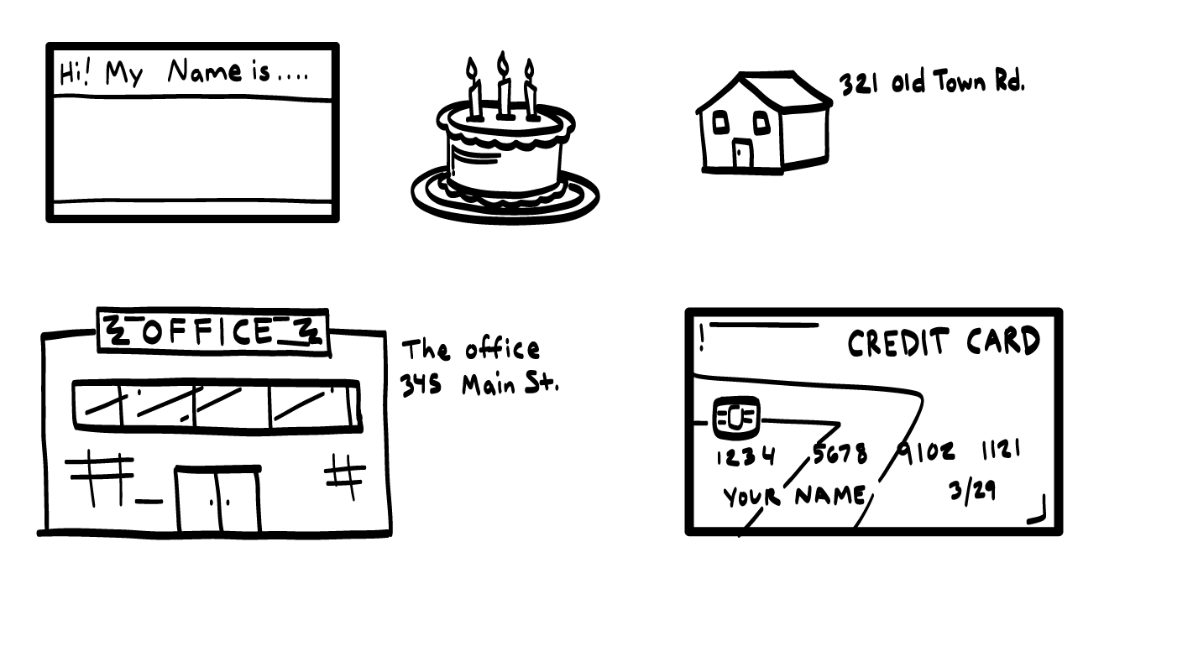
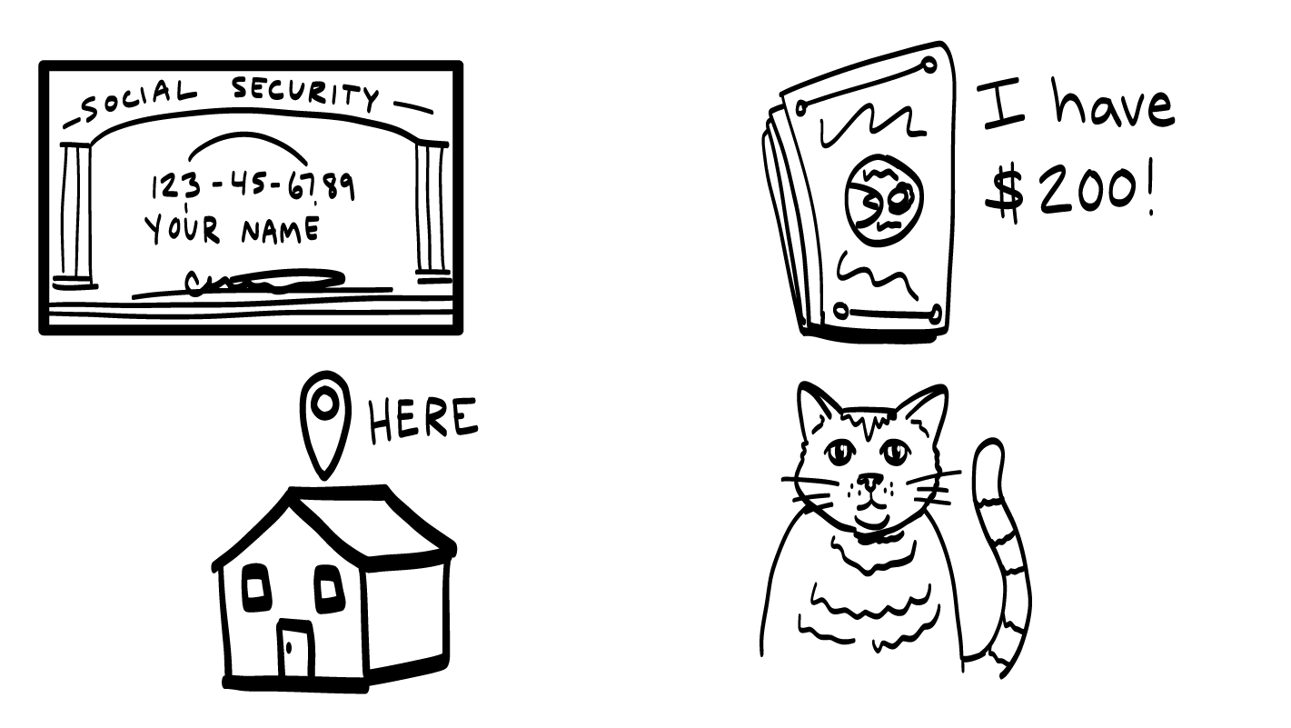
Things you should not share with someone in your red circle.
© 2026 SAFE Disability Services Program
Notes:
Say: To be safer, there are some things you should not share with someone you are just getting to know for the first time. You should never share private information like your last name, your age, or your address with someone in your outer red circle, because you can’t trust them. They might use that information to hurt you. You also should not share anything like a credit card, your ID, or social security numbers with someone you do not know if you can trust. These are people in your outer red circle of people you don’t know yet or don’t know well.
If you aren’t sure if it is okay to share something with someone in your outer red circle, ask an adult you trust from your inner green circle of trust for help.

Slide 11
Meeting New People
Okay to Ask?
Brain break
Getting to Know Someone Practice
Moving Into Middle (yellow) and Inner Circles (green) circles
© 2026 SAFE Disability Services Program
Notes:
Say: One way you might get to know someone new is by asking them questions. We are going to talk next about questions that are okay and safe to ask someone that you do not know yet. These are people in your outer red circle, and what questions are too personal or creepy to ask someone in your outer red circle.

Slide 12


Okay to ask?
YES
NO
© 2026 SAFE Disability Services Program
Notes:
Write “Yes” on one side of the board and “No” on the other.
Say: In just a minute, you are going to find a partner. I am going to give you and your partner a card with a question on it. I want you to think about if this question is okay and safe to ask someone in your outer red circle of people you don’t yet know enough to trust, or if the question is too personal or too creepy. If the question is okay to ask, tape it under the word “Yes.” If it is not okay to ask, tape it under the word “No.”
Assist students as needed to find a partner. Pass out Okay to Ask? Activity Cards to student pairs (see template at end of lesson plan). After all students have taped up their cards, use the next slides to go through the questions as a class.(

Slide 13
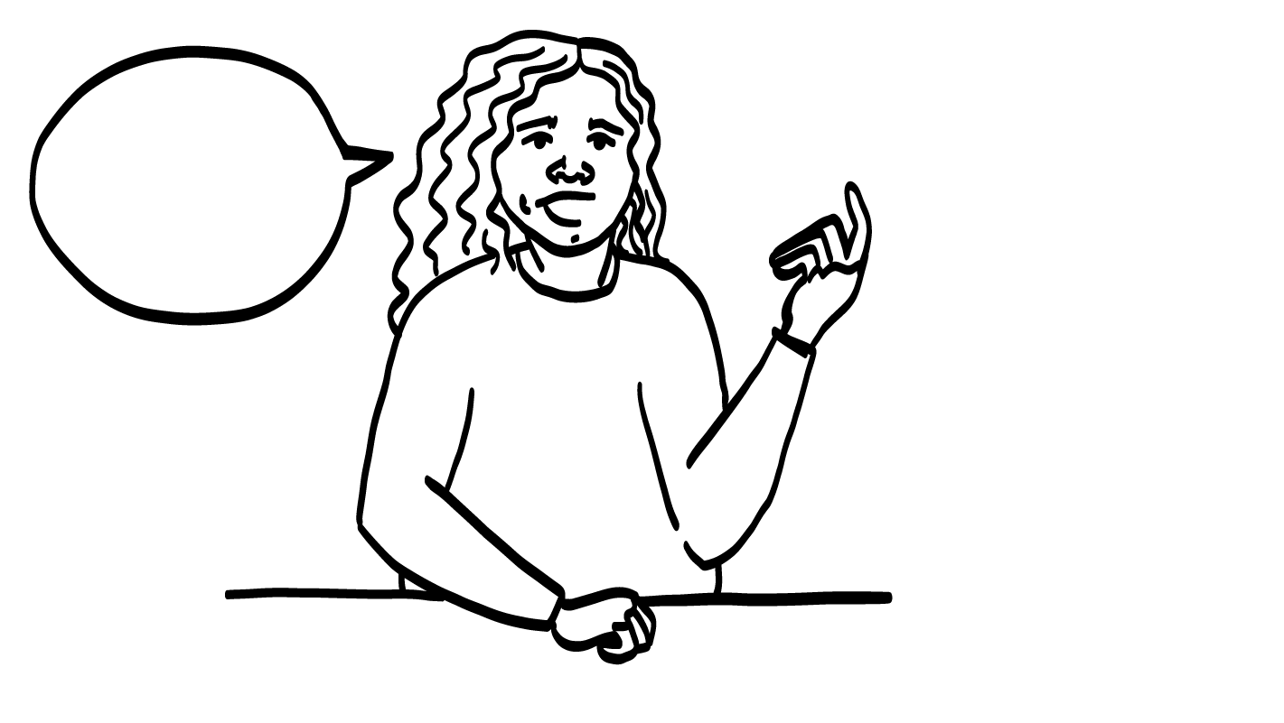


How are you?
Okay to ask?
YES
NO
© 2026 SAFE Disability Services Program
Notes:
There is one PowerPoint slide for each of the Okay to Ask? Activity Cards. After you display the slide, look to see where the corresponding card is on the chart paper. Ask your class to give a “thumbs up” if they agree with the placement of the card, or a “thumbs down” if they don’t. Ask students to explain their thoughts if there is disagreement. If needed, move the Okay to Ask? Activity Card to the correct side.
Sample talking points:
Asking “How are you?” is a great way to start a conversation with someone new.
This question is not too personal.

Slide 14
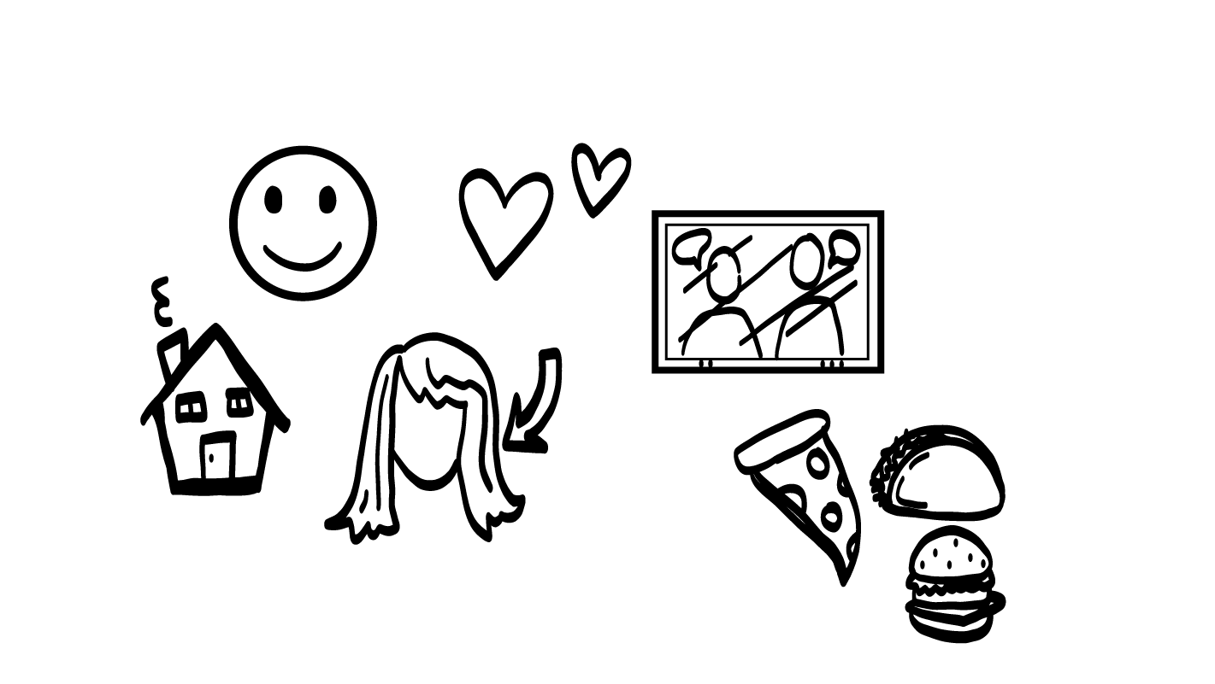
Can I touch your hair?
Okay to ask?
YES
NO
© 2026 SAFE Disability Services Program
Notes:
There is one PowerPoint slide for each of the Okay to Ask? Activity Cards. After you display the slide, look to see where the corresponding card is on the chart paper. Ask your class to give a “thumbs up” if they agree with the placement of the card, or a “thumbs down” if they don’t. Ask students to explain their thoughts if there is disagreement. If needed, move the Okay to Ask? Activity Card to the correct side.
Sample talking points:
Asking “Can I touch your hair?” is not a safe way to start a conversation with someone new.
This question is creepy.
The other person will probably feel weird, uncomfortable, or scared if you ask this.

Slide 15
Where do you live?
Okay to ask?
YES
NO
© 2026 SAFE Disability Services Program
Notes:
There is one PowerPoint slide for each of the Okay to Ask? Activity Cards. After you display the slide, look to see where the corresponding card is on the chart paper. Ask your class to give a “thumbs up” if they agree with the placement of the card, or a “thumbs down” if they don’t. Ask students to explain their thoughts if there is disagreement. If needed, move the Okay to Ask? Activity Card to the correct side.
Sample talking points:
Asking “Where do you live?” is not a safe way to start a conversation with someone new.
This question is too personal for someone in your red circle.

Slide 16
What do you like to do for fun?
Okay to ask?
YES
NO
© 2026 SAFE Disability Services Program
Notes:
There is one PowerPoint slide for each of the Okay to Ask? Activity Cards. After you display the slide, look to see where the corresponding card is on the chart paper. Ask your class to give a “thumbs up” if they agree with the placement of the card, or a “thumbs down” if they don’t. Ask students to explain their thoughts if there is disagreement. If needed, move the Okay to Ask? Activity Card to the correct side.
Sample talking points:
Asking “What do you like to do for fun?” is a great way to start a conversation with someone new.
This question is not too personal.

Slide 17
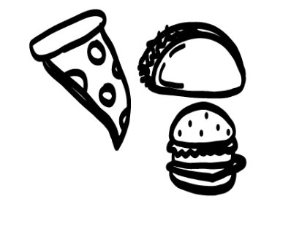
What is your favorite food?
Okay to ask?
YES
NO
© 2026 SAFE Disability Services Program
Notes:
There is one PowerPoint slide for each of the Okay to Ask? Activity Cards. After you display the slide, look to see where the corresponding card is on the chart paper. Ask your class to give a “thumbs up” if they agree with the placement of the card, or a “thumbs down” if they don’t. Ask students to explain their thoughts if there is disagreement. If needed, move the Okay to Ask? Activity Card to the correct side.
Sample talking points:
Asking “What is your favorite food?” is a great way to start a conversation with someone new.
This question is not too personal.

Slide 18
What T.V. shows do you like to watch?
Okay to ask?
YES
NO
© 2026 SAFE Disability Services Program
Notes:
There is one PowerPoint slide for each of the Okay to Ask? Activity Cards. After you display the slide, look to see where the corresponding card is on the chart paper. Ask your class to give a “thumbs up” if they agree with the placement of the card, or a “thumbs down” if they don’t. Ask students to explain their thoughts if there is disagreement. If needed, move the Okay to Ask? Activity Card to the correct side.
Sample talking points:
Asking “What TV shows do you like to watch?” is a great way to start a conversation with someone new.
This question is not too personal.

Slide 19
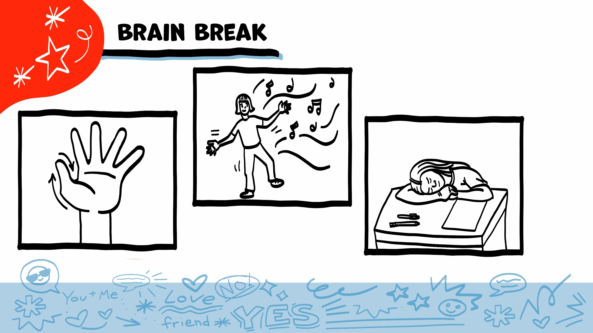
© 2026 SAFE Disability Services Program
Notes:
Say: That was a lot of information, and you all are doing an amazing job! Every week in class we will take a brain break in the middle. This is a chance to move a little and take a break from thinking!
Below are three ideas to give students a quick opportunity for a brain break. You are also welcome to come up with your own ideas for brain breaks that work best for your class.
Five finger breathing
For this exercise, have all students place their hand in front of their chest with their five fingers spread out. Next, use the pointer finger of the other hand to trace up and down each of the five fingers, beginning with the thumb. As students trace up a finger, they will breathe in. As they trace down a finger, they will breathe out. When students breathe out on the pinky finger, you can tell them to shake out their hands and arms. As the school year goes on, you can ask students to lead this exercise for their peers.
If this exercise is physically inaccessible for your class, you can also model the hand tracing for students while they breathe in and out.
Stretch break
Lead students through a series of basic stretches. These can be completed in a chair, or while standing up, depending on the accommodation needs of your class. Some ideas include reaching toward the ceiling, stretching one arm at a time across the chest, reaching toward toes, turning head from side to side, etc. Ask students to hold a pose while you count to ten. As the school year goes on, you can ask students to lead stretches for their peers.
Dance party
If your class likes to dance, you can put on a short song for them to dance to. This is especially effective if you are able to find a song that relates to the theme for that week’s class.

Slide 20
Meeting New People
Okay to Ask?
Brain break
Getting to Know Someone Practice
Moving Into Yellow
and Green Circles
© 2026 SAFE Disability Services Program
Notes:
Say: Now that we’ve talked about safer ways to get to know someone new, let’s talk about how to let someone know you are listening!

Slide 21

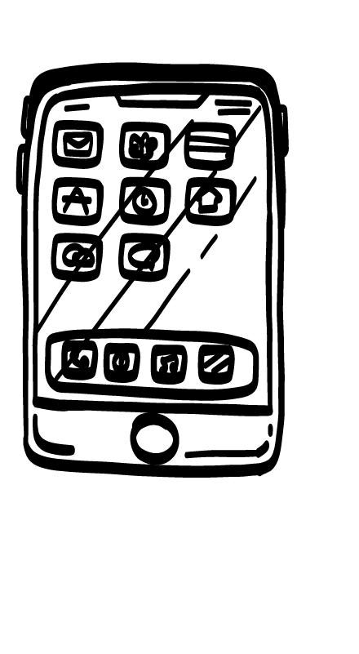
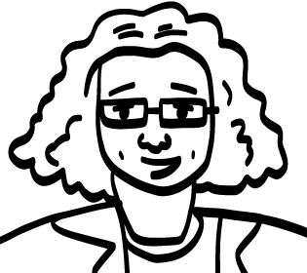
How do you show someone you are listening?
?
?
© 2026 SAFE Disability Services Program
Notes:
Say: As you are getting to know someone new, it’s important to really show them that you are listening. One way to let the other person know you are paying attention is to make eye contact. Not everyone likes to make eye contact though. What are other ways you can show someone that you’re paying attention?
Give students enough time to process the question and make their decisions. As students make suggestions, write their ideas on the board or a piece of chart paper. Some sample ideas are included below and on the slide:
Putting down your phone
Nodding your head
Asking questions about the thing the other person is talking about

Slide 22
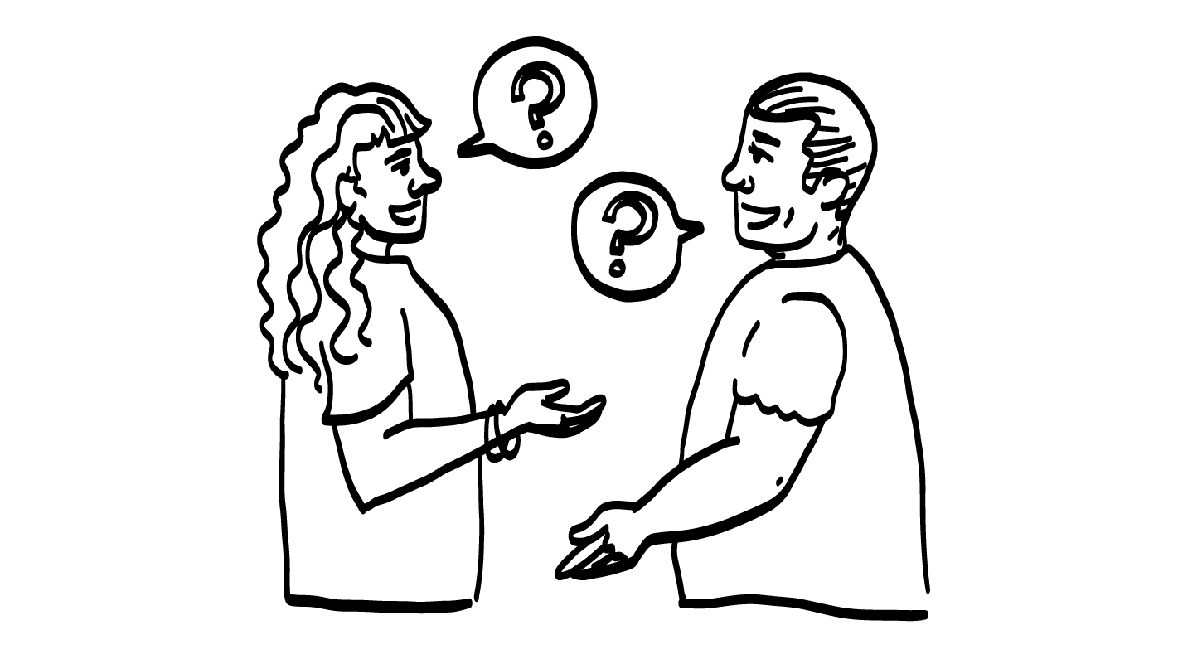
Practice!
  How are you?
  What do you like to do for fun?
  What is your favorite food?
  What TV shows do you like to watch?
© 2026 SAFE Disability Services Program
Notes:
Say: In just a minute, everyone is going to walk around the room and pretend like you are meeting each other for the first time. When you go up to someone, you can introduce yourself by saying hi and telling the other person your name. You might shake hands with each other but remember to ask for consent first. Then, you can ask one of the Ok to Ask questions on the screen. Make sure to show that you are paying attention as the other person answers. Then, you can switch roles. The person who just answered a question can ask the next question. Once both people have asked and answered questions, look for someone else to partner with. Keep talking to new people until I tell you to stop.
Support students as needed to practice their skills for approximately five minutes.

Slide 23
Meeting New People
Okay to Ask?
Brain break
Getting to Know Someone Practice
Moving Into Yellow
and Green Circles
© 2026 SAFE Disability Services Program
Notes:
Say: Great job practicing getting to know new people! The last thing we will do today is talk about how people you have just met move from your outer red circle of people you don’t know and can’t trust yet to your middle yellow circle of people you are getting to know and eventually to your inner green circle of people you trust.

Slide 24
Moving Into The Yellow Circle
  It takes weeks to months for someone to move from your outer red circle into your middle yellow circle.
© 2026 SAFE Disability Services Program
Notes:
Say: It takes a long time for someone to move into your middle yellow circle of people that you are getting to know, and for you to be able to start to trust that person. It doesn’t happen overnight! It takes weeks to months for you to get to know someone well enough for you to begin to trust them. And remember, if you’ve only ever talked to someone online, they stay in your outer red circle.
After weeks or months have gone by, someone you met may move into the yellow circle.

Slide 25
  If you aren’t sure if someone is in your yellow circle, who could you ask?
You can ask an adult from your inner green circle of trust.
© 2026 SAFE Disability Services Program
Notes:
Say: If you aren’t sure if someone is in your middle yellow circle, or if it’s safe to share information with someone, who could you ask?
Give students enough time to process the question and make their decisions.
Say: You can ask an adult from your inner green circle of trust.

Slide 26
Moving into the inner green circle of trust
  It takes months to years for someone to move from your middle yellow circle into your inner green circle of trust.
  Your inner green circle of trust is for close family or best friends you have known for a long time.
© 2026 SAFE Disability Services Program
Notes:
Say: You know and are getting to know and learning if you can trust people in your middle yellow circle. Over months to years, someone can move from your middle yellow circle of people you are getting to know into your close circle of people, your inner green circle of trust. This inner green circle of trust is for close family or best friends you have known for a long time, and you trust the most.
In today’s class, you’ve seen how someone can start as a stranger in your outer red circle, move into your middle yellow circle after weeks or months of getting to know them, and finally move into your inner green circle of trust after months or years of knowing them. At each step along the way, check in with an adult in your inner green circle of trust to make sure you can really trust the person who is moving from one circle to another.

Slide 27
Moving To The Red Circle
  If someone in your middle yellow circle or your inner green circle of trust does something that crosses your boundaries, you can move them back to your outer red circle.
  You choose who is in your circles!
© 2026 SAFE Disability Services Program
Notes:
Say: And remember, if someone in your middle yellow circle or inner green circle of trust does something that crosses your boundaries, or is not cool, you can move them back to your outer red circle. You choose who is in your circles!

Slide 28
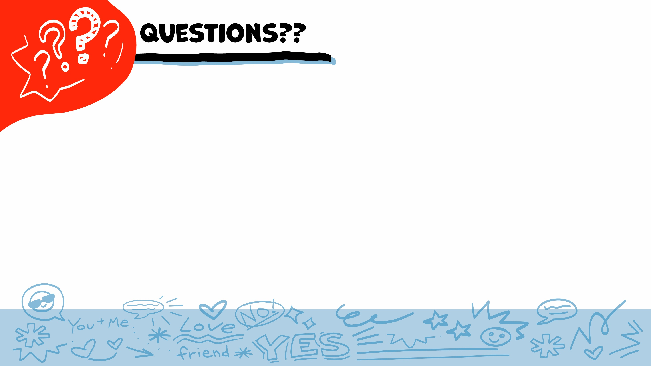
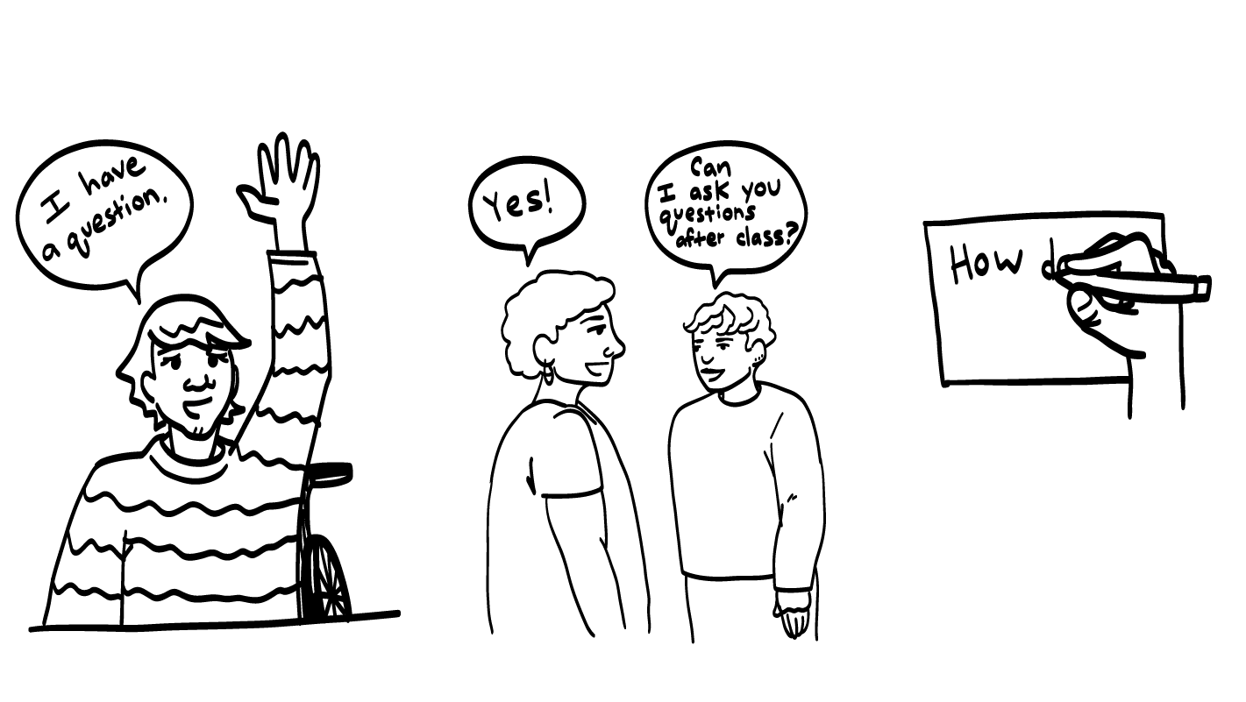
© 2026 SAFE Disability Services Program
Notes:
Say: Does anyone have any questions about today’s class? Remember, if you don’t want to ask your question out loud, you can write your question on a notecard and leave it on your desk. You can also ask someone you trust to help you write your question on the notecard. I will pick up the notecards and will answer the questions the next time we meet. When I answer a question, I won’t tell anyone who asked it.

Slide 29
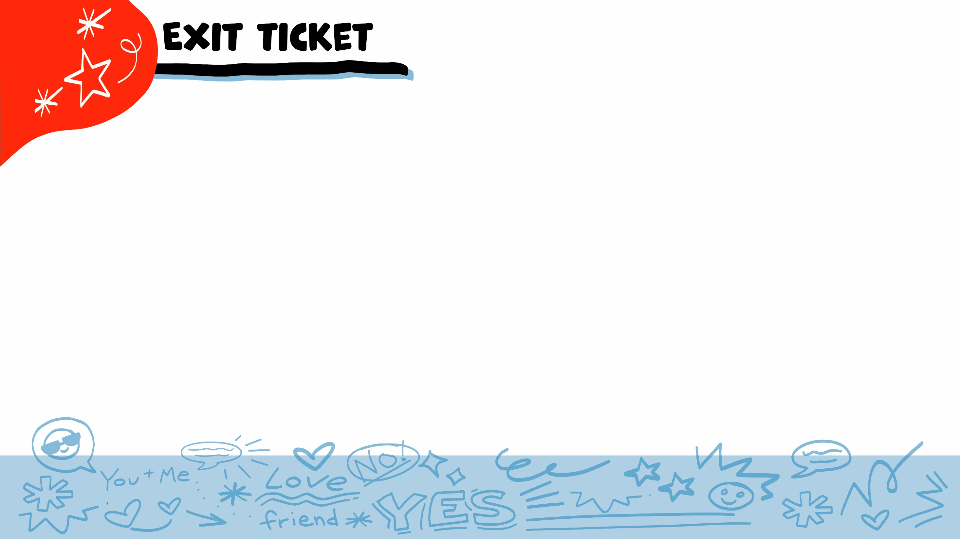


Should you bring an adult you trust with you if you want to meet in-person with someone you’ve only talked to online?
YES
NO
© 2026 SAFE Disability Services Program
Notes:
Say: Should you bring an adult you trust with you if you want to meet in-person with someone you’ve only talked to online? Give a thumbs up for yes and a thumbs down for no.
Give students enough time to process the question and make their decisions.
Say: Yes! You should bring an adult you trust and meet in a public place.

Slide 30
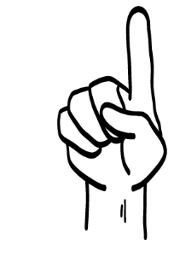
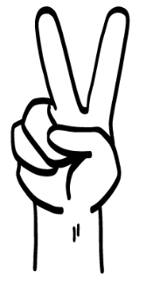
Which of these questions is okay to ask someone you are meeting for the first time?
How are you?
Can I touch your hair?
1
2
© 2026 SAFE Disability Services Program
Notes:
Say: Which of these questions is okay to ask someone you are meeting for the first time? Hold up one finger for “How are you?” and two fingers for “Can I touch your hair?”
Give students enough time to process the question and make their decisions.
Say: Asking someone how they are is a great way to start a conversation with someone new, because it is not too personal. Asking to touch someone’s hair is creepy. It will probably make the other person feel weird or scared if you ask this.

Slide 31
Can someone move from your outer red circle to your inner green circle of trust in one week?
YES
NO
© 2026 SAFE Disability Services Program
Notes:
Say: Can someone move from your outer red circle to your inner green circle of trust in one week? Hold a thumbs up for yes and a thumbs down for no.
Give students enough time to process the question and make their decisions.
Say: No, it takes weeks to months for someone to move into your middle yellow circle. After someone moves into your middle yellow circle, it takes more months to years for them to move into your inner green circle of trust.

Slide 32
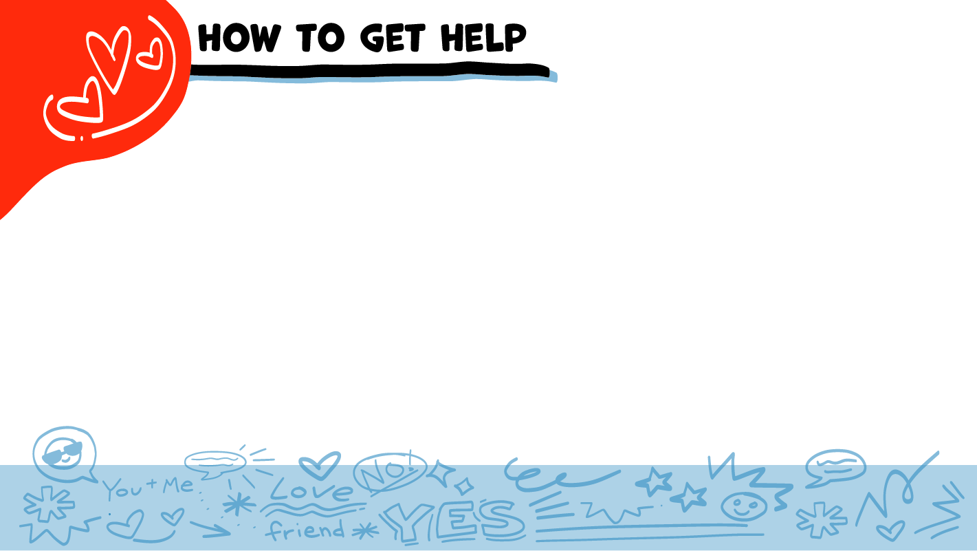
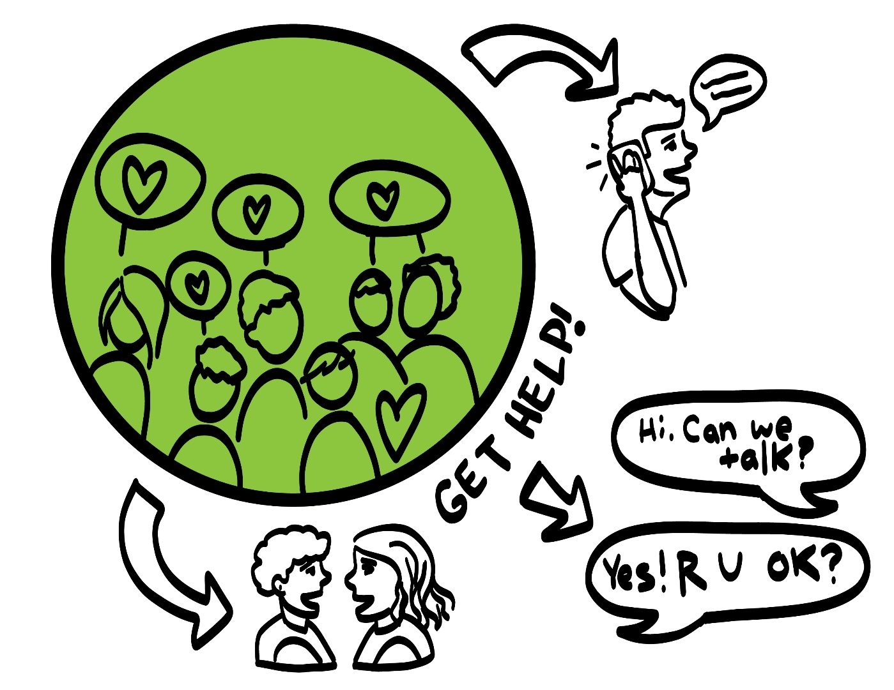
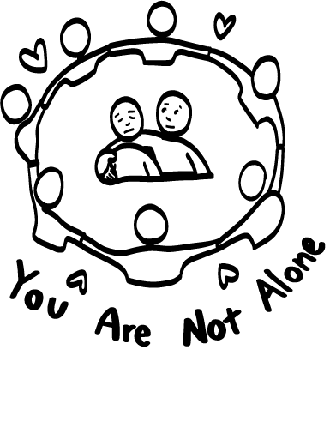
© 2026 SAFE Disability Services Program
Notes:
Say: If you are being hurt, or if someone ever touches your body in a way that you don’t like, you can get help. You did not do anything wrong, and you are not alone. You can get help by talking to an adult from your inner green circle of trust. If someone you care about is being hurt, you can also get help by talking to an adult from your inner green circle of trust. If an emergency is happening, you can always call 911. If you call 911 for help, a police officer or an ambulance might come.
If the first person you tell doesn’t believe you or doesn’t get you help, keep telling adults you trust what is going on until you get the help you need.

Slide 33
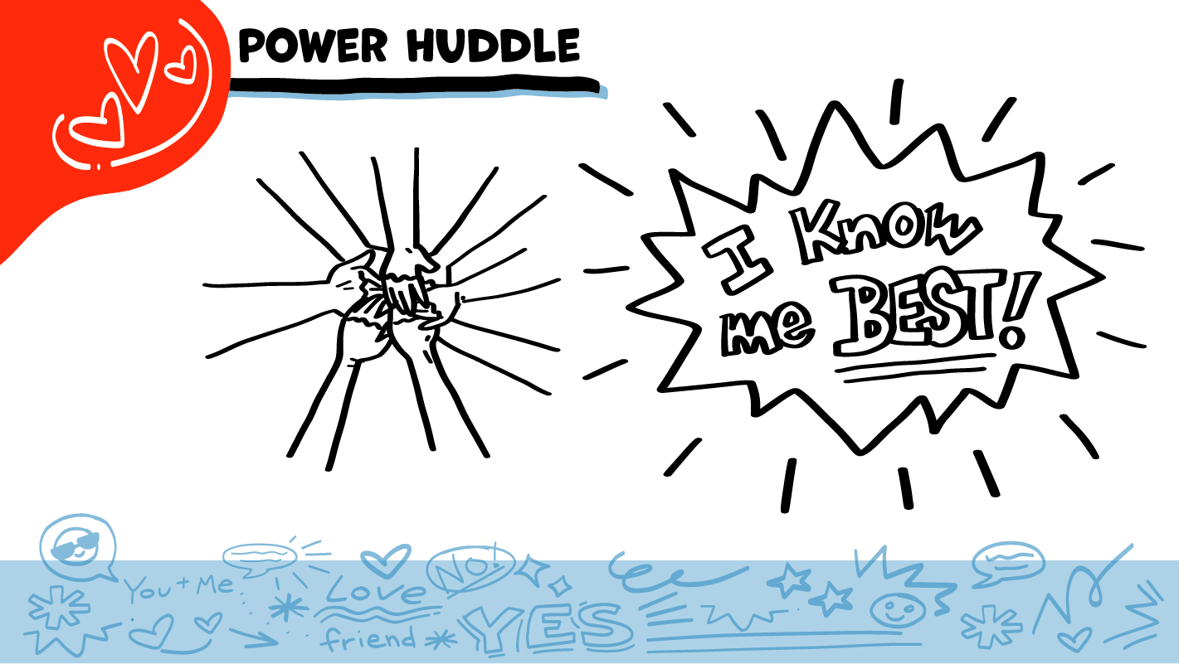
© 2026 SAFE Disability Services Program
Notes:
Say: Does anyone remember what our power statement is? Our power statement is “I know me best.” This means that each of you knows yourself better than anyone else does. Today you learned more about safer ways to get to know someone new. Let’s gather together and on the count of three, say our power statement.
Have each interested student put one hand in the middle of the circle. Ask for a student volunteer to count to three. After three, all participants say the power statement while lifting their hands into the air. Students can also stand in the circle without touching hands if they prefer.

Slide 34

This work is supported by the Texas Council for Developmental Disabilities through a grant from the U.S. Administration for Community Living (ACL), Department of Health and Human Services (HHS), Washington, D.C. 20201 with a 100% federal funding award totaling $6,161,072. Council efforts are those of the grantee and do not necessarily represent the official views of nor are endorsed by ACL, HHS, or the U.S. government.
© 2026 SAFE Disability Services Program
Notes:
SAFE would like to thank the Texas Council for Developmental Disabilities for the funding for this curriculum.

Slide 35

This curriculum is offered online at no cost. You are free to use the resources in the original format for educational purposes only. Please reference The SAFE Alliance appropriately (citations at bottom of page).
We ask that you do not alter curriculum images/art, slides, or lesson plan materials. You may not use My Rights My Life (18+ or High School) curriculum for commercial purposes (i.e., selling workshops you facilitate based on MRML curriculum; and/or creating links/websites to re-distribute any materials associated SAFE’s My Rights My Life).
This resource, My Rights My Life: A curriculum for healthier relationships for high school students (grades 9-12) is based on the original My Rights My Life: A curriculum for safer relationships (age 18+) written by Megan Westmore, Heidi Lersch, and edited by Schwartz, M. (2022). Selling materials from MRML is a copyright violation.
Burleson, Anna Belle & Benitez, Sophie (2026) provided light modification and abbreviated the original curriculum
(Westmore & Lersch, 2022) to offer an age appropriate resource for High School Students (grades 9-12).
Schwartz, M. (Ed.). The SAFE Alliance, Austin, Texas.
Westmore, M. & Lersch, H. (2022). My rights my life: A curriculum for safer relationships.
Schwartz, M. (Ed.). The SAFE Alliance: Austin, TX.
© 2026 SAFE Disability Services Program

