Slide 1
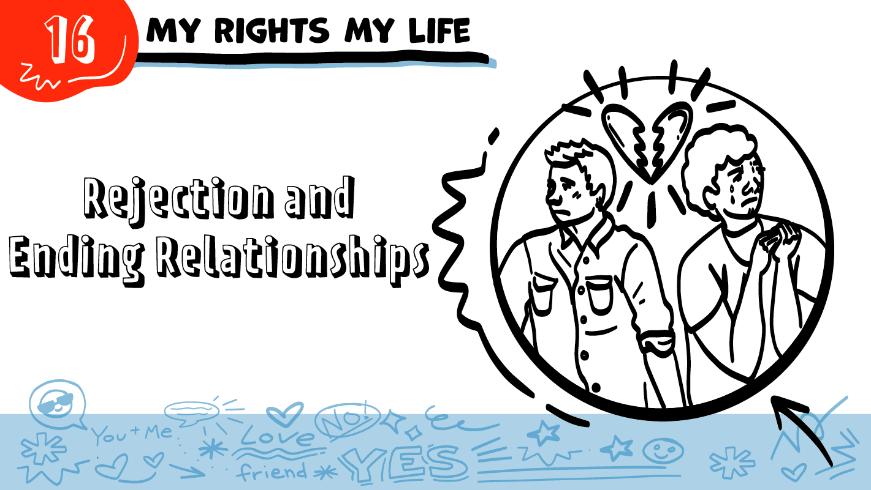

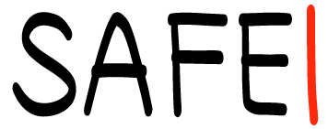
for High School Students
© 2026 SAFE Disability Services Program
Notes:
Repetition is beneficial for learning. Take time to review the last My Rights My Life class you taught prior to beginning this session. You can also answer any private questions students submitted on notecards during your previous class session.
Today, We are going to talk about rejection and ending relationships.

Slide 2
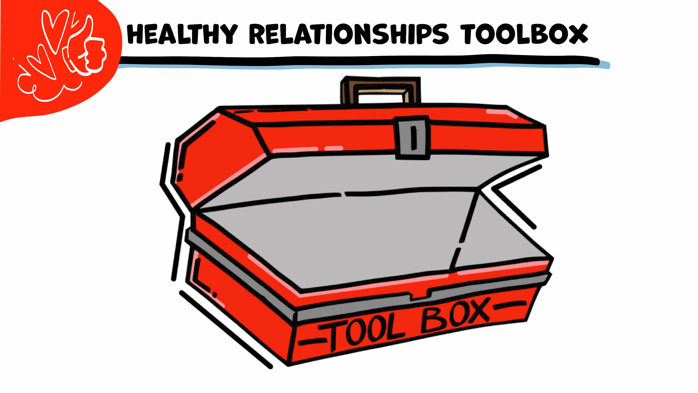
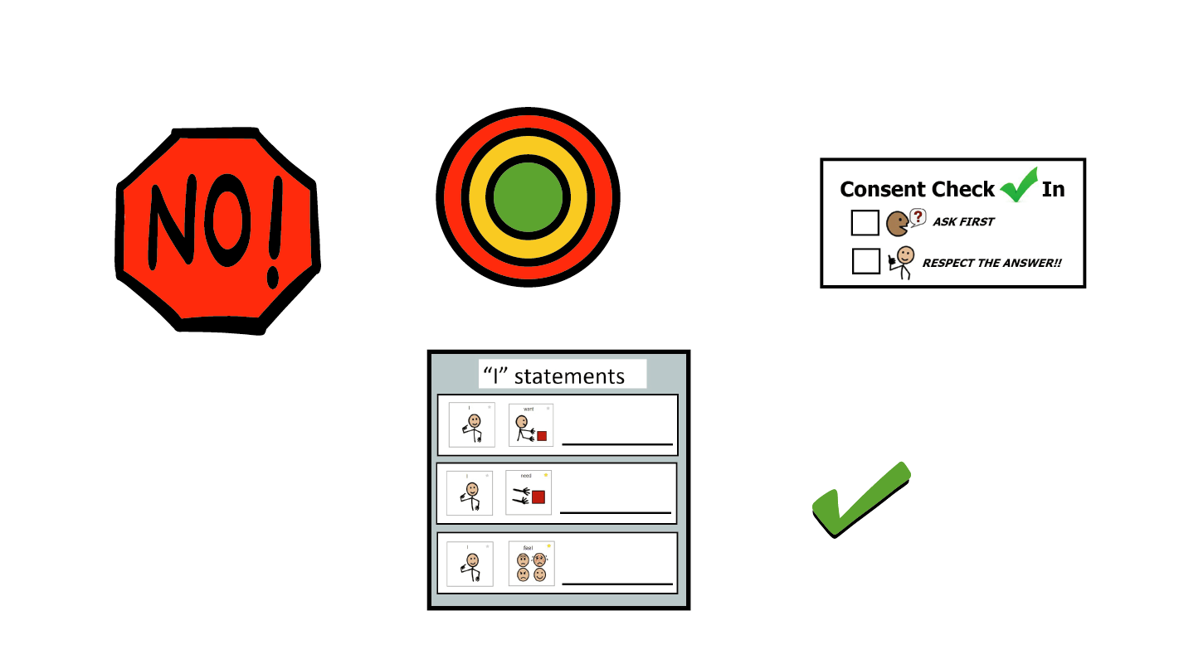
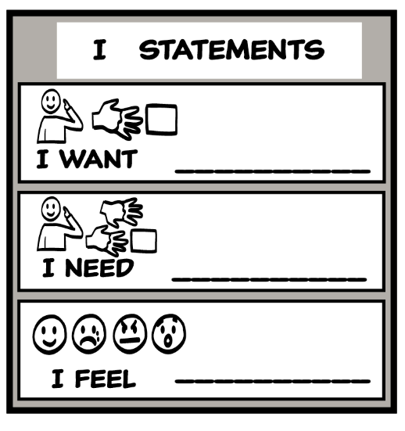
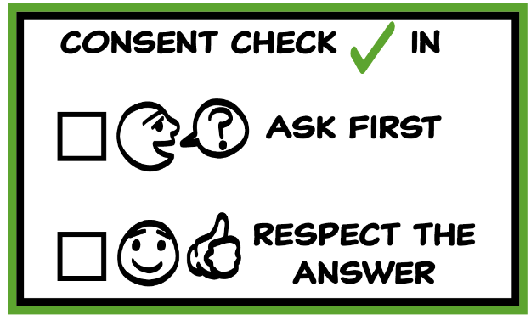
© 2026 AFE Disability Services Program
Notes:
Use the large class Healthy Relationship Toolbox to review the Healthy Relationship Tools (I Statement, Relationship Map, NO!, and Consent Check-In). You can ask students to pull off one tool at a time and discuss what it is and how it is used. It can be particularly helpful for this review if you give students specific scenarios to think through. For example, you might ask, “If your friend lies to you, what is one I Statement you could use to tell your friend how you feel?” You may even consider using examples of situations that have recently occurred in your classroom, as long as doing so does not break student confidentiality. You can also ask students to connect the toolbox tools to their current relationships. You might say, “Can anyone volunteer and tell me about something going on in your life right now that the toolbox could help you with?”
Instructions for how to use each Healthy Relationship Tool can be found in the following classes:
I Statements: Classes 2 and 3
Relationship Map: Class 4
NO!: Class 5
Consent Check-In: Class 6

Slide 3
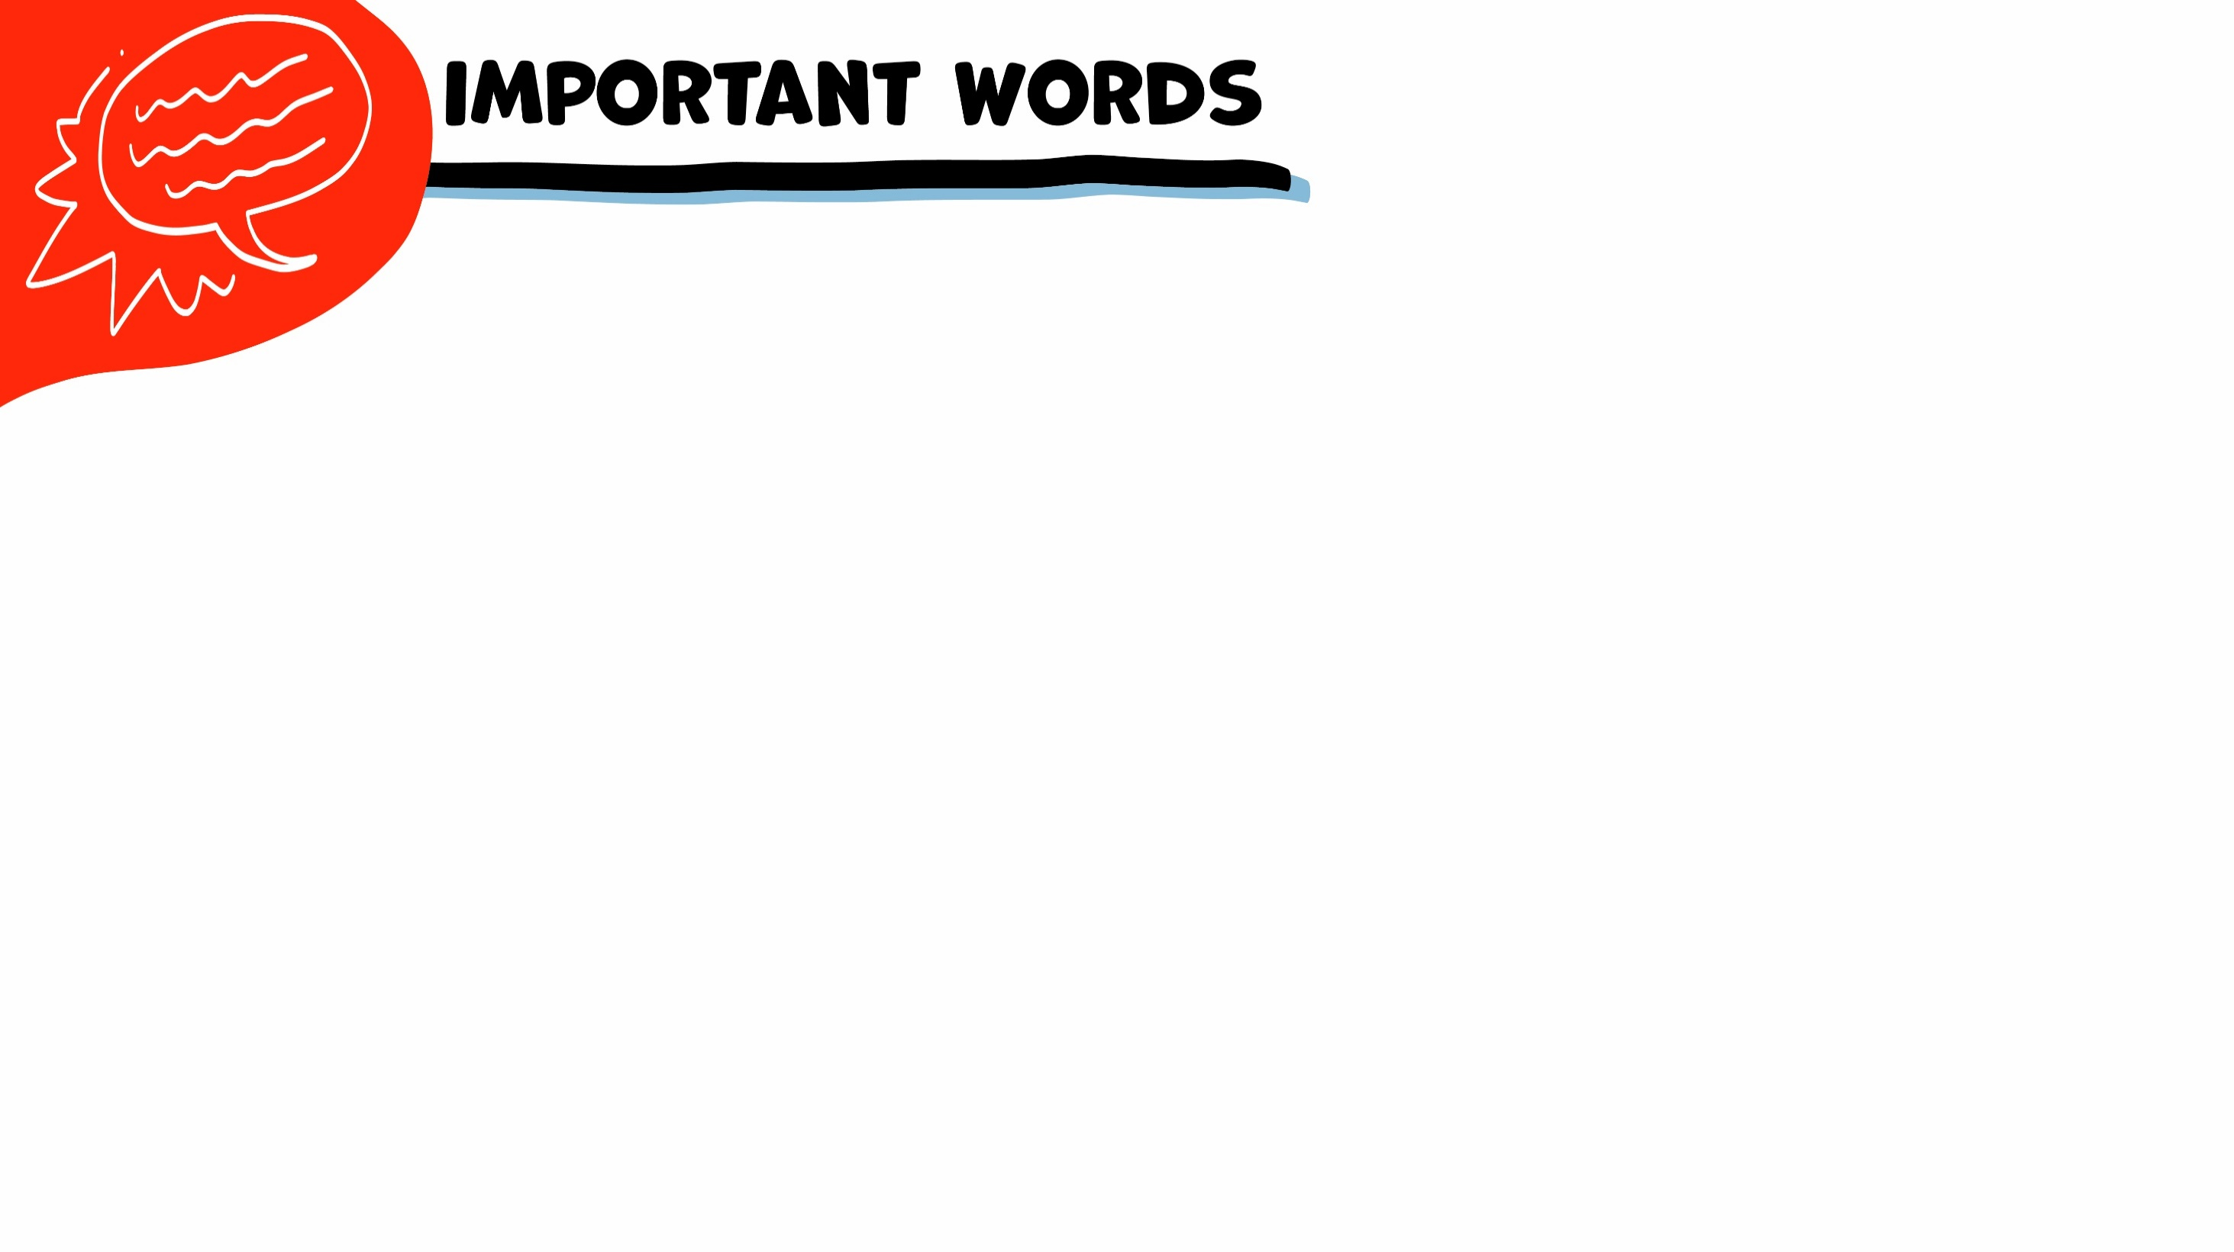
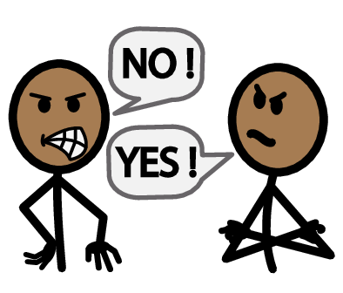
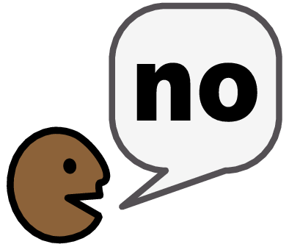
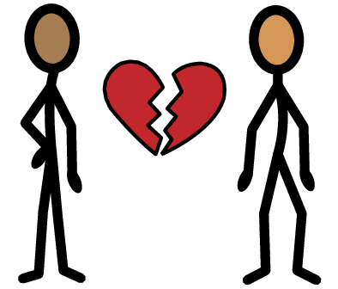


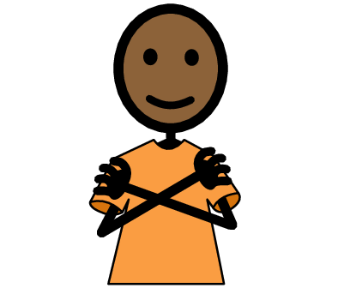
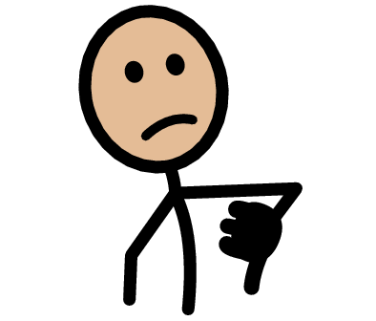


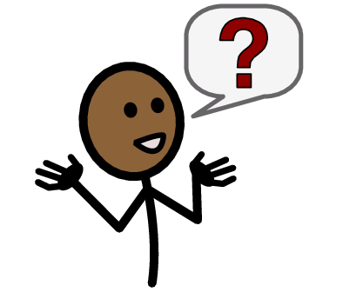
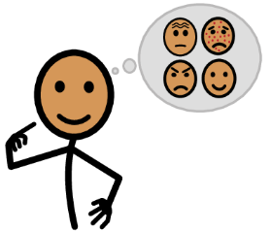



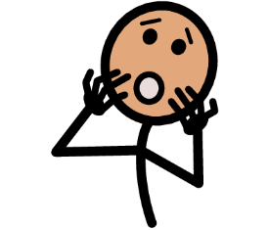
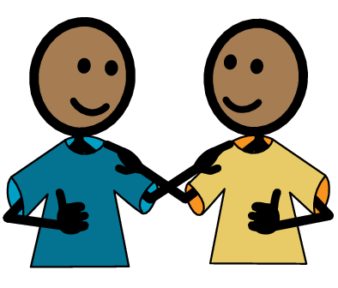
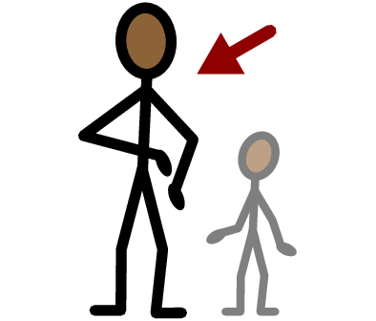
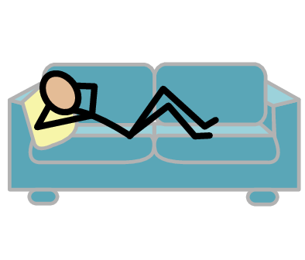
Disagreement
Rejection
Break-up
Yes
No
Self-care
Unhealthy
Healthy
I need help
I have a question
Trust
Adult
Take a break
I feel
Happy
Sad
Mad
Scared
Copyright © 2021 SymbolStix, LLC. All rights reserved. Used with Permission.
Notes:
You can print this slide separately so each student can use the Important Words Sheet as a communication board throughout class. Review the words using the suggested definitions below. To enhance understanding, you can ask students to come up with their own definitions for vocabulary words or to provide a sentence or scenario using the new word.
Disagreement: when two people have different opinions about something
Healthy: when a relationship feels good to both people
Unhealthy: when a relationship does not feel good to both people
Rejection: when you ask someone to do something and they say no
Break-up: when one or both people decide to end a relationship
Self-care: when you do things that you love and that make you feel really good

Slide 4
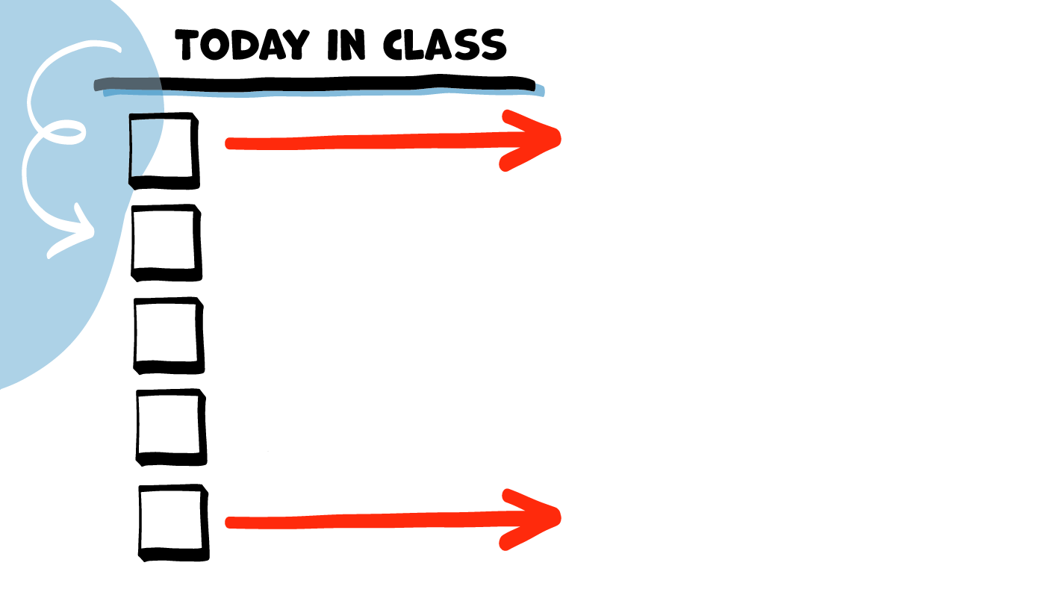
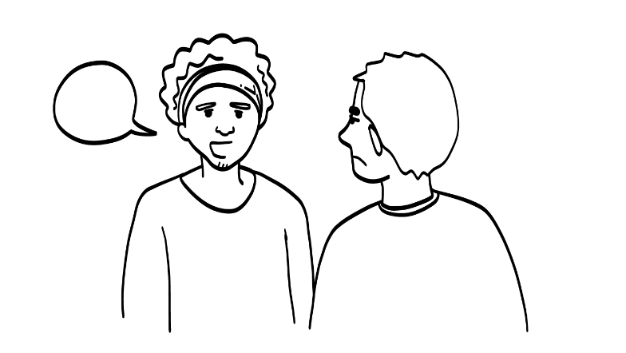

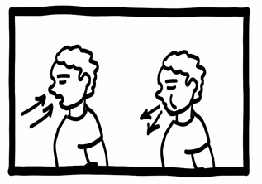
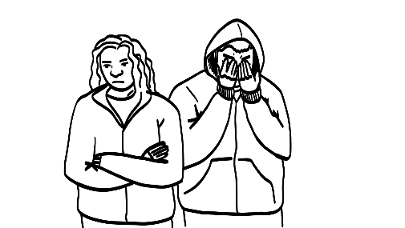
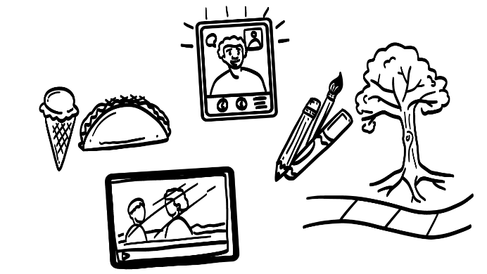
Healthy
Disagreements
Disagreements Practice
Brain break
Ending Relationships
Rejection
Self-Care Plan
© 2026 SAFE Disability Services Program
Notes:
Read the agenda. Alternatively, you can ask for a student volunteer to read the agenda.

Slide 5
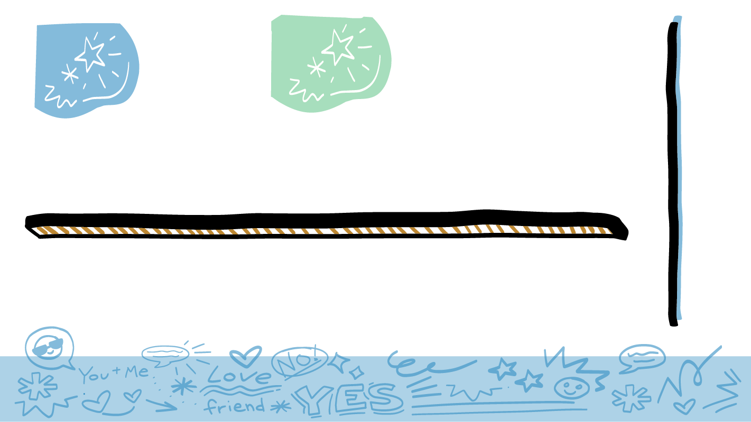
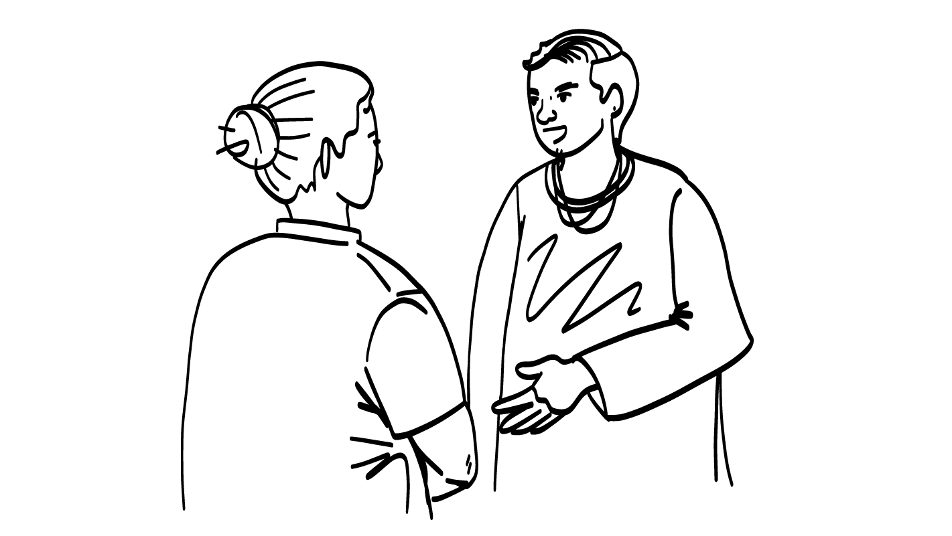
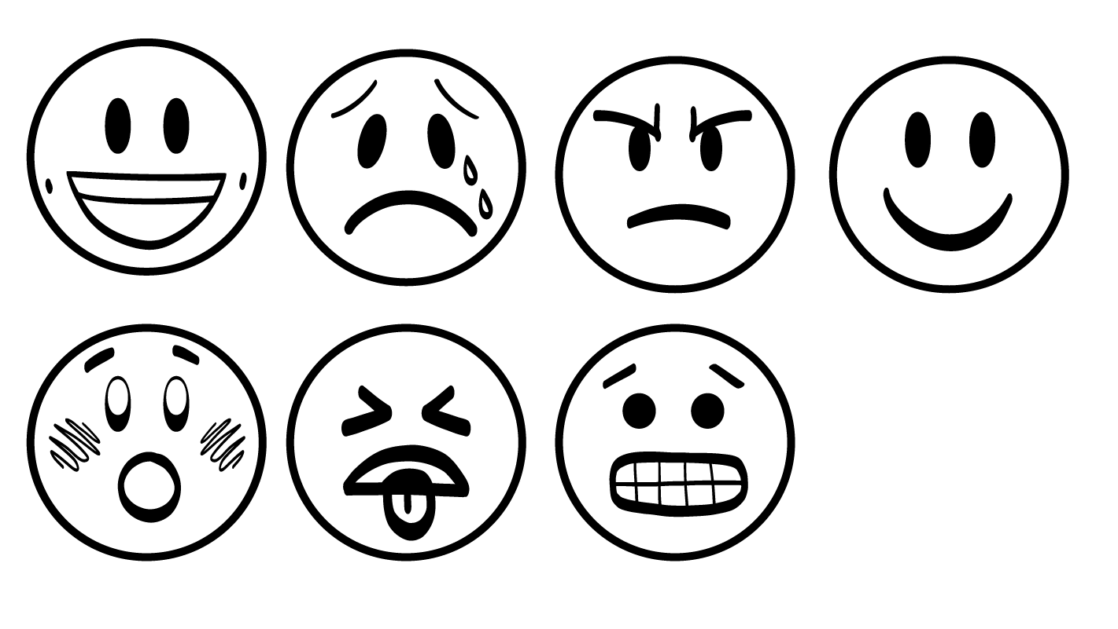
Do friends in healthy relationships ever disagree?
© 2026 SAFE Disability Services Program
Notes:
Say: What do you all think? Do friends in healthy relationships ever disagree? Give a thumbs up for yes and a thumbs down for no.
Give students enough time to process the question and make their decisions.
Say: Yes! Even in a healthy relationship, it’s normal for friends to disagree or get into arguments. There are healthy and unhealthy ways to have those disagreements, however.

Slide 6
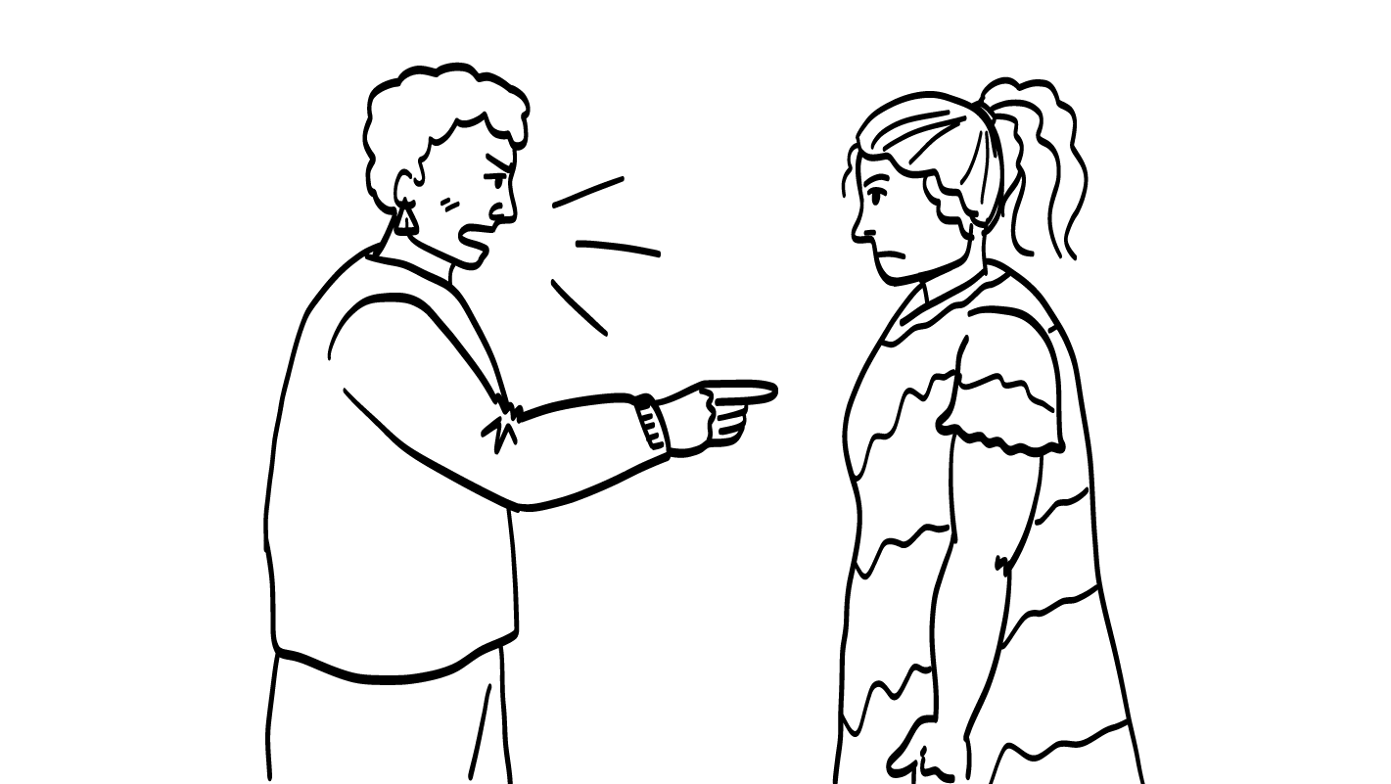
Is yelling a healthy way to disagree?
© 2026 SAFE Disability Services Program
Notes:
Say: What about yelling? Do you all think yelling is a healthy way to have a disagreement with your friend? Give a thumbs up for yes and a thumbs down for no.
Give students enough time to process the question and make their decisions.
Say: No, this is not a healthy way to disagree. This will probably make both people feel bad or mad. The argument will probably get worse if both people yell at each other.

Slide 7
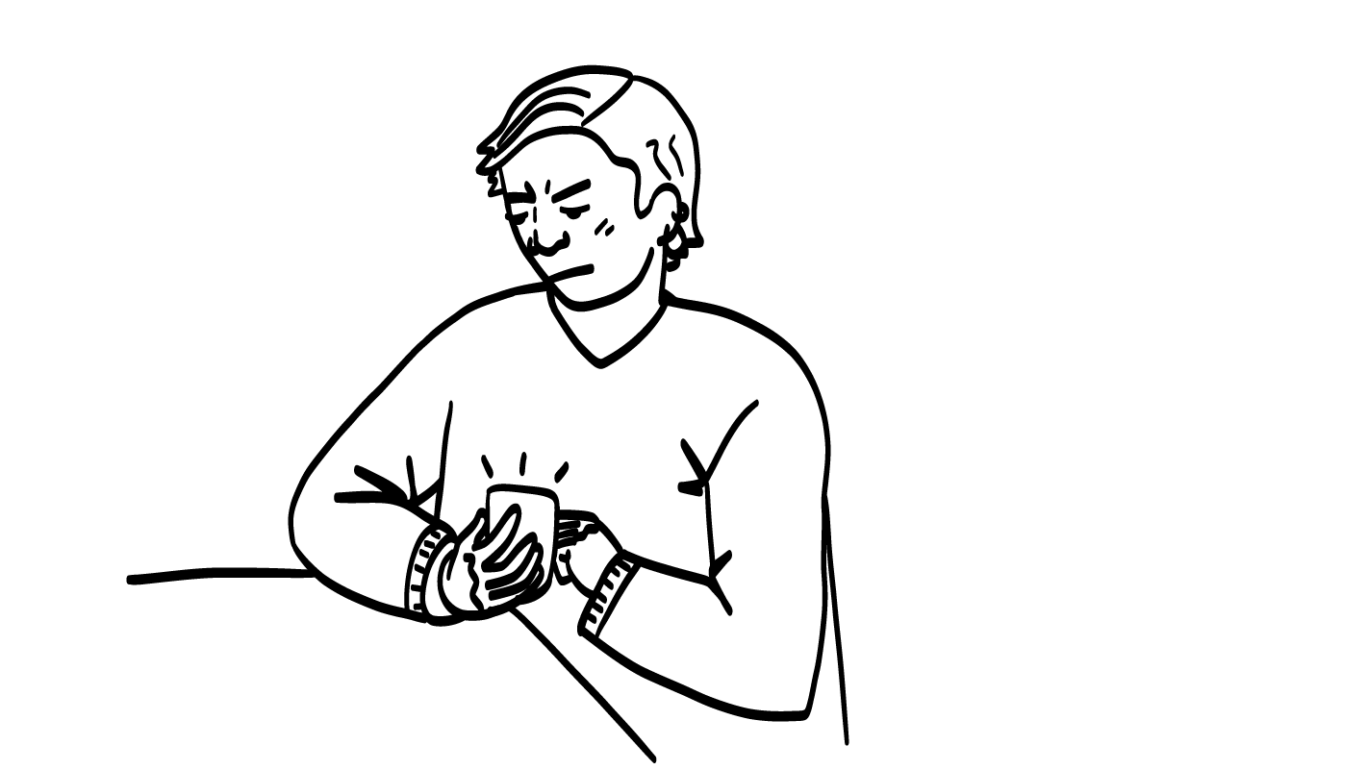
Is hanging up the phone a healthy way to disagree?
© 2026 SAFE Disability Services Program
Notes:
Say: What about hanging up the phone? Do you all think hanging up on your friend is a healthy way to disagree? Give a thumbs up for yes and a thumbs down for no.
Give students enough time to process the question and make their decisions.
Say: No, this is not a healthy way to disagree. If you just hang up when you get mad, your friend won’t know what’s going on with you.
If you are getting really mad, it is okay to tell your friend you need to take a break from the phone call. After your break, you can talk to your friend again when you feel calmer. This is okay. But it’s not okay to just hang up without saying anything to your friend about what’s going on.

Slide 8
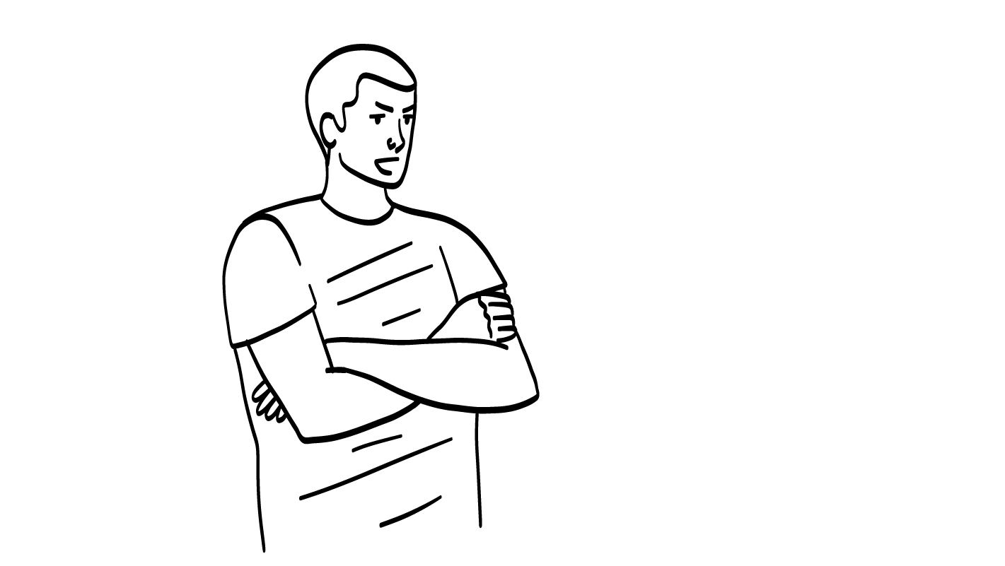
Is the silent treatment a healthy way to disagree?
Why won’t you talk to me? Please talk to me.
© 2026 SAFE Disability Services Program
Notes:
Say: What about the silent treatment? The silent treatment is when someone refuses to talk to their friend and won’t say anything at all. Do you all think the silent treatment is a healthy way to have a disagreement with your friend? Give a thumbs up for yes and a thumbs down for no.
Give students enough time to process the question and make their decisions.
Say: No, this is not a healthy way to disagree. If you give your friend the silent treatment, they won’t know what’s going on with you. You won’t be able to talk through your disagreement.
Yelling, hanging up the phone, and the silent treatment are all unhealthy ways to respond to a disagreement. If your friend does these things, that’s a warning sign that the relationship is unhealthy. These are things that you would want to talk to your friend about. If they don’t stop doing these things after you’ve talked to them, then it is not a healthy relationship to stay in.

Slide 9
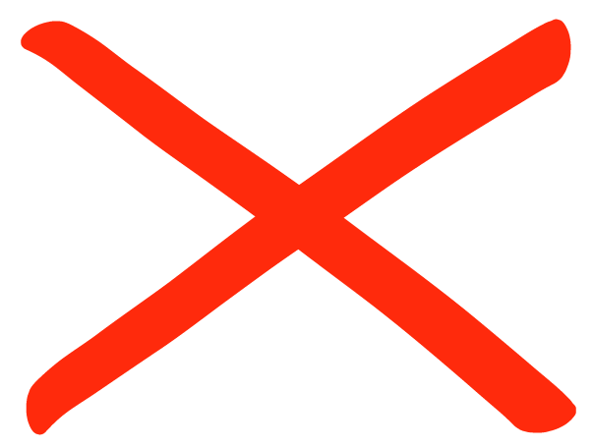
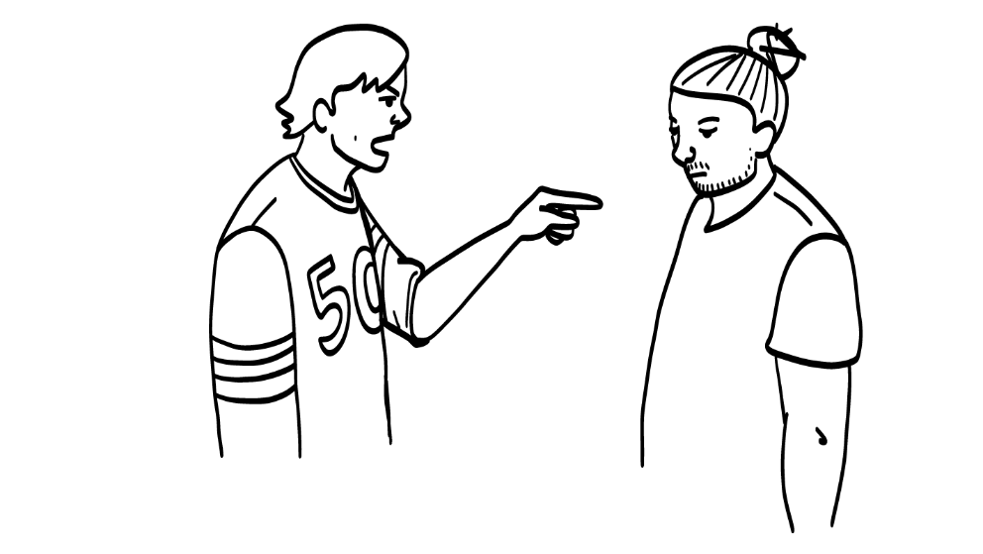
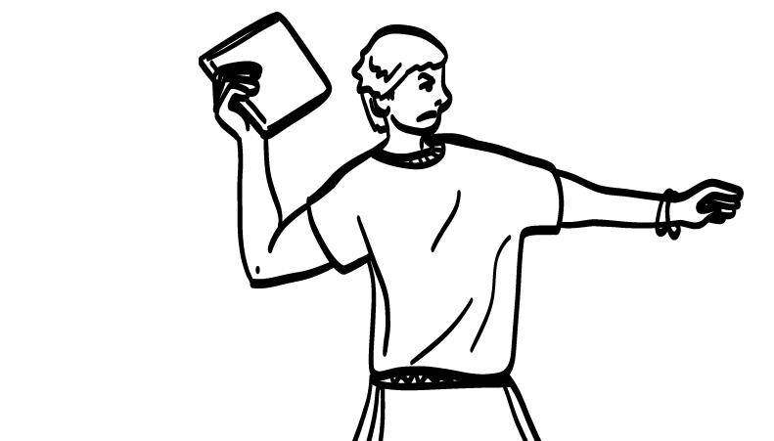
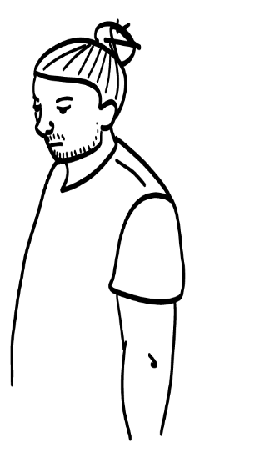
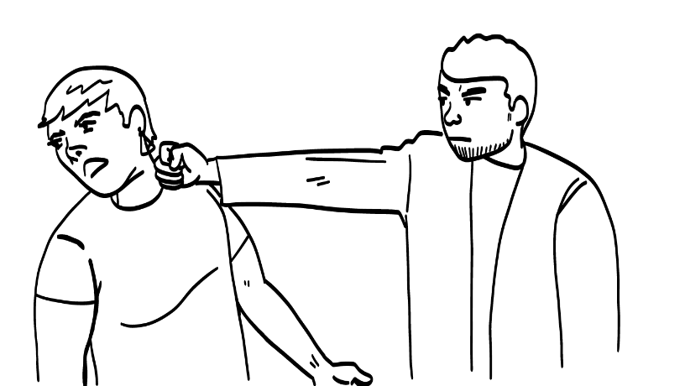
Not okay—not even once
Calling each other mean names
Hurting each other’s bodies
Throwing things at each other
It is never okay for you and your friend to: call each other mean names, throw things at each other, or hurt each other's bodies.
© 2026 SAFE Disability Services Program
Notes:
Say: Sometimes people do things that are so unhealthy, they are not okay even one time. If you and your friend are disagreeing, it is never okay to call each other mean names, throw things at each other, or physically hurt each other’s bodies.
All of these things are abuse and they are never okay.

Slide 10
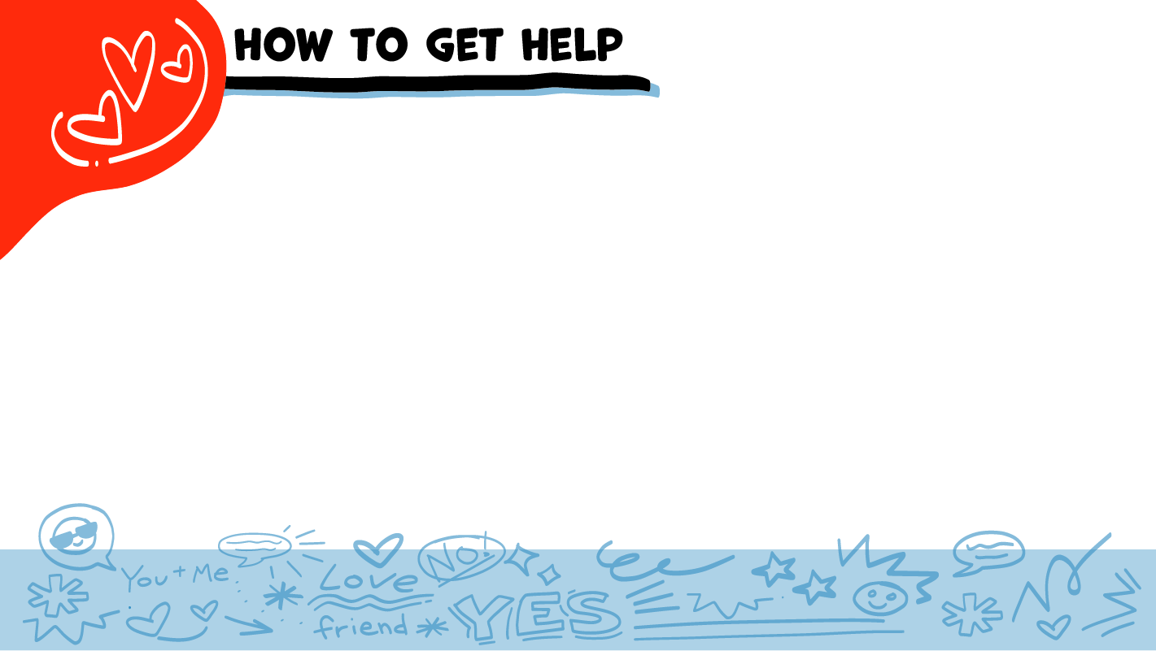
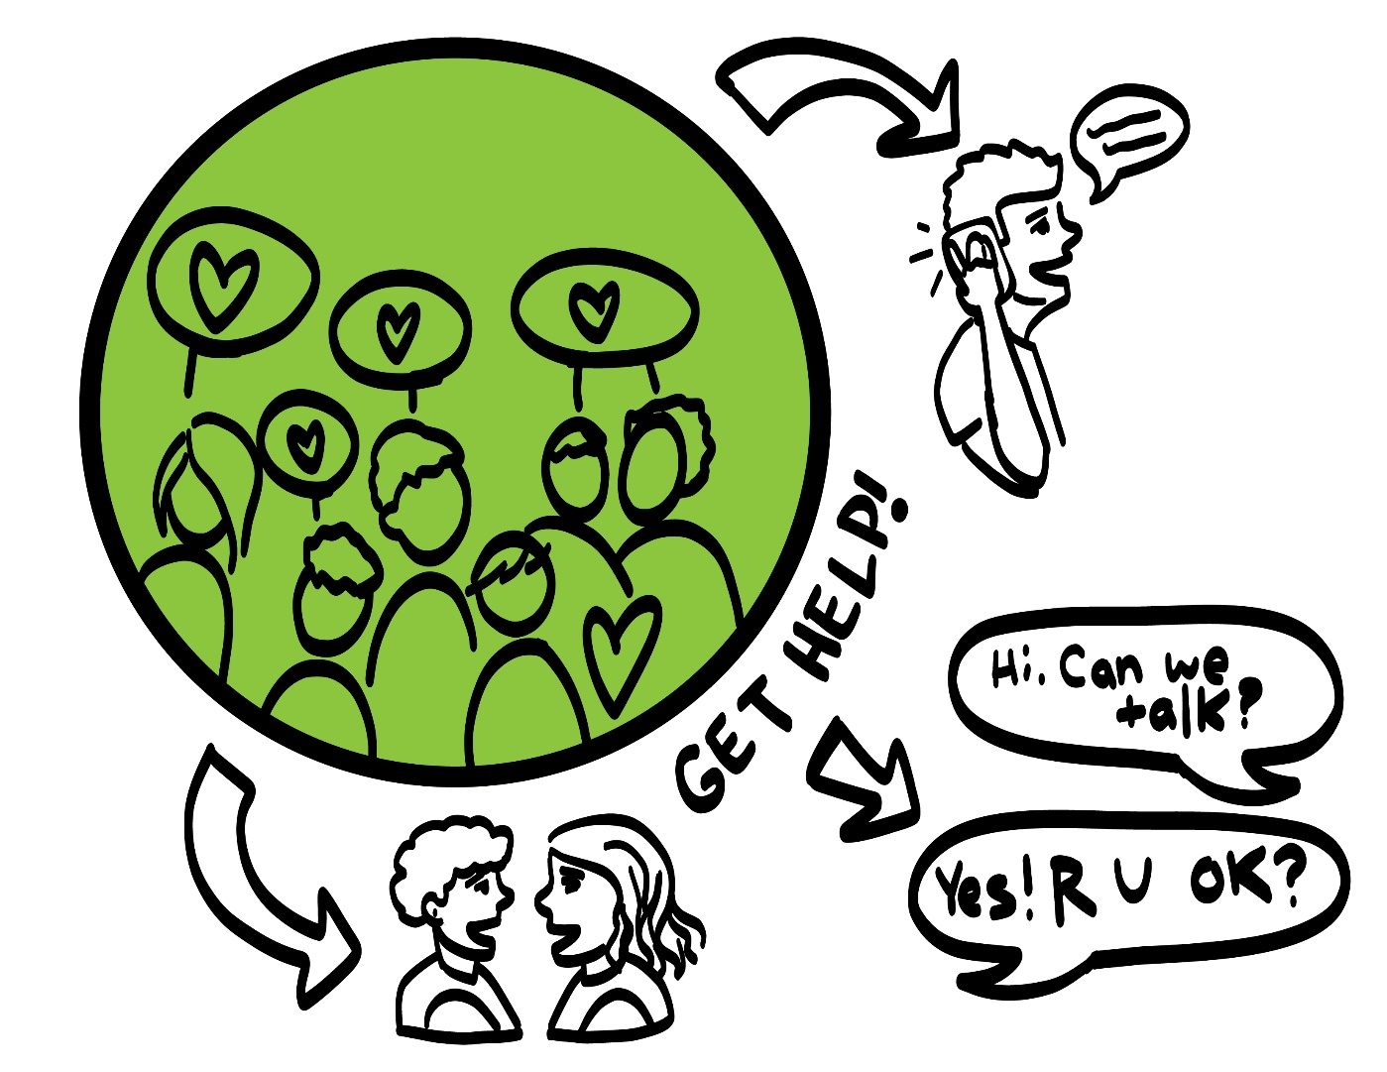
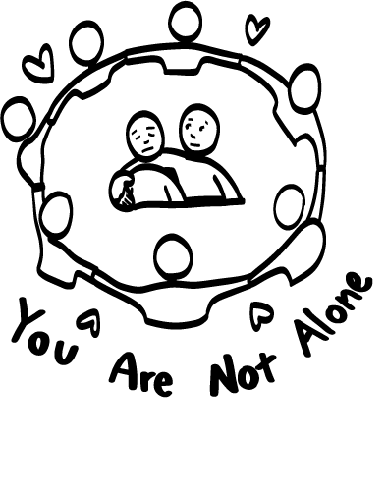
© 2026 SAFE Disability Services Program
Notes:
Say: If your friend calls you mean names, throws things at you, or hurts your body when you disagree, you can get help. You did not do anything wrong, and you are not alone. You can get help by talking to an adult from your inner green circle of trust. If an emergency is happening, you can always call 911. If you call 911 for help, a police officer or an ambulance might come.
If the first person you tell doesn’t believe you or doesn’t get you help, keep telling adults you trust what is going on until you get the help you need.

Slide 11
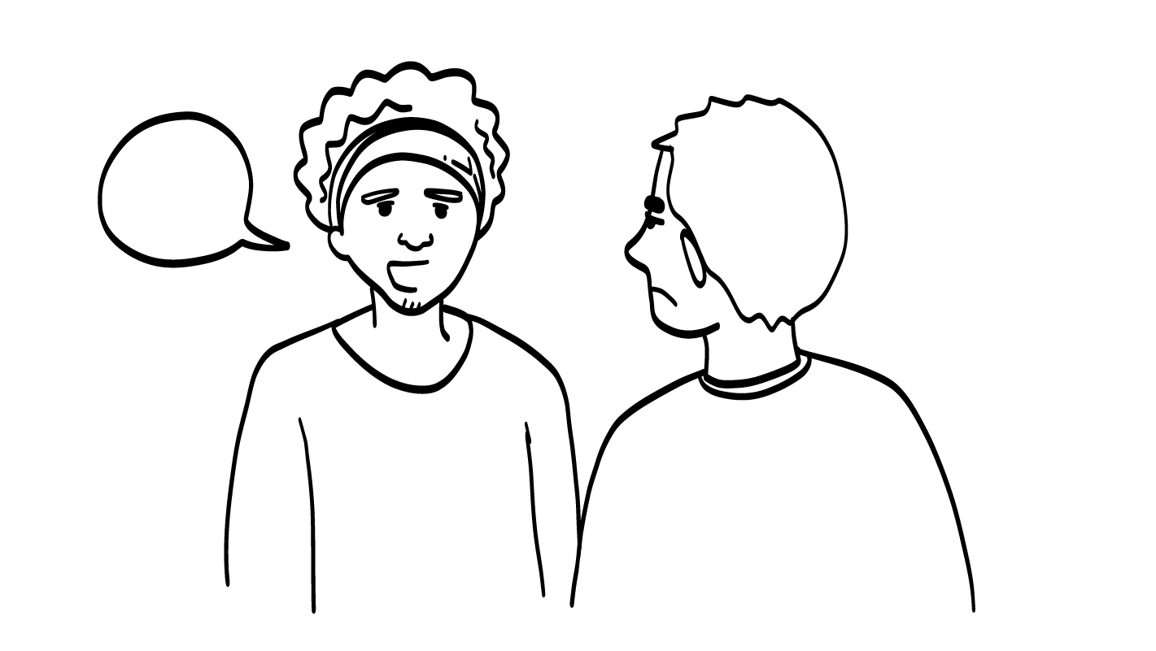
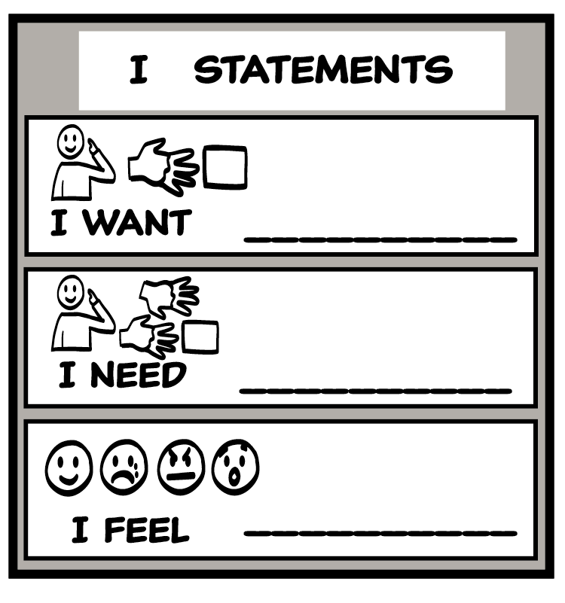
Healthy disagreements and I statements
I feel upset when you don’t
listen when I’m talking to you
One healthy way to disagree is to use the
I Statements Tool.
© 2026 SAFE Disability Services Program
Notes:
Say: So, if those are all unhealthy ways to disagree, what’s a healthy way to disagree?
One healthy way to disagree is to use I statements.

Slide 12
Healthy
Disagreements
Disagreements Practice
Brain break
Ending Relationships
Rejection
Self-Care Plan
© 2026 SAFE Disability Services Program
Notes:
Say: You are going to practice using the I Statement Tool to disagree with your friends in a healthy way.

Slide 13
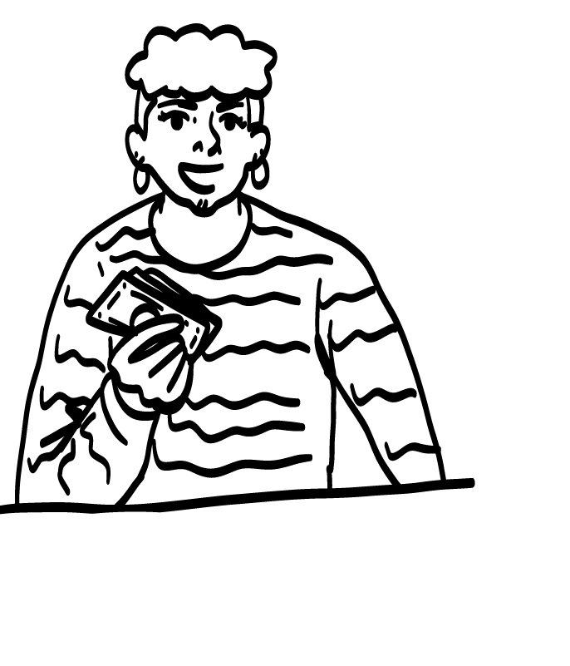
Healthy Disagreements Practice
You and your friend have been going to a lot of expensive places. You are both running out of money.
What’s an I statement you could use to talk to your friend about this?
© 2026 SAFE Disability Services Program
Notes:
Say: Imagine you and your friend have been going to many places that cost a lot of money. You are both running out of money. What’s an I statement you could use to talk to your friend about this problem?
Give students enough time to process the question and make their decisions. Sample answers include:
I feel worried about all of the money we are spending.
I want to stop spending so much money.
I need us to do cheaper (or less expensive) activities.

Slide 14
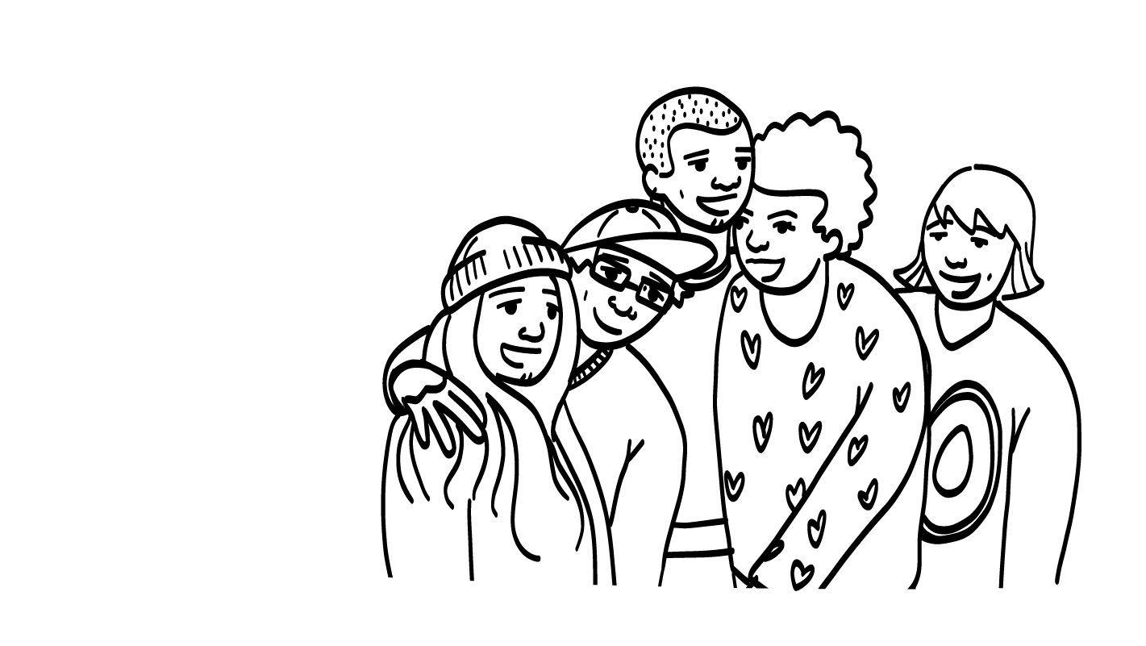
Healthy Disagreements Practice
You have been hanging out with your other friends a lot, and your BFF is mad that you are spending so much time with your other friends.
What’s an I statement you could use to talk to your friend about this?
© 2026 SAFE Disability Services Program
Notes:
Say: Now I want you to imagine that you have been hanging out with your friends a lot, and your BFF is mad that you are spending so much time with your other friends. What’s an I statement you could use to talk to your BFF about this?
Give students enough time to process the question and make their decisions. Sample answers include:
I feel mad when you say I am spending too much time with my friends.
I want to hang out with my other friends.
I need time with my other friends.

Slide 15
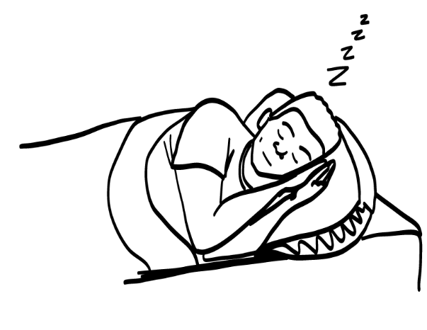
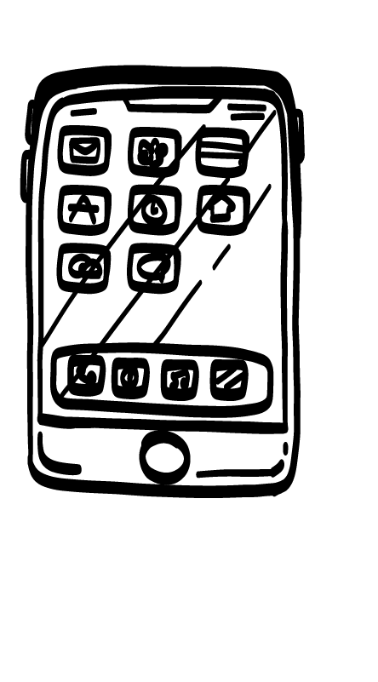
Healthy Disagreements Practice
Your friend called you late at night just to talk when you were trying to sleep.
What’s an I statement you could use to talk to your friend about this?
© 2026 SAFE Disability Services Program
Notes:
Say: Now imagine that your friend called you late at night just to talk when you were trying to sleep. What’s an I statement you could use to talk to your friend about this problem?
Give students enough time to process the question and make their decisions. Sample answers include:
I feel mad that you woke me up just to talk.
I want to go back to sleep.
I need you not to call me after 10 PM.

Slide 16
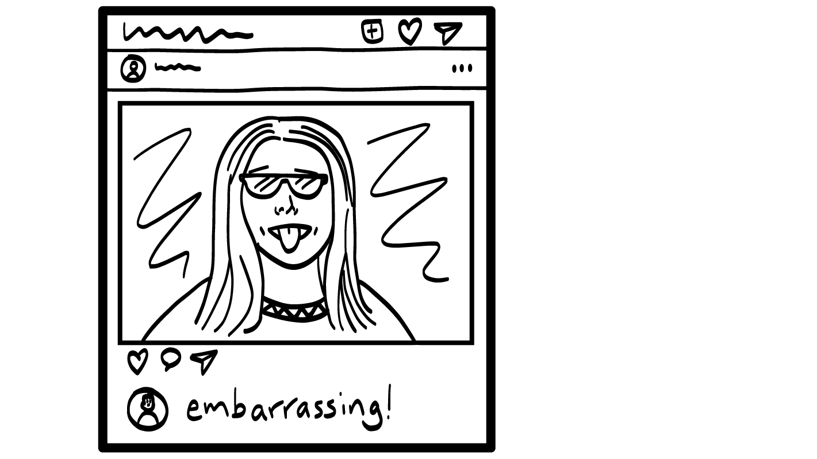
Healthy Disagreements Practice
Your friend posted a bunch of pictures of you on Instagram that you don’t like.
What’s an I statement you could use to talk to your friend about this?
© 2026 SAFE Disability Services Program
Notes:
Say: Finally, imagine that your friend posted a bunch of pictures of you on Instagram that you don’t like. What’s an I statement you could use to talk to your friend about this?
Give students enough time to process the question and make their decisions. Sample answers include:
I feel mad that you posted those pictures.
I want you to take the pictures down.
I need you to ask before posting my pictures online.

Slide 17
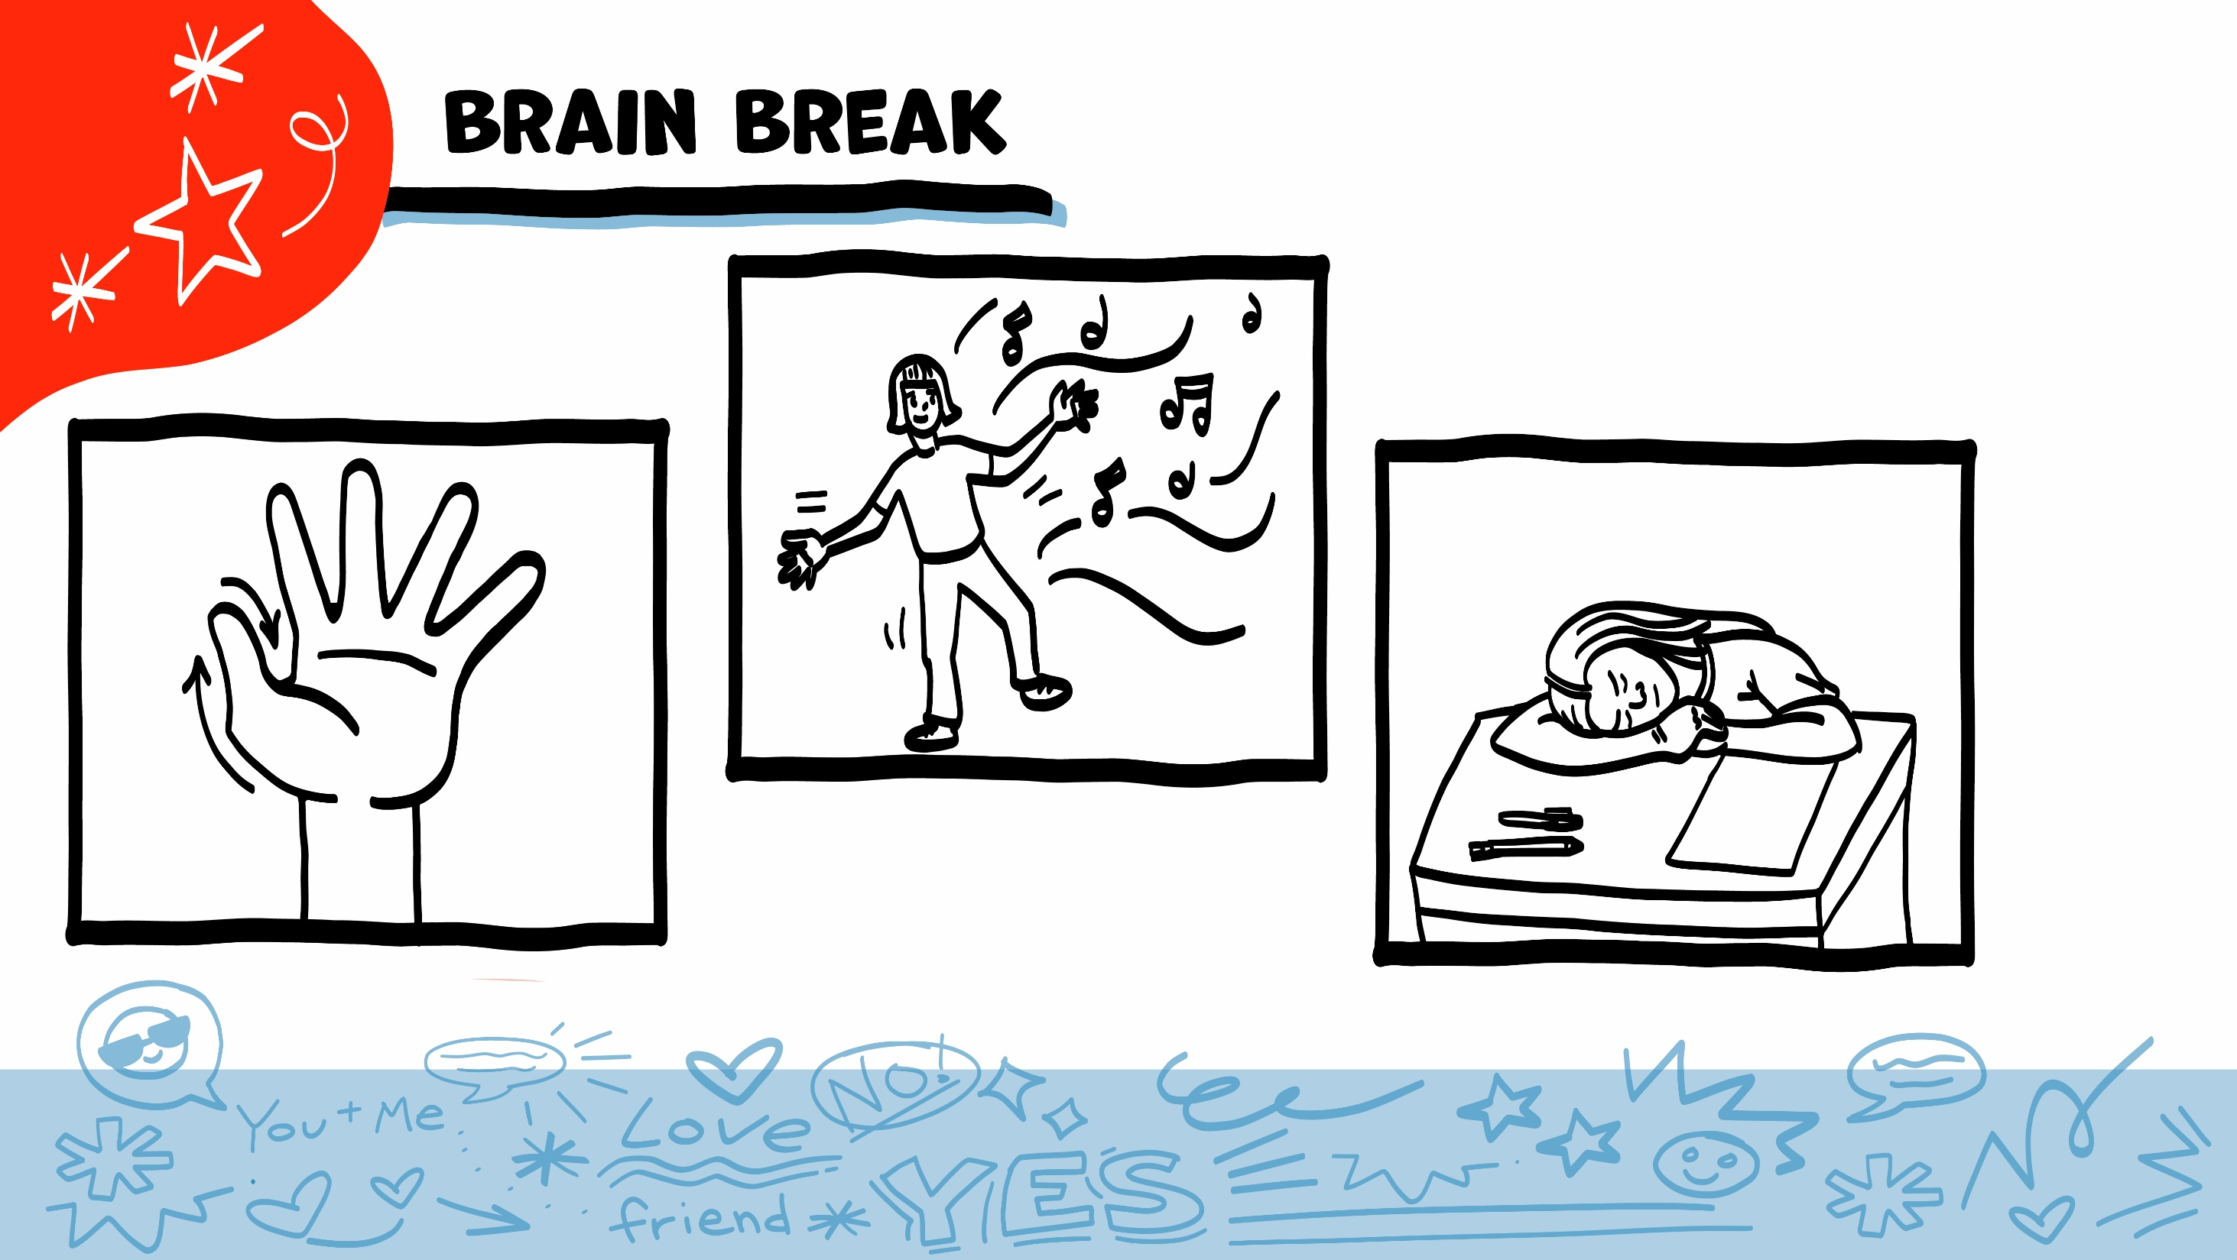
© 2026 SAFE Disability Services Program
Notes:
Say: That was a lot of information, and you all are doing an amazing job! Every week in class we will take a brain break in the middle. This is a chance to move a little and take a break from thinking!
Below are three ideas to give students a quick opportunity for a brain break. You are also welcome to come up with your own ideas for brain breaks that work best for your class.
Five finger breathing
For this exercise, have all students place their hand in front of their chest with their five fingers spread out. Next, use the pointer finger of the other hand to trace up and down each of the five fingers, beginning with the thumb. As students trace up a finger, they will breathe in. As they trace down a finger, they will breathe out. When students breathe out on the pinky finger, you can tell them to shake out their hands and arms. As the school year goes on, you can ask students to lead this exercise for their peers.
If this exercise is physically inaccessible for your class, you can also model the hand tracing for students while they breathe in and out.
Stretch break
Lead students through a series of basic stretches. These can be completed in a chair, or while standing up, depending on the accommodation needs of your class. Some ideas include reaching toward the ceiling, stretching one arm at a time across the chest, reaching toward toes, turning head from side to side, etc. Ask students to hold a pose while you count to ten. As the school year goes on, you can ask students to lead stretches for their peers.
Dance party
If your class likes to dance, you can put on a short song for them to dance to. This is especially effective if you are able to find a song that relates to the theme for that week’s class.

Slide 18
Healthy
Disagreements
Disagreements Practice
Brain break
Ending Relationships
Rejection
Self-Care Plan
© 2026 SAFE Disability Services Program
Notes:
Say: Sometimes when you have disagreements in your relationships, you can work through them in healthy ways. Other times, the relationship needs to end. We are going to talk about that now.

Slide 19
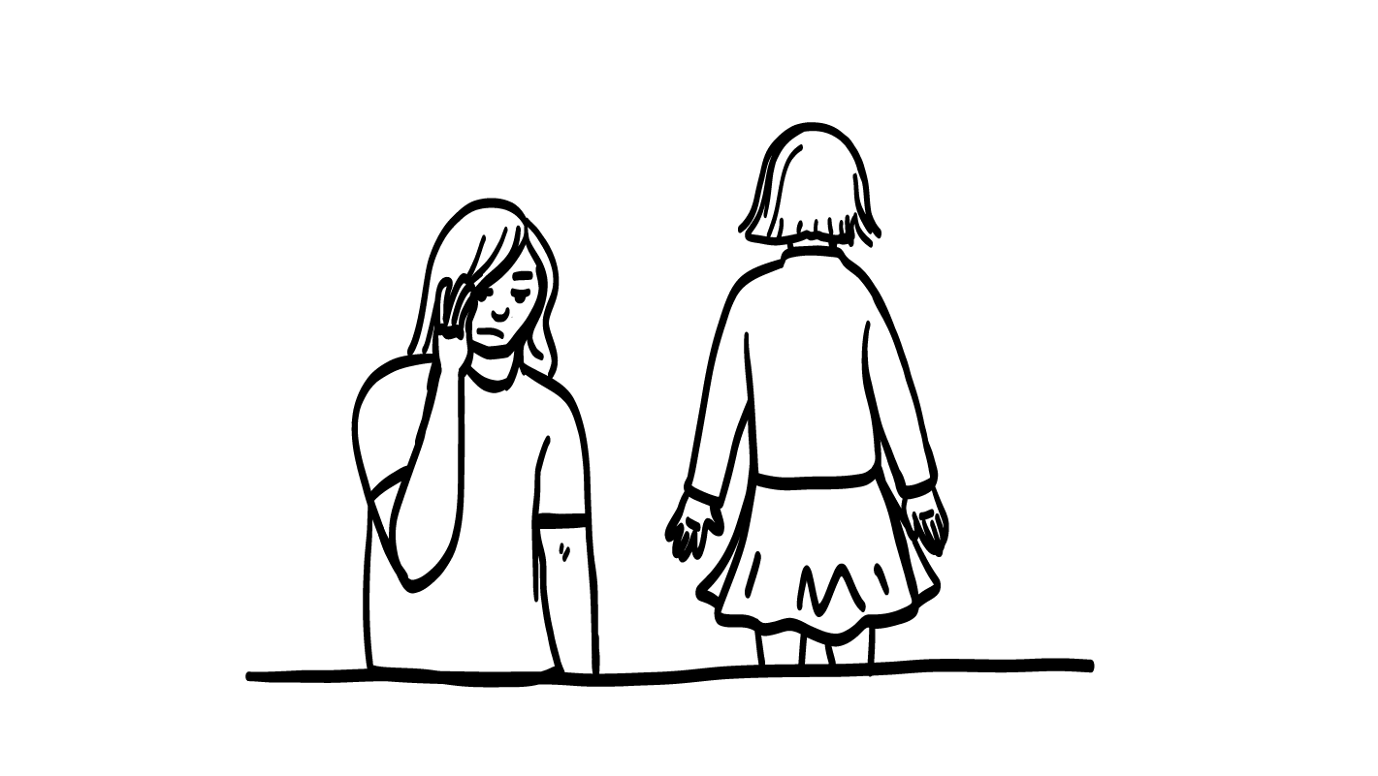
Breaking Up
You always have the right to say NO! to being friends with someone.
It is okay to break up with a friend who
does not make you happy.
© 2026 SAFE Disability Services Program
Notes:
Say: If you don’t want to be friends with someone, it is okay to say no. Remember, you can always say no to anyone or anything that crosses your boundary, or that you are not cool with.
It is important to know that not all relationships last forever.
If you have used healthy relationship tools such as I statements to try to work on the problems in your relationship, but you are still unhappy with someone, you might decide to break up with them. Or if a friend ever makes you feel unsafe or hurts you, you need to safely end the relationship as quickly as possible. It is okay to break up with someone you don’t feel happy or safe with.

Slide 20
Get Help From
An Adult You Trust
Who is an adult
you trust to help you
if you need
to break up
with your friend?
© 2026 SAFE Disability Services Program
Notes:
Say: How you break up with someone might look a little different for each person and relationship. Who could help you figure out how to safely break up with your friend?
Give students enough time to process the question and make their decisions.
Say: An adult from your inner green circle of trust.

Slide 21
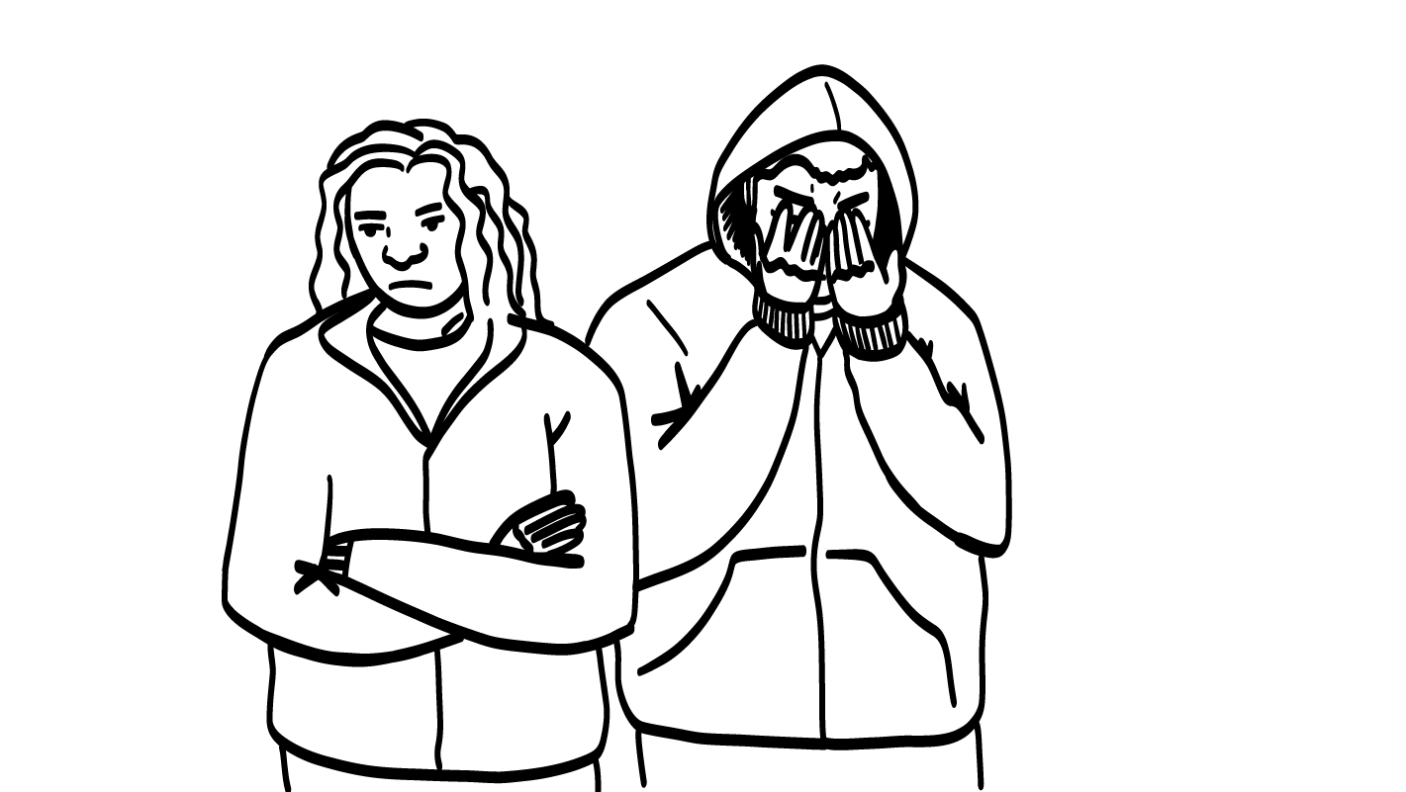
What is rejection?
When you ask someone
to be your friend and they say no.
When someone
breaks up with you.
Really hard!
© 2026 SAFE Disability Services Program
Notes:
Say: Rejection is when you try for something you want, and someone says no. For example, you might try out to be on a soccer team. If you don’t make the team, that’s rejection.
In friendships, rejection is when you ask someone to be your friend, and they say no. Rejection is also when someone who is your friend breaks up with you. How does rejection make people feel?
Give students enough time to process the question and make their decisions.
Say: Rejection can make people feel really sad, hurt, worried, or mad. It is hard to get rejected. But you won’t feel bad forever!

Slide 22
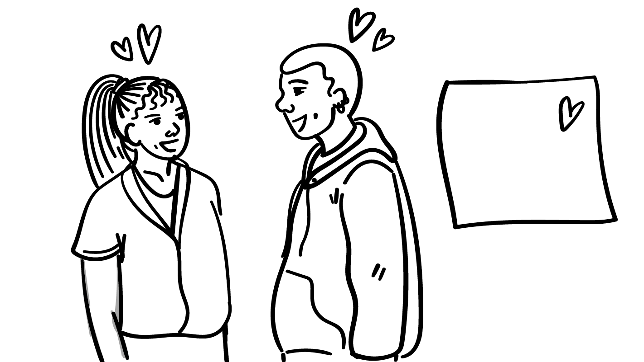
It’s going to be ok
I don’t
want to be your friend.
Okay, I understand.
Other people have the right to tell you NO!
If someone says no to being your friend, or if they break up with you, you have to
respect their answer.
© 2026 SAFE Disability Services Program
Notes:
Say: We all get rejected sometimes, and that’s okay. You have to respect when someone says no to being your friend, or when someone breaks up with you. It doesn’t mean that there’s anything wrong with you. It just means that person wasn’t right to be your friend.
If someone says no when you ask them to be your friend, is it okay to keep asking them over and over again until they say yes? Give a thumbs up for yes and a thumbs down for no.
Give students enough time to process the question and make their decisions.
Say: No, this is not an okay thing to do. Just like you have the right to say no to anyone or anything that you are not comfortable with, other people have the right to tell you no too. If they say no, you should back off and give them space. You have to respect their answer. How might someone feel if you keep asking them to be your friend even after they have said no?
Give students enough time to process the question and make their decisions.
Say: They might feel really mad, frustrated, or scared. This is not cool. You have to listen and respect the answer when someone says no.

Slide 23
Healthy
Disagreements
Disagreements Practice
Brain break
Ending Relationships
Rejection
Self-Care Plan
© 2026 SAFE Disability Services Program
Notes:
Say: So, what can you do when you feel big emotions after being rejected? We are going to talk about that next.

Slide 24
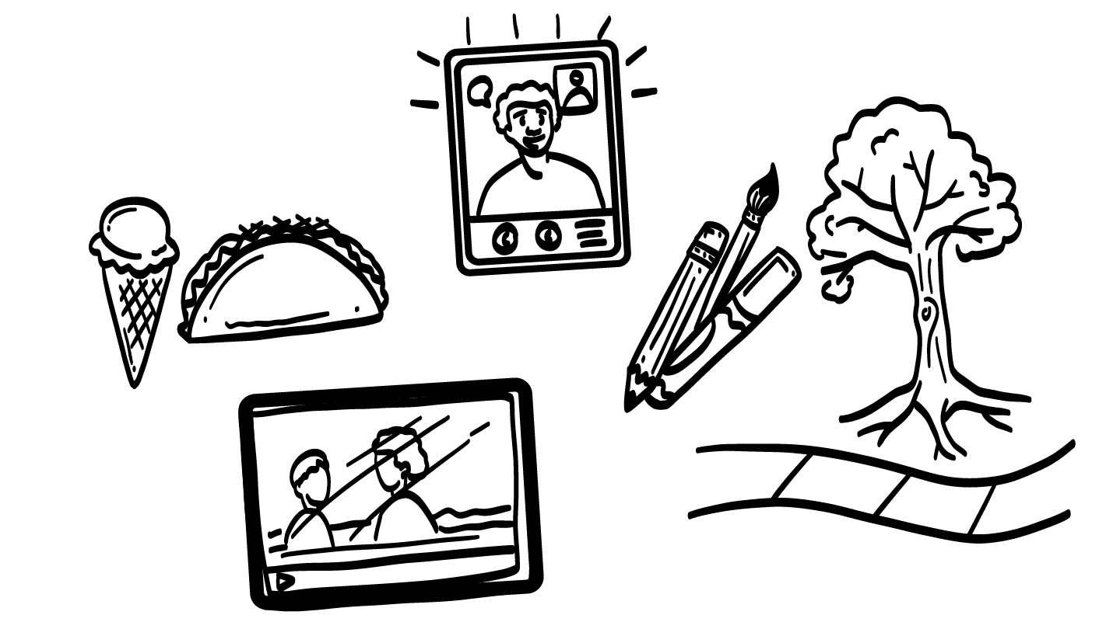
What makes you feel better after rejection?
Self-care can
help you feel
better after rejection!
© 2026 SAFE Disability Services Program
Notes:
Say: In an earlier class, we talked about self-care. Self-care is when you do things you love that make you feel really good. When you are rejected and feeling strong emotions like sad, mad, or hurt, you can use self-care to feel better. What are some things that you really love to do?
Give students enough time to process the question and make their decisions. As students name things, write them on the whiteboard or a piece of chart paper.
Say: This is a great list! Now I want you all to think of what things you specifically will do if you are rejected. You can write or draw them on your Rejection Self-Care Plan.
Give each student a printed copy of the Rejection Self-Care Plan (see template at end of the lesson plan). Support students as needed to fill out their plans.

Slide 25
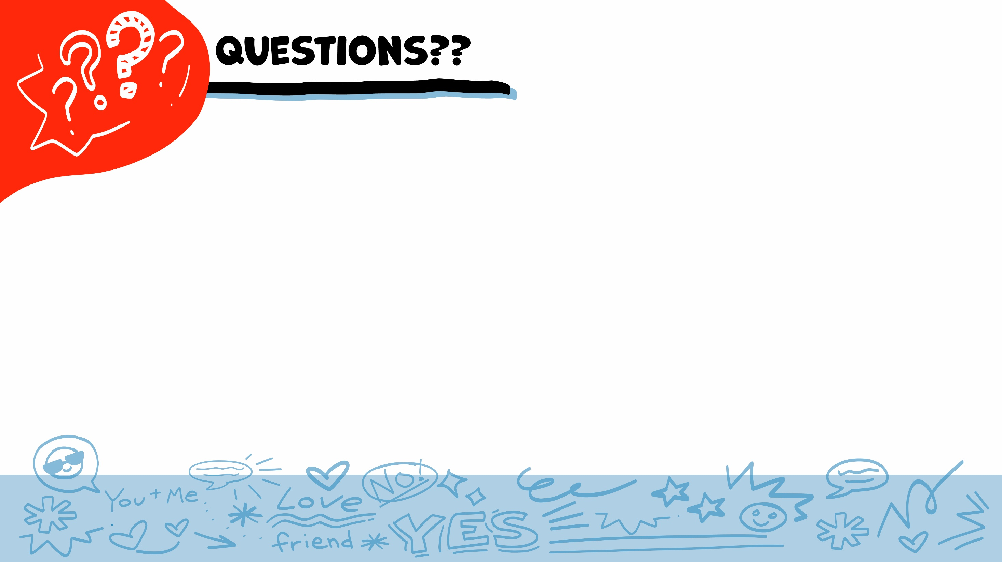

© 2026 SAFE Disability Services Program
Notes:
Say: Does anyone have any questions about today’s class? Remember, if you don’t want to ask your question out loud, you can write it on a notecard and leave it on your desk. You can also ask someone you trust to help you write your question on the notecard. I will pick up the notecards and will answer the questions the next time we meet. When I answer a question, I won’t tell anyone who asked it.

Slide 26




What is a healthy way to have a disagreement with a friend?
Yell at them
Use an I statement
Ignore them
1
2
3
© 2026 SAFE Disability Services Program
Notes:
Say: What is a healthy way to have a disagreement with a friend? Hold up one finger for “yell at them,” two fingers for “use an I statement,” and three fingers for “ignore them.”
Give students enough time to process the question and make their decisions.
Say: Using an I statement is a healthy way to disagree with your friend. You practiced this today!

Slide 27


If you are unhappy with your friend, is it okay to break up with them?
YES
NO
© 2026 SAFE Disability Services Program
Notes:
Say: If you are unhappy with your friend, is it okay to break up with them? Give a thumbs up for yes and a thumbs down for no.
Give students enough time to process the question and make their decisions.
Say: Yes! It is always okay to tell someone no. If you no longer want to be in a friendship, it is okay to break up with someone. You can talk to an adult in your inner green circle of trust for help breaking up with someone safely.

Slide 28
What is one thing you can do to feel better if you are sad about being rejected?
© 2026 SAFE Disability Services Program
Notes:
Say: What is one thing you can do to feel better if you are sad about being rejected?
Give students enough time to process the question and make their decisions. Go around the room and ask each student to share one thing from their Rejection Self-Care Plan.

Slide 29
© 2026 SAFE Disability Services Program
Notes:
Say: Another thing you can do to feel better after rejection is talking to an adult in your inner green circle of trust. Who is one adult from your inner green circle of trust that can help you if you feel bad about being rejected?
Give students enough time to process the question and make their decisions. Go around the room and ask each student to share the name of one adult from their inner green circle of trust they could talk to after being rejected.

Slide 30

© 2026 SAFE Disability Services Program
Notes:
Say: Does anyone remember what our power statement is? Our power statement is “I know me best.” This means that each of you knows yourself better than anyone else does. Today you learned more about having healthy disagreements with your friends, and handling rejection. Let’s gather together and on the count of three, say our power statement.
Have each interested student put one hand in the middle of the circle. Ask for a student volunteer to count to three. After three, all participants say the power statement while lifting their hands into the air. Students can also stand in the circle without touching hands if they prefer.

Slide 31

This work is supported by the Texas Council for Developmental Disabilities through a grant from the U.S. Administration for Community Living (ACL), Department of Health and Human Services (HHS), Washington, D.C. 20201 with a 100% federal funding award totaling $6,161,072. Council efforts are those of the grantee and do not necessarily represent the official views of nor are endorsed by ACL, HHS, or the U.S. government.
© 2026 SAFE Disability Services Program
Notes:
SAFE would like to thank the Texas Council for Developmental Disabilities for the funding for this curriculum.

Slide 32

This curriculum is offered online at no cost. You are free to use the resources in the original format for educational purposes only. Please reference The SAFE Alliance appropriately (citations at bottom of page).
We ask that you do not alter curriculum images/art, slides, or lesson plan materials. You may not use My Rights My Life (18+ or High School) curriculum for commercial purposes (i.e., selling workshops you facilitate based on MRML curriculum; and/or creating links/websites to re-distribute any materials associated SAFE’s My Rights My Life).
This resource, My Rights My Life: A curriculum for healthier relationships for high school students (grades 9-12) is based on the original My Rights My Life: A curriculum for safer relationships (age 18+) written by Megan Westmore, Heidi Lersch, and edited by Schwartz, M. (2022). Selling materials from MRML is a copyright violation.
Burleson, Anna Belle & Benitez, Sophie (2026) provided light modification and abbreviated the original curriculum
(Westmore & Lersch, 2022) to offer an age appropriate resource for High School Students (grades 9-12).
Schwartz, M. (Ed.). The SAFE Alliance, Austin, Texas.
Westmore, M. & Lersch, H. (2022). My rights my life: A curriculum for safer relationships.
Schwartz, M. (Ed.). The SAFE Alliance: Austin, TX.
© 2026 SAFE Disability Services Program

