Slide 1
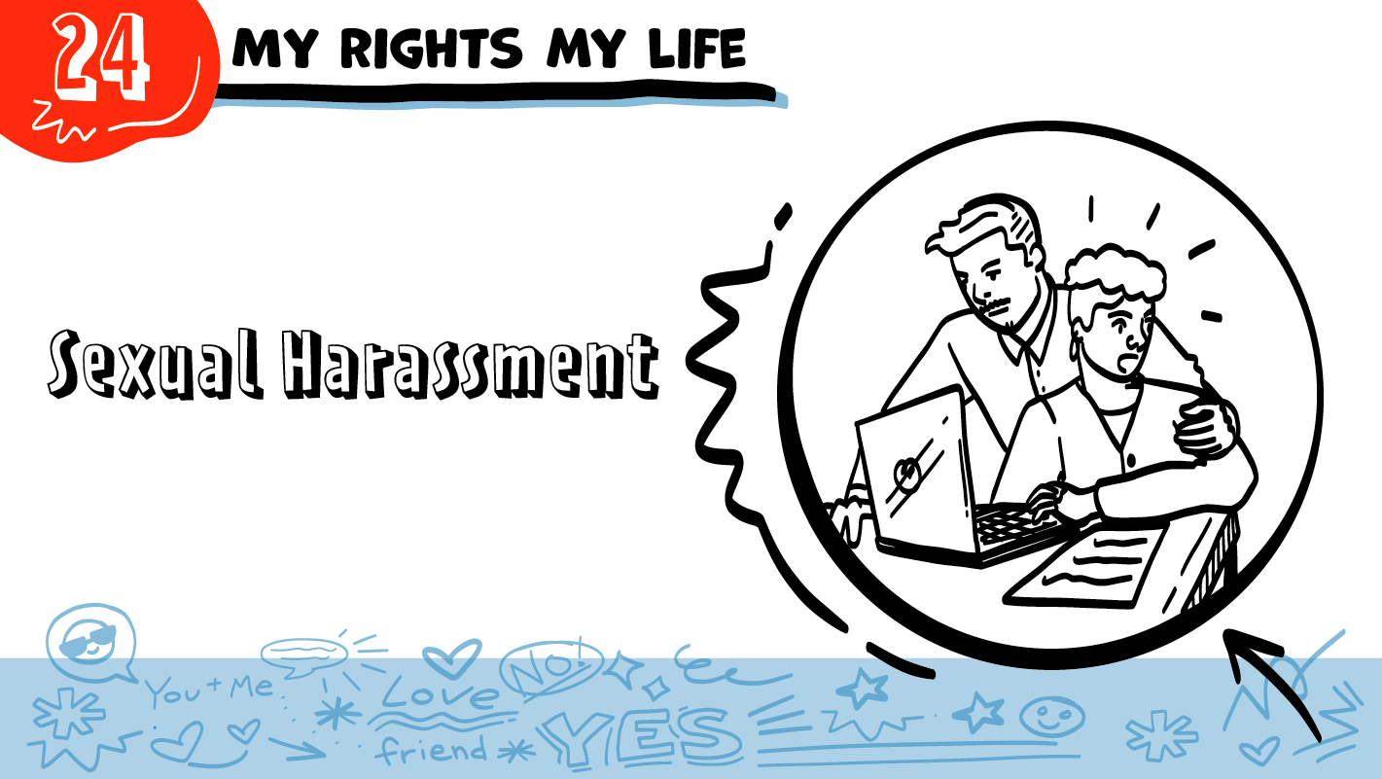


© 2026 SAFE Disability Services Program
Notes:
Repetition is beneficial for learning. Take time to review the last My Rights My Life class you taught prior to beginning this session. You can also answer any private questions students submitted on notecards during your previous class session.
Say: Today we are going to talk about something called sexual harassment.

Slide 2
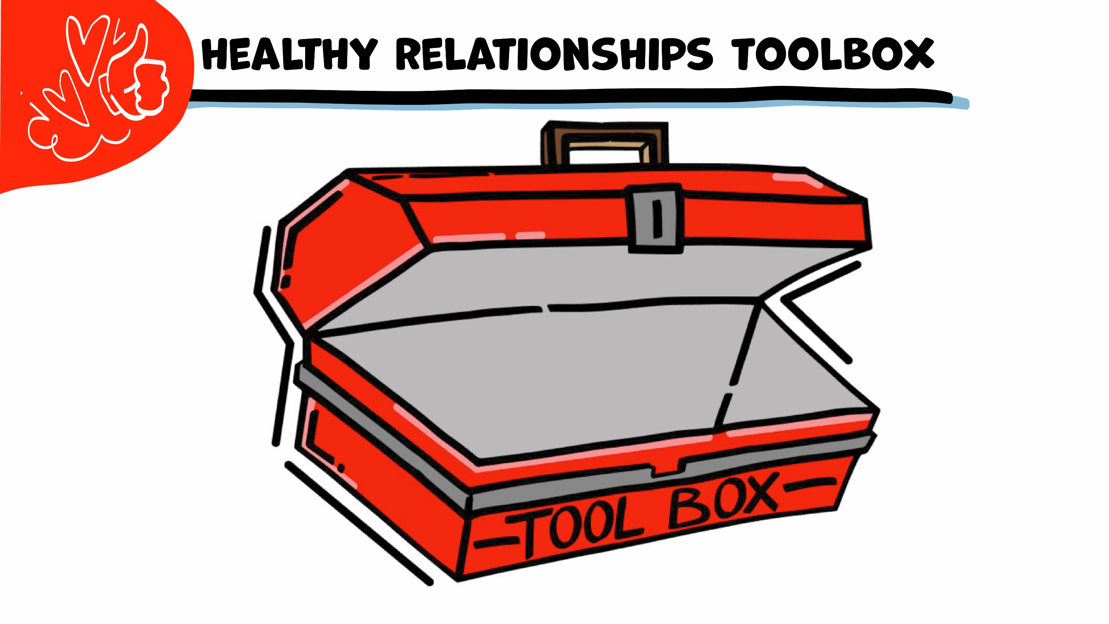
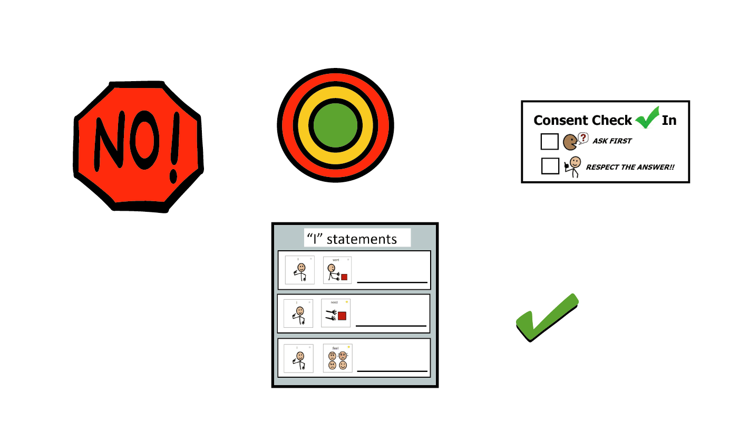
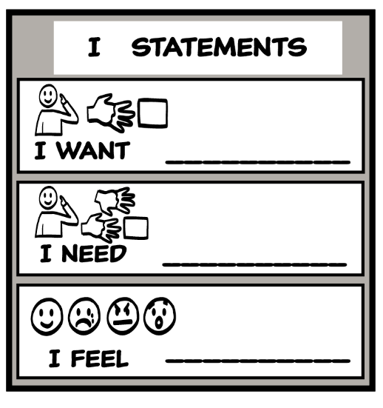
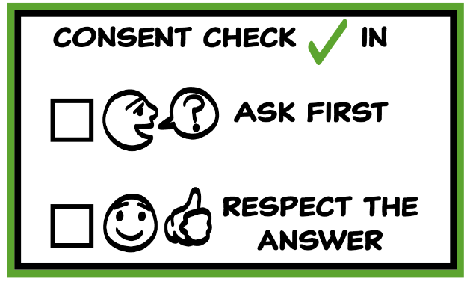
© 2026 SAFE Disability Services Program
Notes:
Use the large class Healthy Relationship Toolbox to review the Healthy Relationship Tools (I Statement, Relationship Map, NO!, and Consent Check-In). You can ask students to pull off one tool at a time and discuss what it is and how it is used. It can be particularly helpful to give students specific scenarios to think through. For example, you might ask, “If your friend lies to you, what is one I Statement you could use to tell your friend how you feel?” You may even consider using examples of situations that have recently occurred in your classroom, as long as doing so does not break student confidentiality. You can also ask students to connect the toolbox tools to their current relationships. You might say, “Can anyone volunteer and tell me about something going on in your life right now that the toolbox could help you with?”
Instructions for how to use each Healthy Relationship Tool can be found in the following classes:
I Statements: Classes 2 and 3
Relationship Map: Class 4
NO!: Class 5
Consent Check-In: Class 6

Slide 3










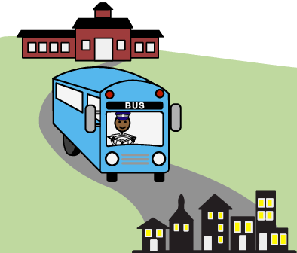
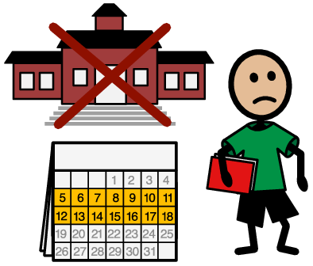



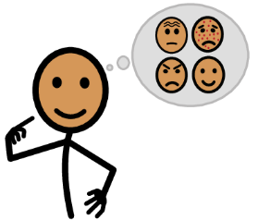





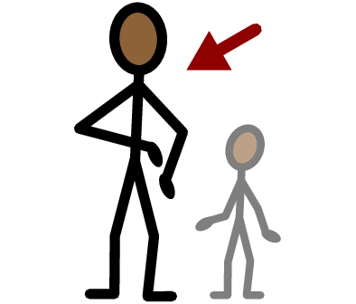
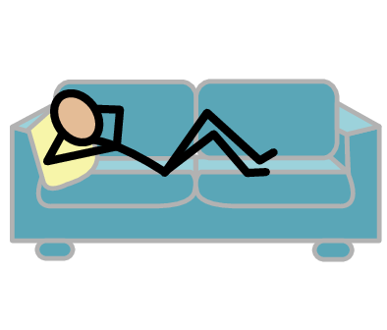
Sexual harassment
Catcall
Unwanted
Touch
Talk
Yes
No
School
Work
Community
Suspended
Fired
I need help
I have a question
Trust
Adult
Take a break
I feel
Happy
Sad
Mad
Scared
Copyright © 2021 SymbolStix, LLC. All rights reserved. Used with Permission.
Notes:
You can print this slide separately so each student can use the Important Words Sheet as a communication board throughout class. Review the words using the suggested definitions below. To enhance understanding, you can ask students to come up with their own definitions for vocabulary words or to provide a sentence or scenario using the new word.
Sexual harassment: unwanted sexual words and touching
Catcall: when someone makes a whistle, sound, or sexual comment to a person on the street. This happens more to women than to people of other genders
Unwanted: something someone does not like
Touch: putting your hands on something
Talk: when you use your words, signs, or pictures to tell someone something
School: a place where you go for classes
Work: a place you go to do your job
Community: places that people who live in the same area can go to, such as a restaurant or a park
Suspended: when your school says you cannot come back for a while
Fired: when your work says you do not have a job anymore

Slide 4
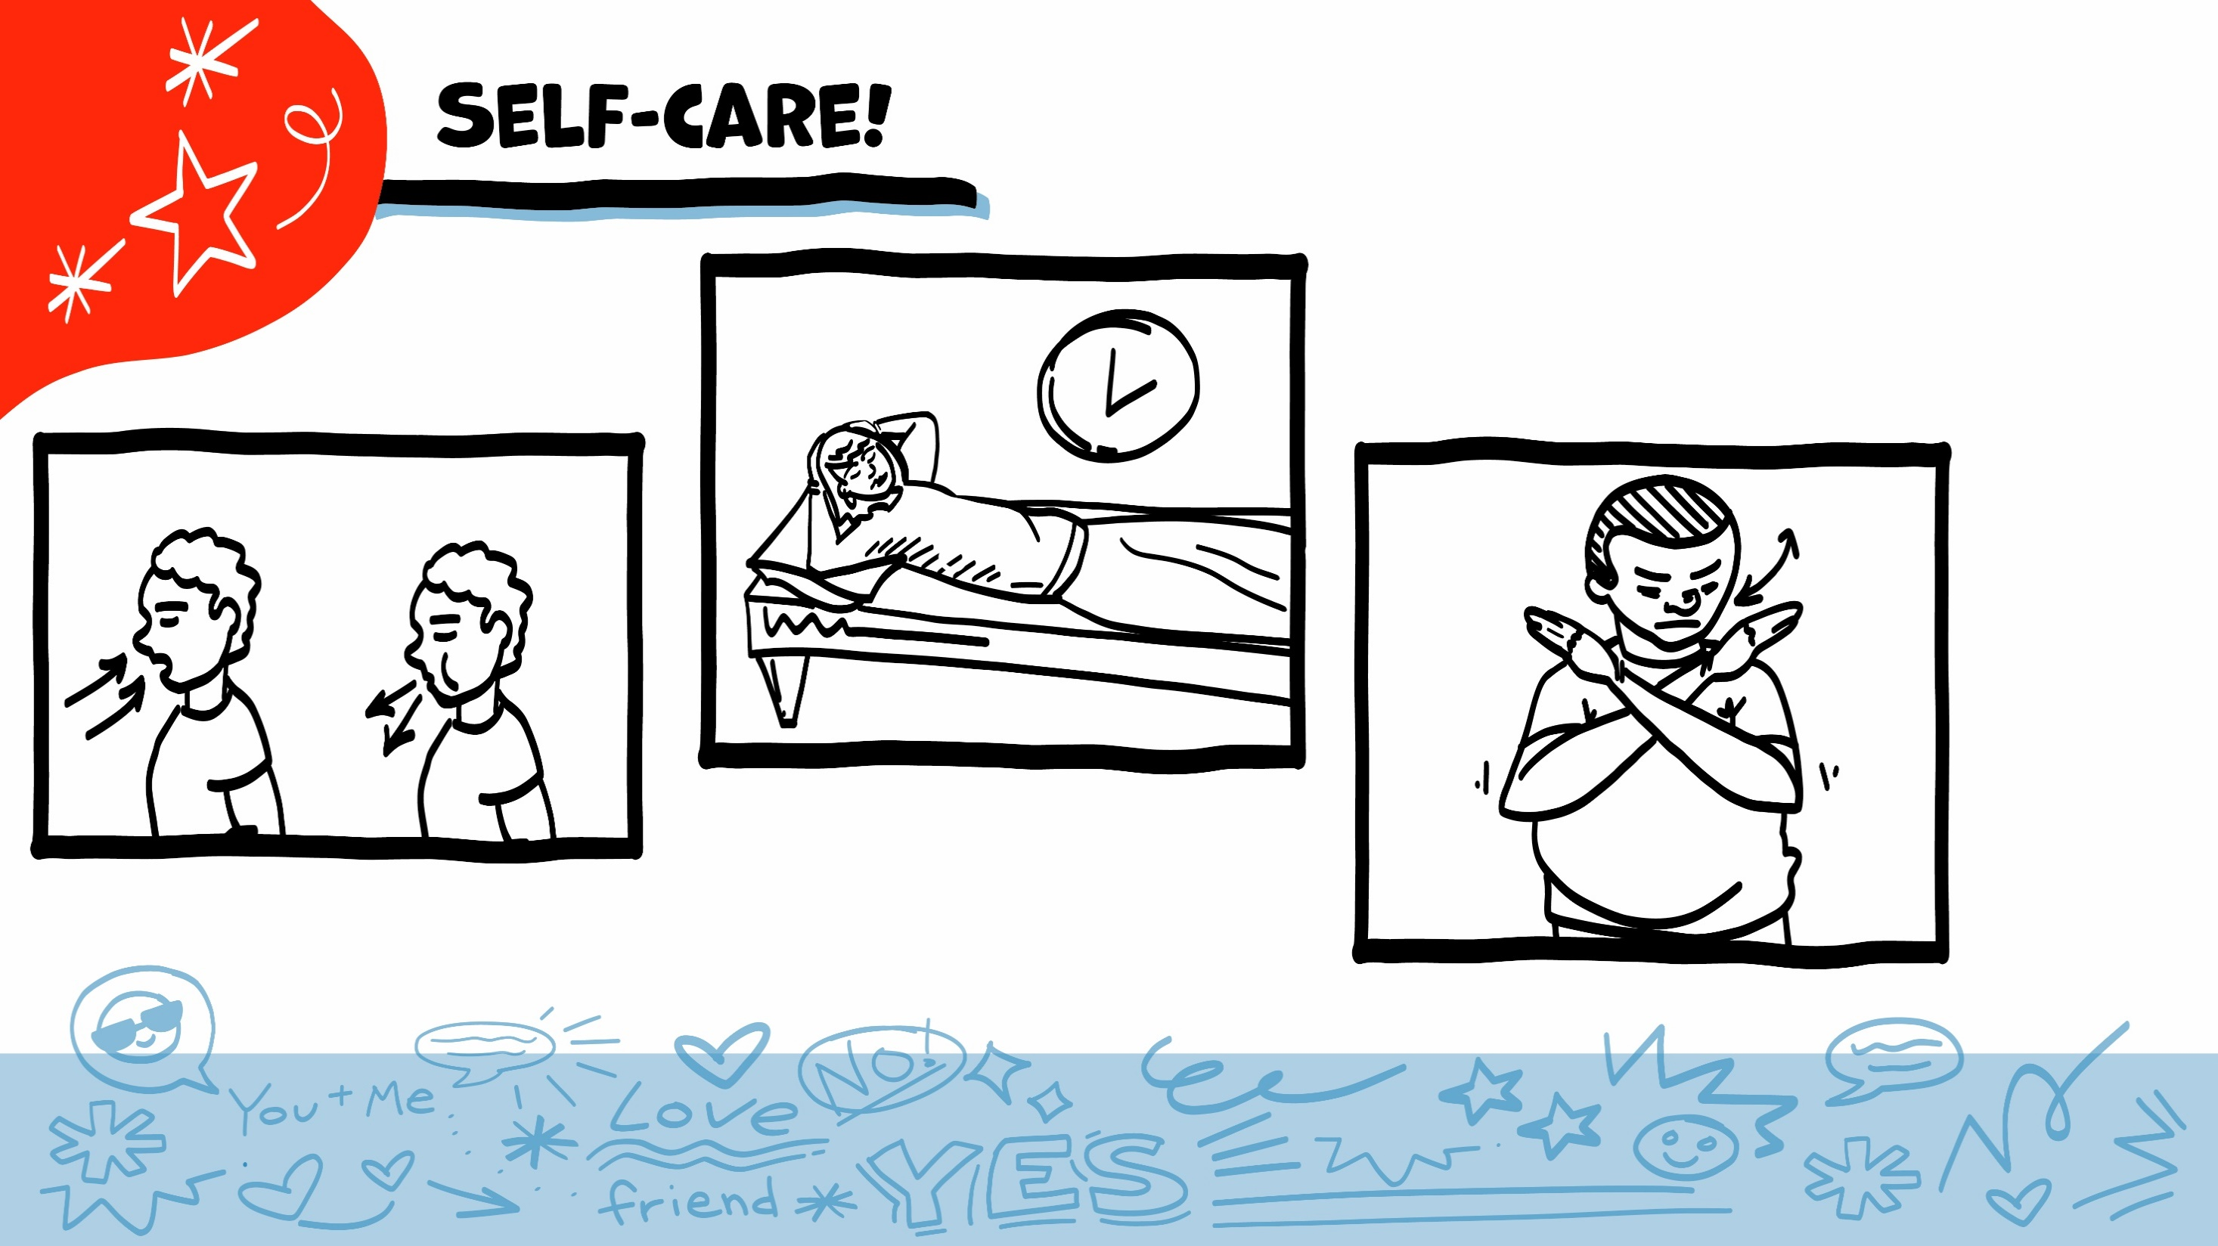
© 2026 SAFE Disability Services Program
Notes:
Say: As part of our class today, we will talk about things people do that feel unsafe. You might feel embarrassed, scared, or upset when we talk about this. Remember to check in with yourself, and to take care of yourself throughout class. If you feel overwhelmed, you can always take some deep breaths, take a break, or pass on an activity. You can also always talk with me after class, or with an adult from your inner green circle of trust.

Slide 5
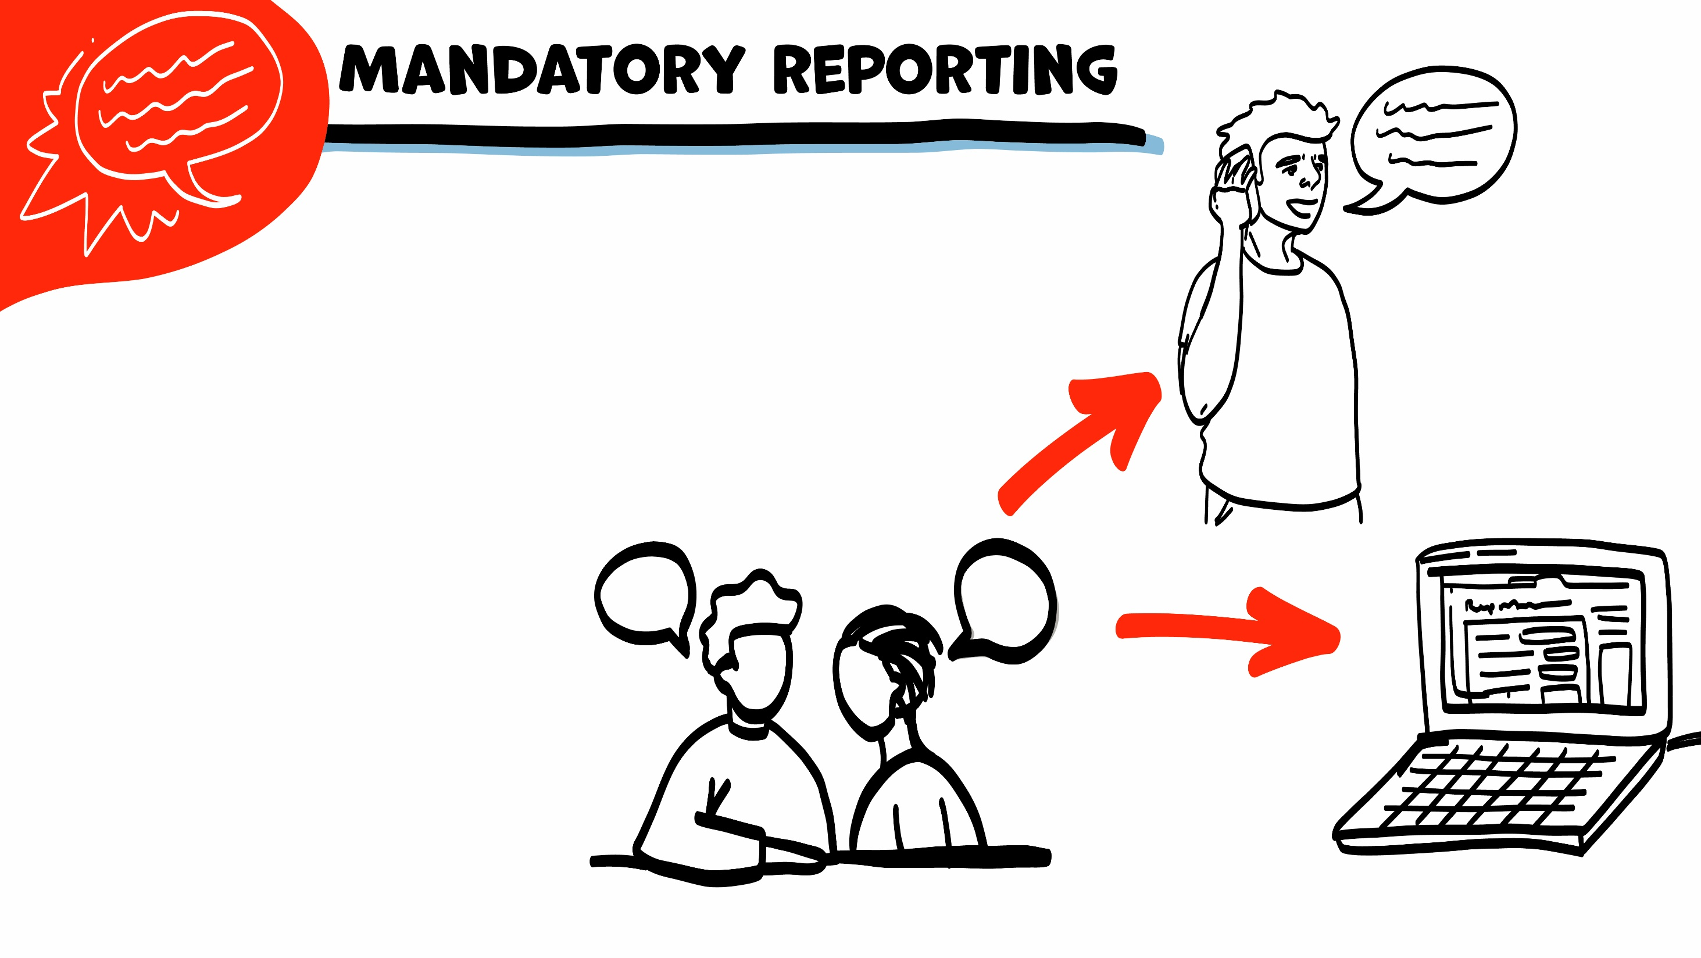
If someone is hurting you, I have to get help. I get help by telling Child Protective Services (CPS) or Adult Protective Services (APS).
If I need to tell CPS or APS, I will let you know first. We can make a report together on the phone or on the computer.
© 2026 SAFE Disability Services Program
Notes:
Say: I want to remind everyone that I am a mandatory reporter to Child Protective Services and Adult Protective Services. Does anyone remember what that means? Normally what we talk about in class stays in class, unless I have your consent to share. This is a private, safe place to ask questions about your bodies and sex. However, if you tell me that you are being hurt, or that someone else is being hurt, I will need to let Child Protective Services or Adult Protective Services know. I would need to get you or the other person help, so no one hurts you anymore. You can also help make the report with me if you want to or be in the room with me when I make a report. Does anyone have any questions about that?

Slide 6
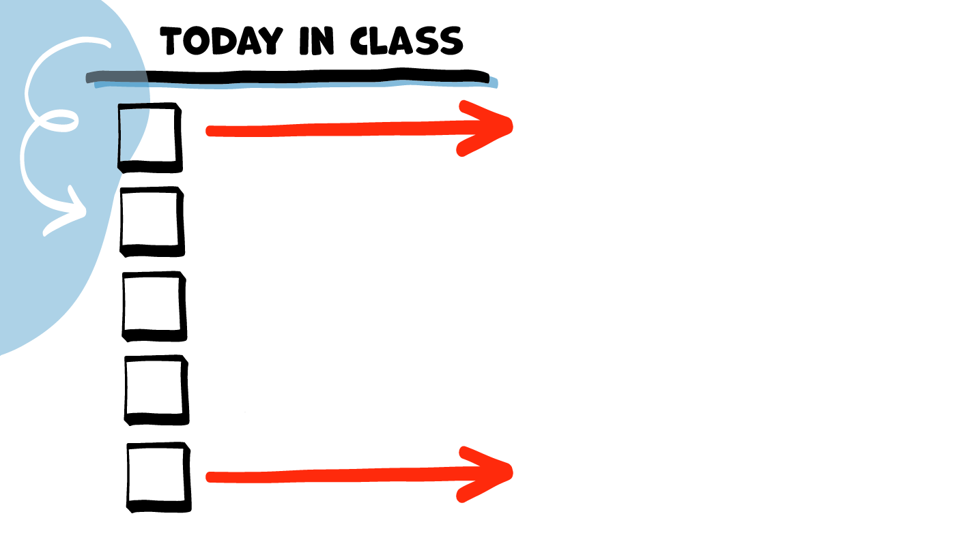
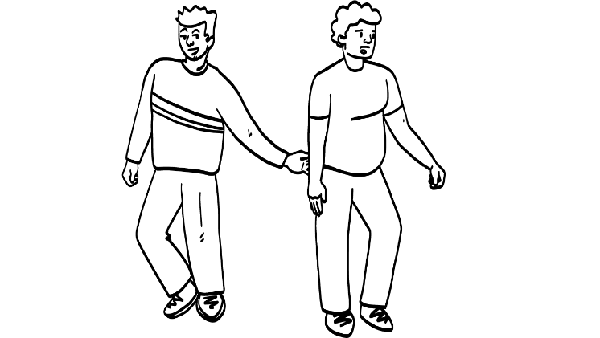



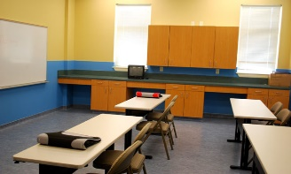
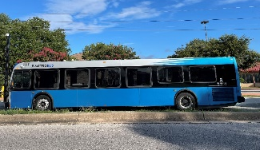

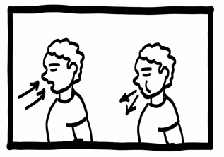
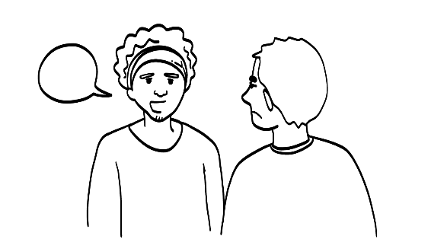
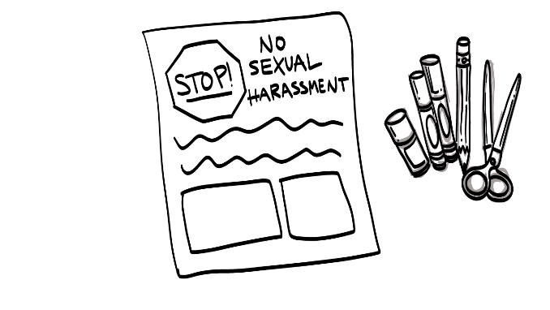
What is sexual harassment?
School, work, and community
Brain break
What can you do?
Poster activity
© 2026 SAFE Disability Services Program
Notes:
Read the agenda. Alternatively, you can ask for a student volunteer to read the agenda.

Slide 7
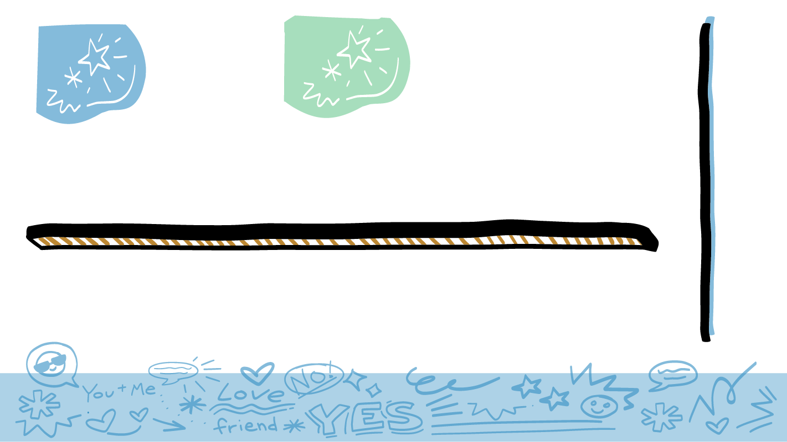

Raise your hand if..
© 2026 SAFE Disability Services Program
Notes:
Start class by helping students to understand how sexual harassment connects to their lives. After each statement below, give students time to process the sentence and decide if they want to raise their hands.
Say: Raise your hand if:
You want your school to be a safe place.
You want your community to be a safe place.
You have a job.
You want a job.
You want your work to be a safe place.
Today we are going to talk about sexual harassment. Sexual harassment can make people feel unsafe at school, at work, or in the community. We will talk about what it is and what you can do to stop it.

Slide 8

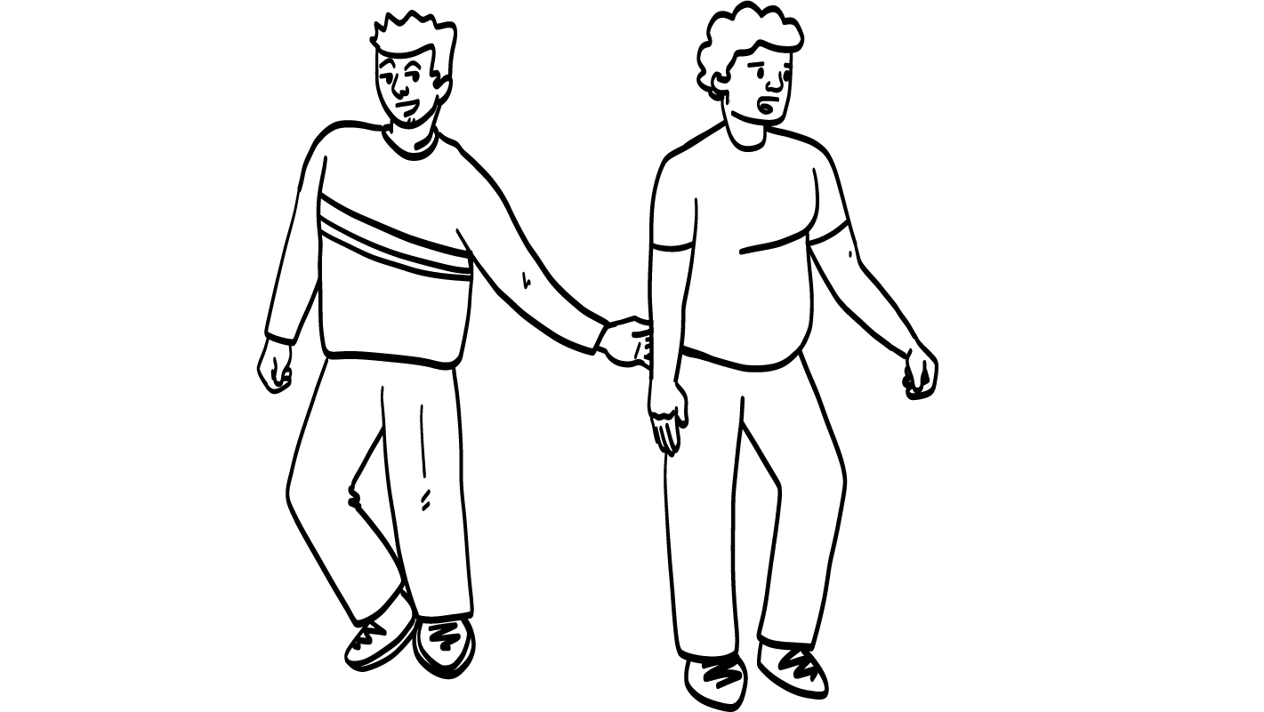
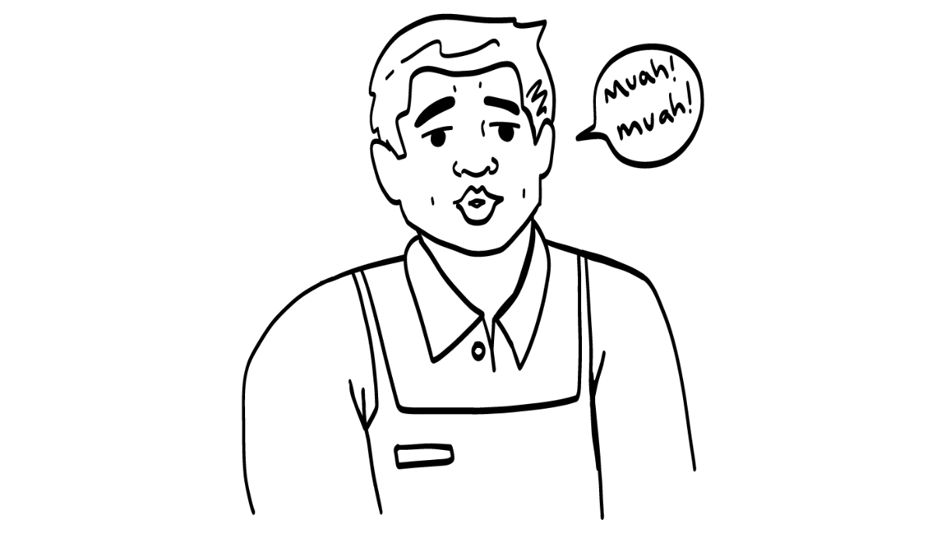
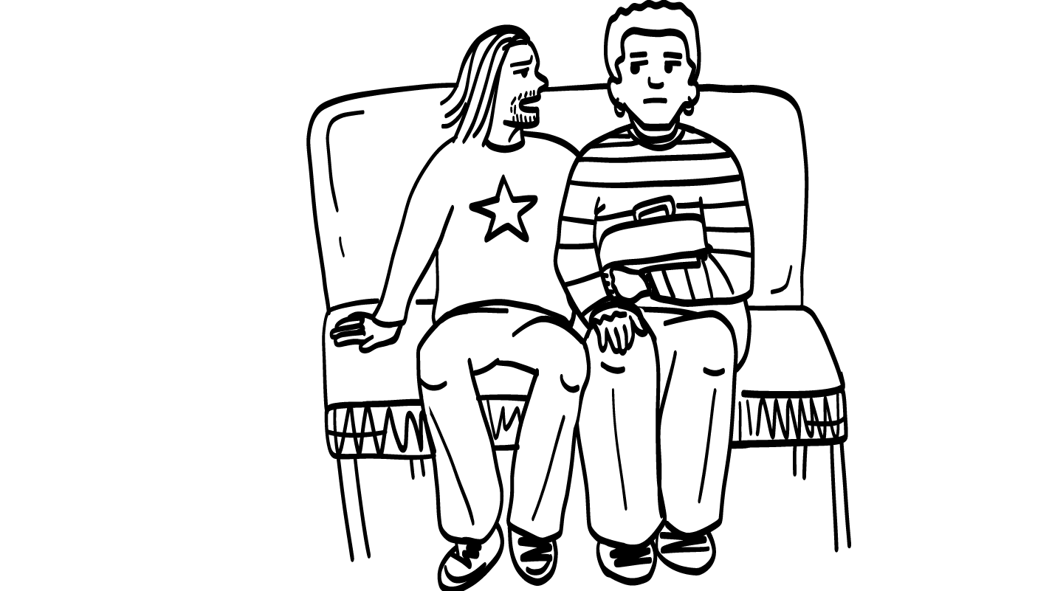
Hey sexy!
Sexual harassment is unwanted sexual words or sexual touching.
© 2026 SAFE Disability Services Program
Notes:
Say: Sexual harassment is unwanted sexual words or sexual touching. Sexual harassment can be unwanted comments about someone’s body or body parts or asking people to do sexual things that they do not want to do. It can also be unwanted touching. Unwanted means the person does not like the words or touching.
Sometimes sexual harassment can be small things like someone staring at you or looking at you in a sexual way. Sexual harassment can also be words that seem nice, but how they are said makes you feel uncomfortable or unsafe. For example, a stranger yelling “You’re beautiful!” or “Looking good!” at you as you walk by is sexual harassment and can make you feel uncomfortable or unsafe.

Slide 9
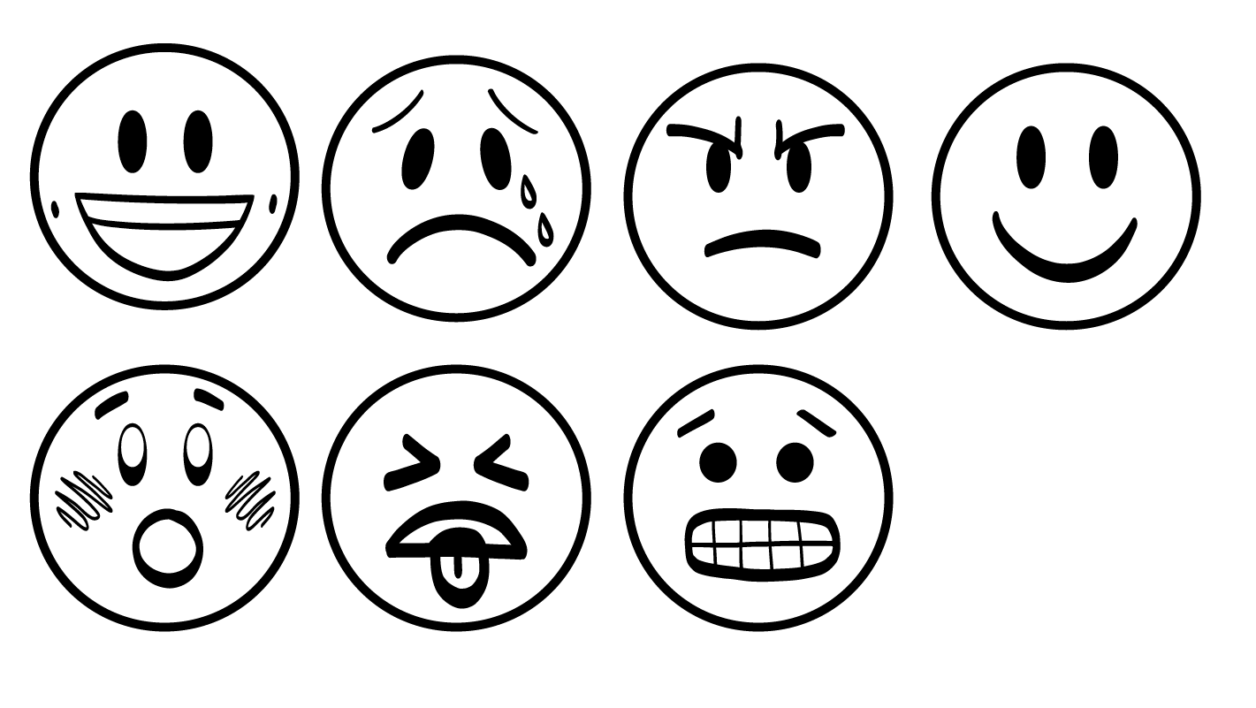
Sexual harassment makes people feel
Grossed out
Nervous
Sad
Mad
Scared
© 2026 SAFE Disability Services Program
Notes:
Say: Sexual harassment is not okay. Sexual harassment makes people feel grossed out, nervous, sad, mad, or scared.

Slide 10
What is sexual harassment?
School, work, and community
Brain break
What can you do?
Poster activity
© 2026 SAFE Disability Services Program
Notes:
Say: Now that we’ve talked about what sexual harassment is, let’s look at where it can happen.

Slide 11

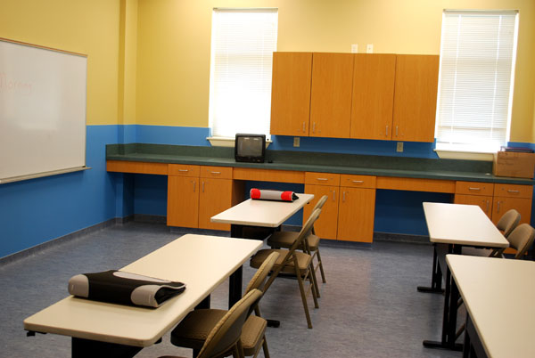

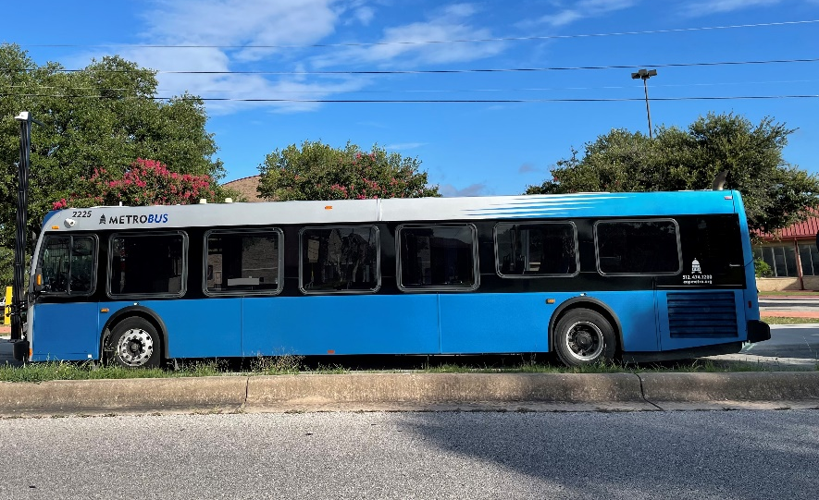
Sexual harassment can happen at school, at work, or in the community
© 2026 SAFE Disability Services Program
Notes:
Say: Sexual harassment can happen at school, at work, or in the community.

Slide 12
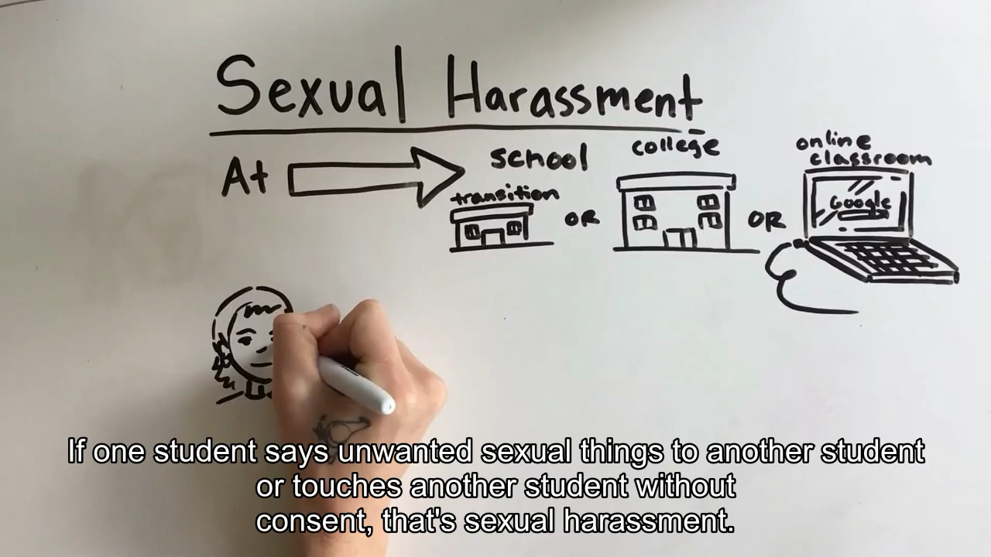
Sexual harassment at school
© 2026 SAFE Disability Services Program
Notes:
Say: We are going to watch a video that talks about what sexual harassment at school can look and sound like.

Slide 13

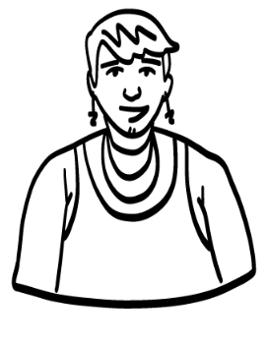
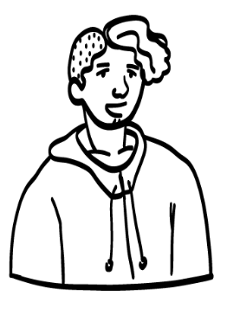
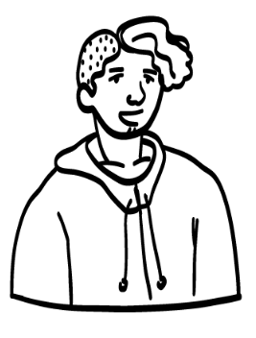
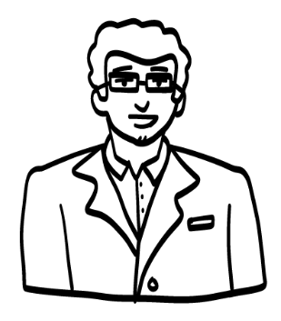
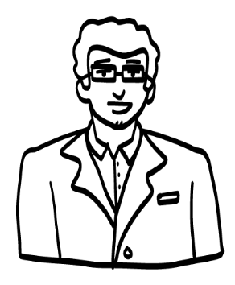
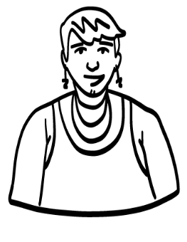
Sexual harassment at school
At school it is against the rules:
For a student to say sexual things to another student or touch another student without consent
For a student to say sexual things to a teacher or touch a teacher without consent
For a teacher to say sexual things to a student or touch a student without consent
Student
Student
Student
Teacher
Teacher
Student
© 2026 SAFE Disability Services Program
Notes:
Say: Just like we saw in the video, if a student says unwanted sexual things to another student, or touches another student without consent, that’s sexual harassment. It is also not okay for a student to say sexual things to a teacher or touch a teacher without consent. If a teacher says sexual things to a student, or touches a student without consent, that’s sexual harassment too.

Slide 14
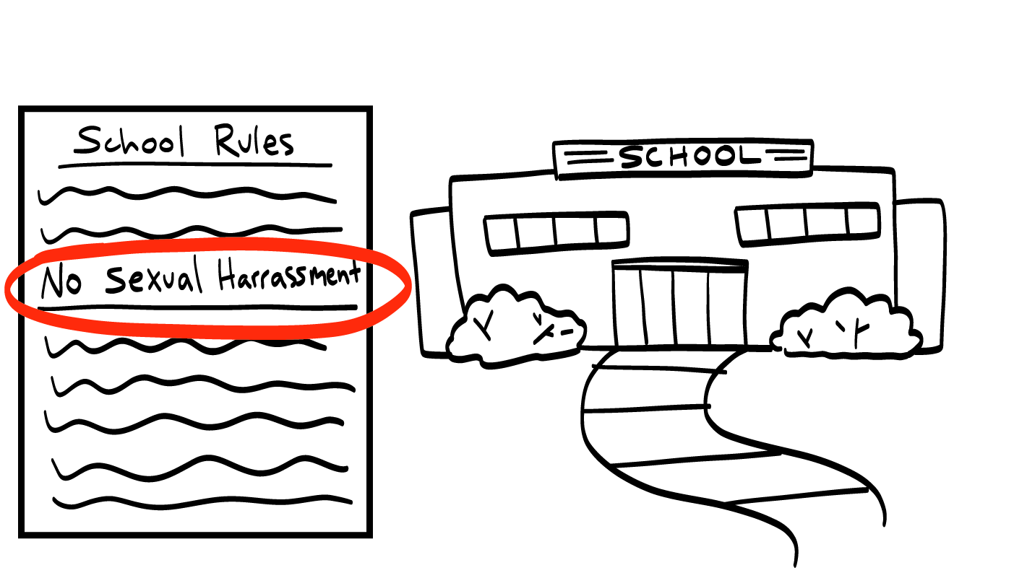
Sexual harassment at school
If you sexually harass someone at school, you can get in trouble and not be able to go to school.
© 2026 SAFE Disability Services Program
Notes:
Say: All students have the right to feel safe at school. Sexual harassment at school is against the rules! You can get in big trouble at school if you sexually harass another student or a teacher. You might be suspended, which means you would not be able to go to school for a while.
If someone sexually harasses you at school, it is not your fault. You can get help from an adult in your inner green circle of trust. We’ll talk more about getting help later in this class.

Slide 15
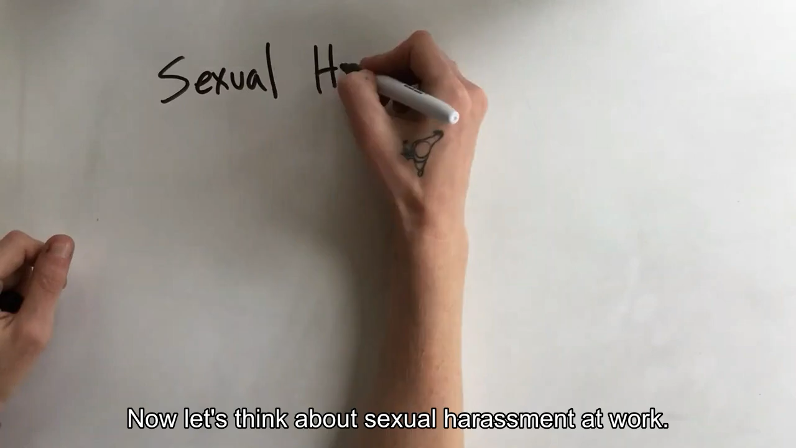
Sexual harassment at work
© 2026 SAFE Disability Services Program
Notes:
Say: Now we are going to talk about sexual harassment at work. Let’s watch a video that talks about what sexual harassment at work looks and sounds like.

Slide 16
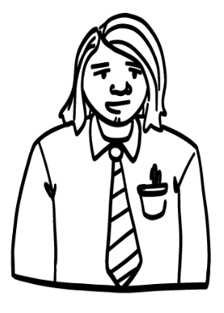
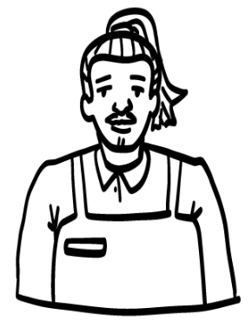
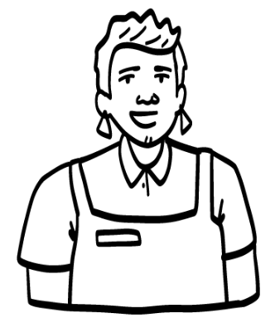
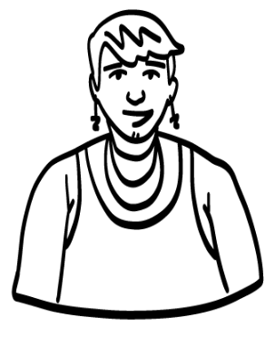
Sexual harassment at work
At work it is against the rules:
For a boss to say sexual things or touch a worker without consent
For a worker to say sexual things or touch a customer without consent
For a worker to say sexual things or touch their boss or coworker without consent
For a customer to say sexual things or touch a worker without consent
Boss
Worker
Customer
Worker
Worker
Worker
© 2026 SAFE Disability Services Program
Notes:
Say: Sexual harassment at work can be done by a boss to their worker, or a worker to their boss. It is also sexual harassment if a coworker says or does unwanted sexual things to another coworker. Finally, if a customer says or does unwanted sexual things to a worker, or a worker says or does unwanted sexual things to a customer, that’s sexual harassment too.

Slide 17
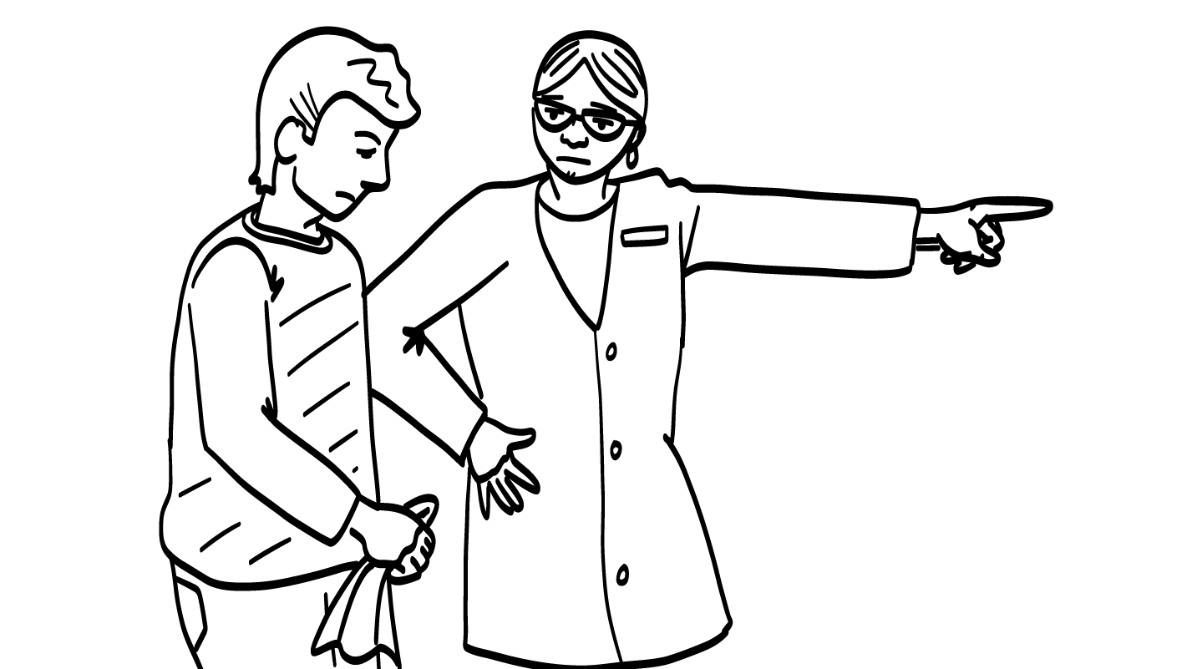
Sexual harassment at work
If you sexually harass someone at work you can be fired and it can be hard to find another job.
© 2026 SAFE Disability Services Program
Notes:
Say: Everyone should always feel safe at work. You have rights at your job. Sexual harassment at work is illegal. This means it is against the law.
If you sexually harass someone at work, you might get in trouble with your boss. You could even be fired, which means that you no longer have a job. It might be hard for you to find another job. Someone could even bring a lawsuit against you. A lawsuit is when someone goes in front of a judge and says that you sexually harassed them. You might have to pay that person money. It is never okay to sexually harass someone.
If you have been sexually harassed at work, it is not your fault. You can get help from an adult in your inner green circle of trust. We’ll talk more about getting help later in this class.

Slide 18

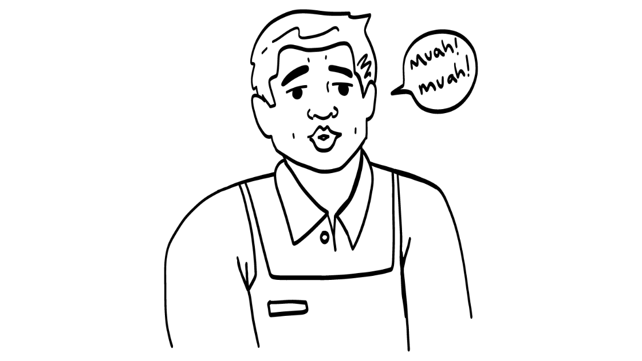
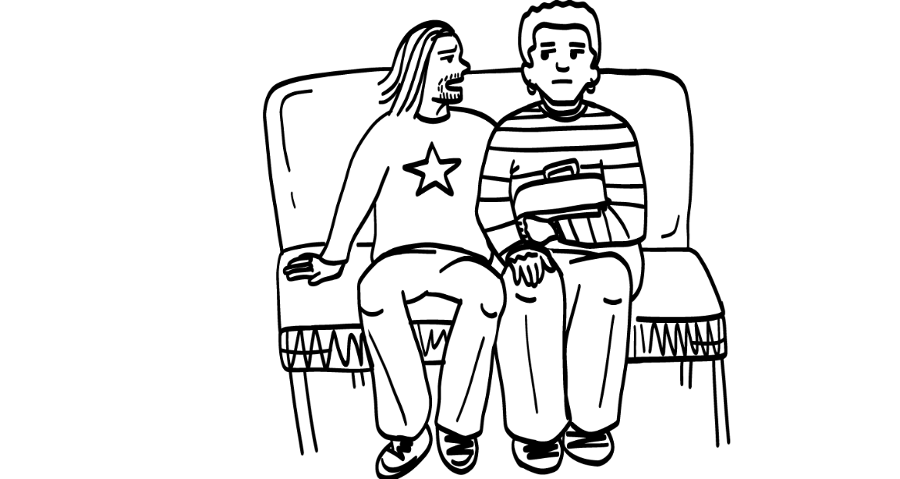
Sexual harassment in the community
Hey sexy!
Sexual harassment can happen on the street, the bus, at a restaurant, or in a community place like a gym.
© 2026 SAFE Disability Services Program
Notes:
Say: Sexual harassment can also happen out in public in the community. It might happen on the street, the bus, at a restaurant, or in a community place like the gym.

Slide 19
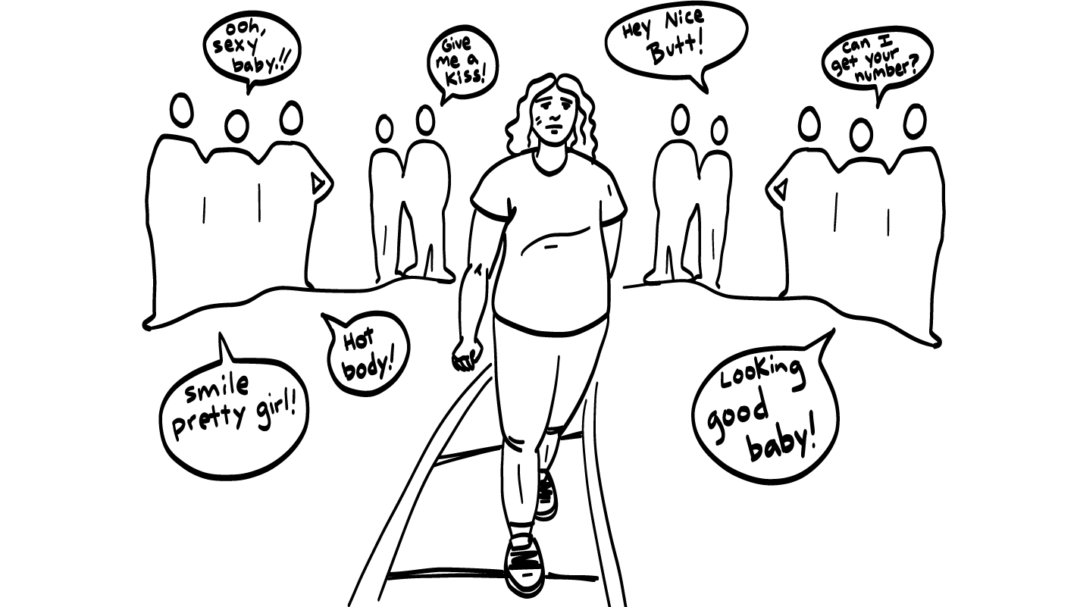
Catcalling
© 2026 SAFE Disability Services Program
Notes:
Say: One type of sexual harassment in the community is catcalling. Catcalling is when someone makes a whistle, a sound, or a sexual comment to a person walking on the street. Women are catcalled more than men.
Sometimes people say that catcalling is a compliment. They think that it’s okay because they are saying that someone is beautiful or looks good. The truth is that catcalling makes people feel really scared and unsafe. It is normal to see someone and think they are cute or beautiful. But that is something you think, not something you say. It is not okay to catcall someone.

Slide 20
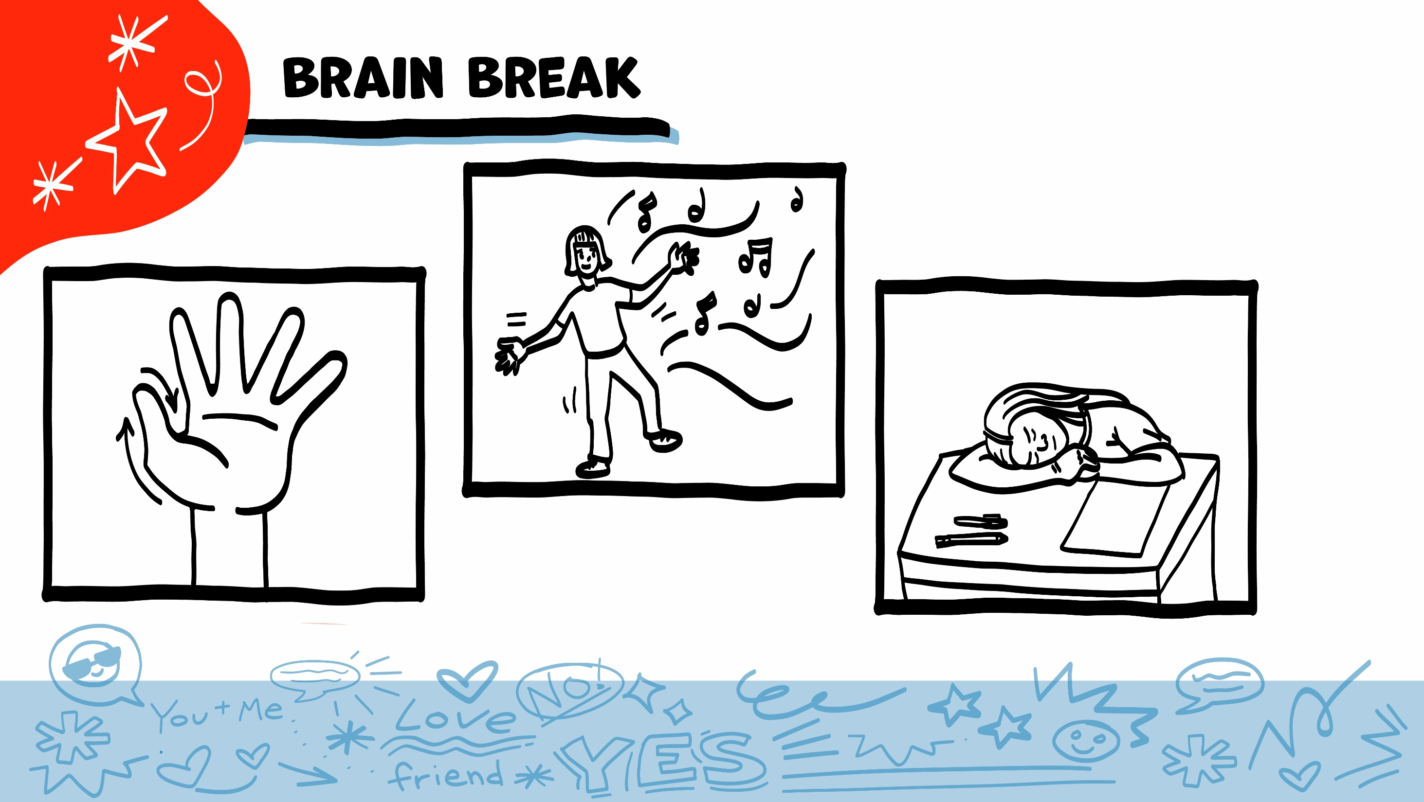
© 2026 SAFE Disability Services Program
Notes:
Say: That was a lot of information, and you all are doing an amazing job! Every week in class we will take a brain break in the middle. This is a chance to move a little and take a break from thinking!
Below are three ideas to give students a quick opportunity for a brain break. You are also welcome to come up with your own ideas for brain breaks that work best for your class.
Five finger breathing
For this exercise, have all students place their hand in front of their chest with their five fingers spread out. Next, use the pointer finger of the other hand to trace up and down each of the five fingers, beginning with the thumb. As students trace up a finger, they will breathe in. As they trace down a finger, they will breathe out. When students breathe out on the pinky finger, you can tell them to shake out their hands and arms. As the school year goes on, you can ask students to lead this exercise for their peers.
If this exercise is physically inaccessible for your class, you can also model the hand tracing for students while they breathe in and out.
Stretch break
Lead students through a series of basic stretches. These can be completed in a chair, or while standing up, depending on the accommodation needs of your class. Some ideas include reaching toward the ceiling, stretching one arm at a time across the chest, reaching toward toes, turning head from side to side, etc. Ask students to hold a pose while you count to ten. As the school year goes on, you can ask students to lead stretches for their peers.
Dance party
If your class likes to dance, you can put on a short song for them to dance to. This is especially effective if you are able to find a song that relates to the theme for that week’s class.

Slide 21

What is sexual harassment?
School, work, and community
Brain break
What can you do?
Poster activity
© 2026 SAFE Disability Services Program
Notes:
Say: Next, we are going to talk about the differences between flirting and sexual harassment.

Slide 22

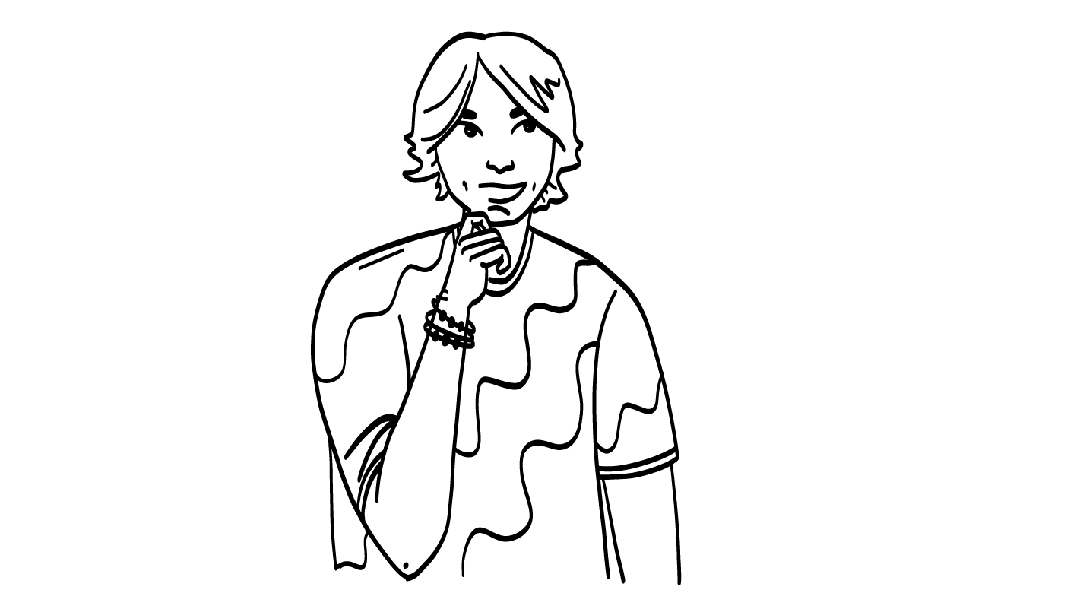
Stop and Think
Do I have consent to do or say this?
Did I ask for consent?
Is this okay to say or do here?
What will happen if I say or do this?
© 2026 SAFE Disability Services Program
Notes:
Say: So how do you know what is okay to do or say and what is not okay to do or say? You should stop and think. You can use these three questions to help you decide what is okay and what is not okay.
Do you have consent to do or say this?
Did you ask for consent? Remember, for it to be consent, both people need to be thinking clearly and give an excited yes! It is not okay to pressure or try to force someone to talk to you.
Is this okay to say or do here? Even if you have consent, it is not okay to say or do uncomfortable things.
What will happen if you say or do this? Will this make someone feel uncomfortable? If it will make someone feel unsafe, you should not do it!
If you aren’t sure of an answer to one of these questions, talk to an adult in your inner green circle of trust. You need to be totally sure that something is okay to say or do before you do it.

Slide 23
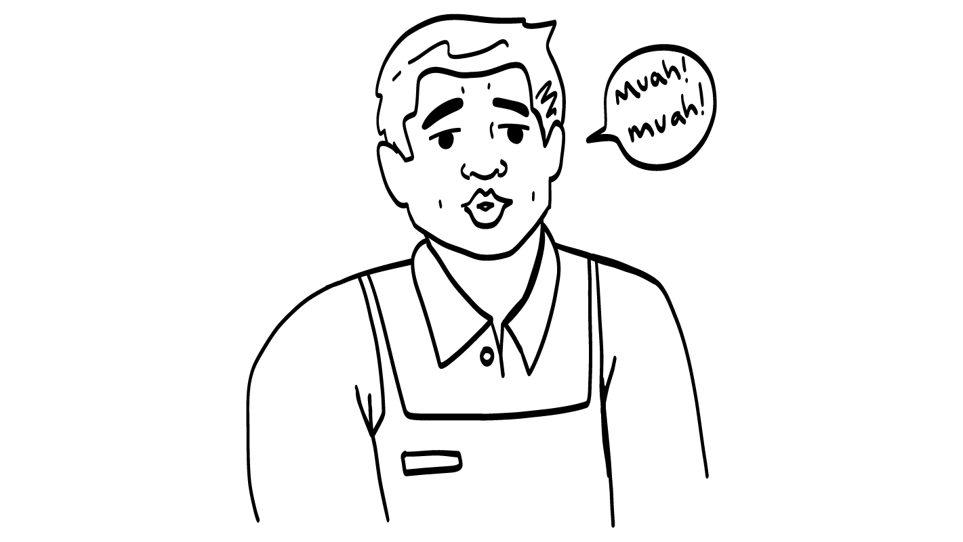


Being nice or sexual harassment?
Your coworker makes kissing noises at you.
Sexual
harassment
Being nice
© 2026 SAFE Disability Services Program
Notes:
Say: Say: Let’s practice! I am going to read the screen, and I want you to decide if the thing is someone being nice or if it is sexual harassment.
Your coworker makes kissing noises at you. Is this being nice or is this sexual harassment? Give a thumbs up for being nice and a thumbs down for sexual harassment.
Give students enough time to process the question and make their decisions.
Say: This is sexual harassment. This would make you feel weird or unsafe. It is not okay to do this.

Slide 24
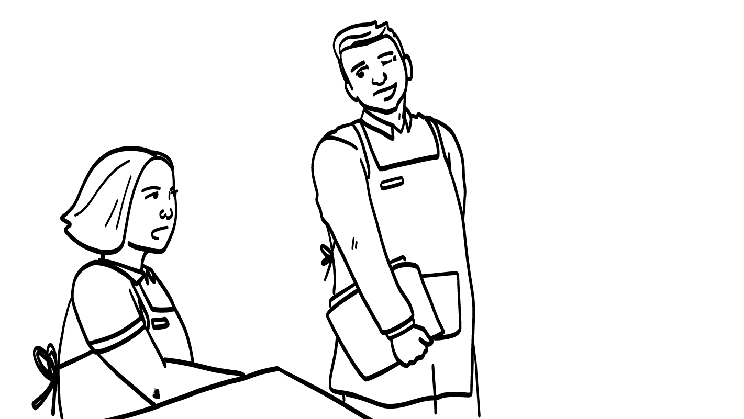

Being nice or sexual harassment?
You look hot!
Your boss says you look hot in your work uniform.
Sexual
harassment
Being nice
© 2026 SAFE Disability Services Program
Notes:
Say: Your boss says you look hot in your work uniform. Is your boss being nice or is this sexual harassment? Give a thumbs up for being nice and a thumbs down for sexual harassment.
Give students enough time to process the question and make their decisions.
Say: This is sexual harassment! Your boss is there to help you at your job. They should not try to date you, talk to you about your body, or touch you in an uncomfortable way. If this happens, you need to get help right away.

Slide 25
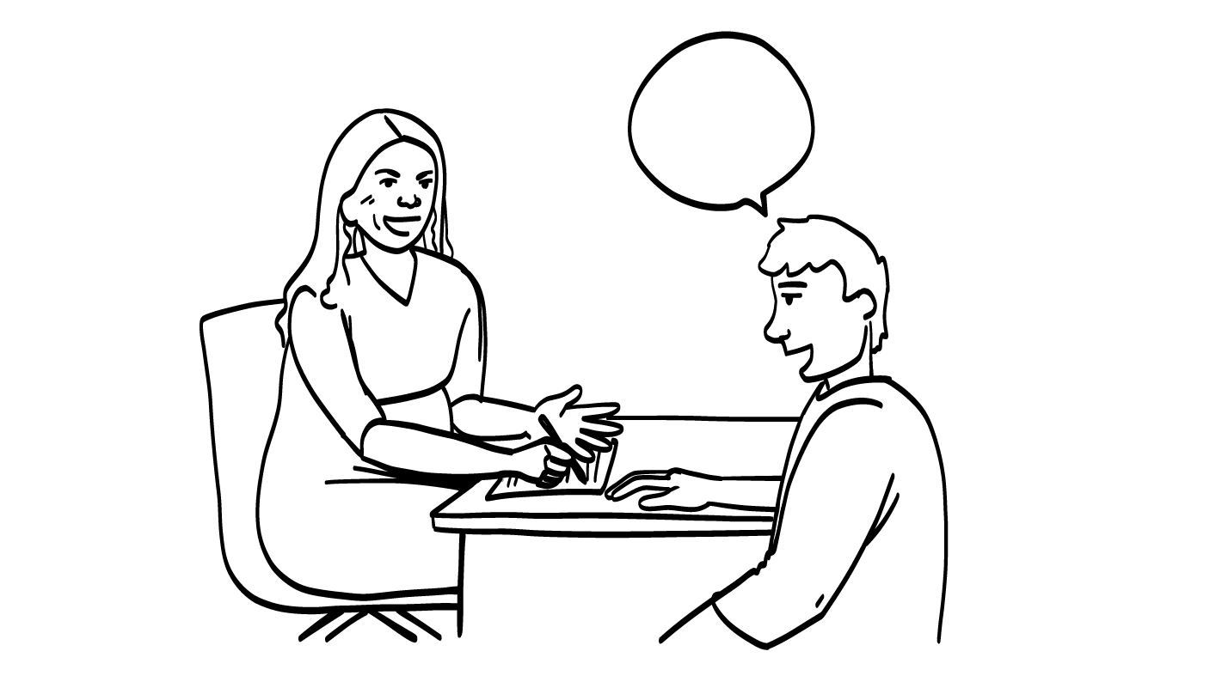
Being nice or sexual harassment?
Your shirt is so cool!
Your coworker tells you that you have a cool shirt.
Sexual
harassment
Being nice
© 2026 SAFE Disability Services Program
Notes:
Say: This is our last example. Your coworker tells you that you have a cool shirt. Is this being nice or is this sexual harassment? Give a thumbs up for being nice and a thumbs down for sexual harassment.
Give students enough time to process the question and make their decisions.
Say: This is being nice! This is not a sexual comment. It is okay to give someone a compliment on their clothing.

Slide 26
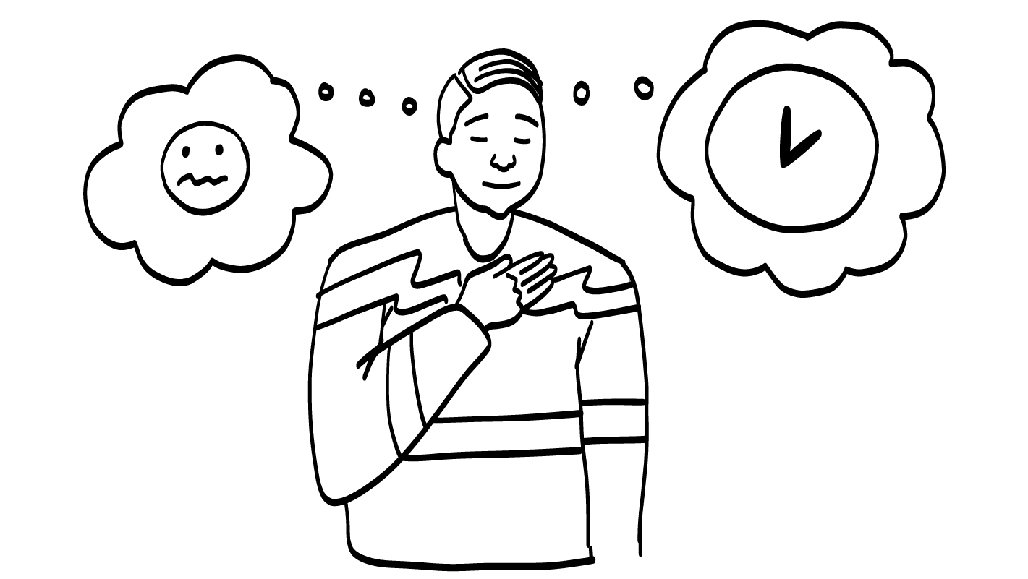
1. Trust your feelings.
Grossed out
Nervous
Sad
Mad
Scared
© 2026 SAFE Disability Services Program
Notes:
Say: If you are sexually harassed, it is never your fault. You can get help. A few weeks ago, we talked about our Boundaries Guide. You can get help by using the guide. You may remember that the first step of the Boundaries Guide is to trust your feelings. Your feelings let you know what your boundaries are. Remember YOU KNOW YOU BEST! Your feelings let you know when things are unsafe. When you feel uncomfortable or unsafe, trust your feelings.

Slide 27
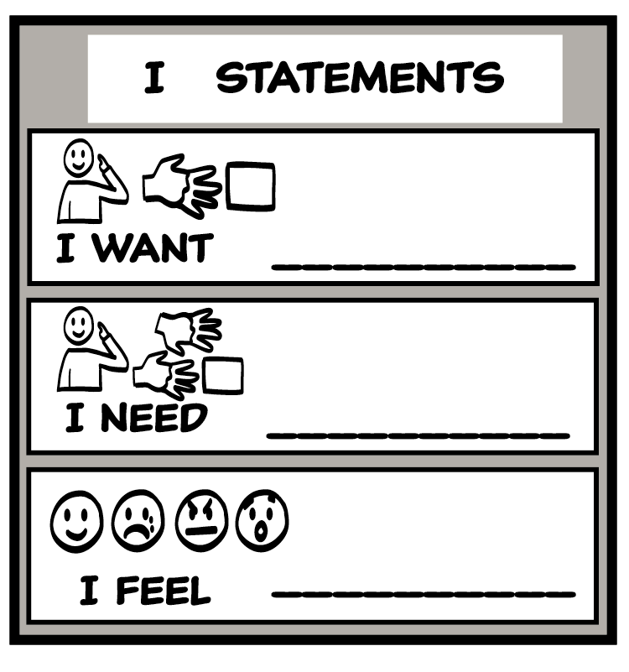
2. Say your boundary.
© 2026 SAFE Disability Services Program
Notes:
Say: The second step is to say your boundary. You can use your voice, signs, pictures, or body to communicate your boundary. There are also two Relationship Toolbox Tools you can use to set your boundary. The first is the NO! Tool. You can always say NO! If you feel safe speaking up, you can let the harasser know that their words or actions are unwelcome and make you feel uncomfortable.
Another way to say your boundary is to use the I Statements Tool. Remember, I statements tell other people how you are feeling or what you want or need. You might say, “I want you to stop.” or “I feel uncomfortable. Please don’t say things like that to me.”
Sometimes when you speak up, people might say things like, “I didn’t do that” or “You are overreacting” or “You’re crazy.” If this happens, talk to someone you trust for help. You know what happened and you know how it made you feel.

Slide 28

3. Get safe.
© 2026 SAFE Disability Services Program
Notes:
Say: The last step is to get safe. Leave the situation if you can.
You can also always tell someone from your inner green circle of trust what happened. Being sexually harassed can be really scary and make you feel sad, angry, scared, or embarrassed. Remember that it is never your fault.
Who is one adult from your inner green circle of trust you could talk to for help if someone sexually harasses you?
Give students enough time to process the question and make their decisions. Go around the room and ask each student to share the name of one person from their inner green circle of trust.

Slide 29

If you see sexual harassment
Stop!
If it is safe, tell the harasser to stop.
© 2026 SAFE Disability Services Program
Notes:
Say: We have talked about how to make sure you don’t sexually harass someone. We also talked about what to do if you are sexually harassed. But what about if you see someone else being sexually harassed? What can you do?
First, if it’s safe, you can tell the harasser to stop. Don’t laugh or encourage the harasser. You don’t want to make the person feel like sexually harassing someone is okay or just a joke.

Slide 30



If you see sexual harassment
Hey, are you okay?
Get help from an adult in your inner green circle of trust.
Check in with the person who was harassed.
© 2026 SAFE Disability Services Program
Notes:
Say: Next, you can check in with the person who was harassed. If it feels safe, ask them if they are okay or if they need any help.
Finally, tell someone you trust about what happened. Seeing sexual harassment can be scary. It is always a good idea to talk to a safe person about what happened.

Slide 31
What is sexual harassment?
School, work, and community
Brain break
What can you do?
Poster activity
© 2026 SAFE Disability Services Program
Notes:
Say: You all have learned a lot about sexual harassment today! The last thing we are going to do is make some posters about stopping sexual harassment.

Slide 32

© 2026 SAFE Disability Services Program
Notes:
Say: Next, we’re going break into groups of three to four people. Then, you are going to work with your group to make a poster. The poster should talk about what sexual harassment is and how to stop it. You can write what sexual harassment is at the top of the poster, then add ways to stop it such as tell people it is not okay and get help from an adult you trust! You can decorate your posters and make them stand out so people notice them.
Break the students up into small groups and give each group a blank poster and some art supplies. Support students as needed to work on their posters. You may ask groups to think about who wants to draw and who wants to write on the poster. If there is time, students can share their posters with the class. And, with permission, hang them around the school.

Slide 33


© 2026 SAFE Disability Services Program
Notes:
Say: Does anyone have any questions about today’s class? Remember, if you don’t want to ask your question out loud, you can write it on a notecard and leave it on your desk. You can also ask someone you trust to help you write your question on the notecard. I will pick up the notecards and will answer the questions the next time we meet. When I answer a question, I won’t tell anyone who asked it.

Slide 34



Is sexual harassment wanted?
YES
NO
© 2026 SAFE Disability Services Program
Notes:
Say: Is sexual harassment wanted? Give a thumbs up for yes and a thumbs down for no.
Give students enough time to process the question and make their decisions.
Say: No! Sexual harassment is not wanted words and touch. Sexual harassment is never okay, and it is never funny.

Slide 35


What is catcalling?
Whistling or yelling uncomfortable comments at someone
Setting your boundaries by using I statements
1
2
© 2026 SAFE Disability Services Program
Notes:
Say: What is catcalling? Hold up one finger for “whistling or yelling uncomfortable comments at someone,” and two fingers for “setting your boundaries by using I statements.”
Give students enough time to process the question and make their decisions.
Say: Catcalling is when someone whistles or yells uncomfortable comments at someone walking down the street. Women are catcalled more than men. Catcalling is a kind of sexual harassment, and it is not okay.

Slide 36
If you see someone being sexually harassed, should you laugh?
YES
NO
© 2026 SAFE Disability Services Program
Notes:
Say: If you see someone being sexually harassed, should you laugh? Hold a thumbs up for yes and a thumbs down for no.
Give students enough time to process the question and make their decisions.
Say: No, this is not cool. You should never go along with sexual harassment. If it feels safe, you can tell the harasser to stop or ask if the person being harassed is okay. You can also always get help from an adult in your inner green circle of trust.

Slide 37


© 2026 SAFE Disability Services Program
Notes:
Say: If you are being hurt, or if someone ever touches your body in a way that you don’t like, you can get help. You did not do anything wrong, and you are not alone. You can get help by talking to an adult from your inner green circle of trust. If someone you care about is being hurt, you can also get help by talking to an adult from your inner green circle of trust. If an emergency is happening, you can always call 911. If you call 911 for help, a police officer or an ambulance might come.
If the first person you tell doesn’t believe you or doesn’t get you help, keep telling adults you trust what is going on until you get the help you need.

Slide 38

© 2026 SAFE Disability Services Program
Notes:
Say: Does anyone remember what our power statement is? Our power statement is “I know me best.” This means that each of you knows yourself better than anyone else does. Today you learned about sexual harassment. Let’s gather together and on the count of three, say our power statement.
Have each interested student put one hand in the middle of the circle. Ask for a student volunteer to count to three. After three, all participants say the power statement while lifting their hands into the air. Students can also stand in the circle without touching hands if they prefer.

Slide 39

This work is supported by the Texas Council for Developmental Disabilities through a grant from the U.S. Administration for Community Living (ACL), Department of Health and Human Services (HHS), Washington, D.C. 20201 with a 100% federal funding award totaling $6,161,072. Council efforts are those of the grantee and do not necessarily represent the official views of nor are endorsed by ACL, HHS, or the U.S. government.
© 2026 SAFE Disability Services Program
Notes:
SAFE would like to thank the Texas Council for Developmental Disabilities for the funding for this curriculum.

Slide 40

This curriculum is offered online at no cost. You are free to use the resources in the original format for educational purposes only. Please reference The SAFE Alliance appropriately (citations at bottom of page).
We ask that you do not alter curriculum images/art, slides, or lesson plan materials. You may not use My Rights My Life (18+ or High School) curriculum for commercial purposes (i.e., selling workshops you facilitate based on MRML curriculum; and/or creating links/websites to re-distribute any materials associated SAFE’s My Rights My Life).
This resource, My Rights My Life: A curriculum for healthier relationships for high school students (grades 9-12) is based on the original My Rights My Life: A curriculum for safer relationships (age 18+) written by Megan Westmore, Heidi Lersch, and edited by Schwartz, M. (2022). Selling materials from MRML is a copyright violation.
Burleson, Anna Belle & Benitez, Sophie (2026) provided light modification and abbreviated the original curriculum
(Westmore & Lersch, 2022) to offer an age appropriate resource for High School Students (grades 9-12).
Schwartz, M. (Ed.). The SAFE Alliance, Austin, Texas.
Westmore, M. & Lersch, H. (2022). My rights my life: A curriculum for safer relationships.
Schwartz, M. (Ed.). The SAFE Alliance: Austin, TX.
© 2026 SAFE Disability Services Program

