Slide 1
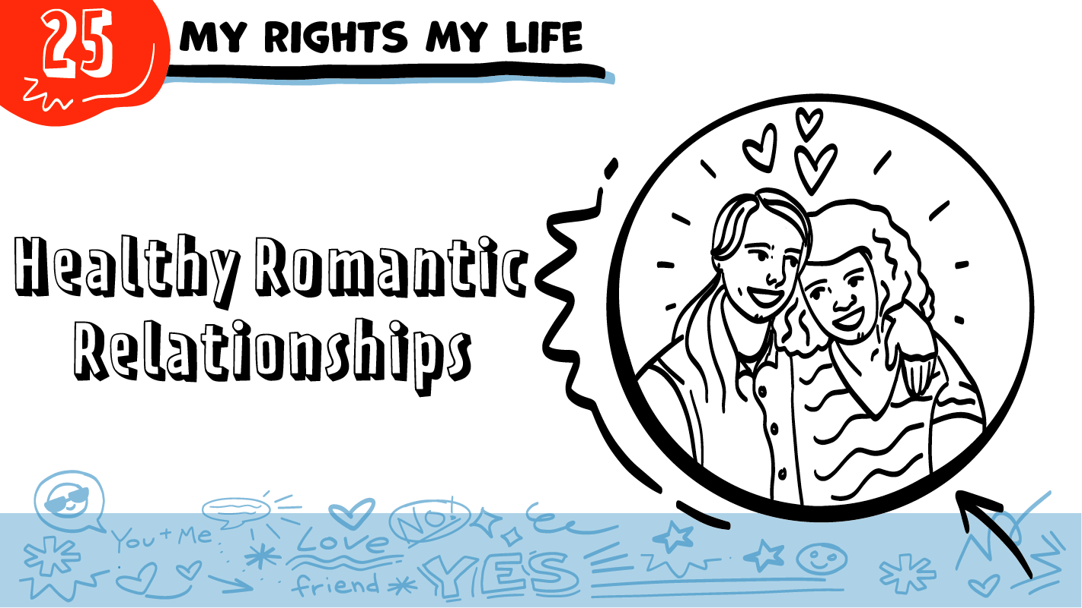

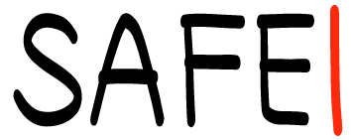

for High School Students
© 2026 SAFE Disability Services Program
Notes:
Repetition is beneficial for learning. Take time to review the last My Rights My Life class you taught prior to beginning this session. You can also answer any private questions students submitted on notecards during your previous class session.
Say: Today we are going to put together many of the things we have talked about so far in My Rights My Life classes. We will talk about what makes relationships healthy.

Slide 2
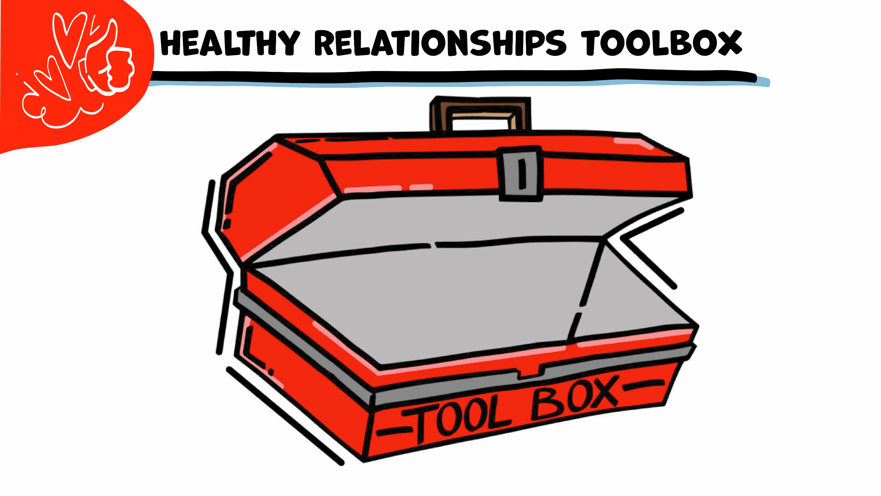
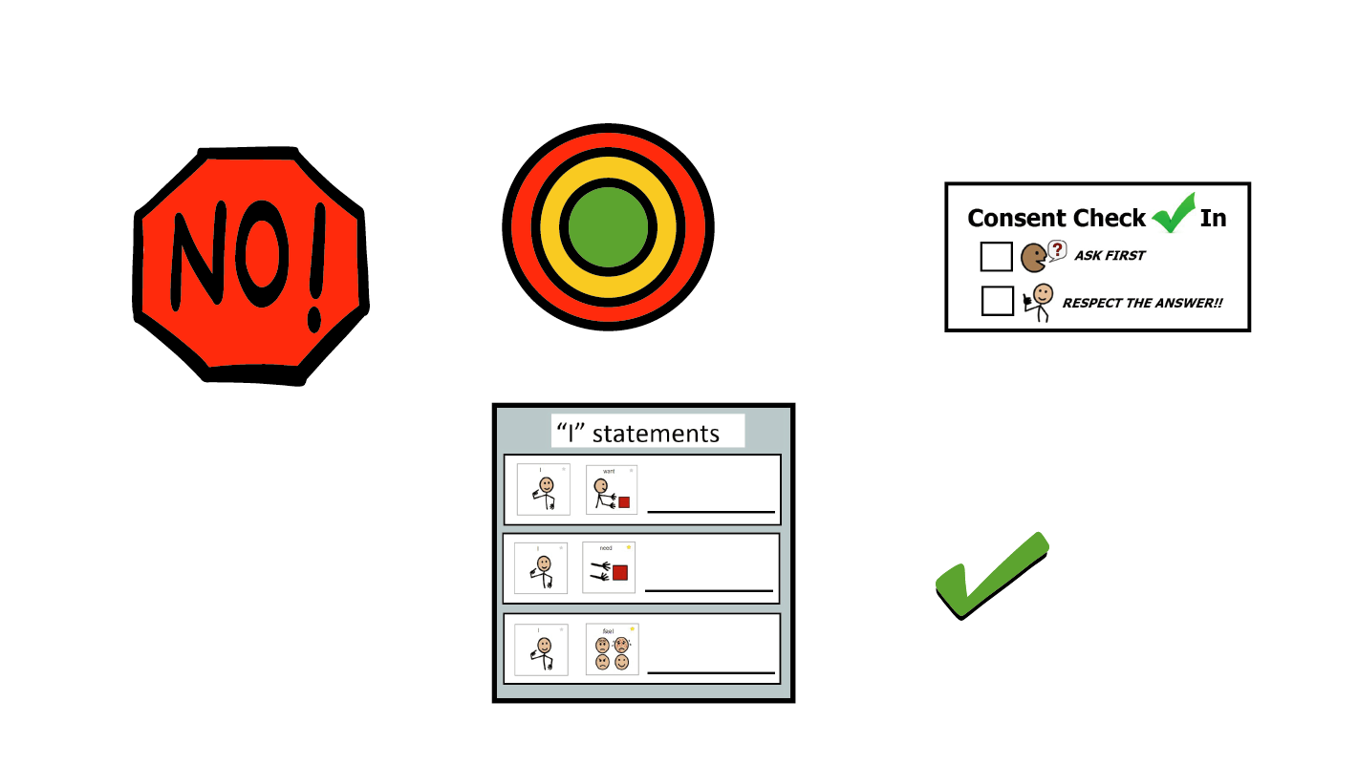
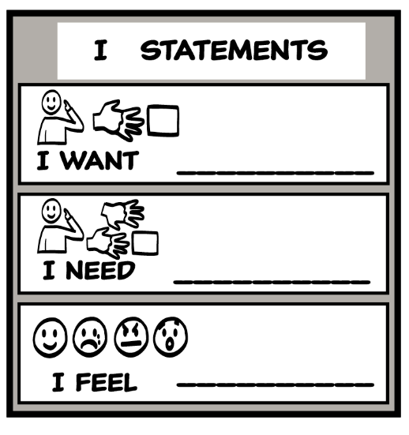
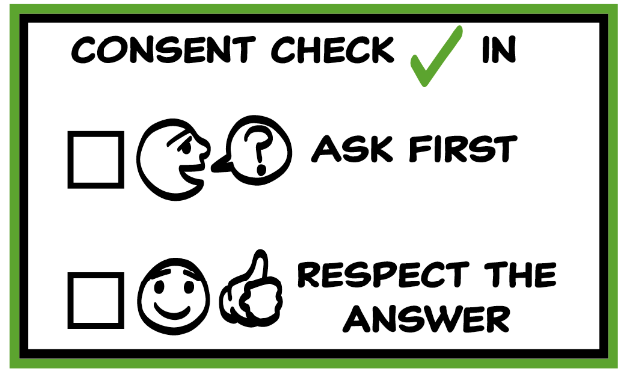
© 2026 SAFE Disability Services Program
Notes:
Use the large class Healthy Relationship Toolbox to review the Healthy Relationship Tools (I Statement, Relationship Map, NO!, and Consent Check-In). You can ask students to pull off one tool at a time and discuss what it is and how it is used. It can be particularly helpful if you give students specific scenarios to think through. For example, you might ask, “If your friend lies to you, what is one “I” Statement you could use to tell your friend how you feel?” You may even consider using examples of situations that have recently occurred in your classroom, as long as doing so does not break student confidentiality. You can also ask students to connect the toolbox tools to their current relationships. You might say, “Can anyone volunteer and tell me about something going on in your life right now that the toolbox could help you with?”
Instructions for how to use each Healthy Relationship Tool can be found in the following classes:
I Statements: Classes 2 and 3
Relationship Map: Class 4
NO!: Class 5
Consent Check-In: Class 6

Slide 3
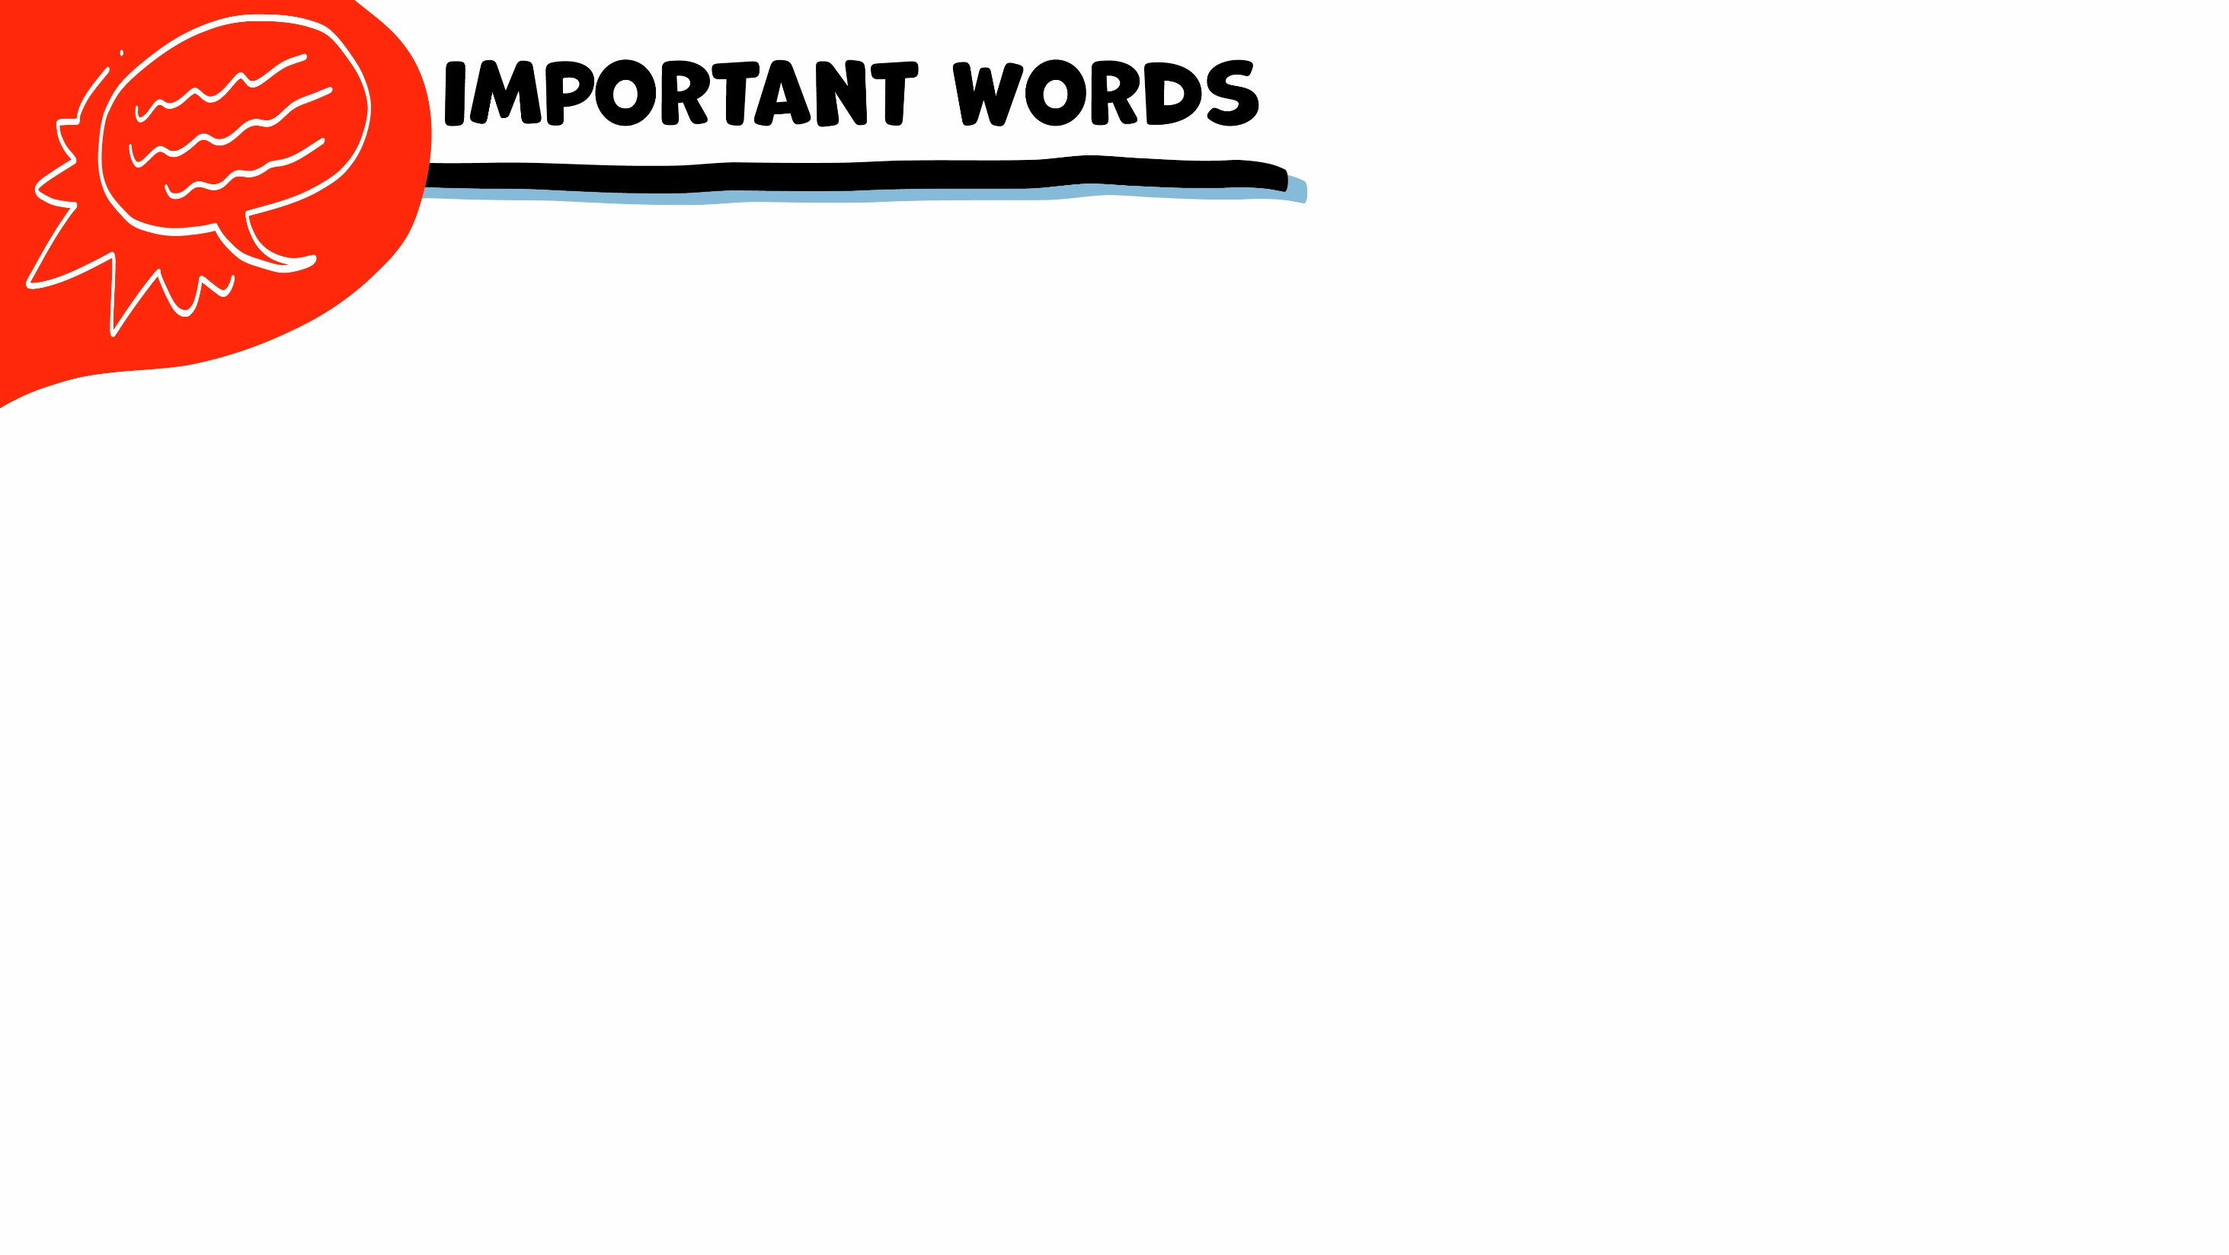
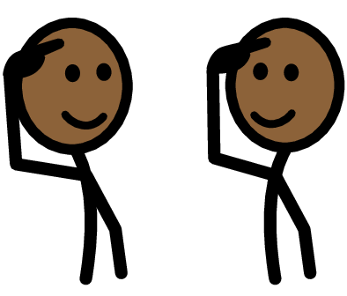
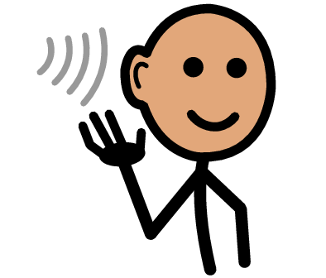
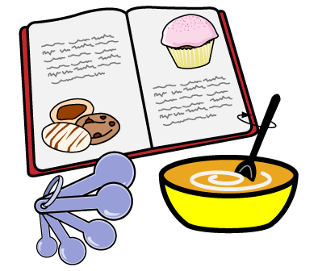
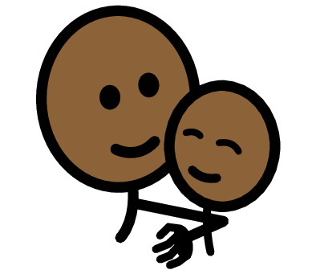


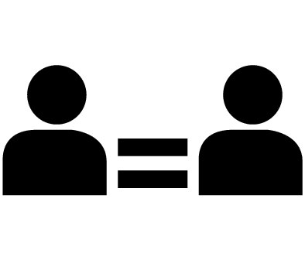

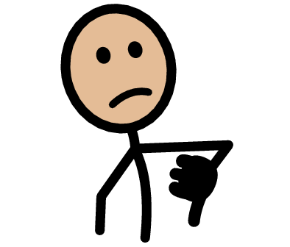

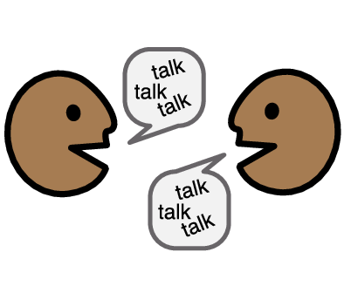

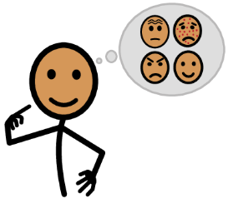



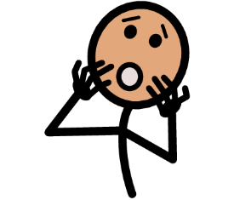
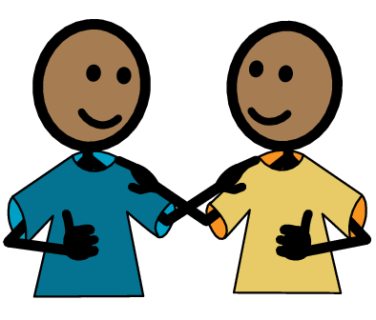
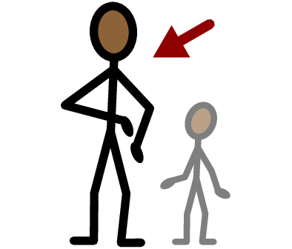
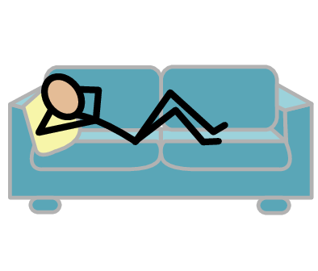
Respect
Listen
Recipe
Safety
Yes
No
Communication
Equality
Healthy
Unhealthy
I need help
I have a question
Trust
Adult
Take a break
I feel
Happy
Sad
Mad
Scared
Copyright © 2021 SymbolStix, LLC. All rights reserved. Used with Permission.
Notes:
You can print this slide separately so each student can use the Important Words Sheet as a communication board throughout class. Review the words using the suggested definitions below. To enhance understanding, you can ask students to come up with their own definitions for vocabulary words or to provide a sentence or scenario using the new word.
Safety: when you feel physically and emotionally okay
Respect: when people listen to your boundaries, and when you can be exactly who you are and no one makes fun of you for it
Equality: when both people in a relationship make choices together, and both people give and get things
Communication: when people talk and listen to each other
Healthy: when a relationship feels good to both people
Unhealthy: when a relationship does not feel good to both people
Recipe: a list of the ingredients, or parts, that are needed to make a food dish
Listen: paying attention to what someone is saying

Slide 4
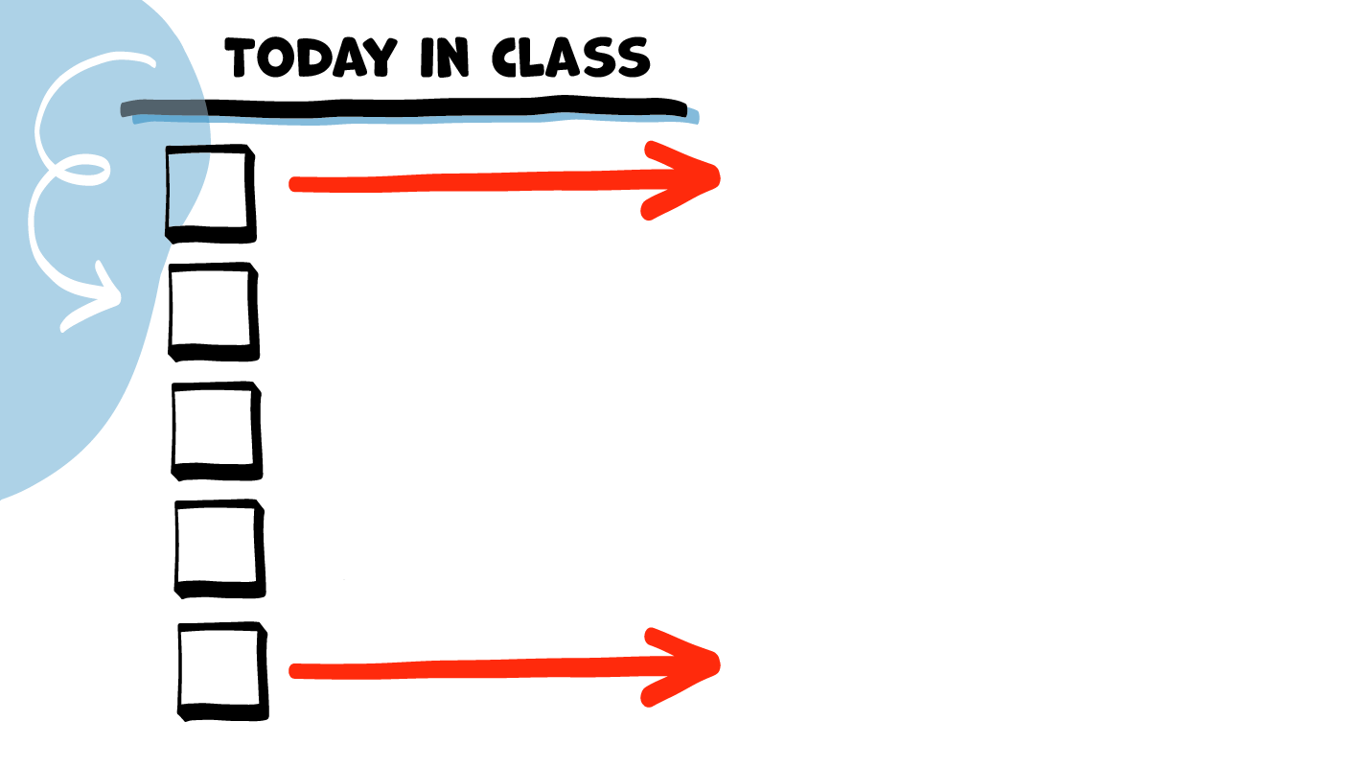
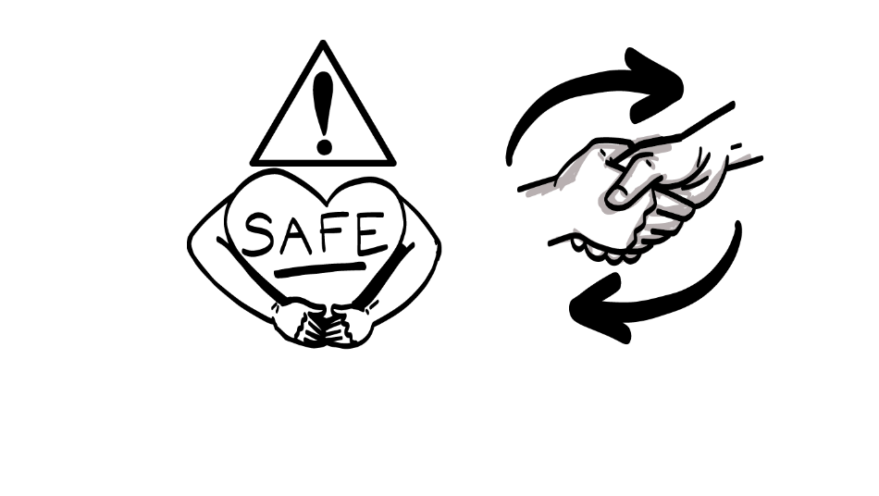
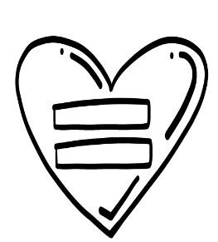
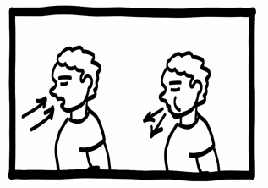
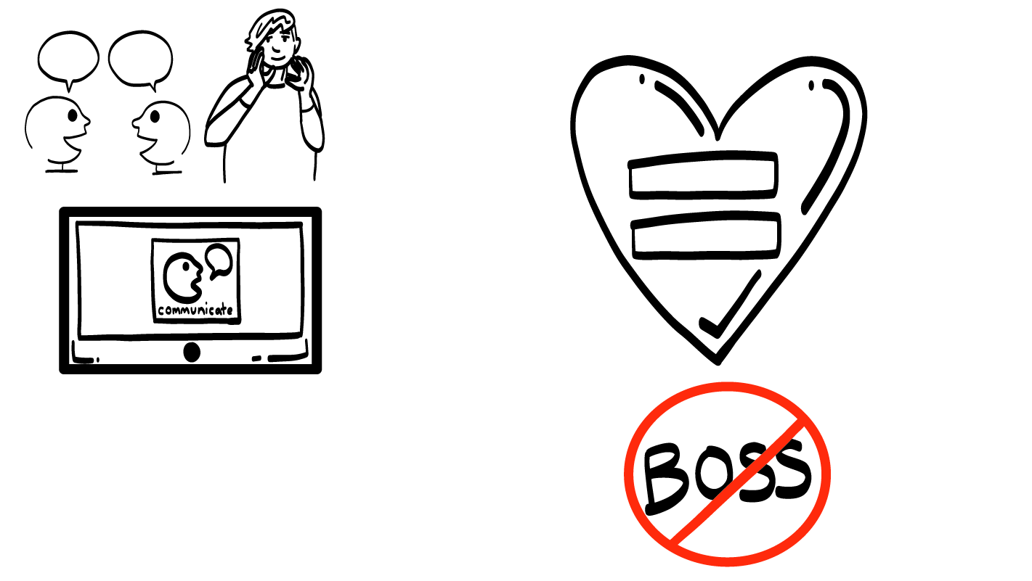
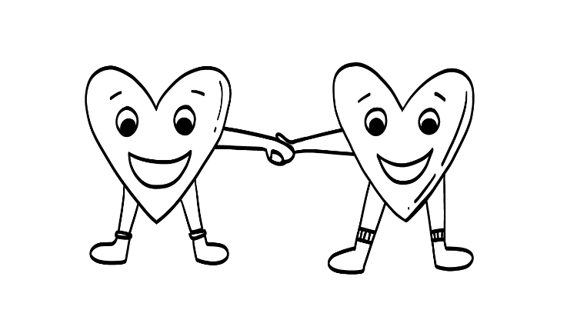
Safety & Respect
Equality
Brain break
Communication
Healthy Relationship Recipes
© 2026 SAFE Disability Services Program
Notes:
Read the agenda. Alternatively, you can ask for a student volunteer to read the agenda.

Slide 5
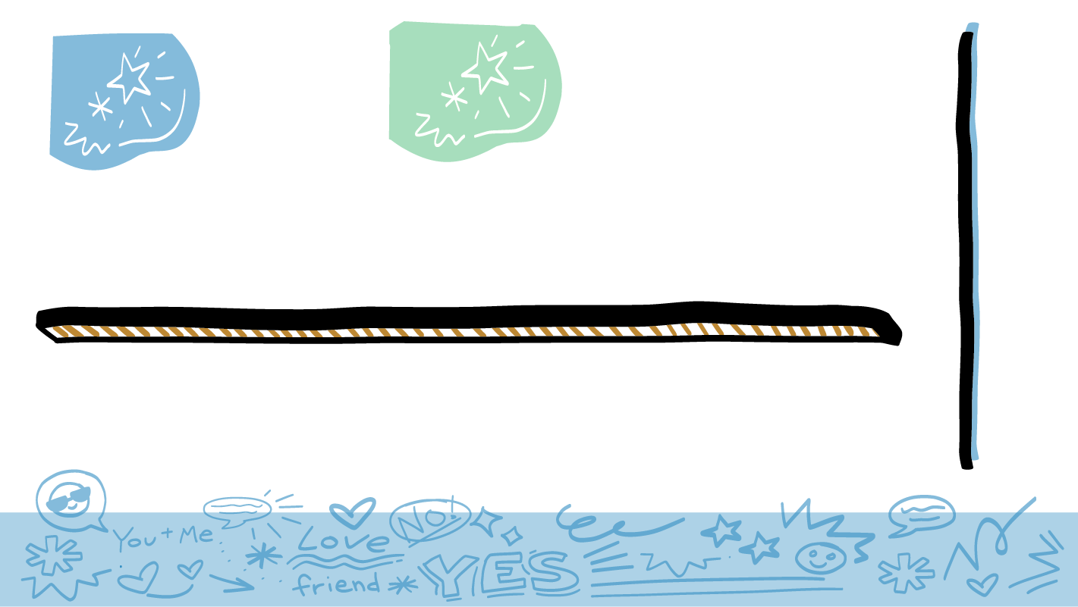
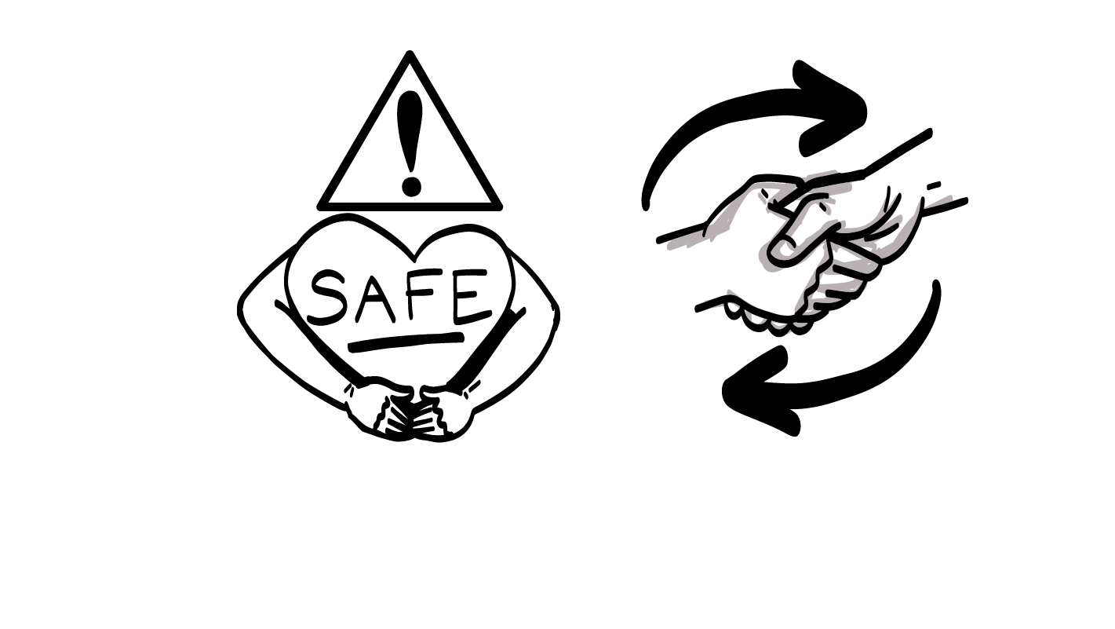
Parts of a
Healthy Relationship
Safety
Respect
Communication
Equality
© 2026 SAFE Disability Services Program
Notes:
Say: You may remember that a while back, we talked about the parts of a healthy relationship. Four things you need to have a healthy relationship with anyone are safety, respect, equality (no person is the boss or “in charge” in the relationship), and communication.

Slide 6
Safety
You should feel like your body and your feelings are safe.
© 2026 SAFE Disability Services Program
Notes:
Say: The first thing you need for a healthy relationship is safety. In every relationship, you should be physically safe. That means that the other person never hurts your body. You should also be emotionally safe. This means that the other person says nice things to you and is kind to you. Let’s look at some examples together.

Slide 7
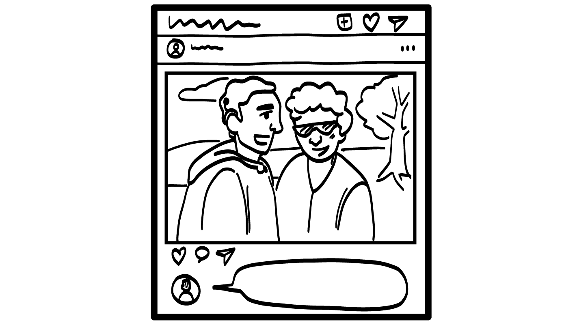


Your cousin comments on your photo, saying you look amazing.
You look amazing!
Is this safe?
YES
NO
© 2026 SAFE Disability Services Program
Notes:
Say: Your cousin comments on your photo, saying you look amazing. Is this safe? Give a thumbs up for yes and a thumbs down for no.
Give students enough time to process the question and make their decisions.
Say: Yes, this is safe. In every relationship, you should feel both physically and emotionally safe. Emotional safety means that your family members are kind to you and respect your feelings.

Slide 8
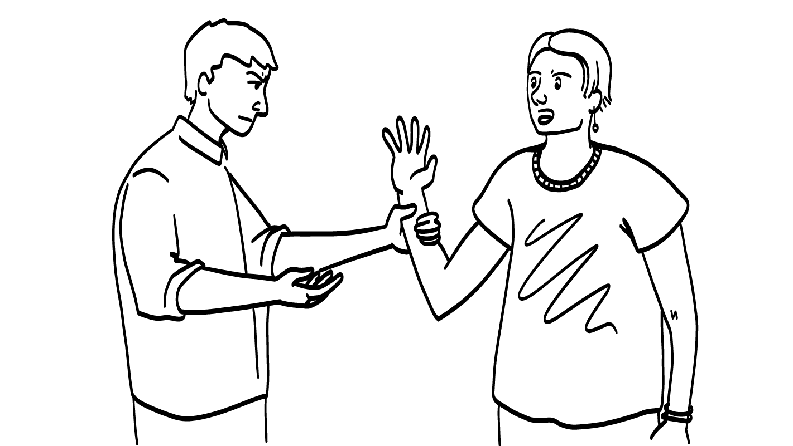
When you try to leave the room, your friend grabs your arm and won’t let go.
Is this safe?
YES
NO
© 2026 SAFE Disability Services Program
Notes:
Say: When you try to leave the room, your friend grabs your arm and won’t let go. Is this safe? Give a thumbs up for yes and a thumbs down for no.
Give students enough time to process the question and make their decisions.
Say: This is not safe. It is never okay for anyone to hurt your body. Your friend should never grab your arm, push, hit, kick, slap, or do anything else to hurt your body.

Slide 9
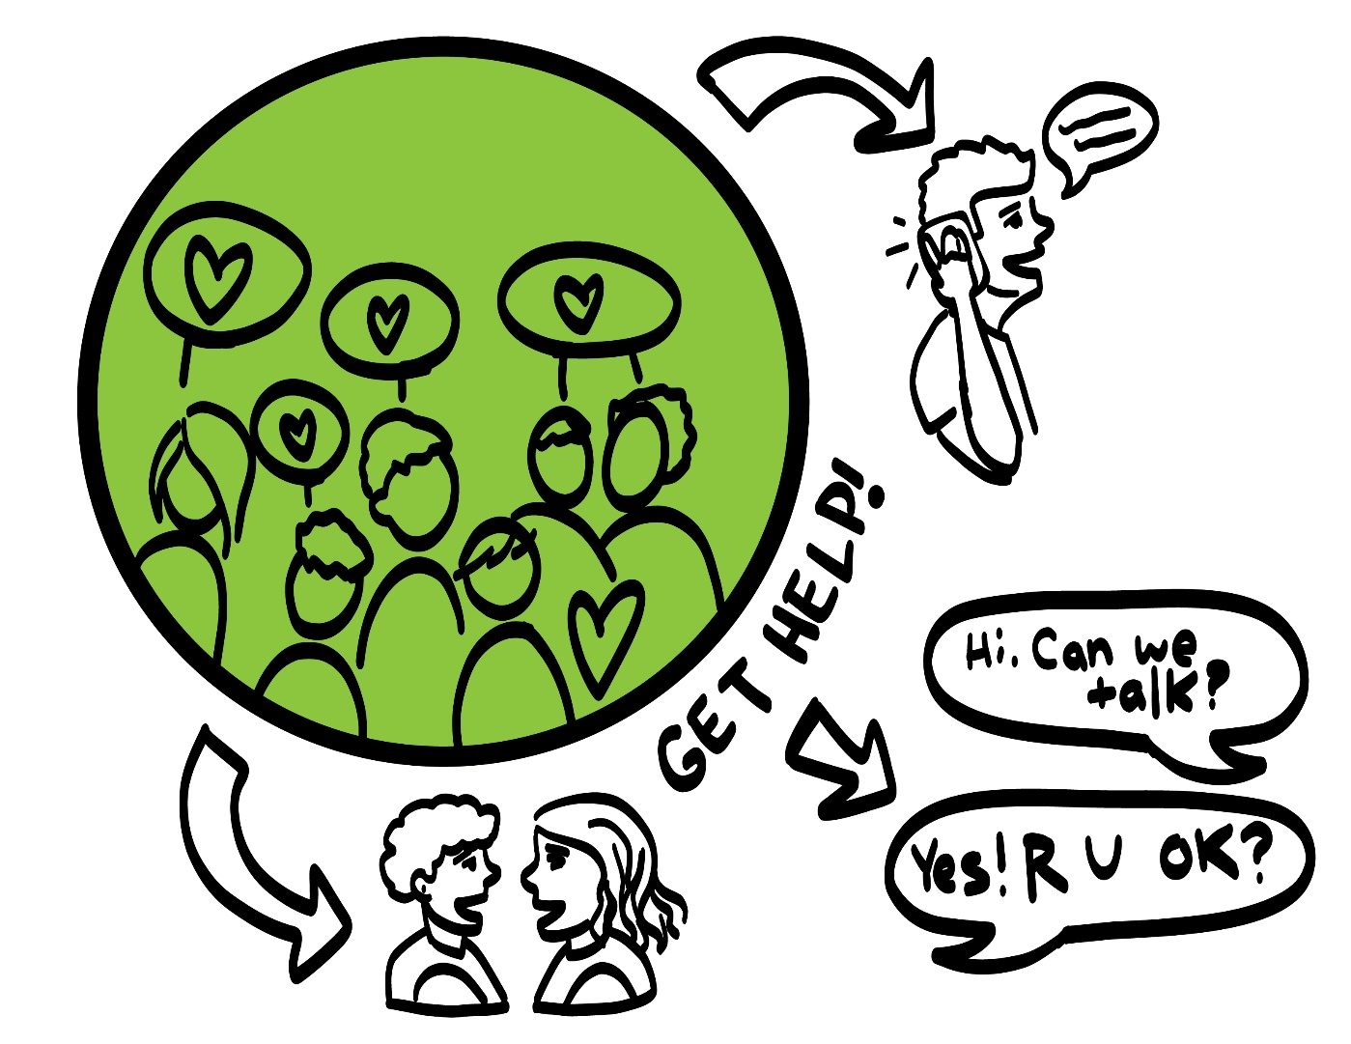
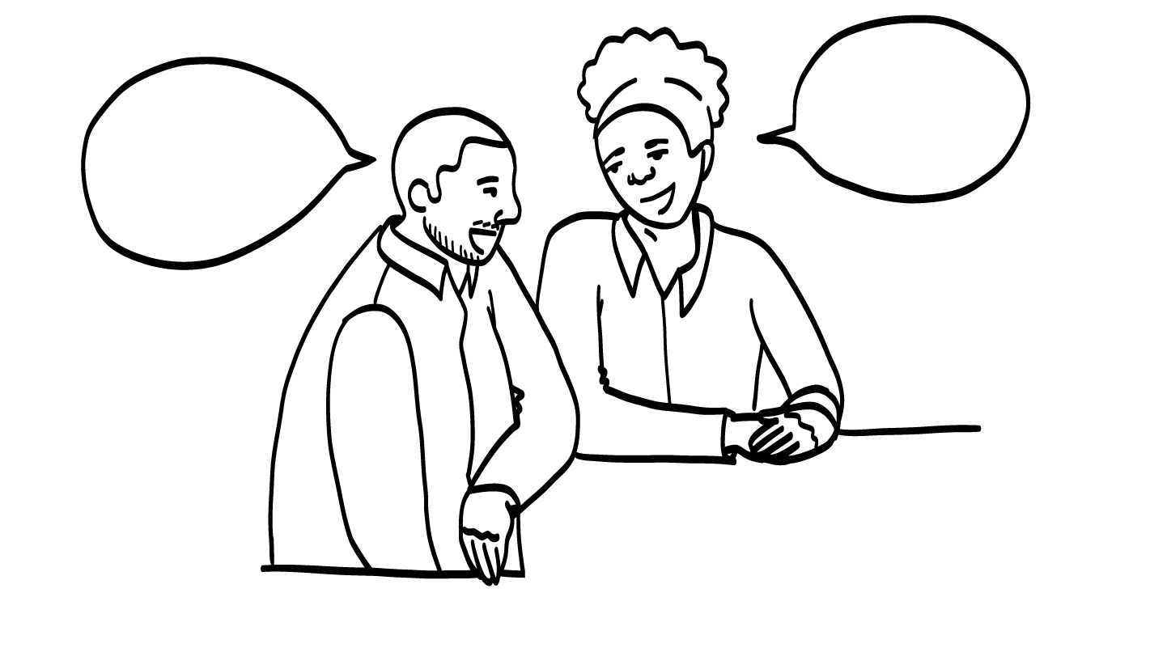
Getting Help
© 2026 SAFE Disability Services Program
Notes:
Say: If you ever feel physically or emotionally unsafe in any relationship, it is not your fault. You did not do anything wrong, and you can get help. You can get help by talking to an adult from your inner green circle of trust. Who is one adult you could talk to if you feel unsafe in a relationship?
Give students enough time to process the question and make their decisions. Go around and ask each student to share the name of one adult they trust who could help if they feel unsafe.

Slide 10
Respect
Your friend listens, respects your boundaries, and you feel good about who you are.
© 2026 SAFE Disability Services Program
Notes:
Say: The second thing you need for a healthy relationship is respect. Respect means that you can be exactly who you are, and your friend will not make fun of you for it. Respect also means that your friend listens to your boundaries. If you tell them no, what should they do?
Your friend listens, respects your boundaries, and you feel good about who you are.
Give students enough time to process the question and make their decisions.
Say: They should stop right away and back off.

Slide 11
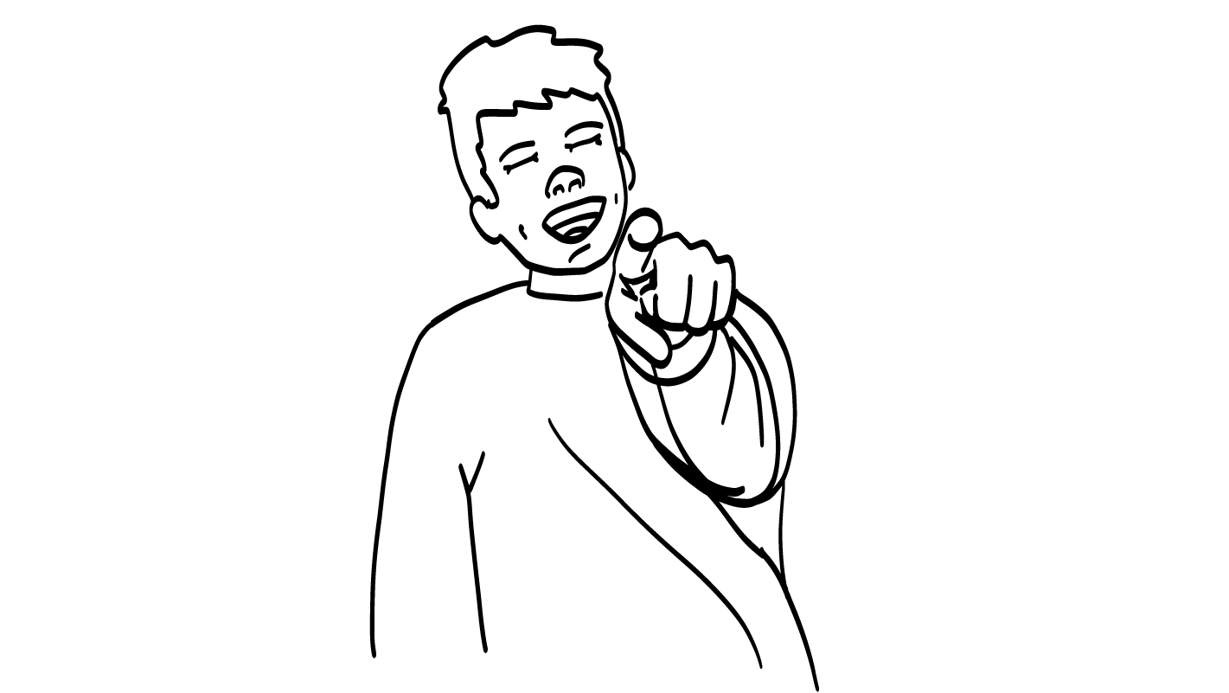
Your friend makes fun of the music you listen to.
Is this respect?
YES
NO
© 2026 SAFE Disability Services Program
Notes:
Say: Let’s do some more practice. Your friend makes fun of the music you listen to. Is this respect? Give a thumbs up for yes and a thumbs down for no.
Give students enough time to process the question and make their decisions.
Say: No, this is not respect. Respect means your friend should like you for who you are. It’s not cool if you feel bad around your friend about the music you like.

Slide 12
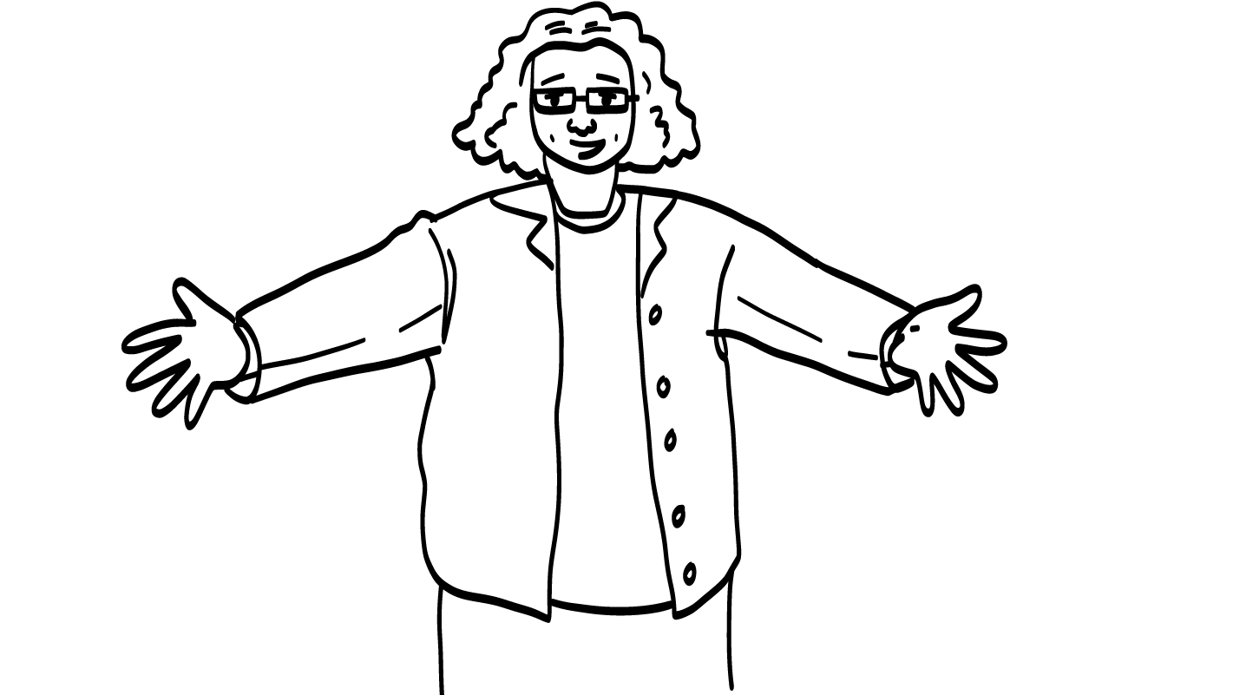
You are having a bad day, and your classmate asks if they can give you a hug.
Is this respect?
YES
NO
© 2026 SAFE Disability Services Program
Notes:
Say: You are having a bad day, and your classmate asks if they can give you a hug. Is this respect? Give a thumbs up for yes and a thumbs down for no.
Give students enough time to process the question and make their decisions.
Say: Yes, this is respect. They are respecting your boundaries by asking permission first. It is so important that your friend listens to your boundaries.

Slide 13
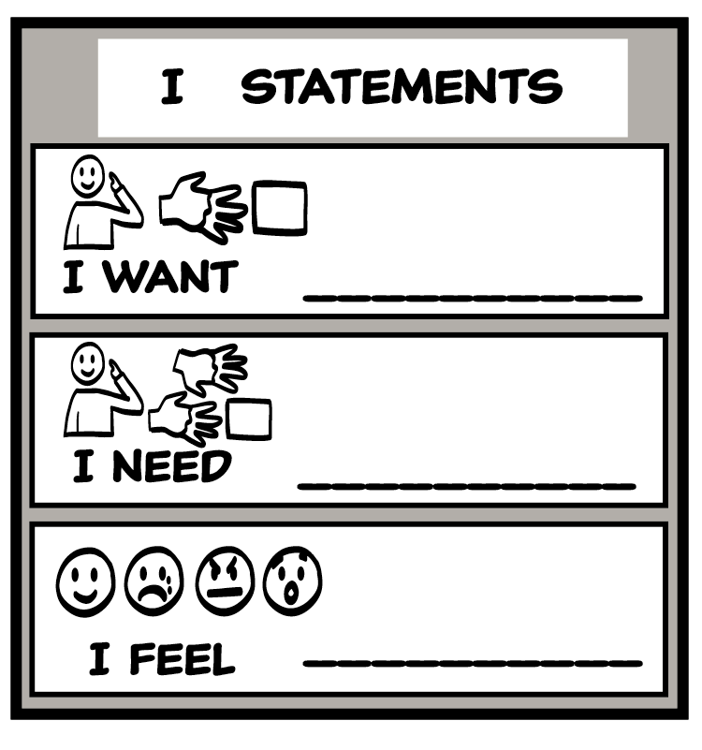
Setting Boundaries
© 2026 SAFE Disability Services Program
Notes:
Say: Let’s review what you can do if your friend is being disrespectful. If your friend is not respecting you, that’s not cool. That’s a boundary crossing. Remember, any time someone does something that crosses your boundaries, you have the right to say NO! Can you all show me how you can say no with your voice, signs, and body?
Give students enough time to process the question and make their decisions. Encourage students to practice saying no assertively, showing no with their signs, or doing things like turning or walking away.
Say: Another way to set your boundaries is to use the I Statement Tool. Let’s think about an example from earlier today. If your friend is making fun of you for the music you like, what is an I statement you could use to talk to them about it?
Give students enough time to process the question and make their decisions. Sample I statements are included below:
I feel sad when you make fun of me.
I want you to respect me.
I need you to be nice to me.
Say: If you have said no or used an I statement, and your friend keeps crossing your boundaries, that is not okay. Talk to an adult in your inner green circle of trust for help safely leaving the relationship.

Slide 14
Safety & Respect
Equality
Brain break
Communication
Healthy Relationship Recipes
© 2026 SAFE Disability Services Program
Notes:
Say: Now let’s talk about the third part of a healthy relationship: equality.

Slide 15
Equality
You make choices together and
no one is the boss.
© 2026 SAFE Disability Services Program
Notes:
Say: Equality means that both people give things and get things in the relationship. You and your friend should make choices together.

Slide 16
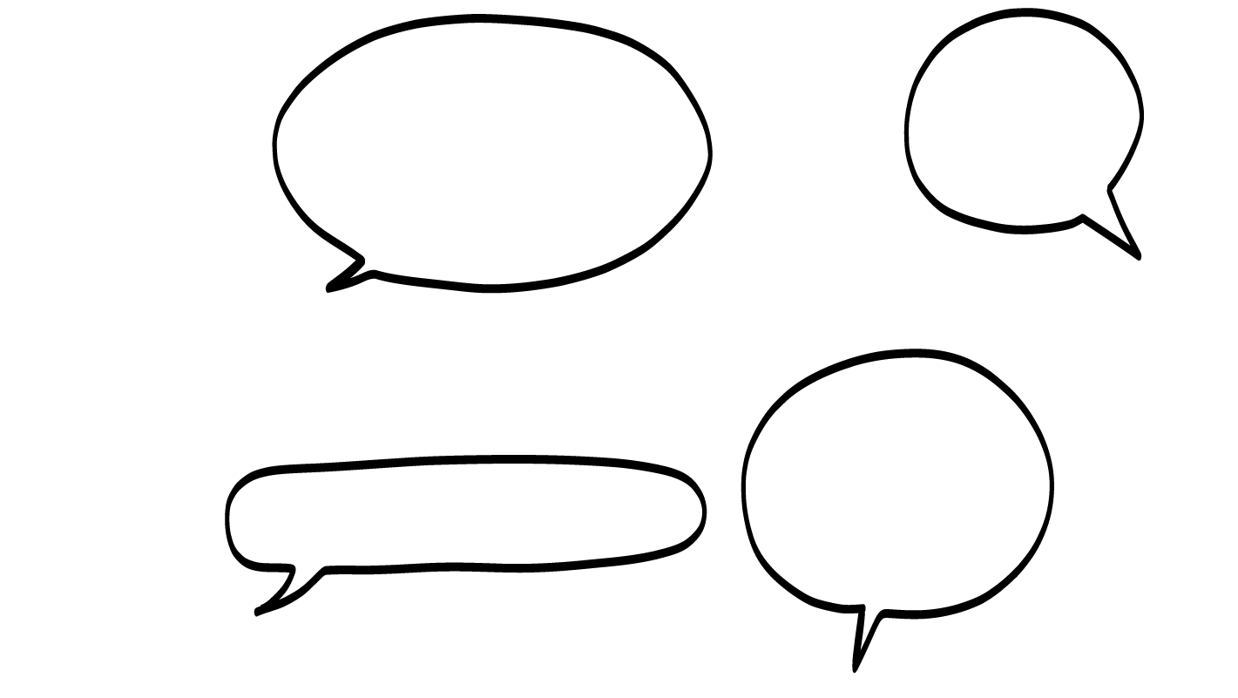
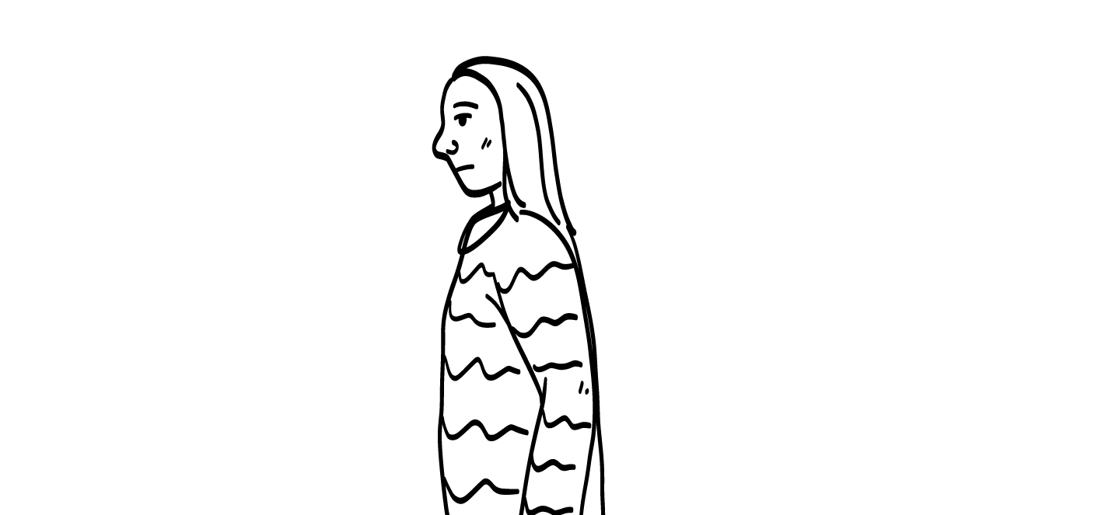
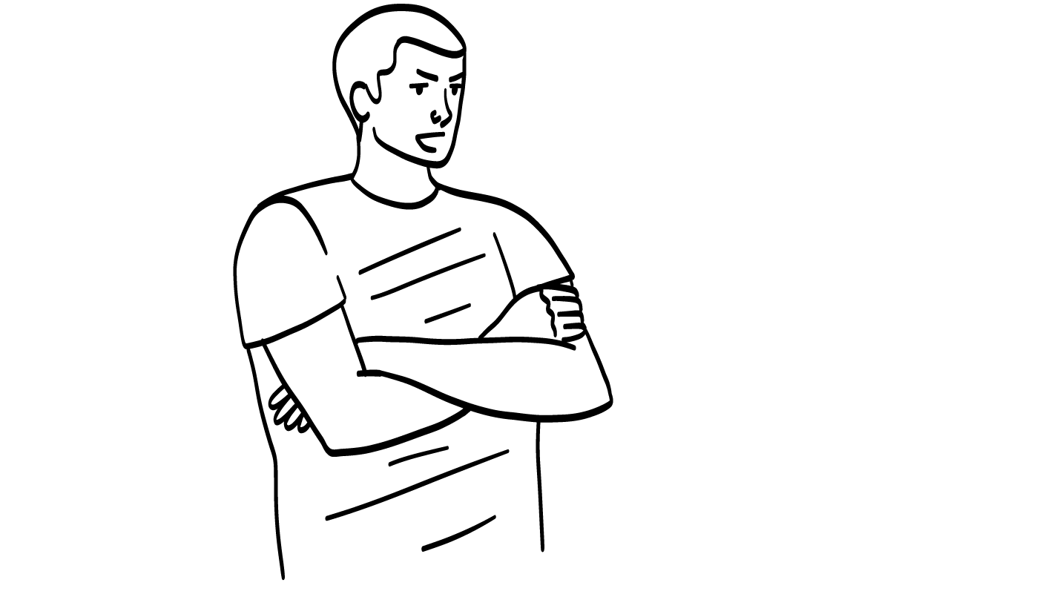
I will pick what we do.
Um……
Your friend always chooses the activities you do together.
Is this equality?
YES
NO
© 2026 SAFE Disability Services Program
Notes:
Say: Let’s practice thinking about equality. Your friend always chooses the activities you do together. Is this equality? Give a thumbs up for yes and a thumbs down for no.
Give students enough time to process the question and make their decisions.
Say: No, this is not equality. Your friend is not the boss of you. They should not tell you what to do. You and your friend can decide together what activities you want to do or take turns choosing what you will do.

Slide 17
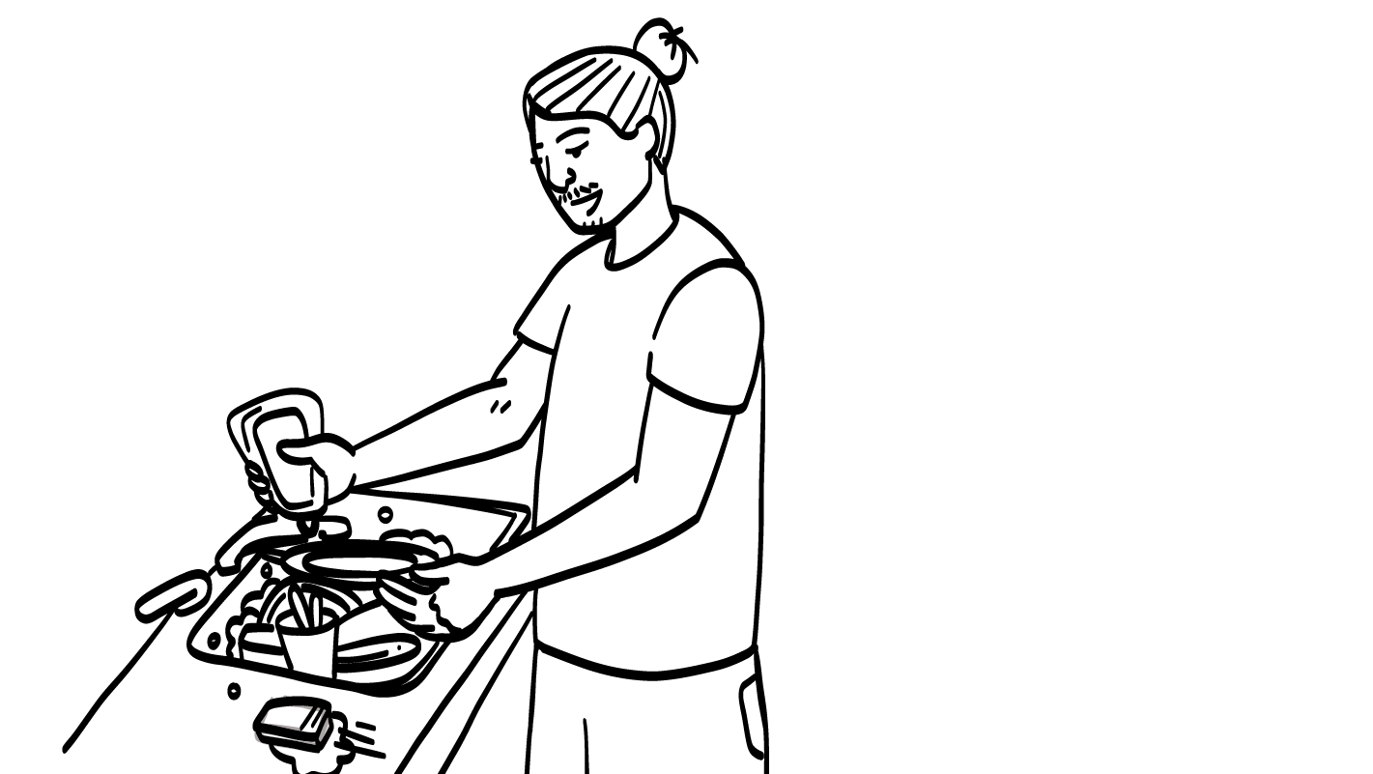
You and your friend take turns cleaning the dishes after dinner.
Is this equality?
YES
NO
© 2026 SAFE Disability Services Program
Notes:
Say: You and your friend take turns cleaning the dishes after having dinner together. Is this equality? Give a thumbs up for yes and a thumbs down for no.
Give students enough time to process the question and make their decisions.
Say: Yes, this is equality. You and your friend should work together when you have things to do. It is not okay for one person to do all of the work in a relationship.

Slide 18
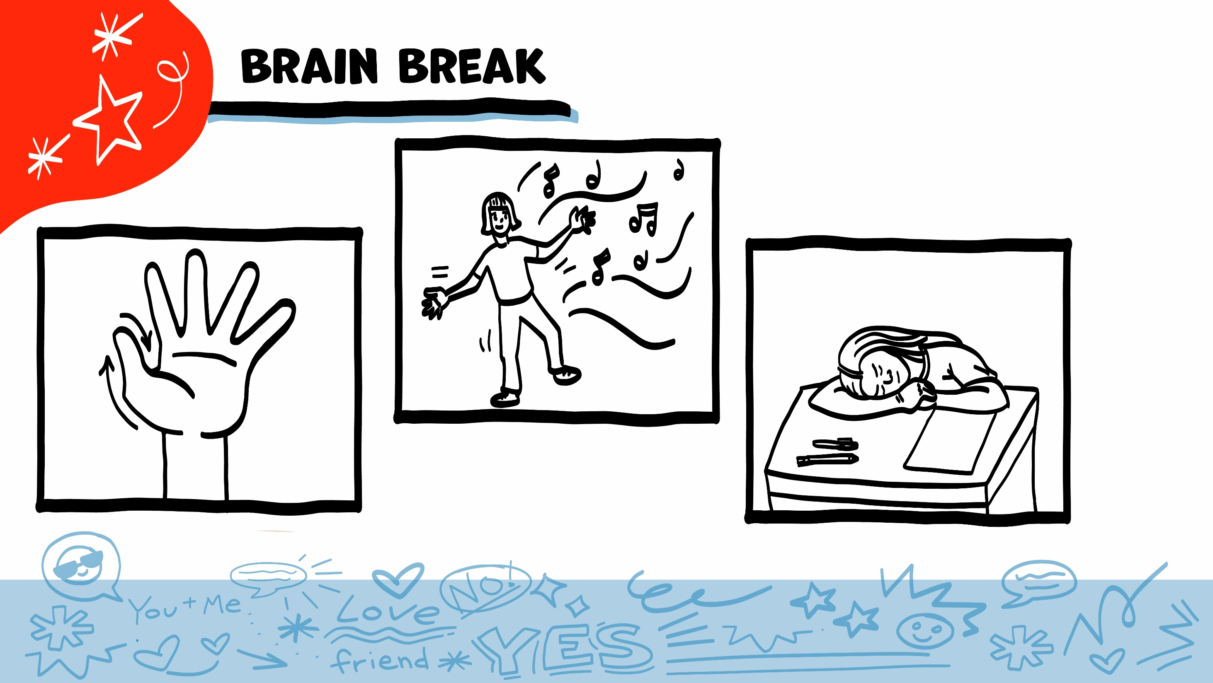
© 2026 SAFE Disability Services Program
Notes:
Say: That was a lot of information, and you all are doing an amazing job! Every week in class we will take a brain break in the middle. This is a chance to move a little and take a break from thinking!
Below are three ideas to give students a quick opportunity for a brain break. You are also welcome to come up with your own ideas for brain breaks that work best for your class.
Five finger breathing
For this exercise, have all students place their hand in front of their chest with their five fingers spread out. Next, use the pointer finger of the other hand to trace up and down each of the five fingers, beginning with the thumb. As students trace up a finger, they will breathe in. As they trace down a finger, they will breathe out. When students breathe out on the pinky finger, you can tell them to shake out their hands and arms. As the school year goes on, you can ask students to lead this exercise for their peers.
If this exercise is physically inaccessible for your class, you can also model the hand tracing for students while they breathe in and out.
Stretch break
Lead students through a series of basic stretches. These can be completed in a chair, or while standing up, depending on the accommodation needs of your class. Some ideas include reaching toward the ceiling, stretching one arm at a time across the chest, reaching toward toes, turning head from side to side, etc. Ask students to hold a pose while you count to ten. As the school year goes on, you can ask students to lead stretches for their peers.
Dance party
If your class likes to dance, you can put on a short song for them to dance to. This is especially effective if you are able to find a song that relates to the theme for that week’s class.

Slide 19
Safety & Respect
Equality
Brain break
Communication
Healthy Relationship Recipes
© 2026 SAFE Disability Services Program
Notes:
Say: Now we will talk about the fourth part of a healthy relationship: communication.

Slide 20
Communication
You share your feelings, wants, and needs, and both people listen to each other.
© 2026 SAFE Disability Services Program
Notes:
Say: The last part of a healthy relationship is communication. Good communication means that you use I statements to tell your friend how you feel, what you want, and what you need. It also means that you and your friend really listen to each other. Remember, you can let your friend know you are paying attention by doing things like putting your phone down, making eye contact with your friend, nodding your head, and asking questions.

Slide 21
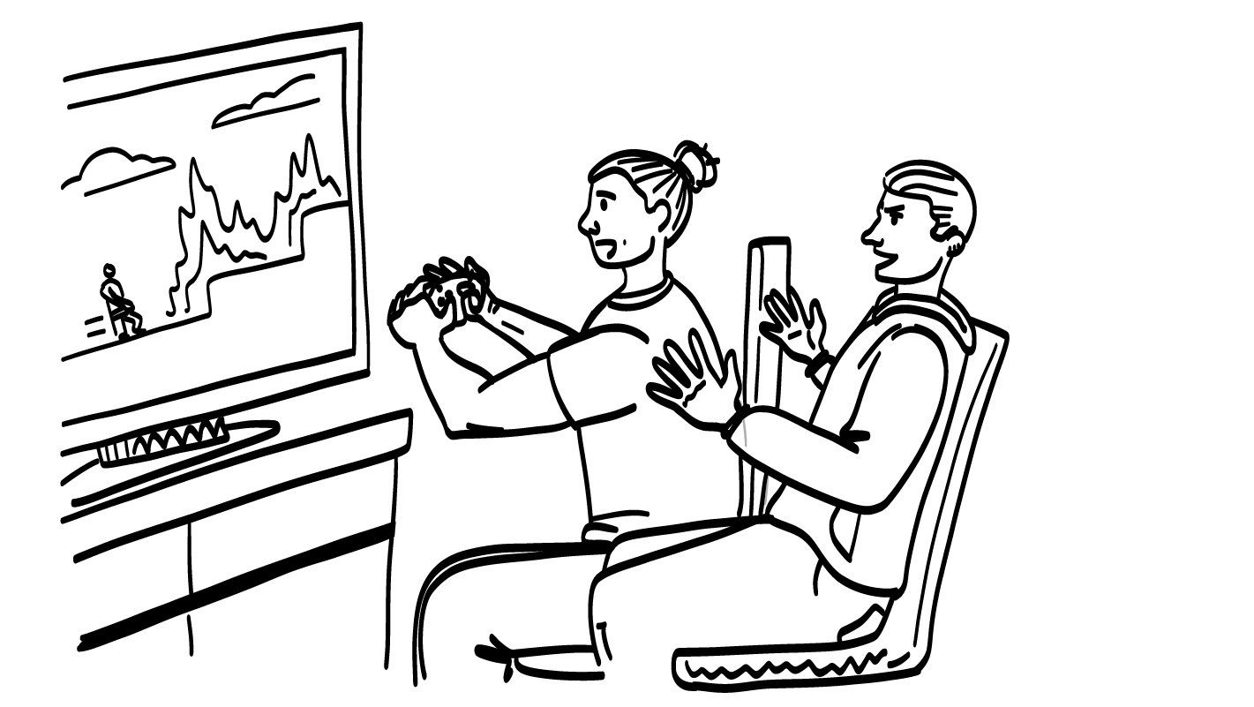
Your brother always plays video games when you try to talk to them.
Is this good communication?
YES
NO
© 2026 SAFE Disability Services Program
Notes:
Say: Let’s do one more round of practice. Your brother always plays video games when you try to talk to them. Is this good communication? Give a thumbs up for yes and a thumbs down for no.
Give students enough time to process the question and make their decisions.
Say: No, this is not good communication. Your brother should pay attention when you are talking to them and not be distracted.

Slide 22
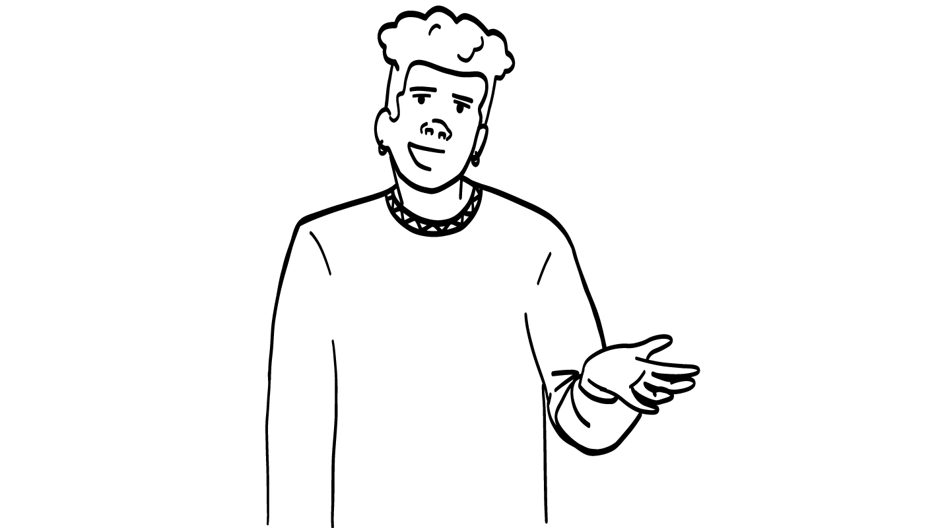
I feel upset. Can we talk about it?
Your mom uses I statements to tell you when they are upset.
Is this good communication?
YES
NO
© 2026 SAFE Disability Services Program
Notes:
Say: Your mom uses I statements to tell you when they are upset. Is this good communication? Give a thumbs up for yes and a thumbs down for no.
Give students enough time to process the question and make their decisions.
Say: Yes, this is good communication. The I Statement Tool is a great way for you and your family members to let each other know how you are feeling. This is a healthy way to talk with each other.

Slide 23
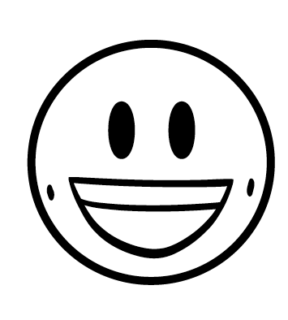
Safety
Respect
Equality
Communication
© 2026 SAFE Disability Services Program
Notes:
Say: In healthy relationships, you feel safe, respected, and equal around your friend or family member. They will use good communication skills to talk to you. Even in healthy relationships, you and your friend might disagree sometimes, and sometimes you might hurt each other’s feelings and make each other mad. That’s normal. But both of you should feel good about each other and the relationship most of the time!

Slide 24
Safety & Respect
Equality
Brain break
Communication
Healthy Relationship Recipes
© 2026 SAFE Disability Services Program
Notes:
Say: Great job going through the four parts of a healthy relationship. The last thing we are going to do today is create healthy relationship recipes.

Slide 25
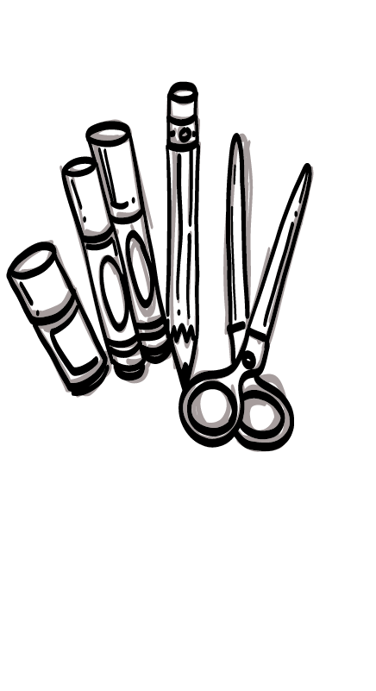
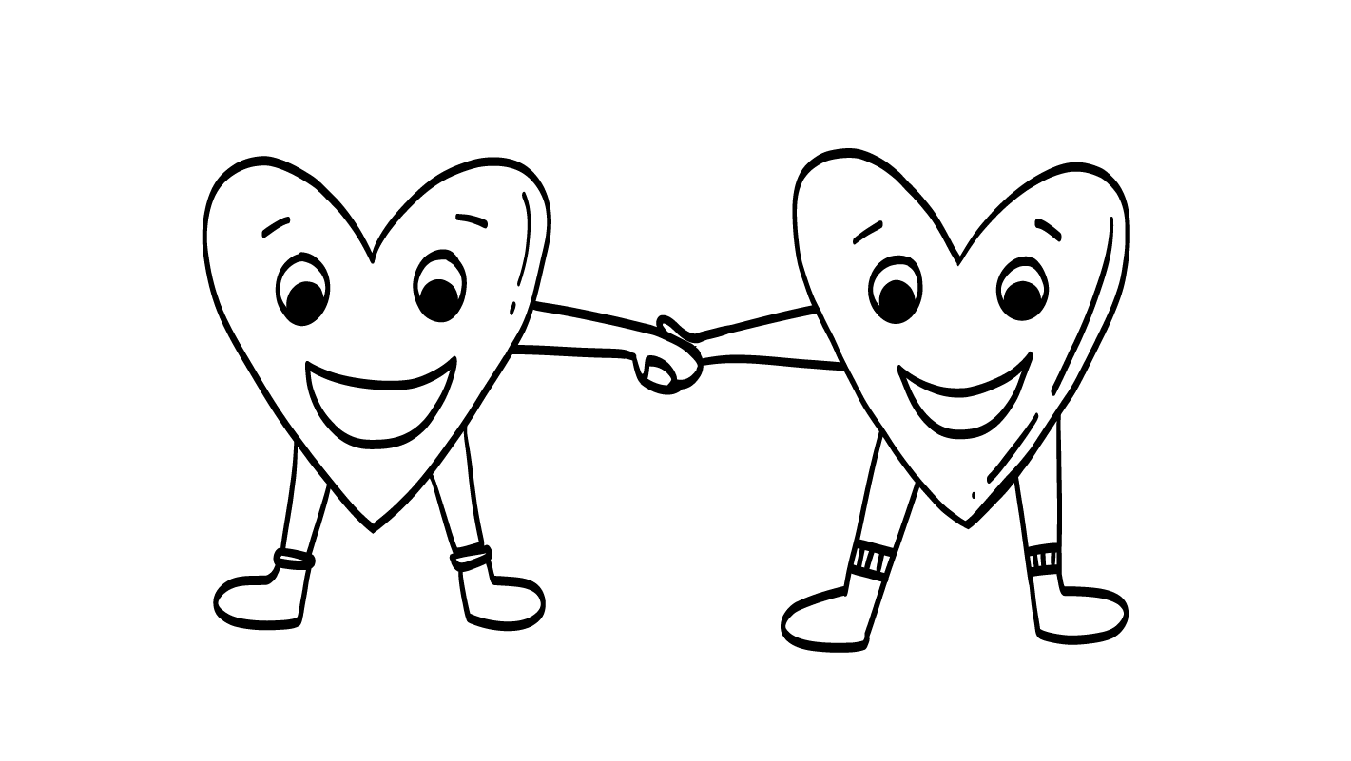
Healthy Relationship Recipe
© 2026 SAFE Disability Services Program
Notes:
Say: You all have learned a lot about healthy relationships over the past few months. And so today, we are going to use all of that knowledge to do an art project! Each of you are going to create a recipe card for a healthy relationship. On your recipe card, you will write or draw the things you want to have in a healthy relationship. These are the ingredients for your recipe. We talked about four ingredients today, but you can also add more! At the bottom of your recipe card, you will also write or draw how you want to feel in your healthy relationships. I will give you some art supplies so you can make your recipe look great! If you have extra time, you can play the matching game on the back of your recipe card.
Give each student some art supplies and a copy of the Healthy Relationship Recipe Card with the Healthy Relationship Toolbox Tools Matching Game on the back (see templates at end of lesson plan). Support students as needed to fill out their Healthy Relationship Recipe Card.
If your students prefer to cut and glue ingredients onto their recipe cards rather than write or draw them, you can use the optional Healthy Relationship Ideas worksheet (see template at end of lesson plan). If you are using this option, give each student a printed copy of this worksheet, scissors, and a glue stick.

Slide 26
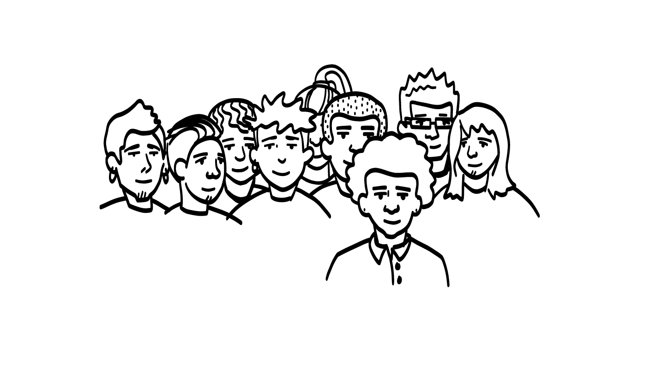
Share your recipe!
© 2026 SAFE Disability Services Program
Notes:
Say: Would anyone like to share their Healthy Relationship Recipe Card with the class?

Slide 27
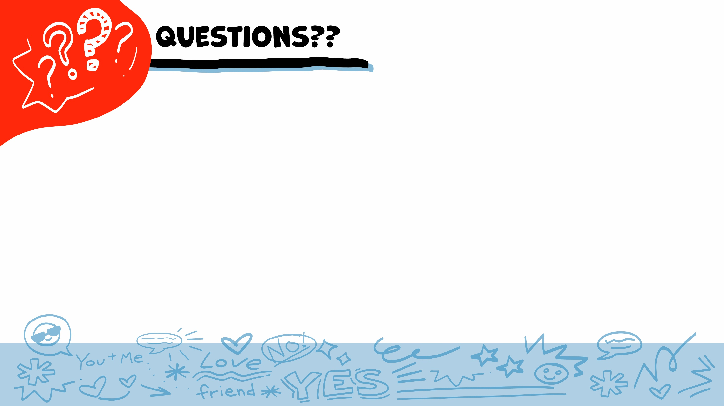
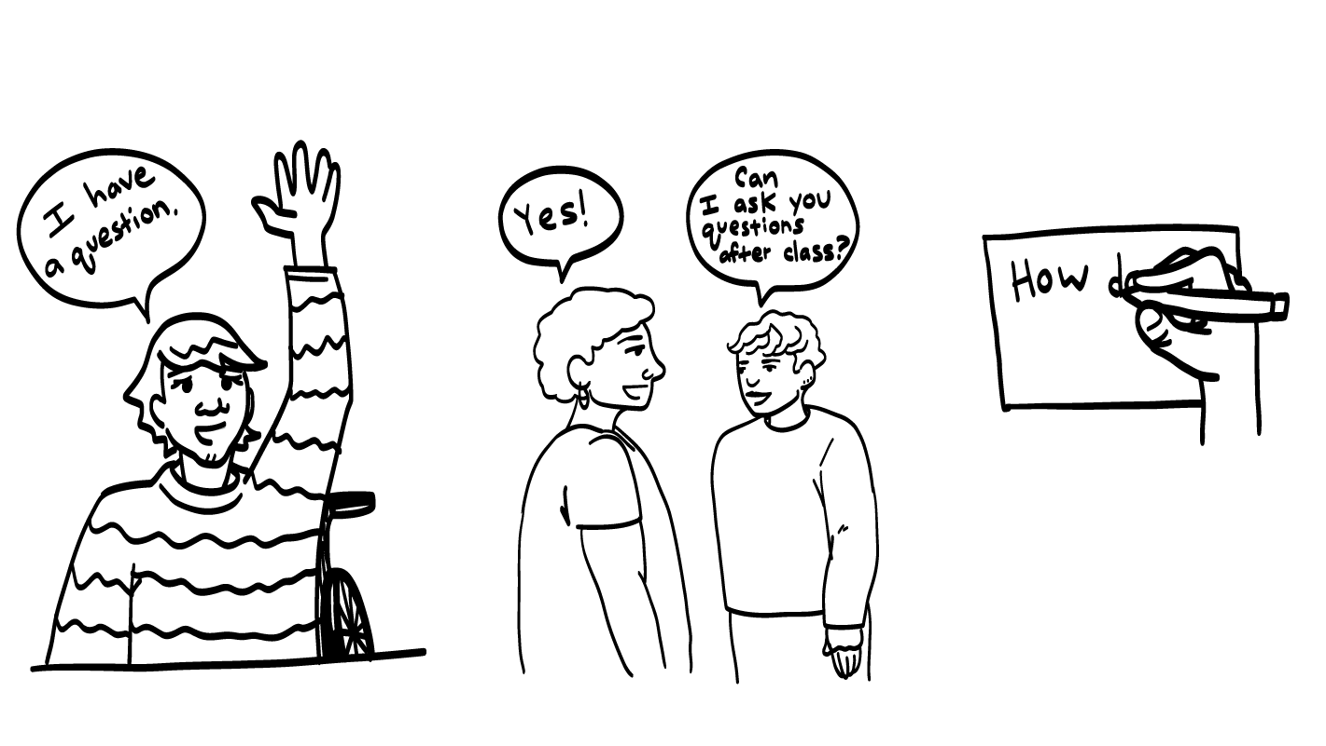
© 2026 SAFE Disability Services Program
Notes:
Say: Does anyone have any questions about today’s class? Remember, if you don’t want to ask your question out loud, you can write it on a notecard and leave it on your desk. You can also ask someone you trust to help you write your question on the notecard. I will pick up the notecards and will answer the questions the next time we meet. When I answer a question, I won’t tell anyone who asked it.

Slide 28
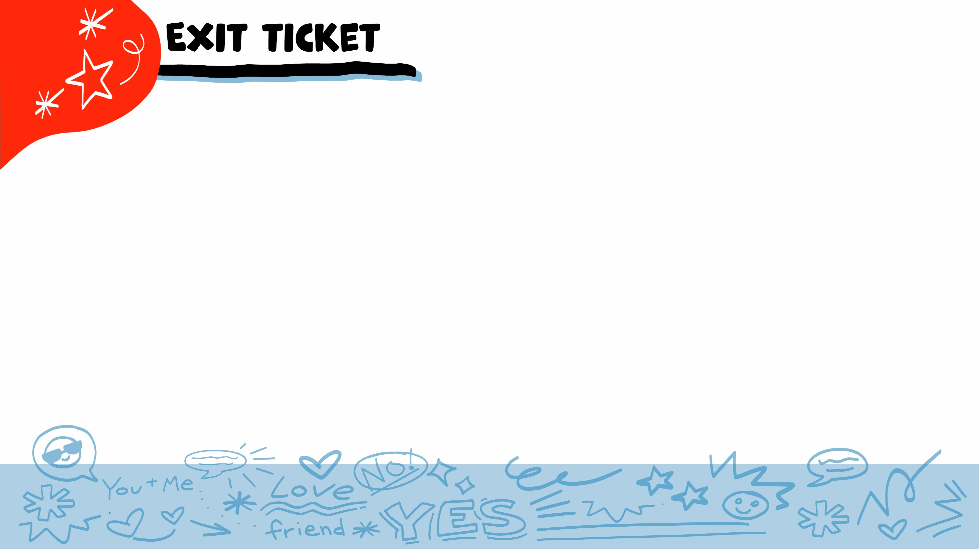
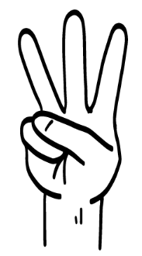
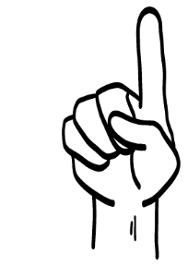



What makes a relationship healthy?
Safety
Respect
Equality
Communication
1
2
3
4
All of the above
5
© 2026 SAFE Disability Services Program
Notes:
Say: What makes a relationship healthy? Hold up one finger for “safety,” two fingers for “respect,” three fingers for “equality,” four fingers for “communication,” and five fingers for “all of the above.”
Give students enough time to process the question and make their decisions.
Say: All of these things are part of a healthy relationship! You need safety, respect, equality, and good communication for a healthy relationship.

Slide 29


Are looking at someone and nodding your head two ways to show that you are listening?
YES
NO
© 2026 SAFE Disability Services Program
Notes:
Say: Are looking at someone and nodding your head two ways to show that you are listening? Give a thumbs up for yes and a thumbs down for no.
Give students enough time to process the question and make their decisions.
Say: Yes! These are two ways you can show someone you are paying attention. Listening to your friends and family members is an important part of having healthy communication.

Slide 30
What is one thing you put on your Healthy Relationship Recipe Card?
© 2026 SAFE Disability Services Program
Notes:
Say: What is one thing you put on your Healthy Relationship Recipe Card?
Give students enough time to process the question and make their decisions. Ask any students if they would like to share their answers.

Slide 31


© 2026 SAFE Disability Services Program
Notes:
Say: If you are being hurt, or if someone ever touches your body in a way that you don’t like, you can get help. You did not do anything wrong, and you are not alone. You can get help by talking to an adult from your inner circle of trust (green circle). If someone you care about is being hurt, you can also get help by talking to an adult from your inner circle of trust (green circle). If you or somebody else is in danger, you can always call 911. If you call 911 for help, a police officer or an ambulance might come.
If the first person you tell doesn’t believe you or doesn’t get you help, keep telling adults you trust what is going on until you get the help you need.

Slide 32

© 2026 SAFE Disability Services Program
Notes:
Say: Does anyone remember what our power statement is? Our power statement is “I know me best.” This means that each of you knows yourself better than anyone else does. Today you created your own healthy relationship recipe card. You know best what will make a relationship feel healthy and good for you. Let’s gather together and on the count of three, say our power statement.
Have each interested student put one hand in the middle of the circle. Ask for a student volunteer to count to three. After three, all participants say the power statement while lifting their hands into the air. Students can also stand in the circle without touching hands if they prefer.

Slide 33

This work is supported by the Texas Council for Developmental Disabilities through a grant from the U.S. Administration for Community Living (ACL), Department of Health and Human Services (HHS), Washington, D.C. 20201 with a 100% federal funding award totaling $6,161,072. Council efforts are those of the grantee and do not necessarily represent the official views of nor are endorsed by ACL, HHS, or the U.S. government.
© 2026 SAFE Disability Services Program
Notes:
SAFE would like to thank the Texas Council for Developmental Disabilities for the funding for this curriculum.

Slide 34

This curriculum is offered online at no cost. You are free to use the resources in the original format for educational purposes only. Please reference The SAFE Alliance appropriately (citations at bottom of page).
We ask that you do not alter curriculum images/art, slides, or lesson plan materials. You may not use My Rights My Life (18+ or High School) curriculum for commercial purposes (i.e., selling workshops you facilitate based on MRML curriculum; and/or creating links/websites to re-distribute any materials associated SAFE’s My Rights My Life).
This resource, My Rights My Life: A curriculum for healthier relationships for high school students (grades 9-12) is based on the original My Rights My Life: A curriculum for safer relationships (age 18+) written by Megan Westmore, Heidi Lersch, and edited by Schwartz, M. (2022). Selling materials from MRML is a copyright violation.
Burleson, Anna Belle & Benitez, Sophie (2026) provided light modification and abbreviated the original curriculum
(Westmore & Lersch, 2022) to offer an age appropriate resource for High School Students (grades 9-12).
Schwartz, M. (Ed.). The SAFE Alliance, Austin, Texas.
Westmore, M. & Lersch, H. (2022). My rights my life: A curriculum for safer relationships.
Schwartz, M. (Ed.). The SAFE Alliance: Austin, TX.
© 2026 SAFE Disability Services Program

