Slide 1
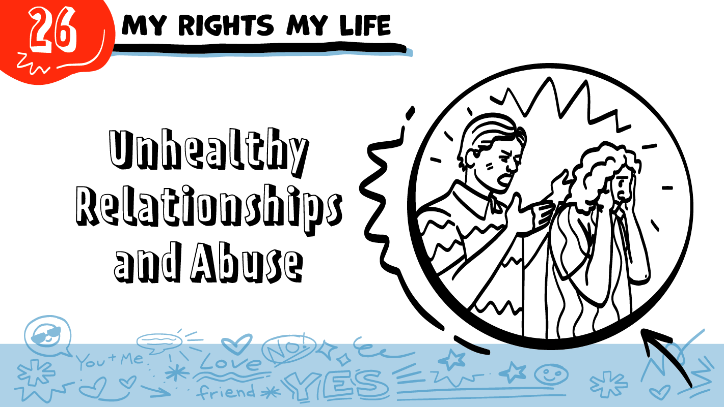

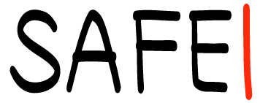
for High School Students
© 2026 SAFE Disability Services Program
Notes:
Repetition is beneficial for learning. Take time to review the last My Rights My Life class you taught prior to beginning this session. You can also answer any private questions students submitted on notecards during your previous class session.
Say: Last week we talked about healthy romantic relationships. Today we are going to talk about unhealthy relationships and abuse.

Slide 2
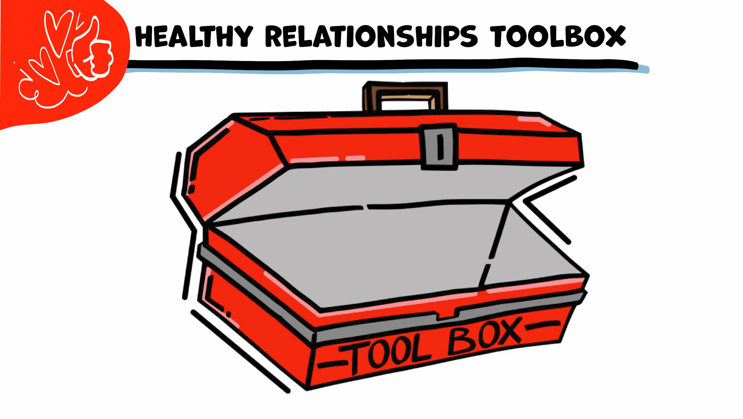
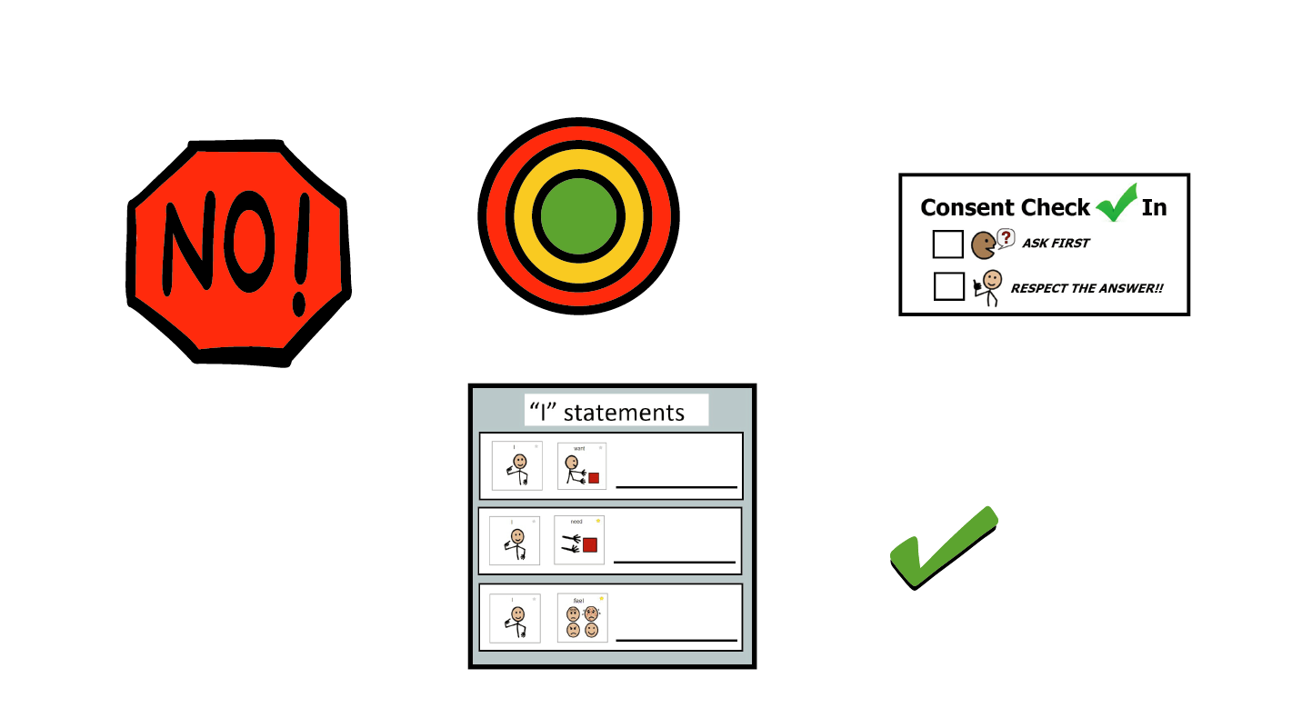
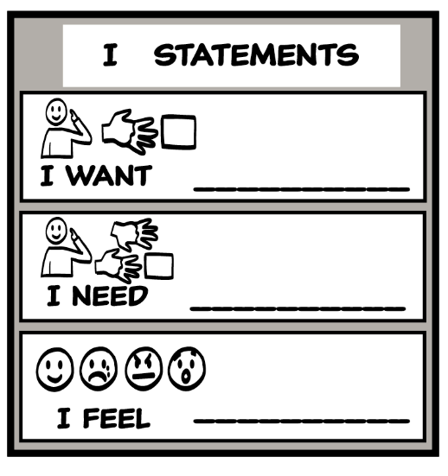
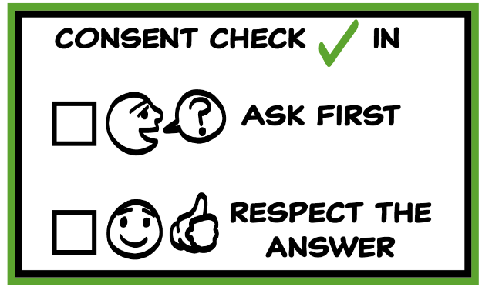
© 2026 SAFE Disability Services Program
Notes:
Use the large class Healthy Relationship Toolbox to review the Healthy Relationship Tools (I Statement, Relationship Map, NO!, and Consent Check-In). You can ask students to pull off one tool at a time and discuss what it is and how it is used. It can be particularly helpful for this review if you give students specific scenarios to think through. For example, you might ask, “If your friend lies to you, what is one I Statement you could use to tell your friend how you feel?” You may even consider using examples of situations that have recently occurred in your classroom, as long as doing so does not break student confidentiality.
You can also ask students to connect the toolbox tools to their current relationships. You might say, “Can anyone volunteer and tell me about something going on in your life right now that the toolbox could help you with?”
Instructions for how to use each Healthy Relationship Tool can be found in the following classes:
I Statements: Classes 2 and 3
Relationship Map: Class 4
NO!: Class 5
Consent Check-In: Class 6

Slide 3
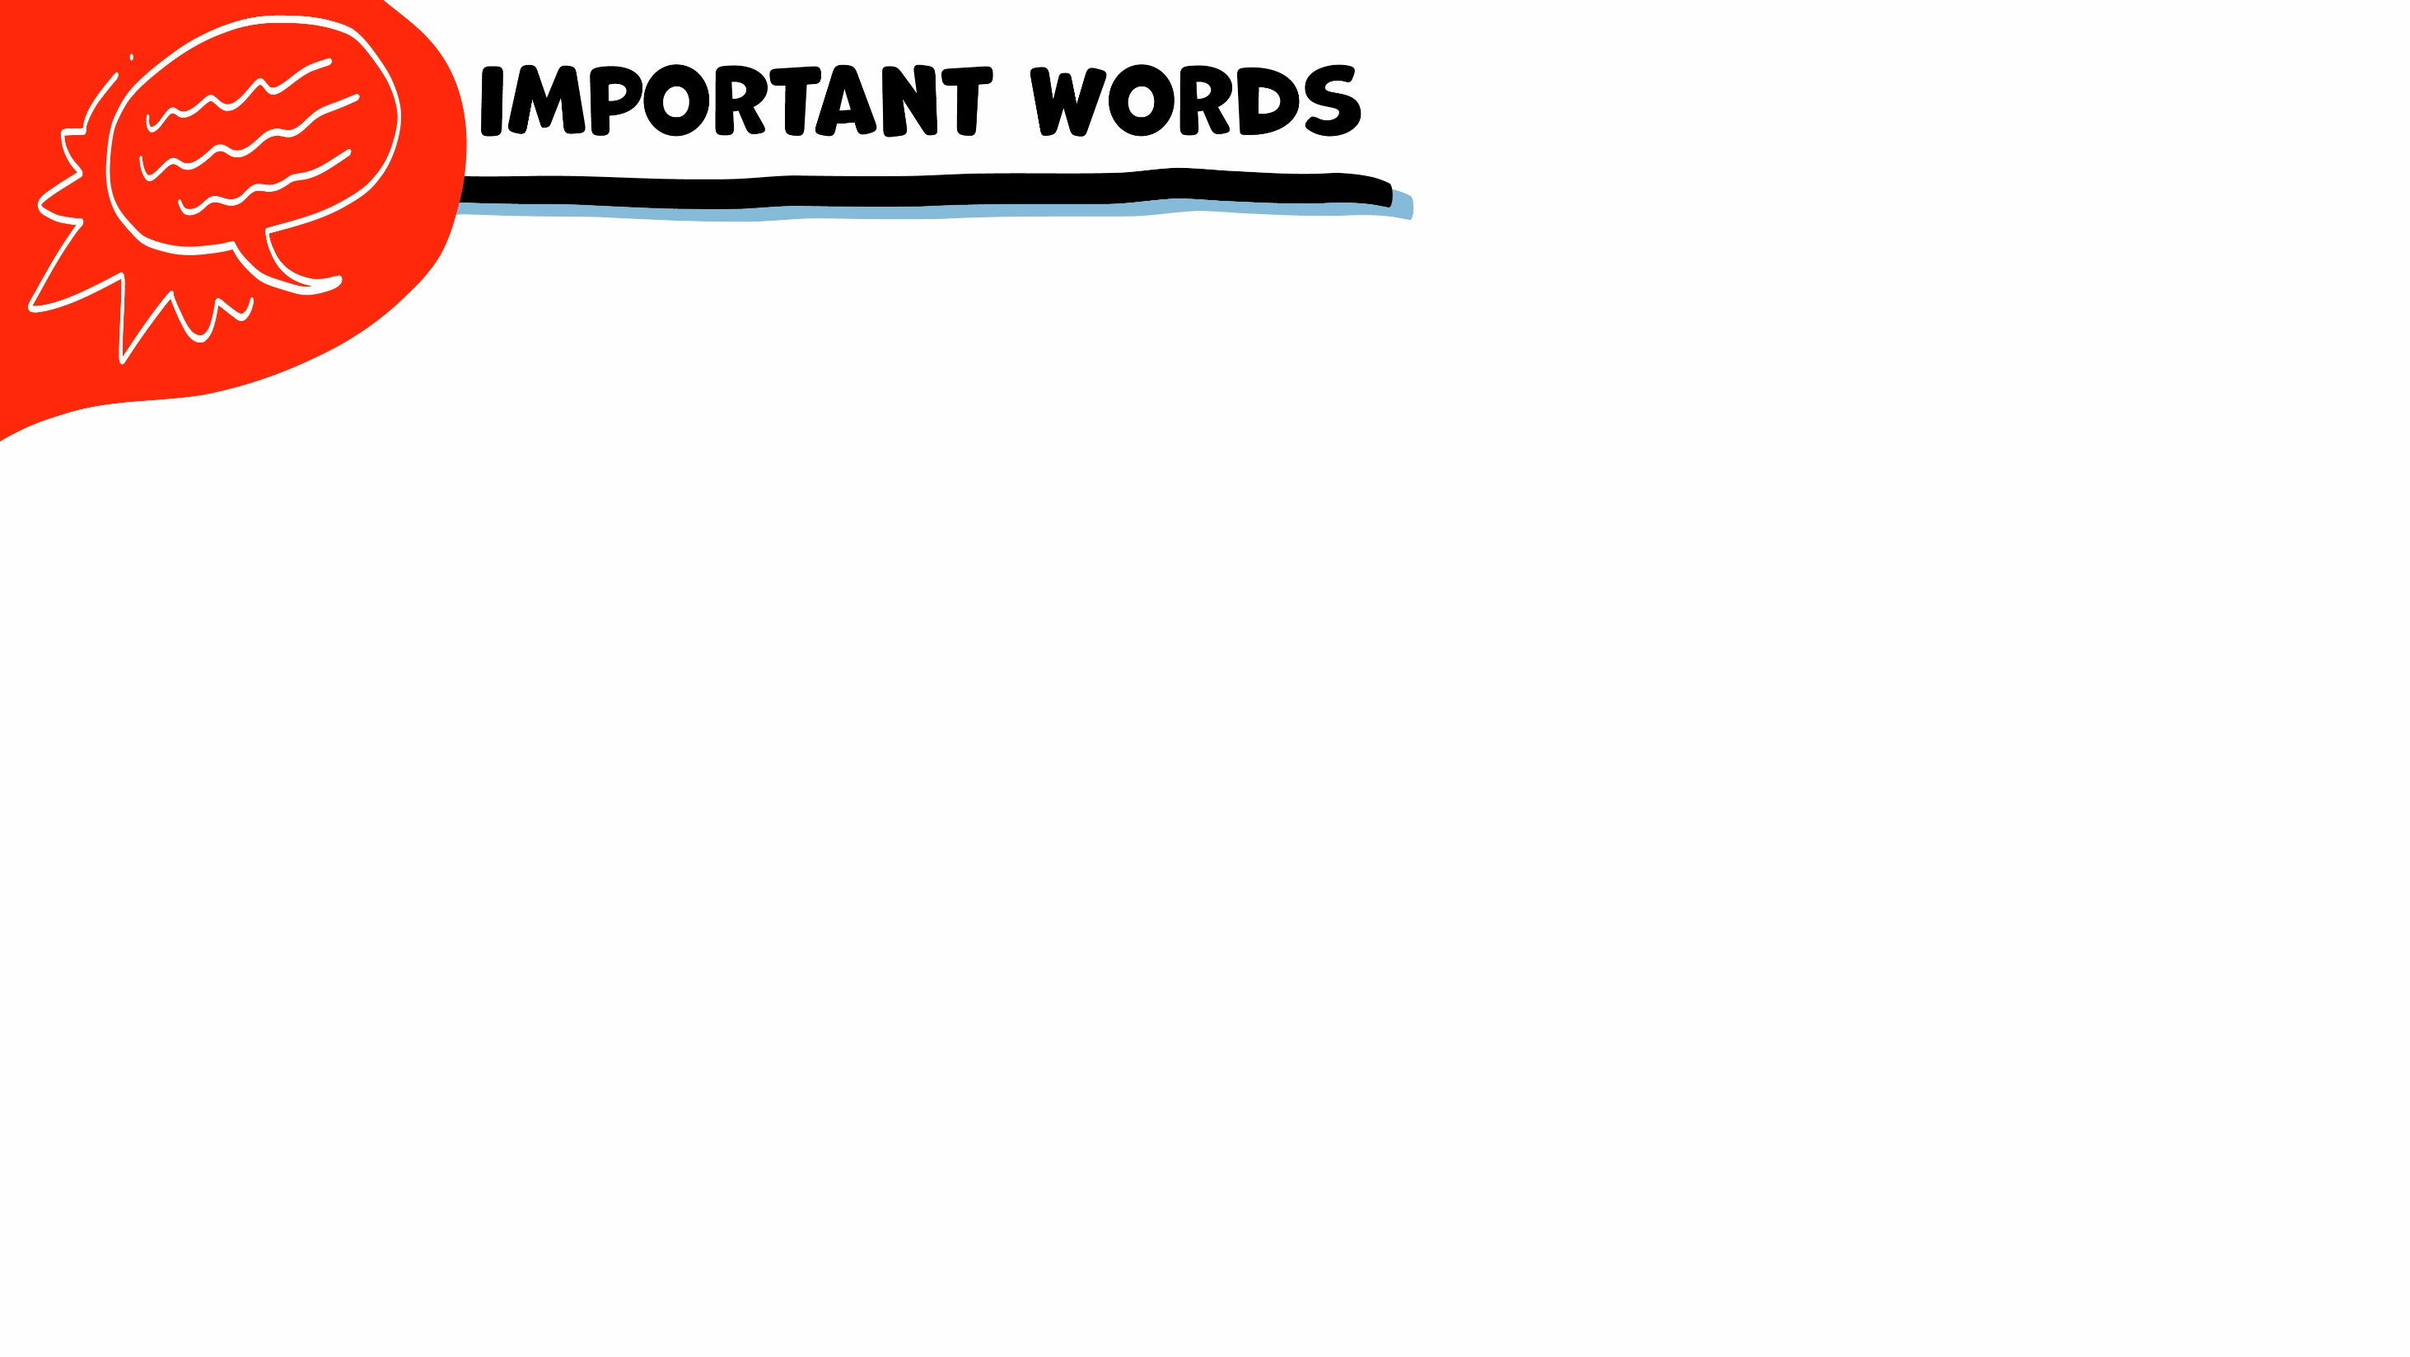


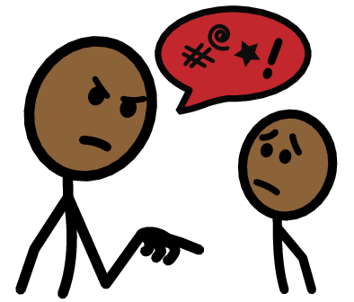


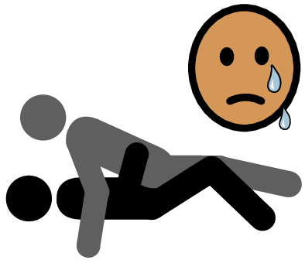
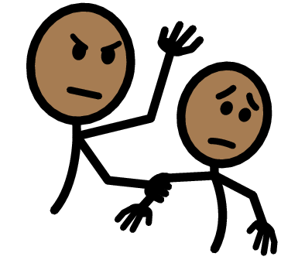

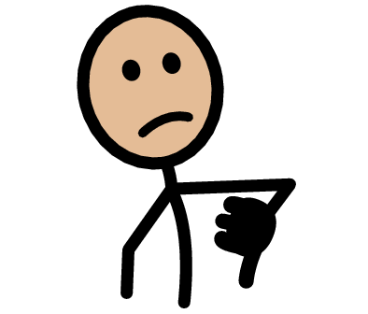


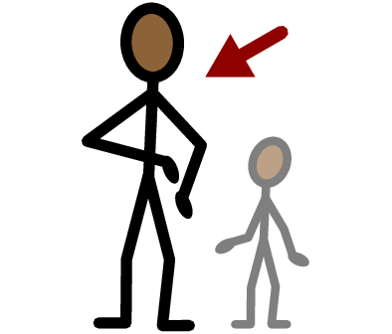
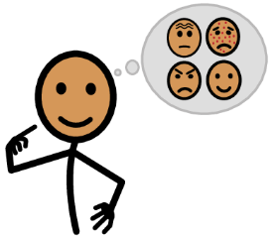



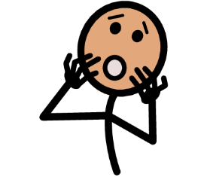
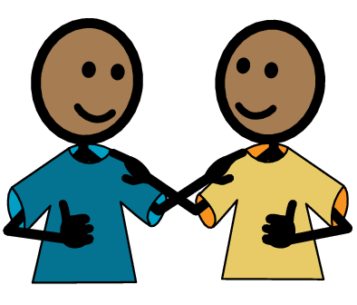
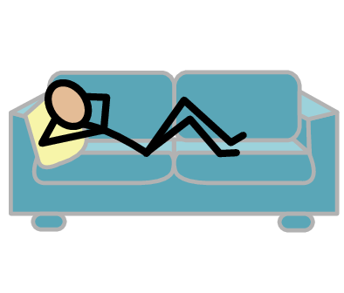
Warning Sign
Dangerous
Verbal abuse
Yes
No
Sexual abuse
Physical abuse
Healthy
Unhealthy
I need help
I have a question
Trust
Adult
Take a break
I feel
Happy
Sad
Mad
Scared
Copyright © 2021 SymbolStix, LLC. All rights reserved. Used with Permission.
Notes:
You can print this slide separately so each student can use the Important Words Sheet as a communication board throughout class. Review the words using the suggested definitions below. To enhance understanding, you can ask students to come up with their own definitions for vocabulary words or to provide a sentence or scenario using the new word.
Healthy: when a relationship feels good to both people
Unhealthy: when a relationship does not feel good to both people
Warning Sign: things that are unhealthy; these may mean that a relationship needs to end
Dangerous: things that are so unhealthy the relationship needs to end right away for the safety of both people
Verbal abuse: when someone uses their words to hurt someone
Physical abuse: when someone hurts someone else’s body
Sexual abuse: when someone touches someone else sexually without consent or in a way they do not like

Slide 4
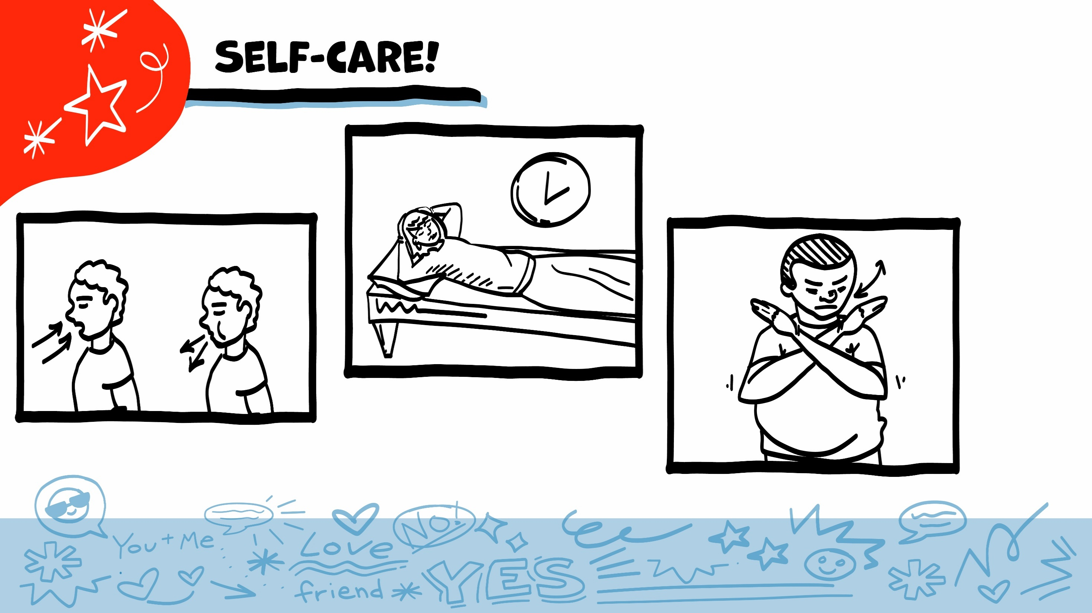
© 2026 SAFE Disability Services Program
Notes:
Say: As part of our class today, we will talk about ways that people are hurt in relationships. This might be hard for you if you have been hurt before. Remember to check in with yourself, and to take care of yourself throughout class. If you feel overwhelmed, you can always take some deep breaths, take a break, or pass on an activity.

Slide 5
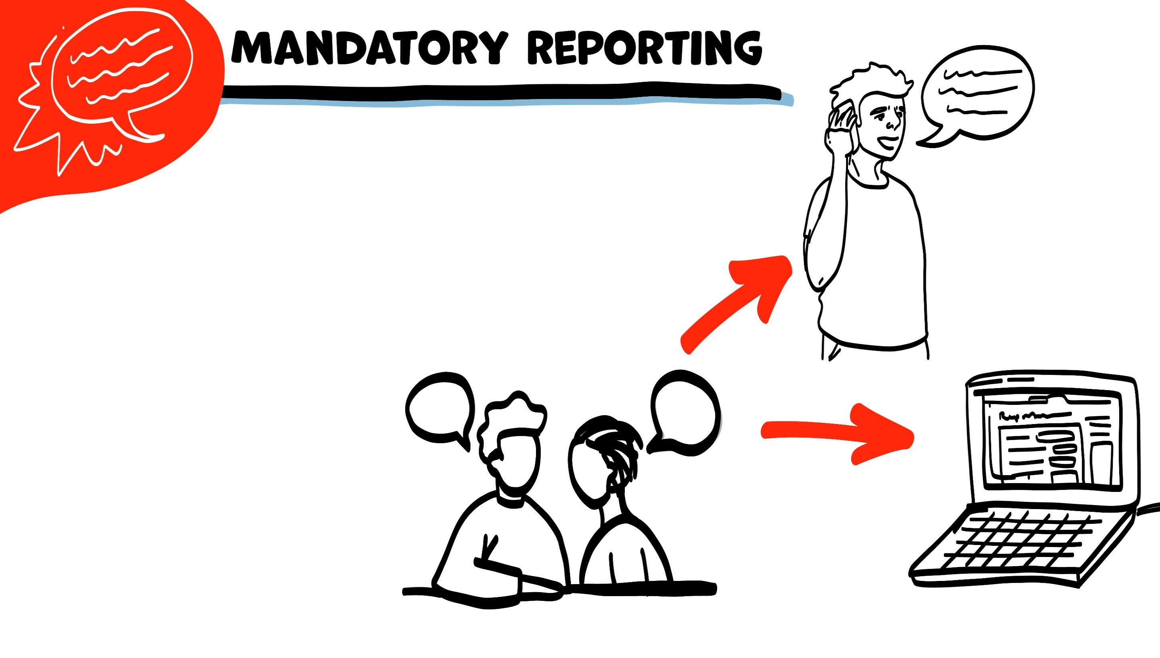
If someone is hurting you, I have to get help. I get help by telling Child Protective Services (CPS) or Adult Protective Services (APS).
If I need to tell CPS or APS, I will let you know first. We can make a report together on the phone or on the computer.
© 2026 SAFE Disability Services Program
Notes:
Say: I wanted to remind everyone that I am a mandatory reporter to Child Protective Services (CPS) if you are under 18 years of age AND Adult Protective Services (APS) if you are 18 years of age or older.
Does anyone remember what that means? Normally what we talk about in class stays in class, unless I have your consent to share. This is a private, safe place to ask questions about your relationships.
However, if you tell me that you are being hurt, or that someone else is being hurt, I would need to let Child Protective Services know (if you are under 18 years of age) or Adult Protective Services know (if you are 18 years of age or older).
I would need to get you or the other person help, so that you (or the other person) is not being hurt more. Does anyone have any questions about that?
Note for facilitators: As much as we may want to, we cannot promise another person that we will make sure they are never hurt again. We can however, work now, to help a student or someone they may know– that is being hurt.

Slide 6
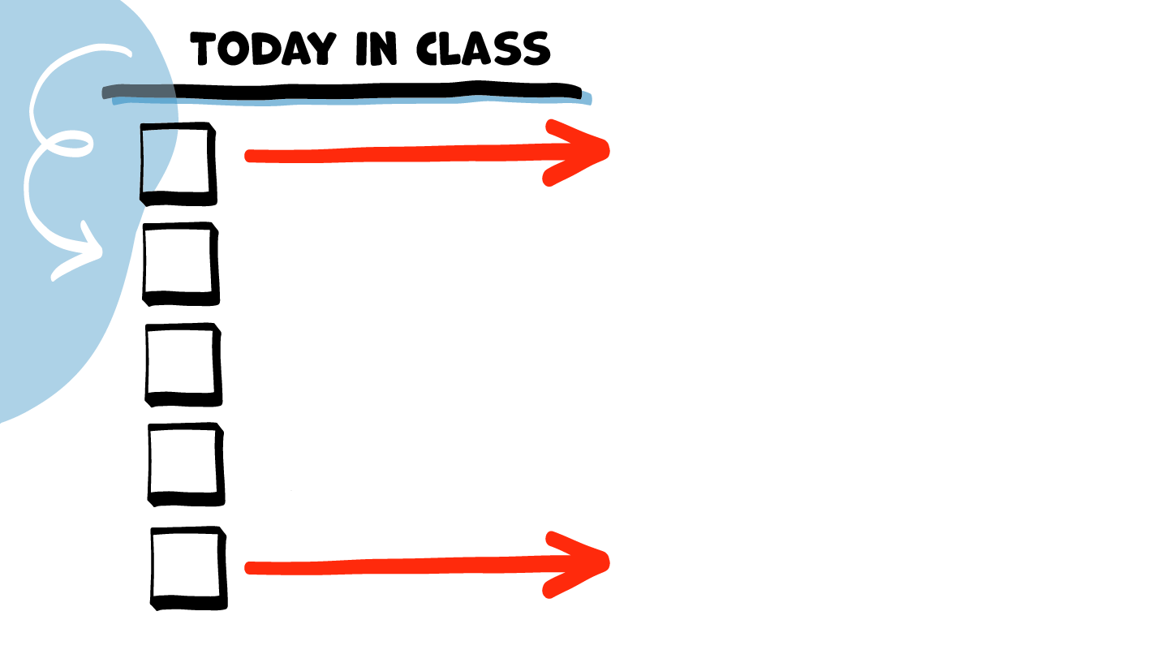
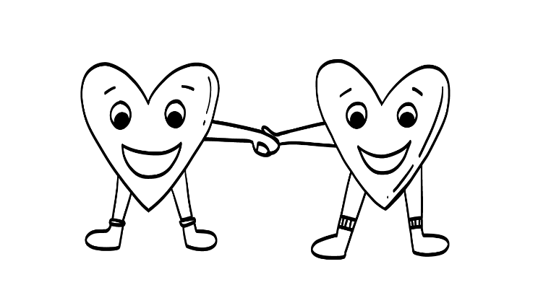
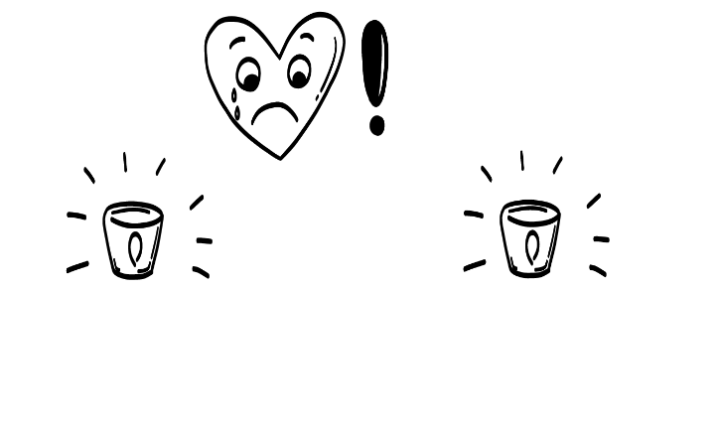
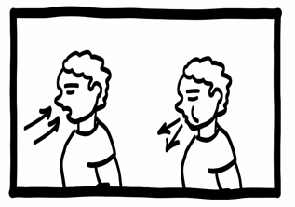
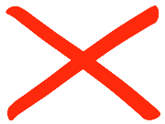
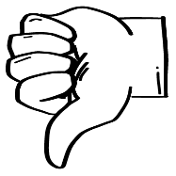
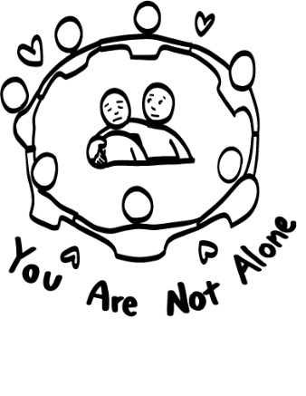
Healthy relationship review
Warning signs
Brain break
Dangerous behaviors
Dangerous!
Getting help
© 2026 SAFE Disability Services Program
Notes:
Read the agenda. Alternatively, you can ask for a student volunteer to read the agenda.

Slide 7
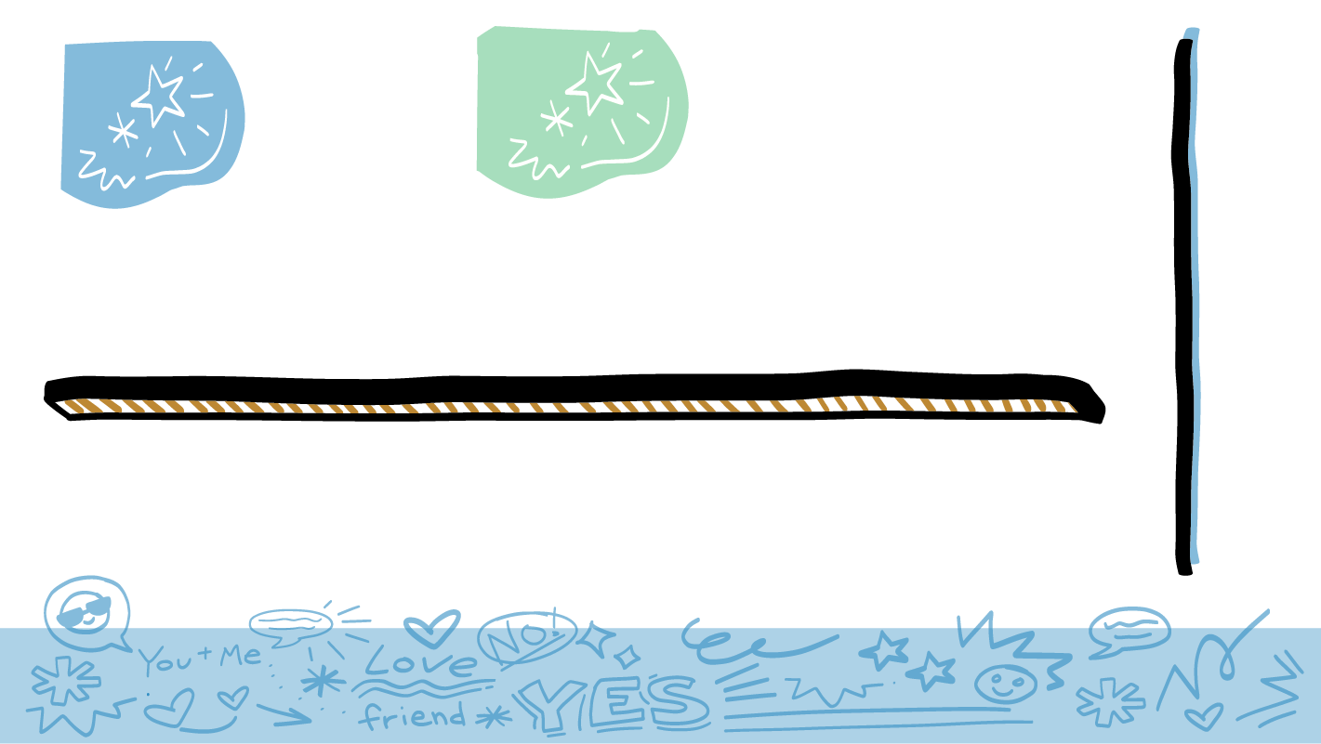
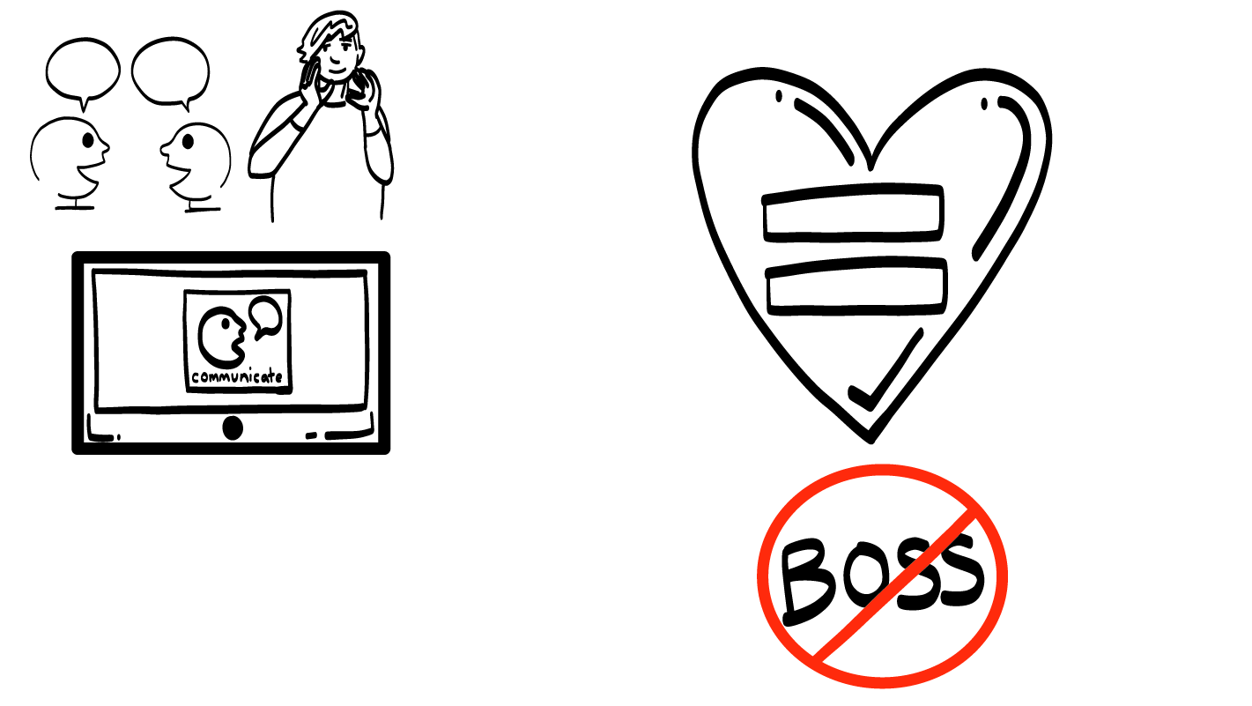
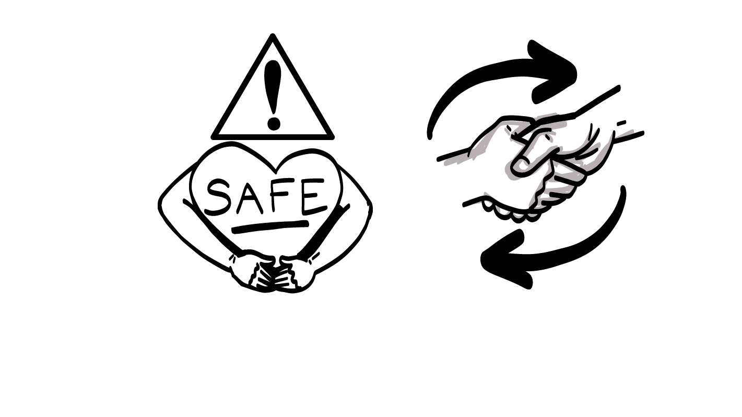
Parts of a
Healthy Relationship
Safety
Respect
Communication
Equality
© 2026 SAFE Disability Services Program
Notes:
Say: Last class, we talked about the four things you need for a healthy relationship—safety, respect, equality, and communication.

Slide 8
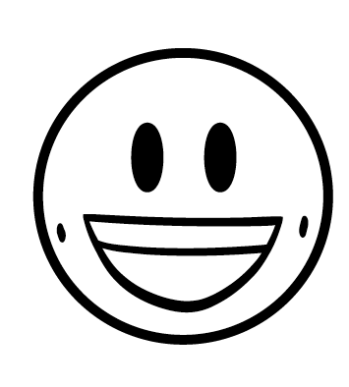
Safety
Respect
Equality
Communication
© 2026 SAFE Disability Services Program
Notes:
Say: Remember, in a healthy relationship, both people feel happy and good most of the time. You may have disagreements from time to time, but you should always feel safe when you are disagreeing.

Slide 9
Healthy relationship review
Warning signs
Brain break
Dangerous behaviors
Dangerous!
Getting help
© 2026 SAFE Disability Services Program
Notes:
Say: Now we are going to talk about some warning signs that a relationship is becoming unhealthy.

Slide 10
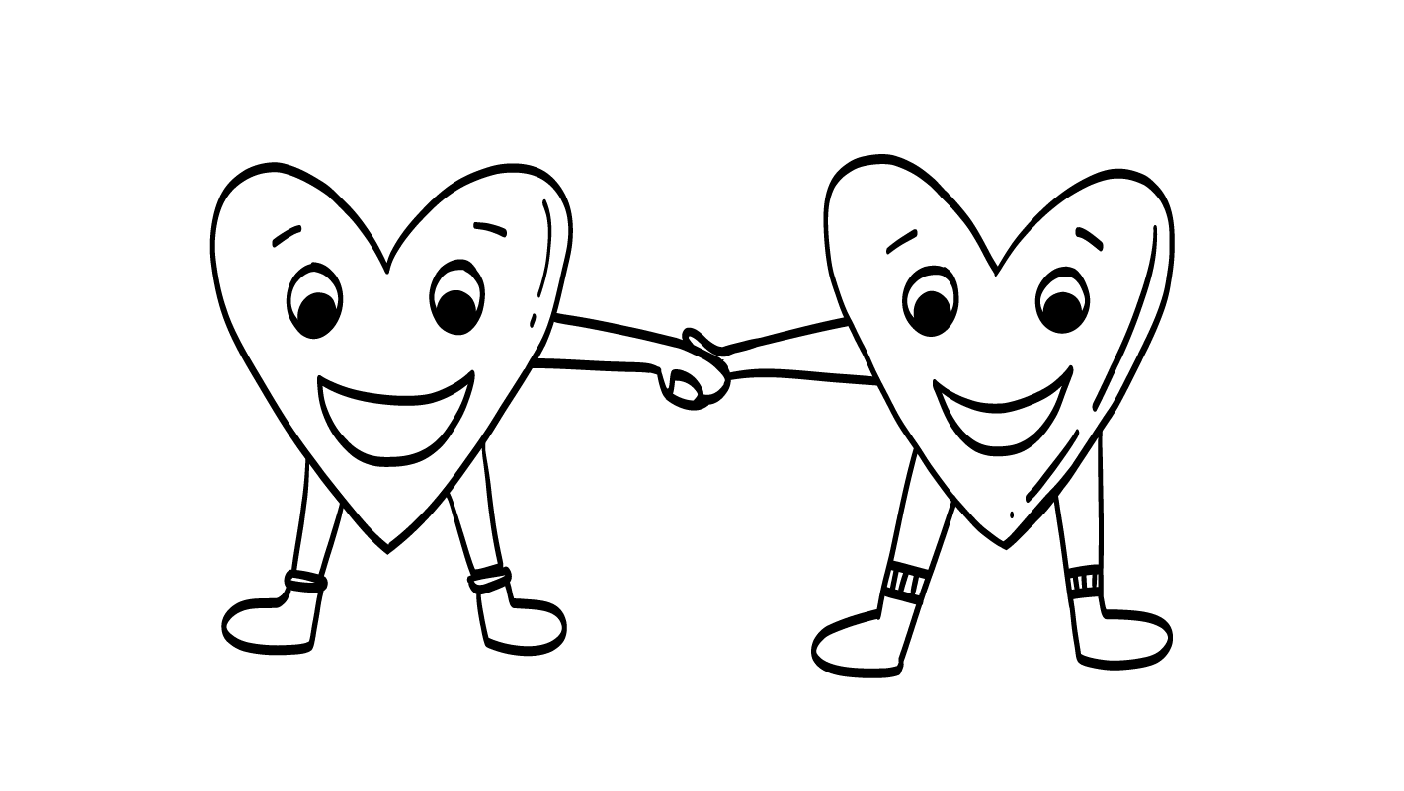
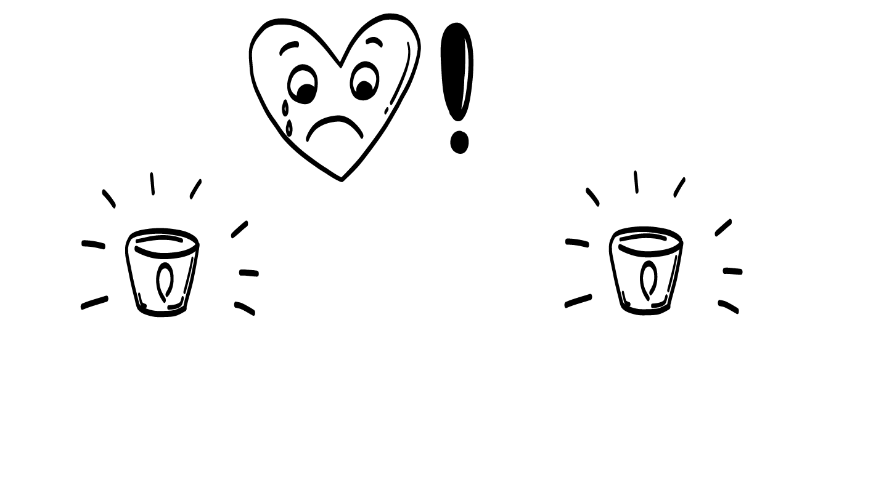
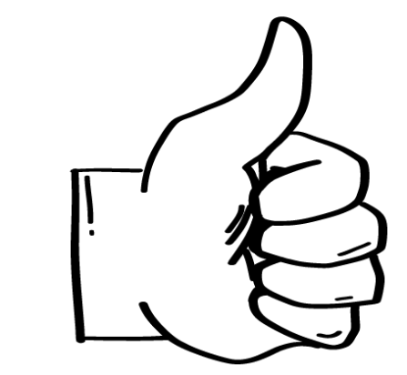
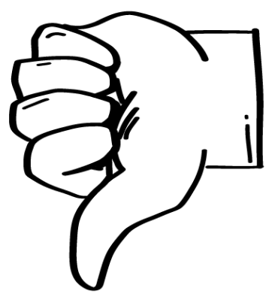
Healthy
Warning Sign
© 2026 SAFE Disability Services Program
Notes:
Write “Healthy” on one side of a dry erase or chalk board or a piece of chart paper, and “warning sign” on the other.
Say: When I say warning sign, I’m not talking about an actual sign that someone holds. I am talking about things people say or do that let you know your relationship is becoming unhealthy. We are going to play a game to think about what relationship behaviors are healthy and what behaviors are warning signs. In just a minute, you will get a partner. I will give you and your partner a card. Read what is on the card and decide if that behavior is healthy or a warning sign. Once you have decided, you can come to the front and tape the card on one side of the board.
Support students as needed to find a partner, and give each pair a Healthy or Warning Sign? Activity Card. Support students as needed to read the card, decide which side of the board it should go on, and tape the card to the corresponding side.

Slide 11
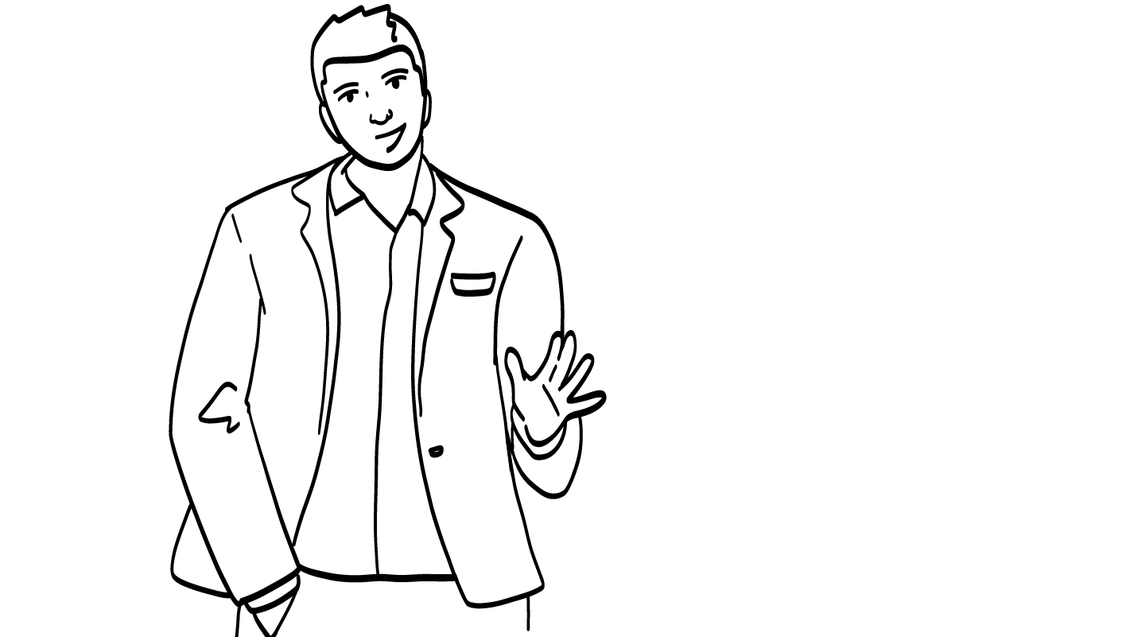
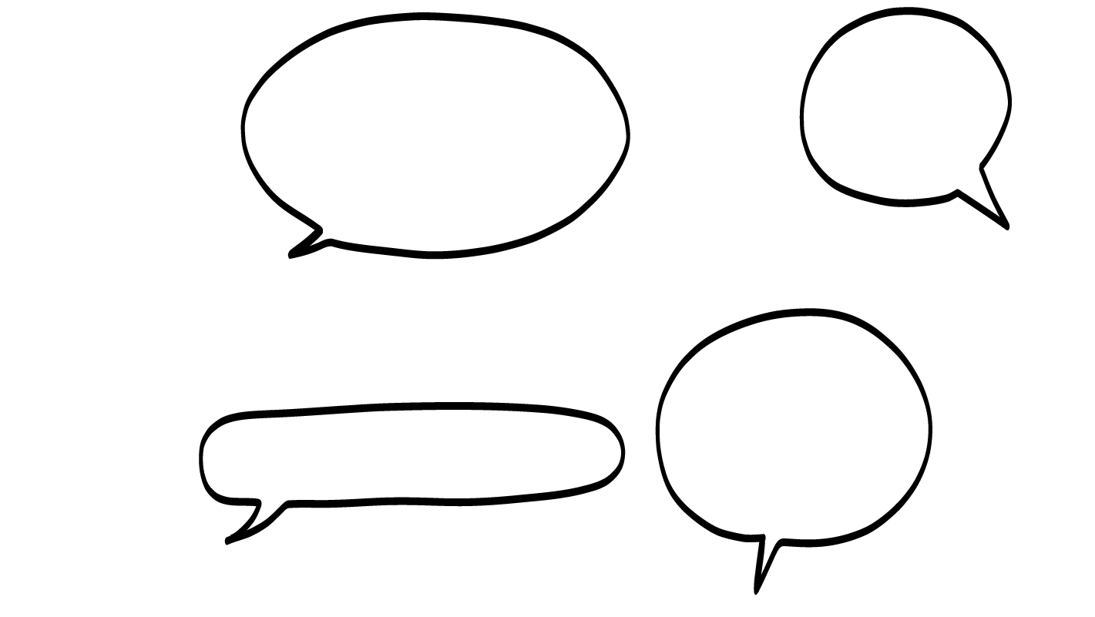
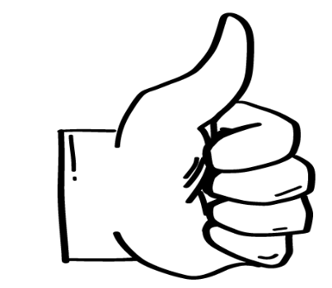
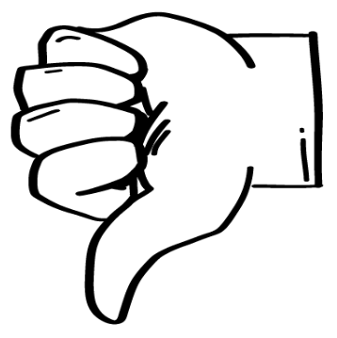
If you don’t want to do that activity, we won’t do it
Your friend respects your boundaries.
Warning
Sign
Healthy
© 2026 SAFE Disability Services Program
Notes:
After all cards have been sorted by your students, go through each one with the class as a whole. There is one PowerPoint slide for each of the Healthy or Warning Sign? Activity Cards. After you display the slide, look to see where the corresponding card is on the whiteboard or chart paper. Ask your class to give a “thumbs up” if they agree with the placement of the card, or a “thumbs down” if they don’t. Ask students to explain their thoughts if there is disagreement. Once the class has come to a consensus, you can press the space bar to reveal the correct answer. If needed, move the Healthy or Warning Sign? Activity Card to the correct side.
Sample talking points are included below.
Say: Your friend respects your boundaries.
This is healthy! Remember, your boundaries are what you are okay with, and what you are not okay with. Your friend should listen to you when you set your boundaries and should never pressure you to do something that you do not want to do.

Slide 12
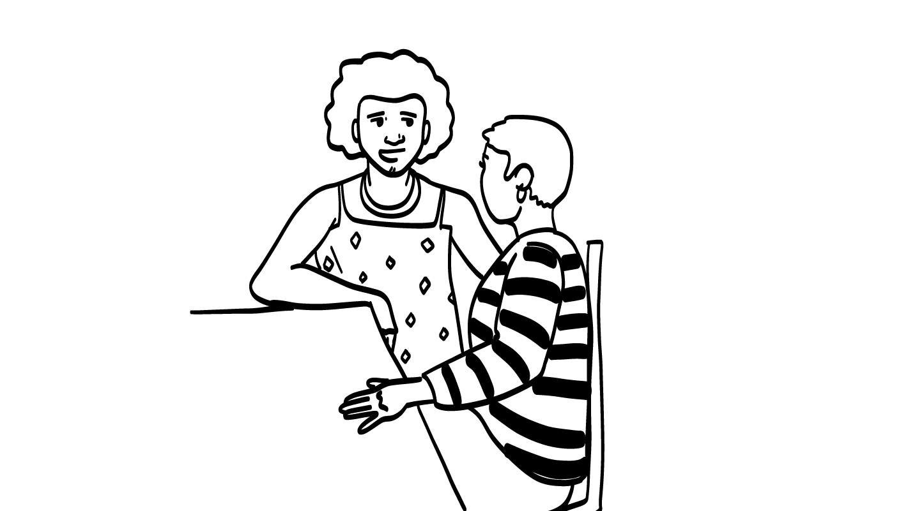
I hear you. How can I help?
Your friend listens when you talk to them.
Warning
Sign
Healthy
© 2026 SAFE Disability Services Program
Notes:
Find the Healthy or Warning Sign? Activity Card that corresponds with this PowerPoint slide. Ask your class to give a “thumbs up” if they agree with the placement of the card, or a “thumbs down” if they don’t. Ask students to explain their thoughts if there is disagreement. Once the class has come to a consensus, you can press the space bar to reveal the correct answer. If needed, move the Healthy or Warning Sign? Activity Card to the correct side.
Sample talking points are included below.
Say: Your friend listens when you talk to them.
This is healthy! Remember, communication is one of our ingredients for a healthy relationship. In order to have good communication, you and your friend need to listen to one another while you are talking.

Slide 13
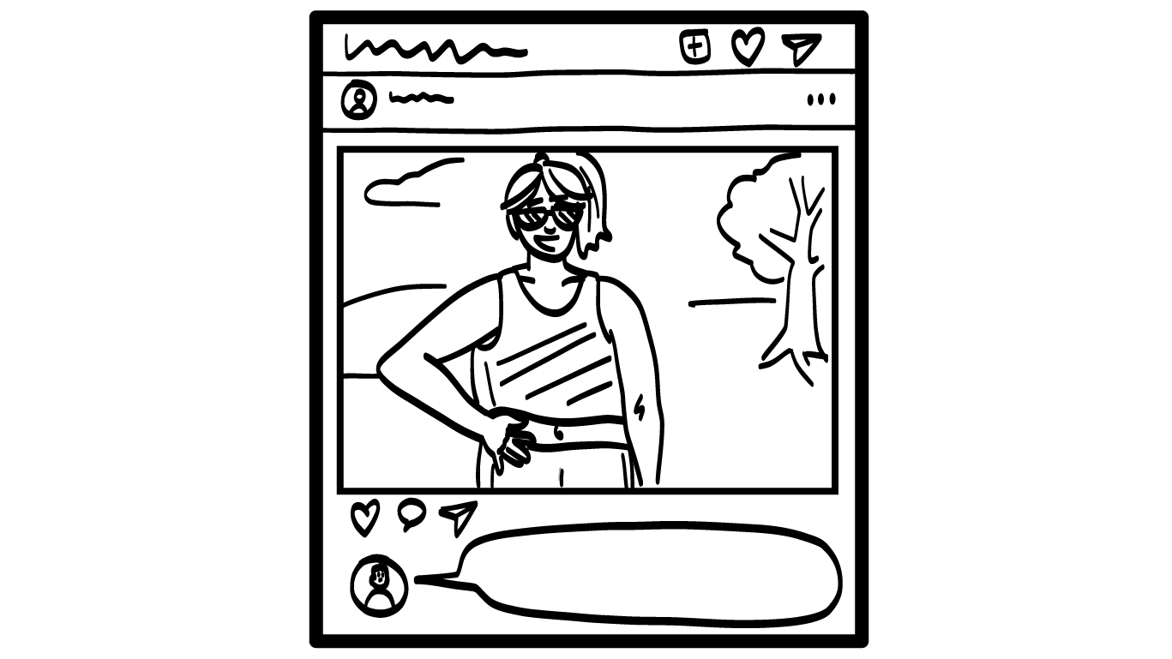
Your friend tells you what you can and can not post online.
Take this down now!
I told you not to post it!
Warning
Sign
Healthy
© 2026 SAFE Disability Services Program
Notes:
Find the Healthy or Warning Sign? Activity Card that corresponds with this PowerPoint slide. Ask your class to give a “thumbs up” if they agree with the placement of the card, or a “thumbs down” if they don’t. Ask students to explain their thoughts if there is disagreement. Once the class has come to a consensus, you can press the space bar to reveal the correct answer. If needed, move the Healthy or Warning Sign? Activity Card to the correct side.
Sample talking points are included below.
Say: Your friend tells you what you can and cannot post online.
This is a warning sign. Remember, we said in a healthy relationship, both people are equals. Neither person is the boss. It is not okay for your friend to try to control what you do. This is unhealthy.

Slide 14
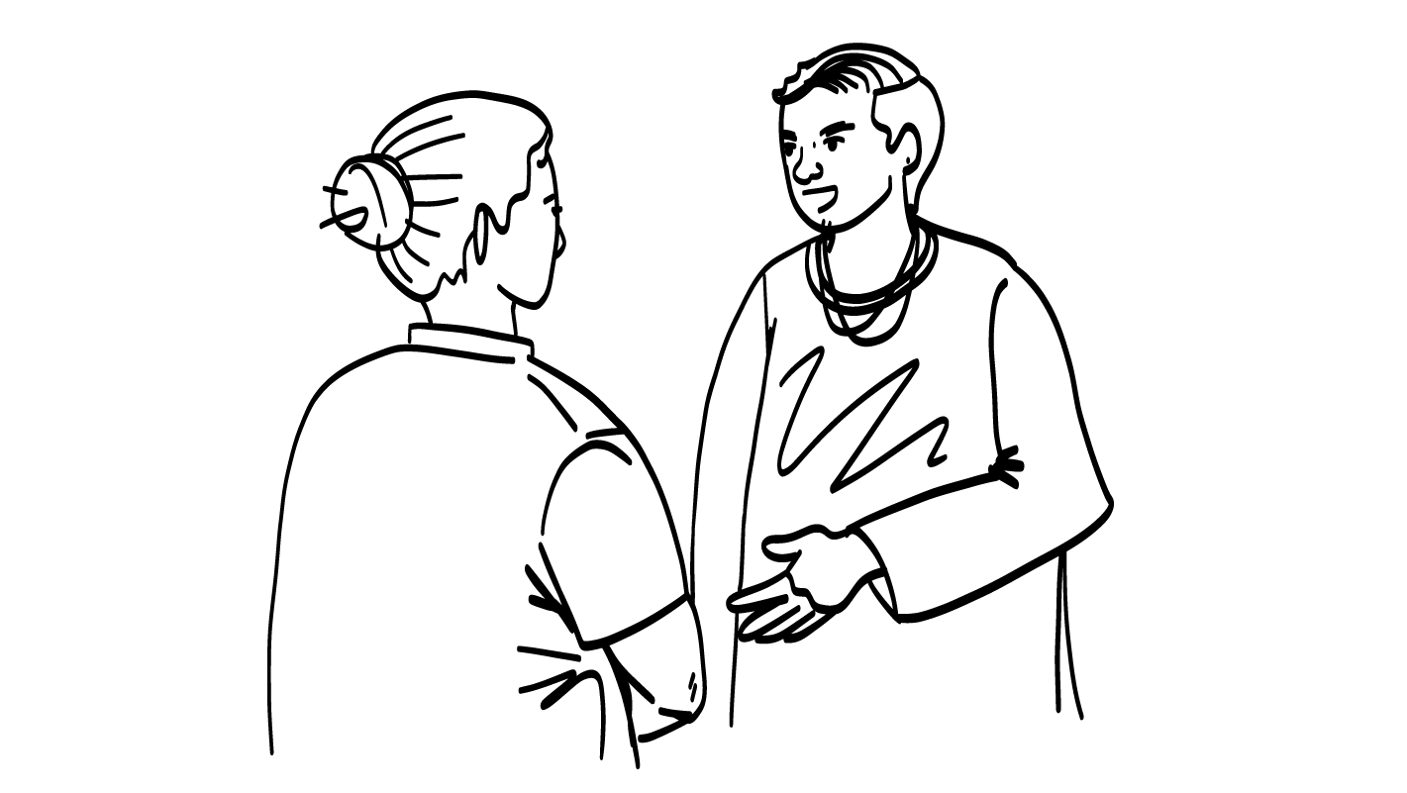
I feel upset because you said you don’t like my shirt.
Your friend uses I statements when they are upset.
Warning
Sign
Healthy
© 2026 SAFE Disability Services Program
Notes:
Find the Healthy or Warning Sign? Activity Card that corresponds with this PowerPoint slide. Ask your class to give a “thumbs up” if they agree with the placement of the card, or a “thumbs down” if they don’t. Ask students to explain their thoughts if there is disagreement. Once the class has come to a consensus, you can press the space bar to reveal the correct answer. If needed, move the Healthy or Warning Sign? Activity Card to the correct side.
Sample talking points are included below.
Say: Your friend uses I Statements when they are upset.
This is healthy! The I Statements Tool is a great way to let your friends know how you feel, what you want, or what you need.

Slide 15
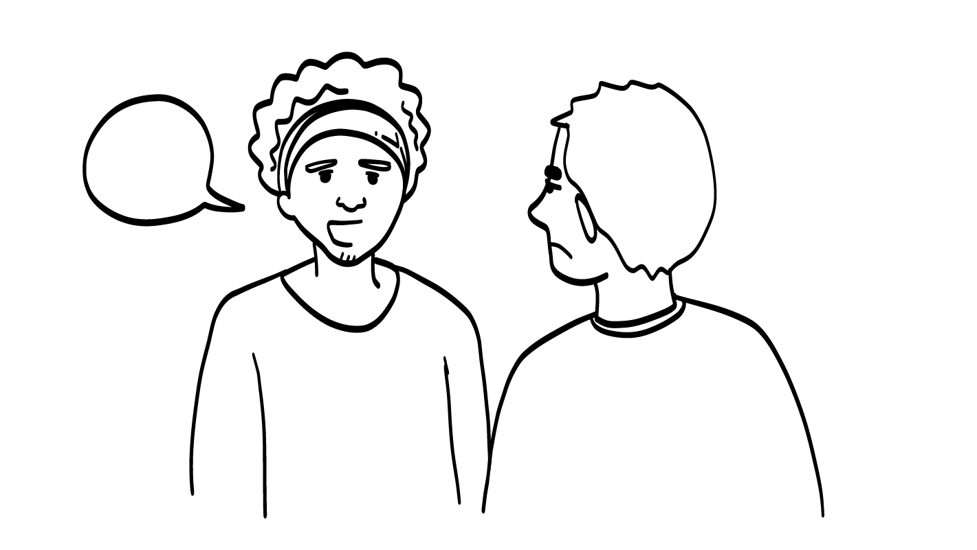
You are lying!
Your friend lies
to you.
Warning
Sign
Healthy
© 2026 SAFE Disability Services Program
Notes:
Find the Healthy or Warning Sign? Activity Card that corresponds with this PowerPoint slide. Ask your class to give a “thumbs up” if they agree with the placement of the card, or a “thumbs down” if they don’t. Ask students to explain their thoughts if there is disagreement. Once the class has come to a consensus, you can press the space bar to reveal the correct answer. If needed, move the Healthy or Warning Sign? Activity Card to the correct side.
Sample talking points are included below.
Say: Your friend lies to you.
This is a warning sign. It is not respectful to lie to someone. Your friends should be honest with you.

Slide 16
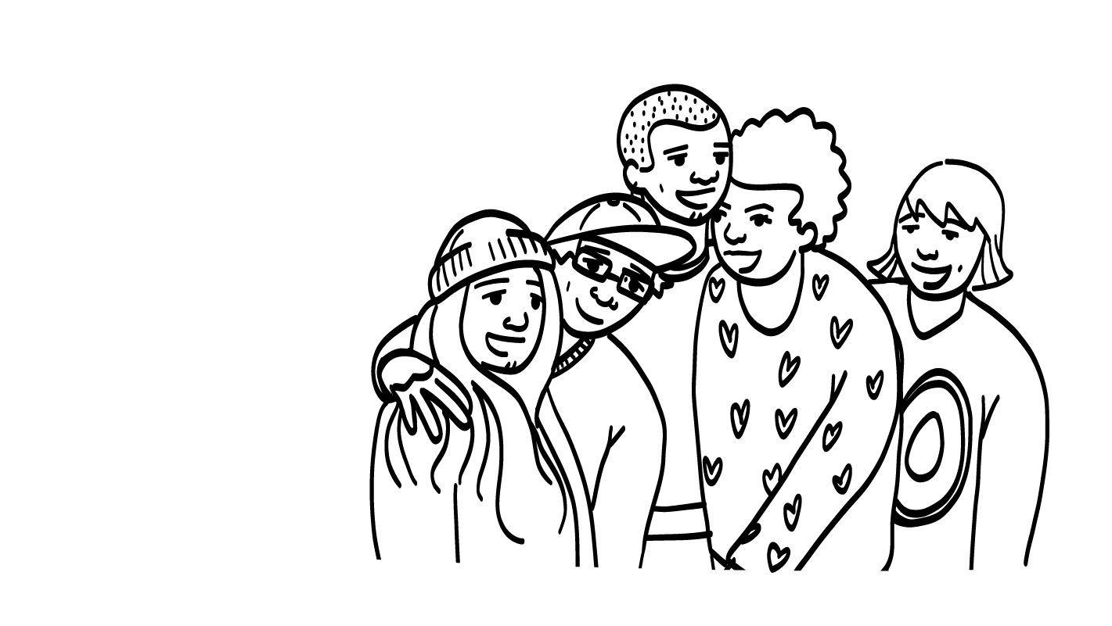
Your friends make you happy.
Warning
Sign
Healthy
© 2026 SAFE Disability Services Program
Notes:
Find the Healthy or Warning Sign? Activity Card that corresponds with this PowerPoint slide. Ask your class to give a “thumbs up” if they agree with the placement of the card, or a “thumbs down” if they don’t. Ask students to explain their thoughts if there is disagreement. Once the class has come to a consensus, you can press the space bar to reveal the correct answer. If needed, move the Healthy or Warning Sign? Activity Card to the correct side.
Sample talking points are included below.
Say: Your friends make you happy.
This is healthy! Even in healthy relationships, you and the other person might get into disagreements. But most of the time, you should feel happy and good. Your friends should feel happy in the relationship, too!

Slide 17
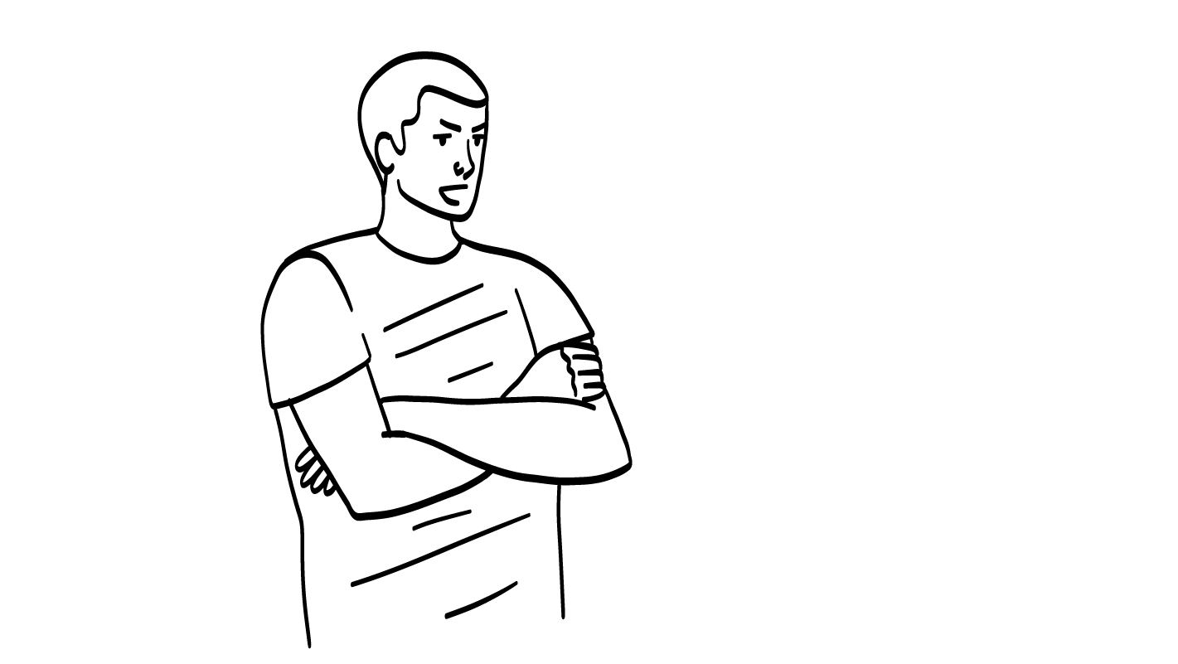
I like you so much, we should spend our time together. Other people just get in the way.
Your friend tells you that you should only hang out with them.
Warning
Sign
Healthy
© 2026 SAFE Disability Services Program
Notes:
Find the Healthy or Warning Sign? Activity Card that corresponds with this PowerPoint slide. Ask your class to give a “thumbs up” if they agree with the placement of the card, or a “thumbs down” if they don’t. Ask students to explain their thoughts if there is disagreement. Once the class has come to a consensus, you can press the space bar to reveal the correct answer. If needed, move the Healthy or Warning Sign? Activity Card to the correct side.
Sample talking points are included below.
Say: Your friend tells you that you should only hang out with them.
This is a warning sign. Remember, your friend is not your boss. They don’t get to tell you what to do. In a healthy relationship, you should still be able to hang out with your other friends and family. It’s not okay for your friend to say that you can only hang out with them.

Slide 18
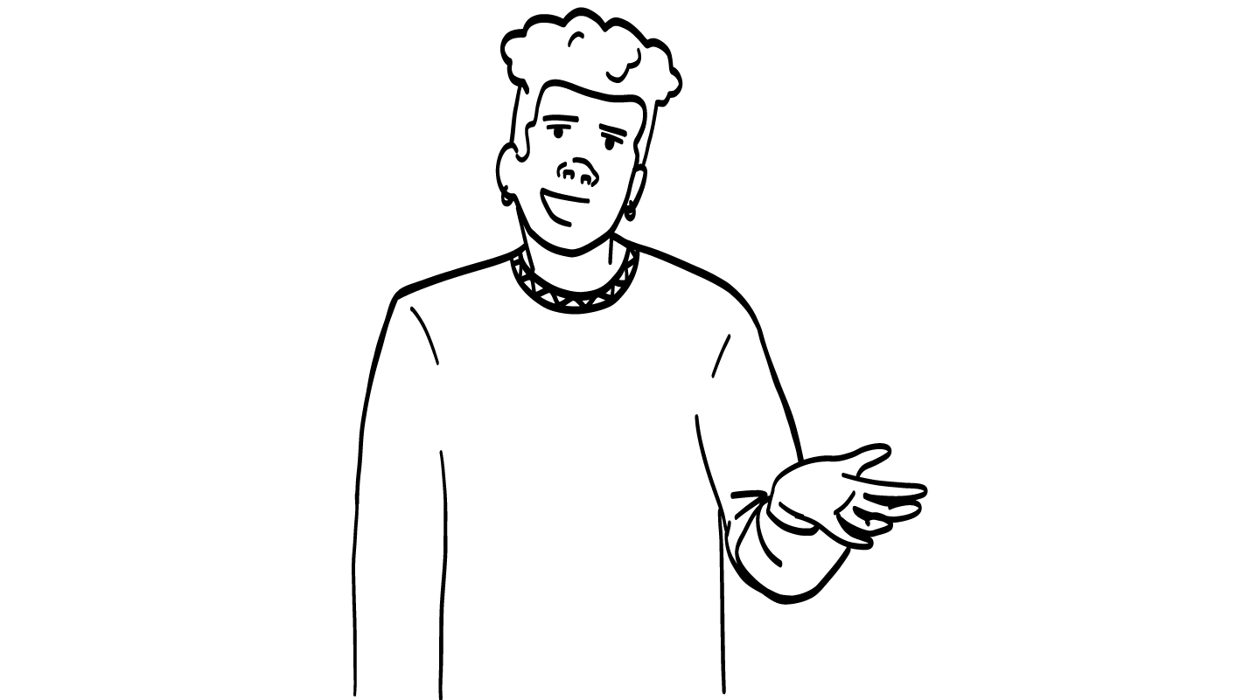
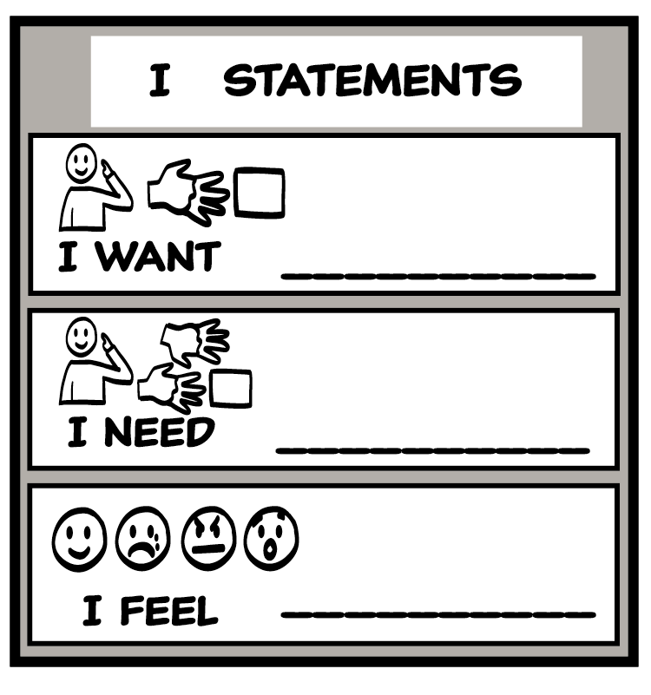
I need time with my other friends and family.
Those relationships are also important to me.
When a warning sign comes up in your relationship, you can use the I Statement Tool and the NO! Tool to talk to your friend and set your boundary.
© 2026 SAFE Disability Services Program
Notes:
Say: When warning signs come up in your relationships, you can use the Healthy Relationship Toolbox Tools to try to make things better. Let’s think about the last example we talked about: your friend says that you should only hang out with them. Since this crosses your boundary, you can say NO! You can say no with your voice, signs, and body. You can also use the I Statement Tool. What’s an I statement you could use to talk to your friend?
Give students enough time to process the question and make their decisions. Sample answers include:
I need time alone with my other friends.
I want some space.
I feel frustrated that you only want me to spend time with you.
Say: You can also talk to an adult in your inner green circle of trust for help when warning signs come up in your relationships.

Slide 19
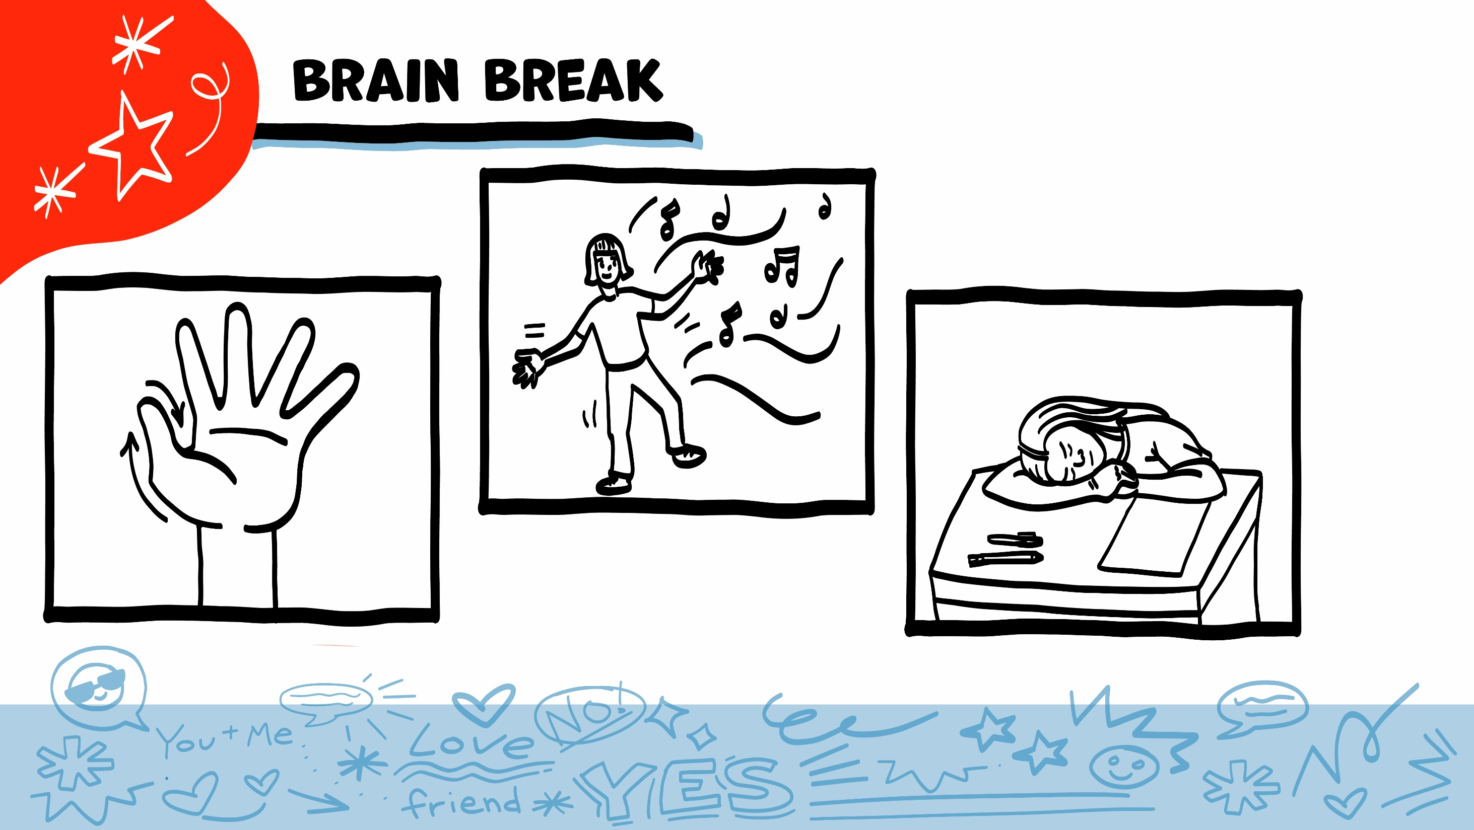
© 2026 SAFE Disability Services Program
Notes:
Say: That was a lot of information, and you all are doing an amazing job! Every week in class we will take a brain break in the middle. This is a chance to move a little and take a break from thinking!
Below are three ideas to give students a quick opportunity for a brain break. You are also welcome to come up with your own ideas for brain breaks that work best for your class.
Five finger breathing
For this exercise, have all students place their hand in front of their chest with their five fingers spread out. Next, use the pointer finger of the other hand to trace up and down each of the five fingers, beginning with the thumb. As students trace up a finger, they will breathe in. As they trace down a finger, they will breathe out. When students breathe out on the pinky finger, you can tell them to shake out their hands and arms. As the school year goes on, you can ask students to lead this exercise for their peers.
If this exercise is physically inaccessible for your class, you can also model the hand tracing for students while they breathe in and out.
Stretch break
Lead students through a series of basic stretches. These can be completed in a chair, or while standing up, depending on the accommodation needs of your class. Some ideas include reaching toward the ceiling, stretching one arm at a time across the chest, reaching toward toes, turning head from side to side, etc. Ask students to hold a pose while you count to ten. As the school year goes on, you can ask students to lead stretches for their peers.
Dance party
If your class likes to dance, you can put on a short song for them to dance to. This is especially effective if you are able to find a song that relates to the theme for that week’s class.

Slide 20
Healthy relationship review
Warning signs
Brain break
Dangerous behaviors
Dangerous!
Getting help
© 2026 SAFE Disability Services Program
Notes:
Write “Healthy” on one side of a whiteboard or a piece of chart paper, and “Dangerous” on the other.
Say: Before the break, we talked about healthy relationship behaviors and warning signs that a relationship is becoming unhealthy. Now we are going to talk about things that are dangerous. Dangerous behaviors are unhealthy and not okay. Dangerous behaviors should not happen even one time. You and your partner are going to work together again. I will give the two of you a card. Read what is on the card and decide if that behavior is healthy or dangerous. Once you have decided, you can come to the front and tape the card on one side of the board.
Support students as needed to find a partner, and give each pair a Healthy or Dangerous? Activity Card. Support students as needed to read the card, decide which side of the board it should go on, and tape the card to the corresponding side.

Slide 21
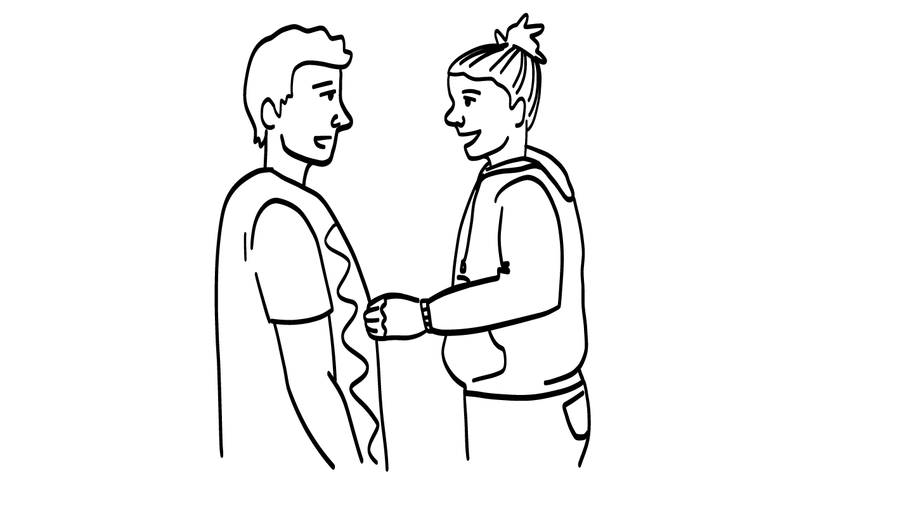
NO!
I hear you, I’ll stop.
Your friend stops teasing you when you say “NO!”
Healthy
Dangerous!
© 2026 SAFE Disability Services Program
Notes:
Find the Healthy or Dangerous? Activity Card that corresponds with this PowerPoint slide. Ask your class to give a “thumbs up” if they agree with the placement of the card, or a “thumbs down” if they don’t. Ask students to explain their thoughts if there is disagreement. Once the class has come to a consensus, you can press the space bar to reveal the correct answer. If needed, move the Healthy or Dangerous? Activity Card to the correct side.
Sample talking points are included below.
Say: Your friend stops teasing you when you say “NO!”.
This is healthy! Your friend has to listen when you set your boundaries. If you say NO!, your friend should stop immediately, back off, and give you some space.

Slide 22
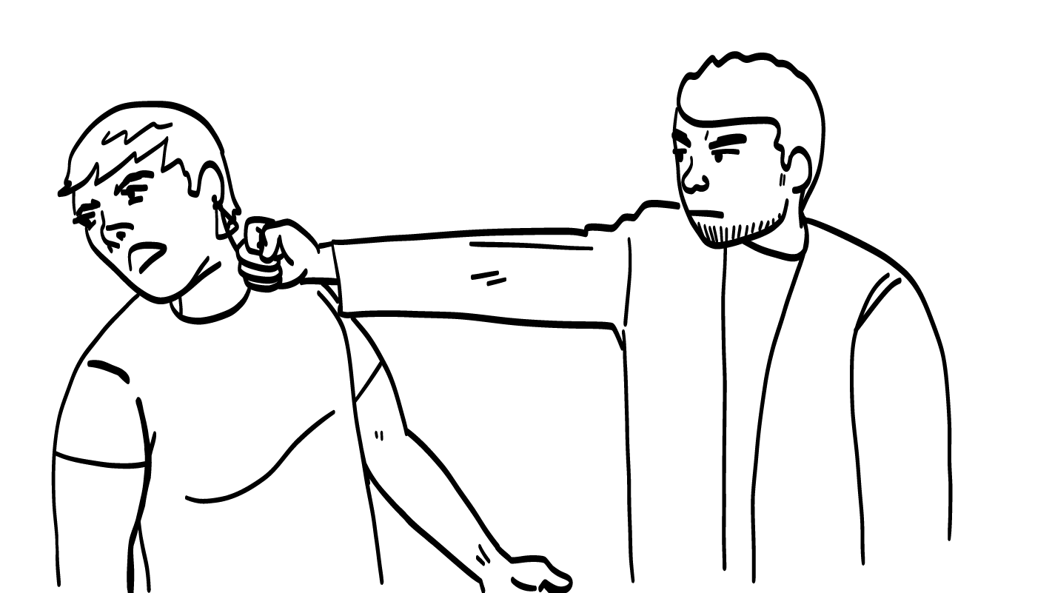
Your friend hits you.
Healthy
Dangerous!
© 2026 SAFE Disability Services Program
Notes:
Find the Healthy or Dangerous? Activity Card that corresponds with this PowerPoint slide. Ask your class to give a “thumbs up” if they agree with the placement of the card, or a “thumbs down” if they don’t. Ask students to explain their thoughts if there is disagreement. Once the class has come to a consensus, you can press the space bar to reveal the correct answer. If needed, move the Healthy or Dangerous? Activity Card to the correct side.
Sample talking points are included below.
Say: Your friend hits you.
This is dangerous. It is never okay for your friend to hurt your body. This is not safe and you should get help right away.

Slide 23
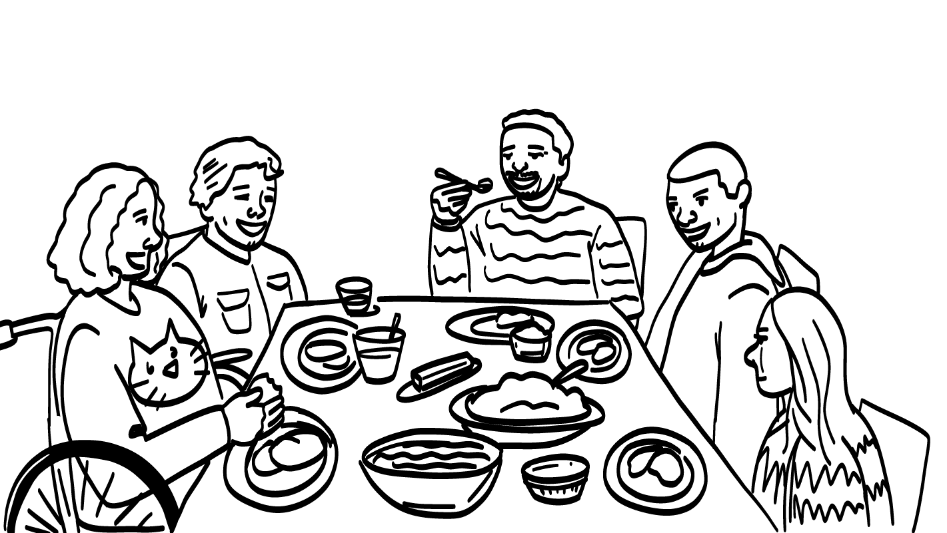
Your friend respects your other friends and family.
Healthy
Dangerous!
© 2026 SAFE Disability Services Program
Notes:
Find the Healthy or Dangerous? Activity Card that corresponds with this PowerPoint slide. Ask your class to give a “thumbs up” if they agree with the placement of the card, or a “thumbs down” if they don’t. Ask students to explain their thoughts if there is disagreement. Once the class has come to a consensus, you can press the space bar to reveal the correct answer. If needed, move the Healthy or Dangerous? Activity Card to the correct side.
Sample talking points are included below.
Say: Your friend respects your friends and family.
This is healthy! In a healthy relationship, your friend will not only respect you, but they will also respect your other friends and family! They should be kind to the people in your middle yellow circle of people you know and your inner green circle of trust on the Relationship Map.

Slide 24
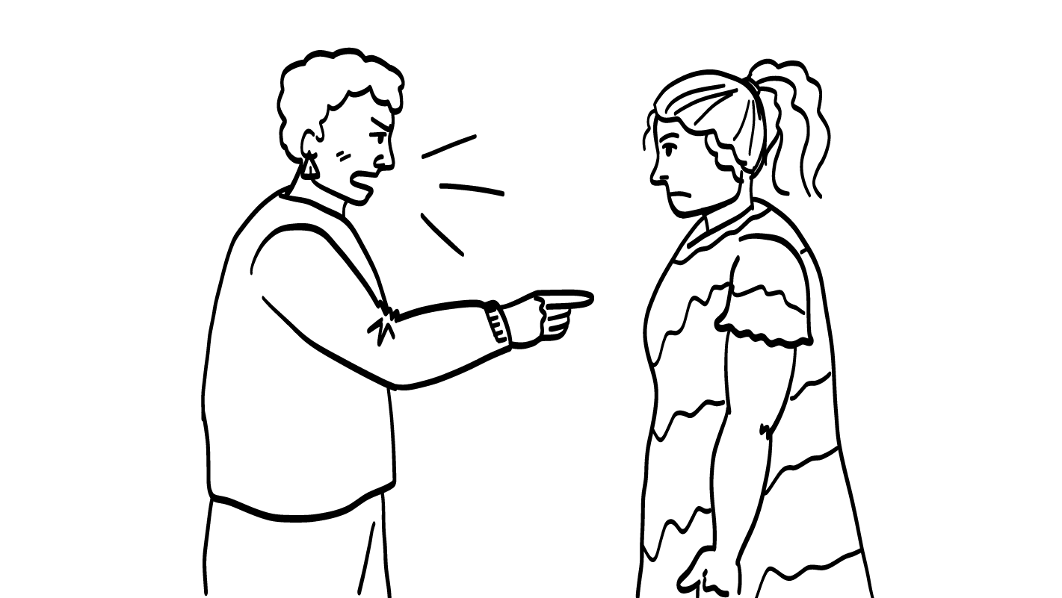
You are an idiot!
Your friend calls you mean names in person and online.
You are a loser!
Healthy
Dangerous!
© 2026 SAFE Disability Services Program
Notes:
Find the Healthy or Dangerous? Activity Card that corresponds with this PowerPoint slide. Ask your class to give a “thumbs up” if they agree with the placement of the card, or a “thumbs down” if they don’t. Ask students to explain their thoughts if there is disagreement. Once the class has come to a consensus, you can press the space bar to reveal the correct answer. If needed, move the Healthy or Dangerous? Activity Card to the correct side.
Sample talking points are included below.
Say: Your friend calls you mean names in person and online.
This is dangerous. It is never okay for your friend to say mean things to you, in person or online. This is not safe and not respectful, and you should get help right away.

Slide 25

I feel so safe with you!
I’m here for you!
Your friend makes you feel safe.
Healthy
Dangerous!
© 2026 SAFE Disability Services Program
Notes:
Find the Healthy or Dangerous? Activity Card that corresponds with this PowerPoint slide. Ask your class to give a “thumbs up” if they agree with the placement of the card, or a “thumbs down” if they don’t. Ask students to explain their thoughts if there is disagreement. Once the class has come to a consensus, you can press the space bar to reveal the correct answer. If needed, move the Healthy or Dangerous? Activity Card to the correct side.
Sample talking points are included below.
Say: Your friend makes you feel safe.
This is healthy! Safety is one of our healthy relationship ingredients. You should always feel safe with your friends, even when you are disagreeing.

Slide 26

Verbal Abuse
Verbal abuse is when someone says mean things to you, calls you names, or uses their words to hurt you.
Verbal abuse is never okay.
© 2026 SAFE Disability Services Program
Notes:
Say: Everyone deserves a healthy relationship with little to no unhealthy behaviors. Sometimes you can talk to your friend about the warning signs in your relationship, and your friend can work on changing them. There are some behaviors, however, that are not okay, even one time. These are the dangerous behaviors we just talked about. It is never okay for anyone to abuse or hurt you, verbally, physically, or sexually.
Verbal abuse is when someone uses words to say mean things to you, calls you names, or uses their words to hurt you. Verbal abuse is never okay.

Slide 27
Physical Abuse
Physical abuse is when someone hurts your body or says they are going to hurt your body.
Physical abuse is never okay.
© 2026 SAFE Disability Services Program
Notes:
Say: Physical abuse is when someone hurts your body or says they are going to hurt your body. Physical abuse is also never okay.

Slide 28

Sexual Abuse
Sexual abuse is unwanted sexual words
or sexual touching.
Sexual abuse is never okay.
© 2026 SAFE Disability Services Program
Notes:
Say: Sexual abuse is unwanted sexual words or sexual touching. Sexual abuse is never okay.

Slide 29

You will not get in trouble.
If someone hurt you it is not your fault. You are doing the right thing by telling me.
I need help but I don’t want to get in trouble.
© 2026 SAFE Disability Services Program
Notes:
Say: What if you are sexually abused? Will you get in trouble if you tell someone what happened?
No. If you are abused, the only person who did anything wrong is the person who hurt you. It is never your fault. When you ask for help, the person who hurt you will get in trouble for breaking the law. You will not get in trouble.

Slide 30
Healthy relationship review
Warning signs
Brain break
Dangerous behaviors
Dangerous!
Getting help
© 2026 SAFE Disability Services Program
Notes:
Say: The last thing we will talk about today is how to get help if you or someone you care about experiences verbal, physical, or sexual abuse.

Slide 31

It is not your fault. You did not do anything wrong.
You are not alone.
You can get help.
© 2026 SAFE Disability Services Program
Notes:
Say: Remember, if you have been abused, it is not your fault. You did not do anything wrong, and you won’t get in trouble.

Slide 32


Getting Help
Can you please help me?
Yes, of course!
© 2026 SAFE Disability Services Program
Notes:
Say: If anyone abuses you verbally, physically, or sexually, you should immediately get help from someone you trust. Who are some people who could help?
Give students enough time to process the question and make their decisions. Possible answers include:
Adults from their inner green circle of trust
Teachers
Parents
Other adult relatives
The police (911)
Say: These were some tough conversations today. Remember you can always talk to someone in your inner green circle of trust.

Slide 33


© 2026 SAFE Disability Services Program
Notes:
Say: Does anyone have any questions about today’s class? Remember, if you don’t want to ask your question out loud, you can write it on a notecard and leave it on your desk. You can also ask someone you trust to help you write your question on the notecard. I will pick up the notecards and will answer the questions the next time we meet. When I answer a question, I won’t tell anyone who asked it.

Slide 34




Which of these is a warning sign that a relationship is becoming unhealthy?
Your friend respects your boundaries
Your friend lies to you
Your friend listens to you
1
2
3
© 2026 SAFE Disability Services Program
Notes:
Say: Which of these is a warning sign that a relationship is becoming unhealthy? Hold up one finger for “your friend lies to you,” two fingers for “your friend respects your boundaries,” and three fingers for “your friend listens to you.”
Give students enough time to process the question and make their decisions.
Say: If your friend lies to you, that’s a warning sign that your relationship is becoming unhealthy. Lying to someone is not respectful. You should have friends who are honest with you.

Slide 35


Is it respectful for your friend to call you mean names?
YES
NO
© 2026 SAFE Disability Services Program
Notes:
Say: Is it respectful for your friend to call you mean names? Give a thumbs up for yes and a thumbs down for no.
Give students enough time to process the question and make their decisions.
Say: NO! It is never okay for your friend to call you mean names. This is verbal abuse. Name calling can lead to other behavior that is harmful and dangerous in relationships.

Slide 36
If you have been abused, is it your fault?
YES
NO
© 2026 SAFE Disability Services Program
Notes:
Say: If you have been abused, is it your fault? Hold a thumbs up for yes and a thumbs down for no.
Give students enough time to process the question and make their decisions.
Say: No, it is never your fault if someone hurts you verbally, physically, or sexually. You can always get help by talking to an adult in your inner green circle of trust.
If the first adult you talk to doesn’t believe you, tell another adult. Keep telling adults until someone listens to you and gets you help.

Slide 37

© 2026 SAFE Disability Services Program
Notes:
Say: Does anyone remember what our power statement is? Our power statement is “I know me best.” This means that each of you knows yourself better than anyone else does. Today you learned more about warning signs that a relationship is becoming unhealthy. You also learned about three types of abuse, and how to get help if you are hurt in your relationships. Let’s gather together and on the count of three, say our power statement.
Have each interested student put one hand in the middle of the circle. Ask for a student volunteer to count to three. After three, all participants say the power statement while lifting their hands into the air. Students can also stand in the circle without touching hands if they prefer.

Slide 38

This work is supported by the Texas Council for Developmental Disabilities through a grant from the U.S. Administration for Community Living (ACL), Department of Health and Human Services (HHS), Washington, D.C. 20201 with a 100% federal funding award totaling $6,161,072. Council efforts are those of the grantee and do not necessarily represent the official views of nor are endorsed by ACL, HHS, or the U.S. government.
© 2026 SAFE Disability Services Program
Notes:
SAFE would like to thank the Texas Council for Developmental Disabilities for the funding for this curriculum.

Slide 39

This curriculum is offered online at no cost. You are free to use the resources in the original format for educational purposes only. Please reference The SAFE Alliance appropriately (citations at bottom of page).
We ask that you do not alter curriculum images/art, slides, or lesson plan materials. You may not use My Rights My Life (18+ or High School) curriculum for commercial purposes (i.e., selling workshops you facilitate based on MRML curriculum; and/or creating links/websites to re-distribute any materials associated SAFE’s My Rights My Life).
This resource, My Rights My Life: A curriculum for healthier relationships for high school students (grades 9-12) is based on the original My Rights My Life: A curriculum for safer relationships (age 18+) written by Megan Westmore, Heidi Lersch, and edited by Schwartz, M. (2022). Selling materials from MRML is a copyright violation.
Burleson, Anna Belle & Benitez, Sophie (2026) provided light modification and abbreviated the original curriculum
(Westmore & Lersch, 2022) to offer an age appropriate resource for High School Students (grades 9-12).
Schwartz, M. (Ed.). The SAFE Alliance, Austin, Texas.
Westmore, M. & Lersch, H. (2022). My rights my life: A curriculum for safer relationships.
Schwartz, M. (Ed.). The SAFE Alliance: Austin, TX.
© 2026 SAFE Disability Services Program

