Slide 1
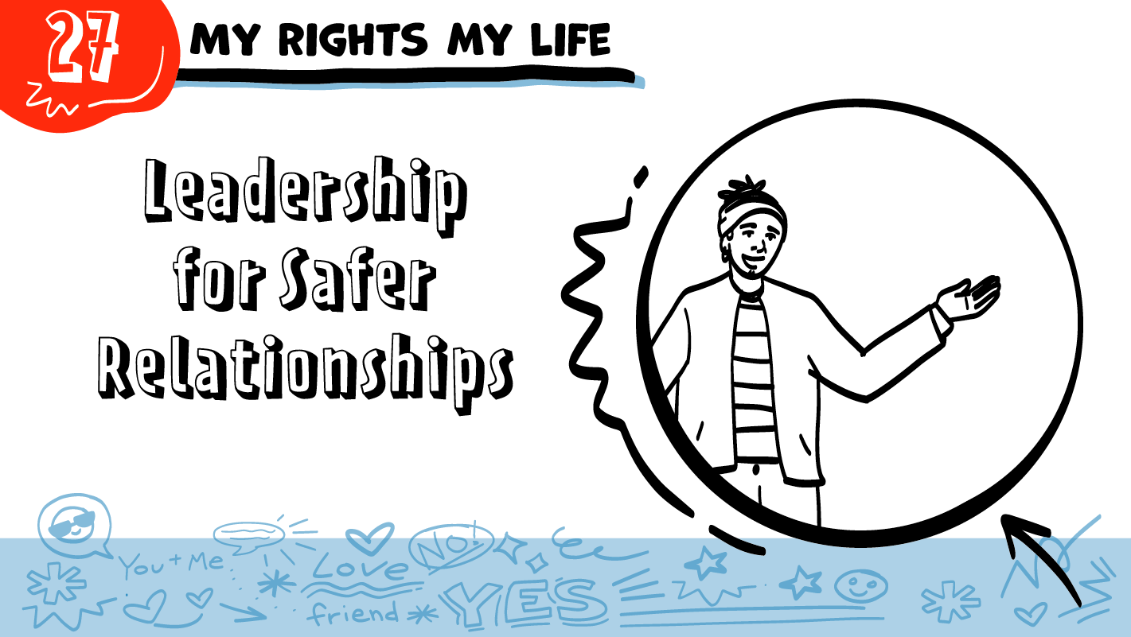



for High School Students
I want to talk to you about consent!
© 2026 SAFE Disability Services Program
Notes:
Repetition is beneficial for learning. Take time to review the last My Rights My Life class you taught prior to beginning this session. You can also answer any private questions students submitted on notecards during your previous class session.
Say: All year you have learned a lot about healthy relationships and safer sexuality. Today you are going to think about how you can be a leader for safer relationships in your communities.

Slide 2
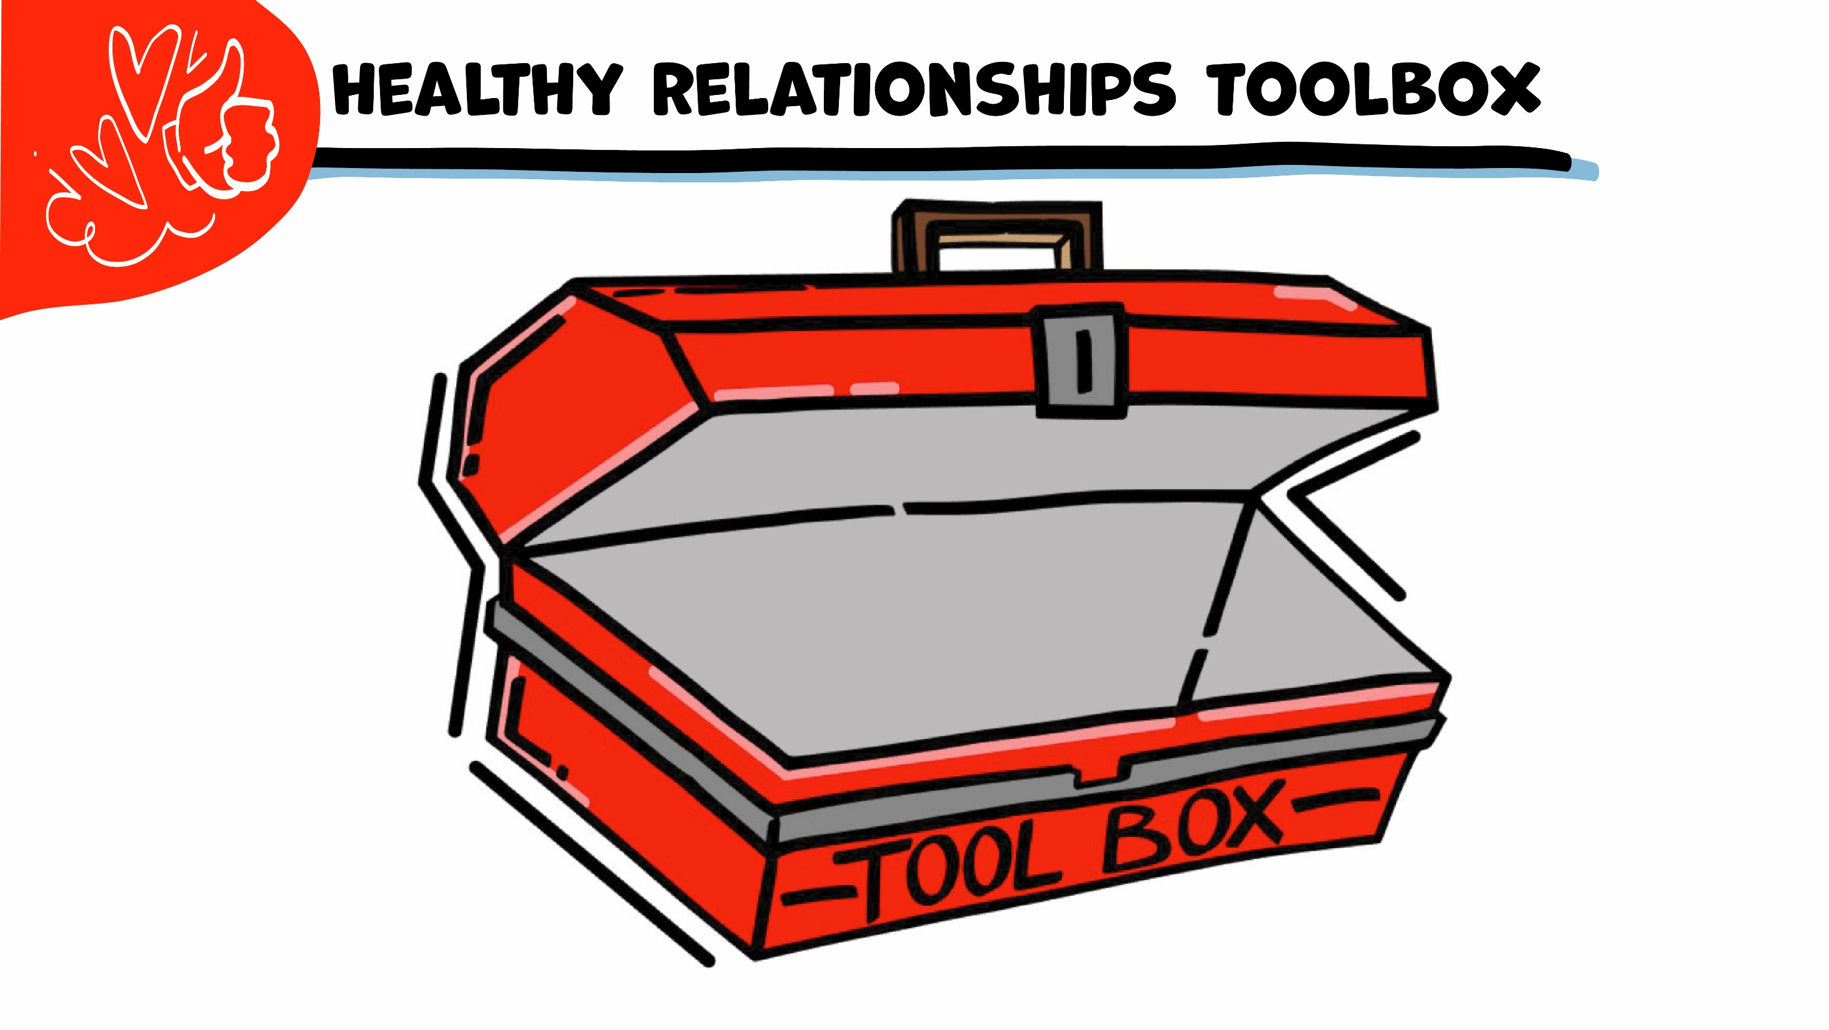
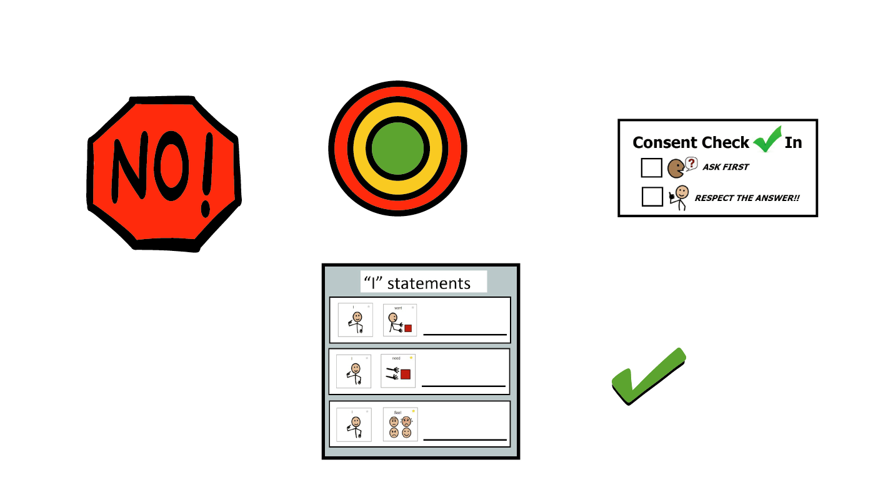
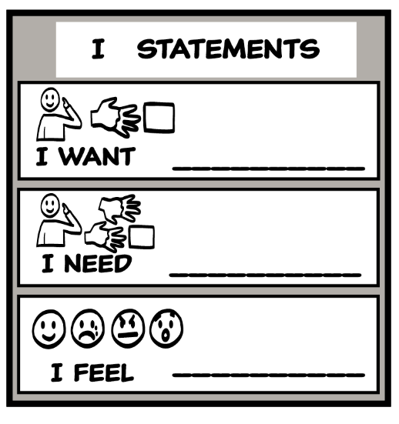
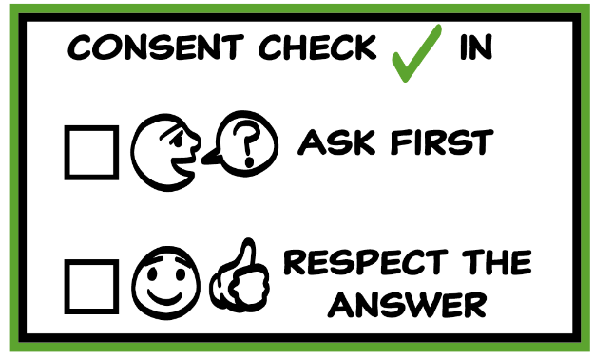
© 2026 SAFE Disability Services Program
Notes:
Use the large class Healthy Relationship Toolbox to review the Healthy Relationship Tools (I Statement, Relationship Map, NO!, and Consent Check-In). You can ask students to pull off one tool at a time and discuss what it is and how it is used. It can be particularly helpful for this review if you give students specific scenarios to think through. For example, you might ask, “If your friend lies to you, what is one I Statement you could use to tell your friend how you feel?” You may even consider using examples of situations that have recently occurred in your classroom, as long as doing so does not break student confidentiality. You can also ask students to connect the toolbox tools to their current relationships. You might say, “Can anyone volunteer and tell me about something going on in your life right now that the toolbox could help you with?”
Instructions for how to use each Healthy Relationship Tool can be found in the following classes:
I Statements: Classes 2 and 3
Relationship Map: Class 4
NO!: Class 5
Consent Check-In: Class 6

Slide 3


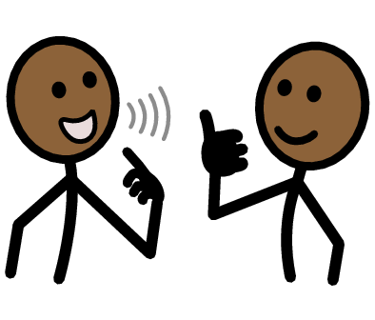

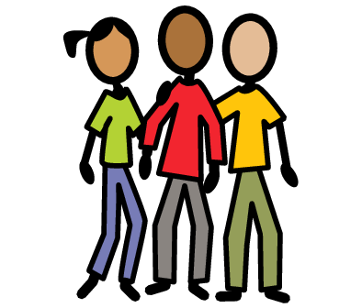
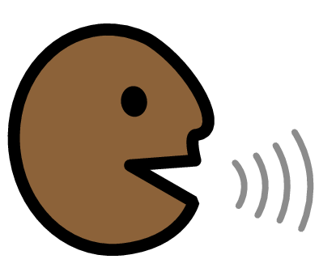



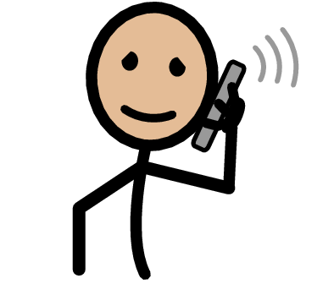
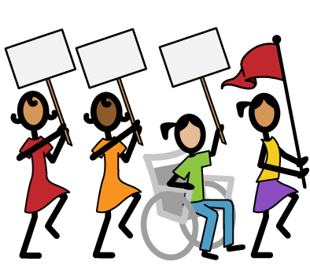
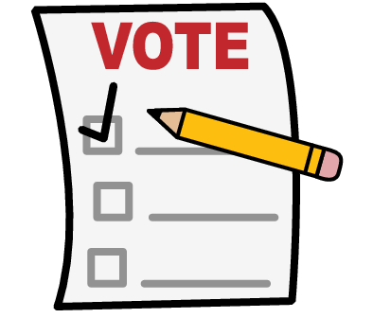


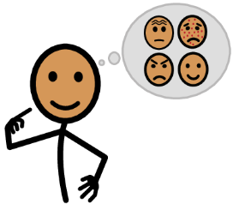




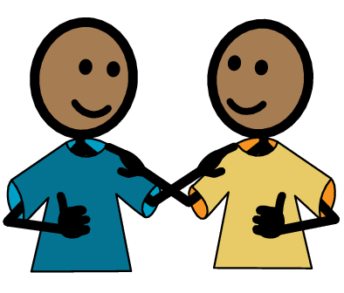
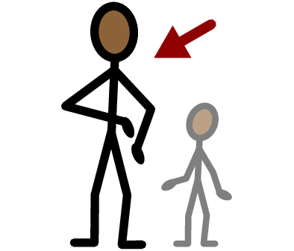
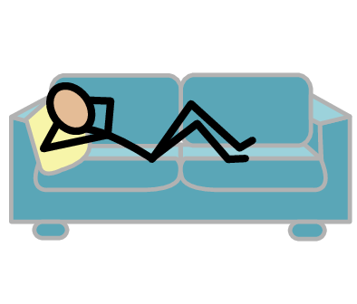
Leader
Advocate
Relationship
Group
Talk
Yes
No
Email
Call
March
Vote
I need help
I have a question
Trust
Adult
Take a break
I feel
Happy
Sad
Mad
Scared
Copyright © 2021 SymbolStix, LLC. All rights reserved. Used with Permission.
Notes:
You can print this slide separately so each student can use the Important Words Sheet as a communication board throughout class. Review the words using the suggested definitions below. To enhance understanding, you can ask students to come up with their own definitions for vocabulary words or to provide a sentence or scenario using the new word.
Leader: a person who other people listen to and follow
Advocate: people who speak up for themselves
Relationship: two or more people who know each other; some types of relationships include friends, family, or classmates
Vote: when you make a choice in an election, for example to choose a president
March: when you walk together with other people to speak up about a problem
Call: when you talk on the phone with someone
Email: sending mail online; examples of email accounts are Gmail and Hotmail
Talk: when you use your words, signs, or pictures to tell someone something
Group: several people who work together on the same problem

Slide 4
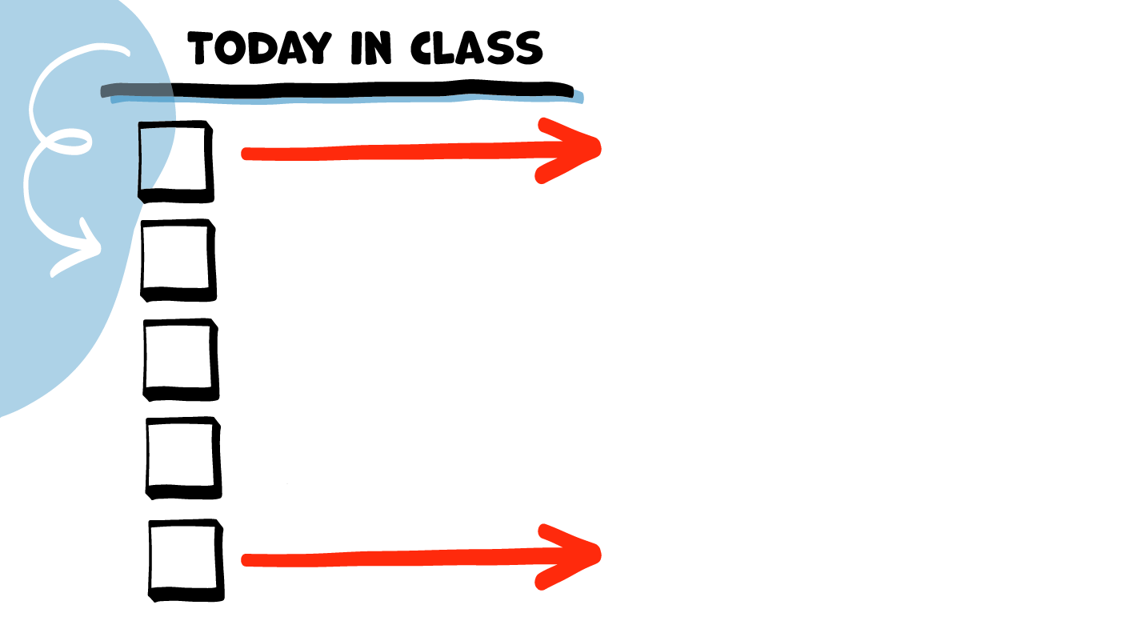
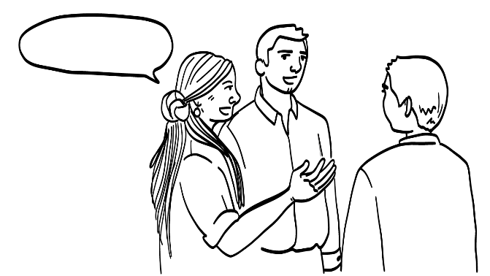
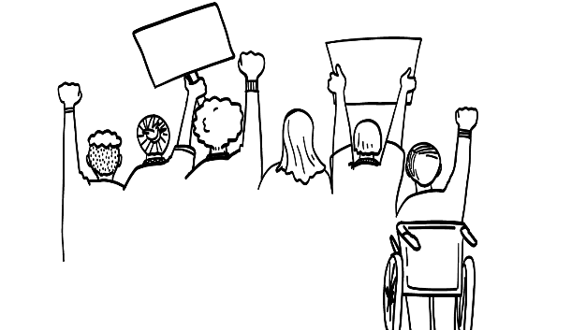
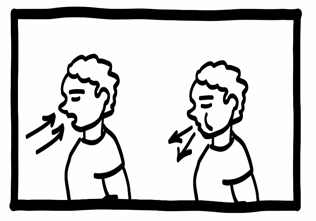

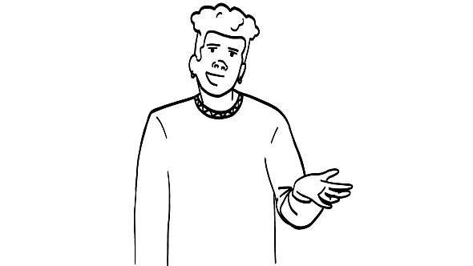
You can be an advocate.
Ways to get involved
Brain break
Class advocacy guide
Student advocacy guides
© 2026 SAFE Disability Services Program
Notes:
Read the agenda. Alternatively, you can ask for a student volunteer to read the agenda.

Slide 5
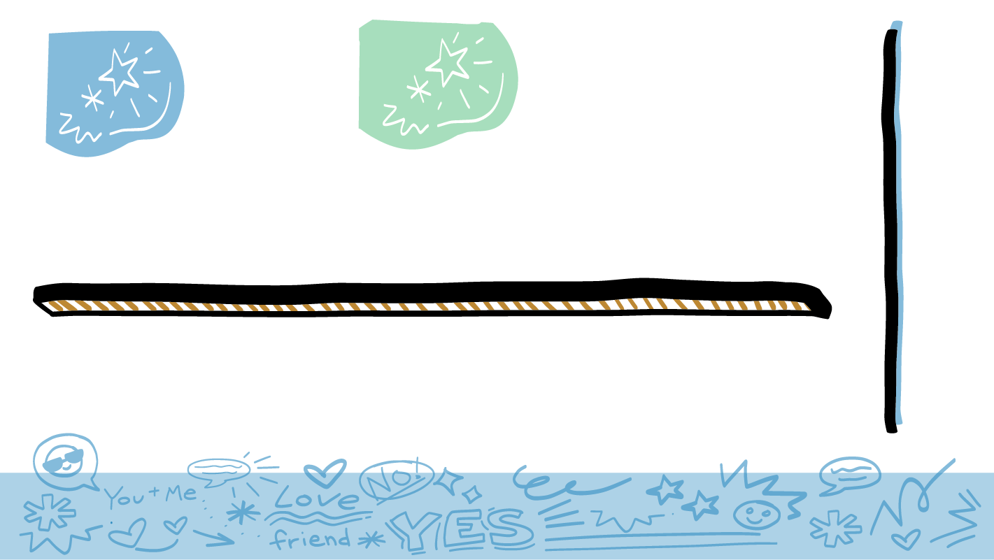

You can be an advocate for safer relationships.
Everyone needs to know about healthy relationships!
© 2026 SAFE Disability Services Program
Notes:
Say: You all know so much now about healthy relationships. But not everyone gets to take My Rights My Life classes, and not everyone knows as much about healthy relationships as you’ve learned. One thing you can do to help other people have healthy relationships is to be an advocate for healthy relationships and safer sexuality in your community. This means you can speak up and tell other people about what you have learned.

Slide 6

List of Healthy Relationship Topics
Consent
Boundaries…..
© 2026 SAFE Disability Services Program
Notes:
Say: Let’s think together about the most important relationship issues we’ve talked about this year. What do you think people need to know about to have healthier relationships?
Give students enough time to process the question and make their decisions. Write ideas on the whiteboard or a piece of flipchart paper as students shout them out. Some ideas if students need prompting:
I statements
Consent
Boundaries
Sexual harassment
Getting help from abuse

Slide 7
You can be an advocate.
Ways to get involved
Brain break
Class advocacy guide
Student advocacy guides
© 2026 SAFE Disability Services Program
Notes:
Say: Now we are going to talk about different ways you can get involved in advocacy for healthier relationships.

Slide 8
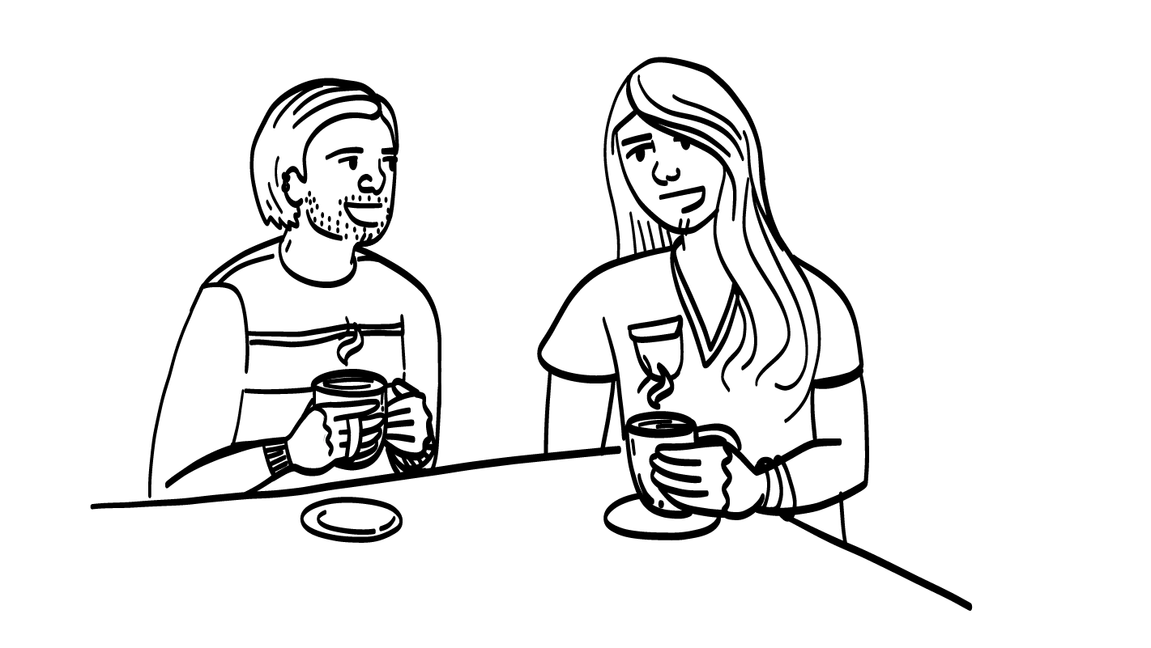
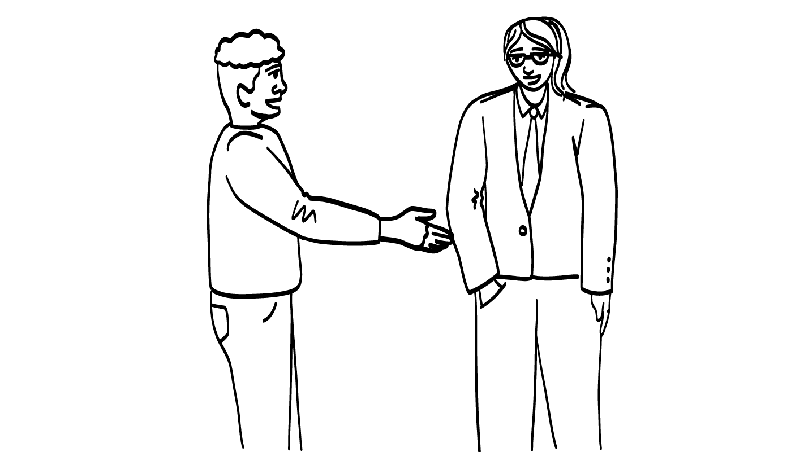
Community Leaders
You can help other people be safer in their relationships by talking about the things you’ve learned in this class. You can talk to friends, family, and other people in your community.
© 2026 SAFE Disability Services Program
Notes:
Say: You can help other people be safer in their relationships by talking about the things you’ve learned in this class. Who can you talk to about healthy relationships? You can talk to people in your middle yellow circle of people you know and inner green circle of people you trust, like your friends and family! You can also talk to elected officials. Elected officials are people you will get to choose by voting when you are 18 years old. They make decisions for your community.

Slide 9
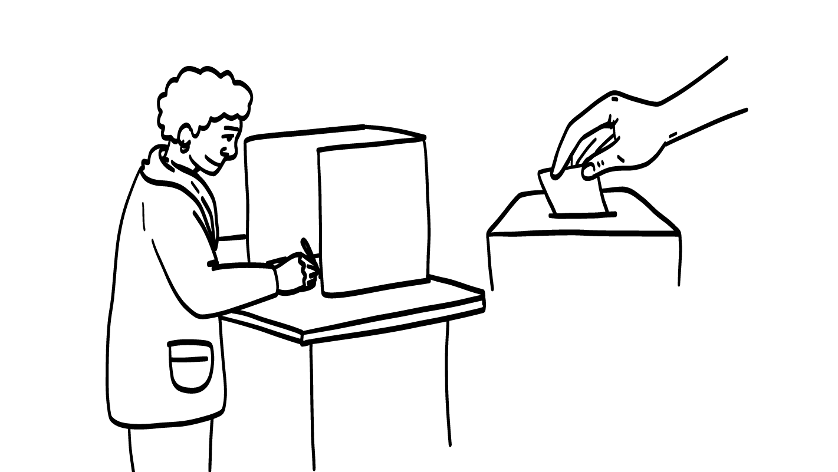
How you can be involved: Voting
You can make your voice heard by voting.
© 2026 SAFE Disability Services Program
Notes:
Say: There are lots of ways you can get involved in advocacy and telling elected officials about the importance of healthy relationships! One way you can make your voice heard one day is by voting. You will be able to register to vote when you are 18 years old. Voting is when you make a choice in an election, such as when you choose who you want to be president.
You will be able to vote for people who support healthy relationships for people with disabilities.

Slide 10
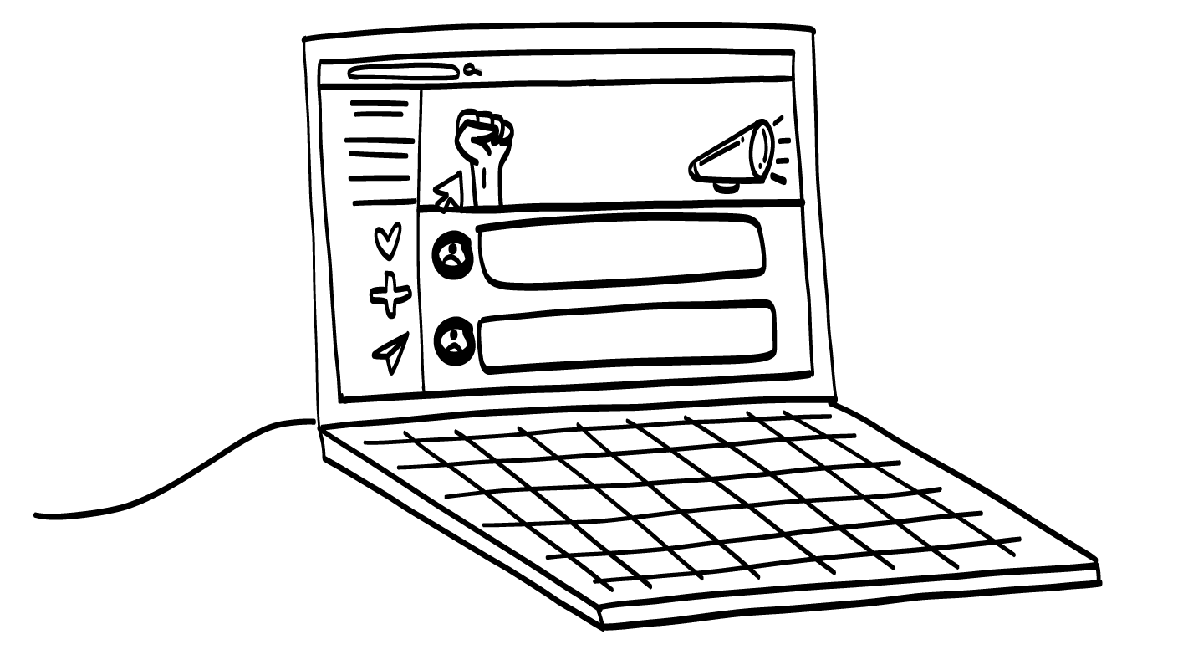
How you can be involved: Joining groups
You can join groups that speak up for healthy relationships. You might find groups that meet in person or online.
Stop abuse
© 2026 SAFE Disability Services Program
Notes:
Say: Another way you can get involved in advocacy is by joining groups that speak up for healthy relationships. You might be able to find some groups of teens who meet in-person in your community. You may also find some groups on social media that are working for healthy relationships and safer sexuality.

Slide 11
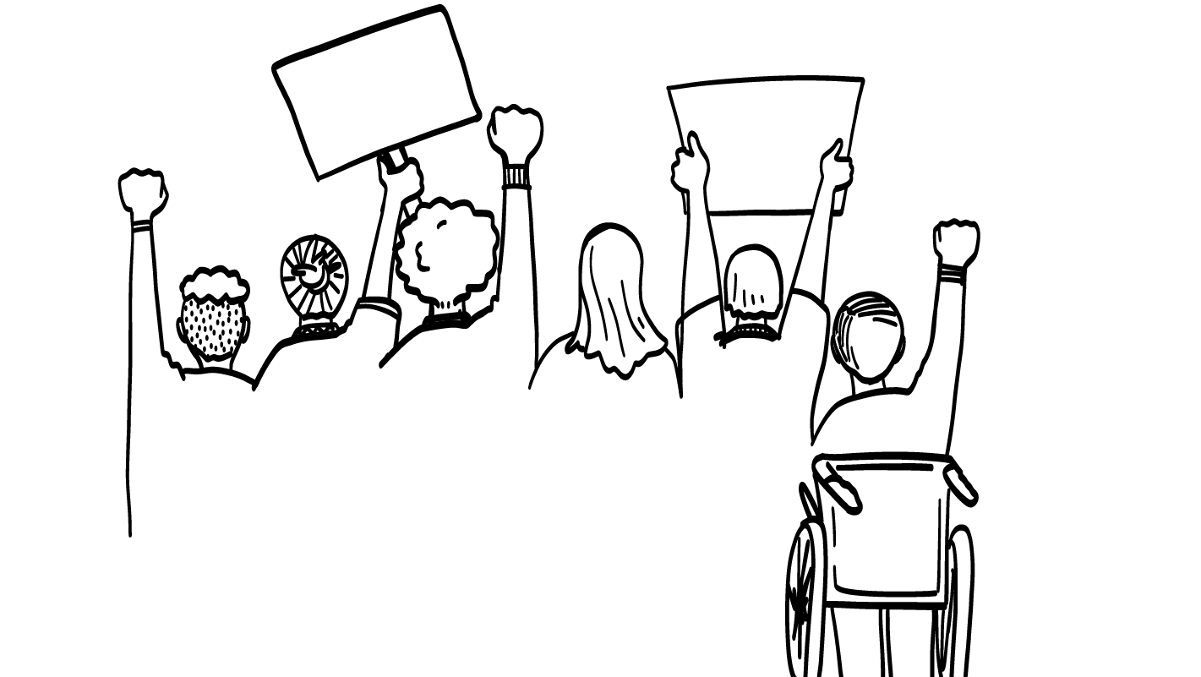
How you can be involved: Marches
You may be able to join local marches to show people how important healthy relationships are!
© 2026 SAFE Disability Services Program
Notes:
Say: Sometimes groups of people will speak up about an issue by marching or going to a rally. Marching is when you walk together with other people to speak up about a problem. You may be able to join local marches with other teens to show people how important healthy relationships are!

Slide 12
How you can be involved: Contacting elected officials
I would like to talk to you about healthy relationships!
Elected officials are people who make laws in your community.
You can talk to elected officials about why healthy relationships are important.
© 2026 SAFE Disability Services Program
Notes:
Say: One final option for getting involved is contacting your elected officials. You have several options for talking to your legislators and other elected officials. Usually, you can go to the elected person’s office and ask to talk with them about an issue. Sometimes when you do this you will actually talk to someone who works for the elected official, but that is okay. They can share the information to the official.
Another way you can contact an elected official is by writing them an email or calling them on the phone.
After the brain break, you are going to practice talking to elected officials about a healthy relationships issue.

Slide 13
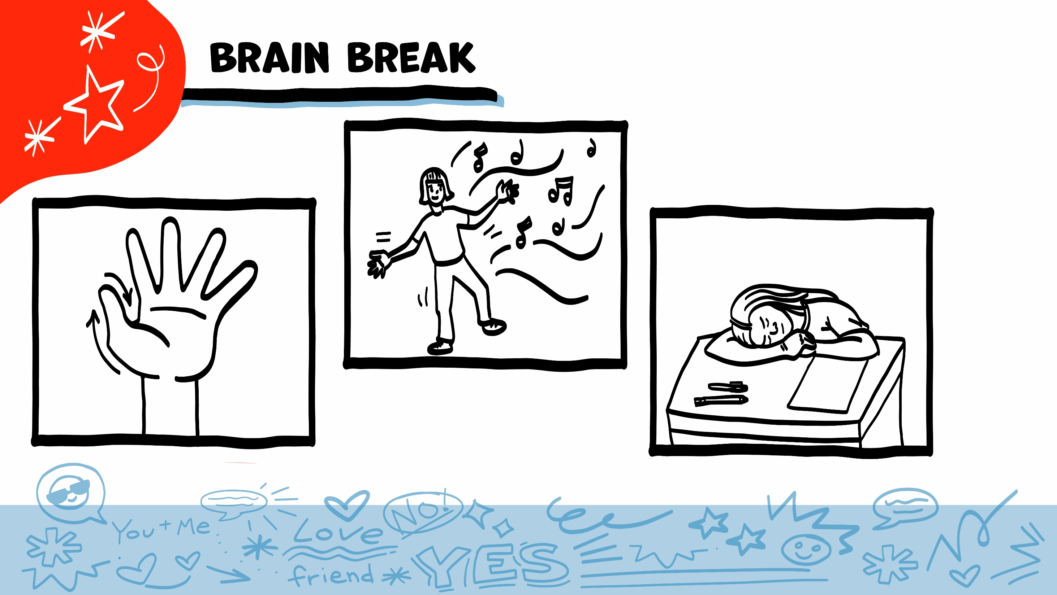
© 2026 SAFE Disability Services Program
Notes:
Say: That was a lot of information, and you all are doing an amazing job! Every week in class we will take a brain break in the middle. This is a chance to move a little and take a break from thinking!
Below are three ideas to give students a quick opportunity for a brain break. You are also welcome to come up with your own ideas for brain breaks that work best for your class.
Five finger breathing
For this exercise, have all students place their hand in front of their chest with their five fingers spread out. Next, use the pointer finger of the other hand to trace up and down each of the five fingers, beginning with the thumb. As students trace up a finger, they will breathe in. As they trace down a finger, they will breathe out. When students breathe out on the pinky finger, you can tell them to shake out their hands and arms. As the school year goes on, you can ask students to lead this exercise for their peers.
If this exercise is physically inaccessible for your class, you can also model the hand tracing for students while they breathe in and out.
Stretch break
Lead students through a series of basic stretches. These can be completed in a chair, or while standing up, depending on the accommodation needs of your class. Some ideas include reaching toward the ceiling, stretching one arm at a time across the chest, reaching toward toes, turning head from side to side, etc. Ask students to hold a pose while you count to ten. As the school year goes on, you can ask students to lead stretches for their peers.
Dance party
If your class likes to dance, you can put on a short song for them to dance to. This is especially effective if you are able to find a song that relates to the theme for that week’s class.

Slide 14
You can be an advocate.
Ways to get involved
Brain break
Class advocacy guide
Student advocacy guides
© 2026 SAFE Disability Services Program
Notes:
Say: Let’s practice advocating for a healthy relationship issue.

Slide 15
Class Advocacy Guide: Start with your name, where you live, and a little about you.
My name is ________.
I live in Austin, Texas.
© 2026 SAFE Disability Services Program
Notes:
For the activity on the next few slides, you will need a permanent marker and the Poster-Sized Class Advocacy Guide (see template at end of lesson plan).
Say: When you go to talk to an elected official, you usually only have a few minutes to tell them what’s important to you. So it can help to have some notes written down to help you remember what to say. In a few minutes, you will each get to practice this by writing a Student Advocacy Guide. But first, let’s do an example together.
Let’s start by looking at the relationship issues everyone came up with at the beginning of class. We are going to choose one of these issues to work on together. Which one would you like to work on?
Give students enough time to process the question and make their decisions. If there is no consensus in the class, you can take a vote to see which issue students would like to work on. As you talk through the parts of the Advocacy Guide, you can write what the class decides to share on the Poster-Sized Class Advocacy Guide.
Say: When you meet an elected official, you should introduce yourself. The first thing you’ll write on your Advocacy Guide is your name.
Model this by writing your name at the top of the Poster-Sized Class Advocacy Guide (ex: My name is ____________________________________________________________.
Say: Next, you’ll write where you live. Why do you think it’s important to tell an elected official where you live?
Give students enough time to process the question and make their decisions.
Say: Each elected official represents a particular area, and the people in that area voted to get them in office. This means that they are supposed to make their choices based on what the people in their area would want. The elected official will want to know that you live in the area they represent.
Write your city below your name (ex: I live in Austin, Texas).
Say: Next, you can say a little more about yourself. You want to tell the elected official something about who you are or what grade you are in at school. This will help them understand why the issue is important to you. I will write…
Choose something that is relevant to the issue that the class has chosen. So for example, if the class chose to talk about consent, you might write, “I want all of my relationships to be healthy.”

Slide 16
Class Advocacy Guide: The issue
I want to talk about consent.
Consent is important because:
People need to respect other people’s boundaries.
Some people don’t like to be touched.
All relationships need consent.
© 2026 SAFE Disability Services Program
Notes:
Say: After you have introduced yourself, it’s time to say what issue you want to talk to the elected official about. You should also tell your elected official why this issue is important. Let’s come up with three reasons. Who can tell me why this is important?
Give students enough time to process the question and make their decisions. When the class decides on three reasons, write them on the Poster-Sized Class Advocacy Guide. For example, if your class is talking about consent, the students might say that it’s important for both people to give an excited yes, that you have to get consent anytime you are going to touch someone’s body, and that consent helps people feel safe.

Slide 17
Class Advocacy Guide:
What you want them to do?
I want you to make a law that says all students will learn about consent in school!
© 2026 SAFE Disability Services Program
Notes:
Say: Finally, you want to end by telling the legislator what you want them to do. This could be to vote for or against something, to write a new law, to speak up about your issue, or something else. What does everybody think we should ask them to do in our example?
Give students enough time to process the question and make their decisions. When the class decides on their ask for elected officials, write it on the Poster-Sized Class Advocacy Guide. For example, your class might choose, “Make sure all students learn about consent in school.”
Say: Great work everyone! Can someone read the completed Advocacy Guide?
Give students enough time to process the question and make their decisions.

Slide 18
You can be an advocate
Ways to get involved
Brain break
Class Advocacy Guide
Student Advocacy Guides
© 2026 SAFE Disability Services Program
Notes:
Say: Now that we have completed the Class Advocacy Guide together, it’s time for you all to work on your own issues. Does anyone have any questions about the Advocacy Guide before you begin?
Give students enough time to process the question and make their decisions.

Slide 19
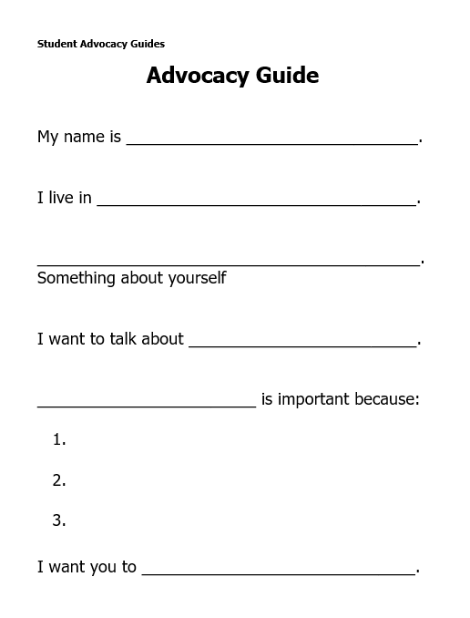
Student Advocacy Guide
© 2026 SAFE Disability Services Program
Notes:
Say: Now you each get to make your own Advocacy Guide. Please pick an issue that is important to you. You can pick one of the issues from the board, or a new healthy relationships issue. After you pick your issue, please fill out your Advocacy Guide. You can write in your answers, or you can draw them.
Give each student a printed copy of the Student Advocacy Guide. Walk around and support students as needed to complete their Advocacy Guides.

Slide 20
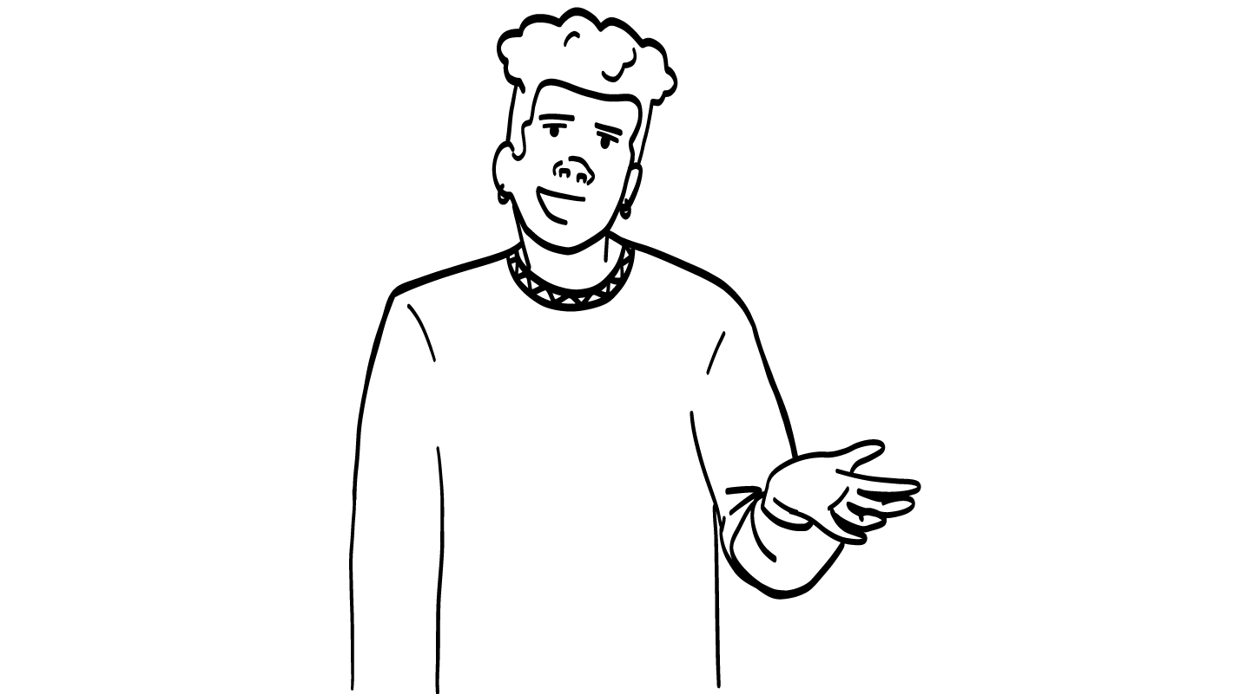
Student Advocacy Guide:
Share with class
I want to talk about boundaries!
© 2026 SAFE Disability Services Program
Notes:
Say: Would anyone like to share their Advocacy Guide with the rest of the class? You can read it or show your drawings.
Give students enough time to process the question and make their decisions.

Slide 21
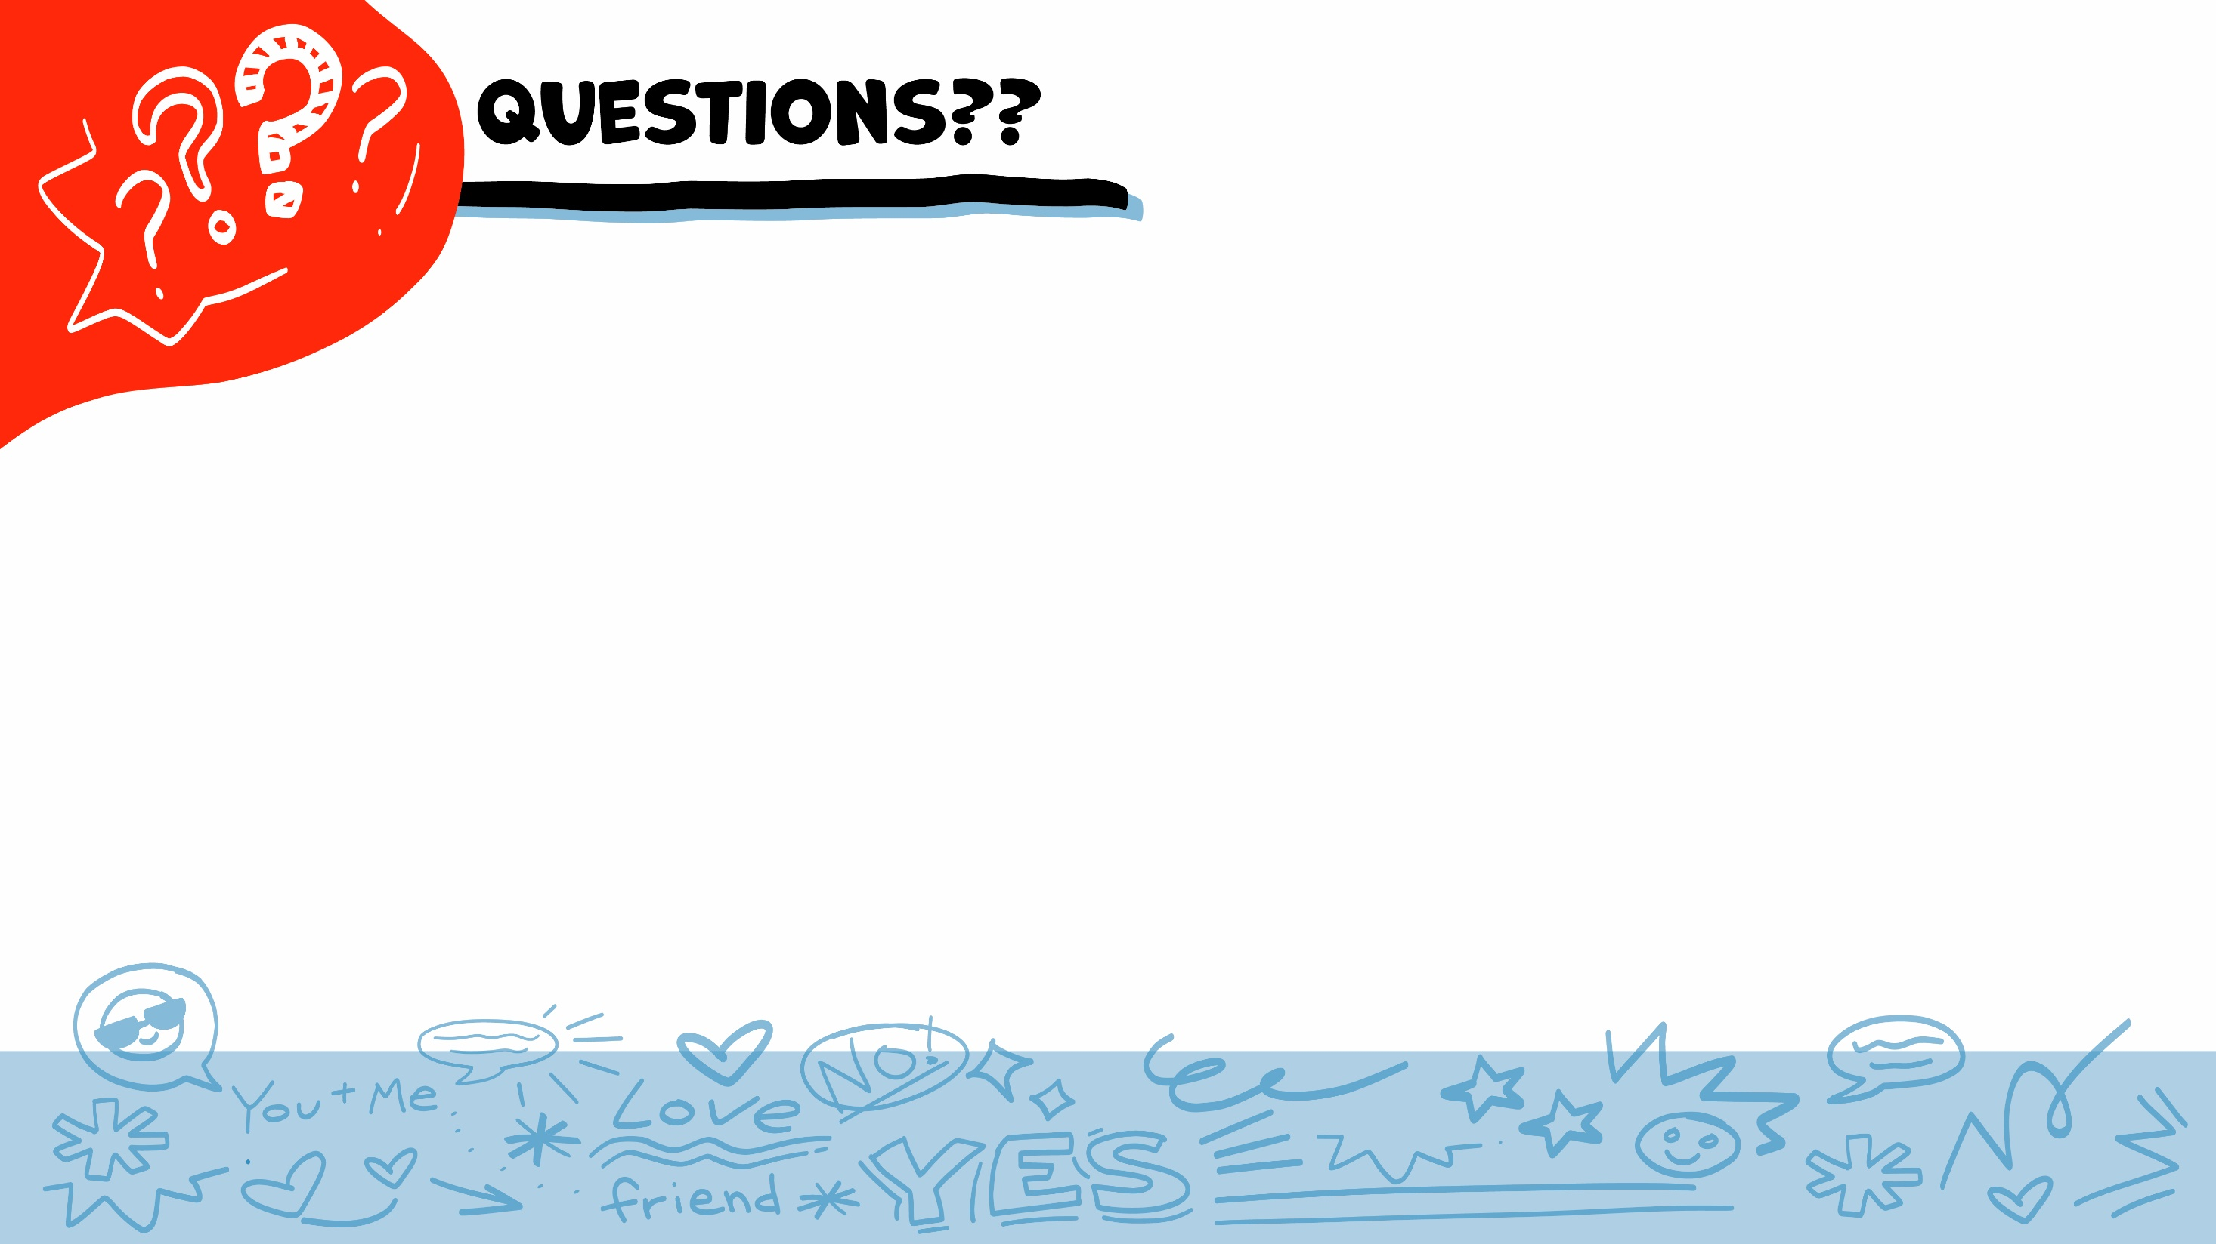
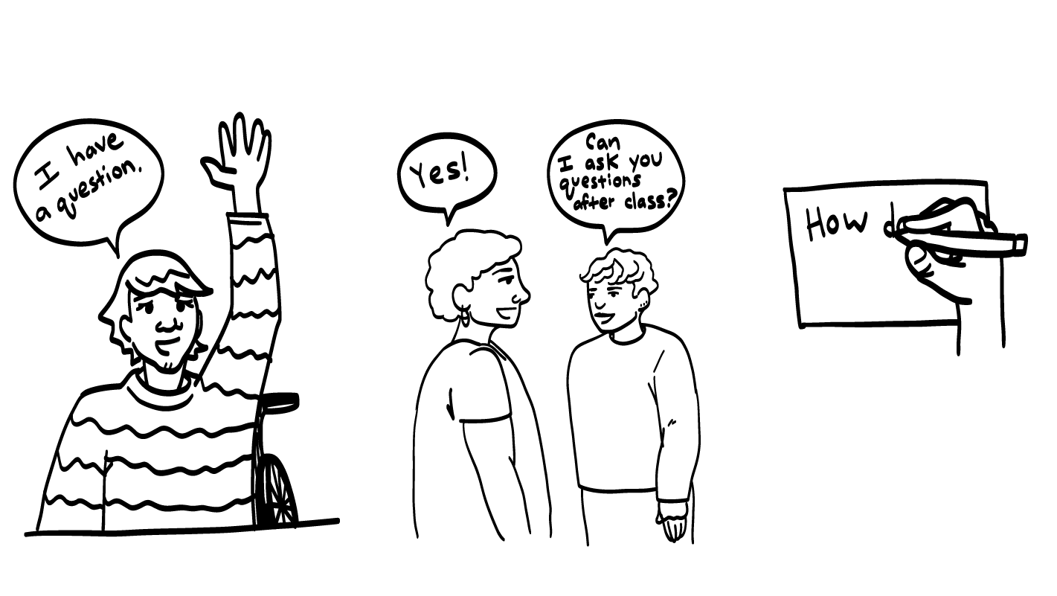
© 2026 SAFE Disability Services Program
Notes:
Say: Does anyone have any questions about today’s class? Remember, if you don’t want to ask your question out loud, you can write it on a notecard and leave it on your desk. You can also ask someone you trust to help you write your question on the notecard.
I will pick up the notecards and make sure to send your teacher an answer for each question that they can read out loud during your next class. When I send your teacher the answers, I won’t tell them or anyone else who asked the question.

Slide 22
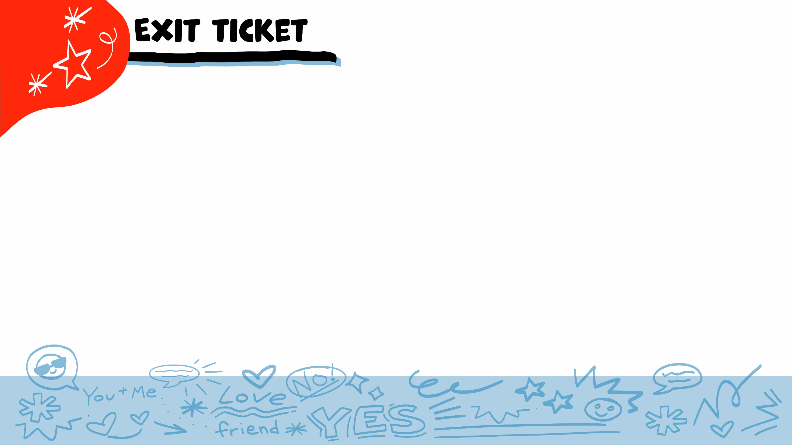


Can you speak up in your community
for healthy relationships?
YES
NO
© 2026 SAFE Disability Services Program
Notes:
Say: Can you speak up in your community for healthy relationships? Give a thumbs up for yes and a thumbs down for no.
Give students enough time to process the question and make their decisions.
Say: Yes! You all have learned so much this year, and you can be leaders for healthy relationships at school, at home, and in our community.

Slide 23
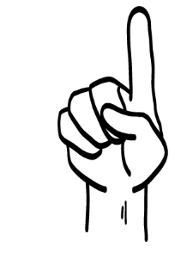
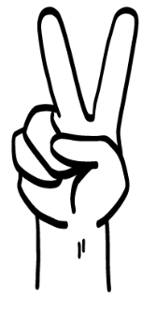
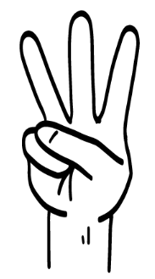
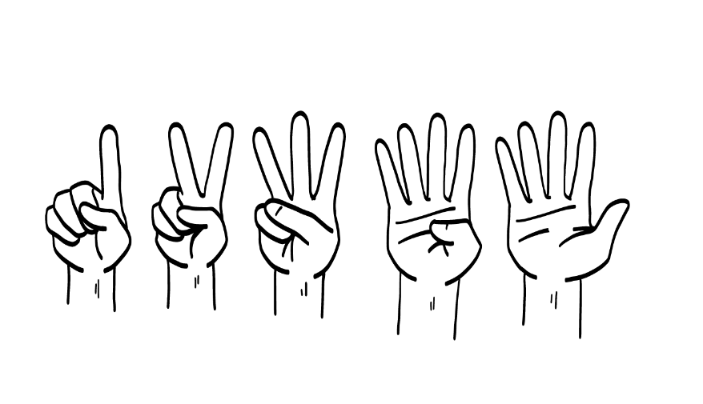
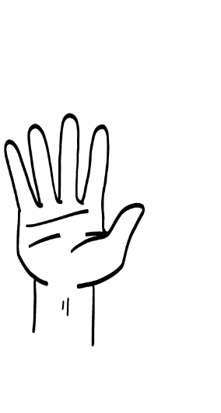
I can speak up for healthy relationships by:
Voting
Marching
Talking to an elected official
Joining a group
1
2
3
4
All of the above
5
© 2026 SAFE Disability Services Program
Notes:
Say: I can speak up for healthy relationships by doing what? Hold up one finger for “voting,” two fingers for “marching,” three fingers for “talking to an elected official,” four fingers for “joining a group,” and five fingers for “all of the above.”
Give students enough time to process the question and make their decisions.
Say: You can do all of the things on this screen to speak up for healthy relationships. You practiced talking to an elected official today.

Slide 24
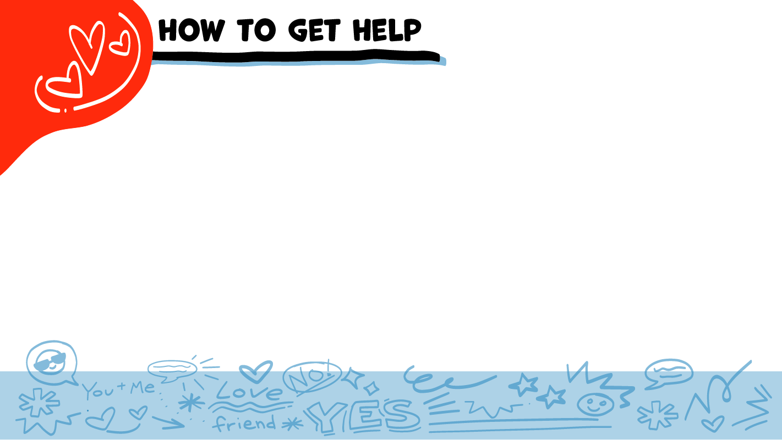
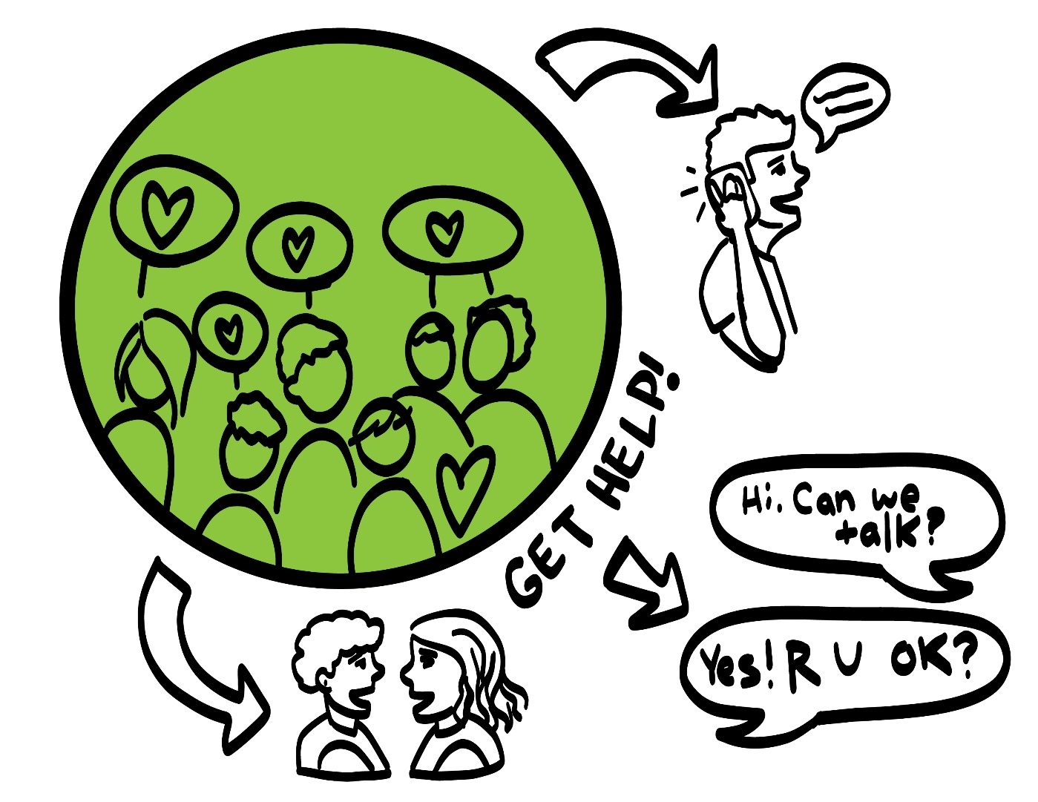
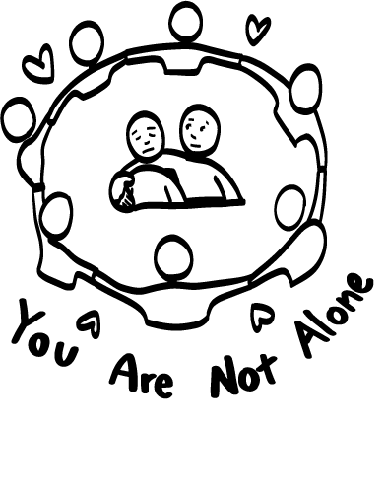
© 2026 SAFE Disability Services Program
Notes:
Say: If you are being hurt, or if someone ever touches your body in a way that you don’t like, you can get help. You did not do anything wrong, and you are not alone. You can get help by talking to an adult from your inner green circle of trust. If someone you care about is being hurt, you can also get help by talking to an adult from your inner green circle of trust. If an emergency is happening, you can always call 911. If you call 911 for help, a police officer or an ambulance might come.
If the first person you tell doesn’t believe you or doesn’t get you help, keep telling adults you trust what is going on until you get the help you need.

Slide 25

© 2026 SAFE Disability Services Program
Notes:
Say: You have all worked so hard in these classes. You were creative and determined, and you learned a lot! You will each receive a certificate that recognizes all of your hard work. This certificate says that you finished all of the classes in the My Rights My Life curriculum. I am so proud of you, and I hope you are proud of yourself, too!
Call each student to the front of the class one-by-one. Give them a My Rights My Life Certificate of Completion and allow the rest of the class to give them a round of applause.

Slide 26
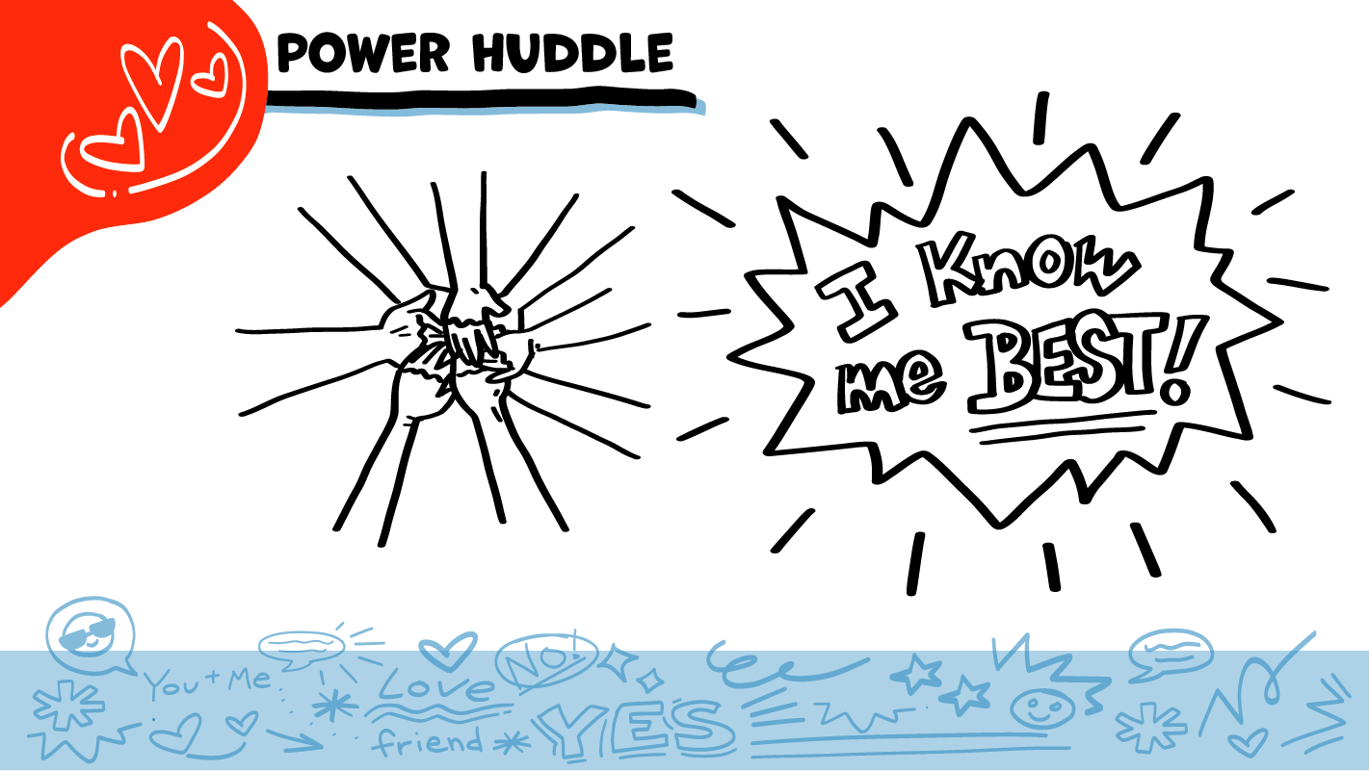
© 2026 SAFE Disability Services Program
Notes:
Say: Does anyone remember what our power statement is? Our power statement is “I know me best.” This means that each of you knows yourself better than anyone else does. One more time, let’s gather together and on the count of three, say our power statement.
Have each interested student put one hand in the middle of the circle. Ask for a student volunteer to count to three. After three, all participants say the power statement while lifting their hands into the air. Students can also stand in the circle without touching hands if they prefer.

Slide 27
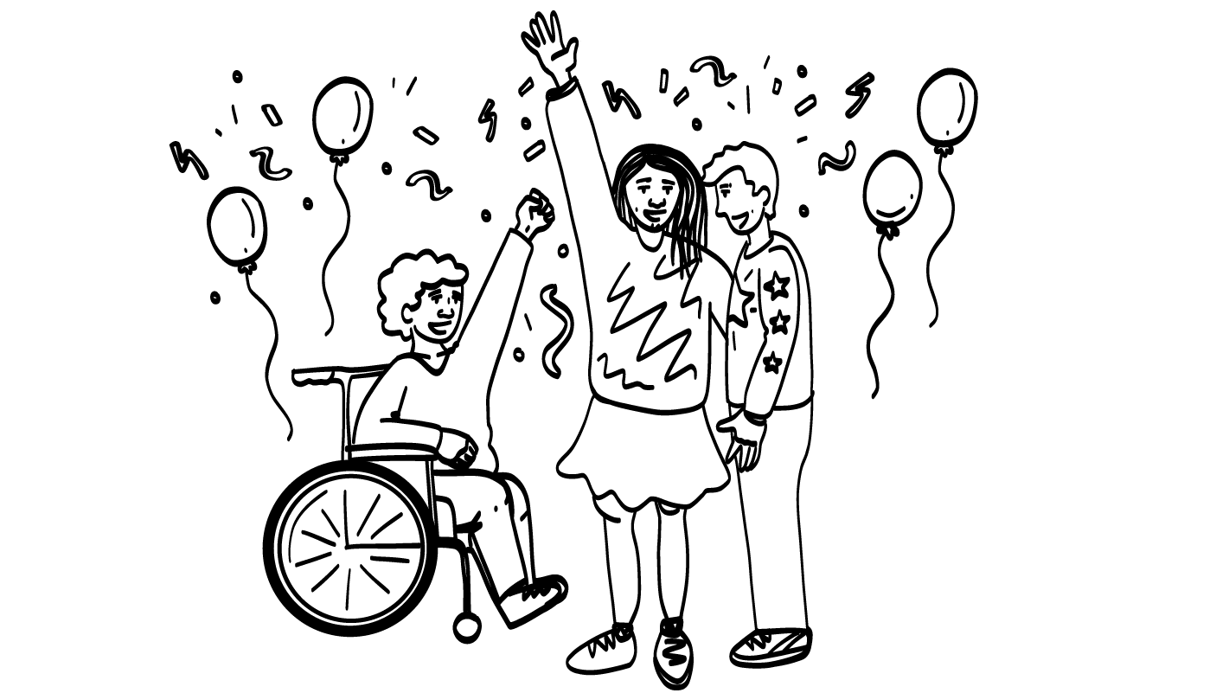
Party!
© 2026 SAFE Disability Services Program
Notes:
Now it is time to celebrate! Put on music, open refreshments, and give your class time to celebrate all of their hard work!

Slide 28

This work is supported by the Texas Council for Developmental Disabilities through a grant from the U.S. Administration for Community Living (ACL), Department of Health and Human Services (HHS), Washington, D.C. 20201 with a 100% federal funding award totaling $6,161,072. Council efforts are those of the grantee and do not necessarily represent the official views of nor are endorsed by ACL, HHS, or the U.S. government.
© 2026 SAFE Disability Services Program
Notes:
SAFE would like to thank the Texas Council for Developmental Disabilities for the funding for this curriculum.

Slide 29

This curriculum is offered online at no cost. You are free to use the resources in the original format for educational purposes only. Please reference The SAFE Alliance appropriately (citations at bottom of page).
We ask that you do not alter curriculum images/art, slides, or lesson plan materials. You may not use My Rights My Life (18+ or High School) curriculum for commercial purposes (i.e., selling workshops you facilitate based on MRML curriculum; and/or creating links/websites to re-distribute any materials associated SAFE’s My Rights My Life).
This resource, My Rights My Life: A curriculum for healthier relationships for high school students (grades 9-12) is based on the original My Rights My Life: A curriculum for safer relationships (age 18+) written by Megan Westmore, Heidi Lersch, and edited by Schwartz, M. (2022). Selling materials from MRML is a copyright violation.
Burleson, Anna Belle & Benitez, Sophie (2026) provided light modification and abbreviated the original curriculum
(Westmore & Lersch, 2022) to offer an age appropriate resource for High School Students (grades 9-12).
Schwartz, M. (Ed.). The SAFE Alliance, Austin, Texas.
Westmore, M. & Lersch, H. (2022). My rights my life: A curriculum for safer relationships.
Schwartz, M. (Ed.). The SAFE Alliance: Austin, TX.
© 2026 SAFE Disability Services Program

