Slide 1
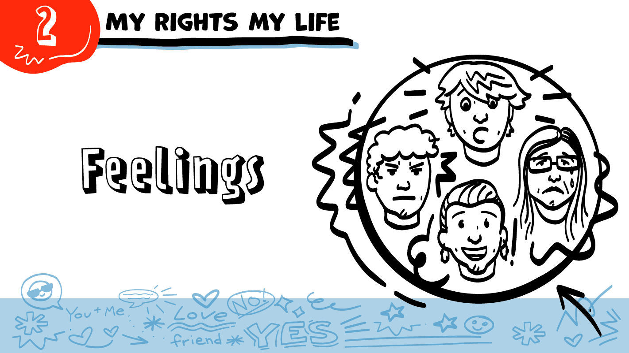
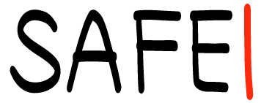

© 2026 SAFE Disability Services Program
Notes:
Repetition is beneficial for learning. Take time to review the last My Rights My Life class you taught prior to beginning this session. You can also answer any private questions students submitted on notecards during your previous class session.
Say: Today in class we are going to talk about feelings. We’ll also talk about what you can do when you have strong feelings.

Slide 2
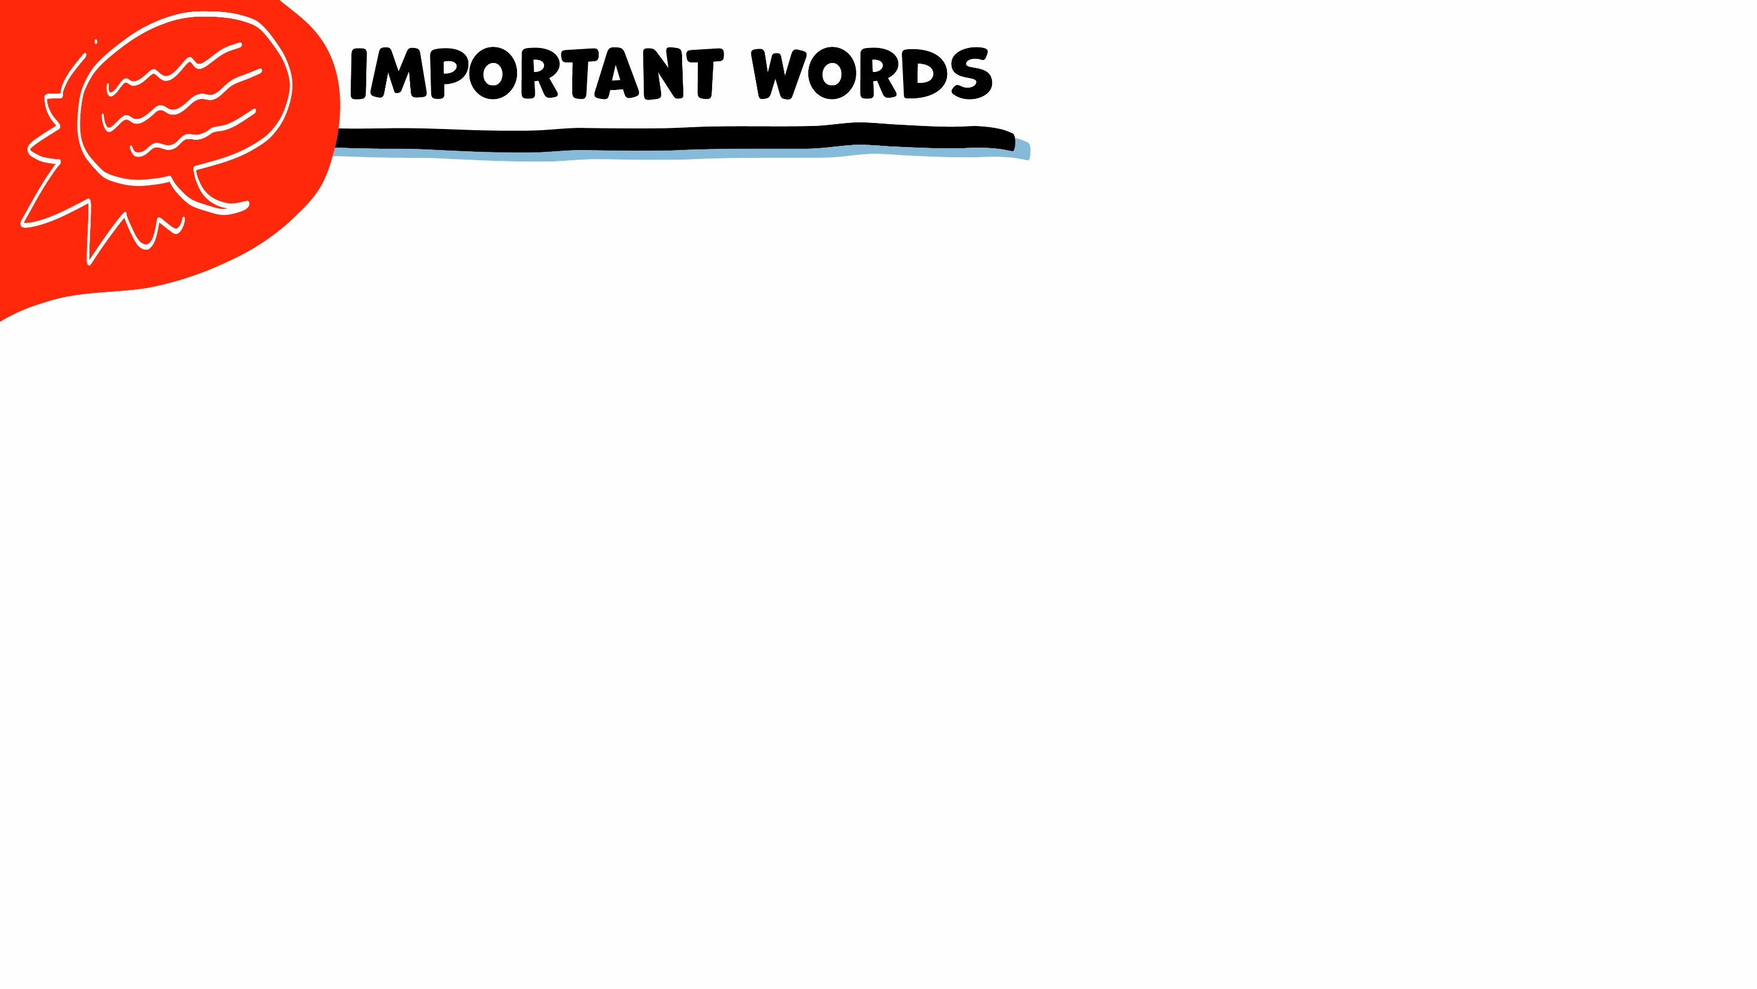
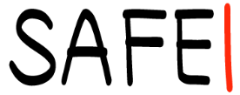
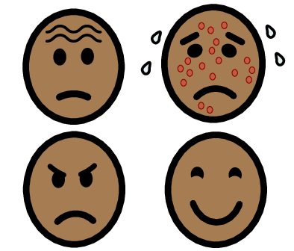
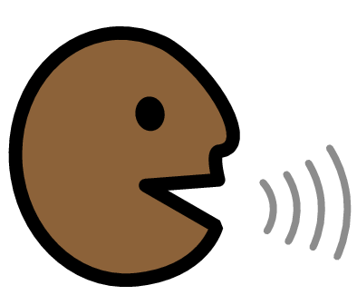
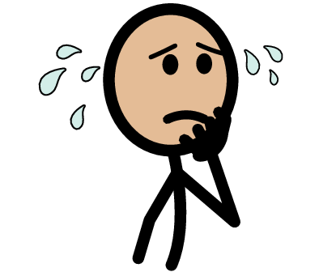



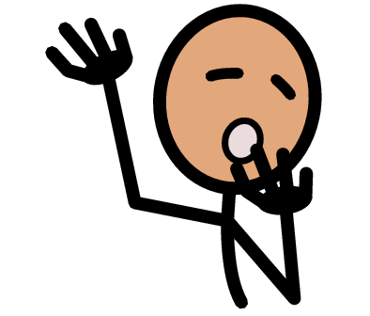
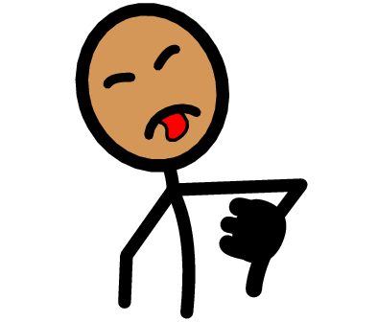
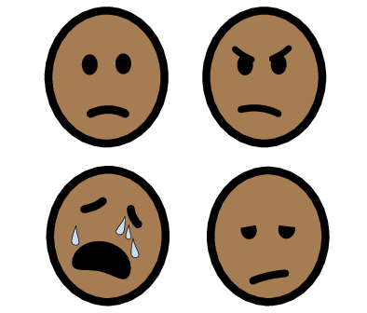
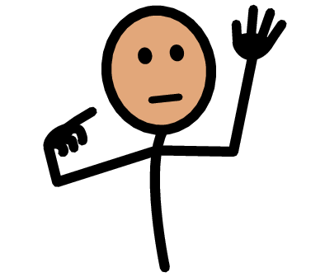
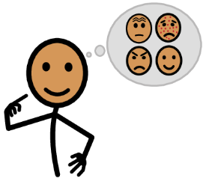

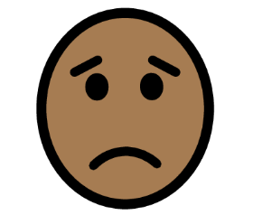

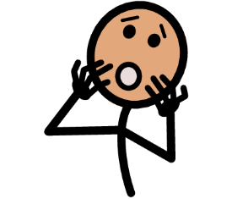
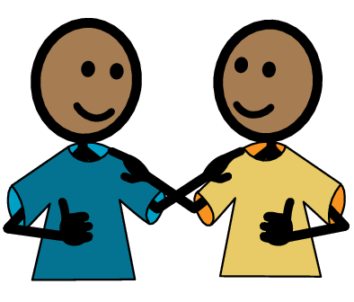
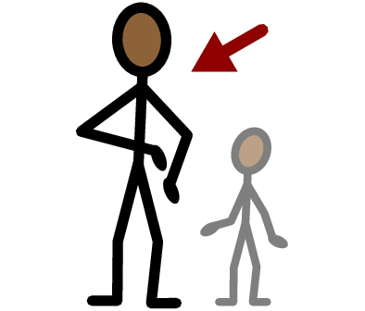
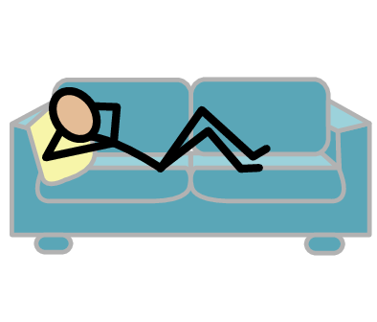
Feelings
I Statements
Nervous
Yes
No
I need help
I have a question
Tired
Grossed out
Hurt
Trust
Adult
Take a break
I feel
Happy
Sad
Mad
Scared
Copyright © 2021 SymbolStix, LLC. All rights reserved. Used with Permission.
Notes:
You can print this slide separately so each student can use the Important Words Sheet as a communication board throughout class. Review the words using the suggested definitions below. To enhance understanding, you can ask students to come up with their own definitions for vocabulary words or to provide a sentence or scenario using the new word.
Feelings: Your emotions, such as happy, sad, mad, or scared
I statements: Sentences that start with the word “I”
Nervous: Feeling worried about something
Tired: Feeling sleepy; people sometimes yawn when they are tired
Grossed out: Feeling sick to your stomach or really uncomfortable
Hurt: When someone does something that makes you sad or upset

Slide 3
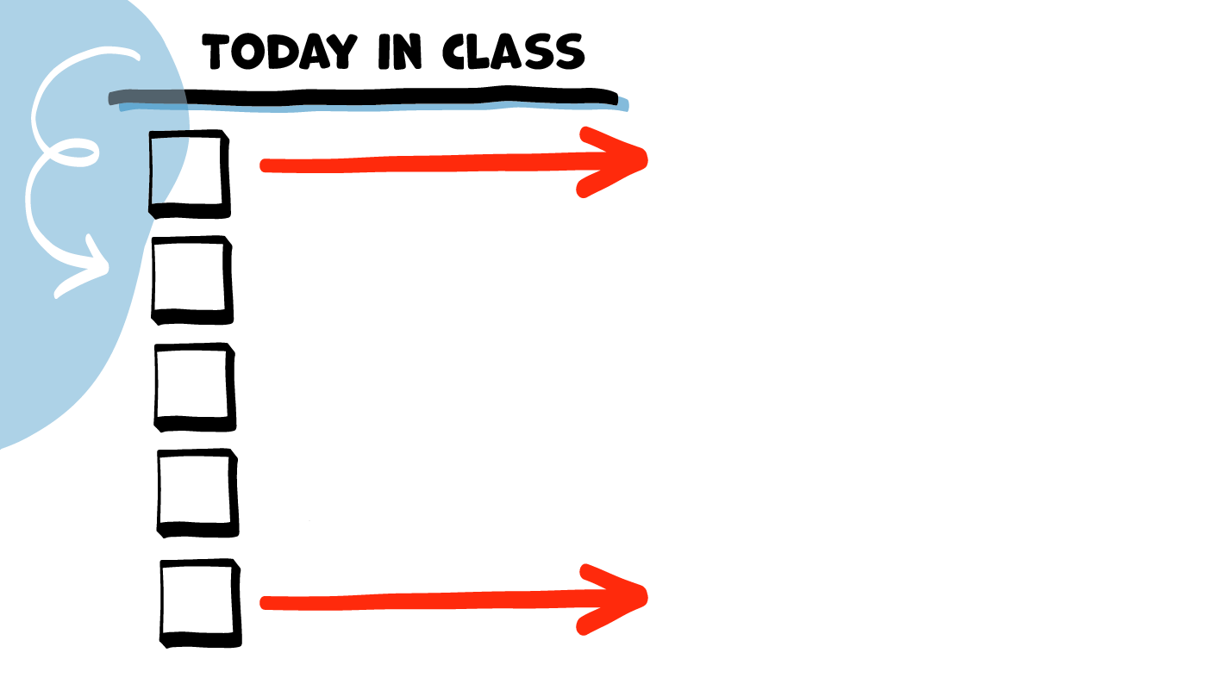
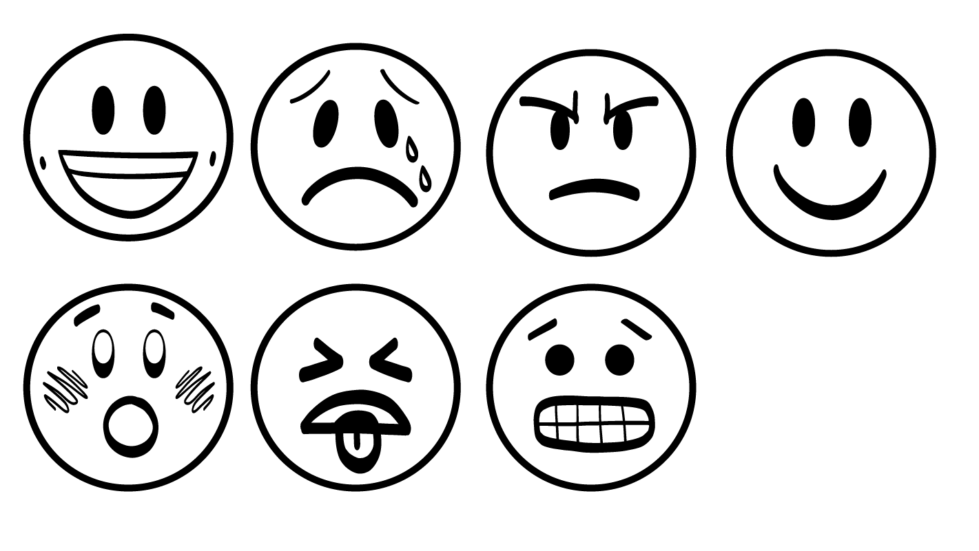
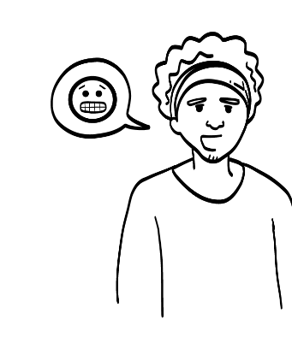
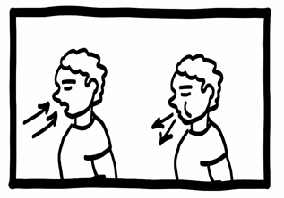
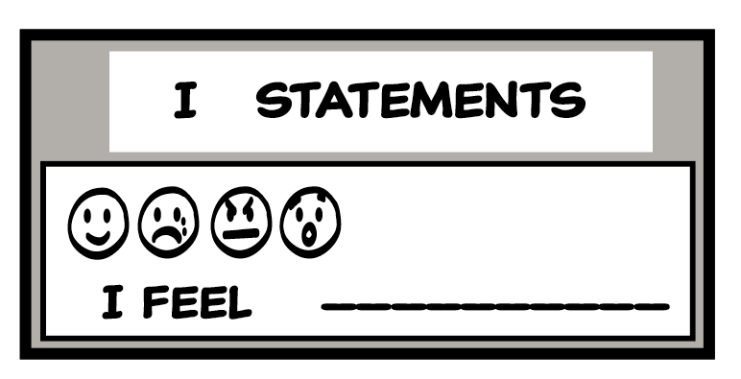
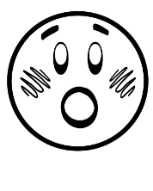


Feelings check-in
Talk about feelings
Brain break
I Statements practice
Feelings worksheet
© 2026 SAFE Disability Services Program
Notes:
Read the agenda. Alternatively, you can ask for a student volunteer to read the agenda.

Slide 4
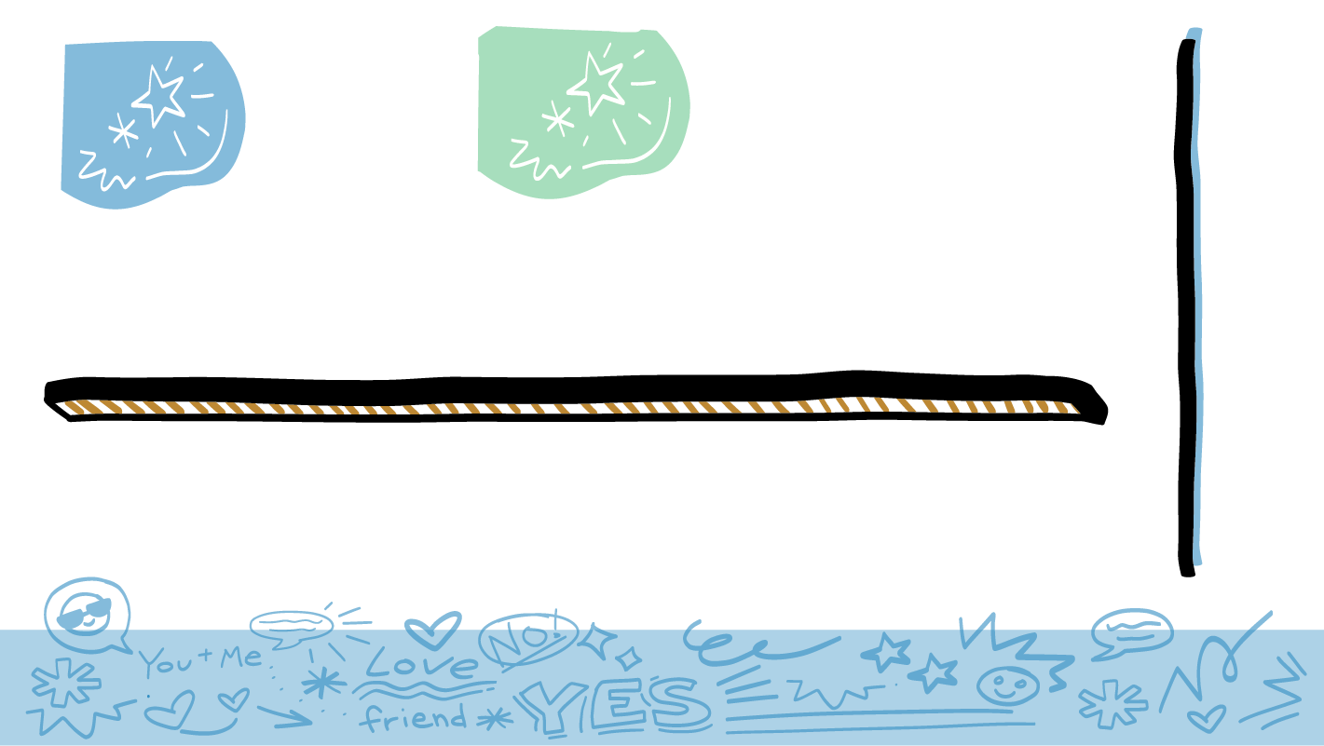
Feelings
© 2026 SAFE Disability Services Program
Notes:
Say: Let’s start our class on feelings by naming as many feelings as you can. Who can name one feeling?
Give students enough time to process the question and make their decisions. As students name emotions, you can write or draw them on a whiteboard or chart paper. You can also ask students to act out what these look like with their faces/bodies (example: smiling for “happy”).

Slide 5
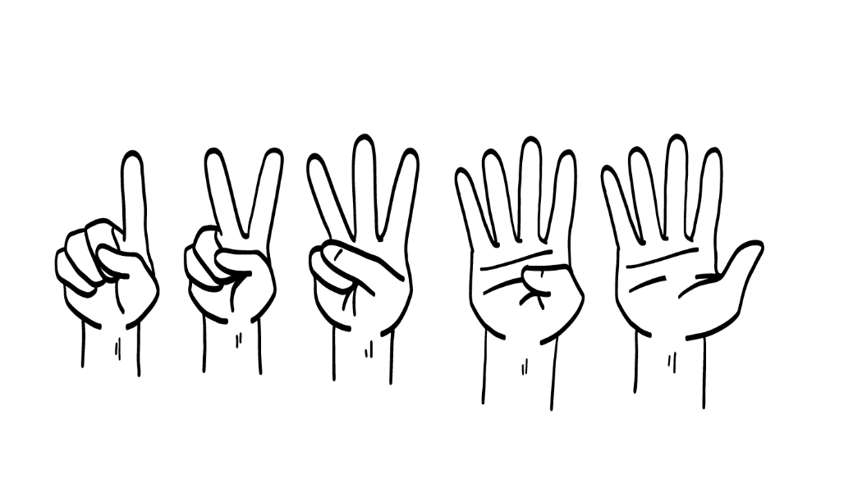
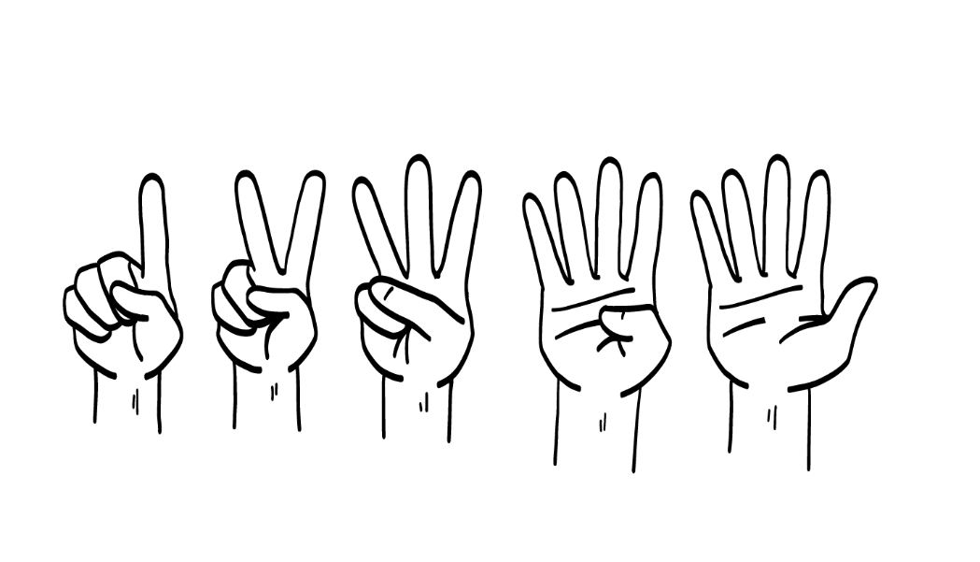
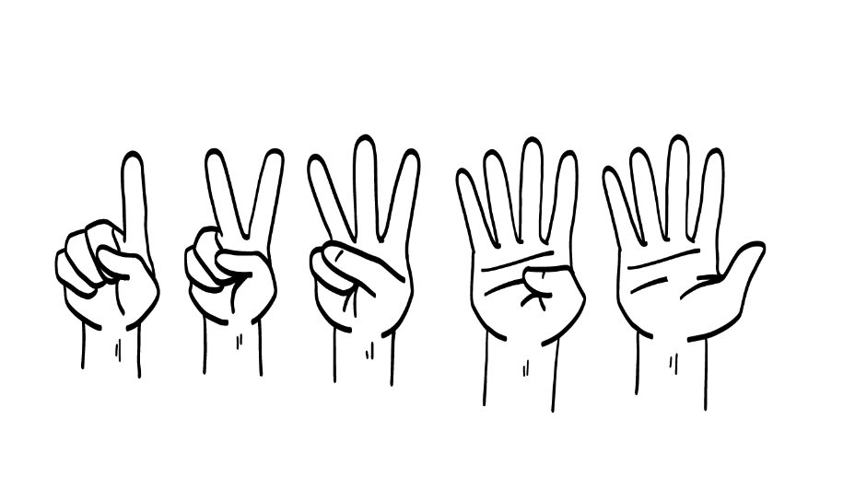
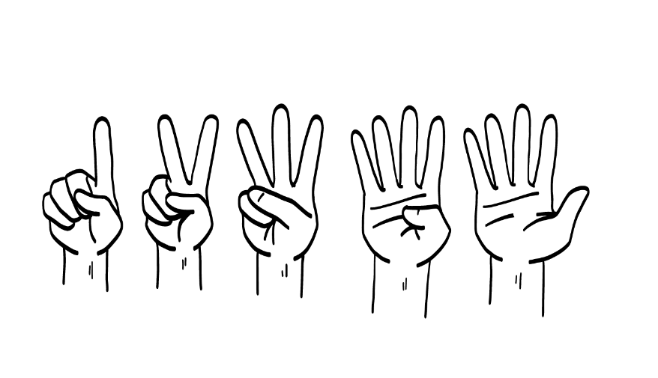
1
2
3
4
Happy
Sad
Mad
Excited
How are
you feeling?
© 2026 SAFE Disability Services Program
Notes:
Say: Now that we’ve named a bunch of feelings, I want to hear how you are feeling! As I call on you, please let us know how you are feeling today. You can hold up one finger for happy, two fingers for sad, three fingers for mad, and four fingers for excited.

Slide 6
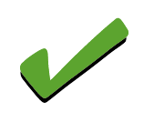
Feelings check-in
Talk about feelings
Brain break
I Statements practice
Feelings worksheet
© 2026 SAFE Disability Services Program
Notes:
Say: Thanks for letting me know how you are feeling. Now we are going to talk more about feelings.

Slide 7
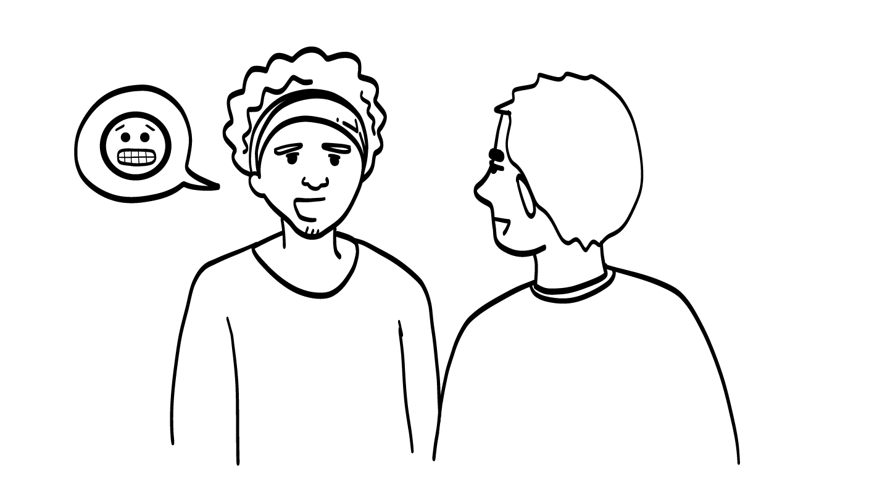
Telling People How You Feel
© 2026 SAFE Disability Services Program
Notes:
Say: Why do you think it is important to tell other people how you feel?
Give students enough time to process the question and make their decisions. After students have shared some ideas, use role play to further the conversation.
Say: I am going to act out some stories. Pay attention to what I say and what I do with my face and body.
Role play 1: Stomp across the room, cross your arms over your chest, and roll your eyes. Ask: How does it make you feel when I come in like this? Do you know what’s going on with me?
Give students enough time to process the question and make their decisions.
Say: You could probably tell that I was mad, but I bet you didn’t know why I was upset. I’m going to act out another story now. Keep paying attention to what I do with my face and body.
Role play 2: Walk in looking upset, but say, “I’m sorry, I’m feeling mad right now because traffic was terrible.” Ask: How do you feel now? Do you know why I am upset?
Give students enough time to process the question and make their decisions.
Say: That time I actually told you why I was mad. What do you all think—can people read your minds? Do they know what you are thinking just by looking at you? Give a thumbs up for yes and a thumbs down for no.
Give students enough time to process the question and make their decisions.
Say: People can’t read your mind! They can’t support you if they don’t know what’s going on with you, and they won’t know what’s going on with you unless you tell them. That’s why it is so important to use your words, signs, and communication boards to let others know how you feel. Talking about how you feel is a super important part of a healthy relationship.

Slide 8
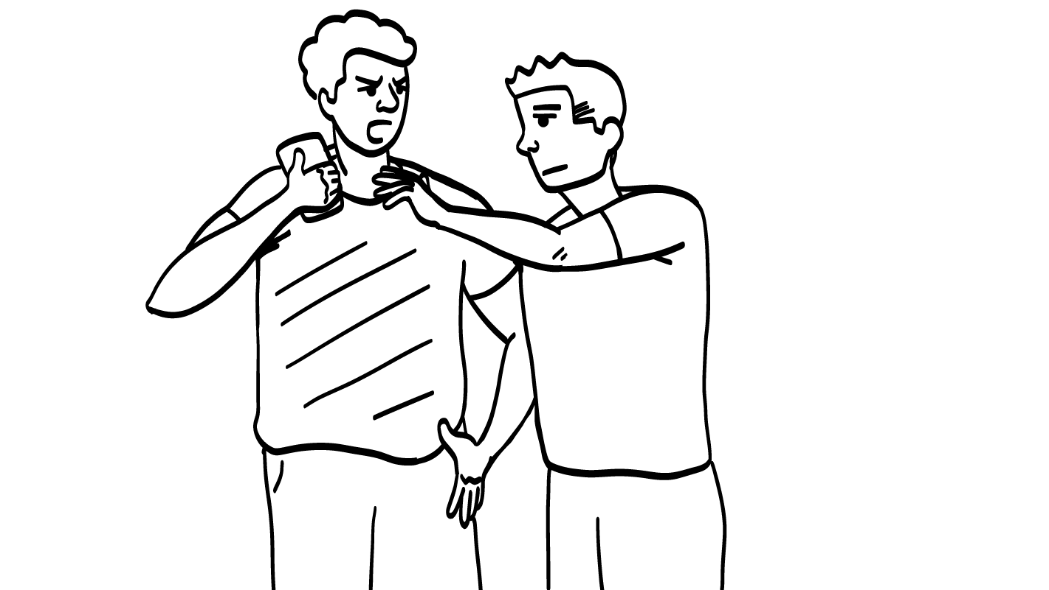
© 2026 SAFE Disability Services Program
Notes:
Say: Does anyone know what I statements are?
Give students enough time to process the question and make their decisions.
Say: I statements start with the word “I.” You can use an I statement to let other people know how you feel. Today you are going to practice using “I feel” statements.
So, for example, if someone came and grabbed your phone without asking, how would you feel?
Give students enough time to process the question and make their decisions. Allow students to share answers out loud or point to pictures on the Important Words Sheet.
Say: You might be mad. You could yell at the person, “You can’t just take my phone without asking. You’re a horrible person and no one likes you.” Do you think this is a good way to respond? How might it make the person feel?
Give students enough time to process the question and make their decisions. Emphasize that responding in this way is likely to upset the other person, and it might make the situation worse.
Say: Instead, you could use an I statement to respond. Can anyone think of an “I feel” statement you could use if someone took your phone without asking?
Give students enough time to process the question and make their decisions. One example includes: I feel mad when you take my phone without asking. Please give it back.
Say: Do you think using an I statement might work better than yelling at the person who took your phone? Why?
Give students enough time to process the question and make their decisions. You can connect back to the earlier discussion about how people cannot read students’ minds, and it is therefore important to know how to tell others how you are feeling.

Slide 9
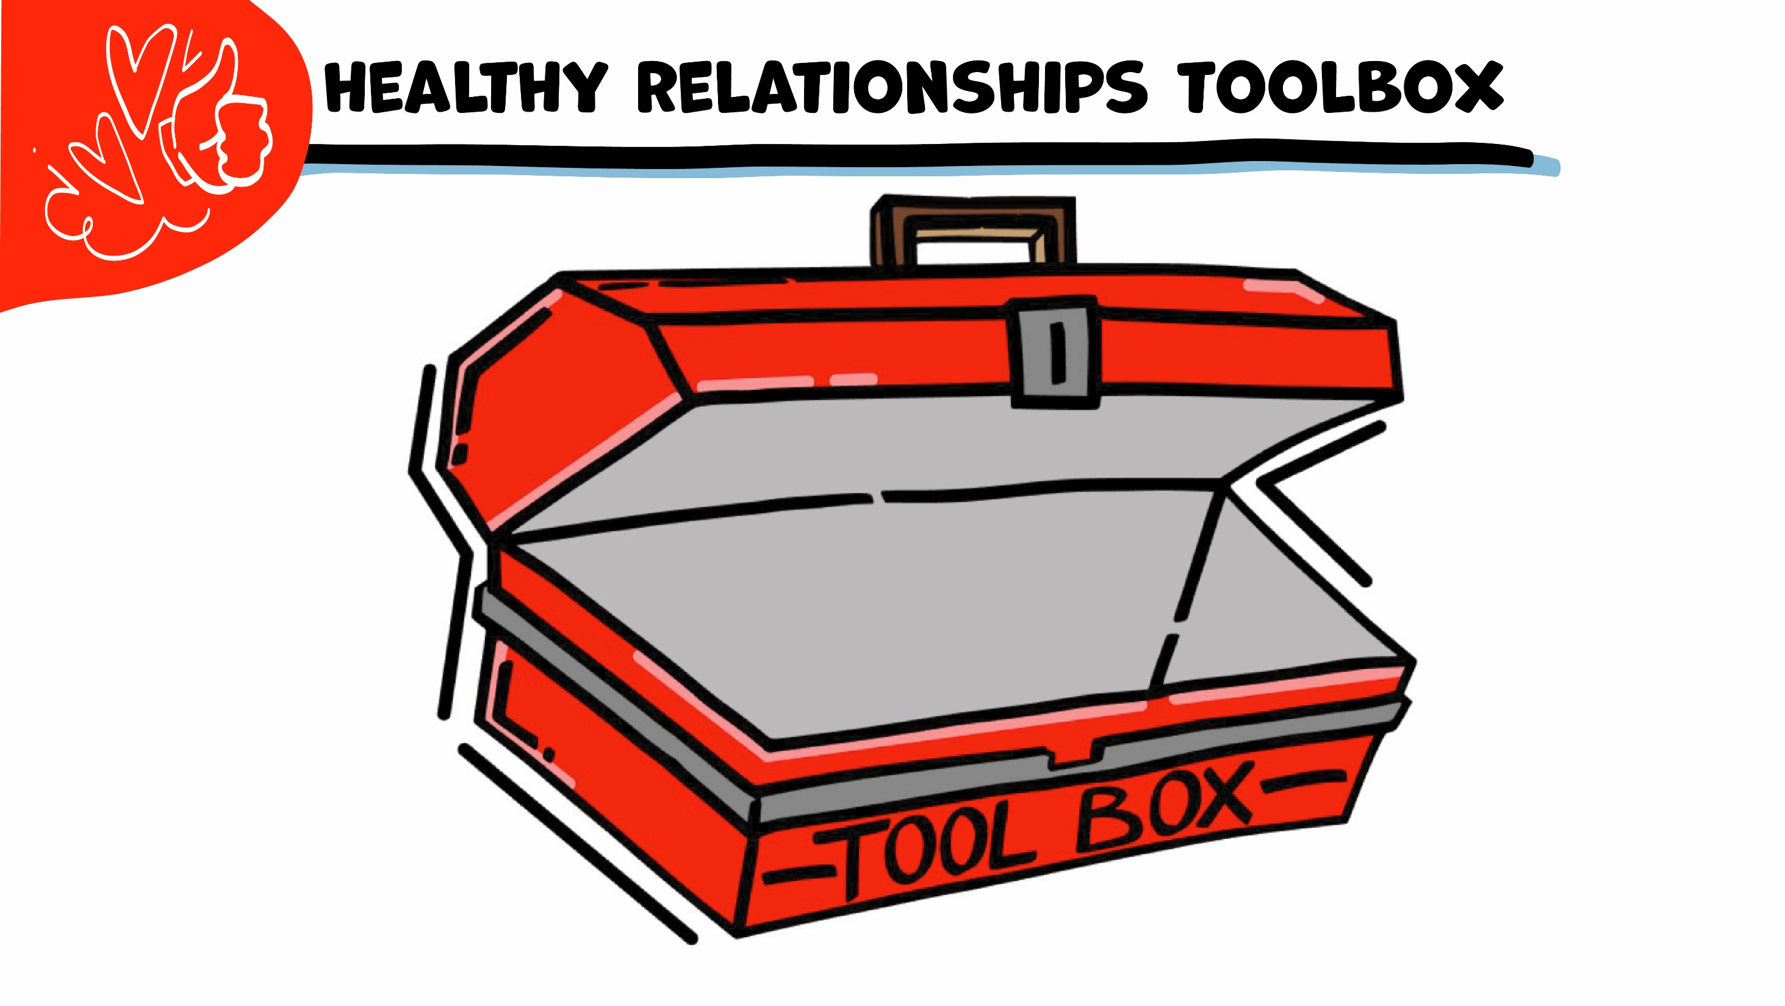
© 2026 SAFE Disability Services Program
Notes:
Say: Throughout the year, we are going to add tools into our Healthy Relationship Toolbox. These are things you can use to have healthy relationships. I Statements is the first tool in our toolbox.

Slide 10
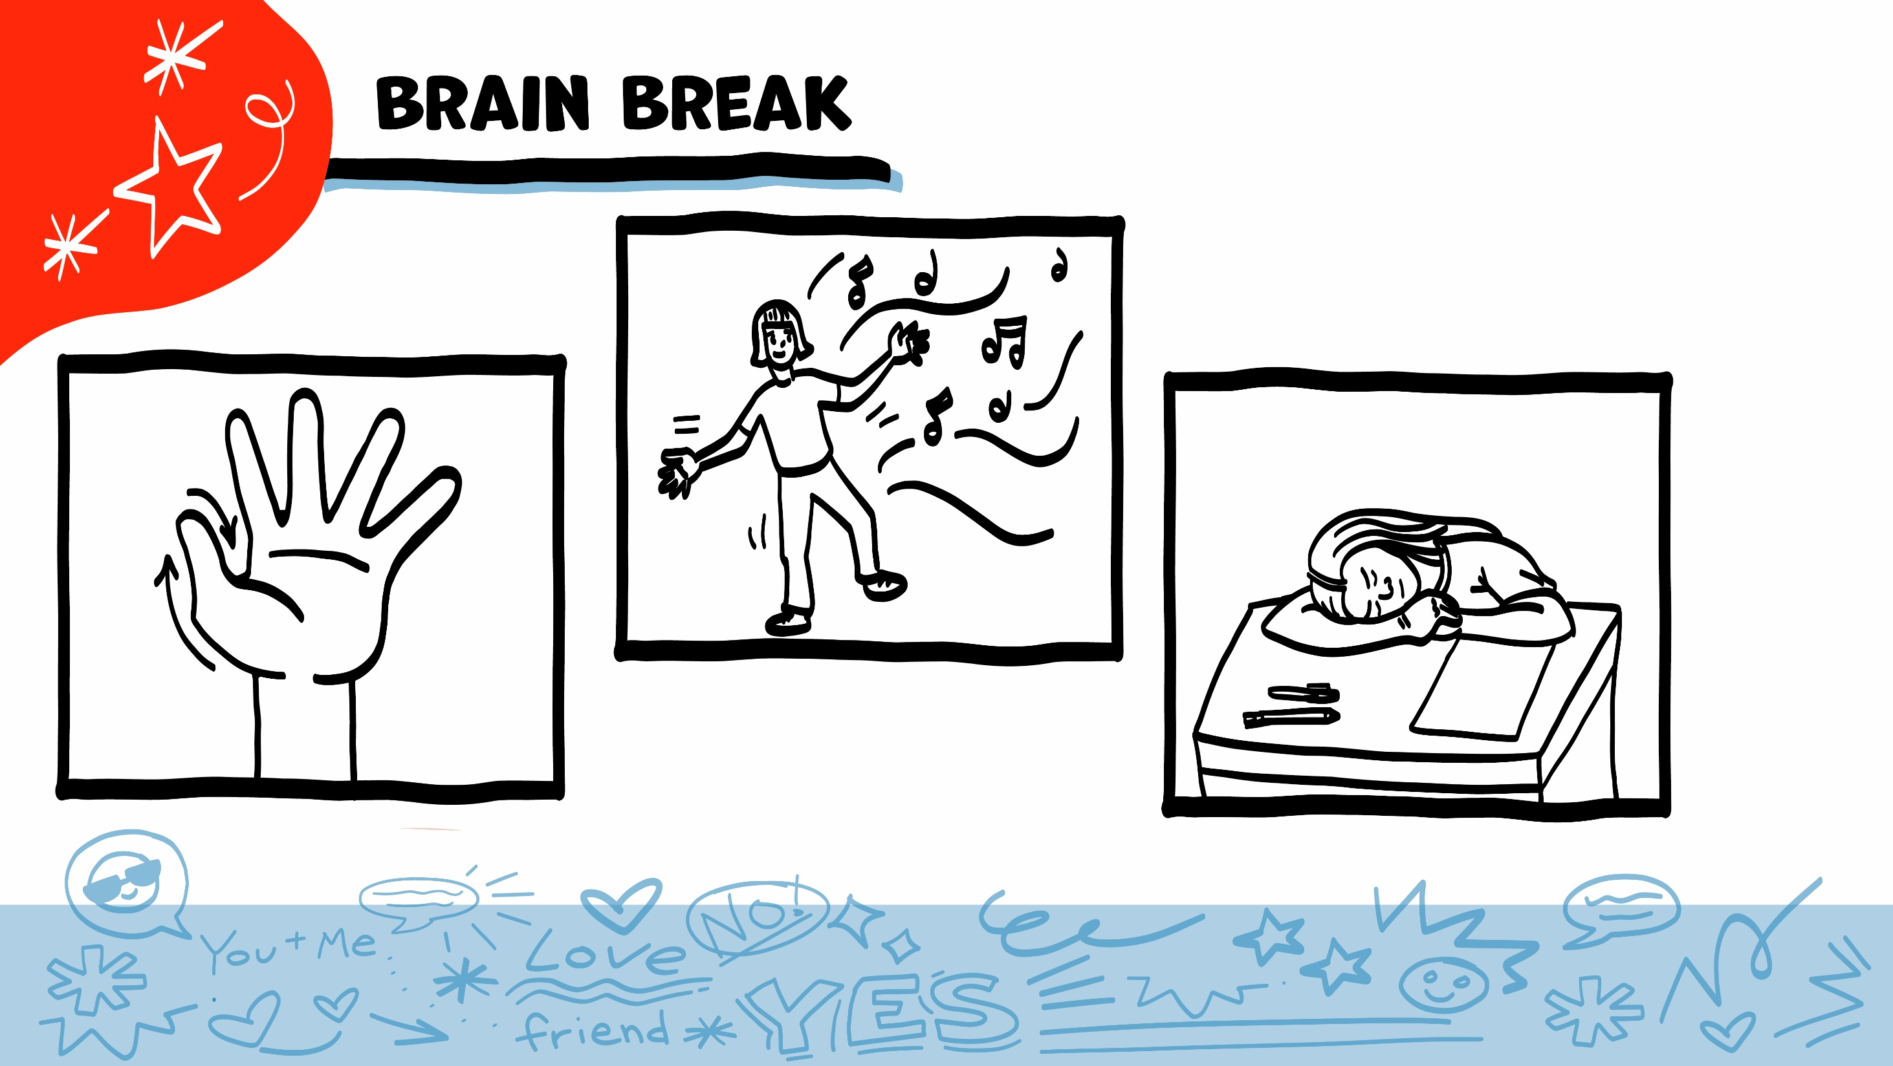
© 2026 SAFE Disability Services Program
Notes:
Say: That was a lot of information, and you all are doing an amazing job! Every week in class we will take a brain break in the middle. This is a chance to move a little and take a break from thinking!
Below are three ideas to give students a quick opportunity for a brain break. You are also welcome to come up with your own ideas for brain breaks that work best for your class.
Five finger breathing
For this exercise, have all students place their hand in front of their chest with their five fingers spread out. Next, use the pointer finger of the other hand to trace up and down each of the five fingers, beginning with the thumb. As students trace up a finger, they will breathe in. As they trace down a finger, they will breathe out. When students breathe out on the pinky finger, you can tell them to shake out their hands and arms. As the school year goes on, you can ask students to lead this exercise for their peers.
If this exercise is physically inaccessible for your class, you can also model the hand tracing for students while they breathe in and out.
Stretch break
Lead students through a series of basic stretches. These can be completed in a chair, or while standing up, depending on the accommodation needs of your class. Some ideas include reaching toward the ceiling, stretching one arm at a time across the chest, reaching toward toes, turning head from side to side, etc. Ask students to hold a pose while you count to ten. As the school year goes on, you can ask students to lead stretches for their peers.
Dance party
If your class likes to dance, you can put on a short song for them to dance to. This is especially effective if you are able to find a song that relates to the theme for that week’s class.

Slide 11
Feelings check-in
Talk about feelings
Brain break
I Statements practice
Feelings worksheet
© 2026 SAFE Disability Services Program
Notes:
Say: Now it’s time for you to practice using I statements.

Slide 12
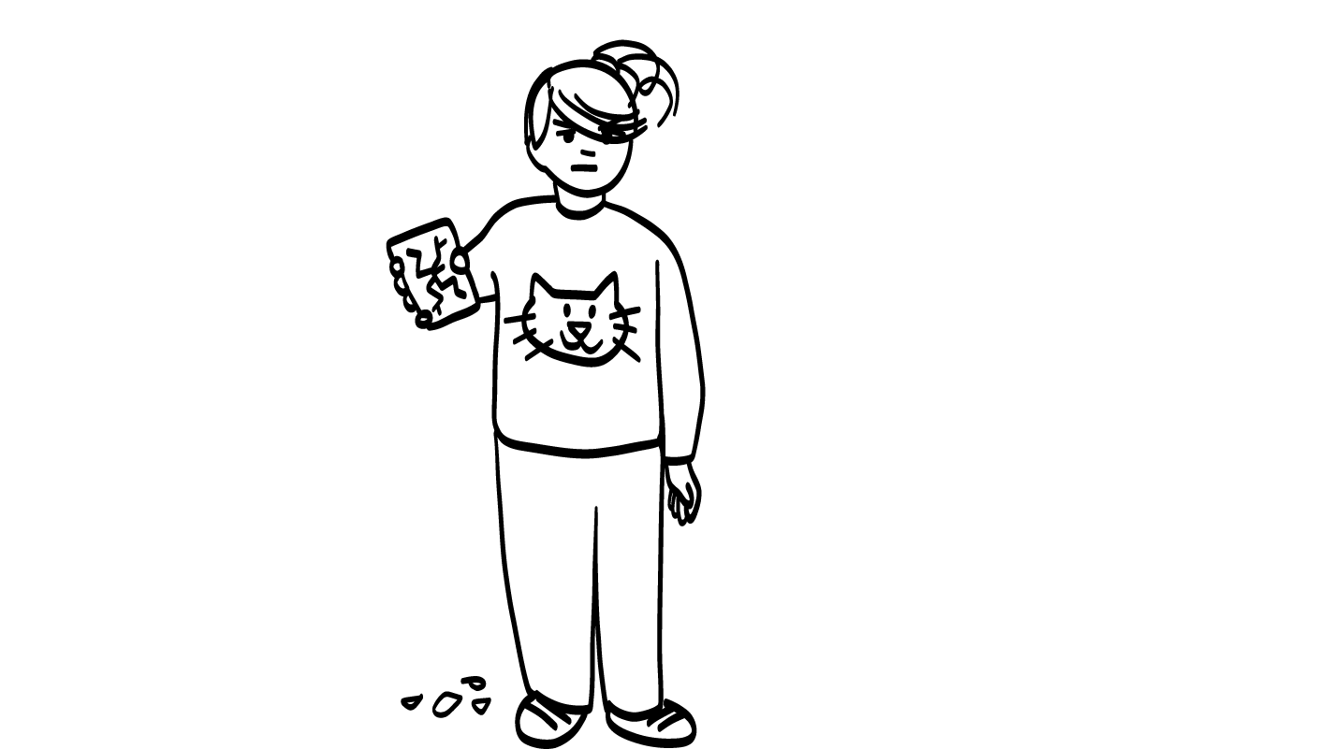
Your sister breaks your phone.
© 2026 SAFE Disability Services Program
Notes:
Say: I am going to show a story up on the board. For each story, you get to decide what emotion you would feel if you were in that story.
You can complete this activity together as a class, or you can ask for a volunteer to do each story. If you decide to have students complete the activity as individual volunteers, follow the steps below:
Ask for a volunteer.
If the volunteer can, have them read the story. If not, you can read the story.
Ask the volunteer how they would feel in that situation. They can also point to an emotion on their Important Words Sheet.
Next, ask the volunteer to share what some negative responses to that emotion might be. For example, if the student volunteer chose “mad,” class members can discuss unhealthy ways to express that emotion (yell, throw something, slam a door, etc.). Ask students: would these be healthy ways to handle that emotion?
Explain that using an I Statement is a healthier way to react when you feel strong emotions.
Ask the volunteer to use an “I feel” statement for the story.

Slide 13
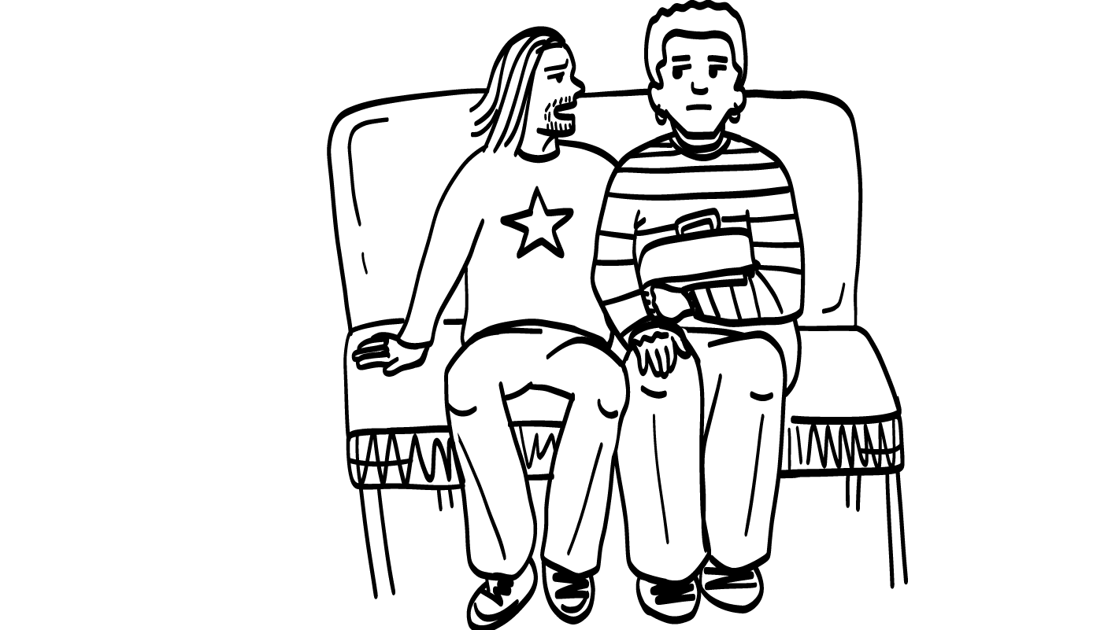
Someone sits too
close to you on the bus.
© 2026 SAFE Disability Services Program
Notes:
You can complete this activity together as a class, or you can ask for a volunteer to do each story. If you decide to have students complete the activity as individuals, follow the steps below:
Ask for a volunteer.
If the volunteer can, have them read the story. If not, you can read the story.
Ask the volunteer how they would feel in that situation. They can also point to an emotion on their Important Words Sheet.
You can discuss some unhealthy ways to respond to that emotion.
Explain that using an I Statement is a healthier way to react when you feel strong emotions.
Ask the volunteer to use an “I feel” statement for the story.

Slide 14
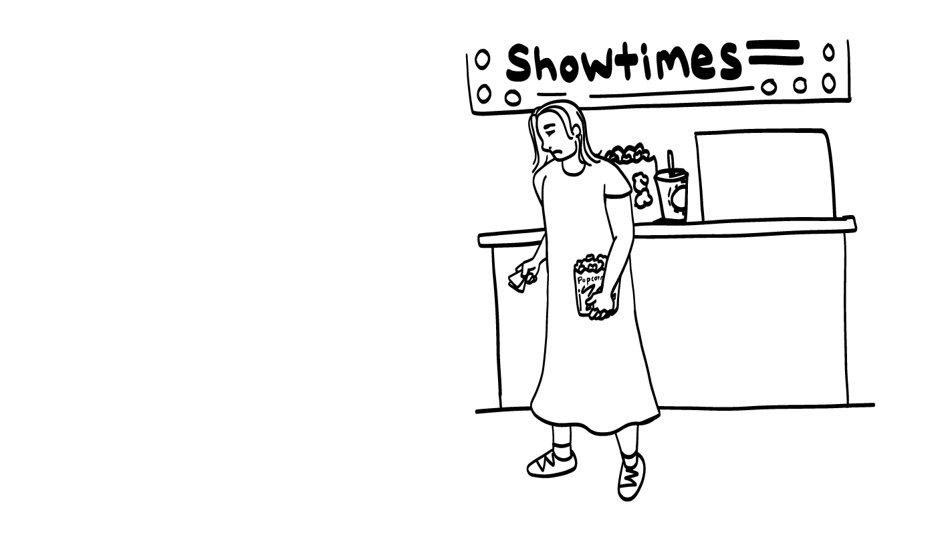
Your BFF doesn’t show up to a movie.
© 2026 SAFE Disability Services Program
Notes:
You can complete this activity together as a class, or you can ask for a volunteer to do each story. If you decide to have students complete the activity as individuals, follow the steps below:
Ask for a volunteer.
If the volunteer can, have them read the story. If not, you can read the story.
Ask the volunteer how they would feel in that situation. They can also point to an emotion on their Important Words Sheet.
You can also discuss what some of the unhealthy ways to respond to strong emotions could be. Also focus time on discussing healthy ways to manage the strong emotion of being ‘mad’ or ‘angry’.
Explain that using an I Statement is a more healthy way to react when you feel strong emotions.
Ask the volunteer to use an “I feel” statement for the story.

Slide 15
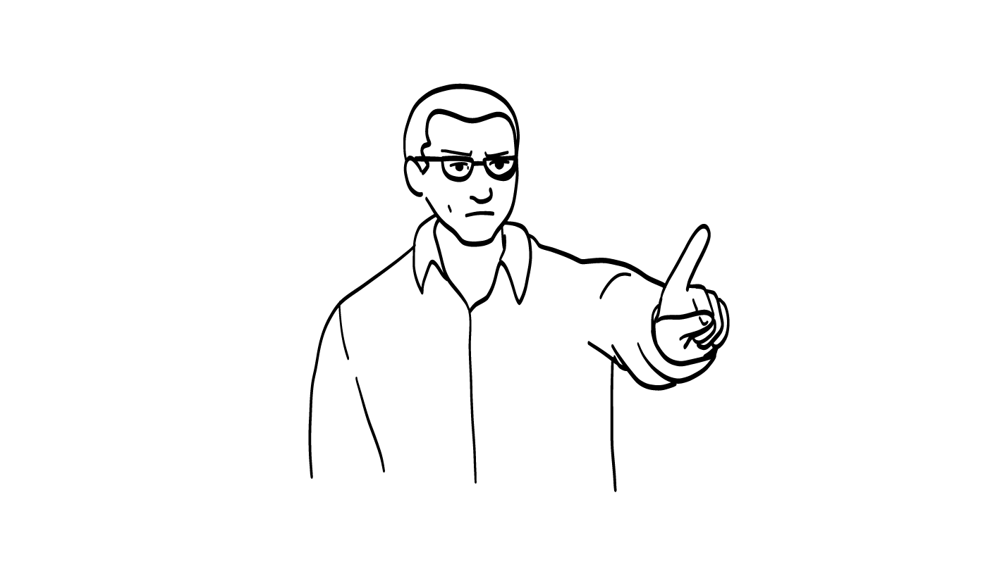
Your parent says you
can’t hang out
with your friends.
© 2026 SAFE Disability Services Program
Notes:
You can complete this activity together as a class, or you can ask for a volunteer to do each story. If you decide to have students complete the activity as individuals, follow the steps below:
Ask for a volunteer.
If the volunteer can, have them read the story. If not, you can read the story.
Ask the volunteer how they would feel in that situation. They can also point to an emotion on their Important Words Sheet.
Talk about / discuss unhealthy / negative responses to that emotion. Then ask the students, for some examples of healthier ways to handle that emotion?
Explain that using an I Statement is a more healthy way to react when you feel strong emotions.
Ask the volunteer to use an “I feel” statement for the story.
*Note. For students that have experienced abuse in their homes or relationships, acting out negative responses to emotions (pretending to yell or hit, or throw things) could be a strong trauma reminder. You can talk about unhealthy ways to respond or express strong emotions. You can keep this in mind throughout MRML Healthy Relationships classes/education. It’s less risky and respectful of any students experiences of abuse to role play healthy responses to strong emotions.

Slide 16
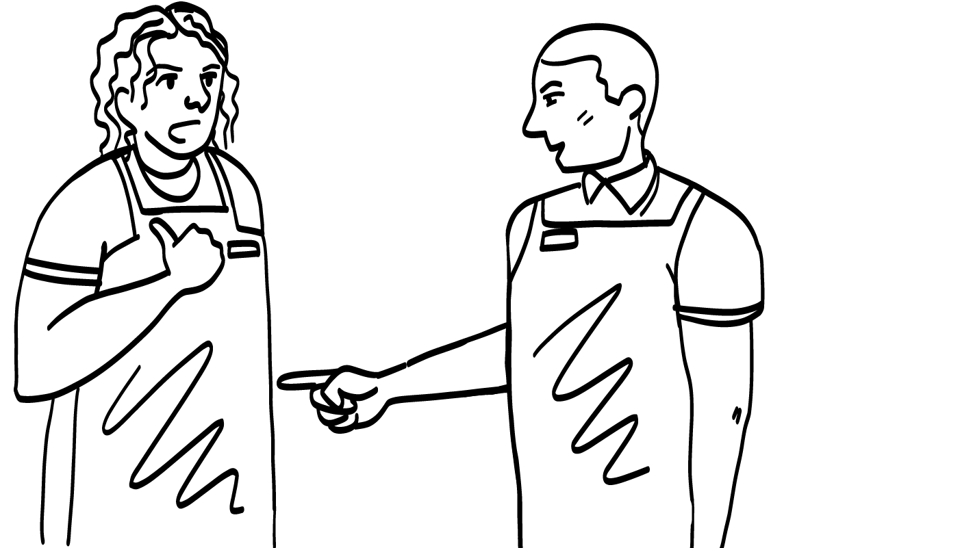
Your coworker bosses
you around at work.
© 2026 SAFE Disability Services Program
Notes:
You can complete this activity together as a class, or you can ask for a volunteer to do each story. If you decide to have students complete the activity as individuals, follow the steps below:
Ask for a volunteer.
If the volunteer can, have them read the story. If not, you can read the story.
Ask the volunteer how they would feel in that situation. They can also point to an emotion on their Important Words Sheet.
You can discuss what some of the negative response to that emotion could be – and then ask about healthier ways to respond to that strong emotion?
Explain that using an I Statement is a more healthy way to react when you feel strong emotions.
Ask the volunteer to use an “I feel” statement for the story.
*Note. For students that have experienced abuse in their homes or relationships, pretending to throw something, hit, or punch anything (e.g., a chair, a wall, etc.) could be a strong trauma reminder. Consider talking about/asking class member to suggest a negative way to show that emotion – rather than role playing unhealthy behaviors (i.e., throwing a chair). Keep this in mind throughout MRML Healthy Relationships classes/education.

Slide 17
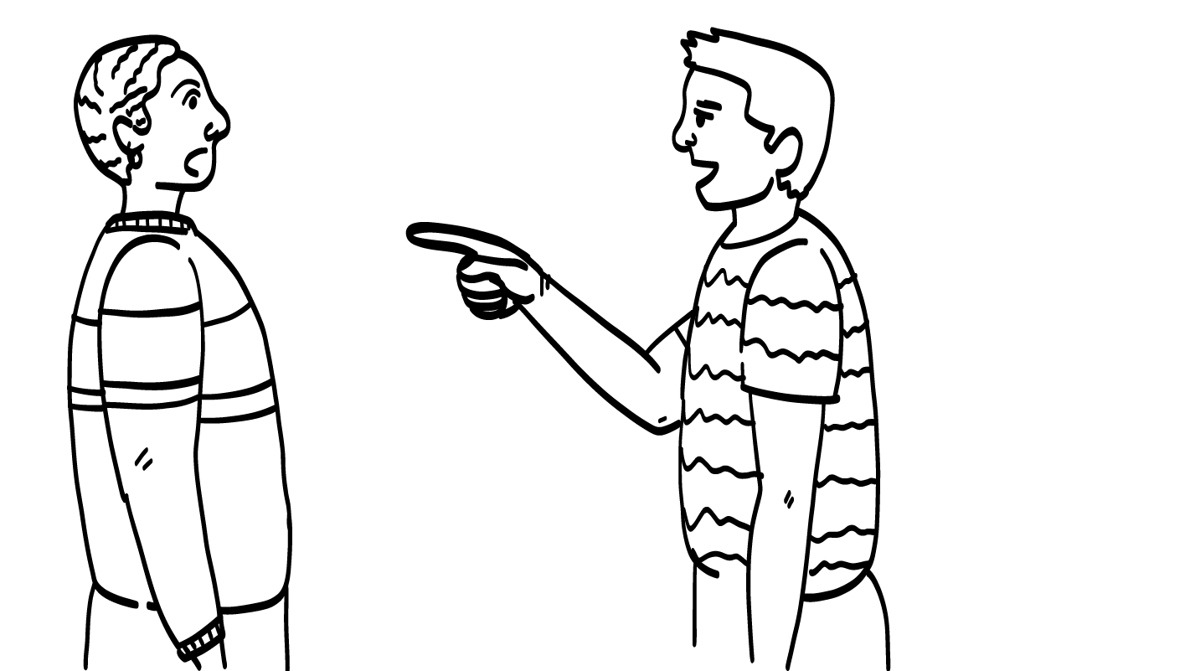
Your friend calls
you a mean name.
© 2026 SAFE Disability Services Program
Notes:
You can complete this activity together as a class, or you can ask for a volunteer to do each story. If you decide to have students complete the activity as individuals, follow the steps below:
Ask for a volunteer.
If the volunteer can, have them read the story. If not, you can read the story.
Ask the volunteer how they would feel in that situation. They can also point to an emotion on their Important Words Sheet.
Ask students to think about some unhealthy ways to respond to this situation and the strong emotion. Explore some more healthy ways to handle the emotion.
Again, explain that using an I Statement is a more healthy way to react when you feel strong emotions.
Ask the volunteer to use an “I feel” statement for the story.
*Note. For students that have experienced abuse in their homes or relationships, pretending to throw something, hit, or punch anything (e.g., a chair, a wall, etc.) could be a strong trauma reminder. Consider talking about/asking class member to suggest a negative way to show that emotion – rather than role playing unhealthy behaviors (i.e., throwing a chair). Keep this in mind throughout MRML Healthy Relationships classes/education.

Slide 18
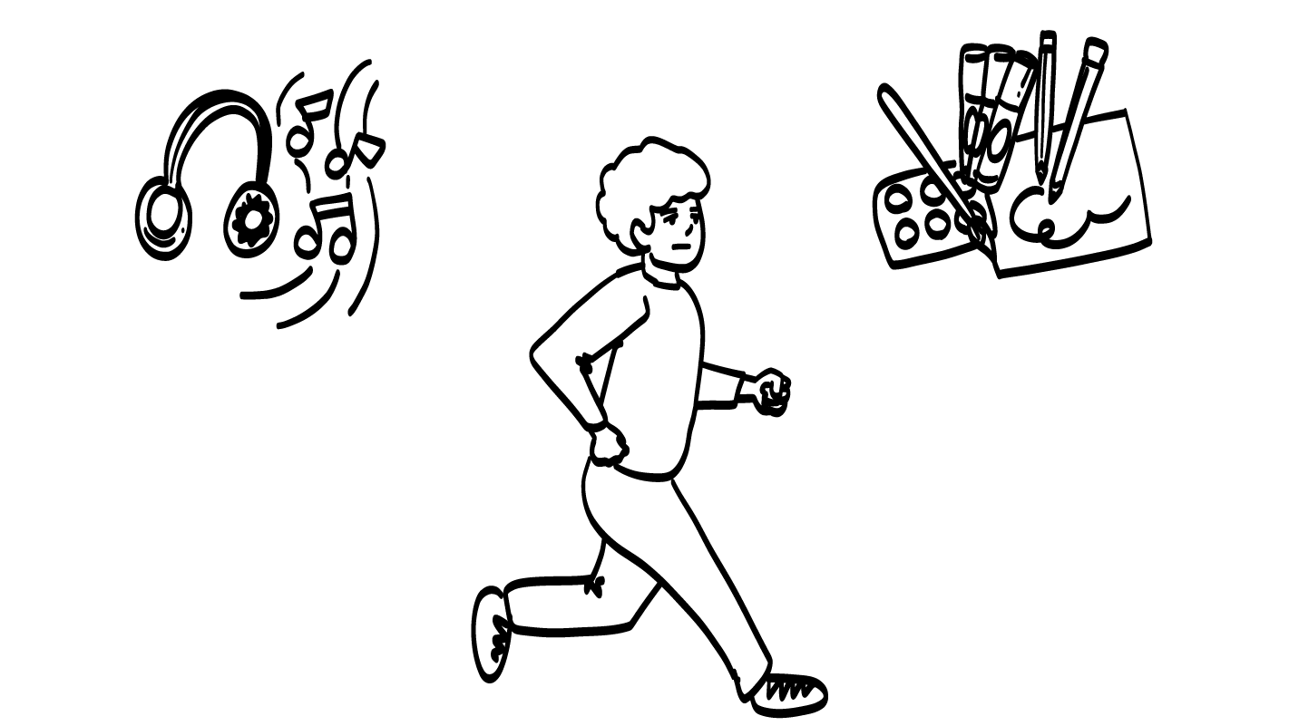
Self-care
© 2026 SAFE Disability Services Program
Notes:
Say: Nice job with the I Statements practice! The last thing we are going to talk about is what you can do to feel better when you have strong feelings. Sometimes this is called “self-care.” We’ll make a list together on this piece of chart paper. Let’s start with “mad.” When I am feeling mad, sometimes I’ll go for a walk to try to feel better. What do you all do to feel better when you are mad?
As students share answers, write their ideas down on a piece of chart paper or whiteboard. Repeat this process for the emotions “sad” and “scared.”

Slide 19
Feelings check-in
Talk about feelings
Brain break
I Statements practice
Feelings worksheet
© 2026 SAFE Disability Services Program
Notes:
Say: The final item on today’s agenda is the Feelings Worksheet.

Slide 20
Mad
© 2026 SAFE Disability Services Program
Notes:
Say: No feelings are bad. It is okay to feel any feeling. We all feel strong emotions. What matters is what you do when you have strong feelings. You all are going to fill out a worksheet with ideas of things you can do to feel better when you have a strong feeling. I’ll show you what the worksheet looks like (show students a copy of the feelings worksheet).
You’ll start by thinking about what you do when you are mad. You’ll write an I Statement that you could use to let someone else know that you are mad. You can also write down some ideas of things you do to feel better when you are mad. What can you do if you need help filling out the sheet? Yes, you can always ask for help.

Slide 21
Sad
© 2026 SAFE Disability Services Program
Notes:
Say: Next, you’ll think about what you do when you are sad. You’ll write an I Statement that you could use to let someone else know that you are sad. You can also write down some ideas of things you do to feel better when you are sad.

Slide 22
Scared
© 2026 SAFE Disability Services Program
Notes:
Say: The last feeling you’ll think about is scared. You’ll write an I Statement that you could use to let someone else know that you are scared. You can also write down some ideas of things you do to feel better when you are scared.

Slide 23
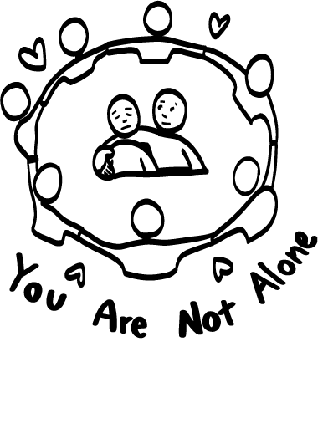
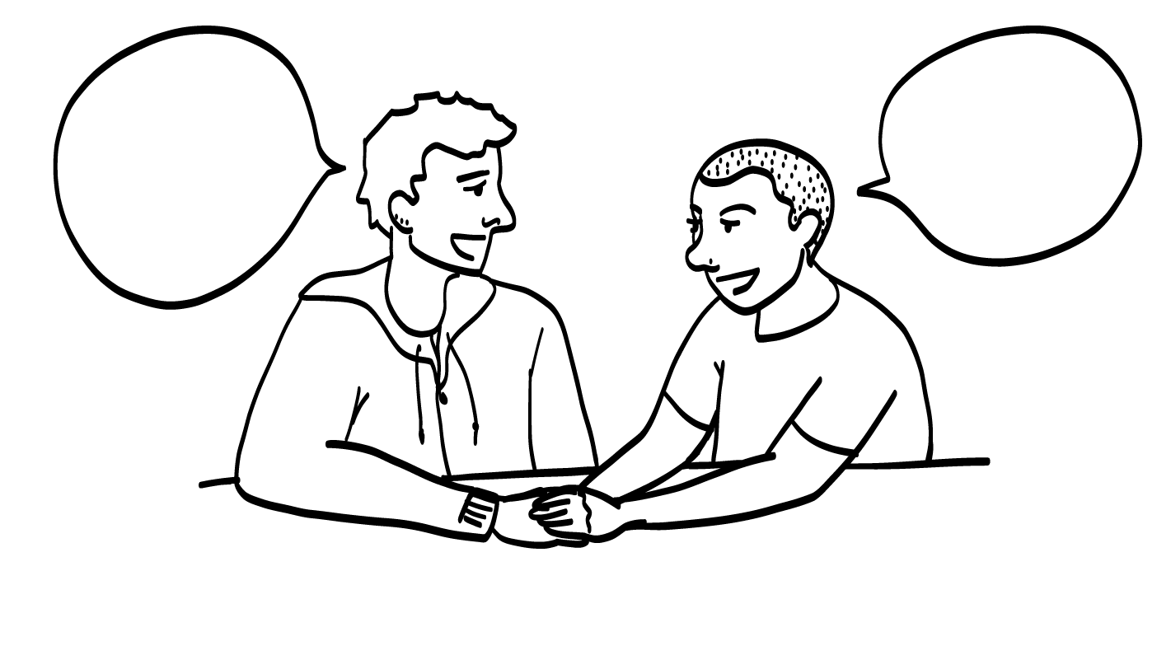
Getting Help with Your Feelings
© 2026 SAFE Disability Services Program
Notes:
Say: Finally, you will think about two adults you trust that you can talk to when you have big feelings. Sometimes, even if you take steps to feel better, you might still be mad, sad, or scared. When that happens, it can help to talk to someone you trust. On your worksheet, you’ll write down the names of two adults you trust.
Give each student a copy of the Feelings Worksheet. Provide support as students complete the worksheet. For some feelings, you may have to help students think of situations that have made them feel that emotion. Then, ask students what they did to feel better in those situations.
If time permits, ask if anybody wants to share all or part of their Feelings Worksheet with the class.

Slide 24
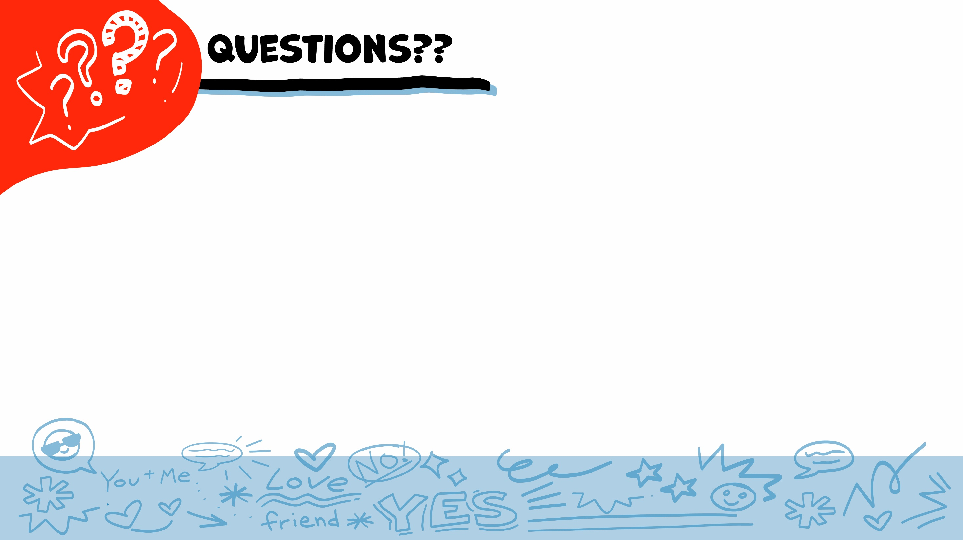
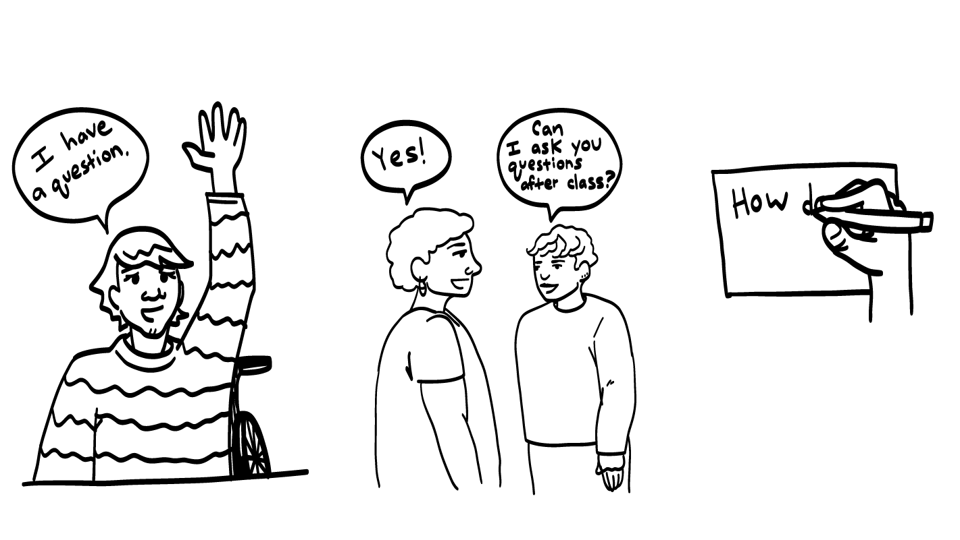
© 2026 SAFE Disability Services Program
Notes:
Say: Does anyone have any questions about today’s class? Remember, if you don’t want to ask your question out loud, you can write it on a notecard and leave it on your desk. You can also ask someone you trust to help you write your question on the notecard. I will pick up the notecards and will answer the questions the next time we meet. When I answer a question, I won’t tell anyone who asked it.
Remember, at the end of every class I will ask you questions that will help me know what you learned. We call these questions exit tickets and we will do the exit tickets for this class next.

Slide 25
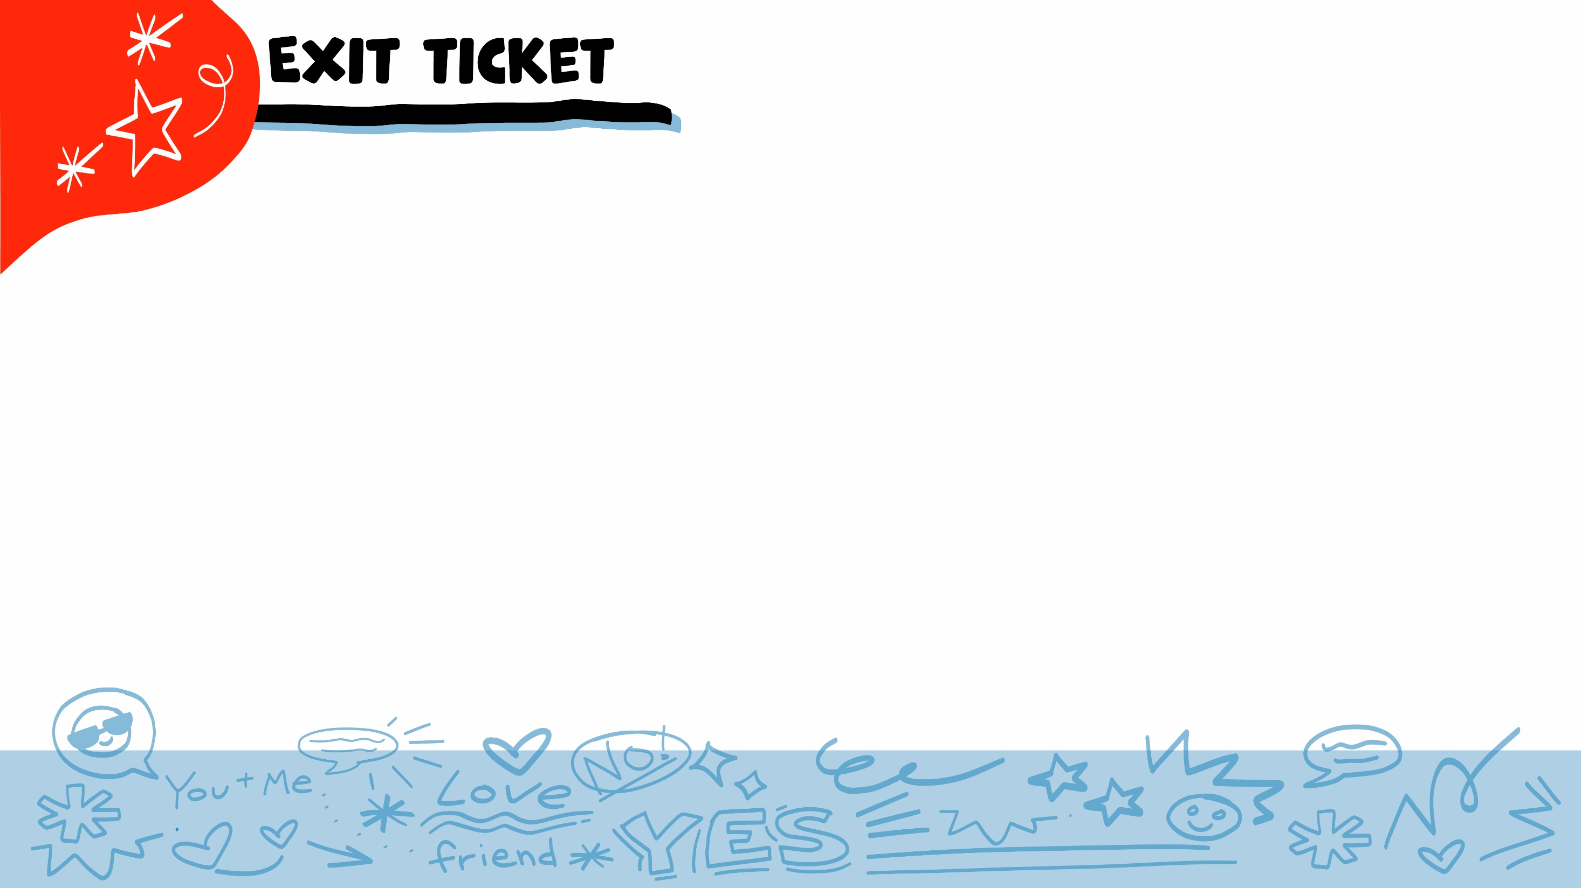
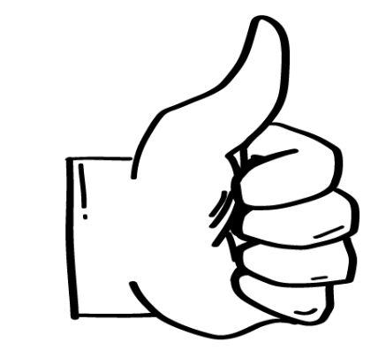
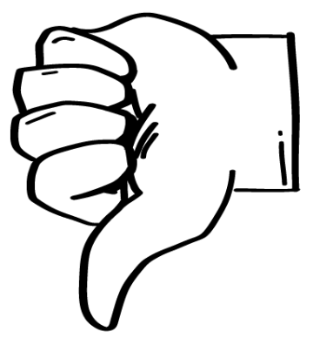
Is yelling at someone a healthy way to react when you are mad?
YES
NO
© 2026 SAFE Disability Services Program
Notes:
Say: Is yelling at someone a healthy way to react when you are mad? Hold up a thumbs up for yes, and a thumbs down for no.
Give students enough time to process the question and make their decisions.
Say: No, in most situations, yelling at someone is only going to make things worse.

Slide 26
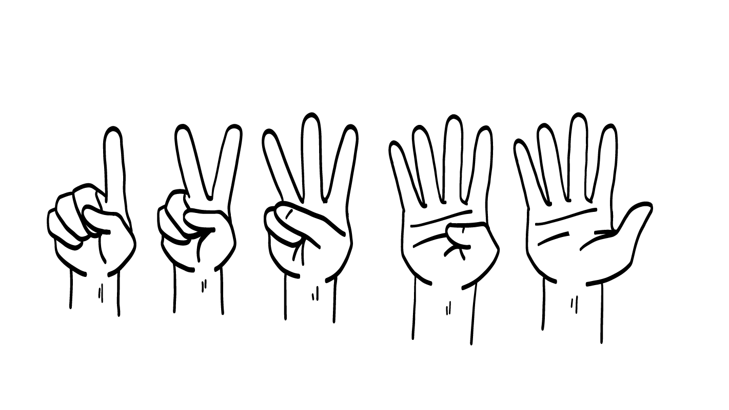
Which of these is an I Statement?
I feel sad when you take my things.
You always make me sad!
Give me my stuff back!!!
1
2
3
© 2026 SAFE Disability Services Program
Notes:
Say: Which of these is an I Statement? Hold up one finger for “I feel sad when you take my things,” two fingers for “You always make me sad!” and three fingers for “Give me my stuff back!”
Give students enough time to process the question and make their decisions.
Say: Number one, “I feel sad when you take my things,” is an I Statement. Remember, I Statements start with the word I and they let people know how you feel. I Statements can be a healthy way to let someone know how you are doing. Other people can’t read your mind, so it’s really important to tell other people how you feel!

Slide 27
What is 1 thing you can do to feel better when you are scared?
© 2026 SAFE Disability Services Program
Notes:
Say: What is one thing you can do to feel better when you are scared?
Give students enough time to process the question and make their decisions. You can go around the room and ask each student to share one coping strategy from their Emotions Worksheet.

Slide 28
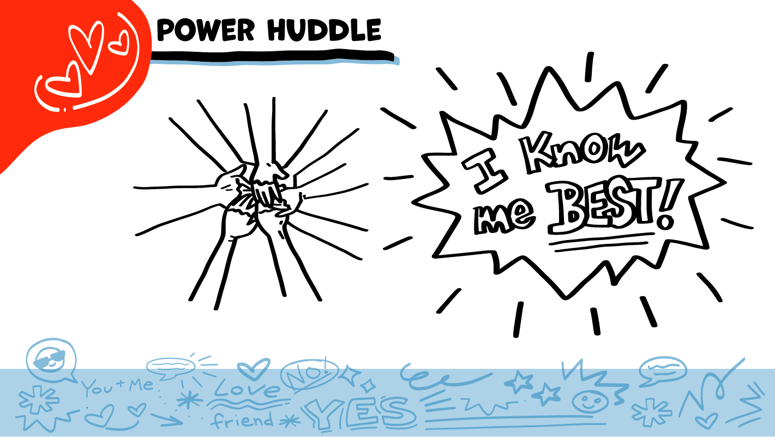
© 2026 SAFE Disability Services Program
Notes:
Say: Does anyone remember what our power statement is? Our power statement is “I know me best.” This means that each of you knows yourself better than anyone else does. You know best how you are feeling, and today you practiced using I Statements to tell other people how you feel. Let’s gather together and on the count of three, say our power statement.
Have each interested student put one hand in the middle of the circle. Ask for a student volunteer to count to three. After three, all participants say the power statement while lifting their hands into the air. Students can also stand in the circle without touching hands if they prefer.

Slide 29

This work is supported by the Texas Council for Developmental Disabilities through a grant from the U.S. Administration for Community Living (ACL), Department of Health and Human Services (HHS), Washington, D.C. 20201 with a 100% federal funding award totaling $6,161,072. Council efforts are those of the grantee and do not necessarily represent the official views of nor are endorsed by ACL, HHS, or the U.S. government.
© 2026 SAFE Disability Services Program
Notes:
SAFE would like to thank the Texas Council for Developmental Disabilities for the funding for this curriculum.

Slide 30

This curriculum is offered online at no cost. You are free to use the resources in the original format for educational purposes only. Please reference The SAFE Alliance appropriately (citations at bottom of page).
We ask that you do not alter curriculum images/art, slides, or lesson plan materials. You may not use My Rights My Life (18+ or High School) curriculum for commercial purposes (i.e., selling workshops you facilitate based on MRML curriculum; and/or creating links/websites to re-distribute any materials associated SAFE’s My Rights My Life).
This resource, My Rights My Life: A curriculum for healthier relationships for high school students (grades 9-12) is based on the original My Rights My Life: A curriculum for safer relationships (age 18+) written by Megan Westmore, Heidi Lersch, and edited by Schwartz, M. (2022). Selling materials from MRML is a copyright violation.
Burleson, Anna Belle & Benitez, Sophie (2026) provided light modification and abbreviated the original curriculum
(Westmore & Lersch, 2022) to offer an age appropriate resource for High School Students (grades 9-12).
Schwartz, M. (Ed.). The SAFE Alliance, Austin, Texas.
Westmore, M. & Lersch, H. (2022). My rights my life: A curriculum for safer relationships.
Schwartz, M. (Ed.). The SAFE Alliance: Austin, TX.
© 2026 SAFE Disability Services Program

