Slide 1
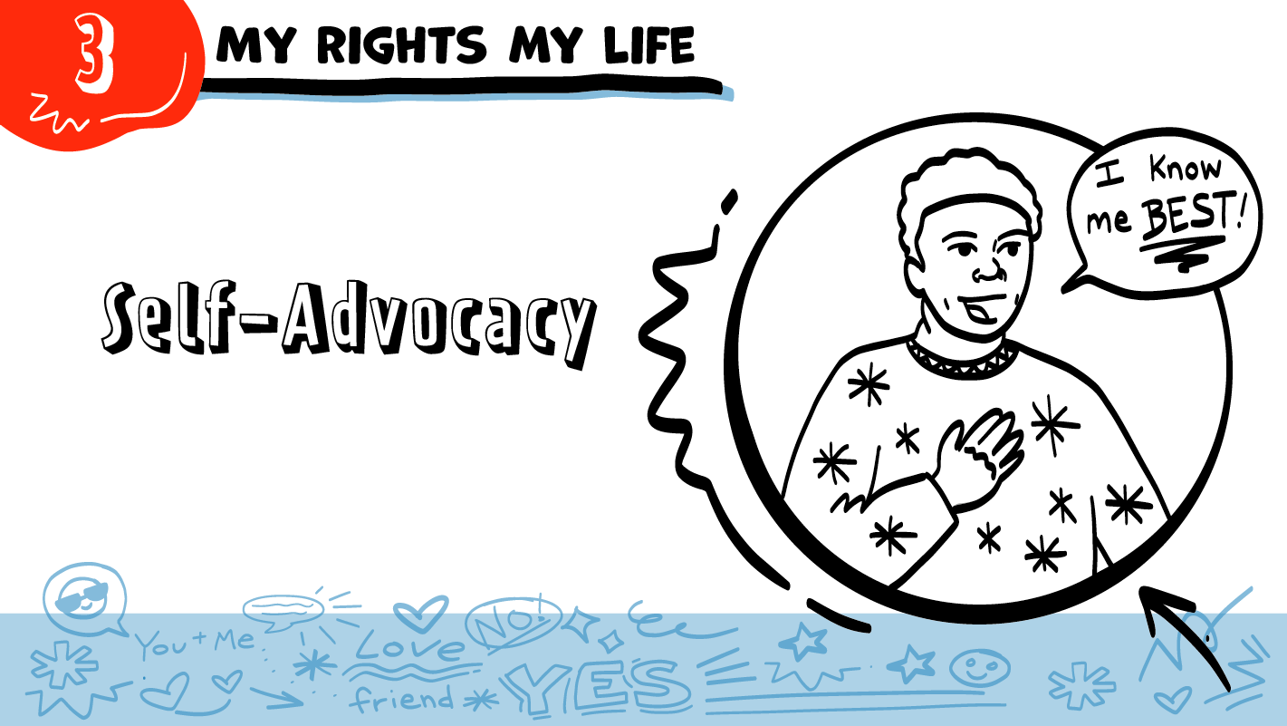

for High School Students
© 2026 SAFE Disability Services Program
Notes:
Repetition is beneficial for learning. Take time to review the last My Rights My Life class you taught prior to beginning this session. You can also answer any private questions students submitted on notecards during your previous class session.
Say: Today in class we will be talking all about something called self-advocacy. We’ll talk about what self-advocacy is, and how you can use it in your relationships.

Slide 2
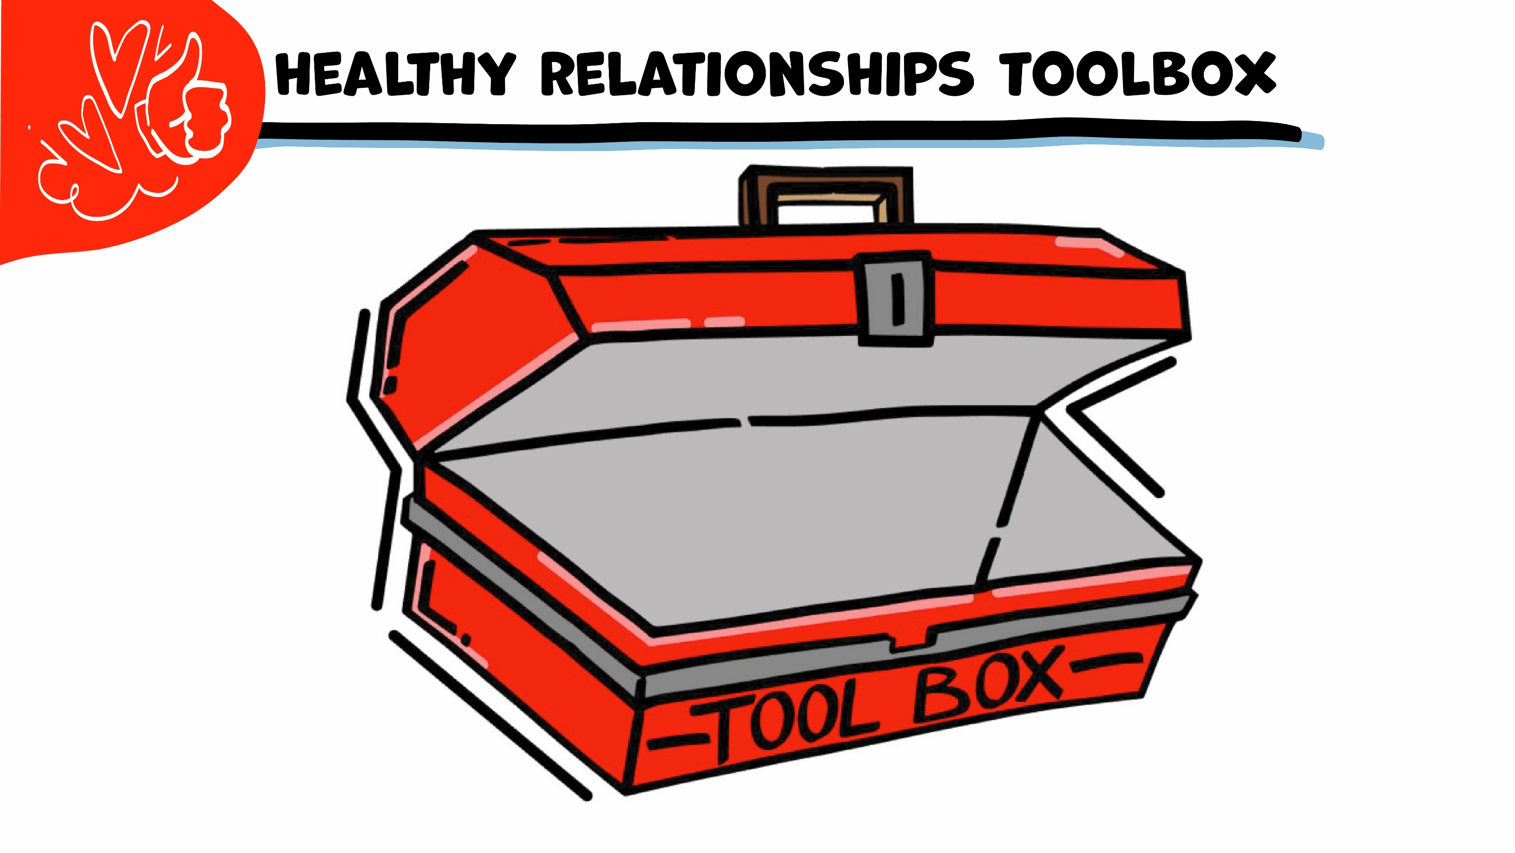

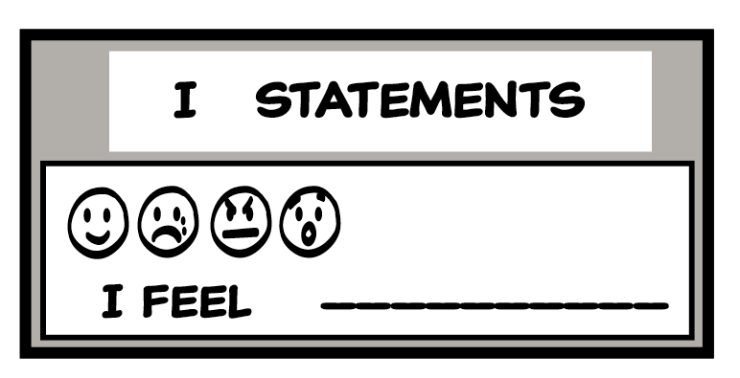
© 2026 SAFE Disability Services Program
Notes:
Say: Remember, all year we will be adding tools to our Healthy Relationship Toolbox. Last week we added “I feel” to our toolbox. A little later today, each of you will get your own toolbox to use in our classes.
Let’s do an example. If your friend lied to you, how would that make you feel? Can anyone practice sharing that feeling using an “I feel” statement?

Slide 3

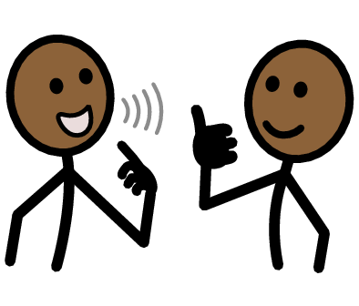
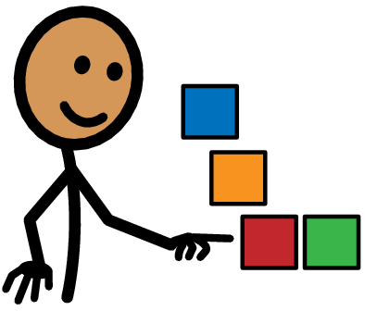


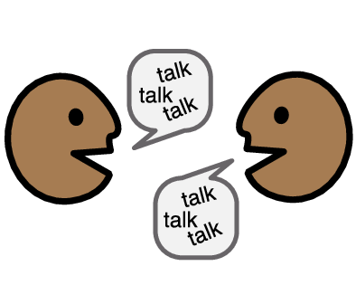
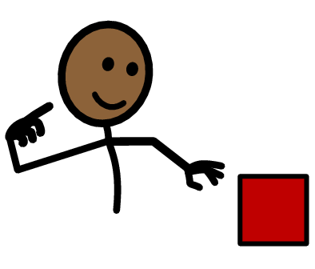
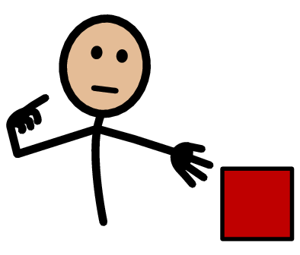


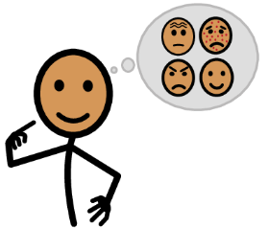




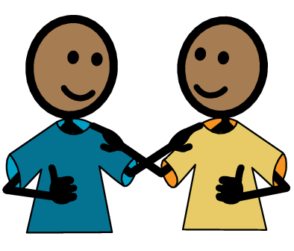
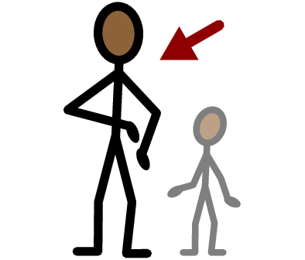
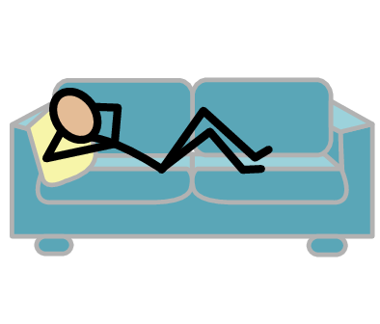
Self-Advocate
Choices
Yes
No
Talk
I want
I need
I need help
I have a question
Trust
Adult
Take a break
I feel
Happy
Sad
Mad
Scared
Copyright © 2021 SymbolStix, LLC. All rights reserved. Used with Permission.
Notes:
You can print this slide separately so each student can use the Important Words Sheet as a communication board throughout class. Review the words using the suggested definitions below. To enhance understanding, you can ask students to come up with their own definitions for vocabulary words or to provide a sentence or scenario using the new word.
Self-advocate: People who speak up for themselves
Choices: Making decisions when you have 2 or more choices.
Talk: When you use your words, signs, or pictures to tell someone something
I want: An I Statement you can use when you would like something
I need: An I Statement you can use when you must get something

Slide 4
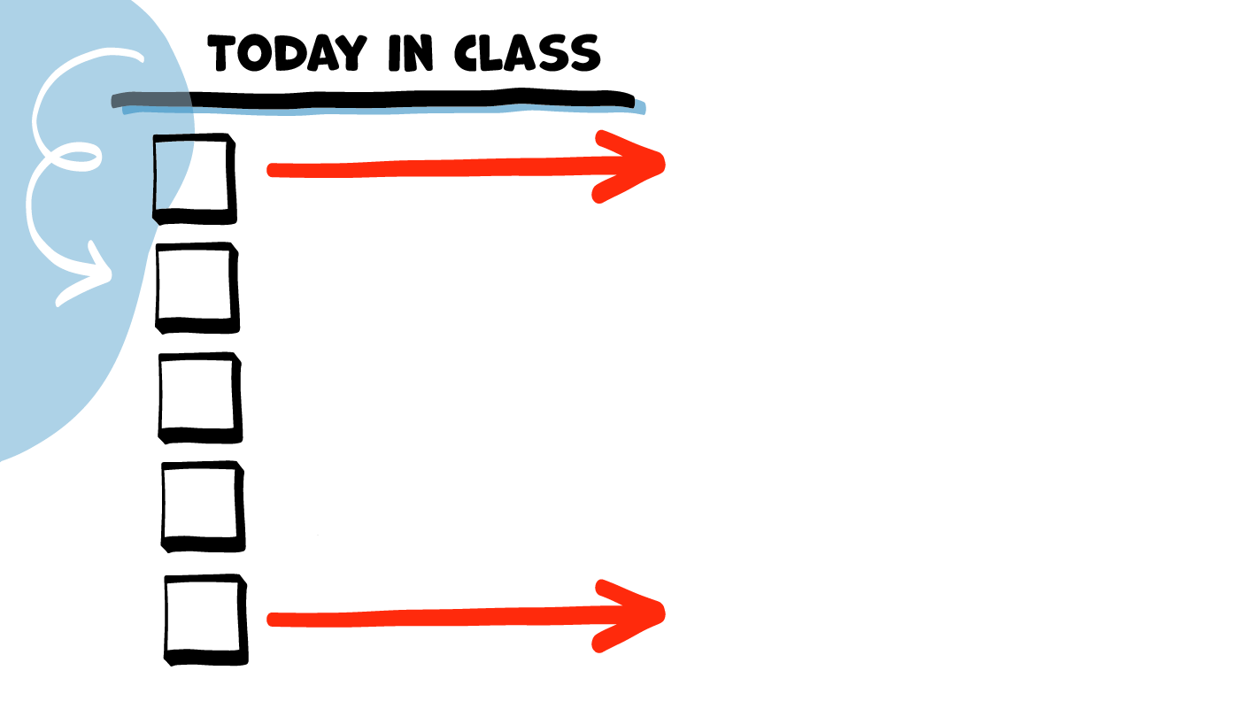
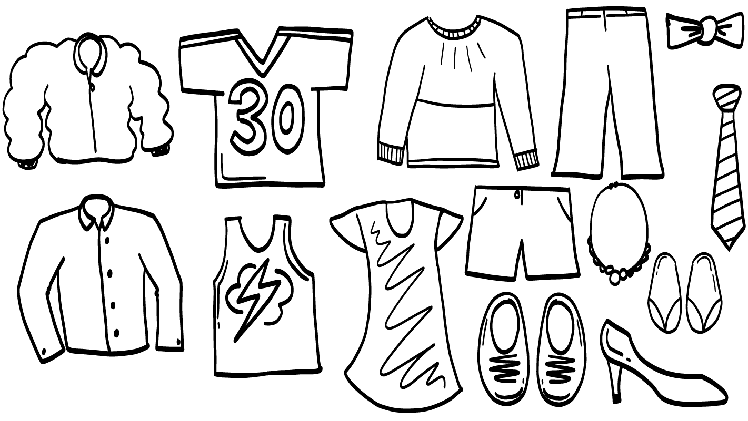
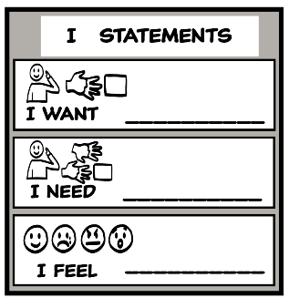
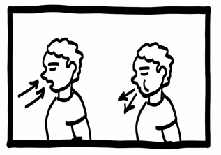

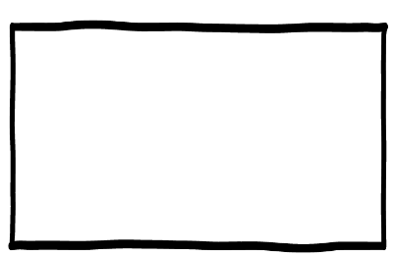

Making choices
Self-advocacy
Brain break
I Statements practice
Self-advocacy video
© 2026 SAFE Disability Services Program
Notes:
Read the agenda. Alternatively, you can ask for a student volunteer to read the agenda.

Slide 5
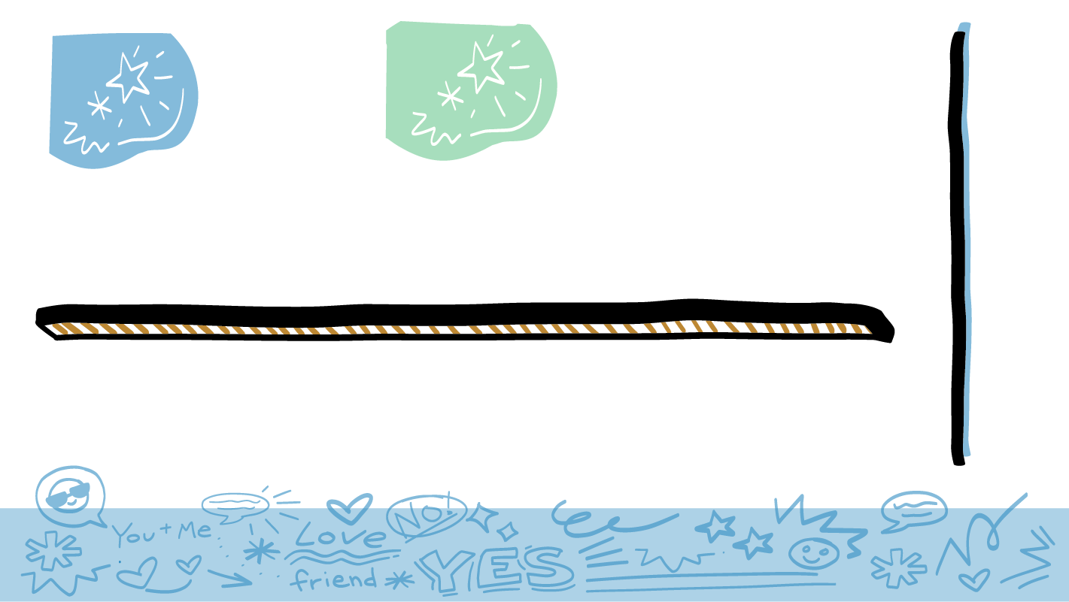
© 2026 SAFE Disability Services Program
Notes:
Say: On the next few slides, we are going to think about all of the choices you make every day! Let’s start first with your clothes. What kinds of clothes do you like to wear? Does anyone want to share?
Give students enough time to process the question and make their decisions.
After a few students have shared, say: Thanks for telling me some of the things you like to wear. Who chooses what clothes you wear?
Give students enough time to process the question and make their decisions.
Say: Choosing what you are going to wear each day is part of self-advocacy! Remember, self-advocacy means speaking up for yourself and telling people about your choices.

Slide 6
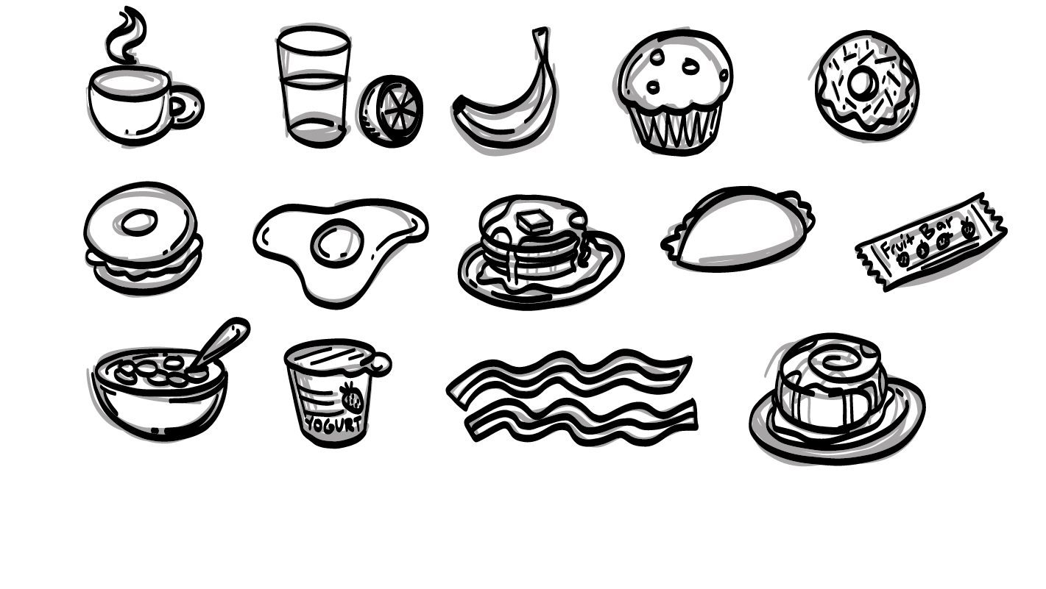
© 2026 SAFE Disability Services Program
Notes:
Say: Let’s look at another example. Think about your breakfast this morning. Raise your hand if you are a juice drinker.
Give students enough time to process the question and make their decisions.
Say: Thanks everyone. What else do you like to have for breakfast? Would someone like to share your favorite breakfast foods and drinks?
Give students enough time to process the question and make their decisions.
Say: Choosing what you eat and drink each day for breakfast is also part of self-advocacy. We talked last week about how people can’t read your mind. That’s why speaking up for yourself using your words, signs, or pictures is so important!

Slide 7
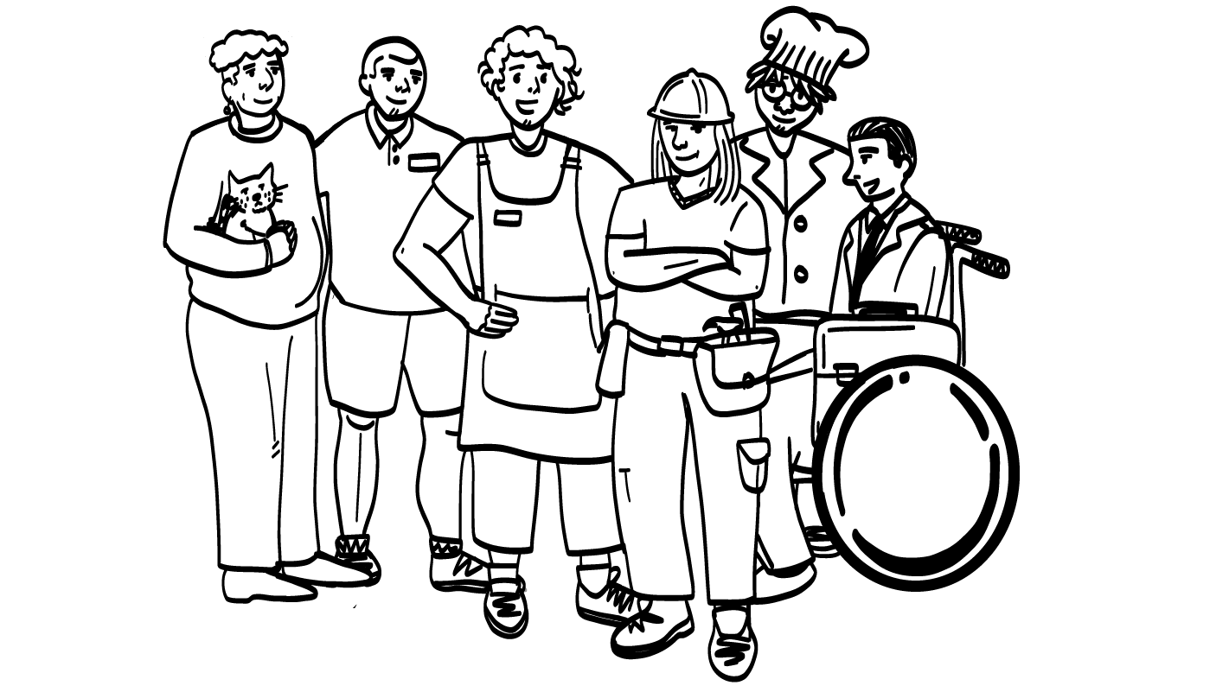
© 2026 SAFE Disability Services Program
Notes:
Say: Now I want you to think about your dream job. Does anyone want to share what job they would like to have some day?
Give students enough time to process the question and make their decisions.
After a few students have shared, say: Thanks for sharing your dream jobs! Who chooses what your dream job is?
Give students enough time to process the question and make their decisions.
Say: You get to choose what your dream job is! Telling other people where you want to work is part of self-advocacy.

Slide 8
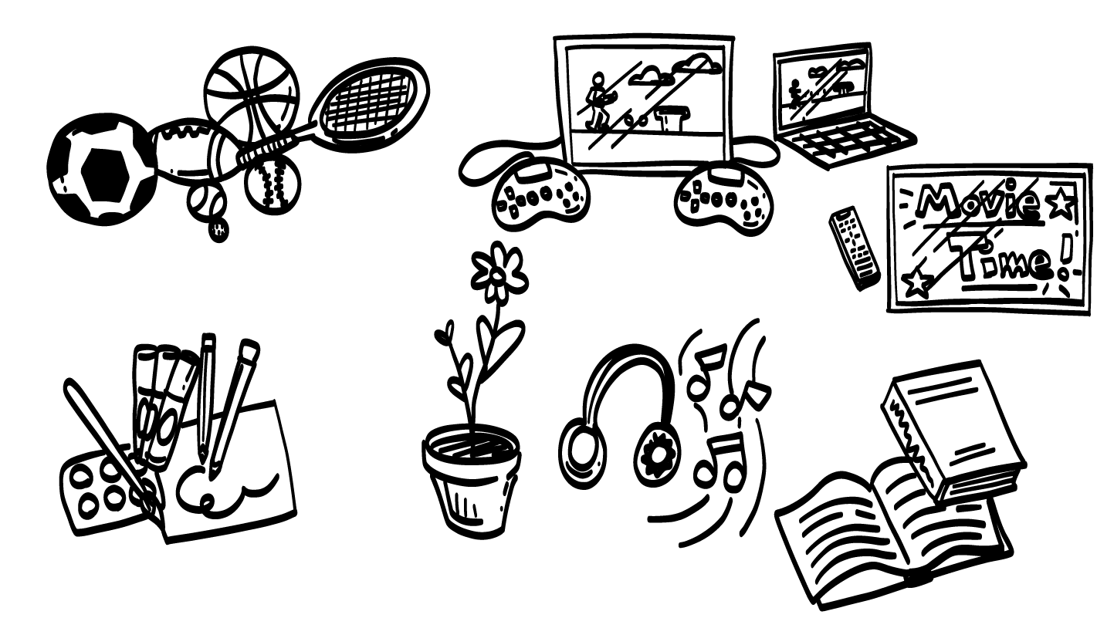
© 2026 SAFE Disability Services Program
Notes:
Say: All right, now I want to hear what you like to do for fun. Raise your hand if you like to draw.
Give students enough time to process the question and make their decisions.
Say: Raise your hand if you like to play videogames.
Give students enough time to process the question and make their decisions.
Say: Raise your hand if you like to watch videos on YouTube.
Give students enough time to process the question and make their decisions.
Say: What else do you like to do for fun? Does anyone want to share?
Give students enough time to process the question and make their decisions.
Say: Choosing what you do for fun is also part of self-advocacy.

Slide 9
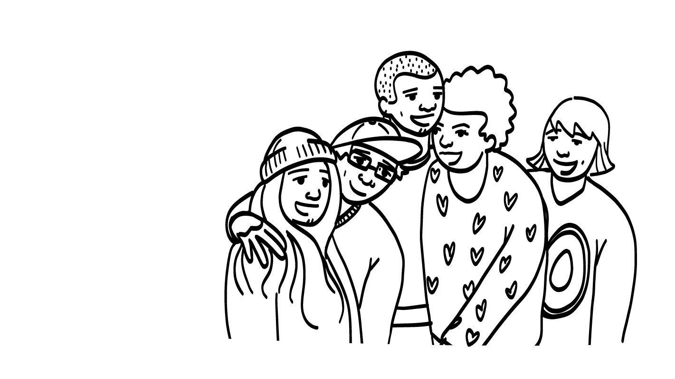
© 2026 SAFE Disability Services Program
Notes:
Say: All right, let’s do one more. We are talking about self-advocacy because it is super important to be able to tell other people how you feel, what you want, and what you need. Self-advocacy is also really important in your relationships, and all year we are going to practice using self-advocacy to have healthier relationships.
Let’s do an example about relationships. Who chooses who your friends are? Who chooses who you hang out with?
Give students enough time to process the question and make their decisions.
Say: Yes! You get to choose who to hang out with. Making decisions about your relationships is also part of self-advocacy.

Slide 10
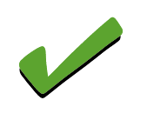
Making choices
Self-advocacy
Brain break
I Statements practice
Self-advocacy video
© 2026 SAFE Disability Services Program
Notes:
Say: Thanks for sharing all of the choices you make! Now we are going to talk more about self-advocacy.

Slide 11
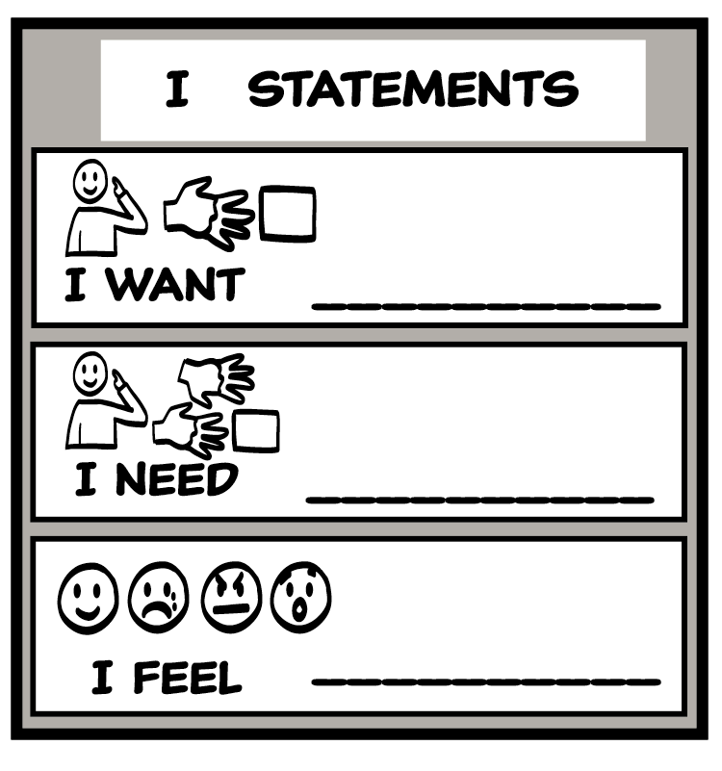
© 2026 SAFE Disability Services Program
Notes:
Say: You all are making lots of choices every day and that’s good practice for deciding what you want. It’s also important to be able to tell other people what you want. For example, what you want to wear, eat, do for a job, and what you want do for fun! It’s also important to be able to tell the people you are in relationships with, like your friends or your family, what you want and need. You are going to get to practice self-advocacy (asking for what you want and need) a little later today.
For now, let’s add “I want” and “I need” to our I Statements Tool.

Slide 12

© 2026 SAFE Disability Services Program
Notes:
Say: Remember, throughout our classes, we are going to be adding new tools to our Healthy Relationships Toolbox. We are going to use a big class toolbox, and each of you will also have your own smaller toolbox. As you learn about new tools, you’ll get a copy of the tool to glue into your toolbox.
Our first tool is the I Statements Tool. Remember, you can use I Statements to tell people how you feel, what you want, and what you need. Let’s start with our large class toolbox. Can I get a volunteer to add the first tool to our toolbox?
Have the volunteer Velcro the Class I Statements Tool manipulative onto the Class Healthy Relationship Toolbox. Next, give each student a glue stick, a copy of the Student Healthy Relationship Toolbox, and a copy of the Student I Statement Tool. Give students a few minutes to glue their tools into their toolboxes. Over the next several weeks, students will be adding tools to their toolboxes, so be sure to ask students to hold onto their toolboxes for the next class.

Slide 13
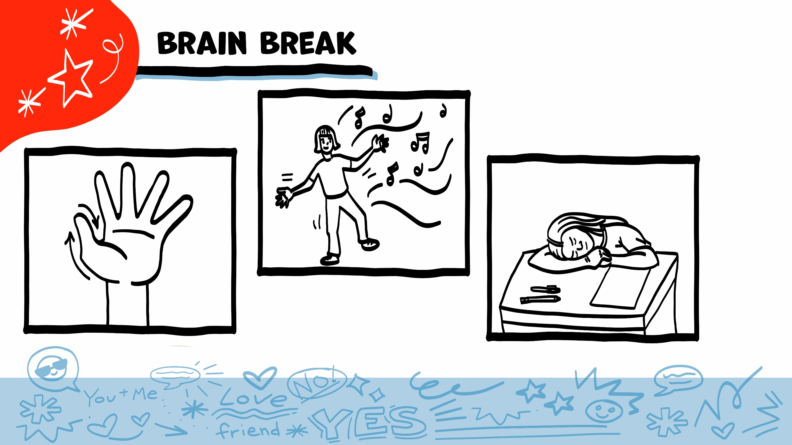
© 2026 SAFE Disability Services Program
Notes:
Say: That was a lot of information, and you all are doing an amazing job! Every week in class we will take a brain break in the middle. This is a chance to move a little and take a break from thinking!
Below are three ideas to give students a quick opportunity for a brain break. You are also welcome to come up with your own ideas for brain breaks that work best for your class.
Five finger breathing
For this exercise, have all students place their hand in front of their chest with their five fingers spread out. Next, use the pointer finger of the other hand to trace up and down each of the five fingers, beginning with the thumb. As students trace up a finger, they will breathe in. As they trace down a finger, they will breathe out. When students breathe out on the pinky finger, you can tell them to shake out their hands and arms. As the school year goes on, you can ask students to lead this exercise for their peers.
If this exercise is physically inaccessible for your class, you can also model the hand tracing for students while they breathe in and out.
Stretch break
Lead students through a series of basic stretches. These can be completed in a chair, or while standing up, depending on the accommodation needs of your class. Some ideas include reaching toward the ceiling, stretching one arm at a time across the chest, reaching toward toes, turning head from side to side, etc. Ask students to hold a pose while you count to ten. As the school year goes on, you can ask students to lead stretches for their peers.
Dance party
If your class likes to dance, you can put on a short song for them to dance to. This is especially effective if you are able to find a song that relates to the theme for that week’s class.

Slide 14
Making choices
Self-advocacy
Brain break
I Statements practice
Self-advocacy video
© 2026 SAFE Disability Services Program
Notes:
Say: Let’s practice using the I Statements Tool.

Slide 15
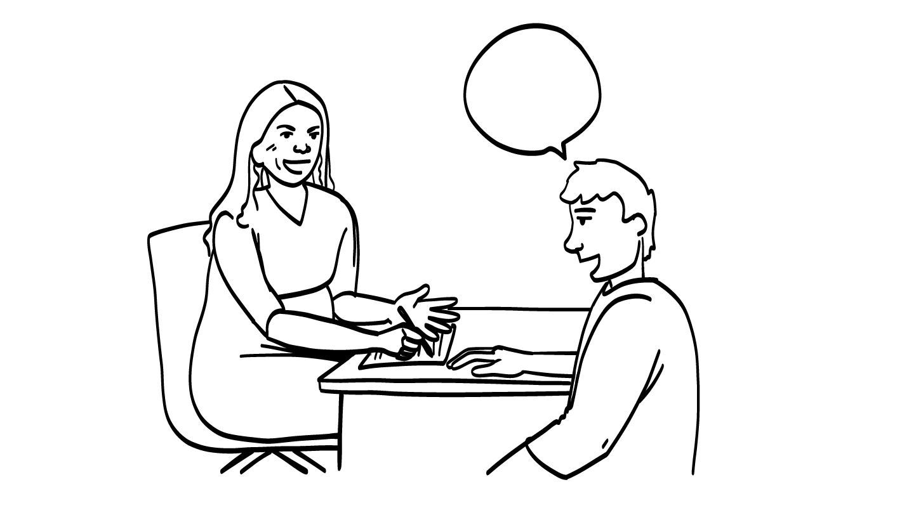
You want to talk to your teacher about starting a new club.
© 2026 SAFE Disability Services Program
Notes:
Say: We are going to do some role plays to practice using the “I want” and “I need” tools. A role play is something that is pretend. On each slide, you will read a story. You are going to imagine that you are in the story. You will get to decide how you could use an “I want” or “I need” statement to help with the story. Can I get a volunteer to go first?
For each scenario, ask the volunteer to read the story out loud. Next, ask them what “I want” or “I need” statement they could use to get help in that story. Sample I Statements are included on each slide for your reference.
Sample I Statements:
I want to start a club at school.
I need an extracurricular activity that is fun for me.
I need your help starting this club.

Slide 16
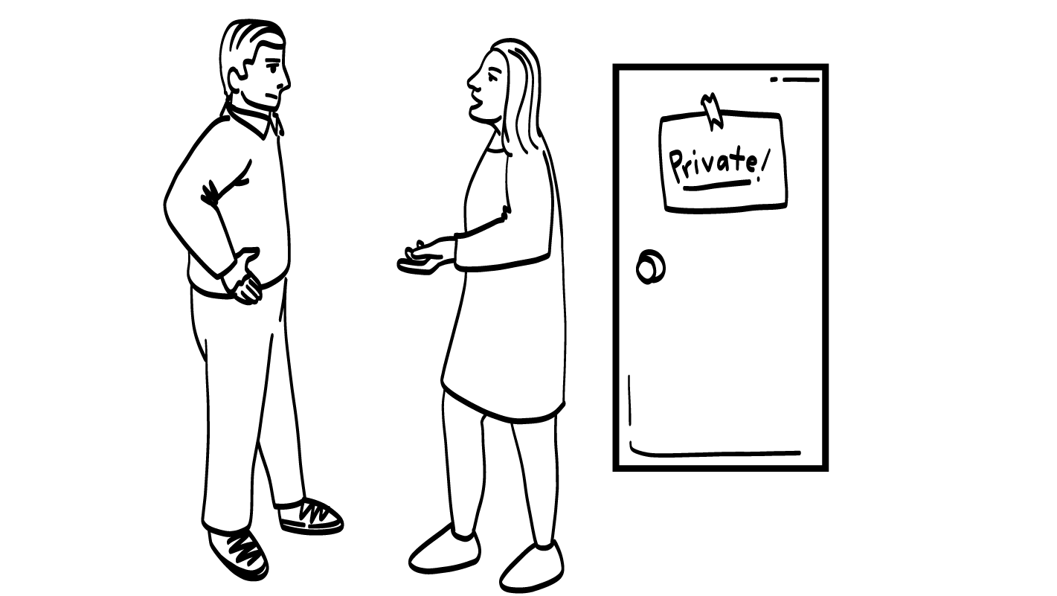
You want to talk to your parent about
having time alone in your room.
© 2026 SAFE Disability Services Program
Notes:
Say: Great job! Can I get a volunteer to do the next story?
For each scenario, ask the volunteer to read the story out loud. Next, ask them what “I want” or “I need” statement they could use to get help in that story. Sample I Statements are included on each slide for your reference.
Sample I Statements:
I need privacy in my room.
I want you to respect my privacy.
I need time every day alone in my room.

Slide 17
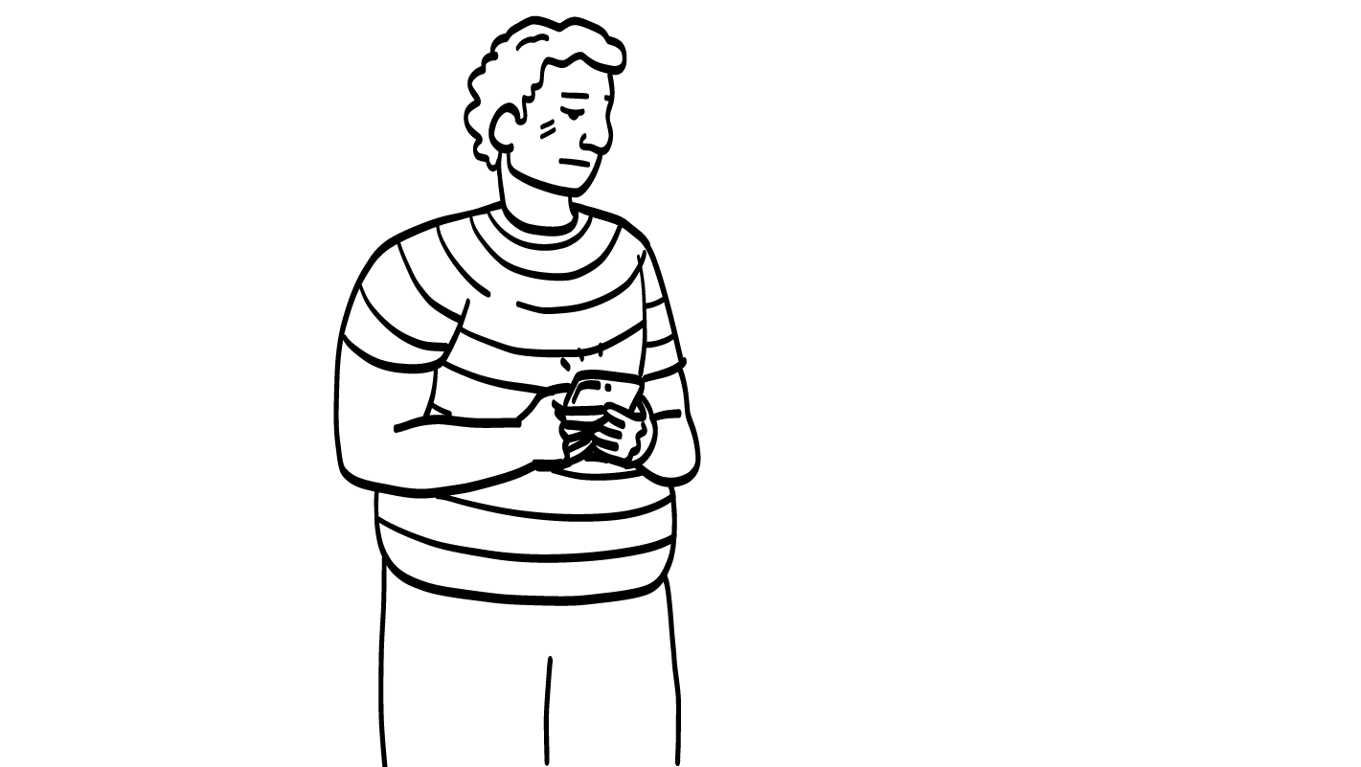
Your classmate looks at your text messages when you are not in the room.
© 2026 SAFE Disability Services Program
Notes:
Say: Great job! Can I get a volunteer to do the next story?
For each scenario, ask the volunteer to read the story out loud. Next, ask them what “I want” or “I need” statement they could use to get help in that story. Sample I Statements are included on each slide for your reference.
Sample I Statements:
I need you to ask before looking at my phone.
I want you to trust me.
I need you to stop reading my text messages.

Slide 18
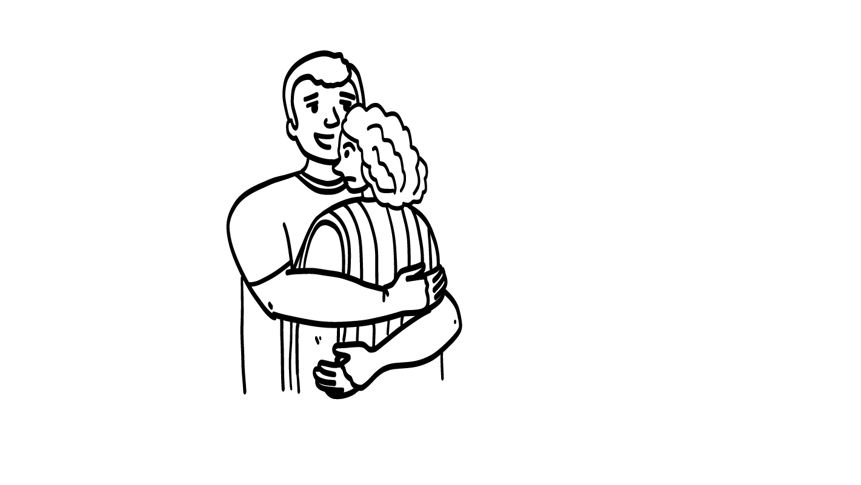
Someone you don’t know hugs you.
© 2026 SAFE Disability Services Program
Notes:
Say: Great job! Can I get a volunteer to do the next story?
For each scenario, ask the volunteer to read the story out loud. Next, ask them what “I want” or “I need” statement they could use to get help in that story. Sample I Statements are included on each slide for your reference.
Sample I Statements:
I want you to stop.
I need space.
I need help.

Slide 19
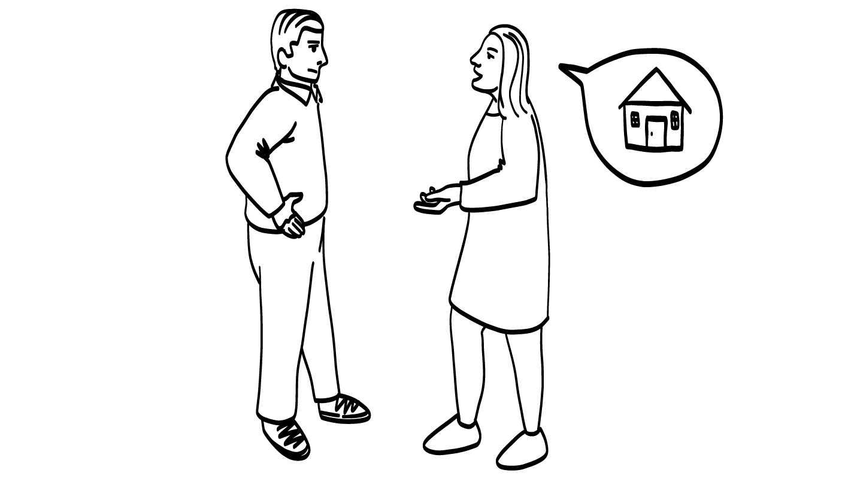
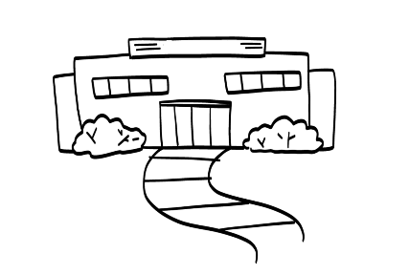
You want to talk to your parent about getting a job.
© 2026 SAFE Disability Services Program
Notes:
Say: Great job! Can I get a volunteer to do the next story?
For each scenario, ask the volunteer to read the story out loud. Next, ask them what “I want” or “I need” statement they could use to get help in that story. Sample I Statements are included on each slide for your reference.
Sample I Statements:
I want a job.
I want to earn some money.
I need your support in finding a job.

Slide 20
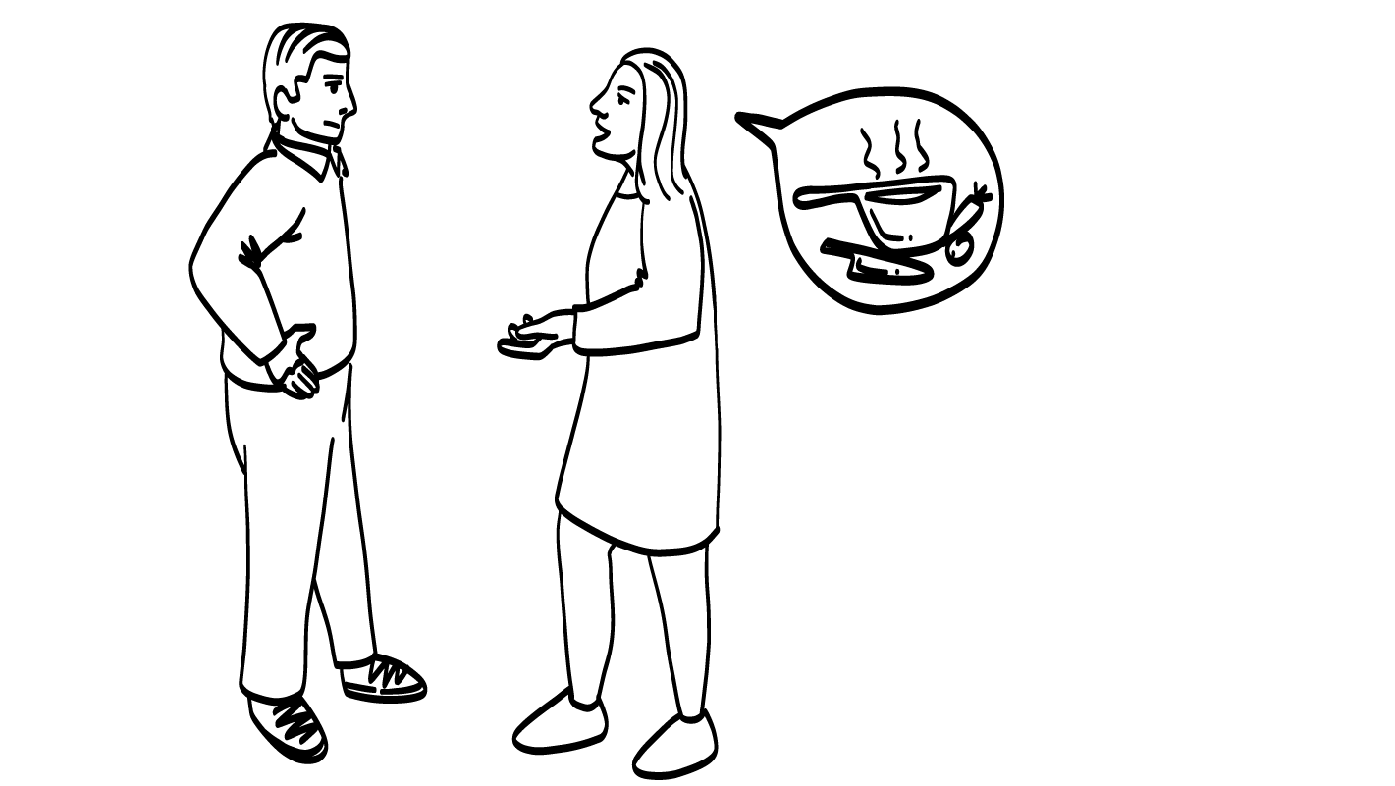
You want to ask your parent
to let you cook at home.
© 2026 SAFE Disability Services Program
Notes:
Say: Great job! Can I get a volunteer to do the next story?
For each scenario, ask the volunteer to read the story out loud. Next, ask them what “I want” or “I need” statement they could use to get help in that story. Sample I Statements are included on each slide for your reference.
Sample I Statements:
I want to learn how to cook.
I need to be able to make my own meals.
I want your help learning to cook.

Slide 21
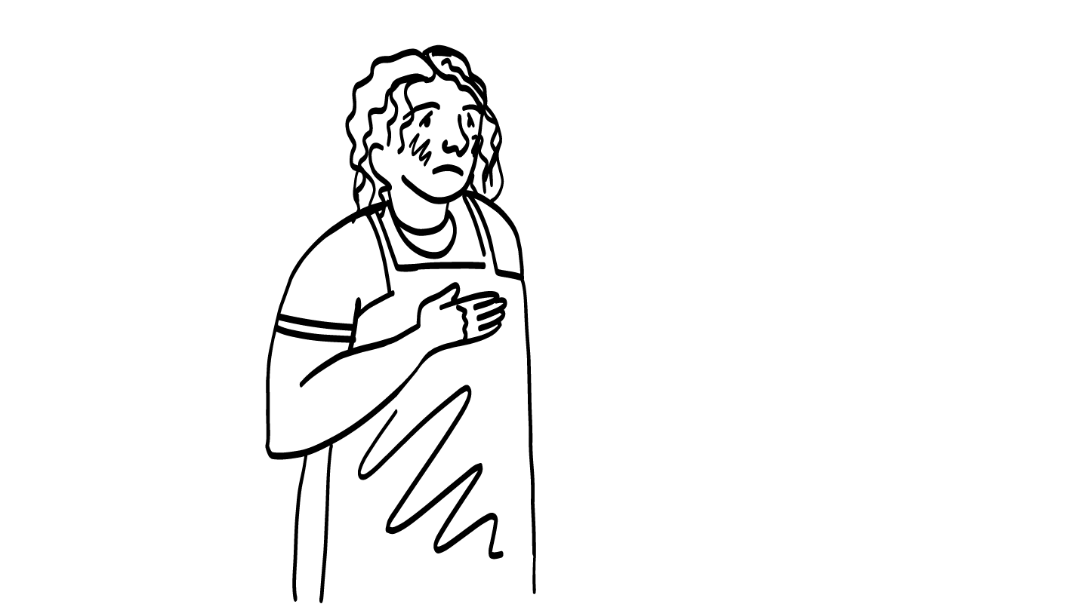
You need to talk to your
teacher because you feel sick.
© 2026 SAFE Disability Services Program
Notes:
Say: Great job! Can I get a volunteer to do the next story?
For each scenario, ask the volunteer to read the story out loud. Next, ask them what “I want” or “I need” statement they could use to get help in that story. Sample I Statements are included on each slide for your reference.
Sample I Statements:
I need to talk to you please.
I need to go home because I am sick.
I want to go home because I am sick.

Slide 22
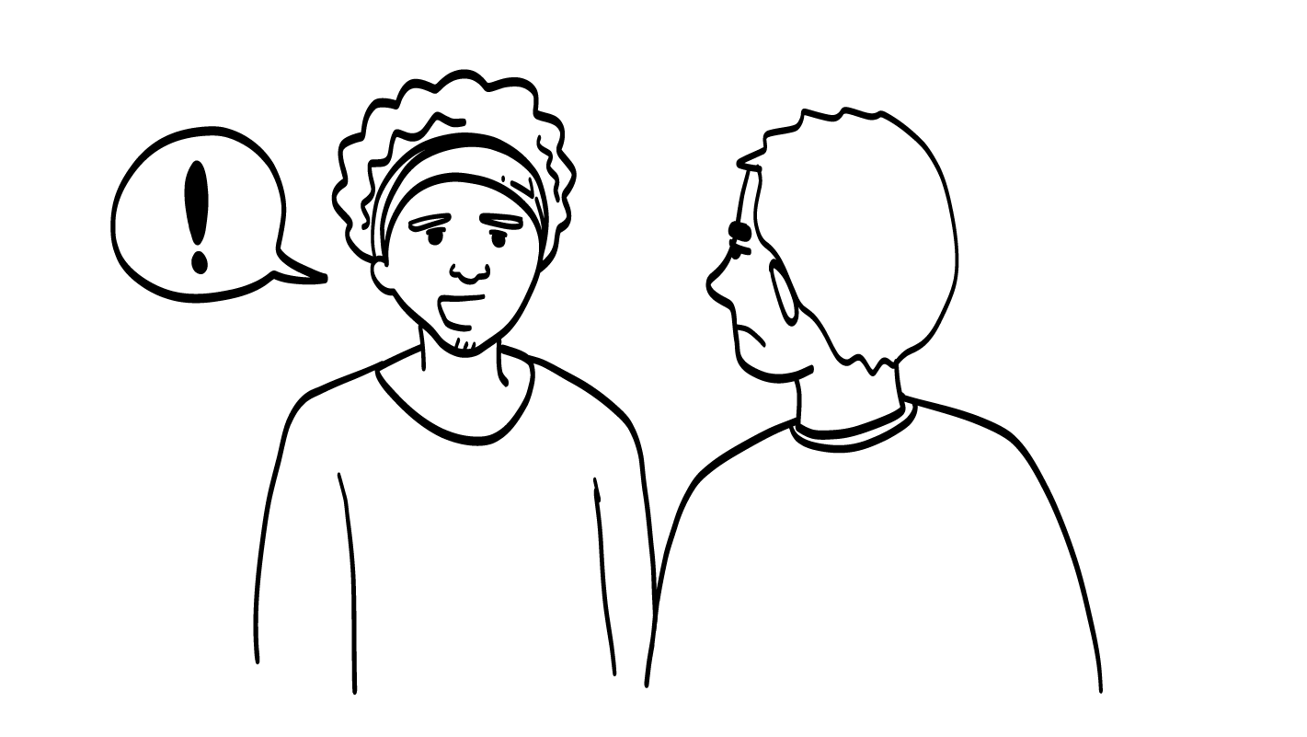
Your friend lies to you.
© 2026 SAFE Disability Services Program
Notes:
Say: Great job! Can I get a volunteer to do the next story?
For each scenario, ask the volunteer to read the story out loud. Next, ask them what “I want” or “I need” statement they could use to get help in that story. Sample I Statements are included on each slide for your reference.
Sample I Statements:
I need you to know that you hurt my feelings.
I want you to be honest with me.
I need you to tell me the truth.

Slide 23
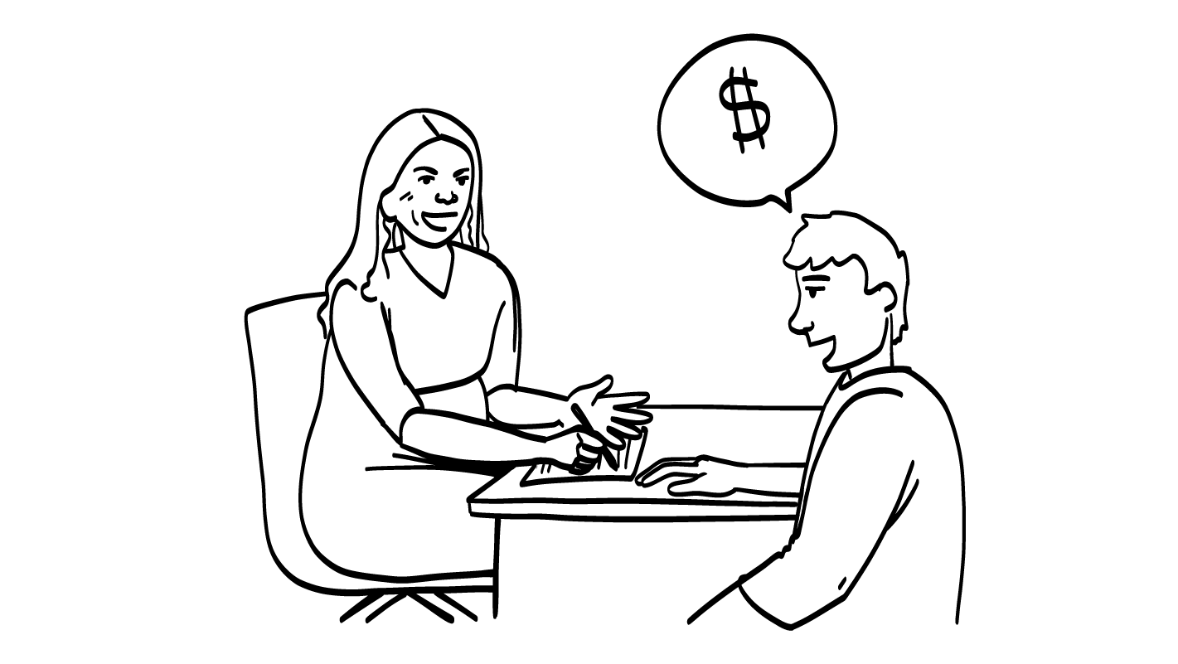
You want to talk to your band director
about trying a new instrument.
© 2026 SAFE Disability Services Program
Notes:
Say: Great job! Can I get a volunteer to do the next story?
For each scenario, ask the volunteer to read the story out loud. Next, ask them what “I want” or “I need” statement they could use to get help in that story. Sample I Statements are included on each slide for your reference.
Sample I Statements:
I want to talk to you please.
I want to try a new instrument.
I need to try something new.

Slide 24
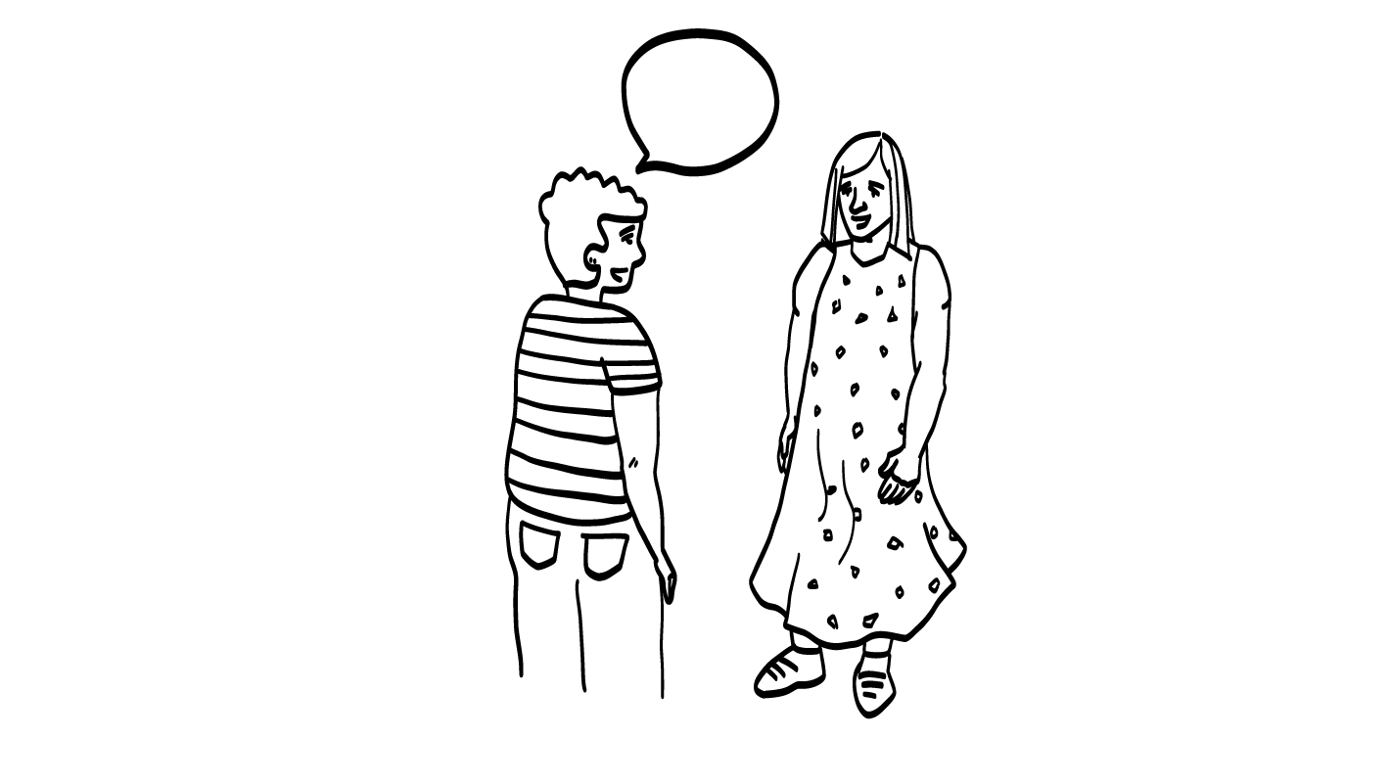
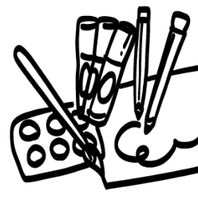
You want to talk to your
friend about getting a
ride to your art class.
© 2026 SAFE Disability Services Program
Notes:
Say: Great job! Can I get a volunteer to do the next story?
For each scenario, ask the volunteer to read the story out loud. Next, ask them what “I want” or “I need” statement they could use to get help in that story. Sample I Statements are included on each slide for your reference.
Sample I Statements:
I need help getting to my art class.
I want to talk to you about my art class.
I need a ride to my art class.

Slide 25
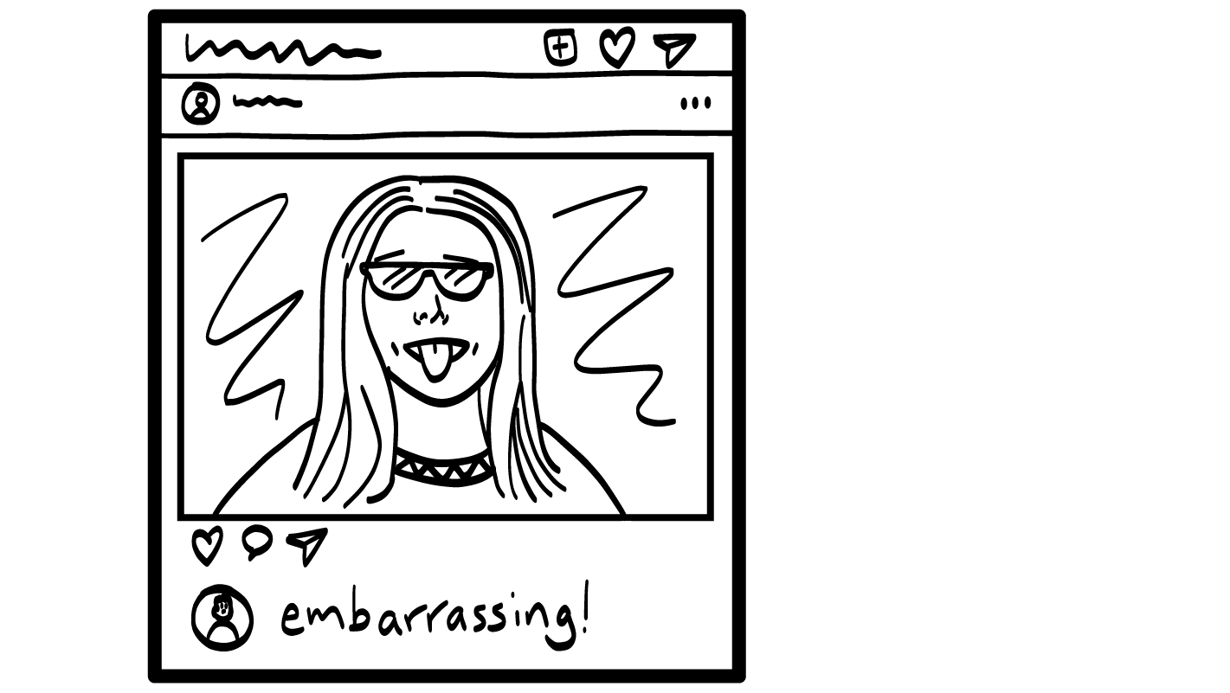
Your friend posts a picture of you online that you don’t like.
© 2026 SAFE Disability Services Program
Notes:
Say: Great job! Can I get a volunteer to do the next story?
For each scenario, ask the volunteer to read the story out loud. Next, ask them what “I want” or “I need” statement they could use to get help in that story. Sample I Statements are included on each slide for your reference.
Sample I Statements:
I need to talk to you.
I want you to take that picture down.
I need you to ask before taking my picture and putting it on social media.

Slide 26
Your friend shares your private story.
© 2026 SAFE Disability Services Program
Notes:
Say: Great job! Can I get a volunteer to do the next story?
For each scenario, ask the volunteer to read the story out loud. Next, ask them what “I want” or “I need” statement they could use to get help in that story. Sample I Statements are included on each slide for your reference.
Sample I Statements:
I want to talk to you.
I need you to keep my stories private.
I want you to stop telling people my story.

Slide 27
Making choices
Self-advocacy
Brain break
I Statements practice
Self-advocacy video
© 2026 SAFE Disability Services Program
Notes:
Say: Awesome work practicing your I statements!

Slide 28
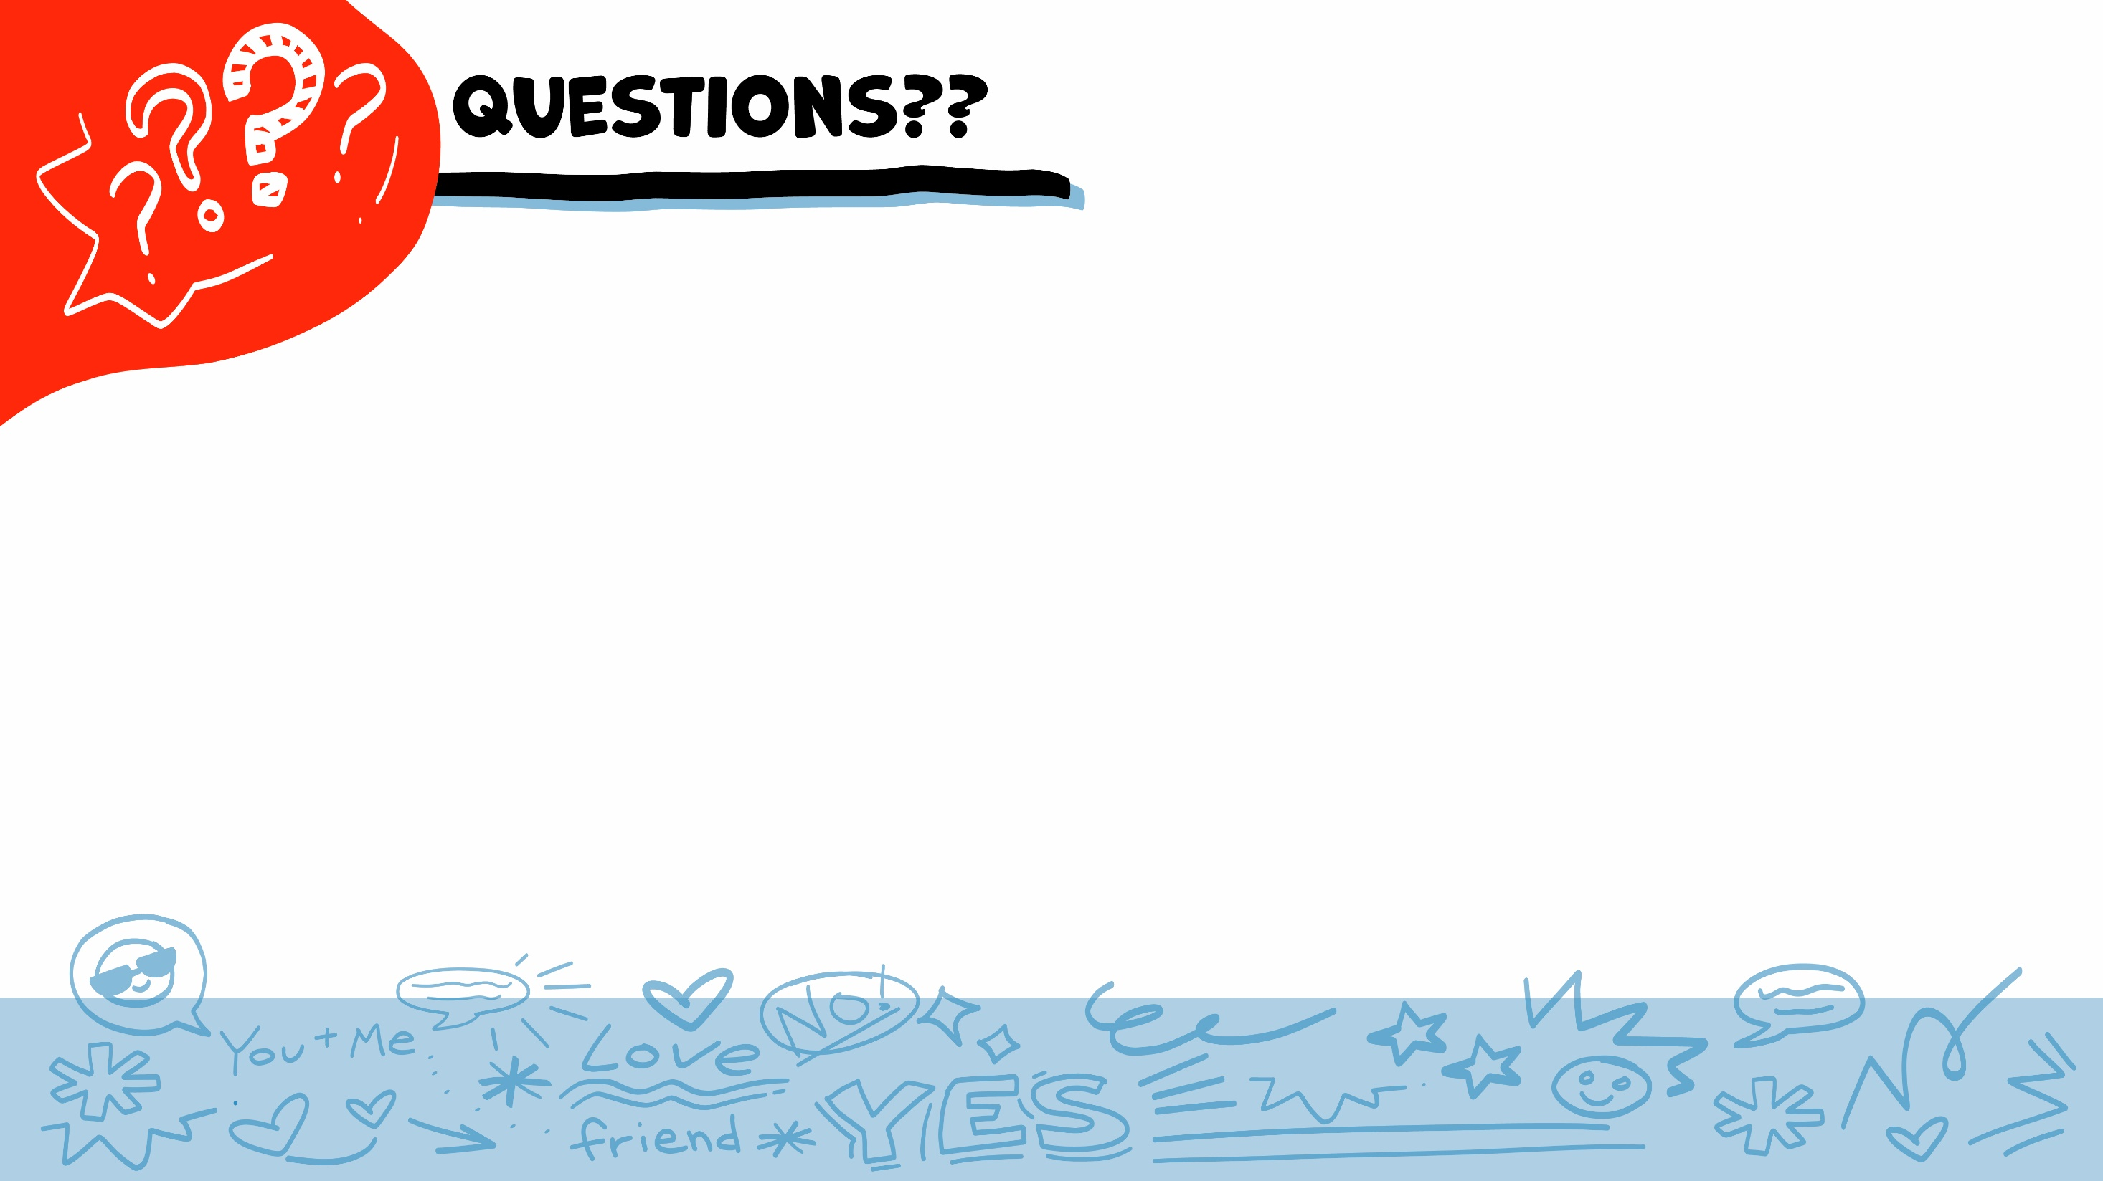
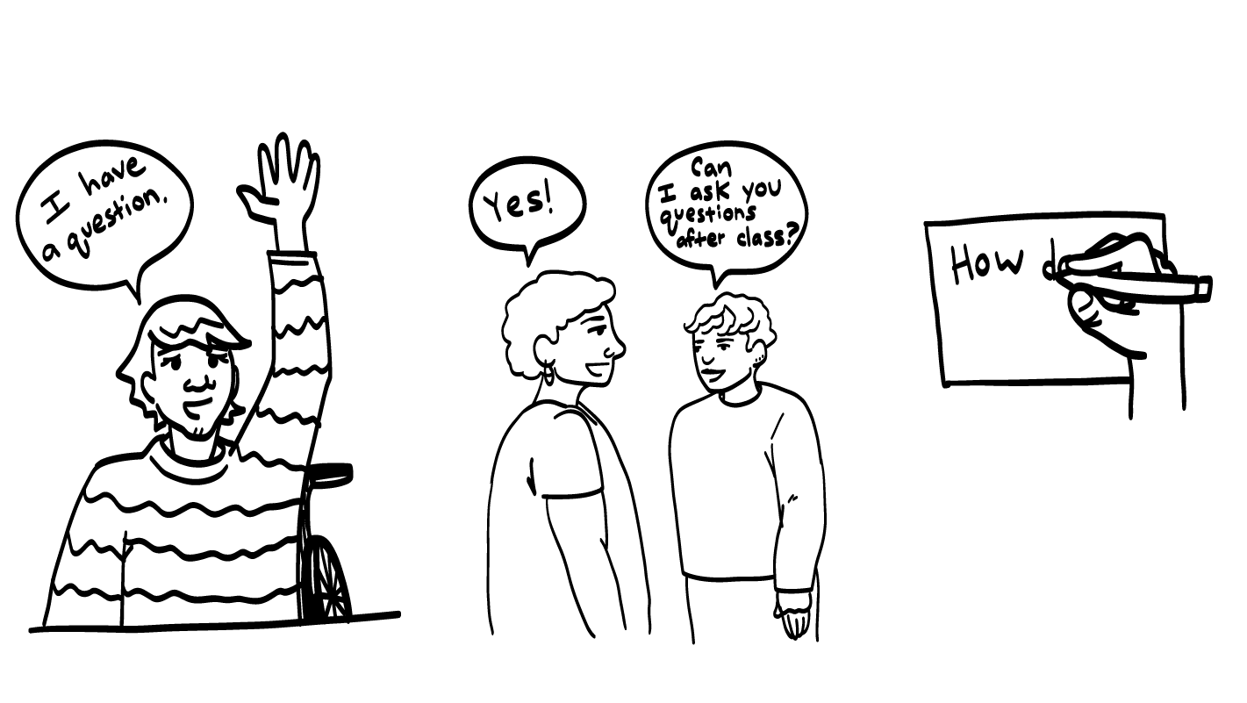
© 2026 SAFE Disability Services Program
Notes:
Say: Does anyone have any questions about today’s class? Remember, if you don’t want to ask your question out loud, you can write it on a notecard and leave it on your desk. You can also ask someone you trust to help you write your question on the notecard. I will pick up the notecards, and will answer the questions the next time we meet. When I answer a question, I won’t tell anyone who asked it.

Slide 29
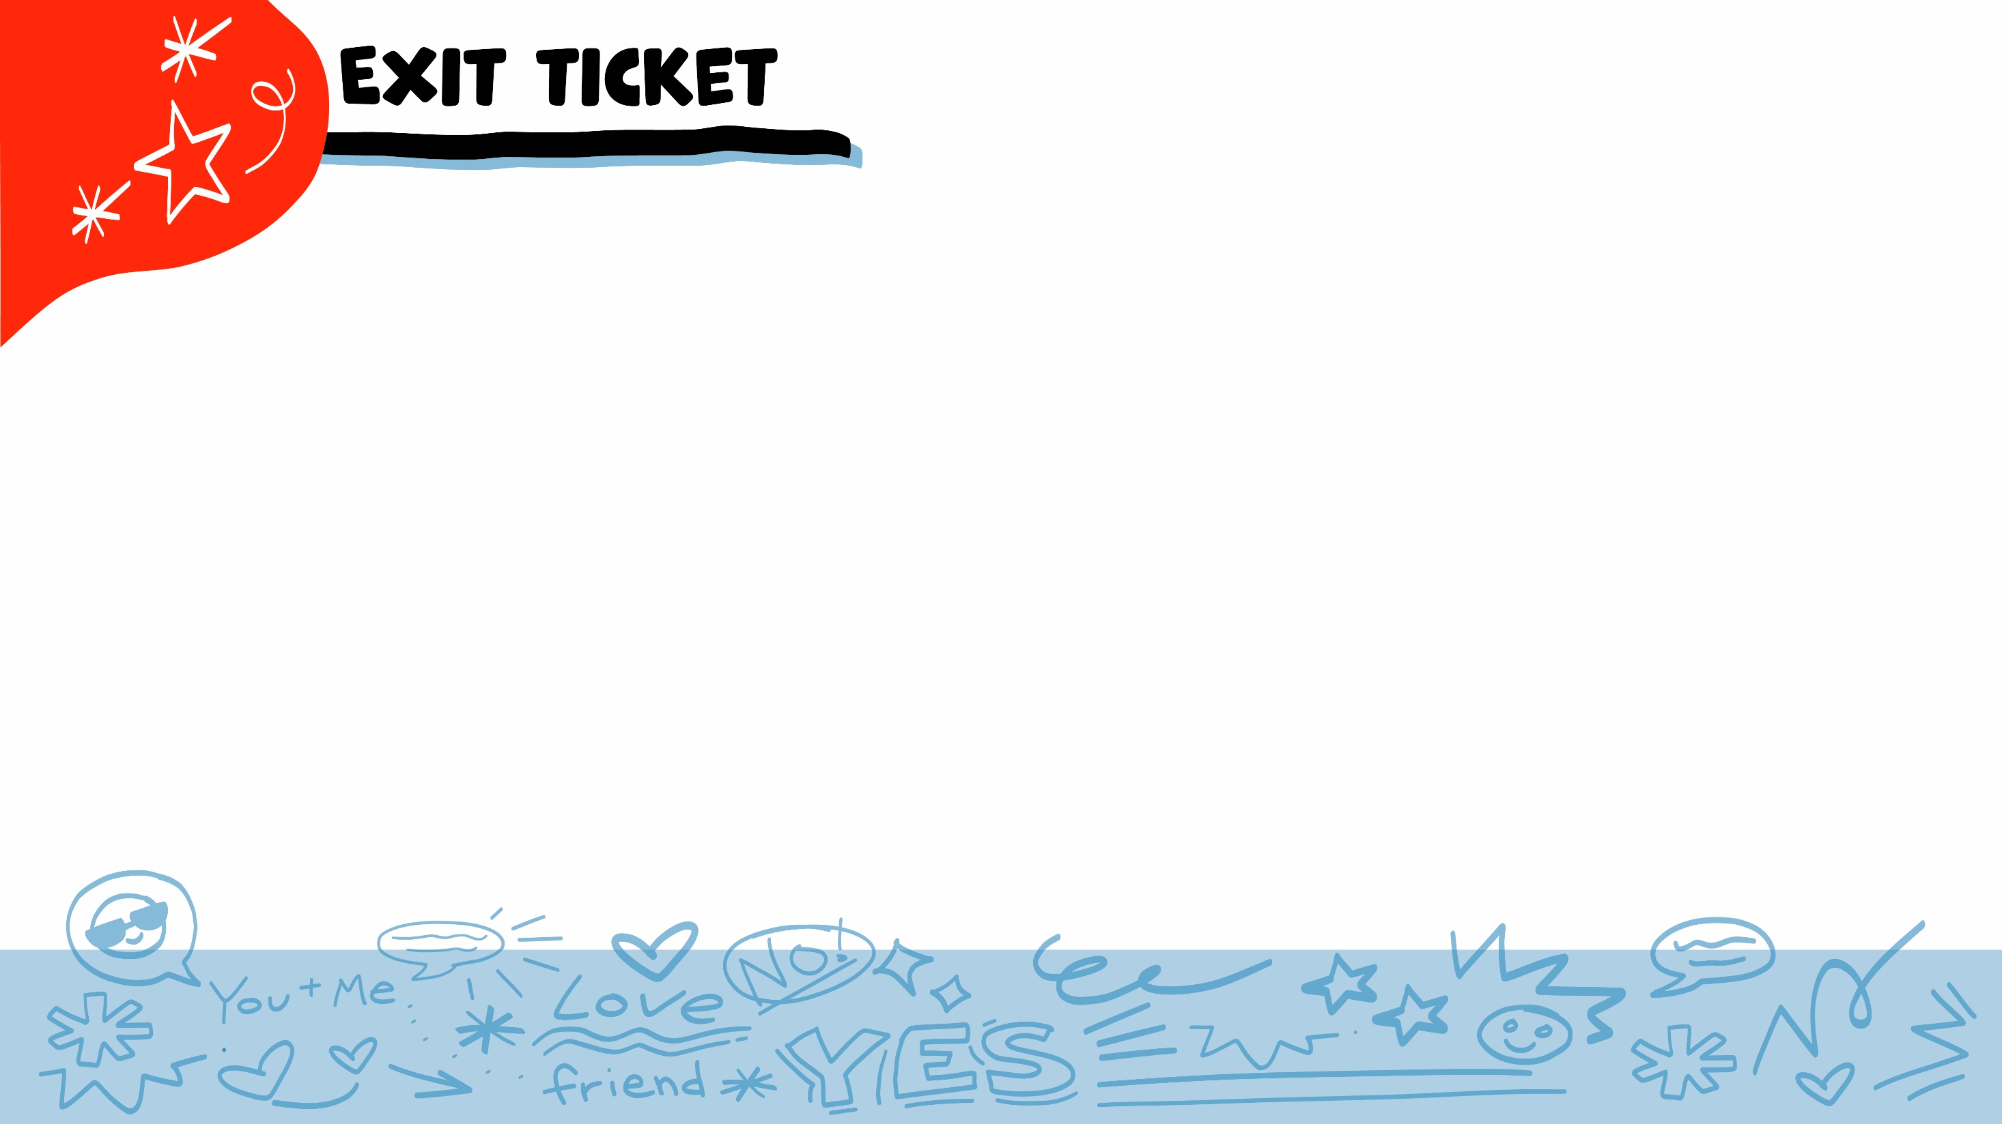


Do self-advocates speak up for themselves?
YES
NO
© 2026 SAFE Disability Services Program
Notes:
Say: Do self-advocates speak up for themselves? Hold up a thumbs up for yes, and a thumbs down for no.
Give students enough time to process the question and make their decisions.
Say: Yes! Remember, people can’t read your mind. It’s super important that you use your words, signs, and pictures to tell other people what you want and need. This is part of having a healthy relationship with friends, family, dating partners, and more!

Slide 30
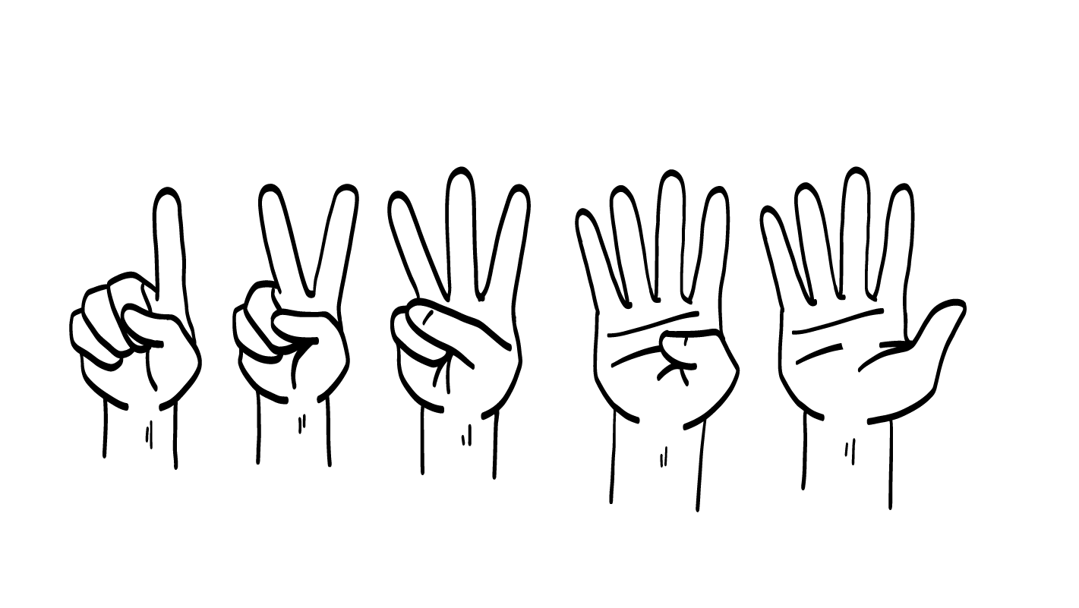
What Healthy Relationship Toolbox Tool did we add today?
You Statements
I Statements
Aggressive Language
1
2
3
© 2026 SAFE Disability Services Program
Notes:
Say: What Healthy Relationship Toolbox Tool did we add today? Hold up one finger for “You Statements,” two fingers for “I Statements,” and three fingers for “Aggressive Language.”
Give students enough time to process the question and make their decisions.
Say: We added I Statements to the Healthy Relationship Toolbox today. Remember, you can use I Statements to tell other people how you feel, what you want, and what you need. These statements start with “I feel,” “I want,” and “I need.”

Slide 31
Why is self-advocacy important?
© 2026 SAFE Disability Services Program
Notes:
Say: Why is self-advocacy important?
Give students enough time to process the question and make their decisions. Go around the room and ask each student to share why they think self-advocacy is important.

Slide 32
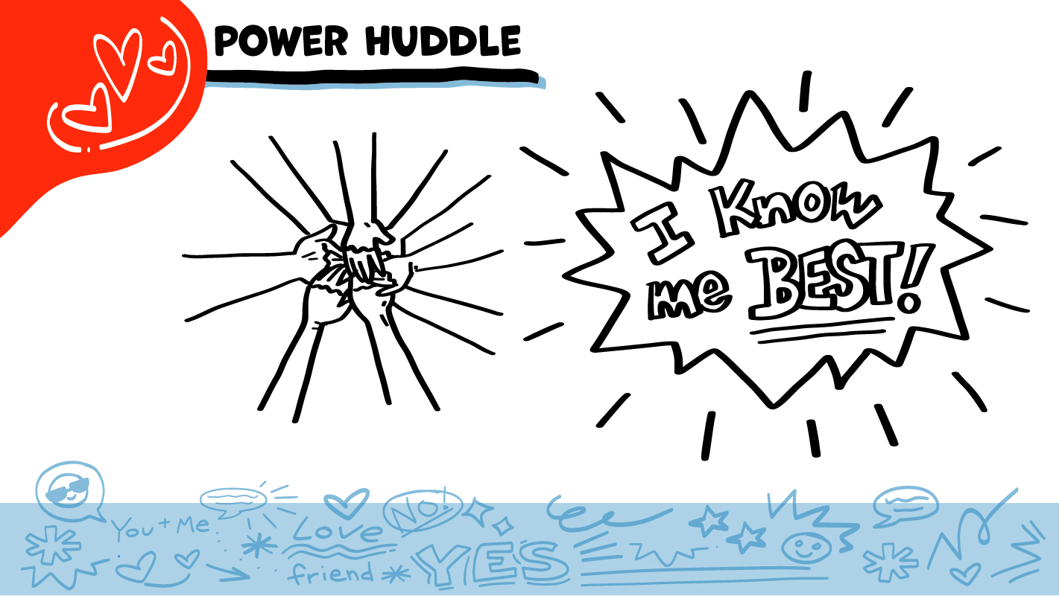
© 2026 SAFE Disability Services Program
Notes:
Say: Does anyone remember what our power statement is? Our power statement is “I know me best.” This means that each of you knows yourself better than anyone else does. You know what you want and need. Today you learned all about self-advocacy and how to tell other people what you want and need. Let’s gather together and on the count of three, say our power statement.
Have each interested student put one hand in the middle of the circle. Ask for a student volunteer to count to three. After three, all participants say the power statement while lifting their hands into the air. Students can also stand in the circle without touching hands if they prefer.

Slide 33

This work is supported by the Texas Council for Developmental Disabilities through a grant from the U.S. Administration for Community Living (ACL), Department of Health and Human Services (HHS), Washington, D.C. 20201 with a 100% federal funding award totaling $6,161,072. Council efforts are those of the grantee and do not necessarily represent the official views of nor are endorsed by ACL, HHS, or the U.S. government.
© 2026 SAFE Disability Services Program
Notes:
SAFE would like to thank the Texas Council for Developmental Disabilities for the funding for this curriculum.

Slide 34

This curriculum is offered online at no cost. You are free to use the resources in the original format for educational purposes only. Please reference The SAFE Alliance appropriately (citations at bottom of page).
We ask that you do not alter curriculum images/art, slides, or lesson plan materials. You may not use My Rights My Life (18+ or High School) curriculum for commercial purposes (i.e., selling workshops you facilitate based on MRML curriculum; and/or creating links/websites to re-distribute any materials associated SAFE’s My Rights My Life).
This resource, My Rights My Life: A curriculum for healthier relationships for high school students (grades 9-12) is based on the original My Rights My Life: A curriculum for safer relationships (age 18+) written by Megan Westmore, Heidi Lersch, and edited by Schwartz, M. (2022). Selling materials from MRML is a copyright violation.
Burleson, Anna Belle & Benitez, Sophie (2026) provided light modification and abbreviation to the original
curriculum (Westmore & Lersch, 2022) to offer an age appropriate resource for High School Students (grades 9-
12). Schwartz, M. (Ed.). The SAFE Alliance, Austin, Texas.
Westmore, M. & Lersch, H. (2022). My rights my life: A curriculum for safer relationships.
Schwartz, M. (Ed.). The SAFE Alliance: Austin, TX.
© 2026 SAFE Disability Services Program

