Slide 1
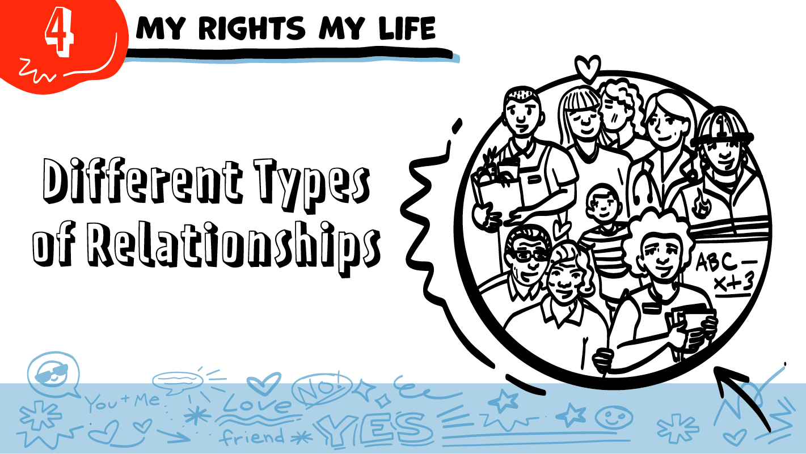
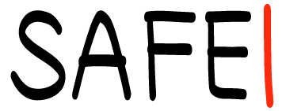
for High School Students
© 2026 SAFE Disability Services Program
Notes:
Repetition is beneficial for learning. Take time to review the last My Rights My Life class you taught prior to beginning this session. You can also answer any private questions students submitted on notecards during your previous class session.
Say: Today in class we are going to talk about different types of relationships. We’ll talk about relationships like friends, family, coworkers, and teachers.

Slide 2
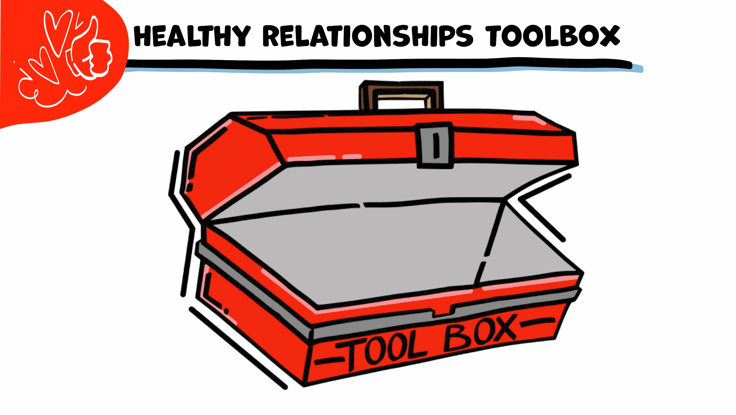
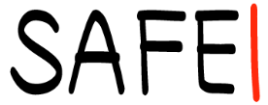
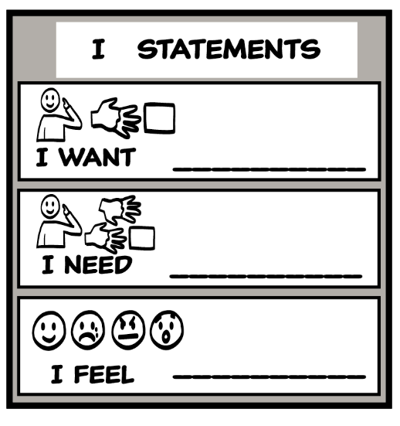
© 2026 SAFE Disability Services Program
Notes:
Say: Let’s start by reviewing our Healthy Relationships Toolbox. Does anyone remember what our first Healthy Relationships Toolbox Tool is?
Give enough time for students to process the question and make their decisions
Say: Our first tool is the I Statements Tool. Remember, I statements start with the word “I” and let people know how you feel, what you want, and what you need. So, if you wanted to ask your teacher for help getting a job, what could you say?
Give students enough time to process the question and make their decisions. A few sample I statements are included below for your reference.
I want to get a job. Can you help?
I need help getting a job.
I feel like a job would be good for me.

Slide 3
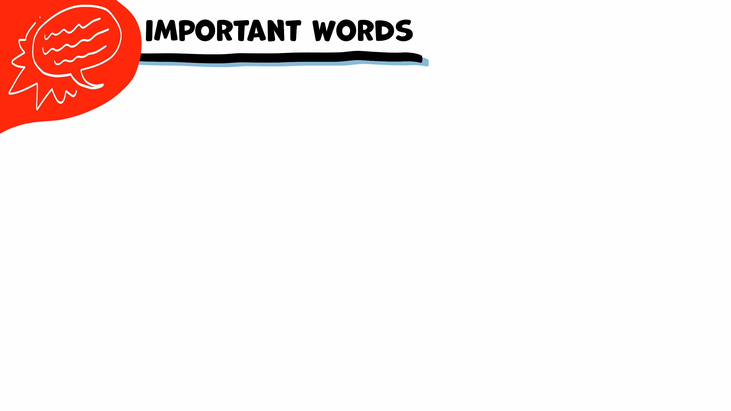
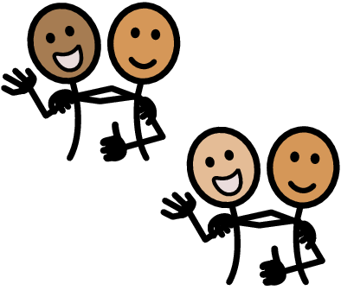
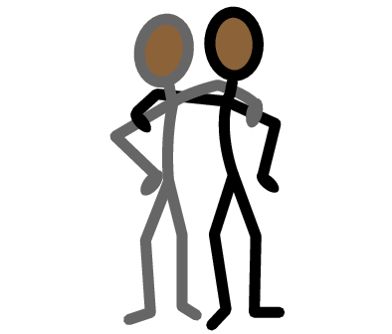
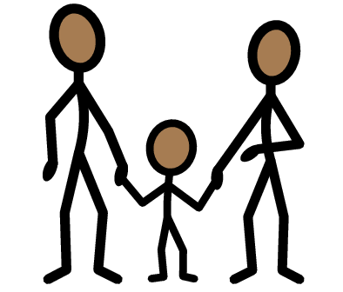
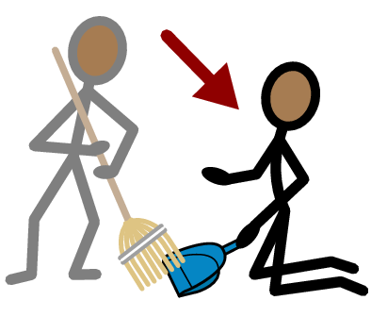
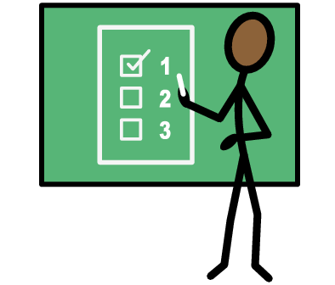


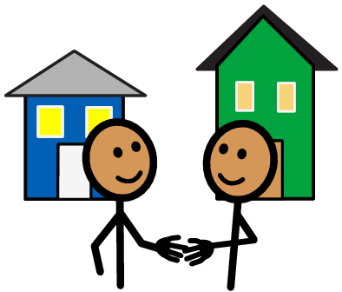
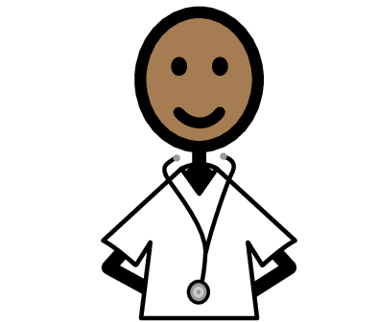
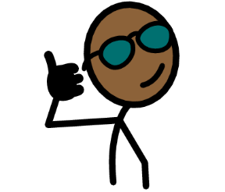
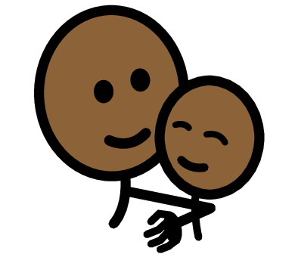
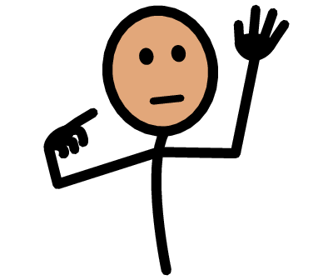

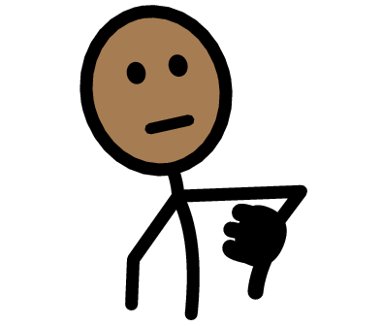
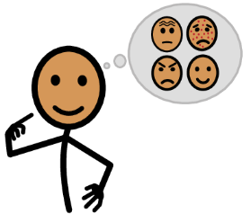



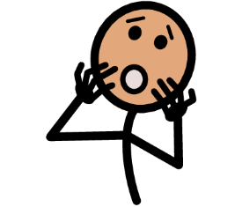
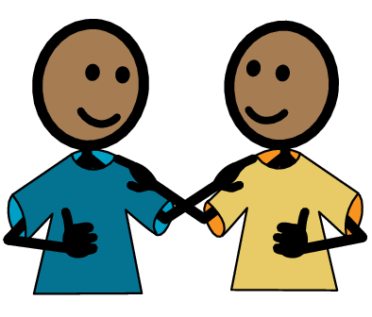
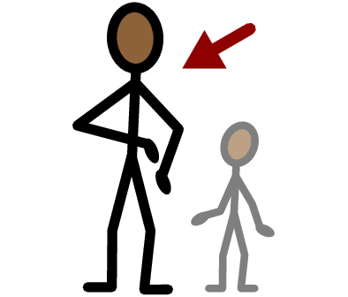
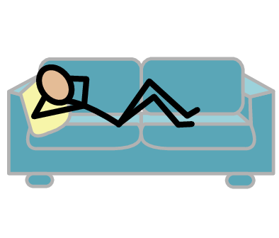
Relationship
Friend
Family
Coworker
Teacher
Yes
No
Neighbor
Doctor
Boundaries
Safe
I need help
I have a question
Trust
Adult
Take a break
I feel
Happy
Sad
Mad
Scared
Copyright © 2021 SymbolStix, LLC. All rights reserved. Used with Permission.
Notes:
You can print this slide separately so each student can use the Important Words Sheet as a communication board throughout class. Review the words using the suggested definitions below. To enhance understanding, you can ask students to come up with their own definitions for vocabulary words or to provide a sentence or scenario using the new word.
Relationship: Two or more people who know each other; some types of relationships include friends, family, or classmates
Friend: Someone you like to spend time with
Family: The people you are related to, such as mom, dad, brother, or sister
Coworker: Someone who works at the same job as you
Teacher: A person who leads a class
Doctor: A person who helps your body stay healthy
Neighbor: A person who lives close to you
Safe: The feeling that you are not going to get hurt and that your feelings are okay
Boundaries: Things that you are okay or not okay with

Slide 4
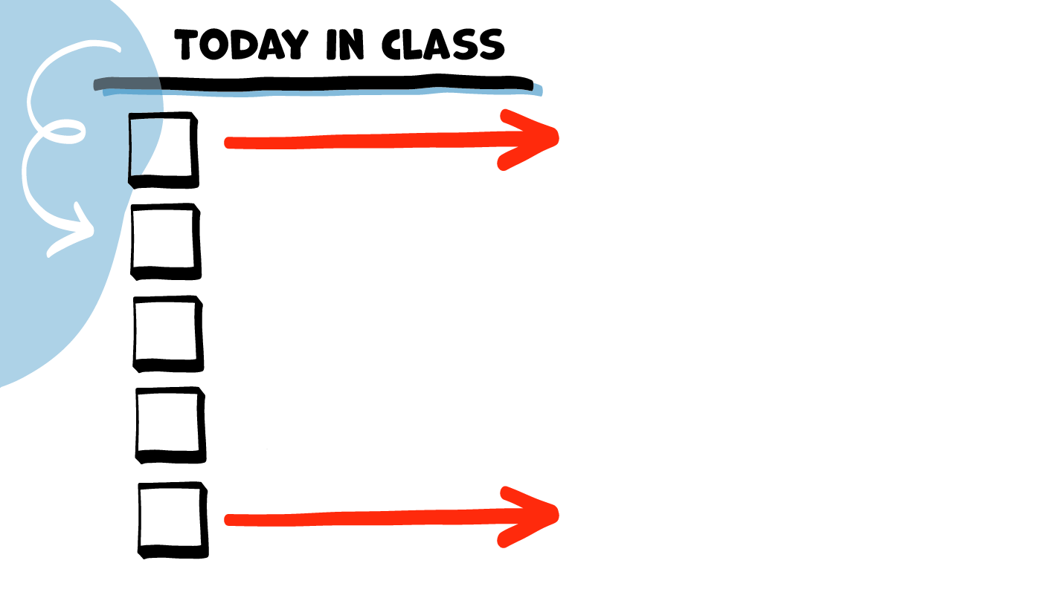

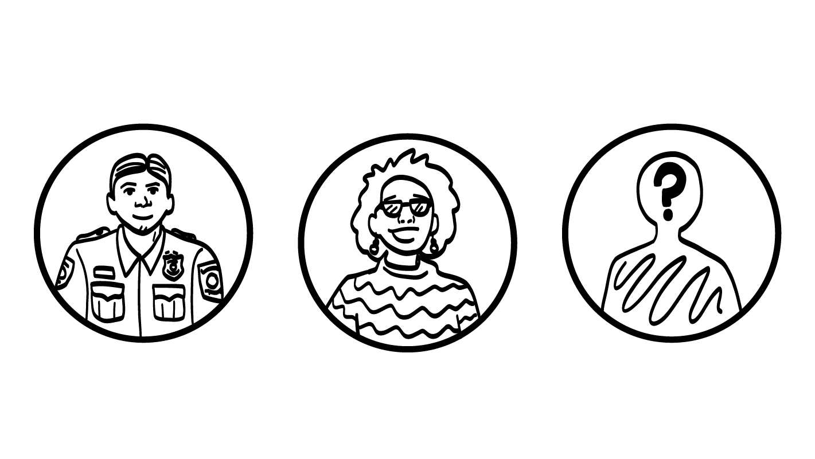
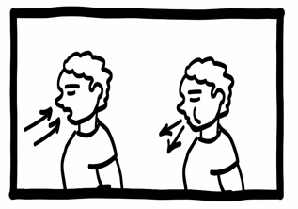
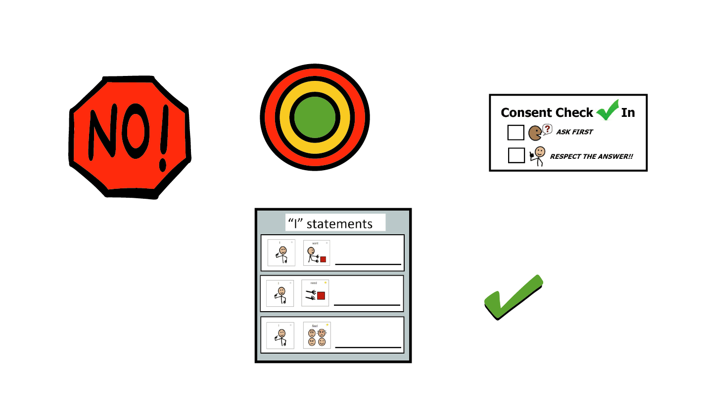
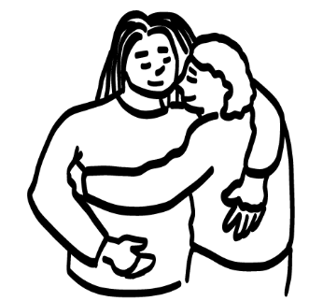
Guess Who? Game
Different types of relationships
Brain break
Relationship Map Tool
Relationship
Map talk
© 2026 SAFE Disability Services Program
Notes:
Read the agenda. Alternatively, you can ask for a student volunteer to read the agenda.

Slide 5
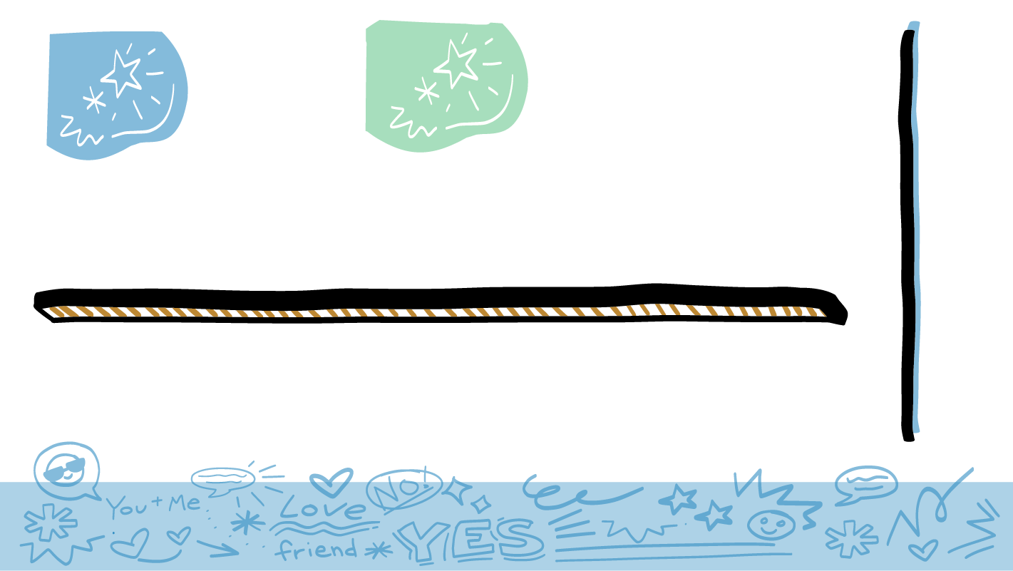

© 2026 SAFE Disability Services Program
Notes:
Say: Today we are going to play the Guess Who Game. For this game, you are going to take turns acting out a story. While two students act out a story, the rest of you will try to guess how the two actors are related. I need two volunteers to go first. I am going to talk to the volunteers for a minute before we start the game.
Meet with the two volunteers somewhere the rest of the class can’t hear your conversation. Give them one of the Guess Who Game cards. As needed, help student volunteers read and understand the story. Tell students to talk with their partner and decide who will play which character, and how those characters would talk and act in the story. You may have to ask prompting questions such as: How would you greet this person? Would you hug them? What about a handshake? What might you say to this person?
Once the volunteers have decided how they are going to act out their relationships, bring them back into the classroom. Remind them that they should not tell the rest of the class what their story is. Remind the rest of the class that they will have to guess the relationship between the two actors at the end of the story. Have the volunteers act out the story. If your class really likes to participate in role plays, you can also get a volunteer to be the Director. The Director says “Action!” at the beginning of the role play and “Cut!” at the end.

Slide 6
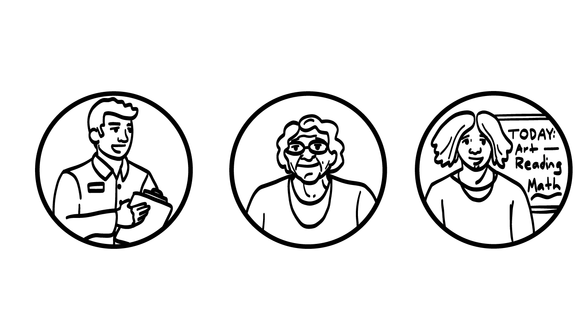
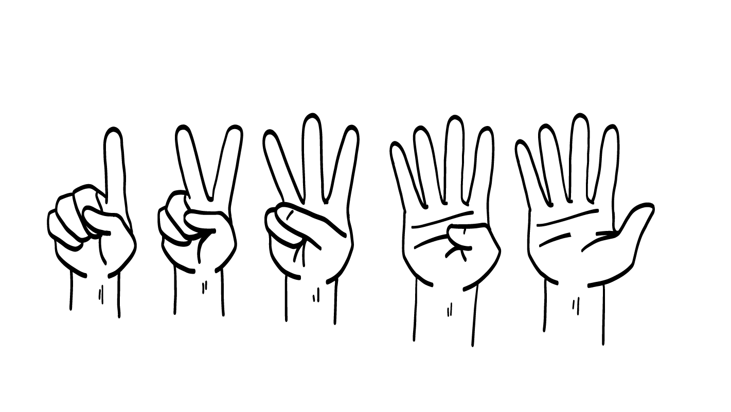
Boss
Grandma
Teacher
© 2026 SAFE Disability Services Program
Notes:
Say: Let’s give a round of applause to our first two actors! Nice job. Now it’s everyone else’s turn to guess what relationship our actors were acting out. Hold up one finger if you think this was a boss and a worker, two fingers if you think this was a grandma and a grandchild, or three fingers if you think this was a teacher and a student.
Give students enough time to process the question and make their decisions. Ask them to explain their choice. If students need help, you can ask prompting questions such as: How did they greet each other? Did it seem like they knew each other well?
Say: Excellent work everyone. Can I get another two volunteers to be our actors?

Slide 7
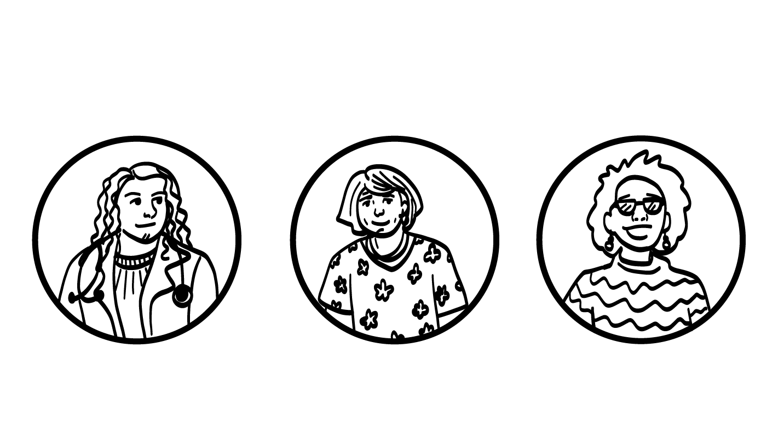
Doctor
Mom
Friend
© 2026 SAFE Disability Services Program
Notes:
Meet with the two volunteers somewhere the rest of the class can’t hear your conversation. Give them one of the Guess Who Game cards. As needed, help student volunteers read and understand the story. Tell students to talk with their partner and decide who will play which character, and how those characters would talk and act in the story. You may have to ask prompting questions such as: How would you greet this person? Would you hug them? What about a handshake? What might you say to this person?
Say: Great job! Let’s give a round of applause to our second two actors! Now it’s everyone else’s turn to guess what relationship our actors were acting out. Hold up one finger if you think this was a doctor and a patient, two fingers if you think this was a mom and a child, or three fingers if you think this was two best friends?
Give students enough time to process the question and make their decisions. Ask them to explain their choice. If students need help, you can ask prompting questions such as: How did they greet each other? Did it seem like they knew each other well?
Say: Excellent work everyone. We are going to do one more story. Can I get another two volunteers to be our last actors?

Slide 8
Police Officer
Friend
Stranger
© 2026 SAFE Disability Services Program
Notes:
Meet with the two volunteers somewhere the rest of the class can’t hear your conversation. Give them one of the Guess Who Game cards. As needed, help student volunteers read and understand the story. Tell students to talk with their partner and decide who will play which character, and how those characters would talk and act in the story. You may have to ask prompting questions such as: How would you greet this person? Would you hug them? What about a handshake? What might you say to this person?
Say: Awesome job! Let’s give a round of applause to our last two actors! Now it’s everyone else’s turn to guess what relationship our actors were acting out. Hold up one finger if you think this was a police officer and a student, two fingers if you think this was two friends, or three fingers if you think this was two strangers?
Give students enough time to process the question and make their decisions. Ask them to explain their choice. If students need help, you can ask prompting questions such as: How did they greet each other? Did it seem like they knew each other well?

Slide 9
Guess Who? Game
Different types of relationships
Brain break
Relationship Map Tool
Relationship
Map talk
© 2026 SAFE Disability Services Program
Notes:
Say: Excellent work with the Guess Who? Game everyone! Now we are going to talk about different types of relationships.

Slide 10
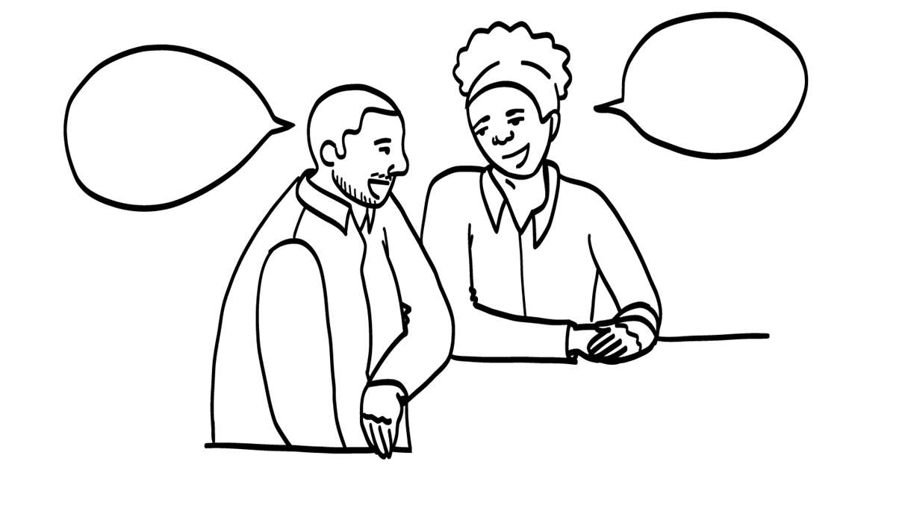
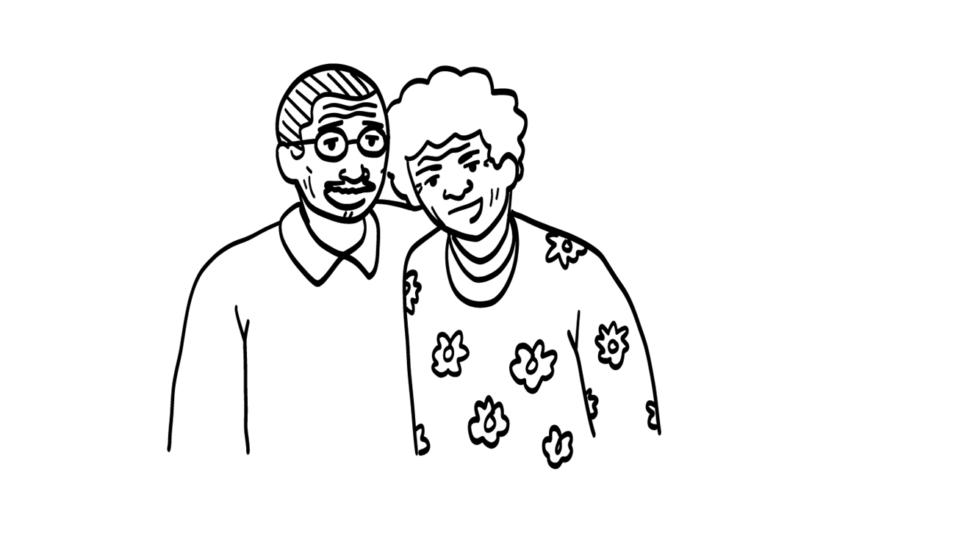
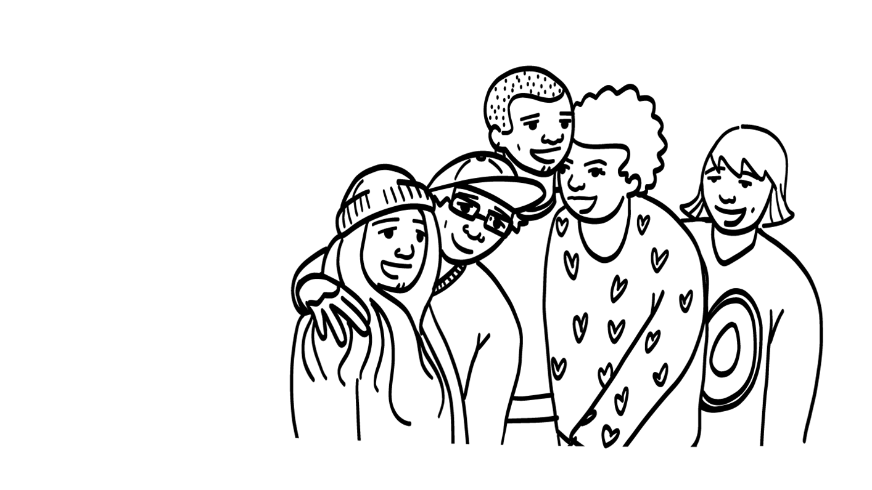
Coworkers
Family
Friends
© 2026 SAFE Disability Services Program
Notes:
Say: Let’s make a list together of all of the types of relationships we saw in the Guess Who? Game. For example, we just saw two strangers in the last round of the game. Can anyone think of any other types of relationships in the game?
Give students enough time to process the question and make their decisions. As students name types of relationships, write them on a piece of chart paper.
Say: Can anyone think of other types of relationships that we didn’t see in the game?
Give students enough time to process the question and make their decisions. As students name types of relationships, continue to write them on a piece of chart paper. Provide prompts as needed until you have a long list of relationship types. Examples: (friends, brother, sister, mom, dad, grandparents, uncles, aunts, cousins, neighbors, coworkers, boss).
Say: Look at all of the different types of relationships you can have! One cool thing is that the way you act and talk can change depending on how well you know someone. What do you all think, would you talk the same way to your sibling as you would to your boss? Hold a thumbs up for yes and a thumbs down for no.
Give students enough time to process the question and make their decisions.
Say: No! You know your sibling way better than your boss. And with your boss, you need to be professional. The things you would say or do with your sibling are different than what you would say or do with your boss. Our behaviors and the way we talk changes with each type of relationship. For example, do you think it is safe to talk to a stranger the same way you would talk to your best friend?
Give students enough time to process the question and make their decisions.
Say: No, it would not be safe to talk to a stranger the same way, because you don’t know them, and you don’t know if you can trust them. We are going to keep talking about how your behavior changes with different people all throughout class today.

Slide 11
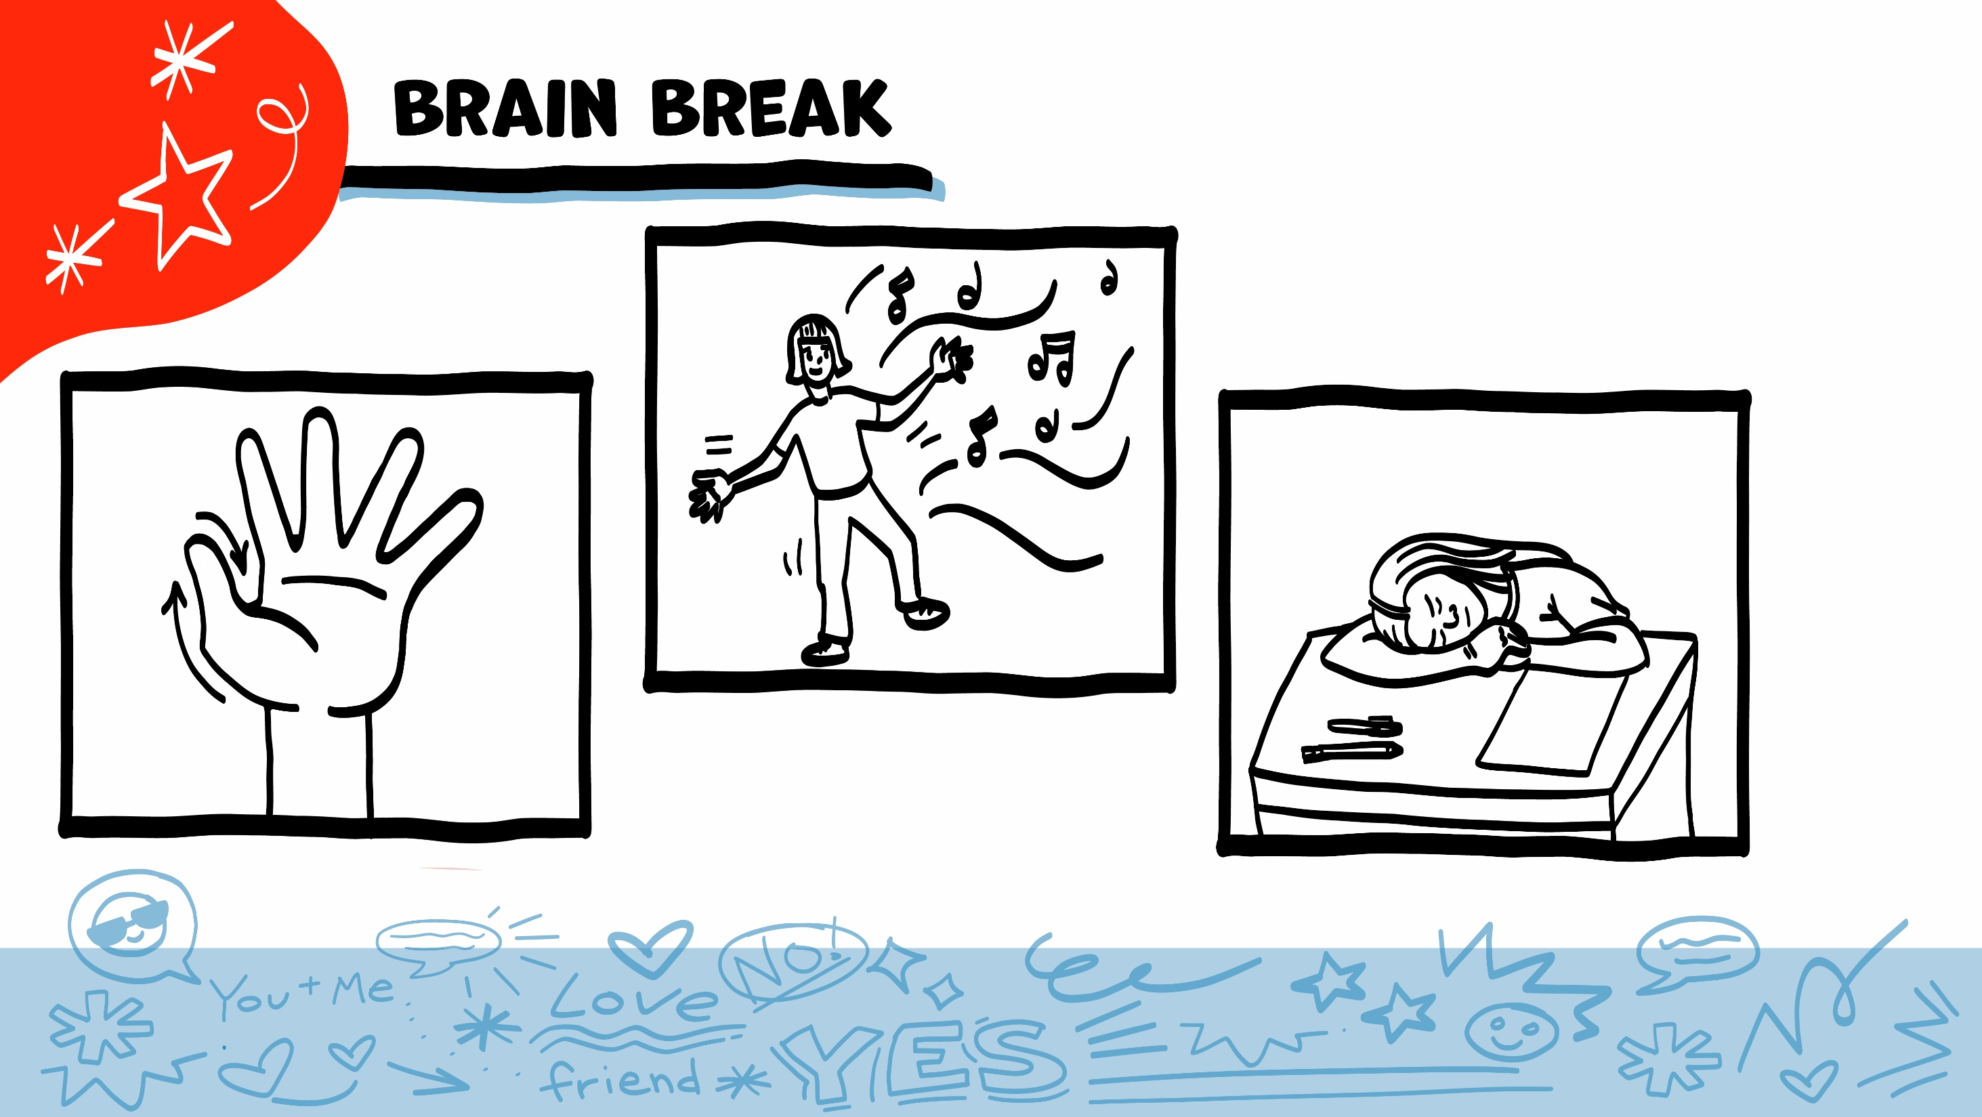
© 2026 SAFE Disability Services Program
Notes:
Say: That was a lot of information, and you all are doing an amazing job! Every week in class we will take a brain break in the middle. This is a chance to move a little and take a break from thinking!
Below are three ideas to give students a quick opportunity for a brain break. You are also welcome to come up with your own ideas for brain breaks that work best for your class.
Five finger breathing
For this exercise, have all students place their hand in front of their chest with their five fingers spread out. Next, use the pointer finger of the other hand to trace up and down each of the five fingers, beginning with the thumb. As students trace up a finger, they will breathe in. As they trace down a finger, they will breathe out. When students breathe out on the pinky finger, you can tell them to shake out their hands and arms. As the school year goes on, you can ask students to lead this exercise for their peers.
If this exercise is physically inaccessible for your class, you can also model the hand tracing for students while they breathe in and out.
Stretch break
Lead students through a series of basic stretches. These can be completed in a chair, or while standing up, depending on the accommodation needs of your class. Some ideas include reaching toward the ceiling, stretching one arm at a time across the chest, reaching toward toes, turning head from side to side, etc. Ask students to hold a pose while you count to ten. As the school year goes on, you can ask students to lead stretches for their peers.
Dance party
If your class likes to dance, you can put on a short song for them to dance to. This is especially effective if you are able to find a song that relates to the theme for that week’s class.

Slide 12
Guess Who? Game
Different types of relationships
Brain break
Relationship Map Tool
Relationship
Map talk
© 2026 SAFE Disability Services Program
Notes:
Say: Now it’s time to add a new tool to our Healthy Relationship Toolbox.

Slide 13
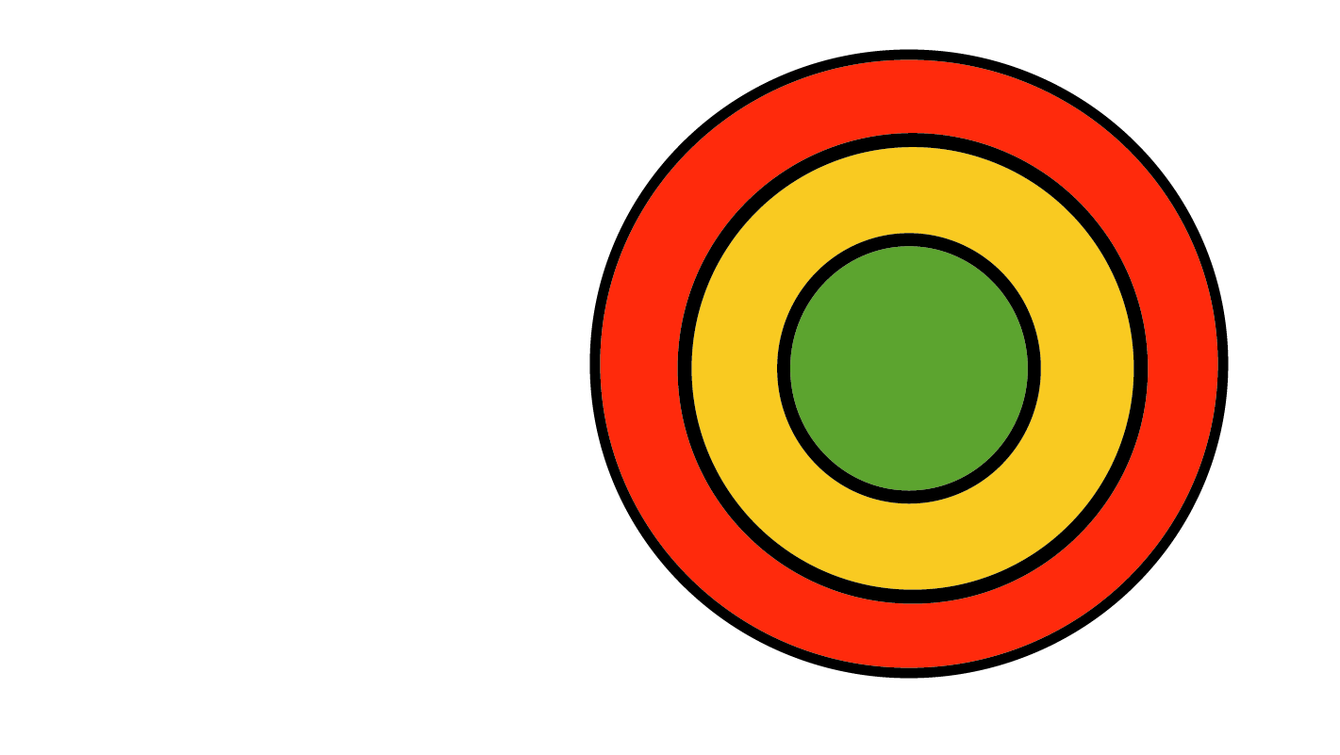
Relationship Map
© 2026 SAFE Disability Services Program
Notes:
Say: To help us keep thinking about relationships, we are going to use something called a Relationship Map. The Relationship Map is a tool you can use to think about the different relationships you have.
Give each student a printed color copy of the Relationship Map Worksheet. You will also use the poster-sized Relationship Map Tool, blank pieces of laminated paper, and dry erase markers for the activity on the next three slides.

Slide 14
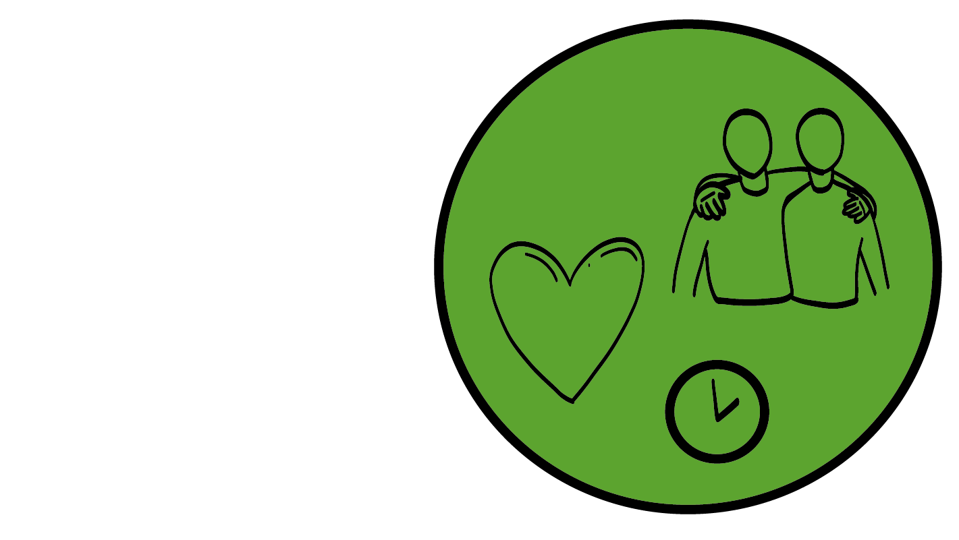
The Inner Green Circle of
People You Trust
People you have known for a long time.
People you love and trust the most.
© 2026 SAFE Disability Services Program
Notes:
Say: You are in the center of your map. The circle in the center of the relationship map is your “inner circle of most trusted people”. This circle is colored green. People in this circle are people you know and love and trust more than anyone else in the world. These are the first people you would call if you ever needed help. These people also know you really well and trust you. For a lot of people, family and best friends go in this inner green circle of most trusted people.
What do you all think—can a celebrity be in your inner green circle of trust? Give a thumbs up for yes and a thumbs down for no.
Give students enough time to process the question and make their decisions.
Say: That’s right. Even if you think a celebrity is really cool, you don’t actually know them in real life. And they don’t know you! So, they cannot go in your inner green circle of most trusted people. What if you see someone on the street you think is cute? Can they be in your inner green circle of most trusted people? Give a thumbs up for yes and a thumbs down for no.
Give students enough time to process the question and make their decisions.
Say: No, people in your inner green circle of most trusted people know you really well, and you know them really well. Celebrities and strangers don’t go in your inner green circle of most trusted people, even if they are super cute. Who from the list of relationships we made earlier is in your inner green circle of trust?
Give students enough time to process the question and make their decisions. As students shout out relationships, have them use a dry erase marker to write it on a laminated strip of blank paper with Velcro on the back. Ask them to put this Velcro paper strip on the poster-sized Relationship Map Tool in the inner green circle of people you trust the most.
Say: Not everyone has the same people in their inner green circle of most trusted people. For example, some people might have their parents in their inner green circle of most trusted people, and other people might not. Only you get to decide who gets to go on your Relationship Map, and which circle they go on. Take a minute to think about who you have in your inner green circle of most trusted people. Who do you love and trust the most? You can write the names of these people in the inner green circle of trusted people on your Relationship Map Worksheet.
Remove the Velcro pieces from the poster-sized Relationship Map Tool so students can focus on their individual Relationship Map Worksheets. Assist students as needed to write the names of these individuals in their green circle of trust. If students have pictures of loved ones from the Pre-Teach Activity, you can also have them glue these pictures onto their worksheets.

Slide 15
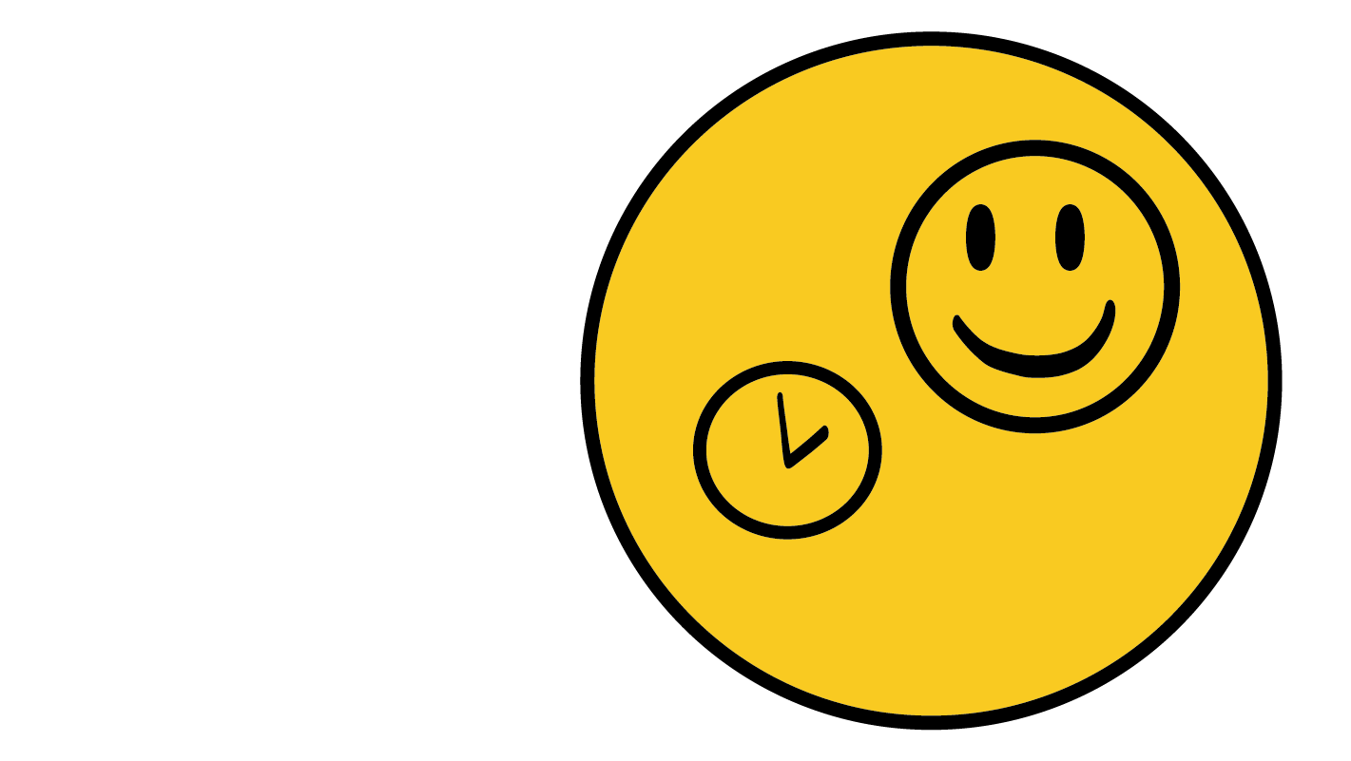
The Middle Yellow Circle of People You Know
People you have known for a while.
People you like and may trust but not as much as people in your inner green circle of trust.
© 2026 SAFE Disability Services Program
Notes:
Say: Nice job on your inner green circle of people you trust the most. Now we are going to talk about people in your middle yellow circle. The middle yellow circle is for people that you may know well, but you’re not quite as close to as the people in your inner green circle of most trusted people. These are not the first people you would call if you need help. Some examples of people who might be in a yellow circle include family you don’t see as often, or friends that are not best friends. You know the people in your yellow circle, and you like them, but you’re not as close with them as you are to the people in your inner green circle of most trusted people. Who from the list of relationships on the board is in your middle yellow circle of people you know?
Give students enough time to process the question and make their decisions. As students shout out relationships, have them use a dry erase marker to write it on a laminated strip of blank paper with Velcro on the back. Ask them to put this Velcro paper strip on the poster-sized Relationship Map Tool in the middle yellow circle.
Say: Take a minute to think about who you have in your middle yellow circle of people you know. Who do you know and like, but you are not really close to? The people in your middle yellow circle are people you know but they are not the people you would call or talk to first if you needed help. In my life, there are a few people I know I can always go to for help and then there are other people I know well but I don’t trust them as much. Those people are in my middle yellow circle of people I know. You can write the names of people in the middle yellow circle of people you know on your Relationship Map Worksheet.
Remove Velcro pieces from the poster-sized Relationship Map Tool so students can focus on their individual Relationship Map Worksheets. Assist students as needed to write the names of these individuals in their yellow circle of people they know. If students have pictures of people they know from the Pre-Teach Activity, you can also have them glue these pictures onto their worksheets.

Slide 16
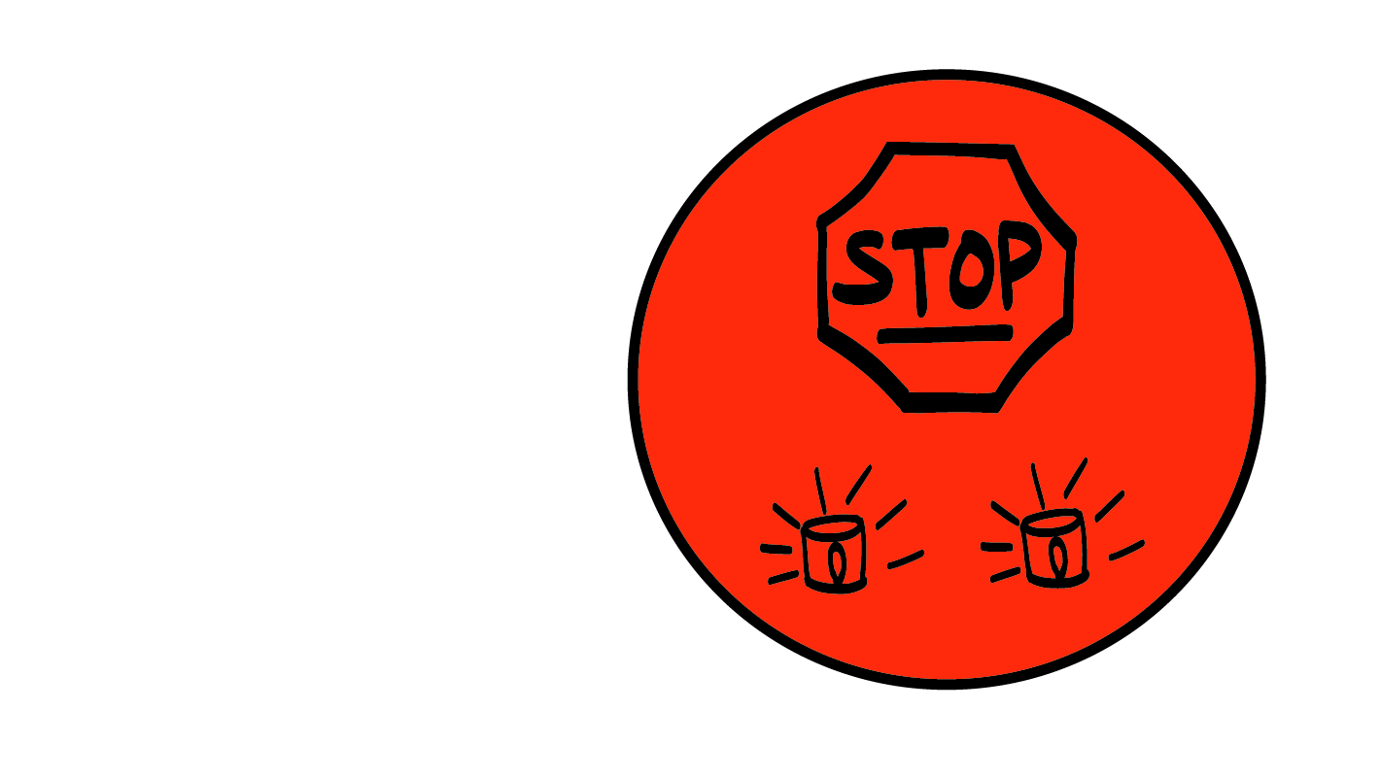
The Outer Red Circle of People
You Do Not Know
People you do not know.
People you just met.
People you do not trust.
© 2026 SAFE Disability Services Program
Notes:
Say: The outer red circle is for strangers or people you’ve just met and don’t know well yet. Or people you do know, but do not trust. You don’t know all the people in this circle, and all these people don’t know you either. So, this might be bus drivers, people at the grocery store, some coworkers, or neighbors. It can also be people you have known for a long time but do not trust or do not feel safe with. Who from the list of relationships on the board is in your outer red circle of people?
Give students enough time to process the question and make their decisions. As students shout out relationships, have them use a dry erase marker to write it on a laminated strip of blank paper with Velcro on the back. Ask them to put this Velcro paper strip on the poster-sized Relationship Map Tool in the red circle.
Say: Think about your life and your relationships. Who are people that you have only met a couple times? These people might be neighbors. You might know who they are but not really know anything about them. Who are strangers you might see in the community, like coffee shop workers or bus drivers? Who are people in your life that you may know, but you don’t feel safe with? Write their names or the type of relationship in your outer red circle of people.
Remove the Velcro pieces from the poster-sized Relationship Map Tool so students can focus on their individual Relationship Map Worksheets. Assist students as needed to write the names of individuals or types of relationships in their red circle.

Slide 17
© 2026 SAFE Disability Services Program
Notes:
Say: Remember, we are going to be adding tools to our Healthy Relationships Toolbox throughout the year. These are tools you can use to have healthier relationships. Our second tool is the Relationship Map Tool. Is there anyone who would like to volunteer to put the Relationship Map Tool on our Healthy Relationships Toolbox?
Have the volunteer Velcro the Class Relationship Map Tool Manipulative onto the Class Healthy Relationship Toolbox. Next, give each student a glue stick and a copy of the Student Relationship Map Tool. Give students a few minutes to glue their tools into their own toolboxes. Over the next several weeks, students will be adding tools to their toolboxes, so be sure to ask students to hold onto their toolboxes for the next class.

Slide 18
Guess Who? Game
Different types of relationships
Brain break
Relationship Map Tool
Relationship
Map talk
© 2026 SAFE Disability Services Program
Notes:
Say: The last thing we are going to do today is talk a little more about the Relationship Map.

Slide 19
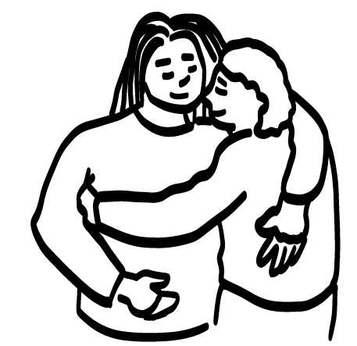
© 2026 SAFE Disability Services Program
Notes:
Say: Take a look at your Relationship Map. Think about how you act with the people close to you in your inner green circle of people you trust the most, and how you act with the people you don’t know or are not close to in your outer red circle. How is it different?
Give students a minute to think about the question.
Say: Who on your Relationship Map would you feel comfortable hugging?
Give students enough time to process the question and make their decisions.
Say: Thanks for sharing. Some people like to hug people in their inner green circle of trust and some people they know in their middle yellow circle. Other people don’t like to hug people at all and that’s okay too. Do you think it would be safe to hug someone you don’t know or just met or don’t trust in your outer red circle of people? Give a thumbs up for yes and a thumbs down for no.
Give students enough time to process the question and make their decisions.
Say: No, it would not be safe to hug someone in your outer red circle of people you don’t know or just met because you don’t know if you can trust them. Or you know them but don’t trust them. If you don’t feel safe or comfortable with someone you do not have to hug them. You get to decide who you hug or not. Every relationship has different boundaries. Boundaries are what you are okay with and not okay with in your relationships. We will talk more about that in our next class. For now, just notice that you don’t act or talk the same way with all people. How you act and talk changes depending on your relationship to the other person.
Do you think people can move on the Relationship Map? Give a thumbs up for yes and a thumbs down for no.
Give students enough time to process the question and make their decisions.
Say: Yes. When you meet someone new, you don’t know them, and they start in your outer red circle of people you don’t know. As you get to know this person more, you might start to trust them more. They might move into your middle yellow circle of people you know, or even your inner green circle of people you trust the most. It takes months for you to get to know someone well enough for them to be in your middle yellow circle of people you know. It takes months or even years to know someone well enough for them to be in your inner green circle of people you trust the most. It takes a long time to get to know someone well enough to trust them.
People can also move further out on your map. Sometimes people move to a new city, and you don’t get to see them anymore. Other times people you trust do something that hurts you. If this happens, a person who was in your inner green circle of most trusted people or your yellow circle of people you know might move back to the outer red circle of people you don’t know or don’t trust. You get to decide if someone is a safe person or not a safe person for you.

Slide 20
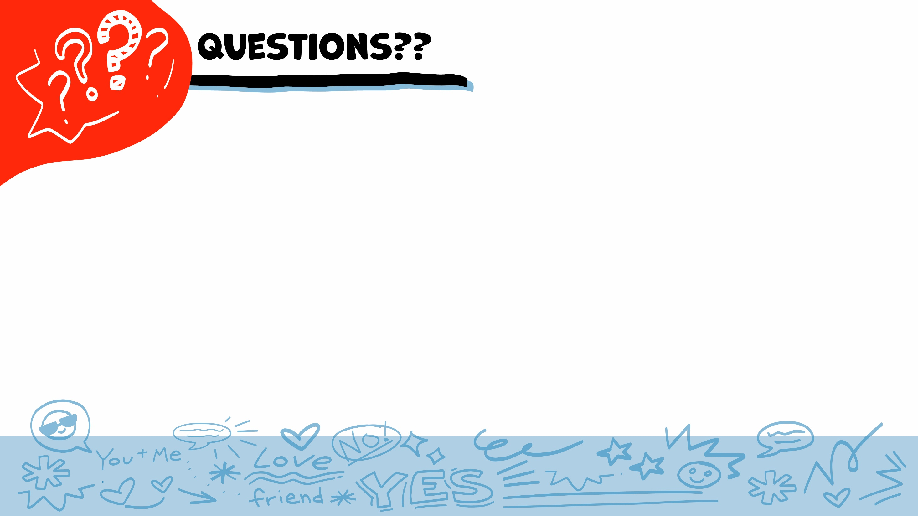
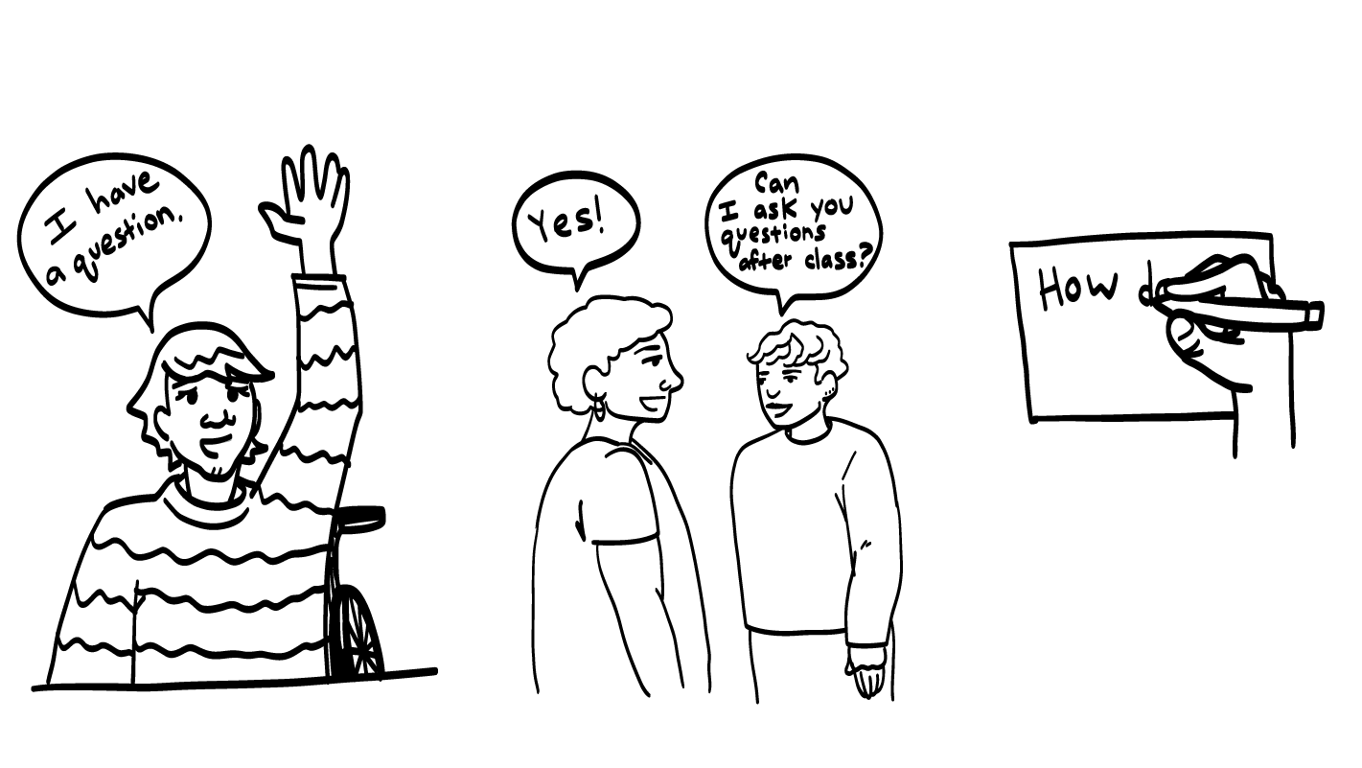
© 2026 SAFE Disability Services Program
Notes:
Say: Does anyone have any questions about today’s class? Remember, if you don’t want to ask your question out loud, you can write it on a notecard and leave it on your desk. You can also ask someone you trust to help you write your question on the notecard. I will pick up the notecards and will answer the questions the next time we meet. When I answer a question, I won’t tell anyone who asked it.

Slide 21
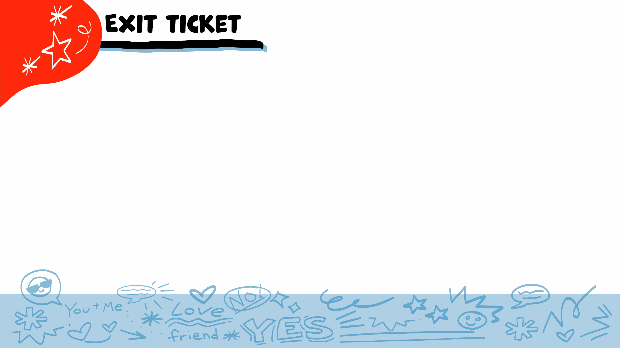
Which circle is for people you know and love and trust more than anyone else?
Inner Green Circle
of Trust
Middle Yellow Circle of people you are getting to know
Outer Red Circle of people you don’t know or trust
2
3
1
© 2026 SAFE Disability Services Program
Notes:
Say: Which circle is for people you know and love and trust more than anyone else? Hold up one finger for your inner green circle of trust, two fingers for the middle yellow circle of people you are getting to know, and three fingers for outer red circle of people you don’t know or trust.
Give students enough time to process the question and make their decisions.
Say: That’s right. The inner green circle is for the people you know and love and trust the most. These are the first people you would call if you ever needed help.

Slide 22
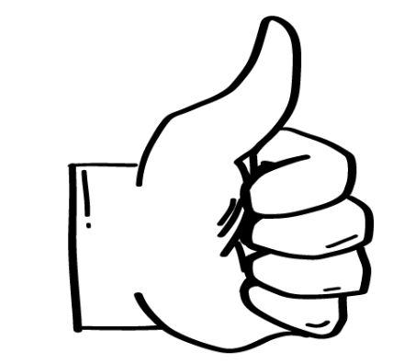
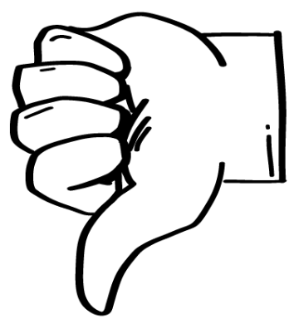
Is it safe to hug someone in your outer red ‘don’t know or don’t trust’ circle?
YES
NO
© 2026 SAFE Disability Services Program
Notes:
Say: Is it safe to hug someone in your outer red ‘don’t know or don’t trust’ circle? Give a thumbs up for yes and a thumbs down for no.
Give students enough time to process the question and make their decisions.
Say: No, it is not safe to hug someone in your outer red circle of trust. You do not know them; you cannot trust them. Or, you may know them but do not trust them. You also shouldn’t share personal information, like your last name or address, with someone in your outer red circle of people you just met or don’t know or don’t trust.

Slide 23
Who is 1 adult in your
inner green circle of trust?
© 2026 SAFE Disability Services Program
Notes:
Say: Who is one adult in your inner green circle of people you trust the most?
Give students enough time to process the question and make their decisions. Go around the room and ask each student to share the name of one adult they trust.
Say: Remember, the adults in your inner green circle of trust are the people you trust the most and can talk to if you ever need help.

Slide 24
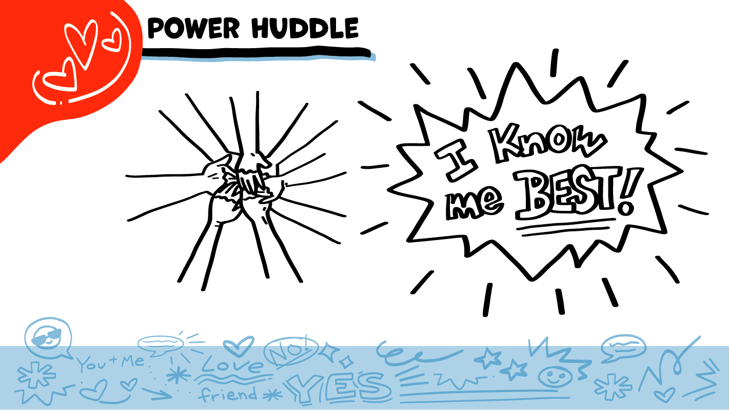
© 2026 SAFE Disability Services Program
Notes:
Say: Does anyone remember what our power statement is? Our power statement is “I know me best.” This means that each of you knows yourself better than anyone else does. Today you thought about your relationships, and who is in your inner green circle of most trusted people, middle yellow circle of people you know, and outer red circle of people you do not know, just met, or don’t trust. You know best who is safe for you, and who is not. Let’s gather together and on the count of three, say our power statement.
Have each interested student put one hand in the middle of the circle. Ask for a student volunteer to count to three. After three, all participants say the power statement while lifting their hands into the air. Students can also stand in the circle without touching hands if they prefer.

Slide 25

This work is supported by the Texas Council for Developmental Disabilities through a grant from the U.S. Administration for Community Living (ACL), Department of Health and Human Services (HHS), Washington, D.C. 20201 with a 100% federal funding award totaling $6,161,072. Council efforts are those of the grantee and do not necessarily represent the official views of nor are endorsed by ACL, HHS, or the U.S. government.
© 2026 SAFE Disability Services Program
Notes:
SAFE would like to thank the Texas Council for Developmental Disabilities for the funding for this curriculum.

Slide 26

This curriculum is offered online at no cost. You are free to use the resources in the original format for educational purposes only. Please reference The SAFE Alliance appropriately (citations at bottom of page).
We ask that you do not alter curriculum images/art, slides, or lesson plan materials. You may not use My Rights My Life (18+ or High School) curriculum for commercial purposes (i.e., selling workshops you facilitate based on MRML curriculum; and/or creating links/websites to re-distribute any materials associated SAFE’s My Rights My Life).
This resource, My Rights My Life: A curriculum for healthier relationships for high school students (grades 9-12) is based on the original My Rights My Life: A curriculum for safer relationships (age 18+) written by Megan Westmore, Heidi Lersch, and edited by Schwartz, M. (2022). Selling materials from MRML is a copyright violation.
Burleson, Anna Belle & Benitez, Sophie (2026) provided light modification and abbreviated the original curriculum
(Westmore & Lersch, 2022) to offer an age appropriate resource for High School Students (grades 9-12).
Schwartz, M. (Ed.). The SAFE Alliance, Austin, Texas.
Westmore, M. & Lersch, H. (2022). My rights my life: A curriculum for safer relationships.
Schwartz, M. (Ed.). The SAFE Alliance: Austin, TX.
© 2026 SAFE Disability Services Program

