Slide 1
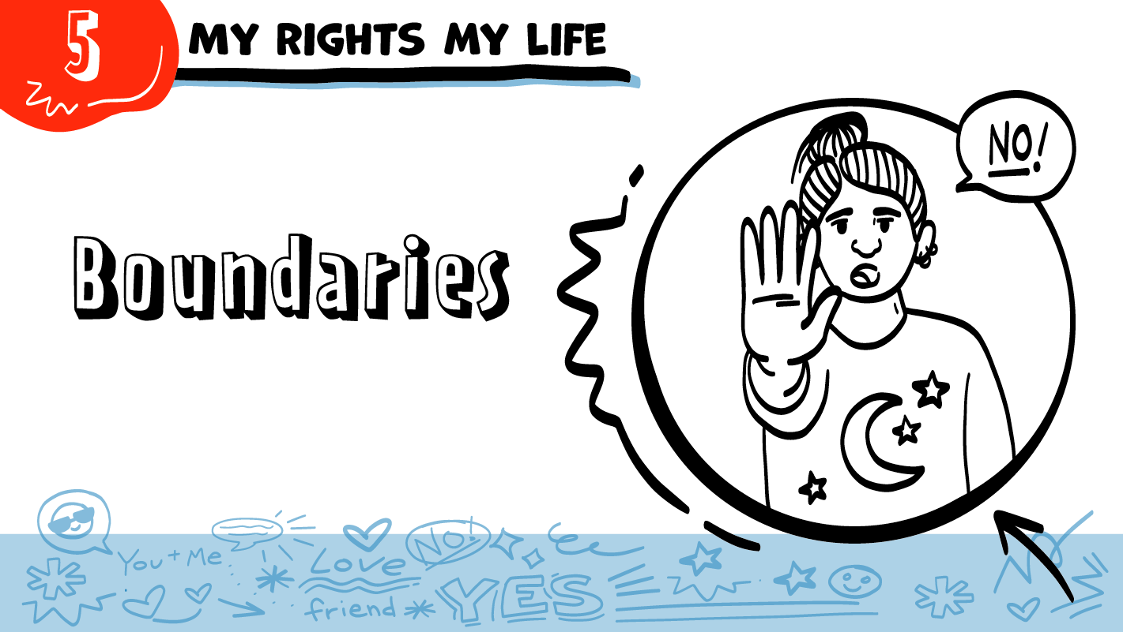

for High School Students
© 2026 SAFE Disability Services Program
Notes:
Repetition is beneficial for learning. Take time to review the last My Rights My Life class you taught prior to beginning this session. You can also answer any private questions students submitted on notecards during your previous class session.
Say: Today in class we are going to talk about something called boundaries. We’ll talk about what boundaries are, and we will also play a game where you can explore the boundaries you have in your relationships.

Slide 2
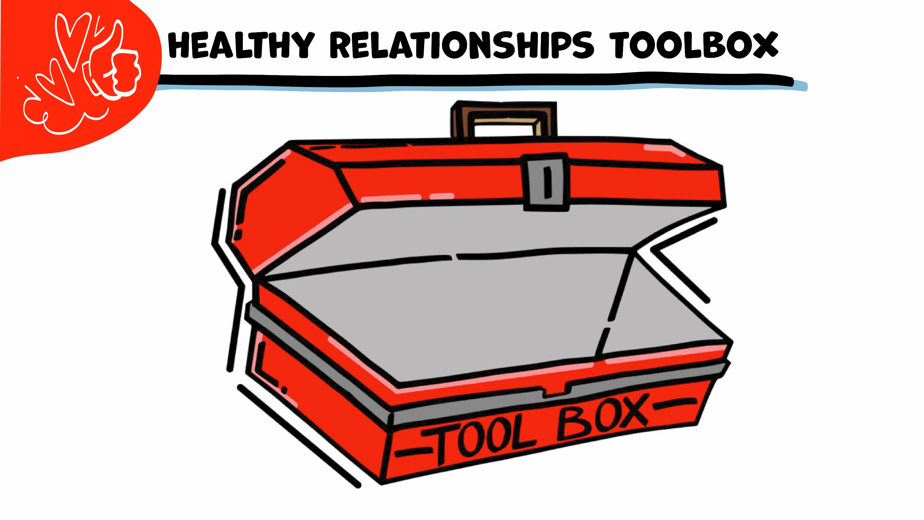

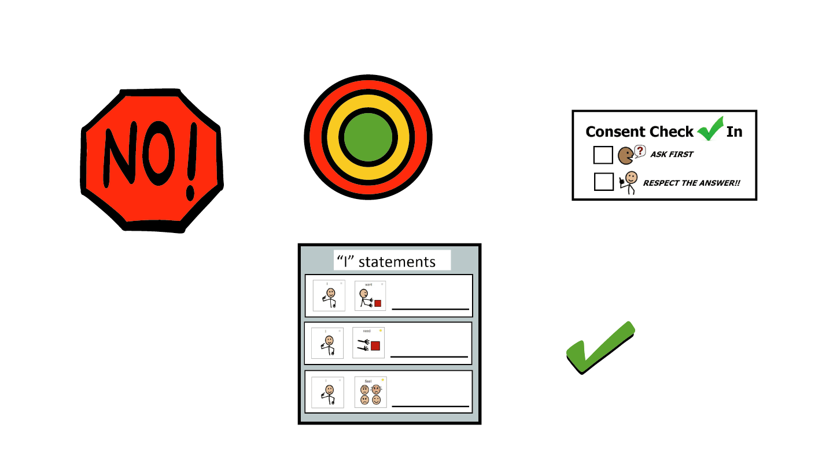
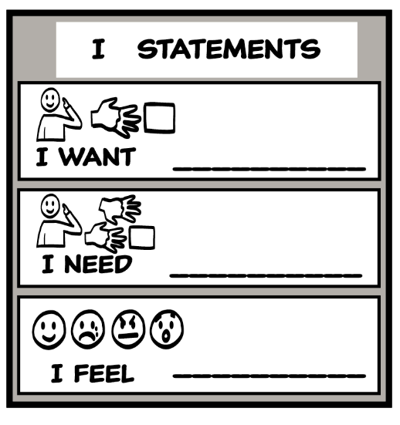
© 2026 SAFE Disability Services Program
Notes:
Say: Let’s start with a review of our Healthy Relationship Toolbox. The first tool we put in the toolbox is the I Statements tool. Does anyone remember what I statements are?
Give students enough time to process the question and make their decisions.
Say: I statements start with the word “I” and let other people know how you feel, what you want, or what you need. You can say “I feel, “I want,” and “I need.” For example, if your best friend is always late to your activities, what’s an I statement you could use to talk to them about it?
Sample I Statements include:
I feel hurt that you are always late to meet me at the movies.
I need you to be on time for our plans.
I want you to text me if you are going to be late.
Say: Our second tool is the Relationship Map. Take a look at the Relationship Map you filled out last week. What circle has the people you know and love and trust the most?
Give students enough time to process the question and make their decisions.
Say: That’s right—your inner green circle has the people you know and love and trust the most. This is the circle of love and trust. The middle yellow circle is for people you know well but are not as close to you as the people in your inner green circle of most trusted people. The outer red circle is for strangers or people you don’t know, or have just met, or people you do not trust. Should you share personal information, like your last name or your address, with people in your outer red circle?
Give students enough time to process the question and make their decisions.
Say: No, it is not safe to share personal information with people in your outer red circle of people you don’t know, just met, or don’t trust. People in your outer red circle cannot be trusted with your personal information. The only time it is okay to share personal information with someone in your outer red circle of people is if they are a community helper. Community helpers are people who help others as a job, like doctors or firefighters. It is okay to share things like your name and address with community helpers, but you should not share this information with other people in your outer red circle of people you do not know, have just met, or do not trust.

Slide 3



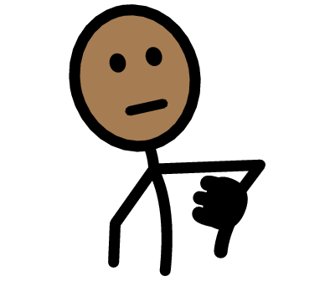
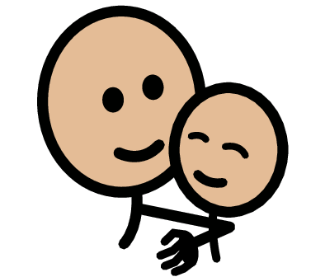


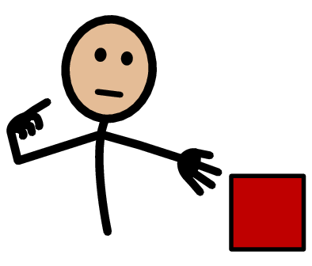
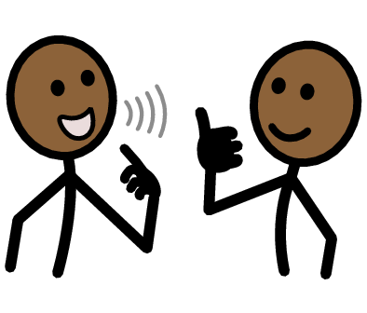
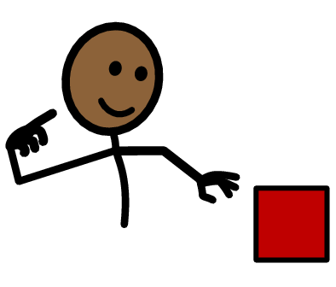


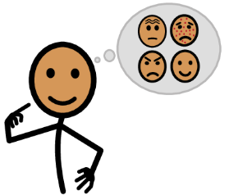




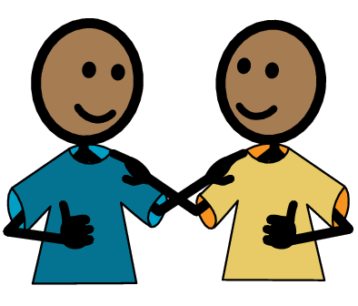
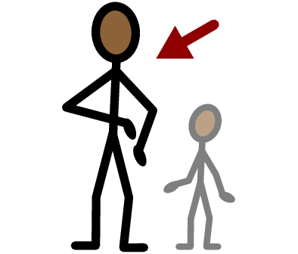
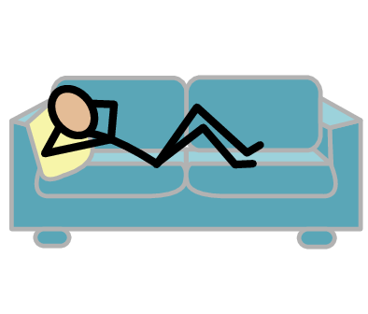
Boundaries
Cool
Not cool
Safe
Yes
No
I need
I want
I need help
I have a question
Self-Advocate
Trust
Adult
Take a break
I feel
Happy
Sad
Mad
Scared
Copyright © 2021 SymbolStix, LLC. All rights reserved. Used with Permission.
Notes:
You can print this slide separately so each student can use the Important Words Sheet as a communication board throughout class. Review the words using the suggested definitions below. To enhance understanding, you can ask students to come up with their own definitions for vocabulary words or to provide a sentence or scenario using the new word.
Boundaries: Your limits; what you are okay and not okay with in your relationships
Cool: Something you are okay with
Not cool: Something you are not okay with
Self-Advocate: People who speak up for themselves
I want: An I statement you can use when you would like something
I need: An I statement you can use when you must get something
Safe: The feeling that you are not going to get hurt and that your feelings are okay

Slide 4
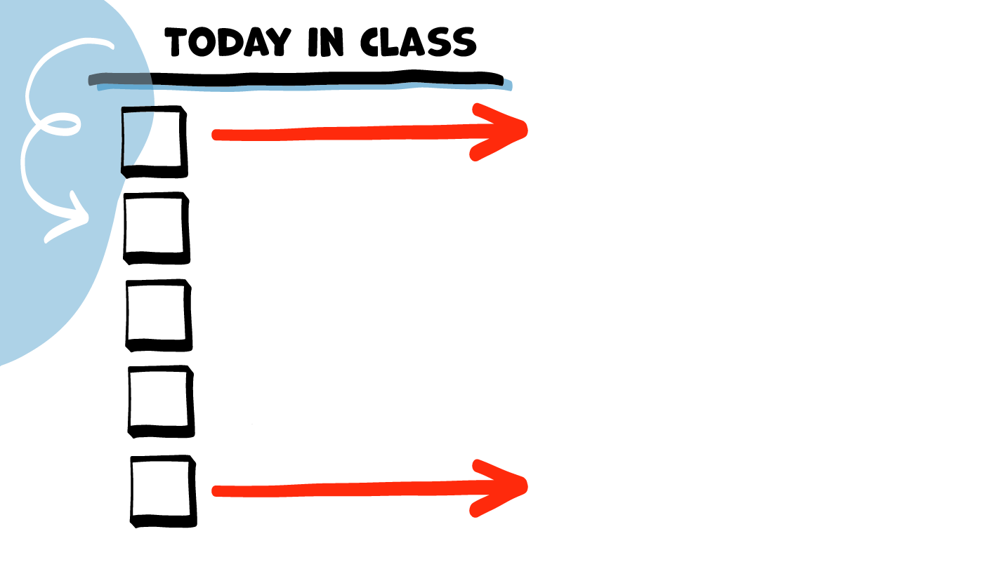
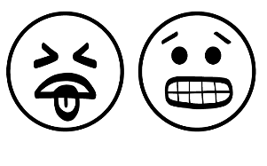




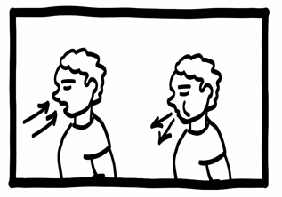
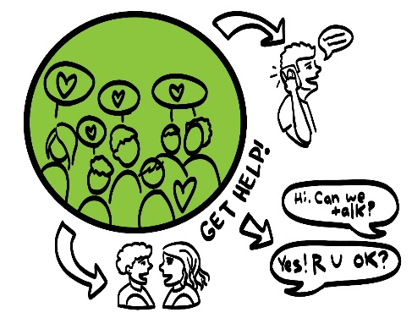
Boundaries
talk
Cool or Not Cool Game
Brain break
NO! Tool
Boundaries Guide
© 2026 SAFE Disability Services Program
Notes:
Read the agenda. Alternatively, you can ask for a student volunteer to read the agenda.

Slide 5
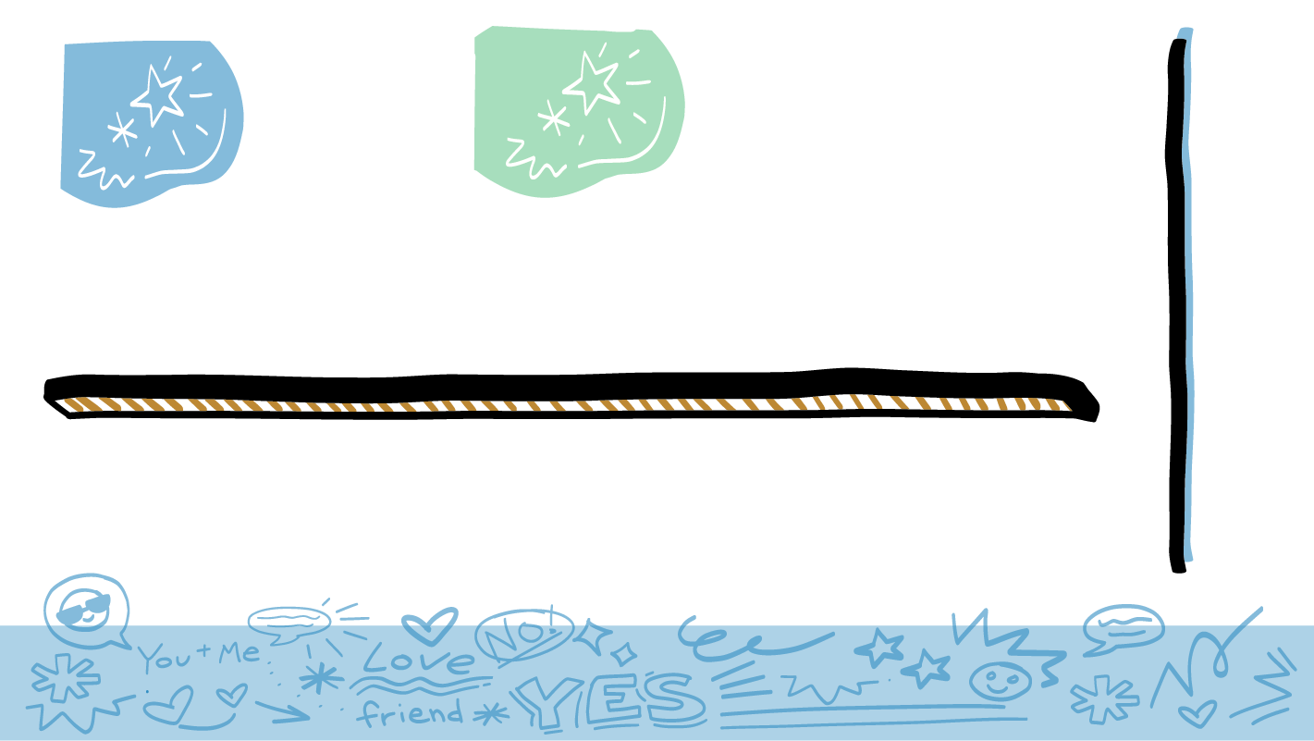
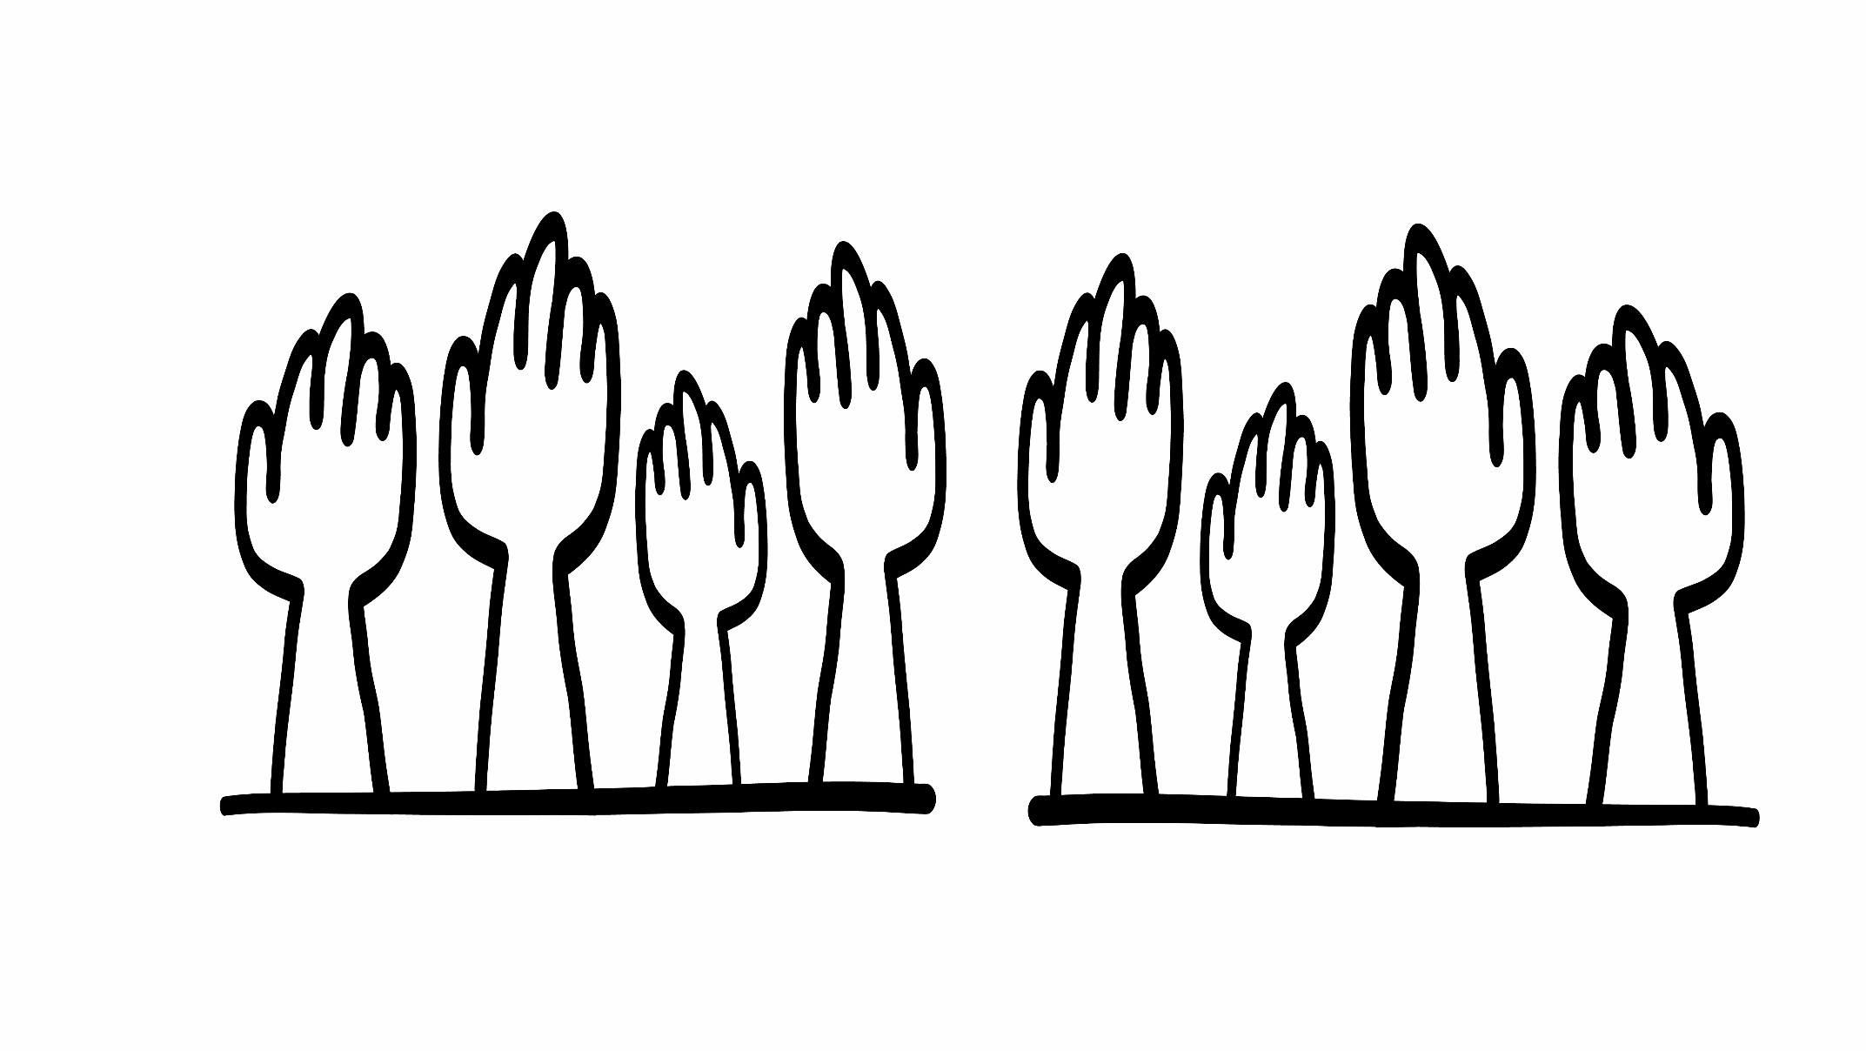


© 2026 SAFE Disability Services Program
Notes:
Say: Who wants to have healthy relationships? Raise your hand if you want healthy relationships.
Give students enough time to process the question and make their decisions.
Say: Yes! We all want healthy relationships. One thing you need to have healthy relationships is something called boundaries. Boundaries are how you know what you’re okay with and what you’re not okay with in your relationships. Look at your Relationship Map that you made in our last class. Boundaries help you feel safe and good with your friends, family, coworkers, and everyone else on your Relationship Map.

Slide 6
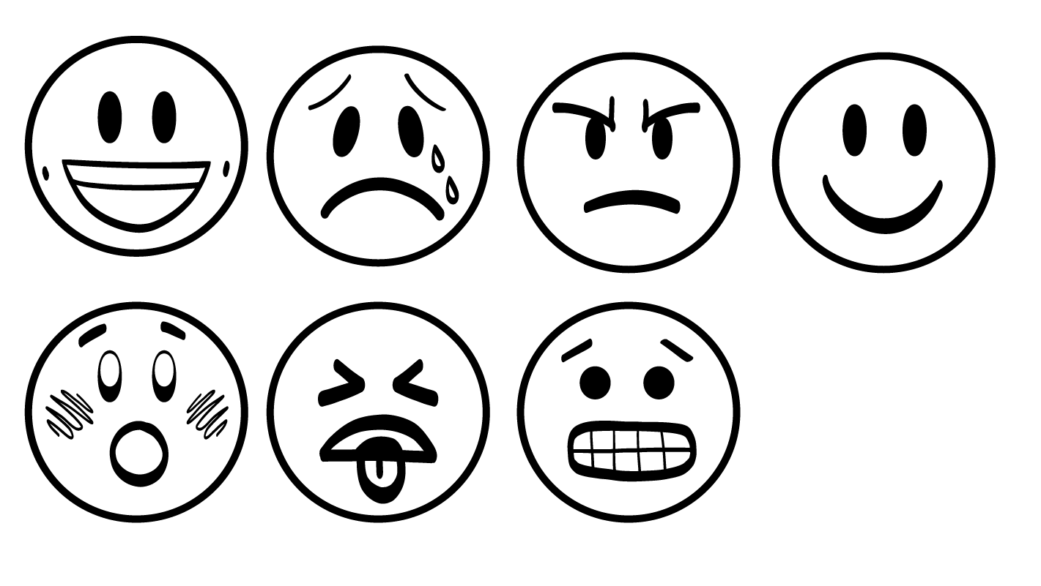
When Your Boundary
is Crossed
Grossed out
Nervous
Sad
Mad
Scared
© 2026 SAFE Disability Services Program
Notes:
Say: When someone does something that you are not okay with, this is called crossing a boundary. For example, it might cross your boundaries if a stranger sits super close to you on the bus. How would that make you feel?
Give students enough time to process the question and make their decisions.
Say: You might feel weird or mad if a stranger sits too close to you on the bus. Another thing that might cross your boundaries is if your friend tries to pressure you, or force you, to do something that you don’t want to do. How would you feel if your friend was trying to pressure you to do something you didn’t want to do?
Give students enough time to process the question and make their decisions.
Say: You might feel scared or hurt if your friend is pressuring you to do something you don’t want to do. If you are feeling strong feelings like the ones on the screen—grossed out, nervous, sad, mad, or scared—this is a sign that someone may have crossed your boundaries. It’s super important to pay attention to how you’re feeling. This lets you know what you are okay with and not okay with in your relationships.

Slide 7
Boundaries
talk
Cool or Not Cool Game
Brain break
NO! Tool
Boundaries Guide
© 2026 SAFE Disability Services Program
Notes:
Say: Now that we have talked a little about what boundaries are, we are going to play a game called Cool or Not Cool. In this game, you’ll get to think about what your boundaries are!

Slide 8
Cool
Not cool
© 2026 SAFE Disability Services Program
Notes:
For this game, you can use a dry erase board and dry erase markers, or chart paper and markers. If you are using a dry erase board, write “Cool” on the left side and “Not Cool” on the right side. If you are using chart paper, write “Cool” on one piece and “Not cool” on another piece.
Say: We are going to play a game to help you think about boundaries. You are going to work with a partner. In just a minute, I will give you and your partner a card. Read what it says on your card or ask for help reading your card and then decide if the behavior on your card crosses your boundaries.
Is it cool or not cool? Thumbs up or thumbs down? After you’ve decided, you and your partner can come up to the front and tape your card on whichever side you think it belongs.
Assist students as needed to find a partner and give each pair a Cool or Not Cool Game Card. Support students to read their card and decide if the behavior described on the card is “cool” or “not cool.” Partners can work through several cards as time allows.

Slide 9
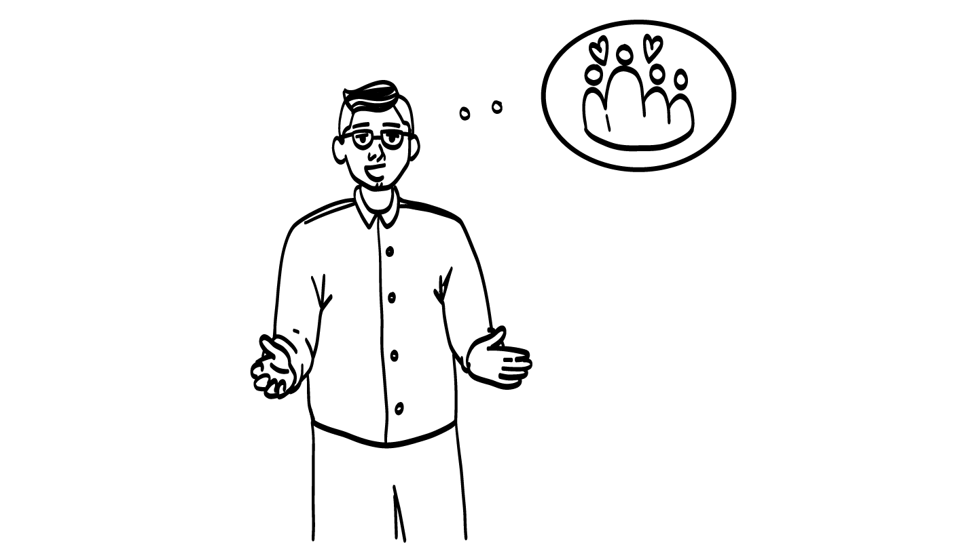

Your best friend wants to
spend time alone with their family.
Cool
© 2026 SAFE Disability Services Program
Notes:
After all cards have been sorted by your students, go through each one with the class as a large group. There is one PowerPoint slide for each of the Cool or Not Cool Game Cards. After you display the slide, look to see where the corresponding card is on the dry erase board or chart paper. Ask your class to give a “thumbs up” if they agree with the placement of the card, or a “thumbs down” if they don’t. Ask students to explain their thoughts if there is disagreement. Once the class has come to a consensus, you can press the space bar to reveal the correct answer. If needed, move the Cool or Not Cool Game Card to the correct side.
Sample talking points are included below:
This is totally cool! Just because you are friends with someone, doesn’t mean they stop caring about their family and friends. It is okay for you or your friend to spend time alone, or to spend time with other friends or family, without the other person. This is a healthy boundary.

Slide 10
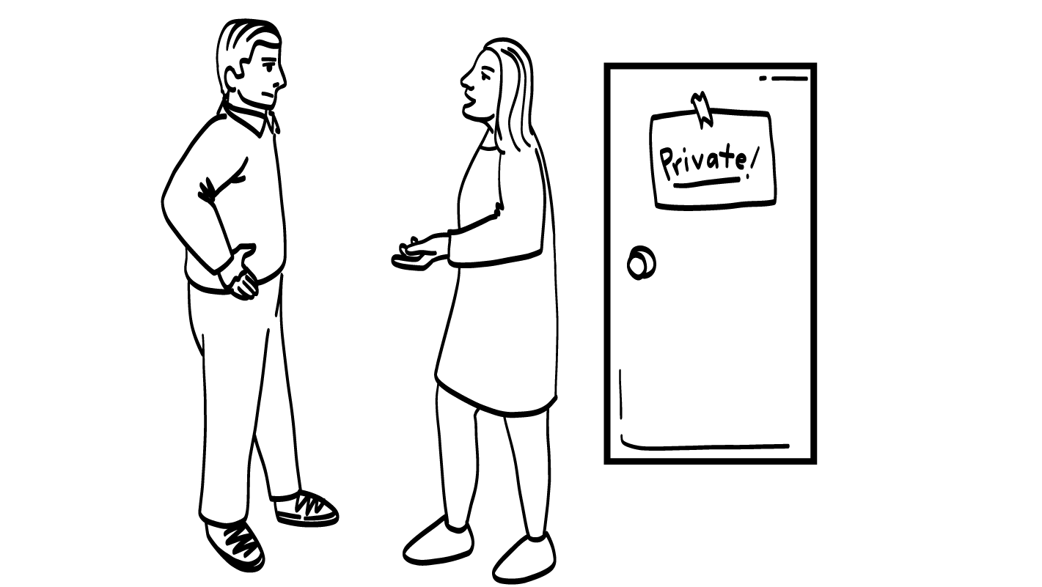
You tell your parents
you need time alone in your room with the door closed.
Cool
© 2026 SAFE Disability Services Program
Notes:
Find the Cool or Not Cool Game Card that corresponds with this PowerPoint slide. Ask your class to give a “thumbs up” if they agree with the placement of the card, or a “thumbs down” if they don’t. Ask students to explain their thoughts if there is disagreement. Once the class has come to a consensus, you can press the space bar to reveal the correct answer. If needed, move the Cool or Not Cool Game Card to the correct side.
Sample talking points are included below:
This is cool! It is okay to ask for time alone in your room with the door closed. You might even use an I statement to let your parent know that you need some private time. This is a healthy boundary.

Slide 11
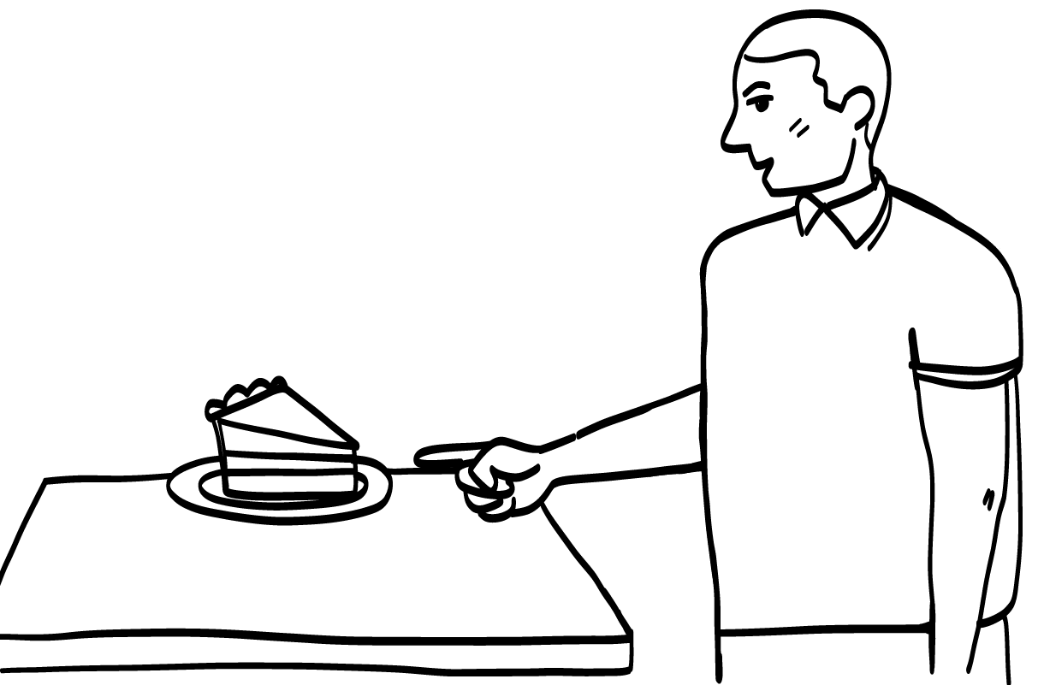

Your uncle says you should not
eat cake because you will get fat.
Not cool
© 2026 SAFE Disability Services Program
Notes:
Find the Cool or Not Cool Game Card that corresponds with this PowerPoint slide. Ask your class to give a “thumbs up” if they agree with the placement of the card, or a “thumbs down” if they don’t. Ask students to explain their thoughts if there is disagreement. Once the class has come to a consensus, you can press the space bar to reveal the correct answer. If needed, move the Cool or Not Cool Game Card to the correct side.
Sample talking points are included below:
This is not cool. It is not okay for anyone in your family to make you feel bad about your body. It is also not okay for your family member to try to control what you do or do not eat. This is a boundary crossing.
Please note, there may be exceptions to the phrase ‘”it is also not okay for your family member to try to control what you do or do not eat” if someone in the family has the responsibility of monitoring a student’s medical condition impacted by food choices (for example diabetes/peanut allergies, etc.).

Slide 12
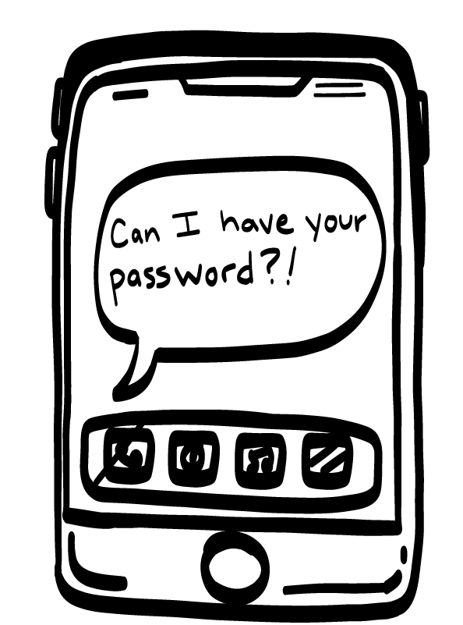
Your classmate asks for the passwords to your social media accounts.
Not cool
© 2026 SAFE Disability Services Program
Notes:
Find the Cool or Not Cool Game Card that corresponds with this PowerPoint slide. Ask your class to give a “thumbs up” if they agree with the placement of the card, or a “thumbs down” if they don’t. Ask students to explain their thoughts if there is disagreement. Once the class has come to a consensus, you can press the space bar to reveal the correct answer. If needed, move the Cool or Not Cool Game Card to the correct side.
Sample talking points are included below:
This is not cool. Your passwords are private information. Your classmate does not need your social media passwords. This is a boundary crossing.

Slide 13
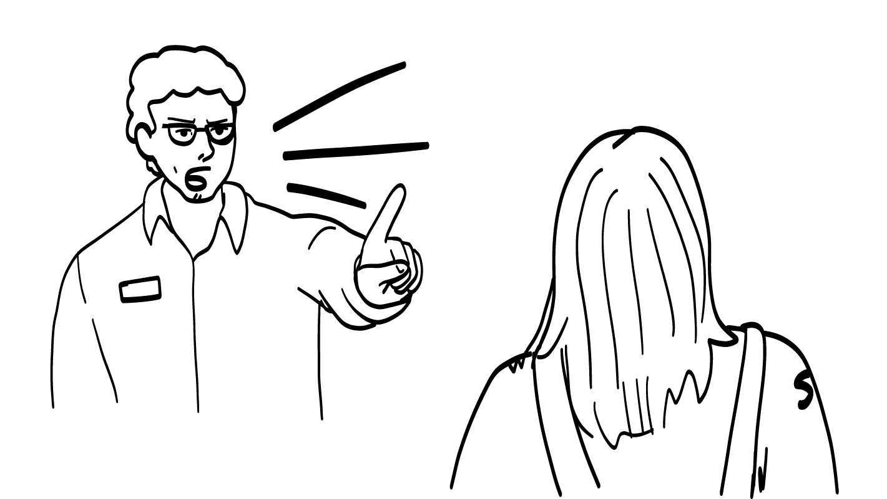
Your coach yells at you because you made a mistake while playing.
Not cool
© 2026 SAFE Disability Services Program
Notes:
Find the Cool or Not Cool Game Card that corresponds with this PowerPoint slide. Ask your class to give a “thumbs up” if they agree with the placement of the card, or a “thumbs down” if they don’t. Ask students to explain their thoughts if there is disagreement. Once the class has come to a consensus, you can press the space bar to reveal the correct answer. If needed, move the Cool or Not Cool Game Card to the correct side.
Sample talking points are included below:
This is not cool. Everyone makes mistakes! It is not okay for your coach to yell at you when you make a mistake. Your coach is supposed to help you; not make you feel bad. This is a boundary crossing.

Slide 14
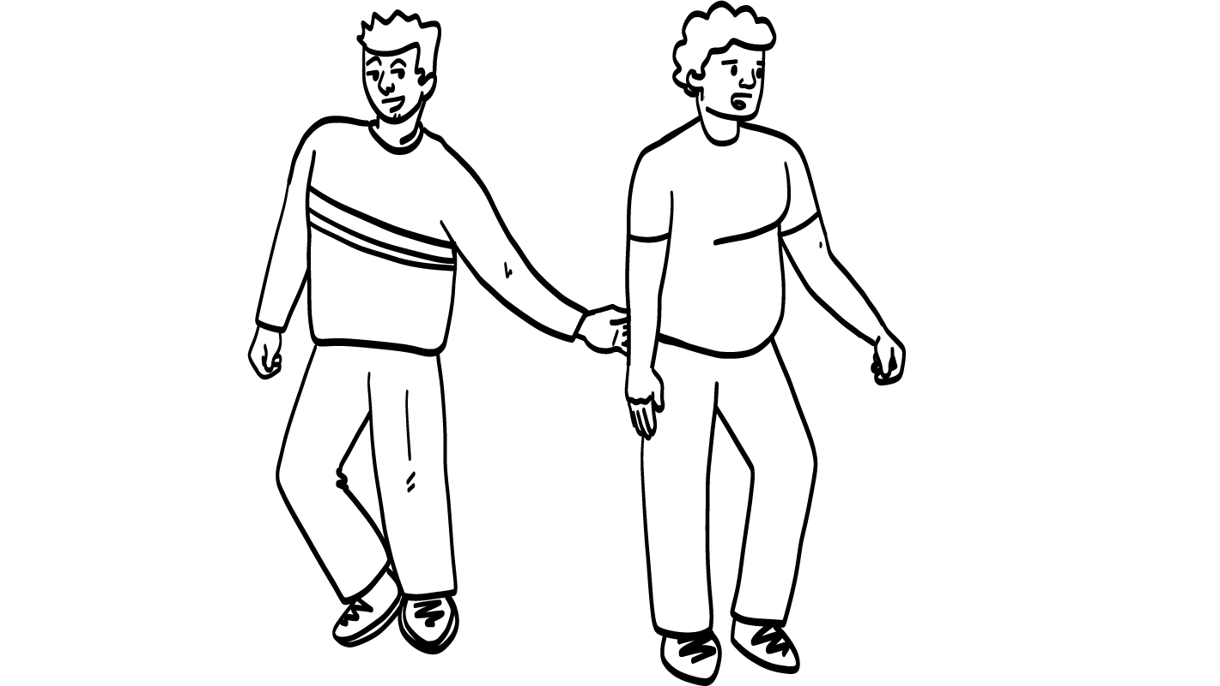
Your friend slaps your butt and when you get mad, they say it was just a joke.
Not cool
© 2026 SAFE Disability Services Program
Notes:
Find the Cool or Not Cool Game Card that corresponds with this PowerPoint slide. Ask your class to give a “thumbs up” if they agree with the placement of the card, or a “thumbs down” if they don’t. Ask students to explain their thoughts if there is disagreement. Once the class has come to a consensus, you can press the space bar to reveal the correct answer. If needed, move the Cool or Not Cool Game Card to the correct side.
Sample talking points are included below:
This is not cool. Your friend should not touch your body without your consent, your okay or permission. Also, if you tell your friend that you are upset, they should listen to you. It’s not okay for them to do something that upsets you and then tell you it was “just a joke.” This is a boundary crossing.

Slide 15
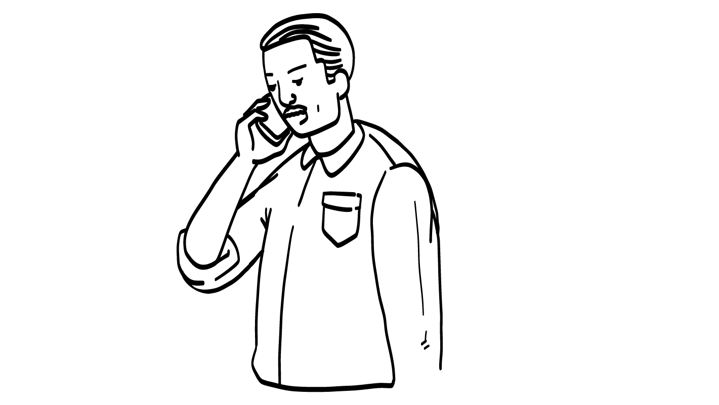
Your parent is always on the phone when you are trying to talk to them.
Not cool
© 2026 SAFE Disability Services Program
Notes:
Find the Cool or Not Cool Game Card that corresponds with this PowerPoint slide. Ask your class to give a “thumbs up” if they agree with the placement of the card, or a “thumbs down” if they don’t. Ask students to explain their thoughts if there is disagreement. Once the class has come to a consensus, you can press the space bar to reveal the correct answer. If needed, move the Cool or Not Cool Game Card to the correct side.
Sample talking points are included below:
This is not cool. Healthy relationships need good communication. Good communication includes listening to the other person when they are talking. This is a boundary crossing.

Slide 16
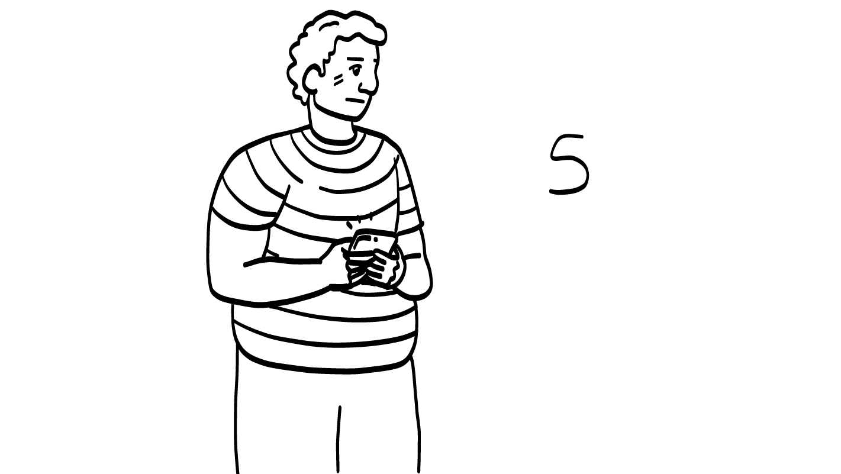
Your friend looks through your text messages when you are not in the room.
Not cool
© 2026 SAFE Disability Services Program
Notes:
Find the Cool or Not Cool Game Card that corresponds with this PowerPoint slide. Ask your class to give a “thumbs up” if they agree with the placement of the card, or a “thumbs down” if they don’t. Ask students to explain their thoughts if there is disagreement. Once the class has come to a consensus, you can press the space bar to reveal the correct answer. If needed, move the Cool or Not Cool Game Card to the correct side.
Sample talking points are included below:
This is not cool. It is not respectful for your friend to look through your private things without your consent, your okay or permission. This is a boundary crossing.

Slide 17
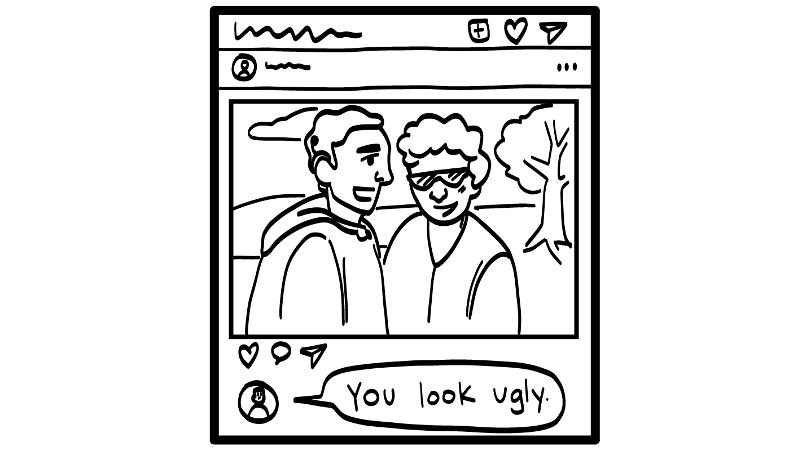
Someone comments on your photo and says you are ugly.
Not cool
© 2026 SAFE Disability Services Program
Notes:
Find the Cool or Not Cool Game Card that corresponds with this PowerPoint slide. Ask your class to give a “thumbs up” if they agree with the placement of the card, or a “thumbs down” if they don’t. Ask students to explain their thoughts if there is disagreement. Once the class has come to a consensus, you can press the space bar to reveal the correct answer. If needed, move the Cool or Not Cool Game Card to the correct side.
Sample talking points are included below:
This is not cool. It is never okay for someone to say mean things to you online or in person. This is cyberbullying, and if you are ever hurt by someone online, you can get help. This is a boundary crossing.

Slide 18
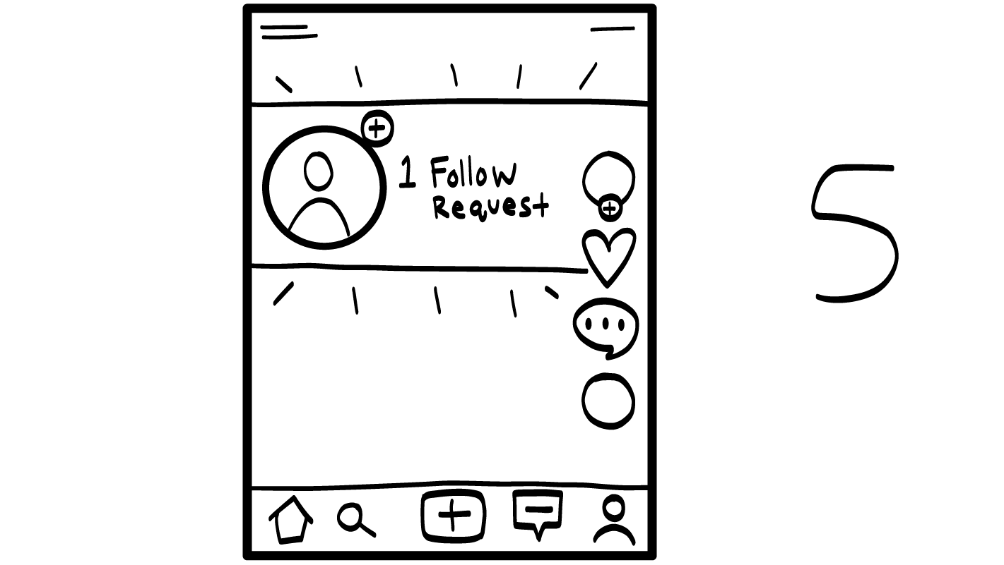
?
Someone you don’t know asks to follow you on Instagram.
Not cool
© 2026 SAFE Disability Services Program
Notes:
Find the Cool or Not Cool Game Card that corresponds with this PowerPoint slide. Ask your class to give a “thumbs up” if they agree with the placement of the card, or a “thumbs down” if they don’t. Ask students to explain their thoughts if there is disagreement. Once the class has come to a consensus, you can press the space bar to reveal the correct answer. If needed, move the Cool or Not Cool Game Card to the correct side.
Sample talking points are included below:
This is not cool. You shouldn’t connect with anyone on social media, including Instagram, that you don’t know. If you don’t know someone, they are in your red circle. You don’t know if they can be trusted and you should not allow them to follow you. This is a boundary crossing.

Slide 19
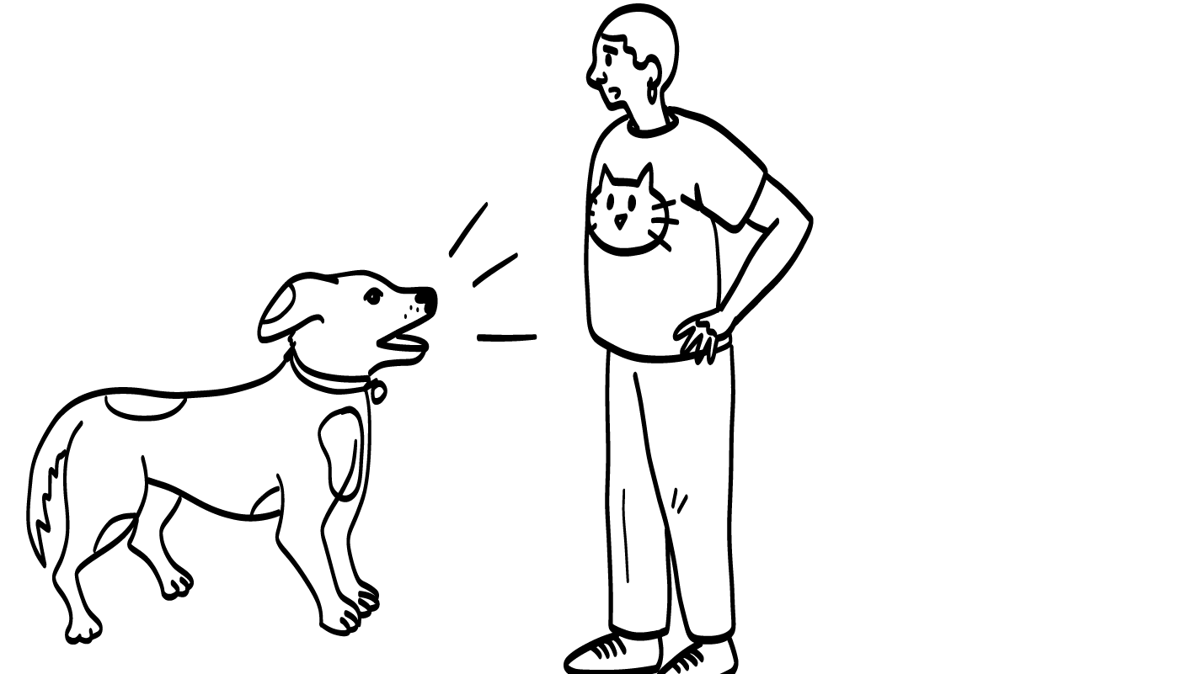
Your friend is afraid of dogs and asks you to put them in the other room.
Cool
© 2026 SAFE Disability Services Program
Notes:
Find the Cool or Not Cool Game Card that corresponds with this PowerPoint slide. Ask your class to give a “thumbs up” if they agree with the placement of the card, or a “thumbs down” if they don’t. Ask students to explain their thoughts if there is disagreement. Once the class has come to a consensus, you can press the space bar to reveal the correct answer. If needed, move the Cool or Not Cool Game Card to the correct side.
Sample talking points are included below:
This is cool! Not all people like dogs. If you have a dog, and your friend is scared of dogs, you should ask your friend what they need to feel okay coming to visit you. This is a healthy boundary.

Slide 20
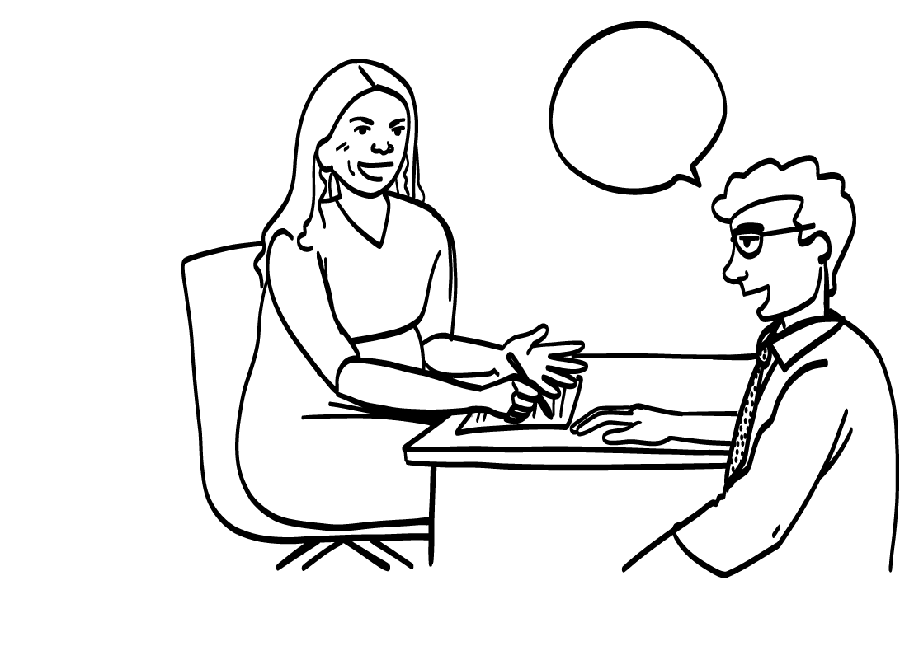
Your teacher says you look nice today.
Cool
Not cool
© 2026 SAFE Disability Services Program
Notes:
Find the Cool or Not Cool Game Card that corresponds with this PowerPoint slide. Ask your class to give a “thumbs up” if they agree with the placement of the card, or a “thumbs down” if they don’t. Ask students to explain their thoughts if there is disagreement. Once the class has come to a consensus, you can press the space bar to reveal the correct answer. If needed, move the Cool or Not Cool Game Card to the correct side.
Sample talking points are included below:
This one is tricky. If your teacher says you look nice in a normal voice, this might be cool. If your teacher says you look nice while looking up and down your body, that’s not cool or OK. If your teacher ever does something that makes you feel uncomfortable or scared or grossed out, you should talk to an adult in your inner green circle of people you trust the most.

Slide 21
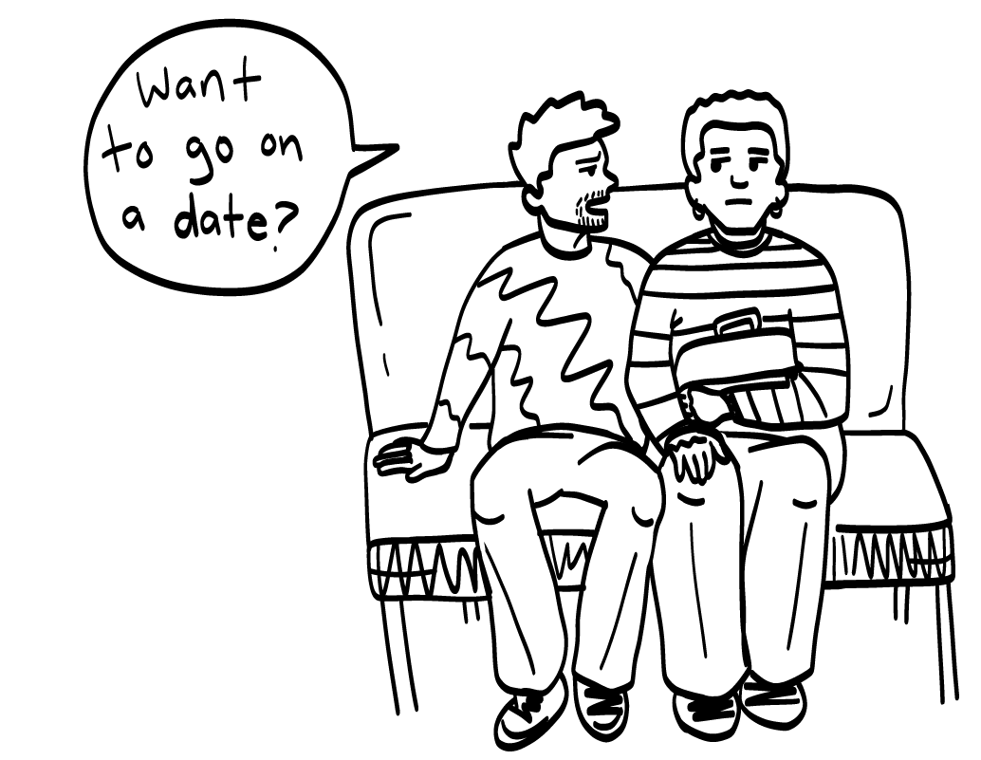
A new student on the bus asks you to go out with them.
Not cool
© 2026 SAFE Disability Services Program
Notes:
Find the Cool or Not Cool Game Card that corresponds with this PowerPoint slide. Ask your class to give a “thumbs up” if they agree with the placement of the card, or a “thumbs down” if they don’t. Ask students to explain their thoughts if there is disagreement. Once the class has come to a consensus, you can press the space bar to reveal the correct answer. If needed, move the Cool or Not Cool Game Card to the correct side.
Sample talking points are included below:
This is not cool. Someone you have only met on the bus is in your outer red circle of people you do not know, or you have just met, and they are not a safe person to go on a date with. This is a boundary crossing.

Slide 22
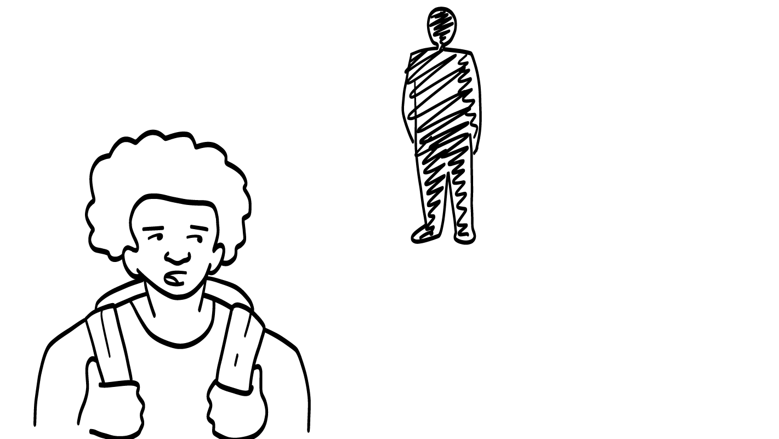
Someone at school keeps following you in the halls.
Not cool
© 2026 SAFE Disability Services Program
Notes:
Find the Cool or Not Cool Game Card that corresponds with this PowerPoint slide. Ask your class to give a “thumbs up” if they agree with the placement of the card, or a “thumbs down” if they don’t. Ask students to explain their thoughts if there is disagreement. Once the class has come to a consensus, you can press the space bar to reveal the correct answer. If needed, move the Cool or Not Cool Game Card to the correct side.
Sample talking points are included below:
This is not cool. It’s not okay for someone to follow you around. This is a boundary crossing.

Slide 23
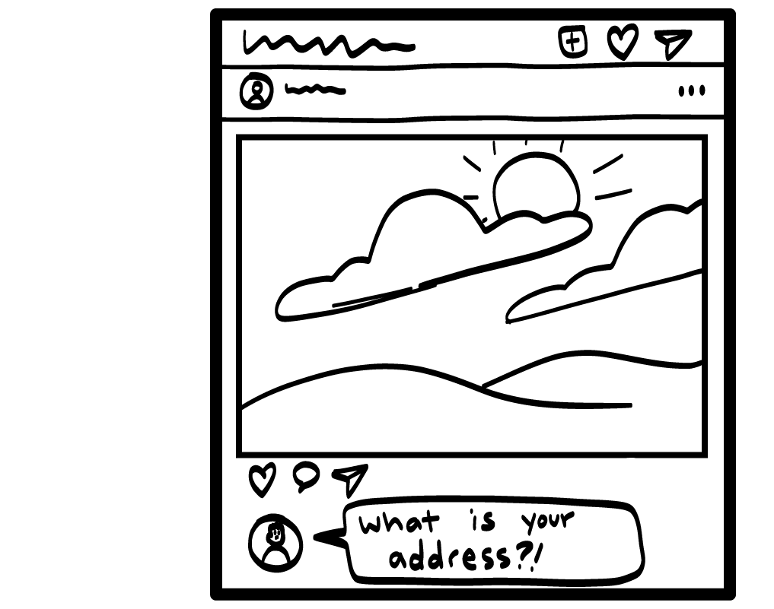
Someone you met online asks for your address.
Not cool
© 2026 SAFE Disability Services Program
Notes:
Find the Cool or Not Cool Game Card that corresponds with this PowerPoint slide. Ask your class to give a “thumbs up” if they agree with the placement of the card, or a “thumbs down” if they don’t. Ask students to explain their thoughts if there is disagreement. Once the class has come to a consensus, you can press the space bar to reveal the correct answer. If needed, move the Cool or Not Cool Game Card to the correct side.
Sample talking points are included below:
This is not cool. Your address is private—that means only people you really trust should know it. Remember, if you’ve only ever talked to someone online, they are in your outer red circle. You cannot trust them yet and you should not share private information with them. This is a boundary crossing.

Slide 24
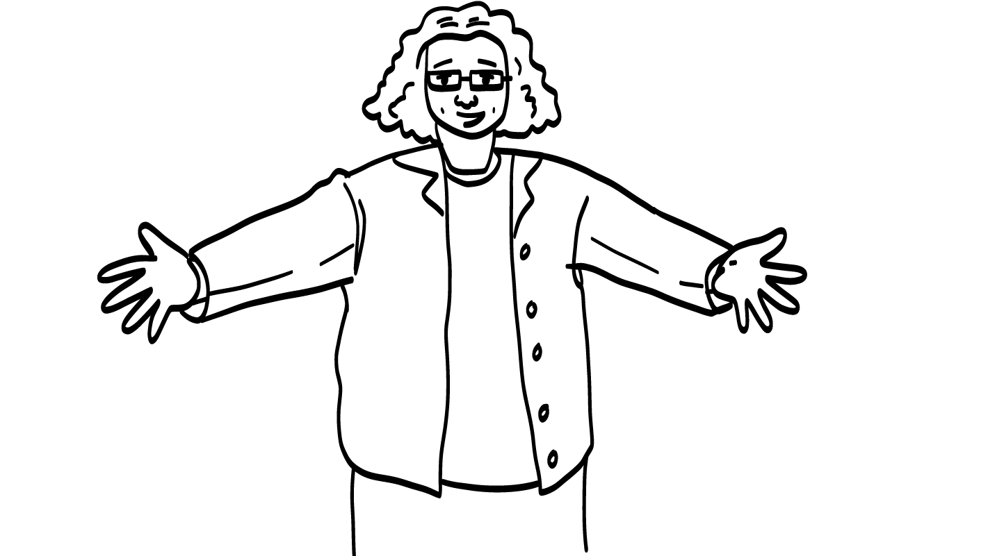
You are having a bad day, and your classmate asks if they can give you a hug.
Cool
© 2026 SAFE Disability Services Program
Notes:
Find the Cool or Not Cool Game Card that corresponds with this PowerPoint slide. Ask your class to give a “thumbs up” if they agree with the placement of the card, or a “thumbs down” if they don’t. Ask students to explain their thoughts if there is disagreement. Once the class has come to a consensus, you can press the space bar to reveal the correct answer. If needed, move the Cool or Not Cool Game Card to the correct side.
Sample talking points are included below:
This is cool! Your classmate is asking for your consent, your okay or permission, to give you a hug. You have to ask before you touch someone’s body. You might not want a hug, and that’s okay. You can tell your classmate “yes” or “no.” This is a healthy boundary.

Slide 25
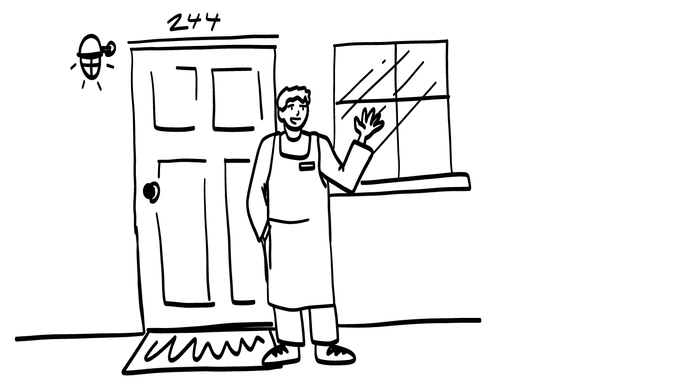
Your friend shows up at your house without being invited.
Not cool
© 2026 SAFE Disability Services Program
Notes:
Find the Cool or Not Cool Game Card that corresponds with this PowerPoint slide. Ask your class to give a “thumbs up” if they agree with the placement of the card, or a “thumbs down” if they don’t. Ask students to explain their thoughts if there is disagreement. Once the class has come to a consensus, you can press the space bar to reveal the correct answer. If needed, move the Cool or Not Cool Game Card to the correct side.
Sample talking points are included below:
This is not cool. It’s not okay to go to someone’s house unless they have asked you to come to their house. This is a boundary crossing.

Slide 26
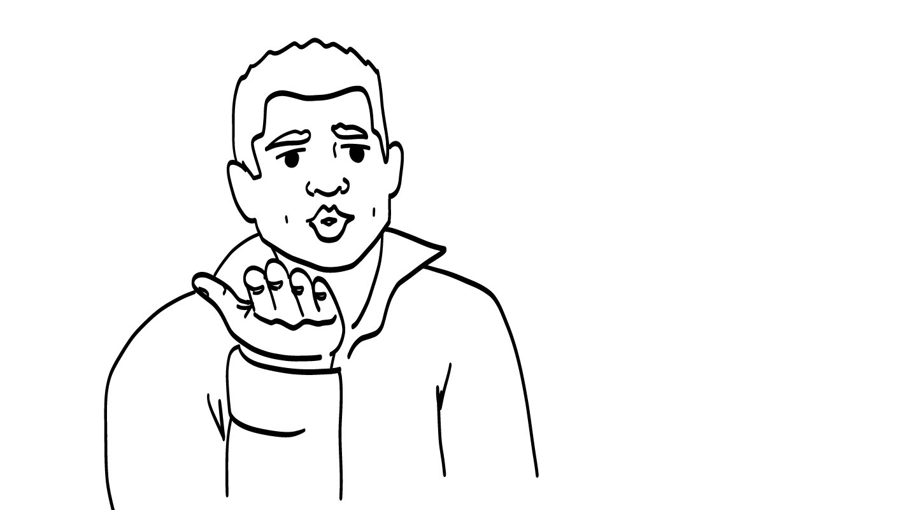
Your classmate keeps staring at you and blowing kisses.
Not cool
© 2026 SAFE Disability Services Program
Notes:
Find the Cool or Not Cool Game Card that corresponds with this PowerPoint slide. Ask your class to give a “thumbs up” if they agree with the placement of the card, or a “thumbs down” if they don’t. Ask students to explain their thoughts if there is disagreement. Once the class has come to a consensus, you can press the space bar to reveal the correct answer. If needed, move the Cool or Not Cool Game Card to the correct side.
Sample talking points are included below:
This is not cool. If someone is staring at you and blowing kisses at you and you don’t like it, that’s sexual harassment. Even if you like the person blowing kisses at you, school is not an okay place to blow kisses at someone. This is a boundary crossing.

Slide 27
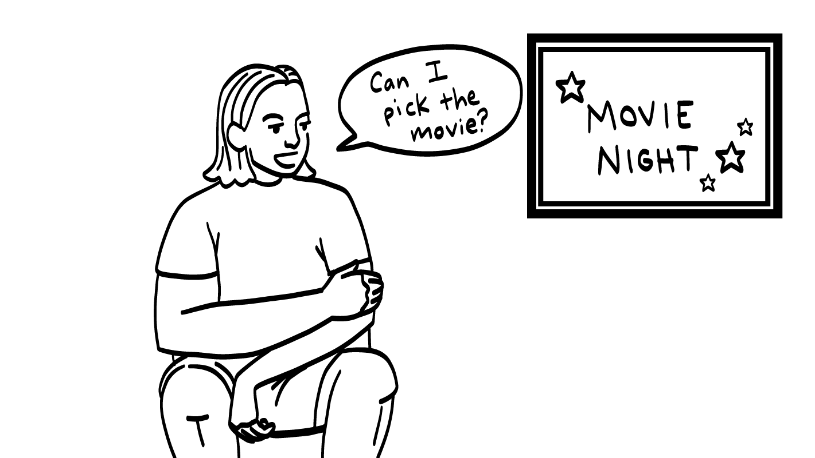
Your friend asks if
they can pick the movie for movie night.
Cool
© 2026 SAFE Disability Services Program
Notes:
Find the Cool or Not Cool Game Card that corresponds with this PowerPoint slide. Ask your class to give a “thumbs up” if they agree with the placement of the card, or a “thumbs down” if they don’t. Ask students to explain their thoughts if there is disagreement. Once the class has come to a consensus, you can press the space bar to reveal the correct answer. If needed, move the Cool or Not Cool Game Card to the correct side.
Sample talking points are included below:
This is cool! In a friendship, no person is the boss. You and your friend should make choices together or take turns making choices. It’s completely okay for your friend to ask if they can choose the movie for your movie night. This is a healthy boundary.

Slide 28
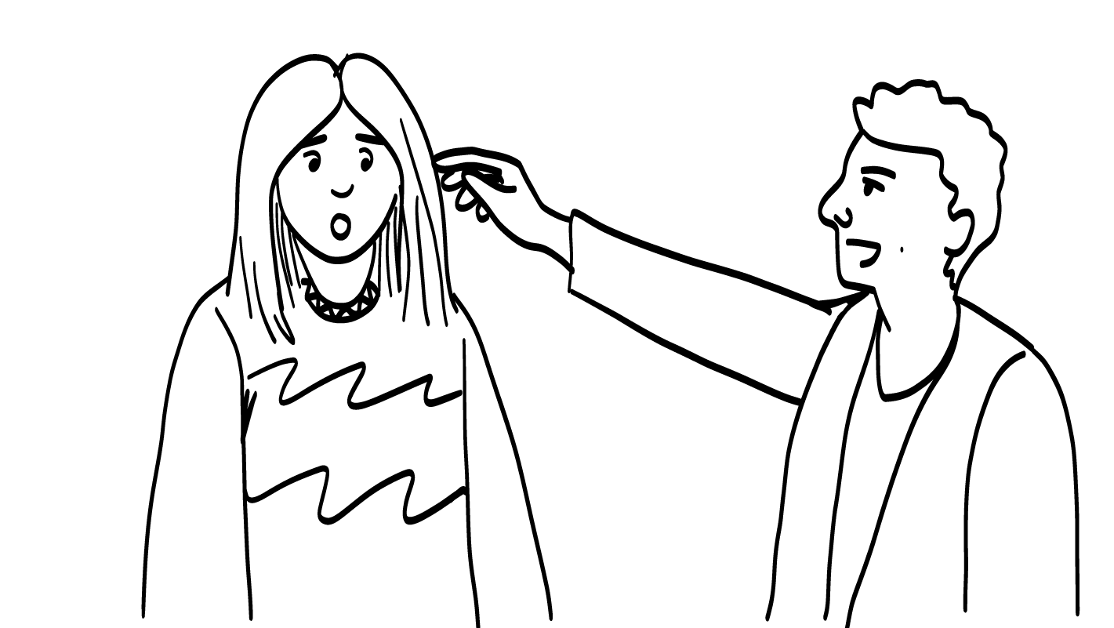
A stranger touches your hair and says: “You are beautiful.”
Not cool
© 2026 SAFE Disability Services Program
Notes:
Find the Cool or Not Cool Game Card that corresponds with this PowerPoint slide. Ask your class to give a “thumbs up” if they agree with the placement of the card, or a “thumbs down” if they don’t. Ask students to explain their thoughts if there is disagreement. Once the class has come to a consensus, you can press the space bar to reveal the correct answer. If needed, move the Cool or Not Cool Game Card to the correct side.
Sample talking points are included below:
This is not cool. It is never okay for a stranger to touch any part of your body. This would feel really scary. If this happens to you, you can get help from someone in your inner green circle of trust. This is a boundary crossing.

Slide 29
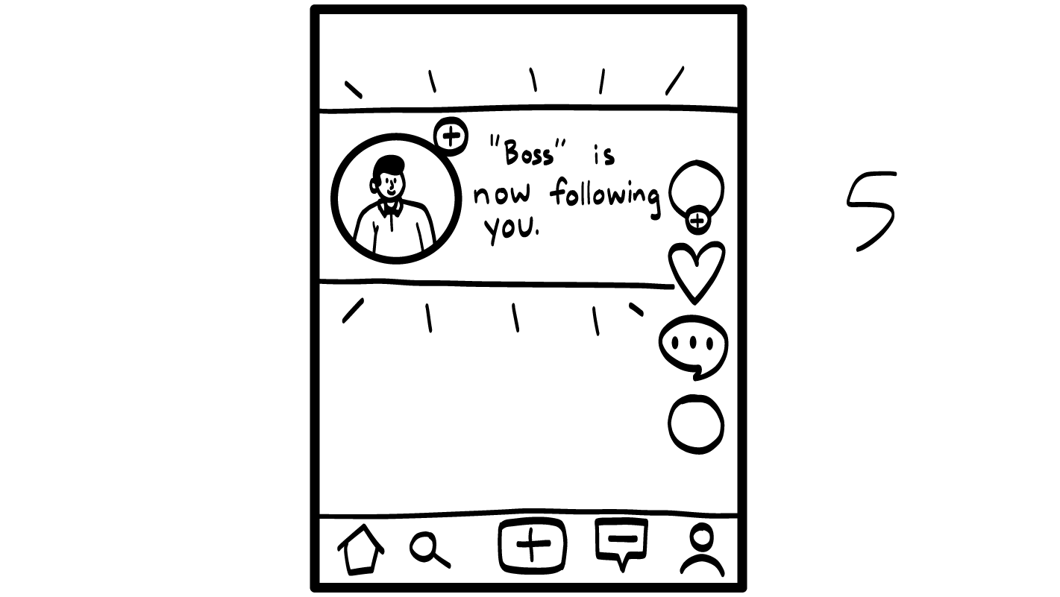
Your teacher friends you on social media.
Not cool
© 2026 SAFE Disability Services Program
Notes:
Find the Cool or Not Cool Game Card that corresponds with this PowerPoint slide. Ask your class to give a “thumbs up” if they agree with the placement of the card, or a “thumbs down” if they don’t. Ask students to explain their thoughts if there is disagreement. Once the class has come to a consensus, you can press the space bar to reveal the correct answer. If needed, move the Cool or Not Cool Game Card to the correct side.
Sample talking points are included below:
In most cases, this is not cool. Most people want to keep their school and personal lives separate. If your teacher tries to friend you on social media, talk to an adult in your inner green circle of most trusted people for help.

Slide 30
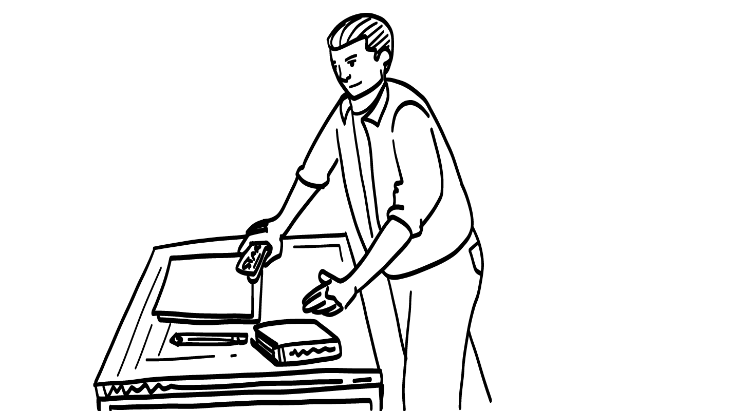
Your classmate takes something from your desk.
Cool
Not cool
© 2026 SAFE Disability Services Program
Notes:
Find the Cool or Not Cool Game Card that corresponds with this PowerPoint slide. Ask your class to give a “thumbs up” if they agree with the placement of the card, or a “thumbs down” if they don’t. Ask students to explain their thoughts if there is disagreement. Once the class has come to a consensus, you can press the space bar to reveal the correct answer. If needed, move the Cool or Not Cool Game Card to the correct side.
Sample talking points are included below:
This is cool as long as your classmate asks first. If they did not ask first, it is not cool. It’s important that any time you are going to use someone’s things, you get their consent, their okay or permission, first.
Say: Thanks for playing the Cool or Not Cool Game everyone! Would anyone like to share any other examples of things that cross your boundaries?
Give students enough time to process the question and make their decisions.

Slide 31
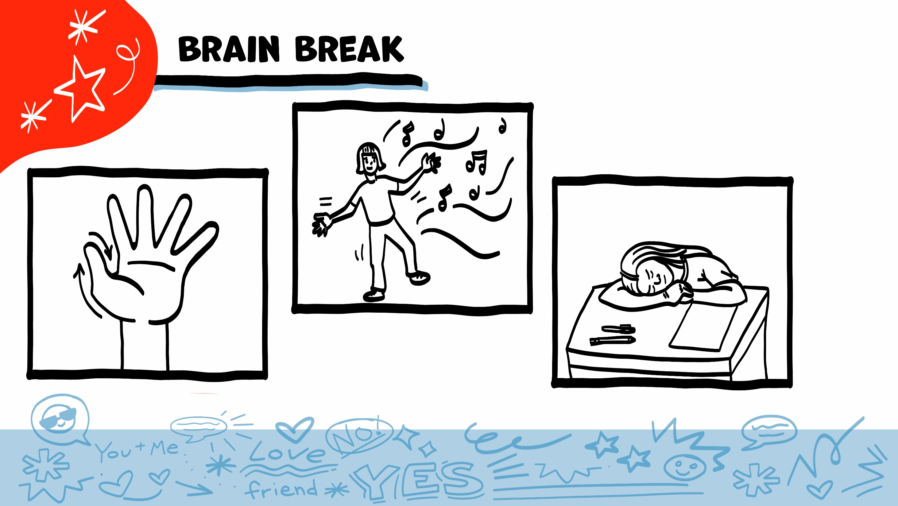
© 2026 SAFE Disability Services Program
Notes:
Say: That was a lot of information, and you all are doing an amazing job! Every week in class we will take a brain break in the middle. This is a chance to move a little and take a break from thinking!
Below are three ideas to give students a quick opportunity for a brain break. You are also welcome to come up with your own ideas for brain breaks that work best for your class.
Five finger breathing
For this exercise, have all students place their hand in front of their chest with their five fingers spread out. Next, use the pointer finger of the other hand to trace up and down each of the five fingers, beginning with the thumb. As students trace up a finger, they will breathe in. As they trace down a finger, they will breathe out. When students breathe out on the pinky finger, you can tell them to shake out their hands and arms. As the school year goes on, you can ask students to lead this exercise for their peers.
If this exercise is physically inaccessible for your class, you can also model the hand tracing for students while they breathe in and out.
Stretch break
Lead students through a series of basic stretches. These can be completed in a chair, or while standing up, depending on the accommodation needs of your class. Some ideas include reaching toward the ceiling, stretching one arm at a time across the chest, reaching toward toes, turning head from side to side, etc. Ask students to hold a pose while you count to ten. As the school year goes on, you can ask students to lead stretches for their peers.
Dance party
If your class likes to dance, you can put on a short song for them to dance to. This is especially effective if you are able to find a song that relates to the theme for that week’s class.

Slide 32
Boundaries
talk
Cool or Not Cool Game
Brain break
NO! Tool
Boundaries Guide
© 2026 SAFE Disability Services Program
Notes:
Say: So far today we have talked a lot about what your boundaries are. Now we are going to talk about how to use the NO! Tool to set your boundaries.

Slide 33
© 2026 SAFE Disability Services Program
Notes:
Say: When someone does something that is not cool, that crosses your boundaries, you can say NO! You always have the right to say NO! to anyone or anything that makes you feel uncomfortable or unsafe. Your can set your boundaries in hallways, classrooms, bathrooms, dorms, all modes of transportation, and the community. You can say NO! with your words, signs, pictures, and body no matter where you are.
Read an example from the “Not Cool” column and ask students to practice responding by saying NO! with their voice, signs, pictures, or body.

Slide 34
© 2026 SAFE Disability Services Program
Notes:
Say: Today we are going to add our third tool to the Healthy Relationship Toolbox. Our third tool is the NO! Tool. If someone crosses your boundaries, you can say “NO!” with your voice, signs, pictures, or body. Is there anyone who would like to volunteer to put the NO! Tool on our Healthy Relationships Toolbox?
Have the volunteer Velcro the Class NO! Tool Manipulative onto the Class Healthy Relationships Toolbox. Next, give each student a glue stick and a copy of the Student NO! Tool. Give students a few minutes to glue their tools into the toolbox. Over the next several weeks, students will be adding tools to their toolboxes, so be sure to ask students to hold onto their toolboxes for the next class.

Slide 35
Boundaries
talk
Cool or Not Cool Game
Brain break
NO! Tool
Boundaries Guide
© 2026 SAFE Disability Services Program
Notes:
Say: The last thing we’ll do today is go over the Boundaries Guide.

Slide 36
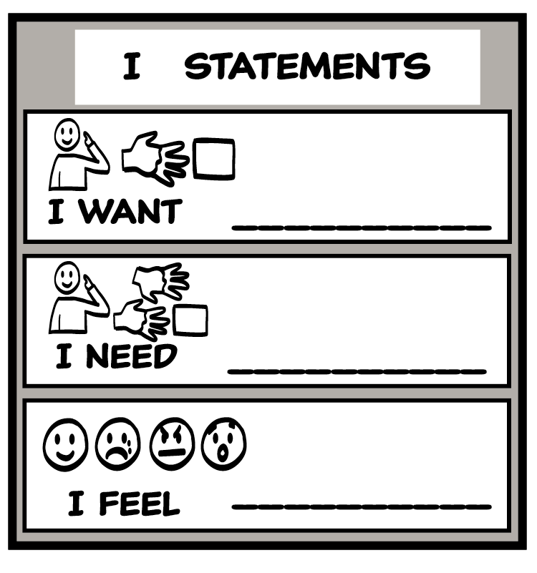
Boundaries Guide
© 2026 SAFE Disability Services Program
Notes:
Say: Can someone read the third step?
The third step is to “Get safe.” If your boundary is not respected, leave the situation or get help from someone you trust as soon as you can. Who could you tell if your boundary was crossed? Where are they on your relationship map?
Give students enough time to process the question and make their decisions.
You could talk to someone in your inner green circle of most trusted people. If someone is hurting you or making you uncomfortable it is important to tell someone you trust so you can get help. If the first person you tell does not believe you, tell a different adult from your inner green circle of trust. Keep telling adults what’s happening until someone believes you and helps you.
Who could you talk to if you are at school? Examples: a teacher, counselor, assistant principal or principal.
Who could you talk to if you are on the bus? Examples: bus monitor or bus driver.
How about if you are out in the community, like a store or the park? Examples: a store employee, security guard, an adult you trust who comes with you to the park.
Note: You can also look up the local domestic violence and/or rape crisis center in your area. They probably have a toll-free hotline that is available 24/7 for individuals whose relationship boundaries have been crossed. Or you can look up Love Is Respect, a project of the National Domestic Violence Hotline which offers 24/7 information, support, and advocacy to young people between the ages of 13 and 26 who have questions or concerns about their romantic relationships. They can also provide support to concerned friends and family members, teachers, counselors, and other service providers through the same free and confidential services via phone, text, and live chat.
Say: In an emergency, you can also call 911. An emergency means you are unsafe and need help right away. When you call 911, it can help to tell the person who answers the phone that you have a disability. When the police get there, they will know about your disability and might be better able to help you. When you call 911, the police or an ambulance might come.
Note: We have told students they can tell 911 dispatchers about their disability because we believe that emergency personnel responding to this call may be better equipped to respond if they have this information. Unfortunately, there have been some cases where law enforcement has responded to people with disabilities and misinterpreted some of their disability signs (ex: slurred speech, not responding to commands, not making eye contact). We feel that being able to tell 911 that the student has a disability is an important part of self-advocacy and safety.
At the time the original manual was written for the 18+ population (2026), many communities were having discussions about police violence. Data analysis shows that people with disabilities experience police violence at higher rates than people without disabilities, and this is especially true for people with disabilities who are also people of color. While we believe that including 911 in safety planning is still a valuable resource, especially because it is such a widely known number that is relatively easy to remember, we also acknowledge that calling law enforcement may not feel safe to all students. If a student expresses concerns about safety when calling 911, you can have a discussion with the class about the pros and cons of calling law enforcement. Ultimately, emphasize that the student has the right to decide what steps feel the safest for them to take after their boundary has been crossed. An important part of self-advocacy for teens with disabilities is being able to identify who and what makes them feel most safe.

Slide 37
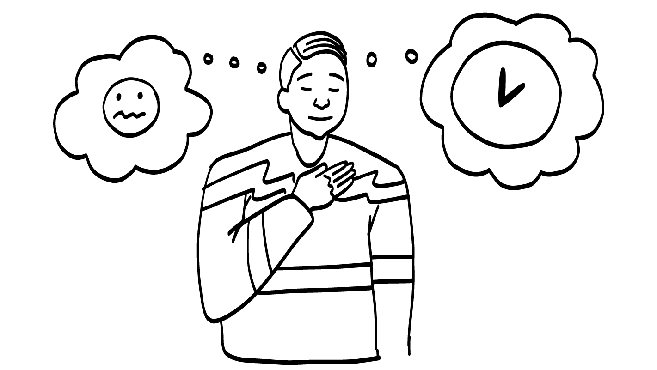
1. Trust your feelings
Grossed out
Nervous
Sad
Mad
Scared
© 2026 SAFE Disability Services Program
Notes:
Say: Can someone read the first step?
The first step is to “Trust your feelings.” Your feelings let you know what your boundaries are. Remember: YOU KNOW YOU BEST! Your feelings let you know when things are unsafe. When you feel uncomfortable or unsafe, trust your feelings.
Read an example or two from the “Not cool” column. For each example, ask the class, “How would this make you feel?”

Slide 38
2. Say your boundary
© 2026 SAFE Disability Services Program
Notes:
Say: Can someone read the second step?
The second step is to “Say your boundary.” You can use your voice, signs, pictures, or body to communicate your boundary. There are also two Relationship Toolbox Tools you can use to set your boundary. The first is the NO! Tool. You can always say NO! If it feels unsafe, you have the right to say NO! to anyone or anything that crosses your boundary. We practiced this just a minute ago.
Another way to say your boundary is to use the I Statement Tool. Remember, I statements tell other people how you are feeling or what you want or need.
Read an example or two from the “Not cool” column and ask students to come up with an “I feel” statement they could use in that scenario. Read a few more examples from the “Not cool” column and ask students to come up with an “I want” or “I need” statement they could use in that scenario.

Slide 39

3. Get safe
© 2026 SAFE Disability Services Program
Notes:
Say: Can someone read the third step?
The third step is to “Get safe.” If your boundary is not respected, leave the situation or get help from someone you trust as soon as you can. Who could you tell if your boundary was crossed? Where are they on your relationship map?
Give students enough time to process the question and make their decisions.
You could talk to someone in your inner green circle of most trusted people. If someone is hurting you or making you uncomfortable it is important to tell someone you trust so you can get help. If the first person you tell does not believe you, tell a different adult from your inner green circle of trust. Keep telling adults what’s happening until someone believes you and helps you.
Who could you talk to if you are at school? Examples: a teacher, counselor, assistant principal or principal.
Who could you talk to if you are on the bus? Examples: bus monitor or bus driver.
How about if you are out in the community, like a store or the park? Examples: a store employee, security guard, an adult you trust who comes with you to the park.
Note: You can also look up the local domestic violence and/or rape crisis center in your area. They probably have a toll-free hotline that is available 24/7 for individuals whose relationship boundaries have been crossed. Or you can look up Love Is Respect, a project of the National Domestic Violence Hotline which offers 24/7 information, support, and advocacy to young people between the ages of 13 and 26 who have questions or concerns about their romantic relationships. They can also provide support to concerned friends and family members, teachers, counselors, and other service providers through the same free and confidential services via phone, text, and live chat.
Say: In an emergency, you can also call 911. An emergency means you are unsafe and need help right away. When you call 911, it can help to tell the person who answers the phone that you have a disability. When the police get there, they will know about your disability and might be better able to help you. When you call 911, the police or an ambulance might come.
Note: We have told students they can tell 911 dispatchers about their disability because we believe that emergency personnel responding to this call may be better equipped to respond if they have this information. Unfortunately, there have been some cases where law enforcement has responded to people with disabilities and misinterpreted some of their disability signs (ex: slurred speech, not responding to commands, not making eye contact). We believe that being able to tell 911 that the student has a disability is an important part of self-advocacy and safety.
At the time the original curriculum was written for the 18+ population (2026), many communities were having discussions about police violence. Data analysis shows that people with disabilities experience police violence at higher rates than people without disabilities, and this is especially true for people with disabilities who are also people of color. While we believe that including 911 in safety planning is still a valuable resource, especially because it is such a widely known number that is relatively easy to remember, we also acknowledge that calling law enforcement may not feel safe to all students. If a student expresses concerns about safety when calling 911, you can have a discussion with the class about the pros and cons of calling law enforcement. Ultimately, emphasize that the student has the right to decide what steps feel the safest for them to take after their boundary has been crossed. An important part of self-advocacy for teens with disabilities is being able to identify who and what makes them feel most safe. Although we will do all that we can to increase and support safety in relationships – we can never promise safety or that a person will never be hurt again in a relationship. Unfortunately, no one has that kind l of power.

Slide 40
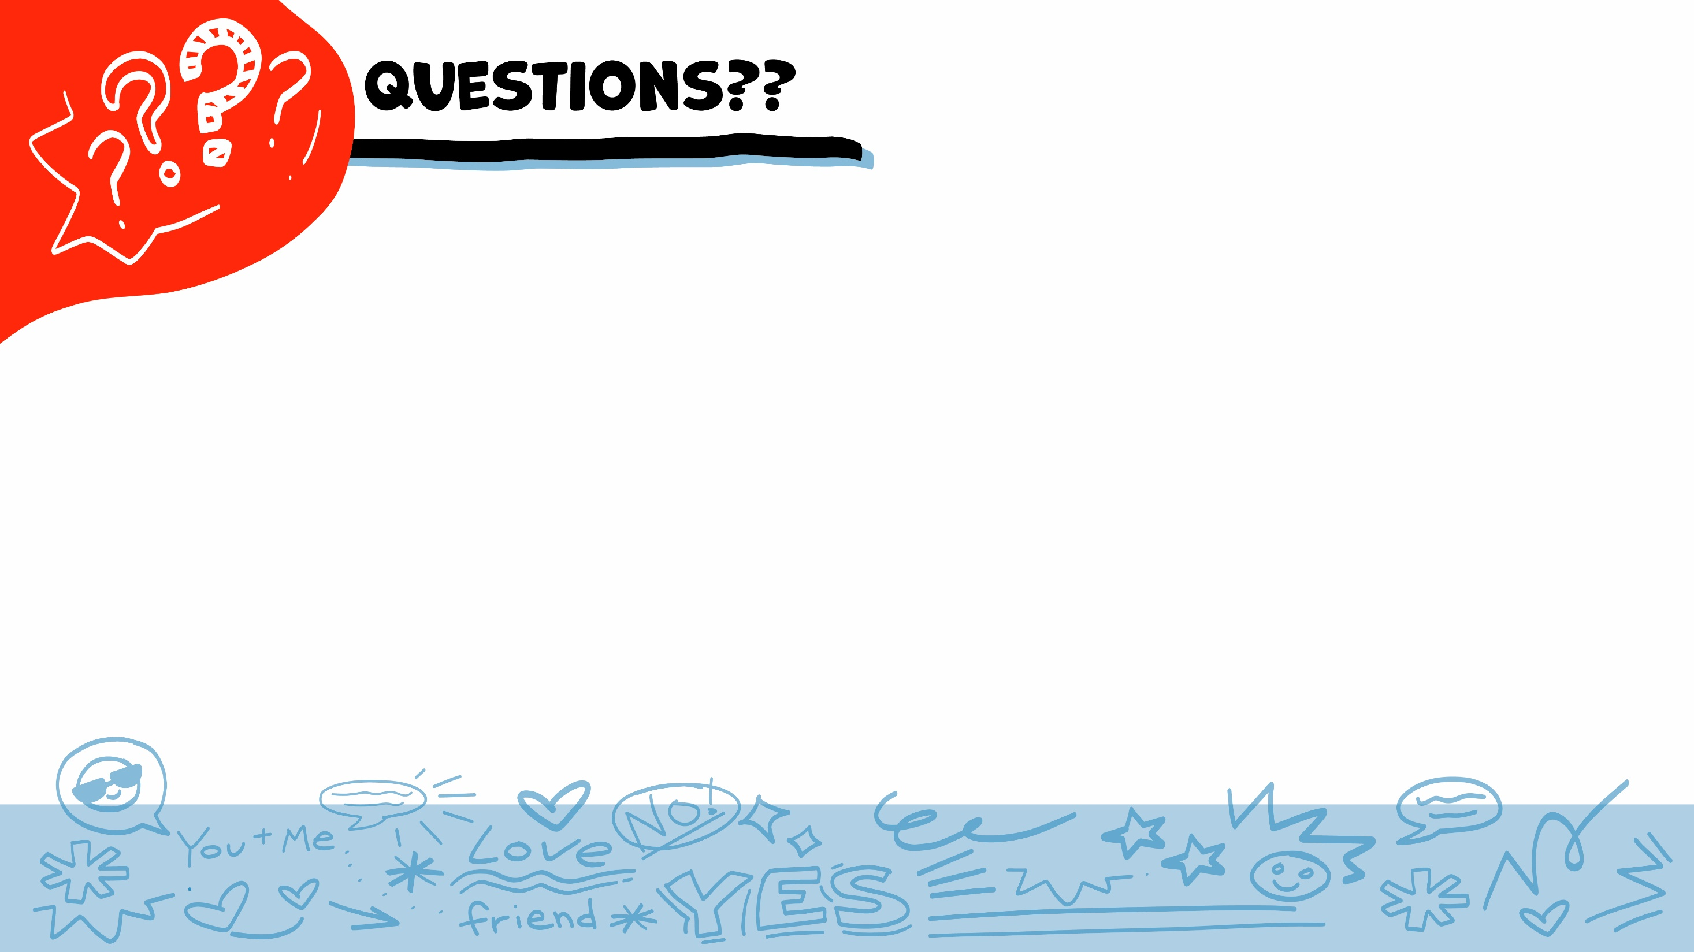
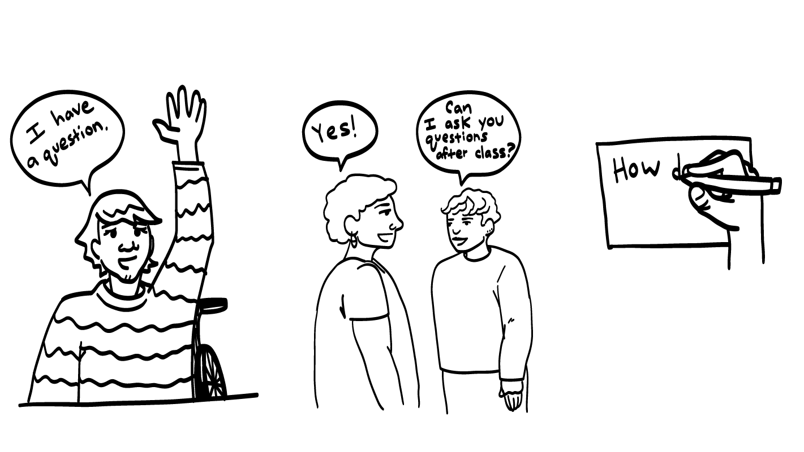
© 2026 SAFE Disability Services Program
Notes:
Say: Does anyone have any questions about today’s class? Remember, if you don’t want to ask your question out loud, you can write it on a notecard and leave it on your desk. You can also ask someone you trust to help you write your question on the notecard. I will pick up the notecards and will answer the questions the next time we meet. When I answer a question, I won’t tell anyone who asked it.

Slide 41
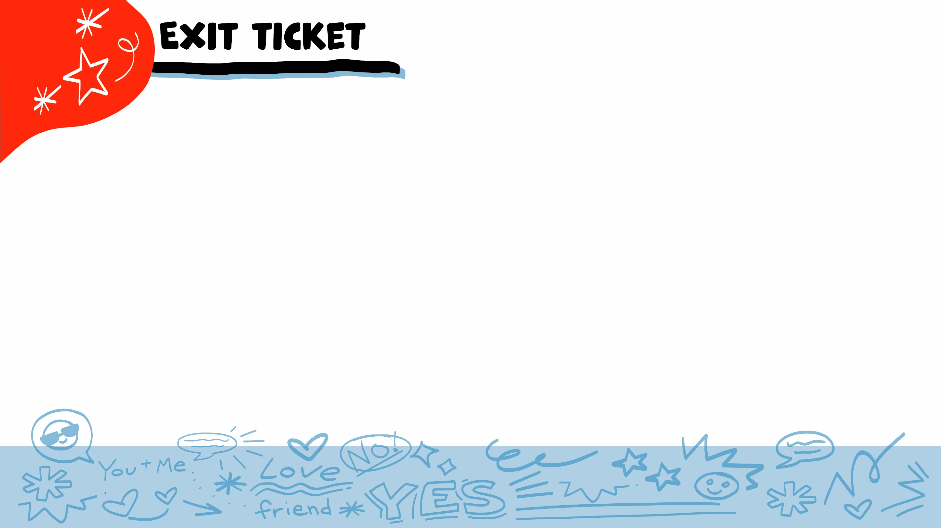


Do your feelings let you know what you are cool and not cool with in your relationships?
YES
NO
© 2026 SAFE Disability Services Program
Notes:
Say: Do your feelings let you know what you are cool and not cool with in your relationships? Hold a thumbs up for yes and a thumbs down for no.
Give students enough time to process the question and make their decisions.
Say: Yes! Remember, the first step of our Boundaries Guide is to “Trust your feelings!” If someone does something that makes you feel sad, mad, scared, nervous, or grossed out, pay attention. Your feelings are letting you know that someone did something that was not cool. This is a boundary crossing.

Slide 42
Do you have the right to say NO! to anyone or anything that crosses your boundary?
YES
NO
© 2026 SAFE Disability Services Program
Notes:
Say: Do you have the right to say NO! to anyone or anything that crosses your boundary? Hold a thumbs up for yes and a thumbs down for no.
Give students enough time to process the question and make their decisions.
Say: Yes, you always have the right to say NO! to anyone or anything that is not cool, or that crosses your boundary. The second step of our Boundaries Guide is to say your boundary. You can say your boundary by saying NO! or by using an I statement.

Slide 43
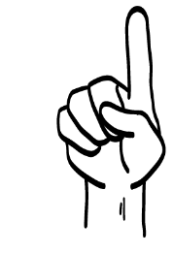
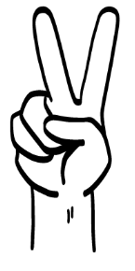

If someone crosses your boundary, the first step is to trust your feelings. The second step is to say your boundary. The third step is to:
Get safe
Take a nap
Just ignore the person
1
2
3
© 2026 SAFE Disability Services Program
Notes:
Say: If someone crosses your boundary, the first step is to trust your feelings. The second step is to say your boundary. The third step is to what? Hold up one finger for “get safe,” two fingers for “take a nap,” and three fingers for “just ignore the person.”
Give students enough time to process the question and make their decisions.
Say: The third step on the Boundaries Guide is to “get safe.” You can leave the situation as soon as possible. Talk to someone in your green circle of trust for help. In an emergency, you also have the option to call 911.

Slide 44


© 2026 SAFE Disability Services Program
Notes:
Say: If you are being hurt, or if someone ever touches your body in a way that you don’t like, you can get help. You did not do anything wrong, and you are not alone. You can get help by talking to an adult from your green circle of trust. If someone you care about is being hurt, you can also get help by talking to an adult from your inner green circle of trust. If an emergency is happening, you can always call 911. If you call 911 for help, a police officer or an ambulance might come.
If the first person you tell doesn’t believe you or doesn’t get you help, keep telling adults you trust what is going on until you get the help you need.

Slide 45

© 2026 SAFE Disability Services Program
Notes:
Say: Does anyone remember what our power statement is? Our power statement is “I know me best.” This means that each of you knows yourself better than anyone else does. Today we learned that you know your boundaries better than anyone else. Let’s gather together and on the count of three, say our power statement.
Have each interested student put one hand in the middle of the circle. Ask for a student volunteer to count to three. After three, all participants say the power statement while lifting their hands into the air. Students can also stand in the circle without touching hands if they prefer.

Slide 46

This work is supported by the Texas Council for Developmental Disabilities through a grant from the U.S. Administration for Community Living (ACL), Department of Health and Human Services (HHS), Washington, D.C. 20201 with a 100% federal funding award totaling $6,161,072. Council efforts are those of the grantee and do not necessarily represent the official views of nor are endorsed by ACL, HHS, or the U.S. government.
© 2026 SAFE Disability Services Program
Notes:
SAFE would like to thank the Texas Council for Developmental Disabilities for the funding for this curriculum.

Slide 47

This curriculum is offered online at no cost. You are free to use the resources in the original format for educational purposes only. Please reference The SAFE Alliance appropriately (citations at bottom of page).
We ask that you do not alter curriculum images/art, slides, or lesson plan materials. You may not use My Rights My Life (18+ or High School) curriculum for commercial purposes (i.e., selling workshops you facilitate based on MRML curriculum; and/or creating links/websites to re-distribute any materials associated SAFE’s My Rights My Life).
This resource, My Rights My Life: A curriculum for healthier relationships for high school students (grades 9-12) is based on the original My Rights My Life: A curriculum for safer relationships (age 18+) written by Megan Westmore, Heidi Lersch, and edited by Schwartz, M. (2026). Selling materials from MRML is a copyright violation.
Burleson, Anna Belle & Benitez, Sophie (2026) provided light modification and abbreviated the original curriculum
(Westmore & Lersch, 2026) to offer an age appropriate resource for High School Students (grades 9-12).
Schwartz, M. (Ed.). The SAFE Alliance, Austin, Texas.
Westmore, M. & Lersch, H. (2026). My rights my life: A curriculum for safer relationships.
Schwartz, M. (Ed.). The SAFE Alliance: Austin, TX.
© 2026 SAFE Disability Services Program

