Slide 1
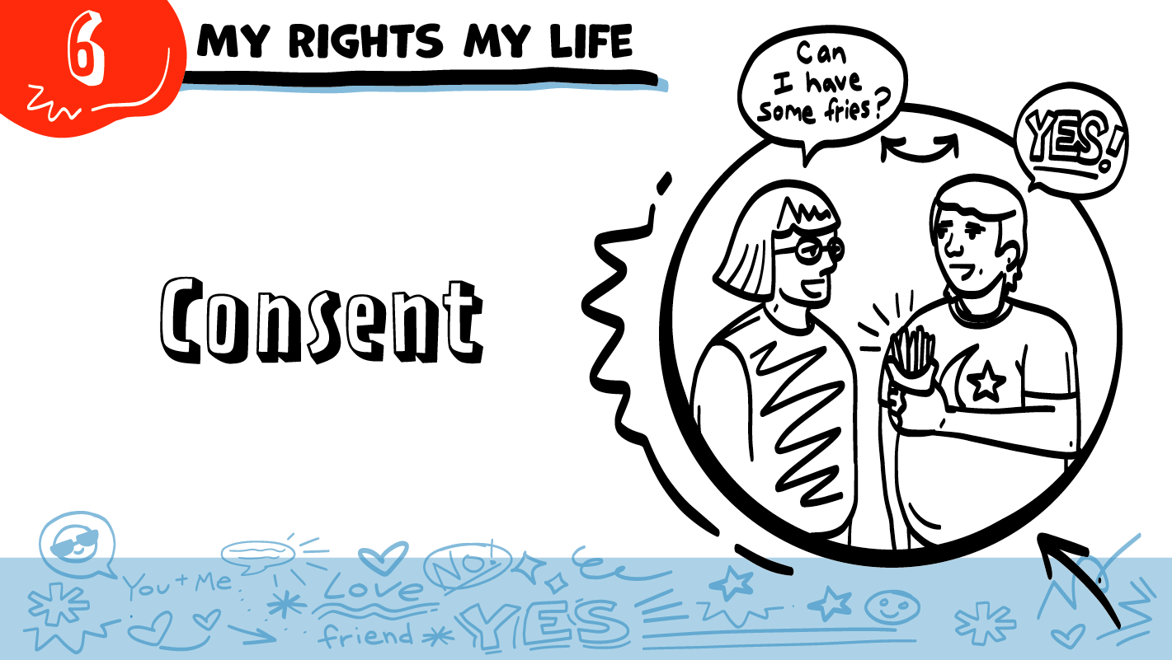

for High School Students
© 2026 SAFE Disability Services Program
Notes:
Repetition is beneficial for learning. Take time to review the last My Rights My Life class you taught prior to beginning this session. You can also answer any private questions students submitted on notecards during your previous class session.
Say: Today in class we will be talking about consent. Consent means getting someone’s okay or permission to do something. Basically, consent is when you ask, and someone says yes. Consent is one of the most important things you need to have in healthy relationships.

Slide 2
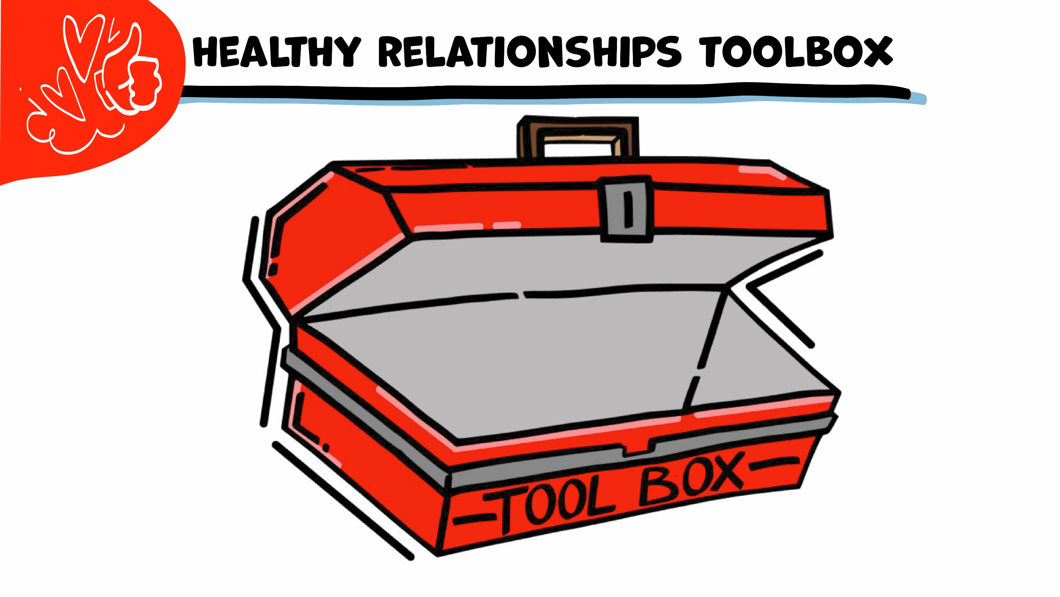

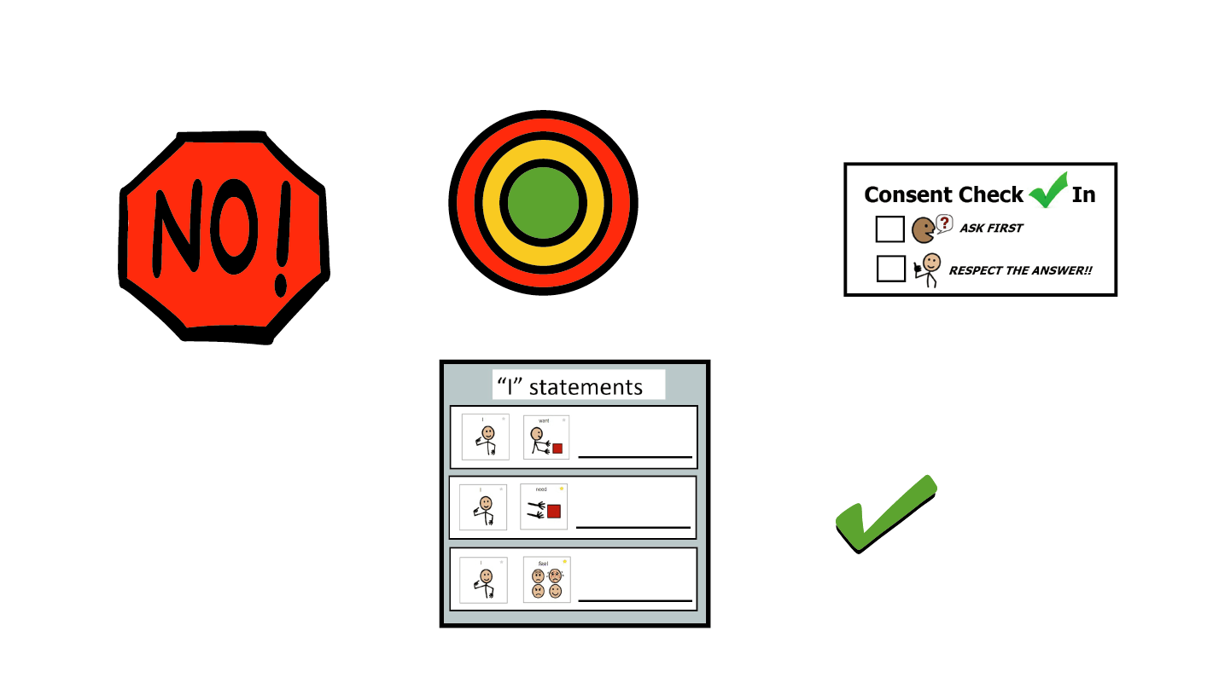
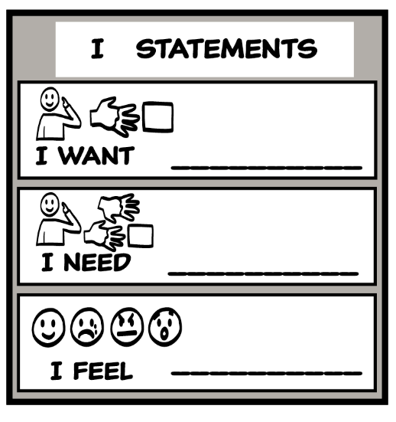
© 2026 SAFE Disability Services Program
Notes:
Say: Let’s start with a review of our Healthy Relationships Toolbox. The first tool we put in the toolbox is the I Statements Tool. Does anyone remember what I statements are?
Give students enough time to process the question and make their decisions.
Say: I statements start with the word “I” and let other people know how you feel, what you want, or what you need. You can say “I feel, “I want,” and “I need.” For example, if your friend says something mean to you online, what’s an I statement you could use to talk to them about it?
Sample I statements include:
I feel sad when you say mean things to me.
I need you to be nice.
I want you to be respectful.
Say: Our second tool is the Relationship Map. Does anyone want to explain the three circles on the map?
Give students enough time to process the question and make their decisions.
Say: The inner green circle of trust stands for the people you know and love and trust the most. These are the first people you go to if you need help. The middle yellow circle is for people you know well but aren’t as close to as you are to the people in your inner green circle of most trusted people. The outer red circle is for strangers, people you don’t know, people you have just met but don’t know well, and for people you know but do not trust. When you first meet someone, they are in your outer red circle. As you get to know them more over several months, they might move into your middle yellow circle of people you know. It takes months or years for you to trust someone enough for them to be in your inner green circle of trust. Some people will always stay in your red circle because you do not trust them.
Last week we added the NO! tool to our toolbox. We talked about how when people do something that is not cool, it crosses your boundaries. Do you have the right to say NO! to anyone or anything that crosses your boundaries?
Give students enough time to process the question and make their decisions.
Say: Yes! You can always say NO! anytime someone does something that you don’t like. If someone makes you feel nervous, sad, scared, mad, or grossed out, you can say your boundary to them and get help from someone in your inner green circle of most trusted people.

Slide 3





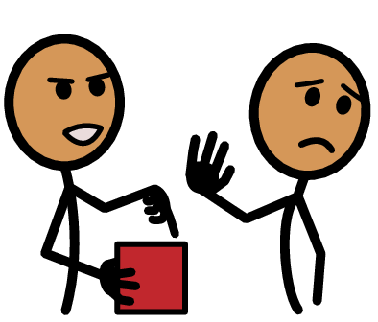



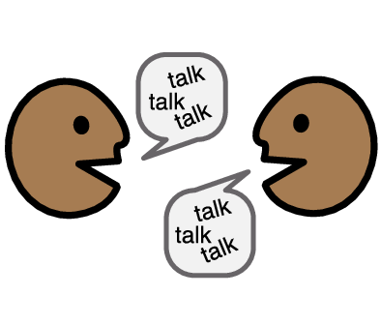

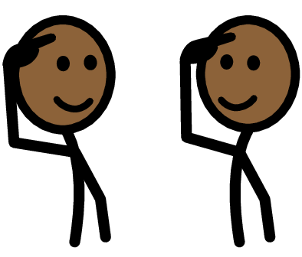


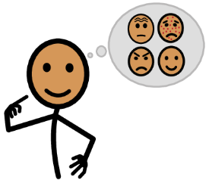




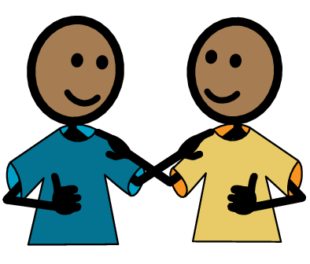
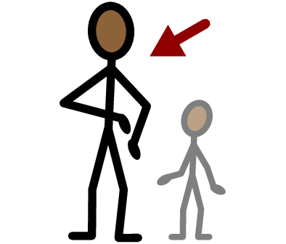
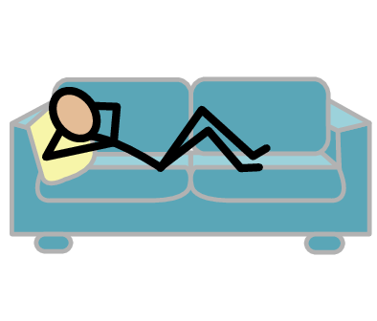
Ask
Awake
Sober
Excited
Pressure
Yes
No
Listen
Check-in
Consent
Respect
I need help
I have a question
Trust
Adult
Take a break
I feel
Happy
Sad
Mad
Scared
Copyright © 2021 SymbolStix, LLC. All rights reserved. Used with Permission.
Notes:
You can print this slide separately so each student can use the Important Words Sheet as a communication board throughout class. Review the words using the suggested definitions below. To enhance understanding, you can ask students to decide on their own definitions for vocabulary words or to provide a sentence or scenario using the new word.
Consent: Getting someone’s okay or permission to do something; when you ask someone and they say yes
Ask: Talking to someone to get an answer
Awake: Not asleep
Sober: Not drinking alcohol or doing drugs
Excited: Feeling very positive and good
Pressure: When someone tries to force you to do something you don’t want to do
Check-in: Talking to someone to see if they are okay
Respect: When someone listens to your boundaries
Listen: Paying attention when someone is talking

Slide 4
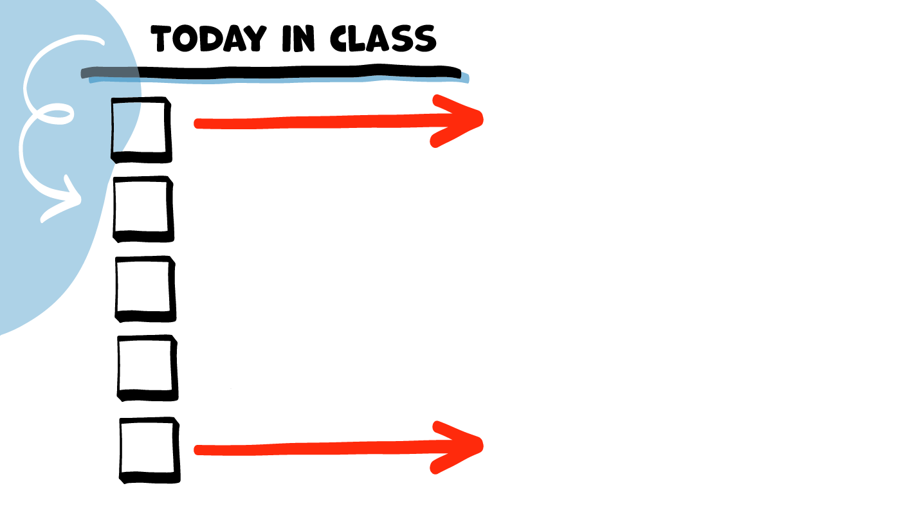
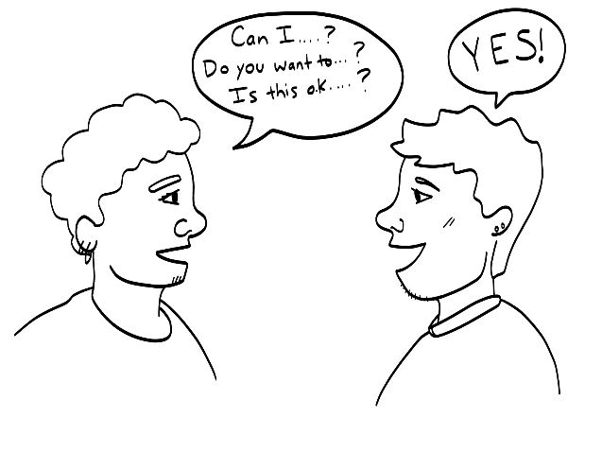
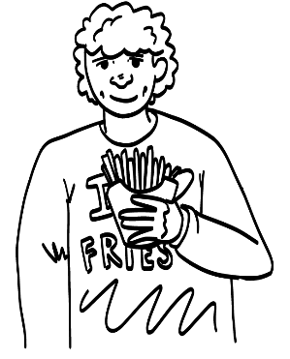
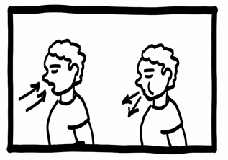
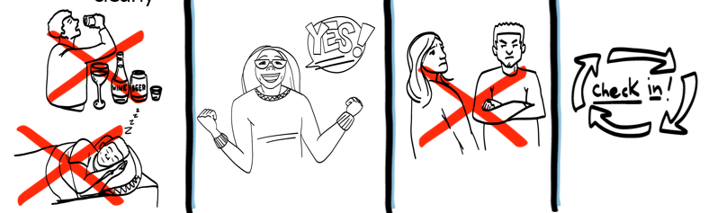
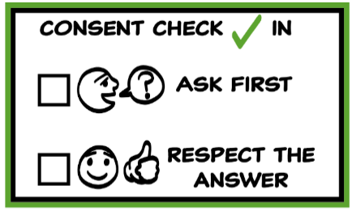
Consent talk
French Fry Game
Brain break
Four parts of consent
Consent Check-In
Tool
© 2026 SAFE Disability Services Program
Notes:
Read the agenda. Alternatively, you can ask for a student volunteer to read the agenda.

Slide 5
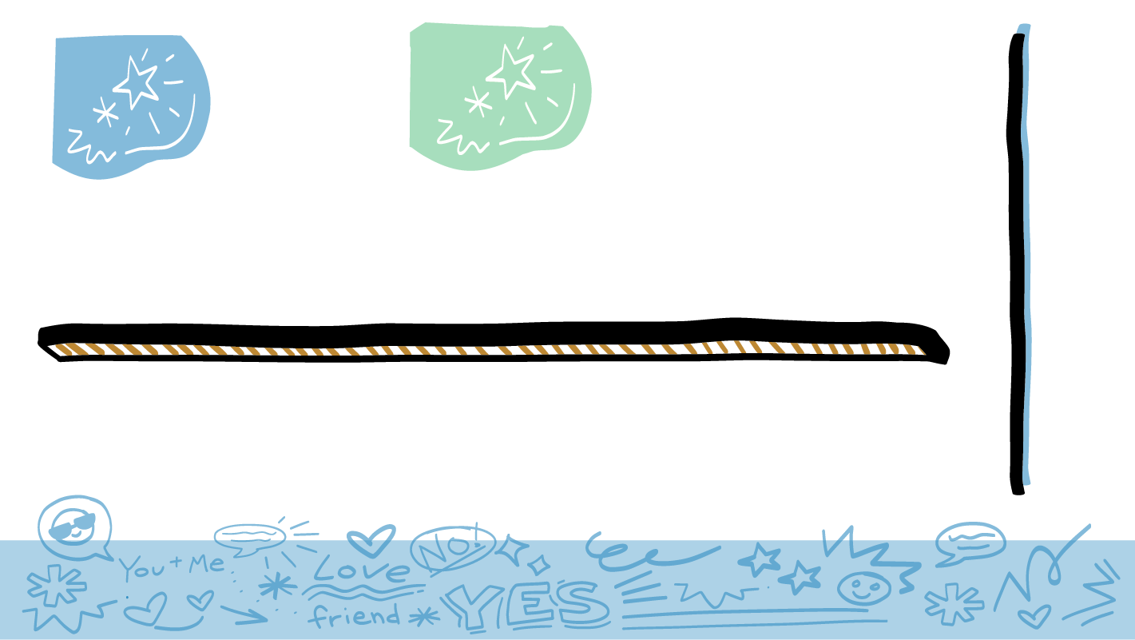
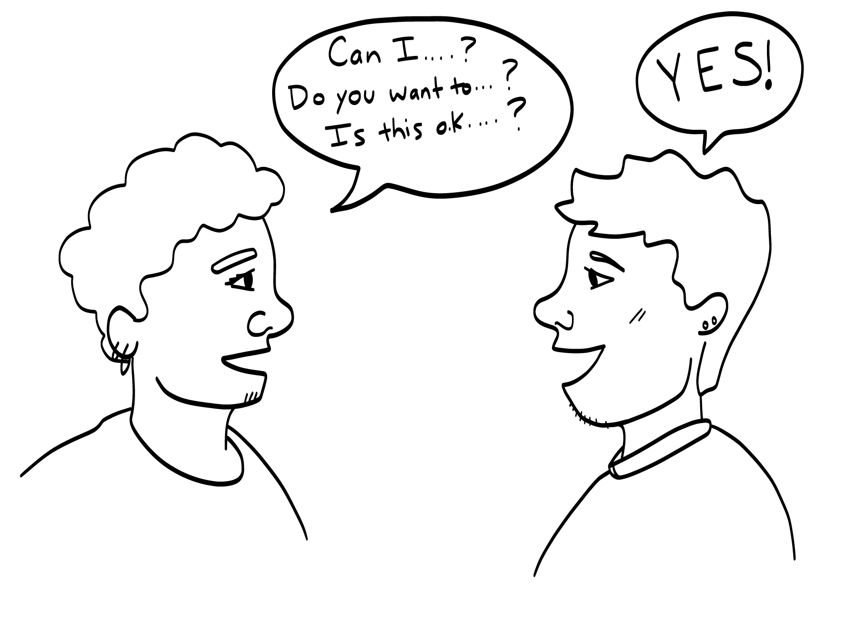
Consent
© 2026 SAFE Disability Services Program
Notes:
Say: Today’s class is all about consent. Consent is getting someone’s okay or permission to do something. Consent is when you ask for something and the person says yes.

Slide 6
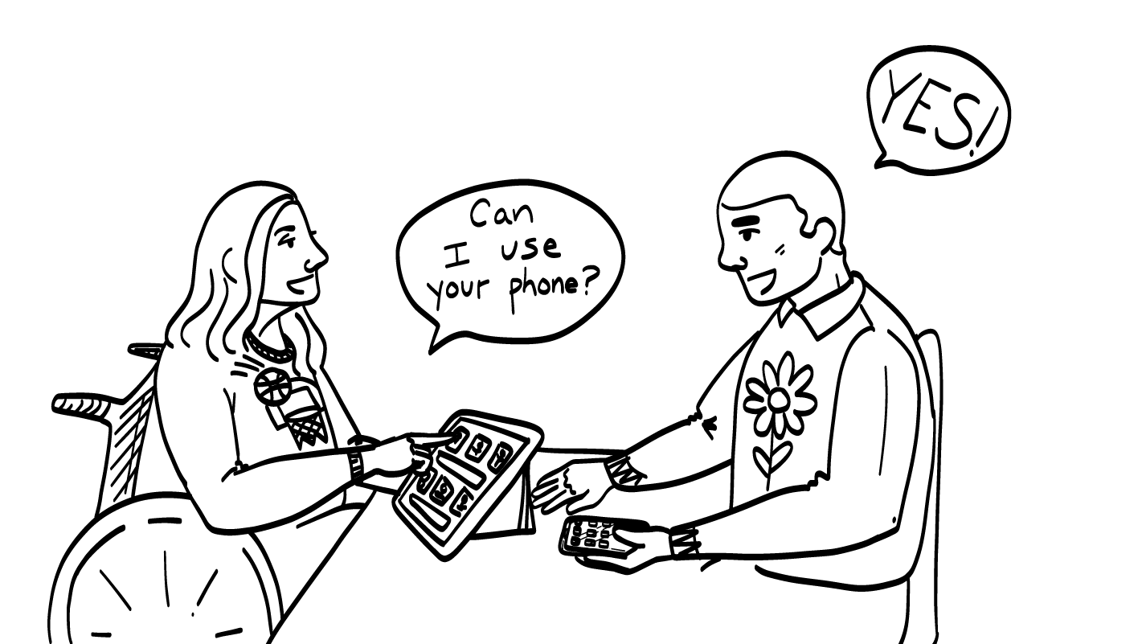
Everyday Consent
Take someone’s picture
Use or borrow something
Share someone’s story
Touch someone
© 2026 SAFE Disability Services Program
Notes:
Say: When do you need to get someone’s consent, their okay or permission, before doing something? Let’s make a list together.
As students name situations when you need to get consent, write their examples on a piece of chart paper. If needed, you can provide some examples (to take someone’s picture; to borrow someone’s phone). You can also ask a prompting question such as, “When do you need to ask before doing something?” If students don’t bring it up on their own, make sure to include some examples related to touch, such as getting consent to hug someone.

Slide 7
Consent talk
French Fry Game
Brain break
Four parts of consent
Consent Check-In Tool
© 2026 SAFE Disability Services Program
Notes:
Say: Now that we’ve talked a little about consent, let’s play the French Fry Game!

Slide 8
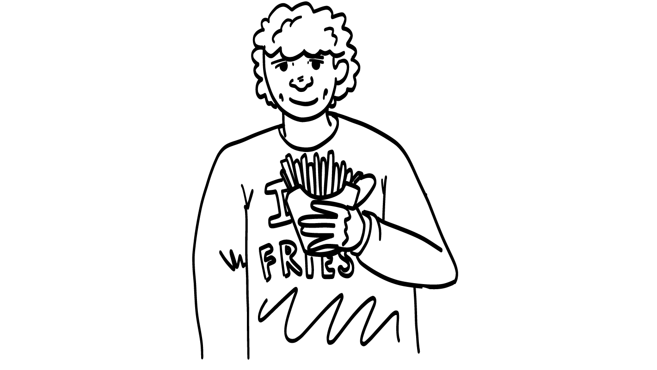
French Fry Game
© 2026 SAFE Disability Services Program
Notes:
Say: One time you need to get consent, is if you want to eat someone else’s French fries. We are going to do a game with a role play. You are going to act out some stories.
One of you will pretend that you just got a large order of French fries. The other person is going to pretend that they are trying to get the fries. The card I give you will tell you how you are going to try to get the fries.
The rest of the class is going to watch the story to see if the person gets consent to have some of the French fries. Do I have two volunteers to go first?

Slide 9
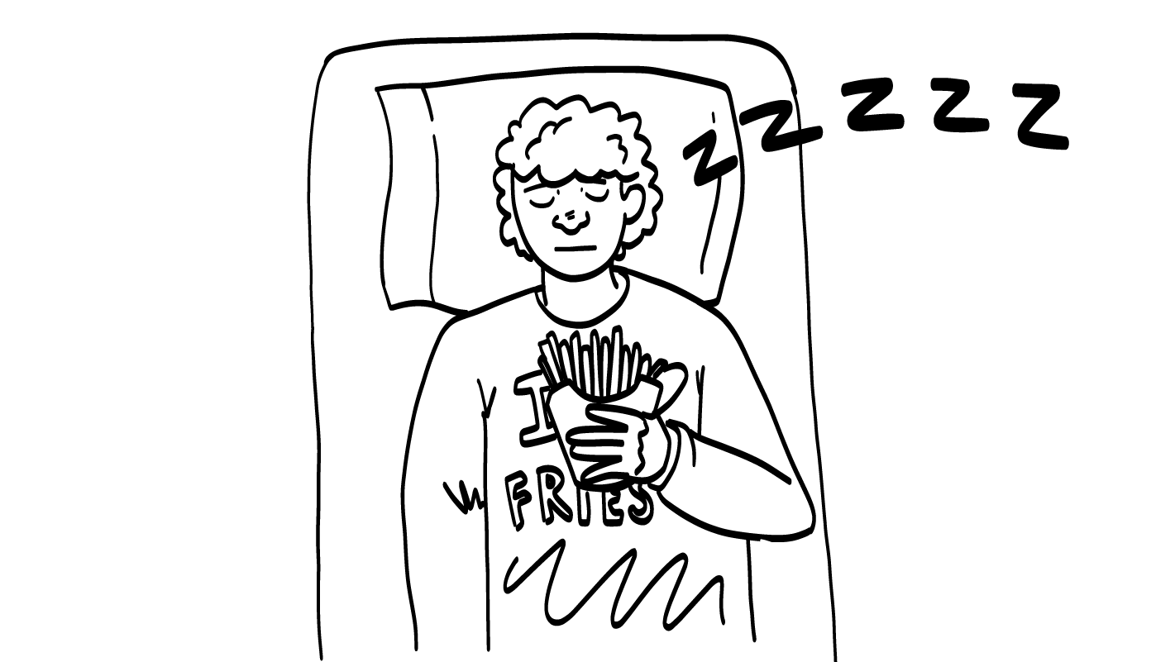


Was that consent?
YES
NO
© 2026 SAFE Disability Services Program
Notes:
Meet with the volunteers somewhere the rest of the class can’t hear your conversation. Give one student volunteer the French Fry Game prop. Give the other volunteer the first French Fry Game Card. Support both students to prepare to act out their roles. You might even have them practice their role play.
Return to the rest of the class. One additional student can be the director, calling “action” and “cut” at the beginning and end of the role play. The rest of the class will act as the audience.
Say: Excellent job actors! Audience, now it’s time for you to participate. Did [student name] get consent to take [student name]’s French fries? Give a thumbs up for yes and a thumbs down for no.
Give students enough time to process the question and make their decisions.
Say: How could you tell that this was not consent?
Give students enough time to process the question and make their decisions.
Say: People who are sleeping can’t make decisions! Sleeping people cannot give consent.
Can I get two volunteers to go next?

Slide 10
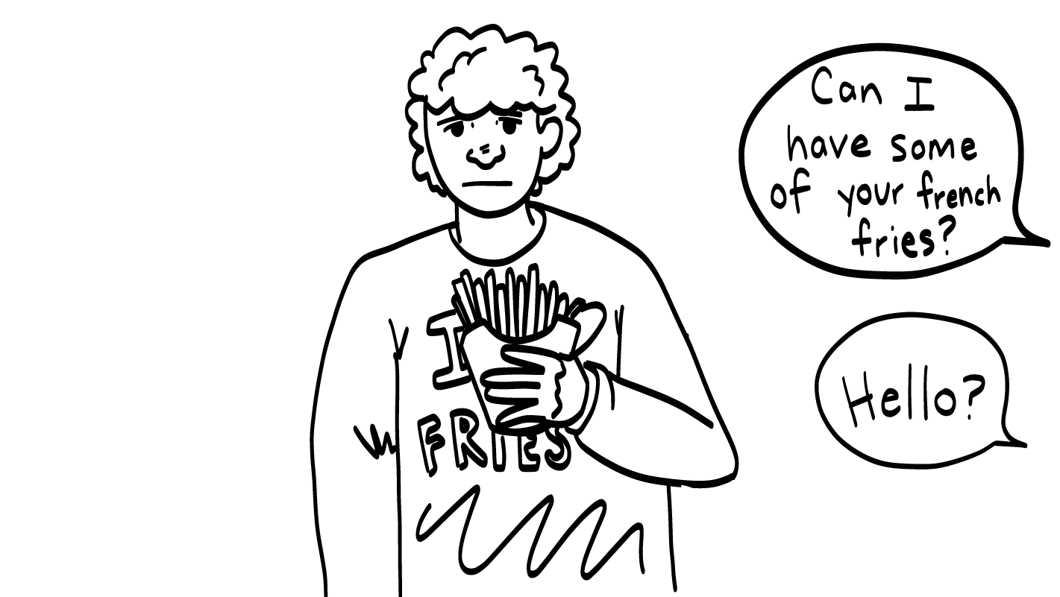
Was that consent?
YES
NO
© 2026 SAFE Disability Services Program
Notes:
Meet with the volunteers somewhere the rest of the class can’t hear your conversation. Give one student volunteer the French Fry Game prop. Give the other volunteer the second French Fry Game Card. Support both students to prepare to act out their roles. You might even have them practice their role play.
Return to the rest of the class. One additional student can be the director, calling “action” and “cut” at the beginning and end of the role play. The rest of the class will act as the audience.
Say: Excellent job actors! Audience, now it’s time for you to participate. Did [student name] get consent to take [student name]’s French fries? Give a thumbs up for yes and a thumbs down for no.
Give students enough time to process the question and make their decisions.
Say: How could you tell that this was not consent?
Give students enough time to process the question and make their decisions.
Say: [Student name] did not say yes, so this was not consent. If you ask for something, and someone does not respond, you should not take the thing you want. That is not consent and it is not okay.
Can I get two volunteers to go next?

Slide 11
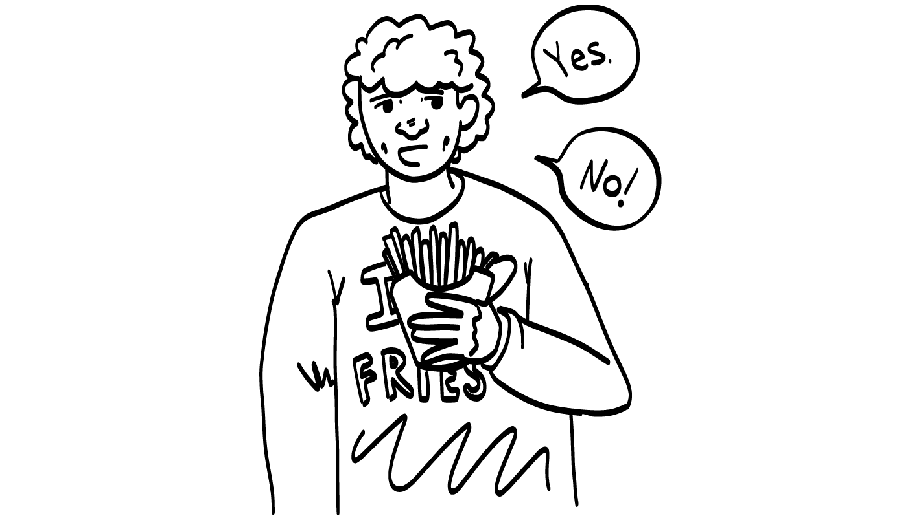
Was that consent?
YES
NO
© 2026 SAFE Disability Services Program
Notes:
Meet with the volunteers somewhere the rest of the class can’t hear your conversation. Give one student volunteer the French Fry Game prop. Give the other volunteer the third French Fry Game Card. Support both students to prepare to act out their roles. You might even have them practice their role play.
Return to the rest of the class. One additional student can be the director, calling “action” and “cut” at the beginning and end of the role play. The rest of the class will act as the audience.
Say: Excellent job actors! Audience, now it’s time for you to participate. Did [student name] get consent to take [student name]’s French fries? Give a thumbs up for yes and a thumbs down for no.
Give students enough time to process the question and make their decisions.
Say: How could you tell that this was not consent?
Give students enough time to process the question and make their decisions.
Say: [Student name] said “yes” at first, but then they changed their mind and said “no.” Is it okay for someone to change their mind? Give a thumbs up for yes and a thumbs down for no.
Give students enough time to process the question and make their decisions.
Say: It is always okay to change your mind! If you ask for something and someone says “yes,” but then changes their mind and says “no,” you need to respect their answer. You should back off and give the person some space.
Can I get two volunteers to go next?

Slide 12
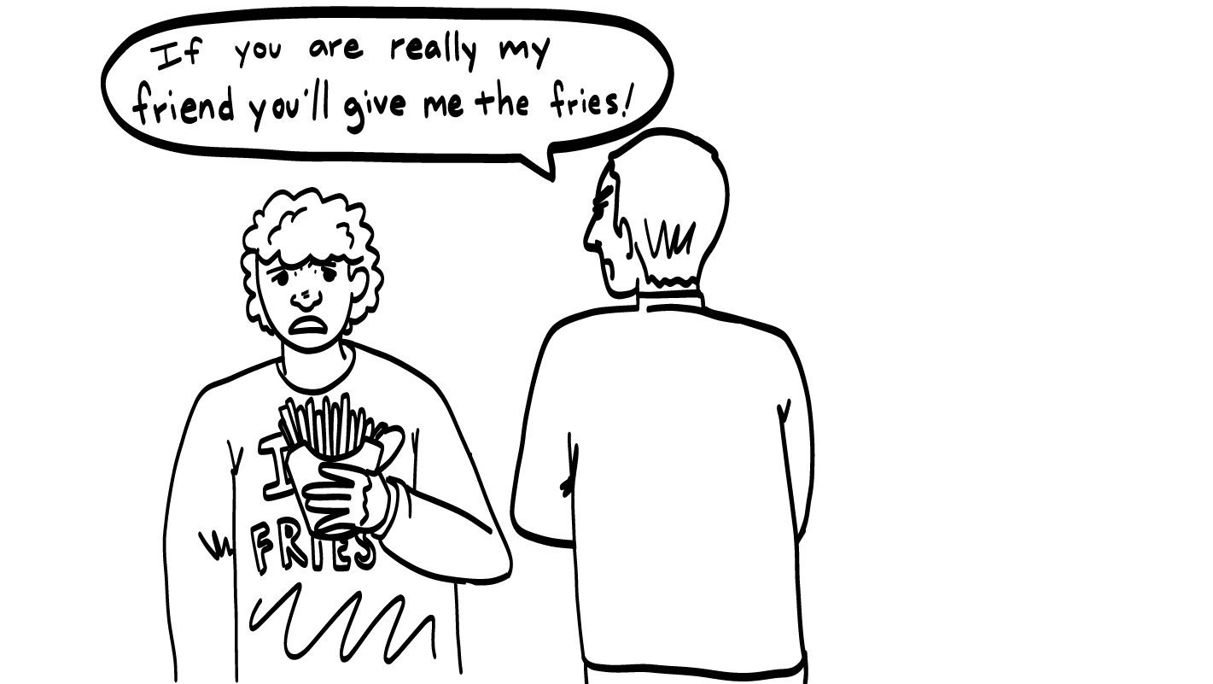
Was that consent?
YES
NO
© 2026 SAFE Disability Services Program
Notes:
Meet with the volunteers somewhere the rest of the class can’t hear your conversation. Give one student volunteer the French Fry Game prop. Give the other volunteer the fourth French Fry Game Card. Support both students to prepare to act out their roles. You might even have them practice their role play. For this role play, it is important that the student who is pressuring the other student to share French fries uses a more intimidating tone of voice. You can coach the student on how to play this part.
Return to the rest of the class. One additional student can be the director, calling “action” and “cut” at the beginning and end of the role play. The rest of the class will act as the audience.
Say: Excellent job actors! Audience, now it’s time for you to participate. Did [student name] get consent to take [student name]’s French fries? Give a thumbs up for yes and a thumbs down for no.
Give students enough time to process the question and make their decisions.
Say: How could you tell that this was not consent?
Give students enough time to process the question and make their decisions.
Say: [Student name] was trying to make [student name] feel bad about not sharing their French fries. They were trying to force them to share by telling them that they are not a good friend if they don’t share their fries. This is something called pressure (or coercion), and it is not okay. If someone is being pressured, then it is not consent.
Can I get two volunteers to go next?

Slide 13
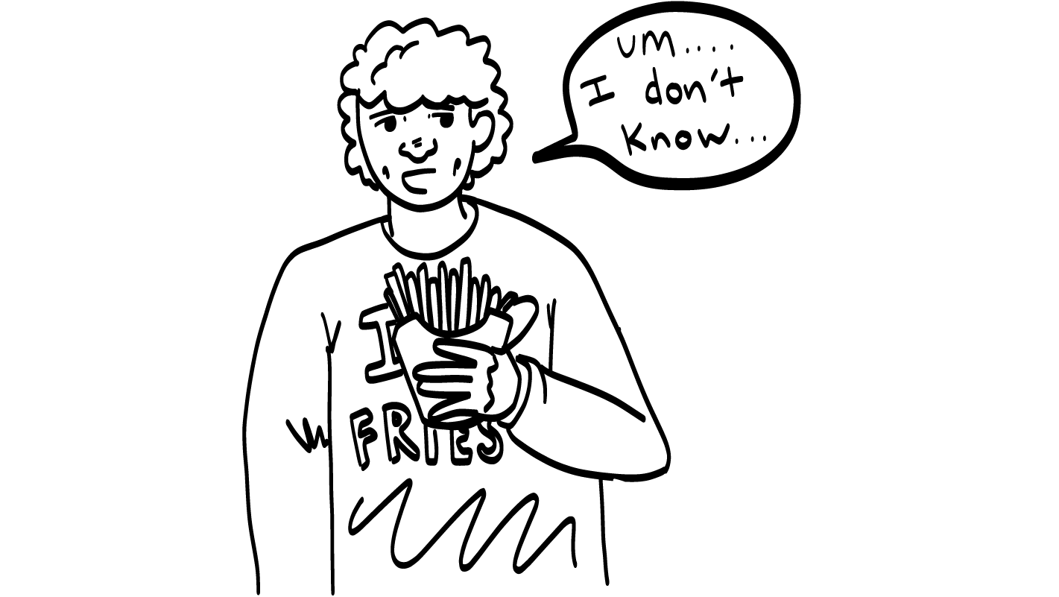
Was that consent?
YES
NO
© 2026 SAFE Disability Services Program
Notes:
Meet with the volunteers somewhere the rest of the class can’t hear your conversation. Give one student volunteer the French Fry Game prop. Give the other volunteer the fifth French Fry Game Card. Support both students to prepare to act out their roles. You might even have them practice their role play.
Return to the rest of the class. One additional student can be the director, calling “action” and “cut” at the beginning and end of the role play. The rest of the class will act as the audience.
Say: Excellent job actors! Audience, now it’s time for you to participate. Did [student name] get consent to take [student name]’s French fries? Give a thumbs up for yes and a thumbs down for no.
Give students enough time to process the question and make their decisions.
Say: How could you tell (or know) that this was not consent?
Give students enough time to process the question and make their decisions.
Say: [Student name] said that they weren’t sure they wanted to share their fries, and then [student name] took the fries anyway! For it to be consent, someone must freely give an excited yes! Does it seem like [student name] was giving an excited yes to sharing their French fries? Give a thumbs up for yes and a thumbs down for no.
Give students enough time to process the question and make their decisions.
Say: No, [student name] was not sure about sharing. Since this was not an excited yes, this was not consent.
Can I get two volunteers to go next?

Slide 14
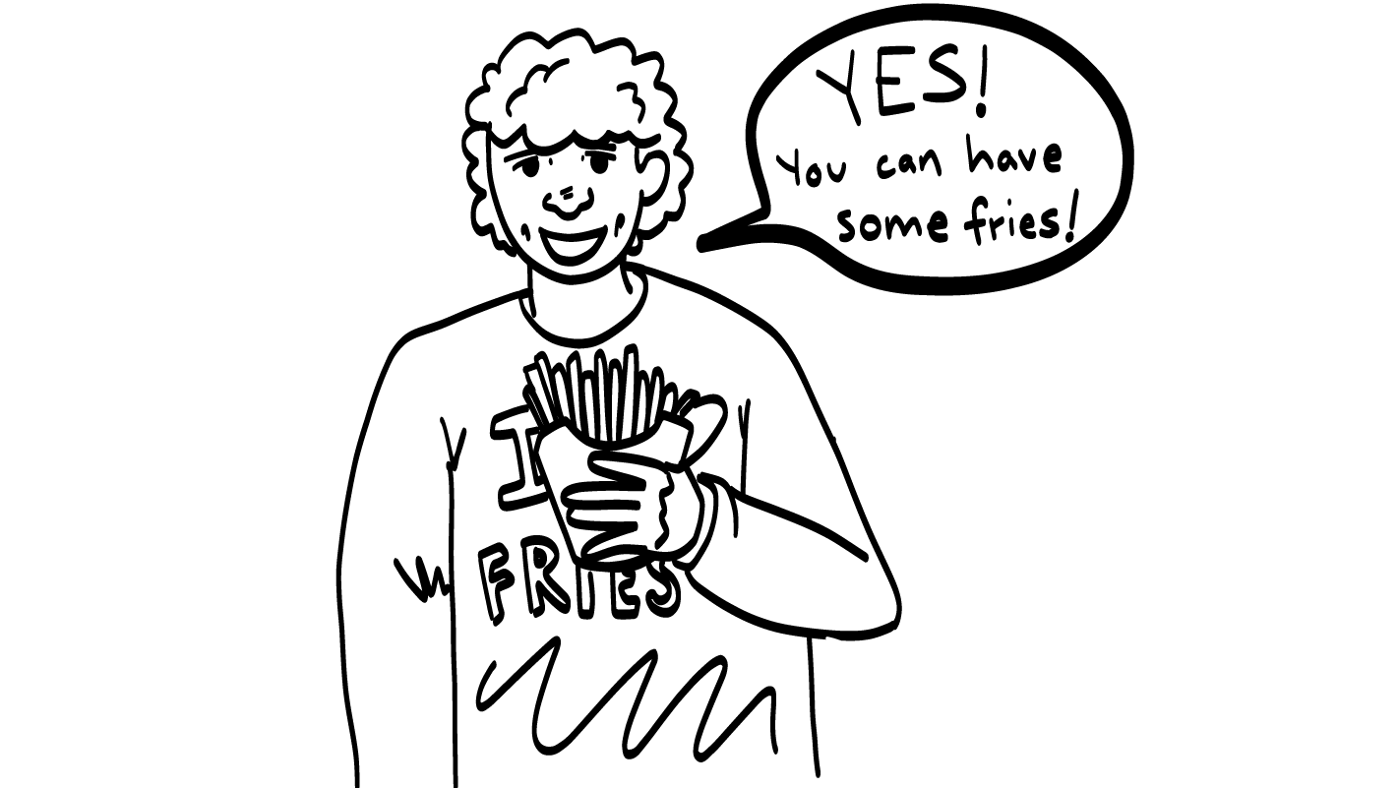
Was that consent?
YES
NO
© 2026 SAFE Disability Services Program
Notes:
Meet with the volunteers somewhere the rest of the class can’t hear your conversation. Give one student volunteer the French Fry Game prop. Give the other volunteer the sixth French Fry Game Card. Support both students to prepare to act out their roles. You might even have them practice their role play.
Return to the rest of the class. One additional student can be the director, calling “action” and “cut” at the beginning and end of the role play. The rest of the class will act as the audience.
Say: Excellent job actors! Audience, now it’s time for you to participate. Did [student name] get consent to take [student name]’s French fries? Give a thumbs up for yes and a thumbs down for no.
Give students enough time to process the question and make their decisions.
Say: Yes! This was finally consent. Remember, consent is when you as ask and someone freely, without pressure, says “yes.” In this story, [student name] asked for some fries, and [student name] said yes. This is consent. Nice work everyone!

Slide 15
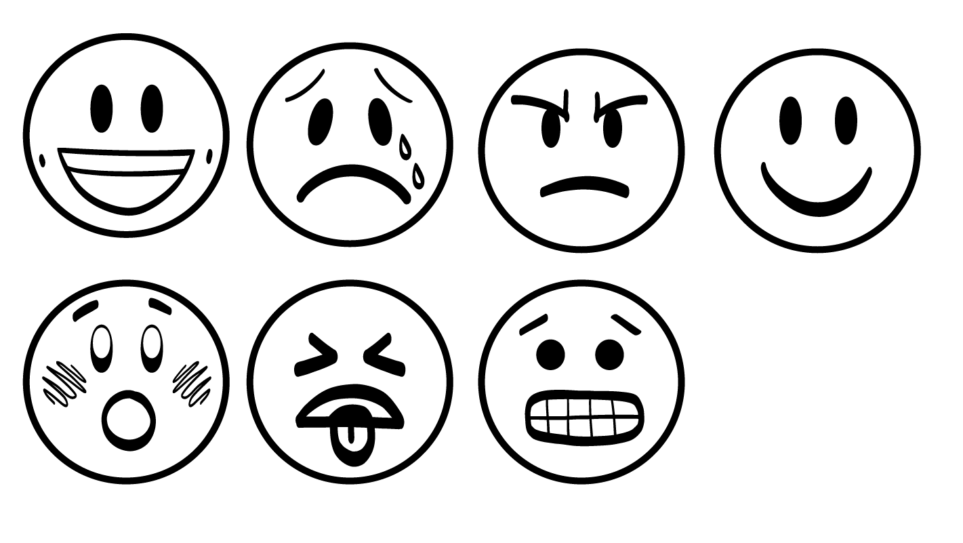
If someone does something without your consent, how does it feel?
Grossed-out or sick
Nervous
Sad
Mad
Scared
© 2026 SAFE Disability Services Program
Notes:
Say: Thanks everyone for playing the French Fry Game! In the game, we saw a lot of people take French fries without getting consent. How would you feel if someone took your fries without getting your consent first?
Give students enough time to process the question and make their decisions. Students can say emotions out loud or point to emotions on their Important Words Sheet.
Say: A lot of us would feel mad if someone took our French fries without asking. Remember, we said last week that when you feel strong feelings like mad, sad, scared, nervous, or grossed out, that’s a sign that someone has crossed your boundaries.
They’ve done something that is not cool. Doing anything without consent is a boundary crossing, and it’s never okay. When things are done without your consent, it can make you feel very sad, mad, scared, nervous, grossed out, or sick.
Consent is a super important part of having healthy relationships with friends, family, coworkers and others! We are going to talk more about consent after the brain break.

Slide 16
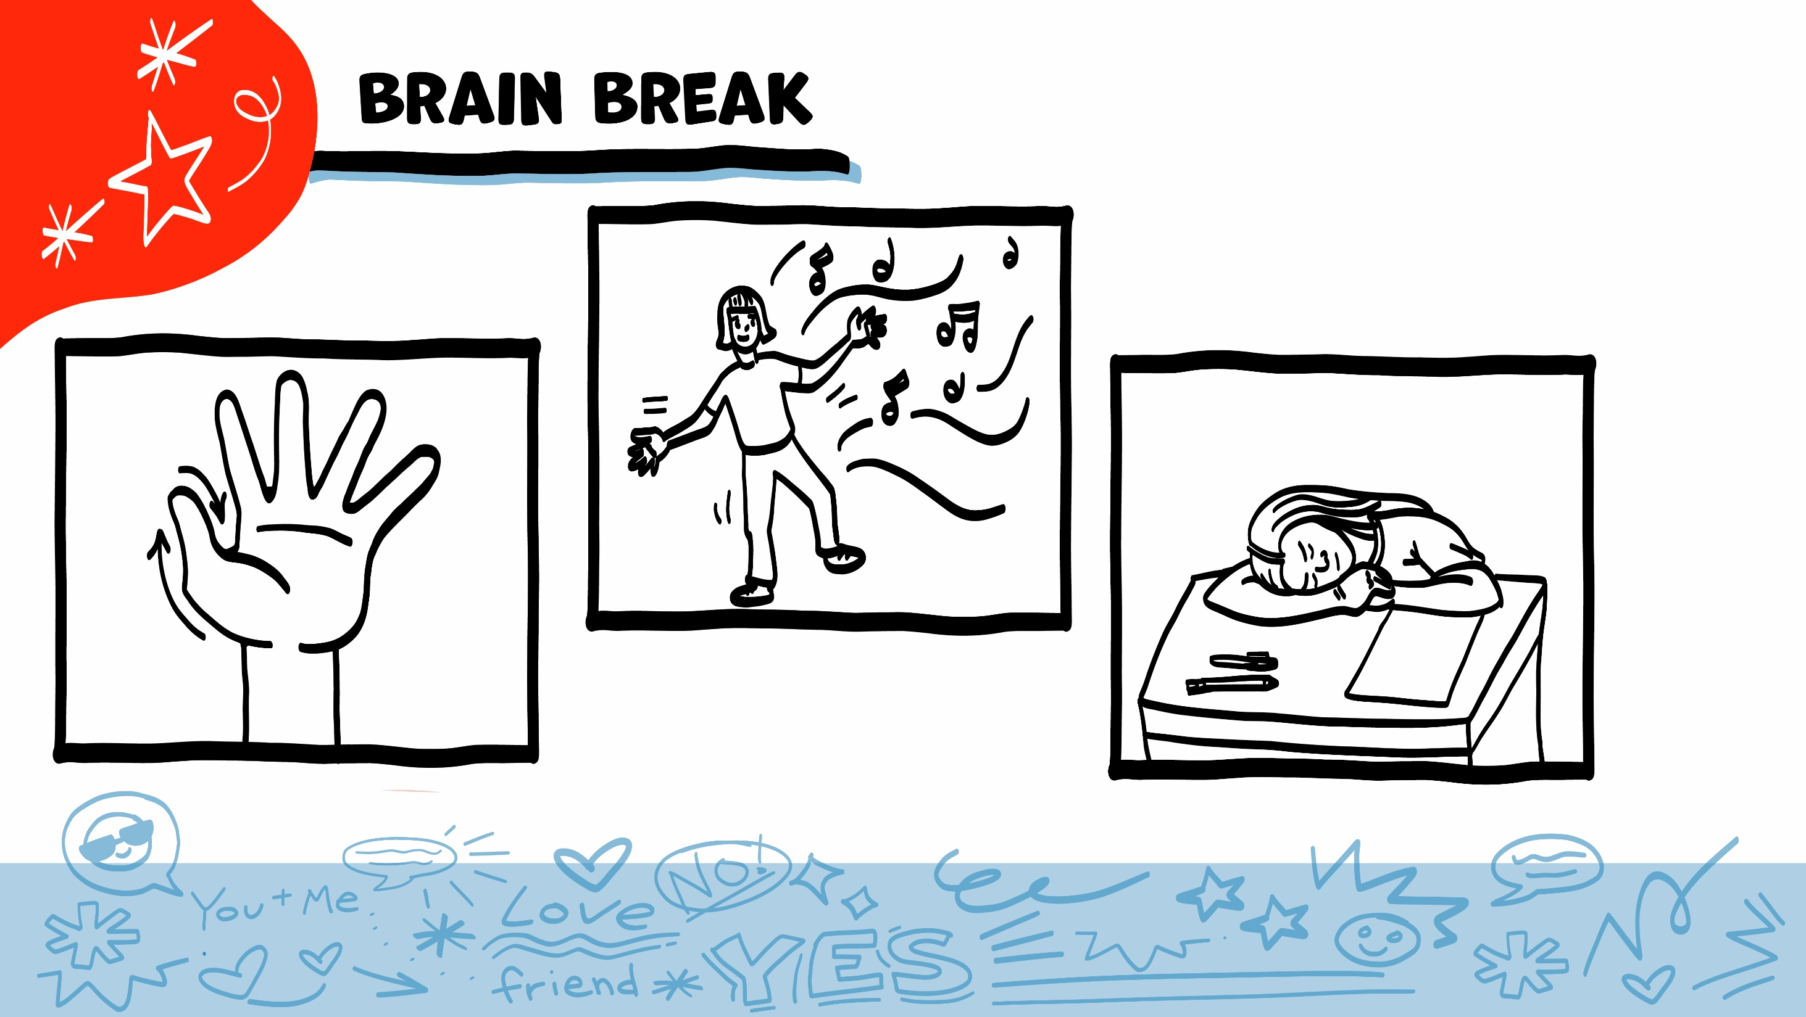
© 2026 SAFE Disability Services Program
Notes:
Say: That was a lot of information, and you all are doing an amazing job! Every week in class we will take a brain break in the middle. This is a chance to move a little and take a break from thinking!
Below are three ideas to give students a quick opportunity for a brain break. You are also welcome to come up with your own ideas for brain breaks that work best for your class.
Five finger breathing
For this exercise, have all students place their hand in front of their chest with their five fingers spread out. Next, use the pointer finger of the other hand to trace up and down each of the five fingers, beginning with the thumb. As students trace up a finger, they will breathe in. As they trace down a finger, they will breathe out. When students breathe out on the pinky finger, you can tell them to shake out their hands and arms. As the school year goes on, you can ask students to lead this exercise for their peers.
If this exercise is physically inaccessible for your class, you can also model the hand tracing for students while they breathe in and out.
Stretch break
Lead students through a series of basic stretches. These can be completed in a chair, or while standing up, depending on the accommodation needs of your class. Some ideas include reaching toward the ceiling, stretching one arm at a time across the chest, reaching toward toes, turning head from side to side, etc. Ask students to hold a pose while you count to ten. As the school year goes on, you can ask students to lead stretches for their peers.
Dance party
If your class likes to dance, you can put on a short song for them to dance to. This is especially effective if you are able to find a song that relates to the theme for that week’s class.

Slide 17
Consent talk
French Fry Game
Brain break
Four parts of consent
Consent Check-In Tool
© 2026 SAFE Disability Services Program
Notes:
Say: Next, we are going to talk about the parts of consent.

Slide 18
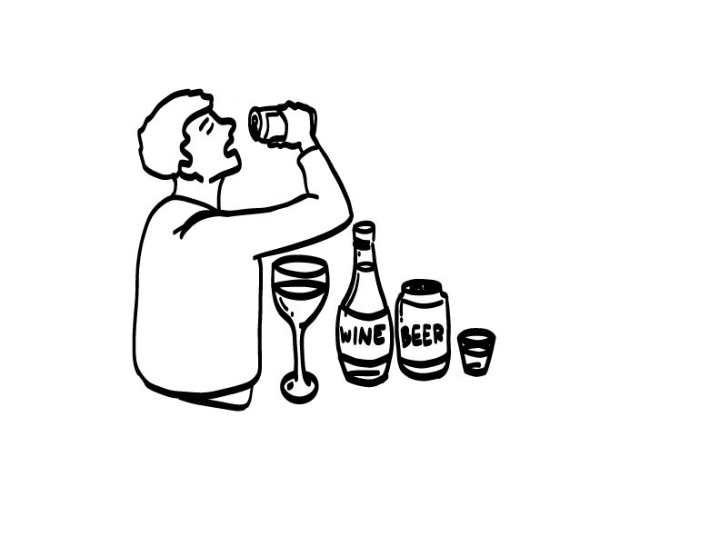
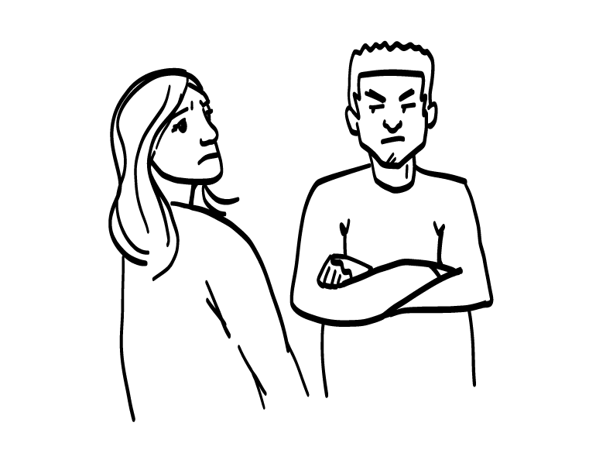
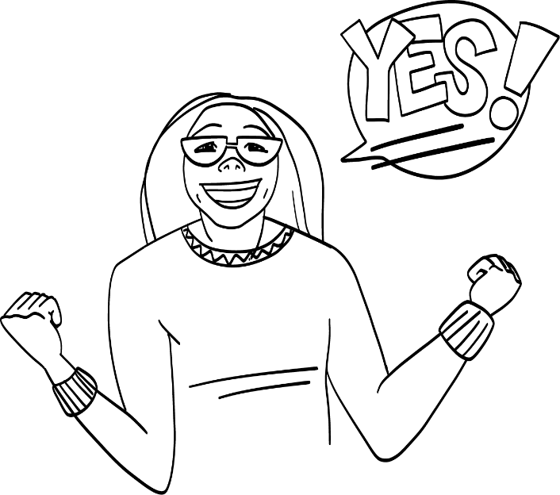
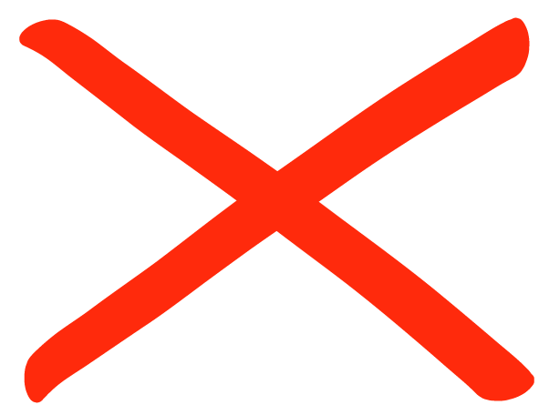
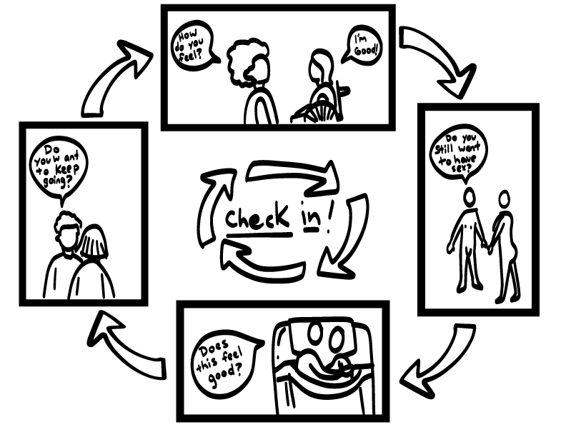
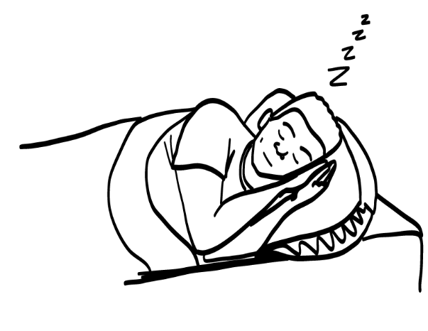
1. Thinking
clearly
2. Excited YES!
3. No pressure
4. Check-ins
4 Parts of Consent
© 2026 SAFE Disability Services Program
Notes:
Say: There are four parts of consent: thinking clearly, excited yes, no pressure (or coercion), and check-ins. We are going to talk about each of these parts of consent next.

Slide 19
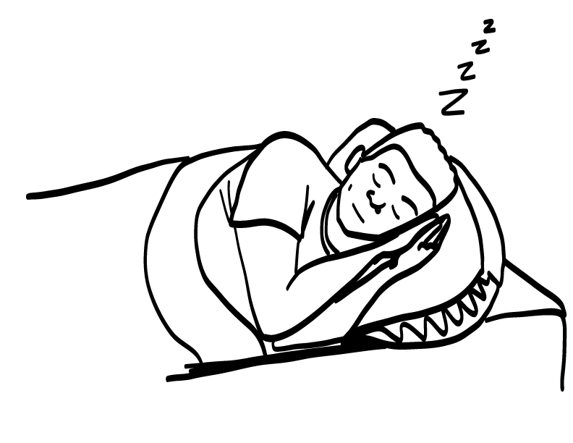
Thinking Clearly
© 2026 SAFE Disability Services Program
Notes:
Say: The first part of consent is thinking clearly. Before you can ask for someone’s consent, you need to make sure that both you and the other person are thinking clearly. Part of thinking clearly means that both of you are awake. Sleeping people cannot answer questions and cannot give consent!
The second part of thinking clearly is that neither you nor the other person are drunk or high. In Texas, you must be over 21 to legally drink alcoholic drinks, such as beer, wine, and mixed drinks like margaritas. Even people who are old enough to drink cannot give consent if they have been drinking.

Slide 20
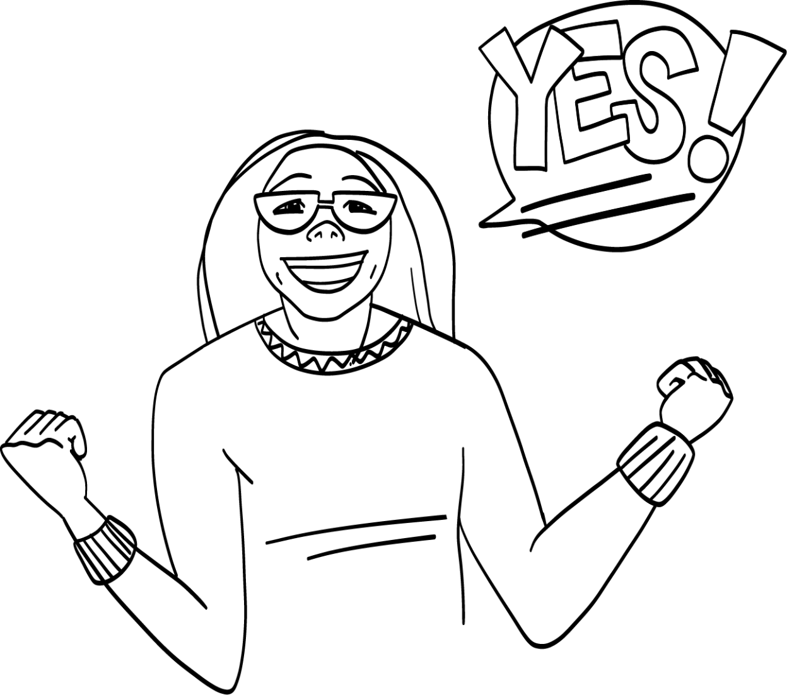
Excited Yes
© 2026 SAFE Disability Services Program
Notes:
Say: The second part of consent is that both people should give an excited yes. What does an excited yes sound like?
Encourage students to share out loud what an excited yes sounds like (ex: YES!, yahoo!, oh yeah!, etc.).
Say: You can also say yes with your body or your signs. What does someone’s face look like when they are excited?
Give students enough time to process the question and make their decisions.
Say: Someone who is excited might smile and look at the other person.

Slide 21
No Pressure
© 2026 SAFE Disability Services Program
Notes:
Say: The third part of consent is that there is no pressure (also called coercion). Some of you may have heard the term “peer pressure” before. Pressure is when someone tries to force you to do something you don’t want to do. It is never okay to pressure someone. Remember in our French Fry Game when [student name] said “If you are my friend, you’ll give me French fries”? That’s an example of pressure.
If someone is ever pressuring you to do something that you do not want to do, get help from an adult in your inner green circle of trust right away.

Slide 22
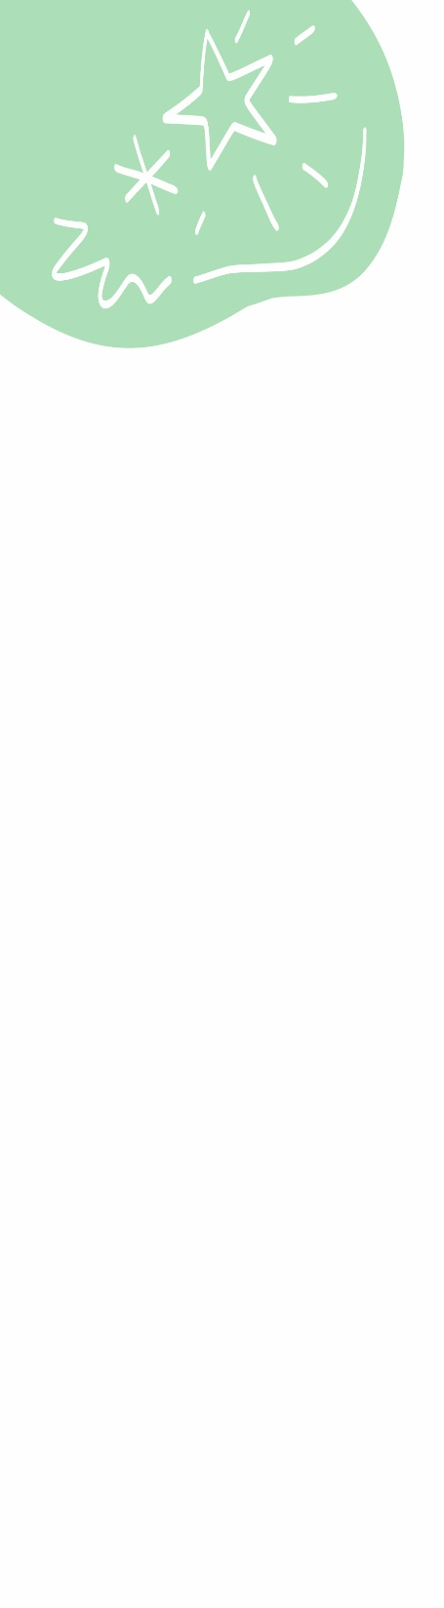
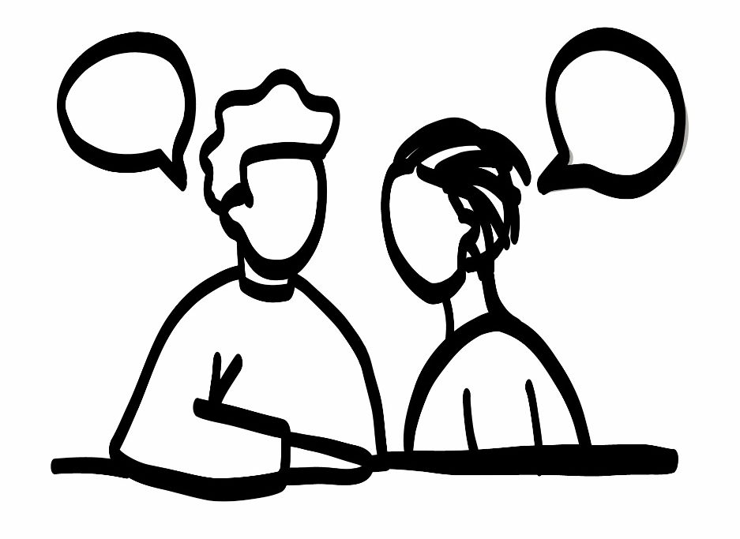
Check-ins
© 2026 SAFE Disability Services Program
Notes:
Say: The last part of consent is check-ins. Consent isn’t a one-time thing. Just because someone says yes today, doesn’t mean that they will say yes tomorrow. You need to ask for consent each and every time you want something from another person. This includes people in your inner green circle of most trusted people and your middle yellow circle of people you are getting to know better. And remember, you always have the right to change your mind or take back your consent.

Slide 23
Consent talk
French Fry Game
Brain break
Four parts of consent
Consent Check-In Tool
© 2026 SAFE Disability Services Program
Notes:
Say: The last thing we are going to do today is add a new tool to our Healthy Relationships Toolbox.

Slide 24
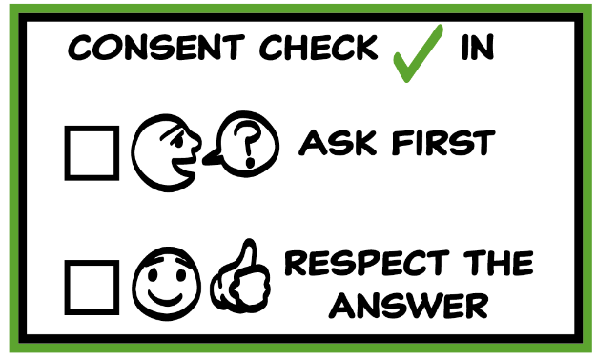
© 2026 SAFE Disability Services Program
Notes:
Say: It’s time to add the last tool to our Healthy Relationships Toolbox. This tool is the Consent Check-In Tool. This tool has two parts. The first part says, “Ask first.” The first thing you need to do to get consent is to ask. So how can you ask for consent? What does that sound like?
Go through a few examples from the everyday consent list the class made on slide six. Brainstorm some ways that people could ask for consent in those situations.
Say: The second part of the Consent Check-In Tool is to “Respect the answer.” If the person says “yes,” that’s awesome! But if the person says no, what should you do?
Give students enough time to process the question and make their decisions.
Say: If someone says no, you need to listen. Back off and give the person space. You might feel disappointed, but it is never okay to do something without someone’s consent.
If someone does something without your consent, that’s a boundary crossing. That’s not cool, and you can get help from an adult in your inner green circle of trust. If someone ever touches your body without your consent, get help from an adult in your inner green circle of trust right away.

Slide 25
© 2026 SAFE Disability Services Program
Notes:
Say: Let’s add the Consent Check-In Tool to our toolbox. Is there anyone who would like to volunteer to put the Consent Check-In Tool on our Healthy Relationships Toolbox?
Have the volunteer Velcro the Class Consent Check-In Tool Manipulative onto the Class Healthy Relationships Toolbox. Next, give each student a glue stick and a copy of the Student Consent Check-In Tool. Give students a few minutes to glue their tools into their toolboxes. Both the class and student toolboxes are now complete. You can continue to display the Healthy Relationships Toolbox in your classroom throughout the year. Students can also keep a copy of their completed toolboxes for use in future classes.

Slide 26
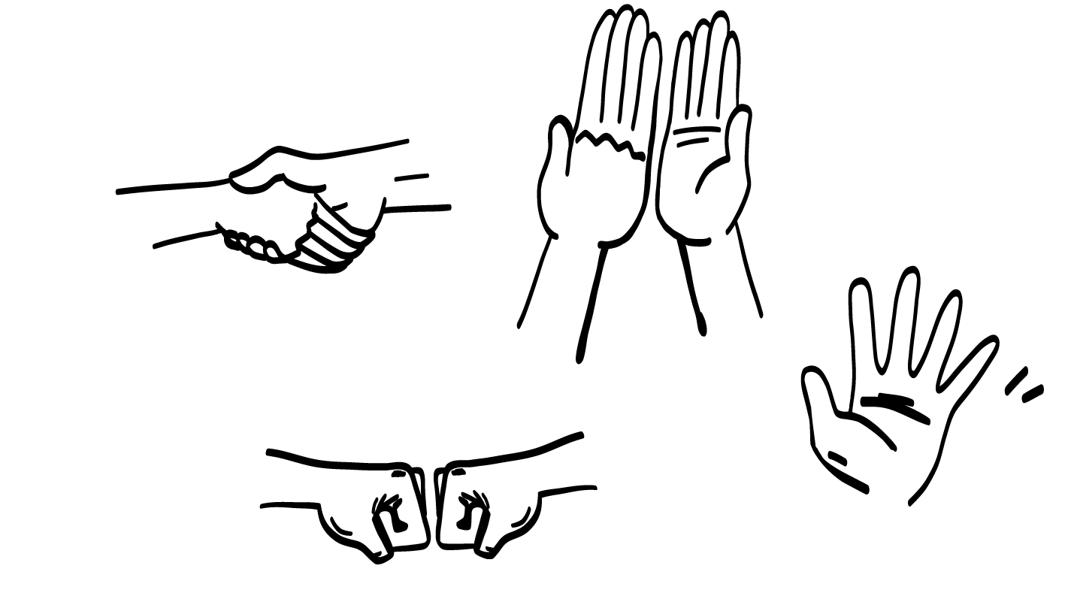
The Greeting Game
© 2026 SAFE Disability Services Program
Notes:
Say: Our last activity today is a greeting game. In a minute, everyone will move around the room and greet someone in the class. You can give the other person a high five, a handshake, a wave, or a fist bump while saying hello. The trick to this game is that you must get consent first before greeting someone. You might ask the person how they like to greet people. And then, tell them how you like to greet people. For example, you might say, “I like high fives. Can I give you a high five?” Have a discussion to make the greeting great for both people. And remember, if someone says no, you can’t use that greeting. Now let’s get consent!!
Facilitators may consider acting out an example of how to greet someone with consent before officially starting the game.

Slide 27
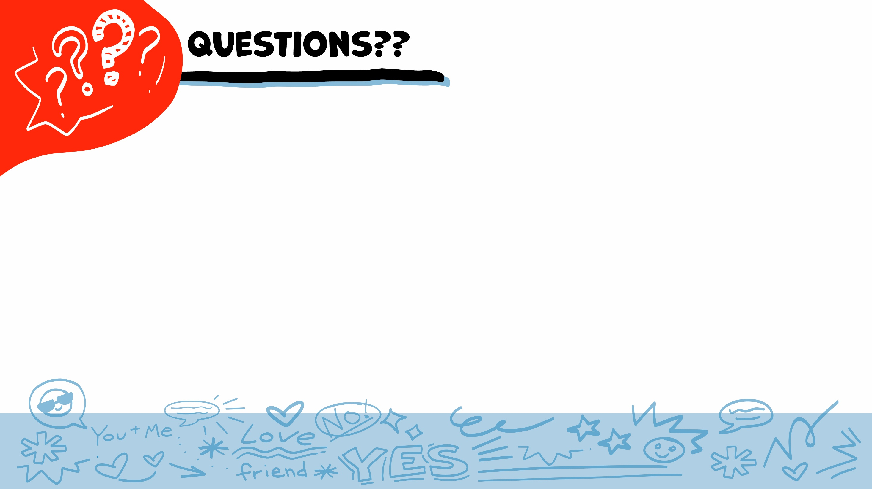
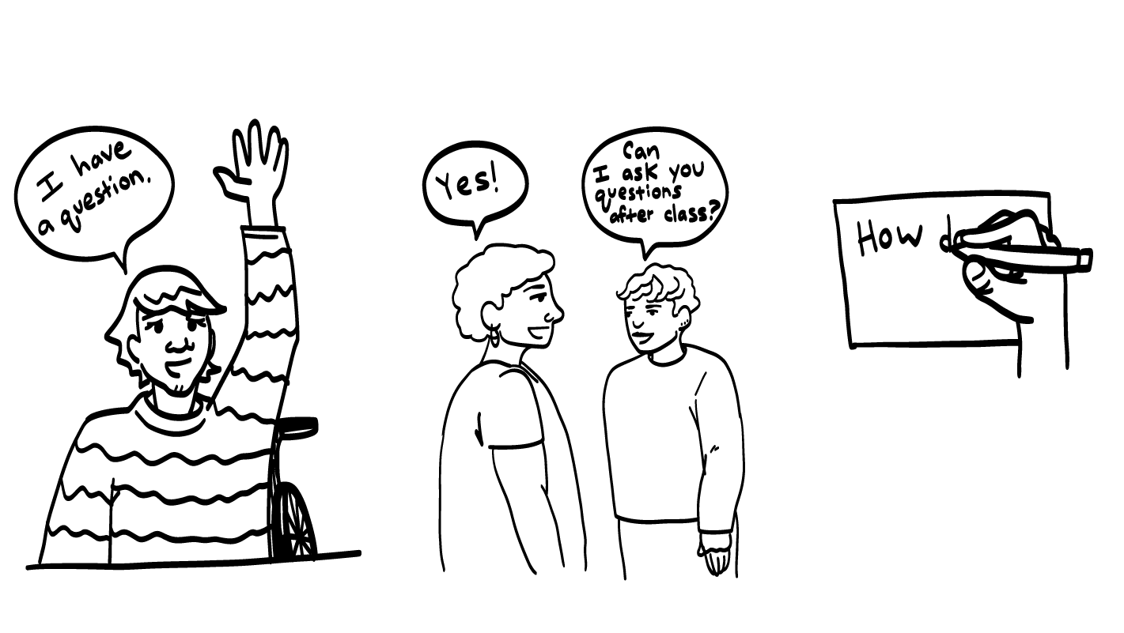
© 2026 SAFE Disability Services Program
Notes:
Say: Does anyone have any questions about today’s class? Remember, if you don’t want to ask your question out loud, you can write it on a notecard and leave it on your desk. You can also ask someone you trust to help you write your question on the notecard. I will pick up all of the notecards, and will answer the questions the next time we meet. When I answer a question, I won’t tell anyone who asked it.

Slide 28
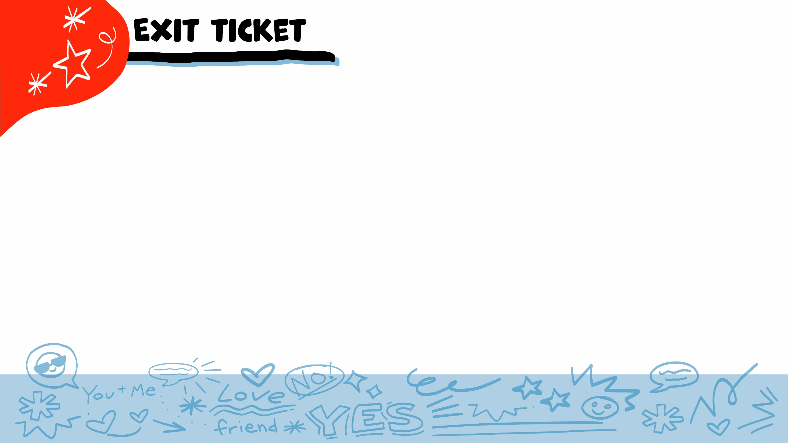


Does consent mean getting someone’s okay or permission to do something?
YES
NO
© 2026 SAFE Disability Services Program
Notes:
Say: Does consent mean getting someone’s okay or permission to do something? Hold a thumbs up for yes and a thumbs down for no.
Give students enough time to process the question and make their decisions.
Say: Yes! Basically, consent is when you ask, and someone says yes. There are lots of times when you need to get someone’s consent—before taking their picture, before borrowing their things, or sharing their stories. You also need to get consent any time you want to touch someone’s body like giving them a hug.

Slide 29
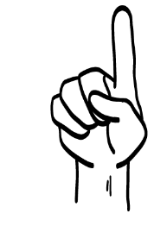
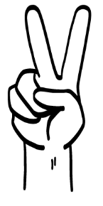
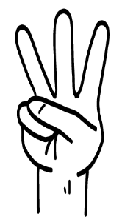
The four parts of consent are:
Thinking Clearly
Excited Yes
No Pressure
???
Greeting someone
Check-ins
Ignoring someone
1
2
3
© 2026 SAFE Disability Services Program
Notes:
Say: The four parts of consent are thinking clearly, excited yes, no pressure, and what? Hold up one finger for “greeting someone,” two fingers for “check-ins,” and three fingers for “ignoring someone.”
Give students enough time to process the question and make their decisions.
Say: The fourth part of consent is check-ins. Consent is an ongoing conversation. Keep talking to make sure that the other person is giving consent!

Slide 30
After you ask for someone’s consent, do you need to respect their answer?
YES
NO
© 2026 SAFE Disability Services Program
Notes:
Say: After you ask for someone’s consent, do you need to respect their answer? Hold a thumbs up for yes and a thumbs down for no.
Give students enough time to process the question and make their decisions.
Say: Yes! The second part of the Consent Check-In Tool is to respect the answer. If the person says yes, that’s consent! If the person says no, you need to listen. Back off and give them some space.

Slide 31
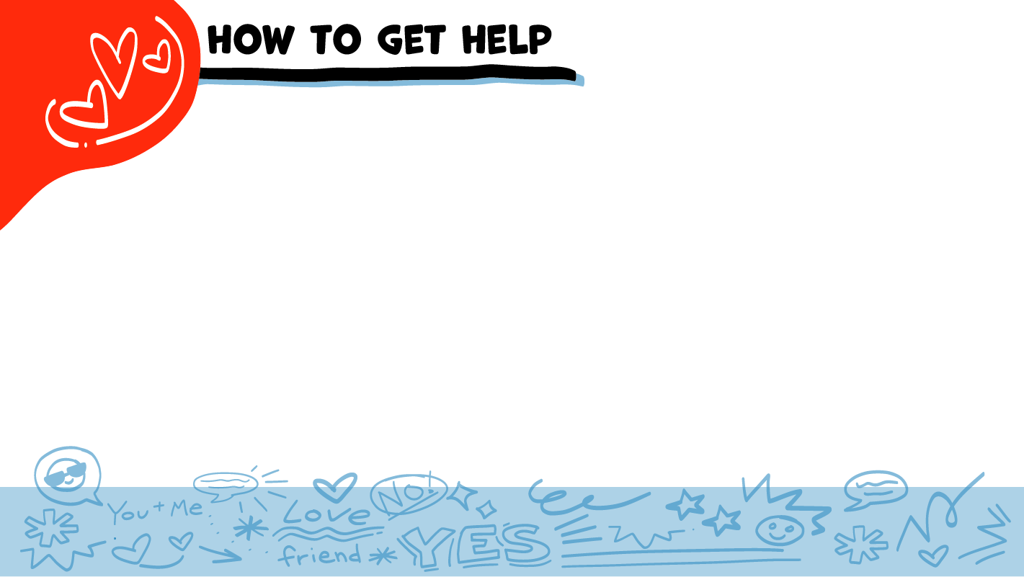
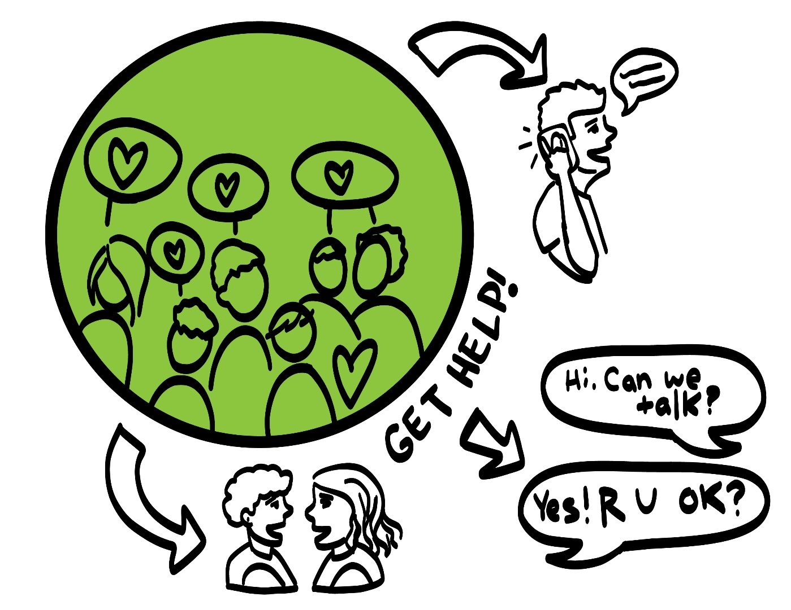
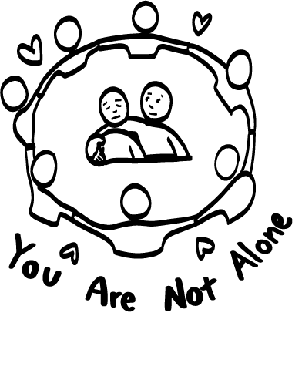
© 2026 SAFE Disability Services Program
Notes:
Say: If you are being hurt, or if someone ever touches your body in a way that you don’t like, you can get help. You did not do anything wrong, and you are not alone.
You can get help by talking to another adult from your inner green circle of trust. If someone you care about is being hurt, you can also get help by talking to an adult from your inner green circle of trust. If an emergency is happening, you can always call 911. If you call 911 for help, a police officer or an ambulance might come.
If the first person you tell doesn’t believe you or doesn’t get you help, keep telling other adults you trust what is going on until you get the help you need.

Slide 32

© 2026 SAFE Disability Services Program
Notes:
Say: Does anyone remember what our power statement is? Our power statement is “I know me best.” This means that each of you knows yourself better than anyone else does. Today we learned all about the importance of consent in your relationships. Let’s gather together and on the count of three, say our power statement.
Have each interested student put one hand in the middle of the circle. Ask for a student volunteer to count to three. After three, all participants say the power statement while lifting their hands into the air. Students can also stand in the circle without touching hands if they prefer.

Slide 33

This work is supported by the Texas Council for Developmental Disabilities through a grant from the U.S. Administration for Community Living (ACL), Department of Health and Human Services (HHS), Washington, D.C. 20201 with a 100% federal funding award totaling $6,161,072. Council efforts are those of the grantee and do not necessarily represent the official views of nor are endorsed by ACL, HHS, or the U.S. government.
© 2026 SAFE Disability Services Program
Notes:
SAFE would like to thank the Texas Council for Developmental Disabilities for the funding for this curriculum.

Slide 34

This curriculum is offered online at no cost. You are free to use the resources in the original format for educational purposes only. Please reference The SAFE Alliance appropriately (citations at bottom of page).
We ask that you do not alter curriculum images/art, slides, or lesson plan materials. You may not use My Rights My Life (18+ or High School) curriculum for commercial purposes (i.e., selling workshops you facilitate based on MRML curriculum; and/or creating links/websites to re-distribute any materials associated SAFE’s My Rights My Life).
This resource, My Rights My Life: A curriculum for healthier relationships for high school students (grades 9-12) is based on the original My Rights My Life: A curriculum for safer relationships (age 18+) written by Megan Westmore, Heidi Lersch, and edited by Schwartz, M. (2026). Selling materials from MRML is a copyright violation.
Burleson, Anna Belle & Benitez, Sophie (2026) provided light modification and abbreviated the original curriculum
(Westmore & Lersch, 2026) to offer an age appropriate resource for High School Students (grades 9-12).
Schwartz, M. (Ed.). The SAFE Alliance, Austin, Texas.
Westmore, M. & Lersch, H. (2026). My rights my life: A curriculum for safer relationships.
Schwartz, M. (Ed.). The SAFE Alliance: Austin, TX.
© 2026 SAFE Disability Services Program

