Slide 1
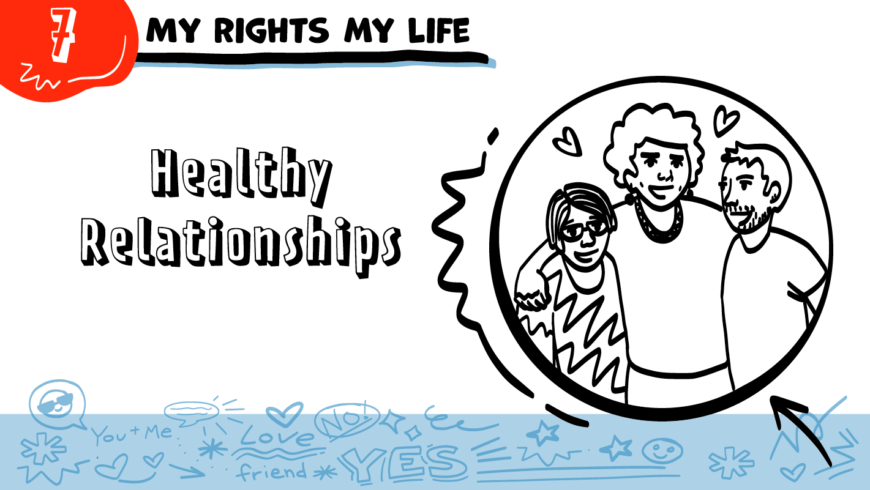
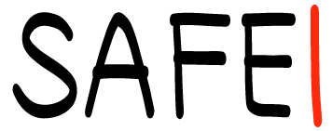
for High School Students
© 2026 SAFE Disability Services Program
Notes:
Repetition is beneficial for learning. Take time to review the last My Rights My Life class you taught prior to beginning this session. You can also answer any private questions students submitted on notecards during your previous class session.
Say: Today in class we are going to talk about healthy relationships. We’ll talk about four parts of a healthy relationship, and you’ll practice deciding if something is healthy or unhealthy.

Slide 2
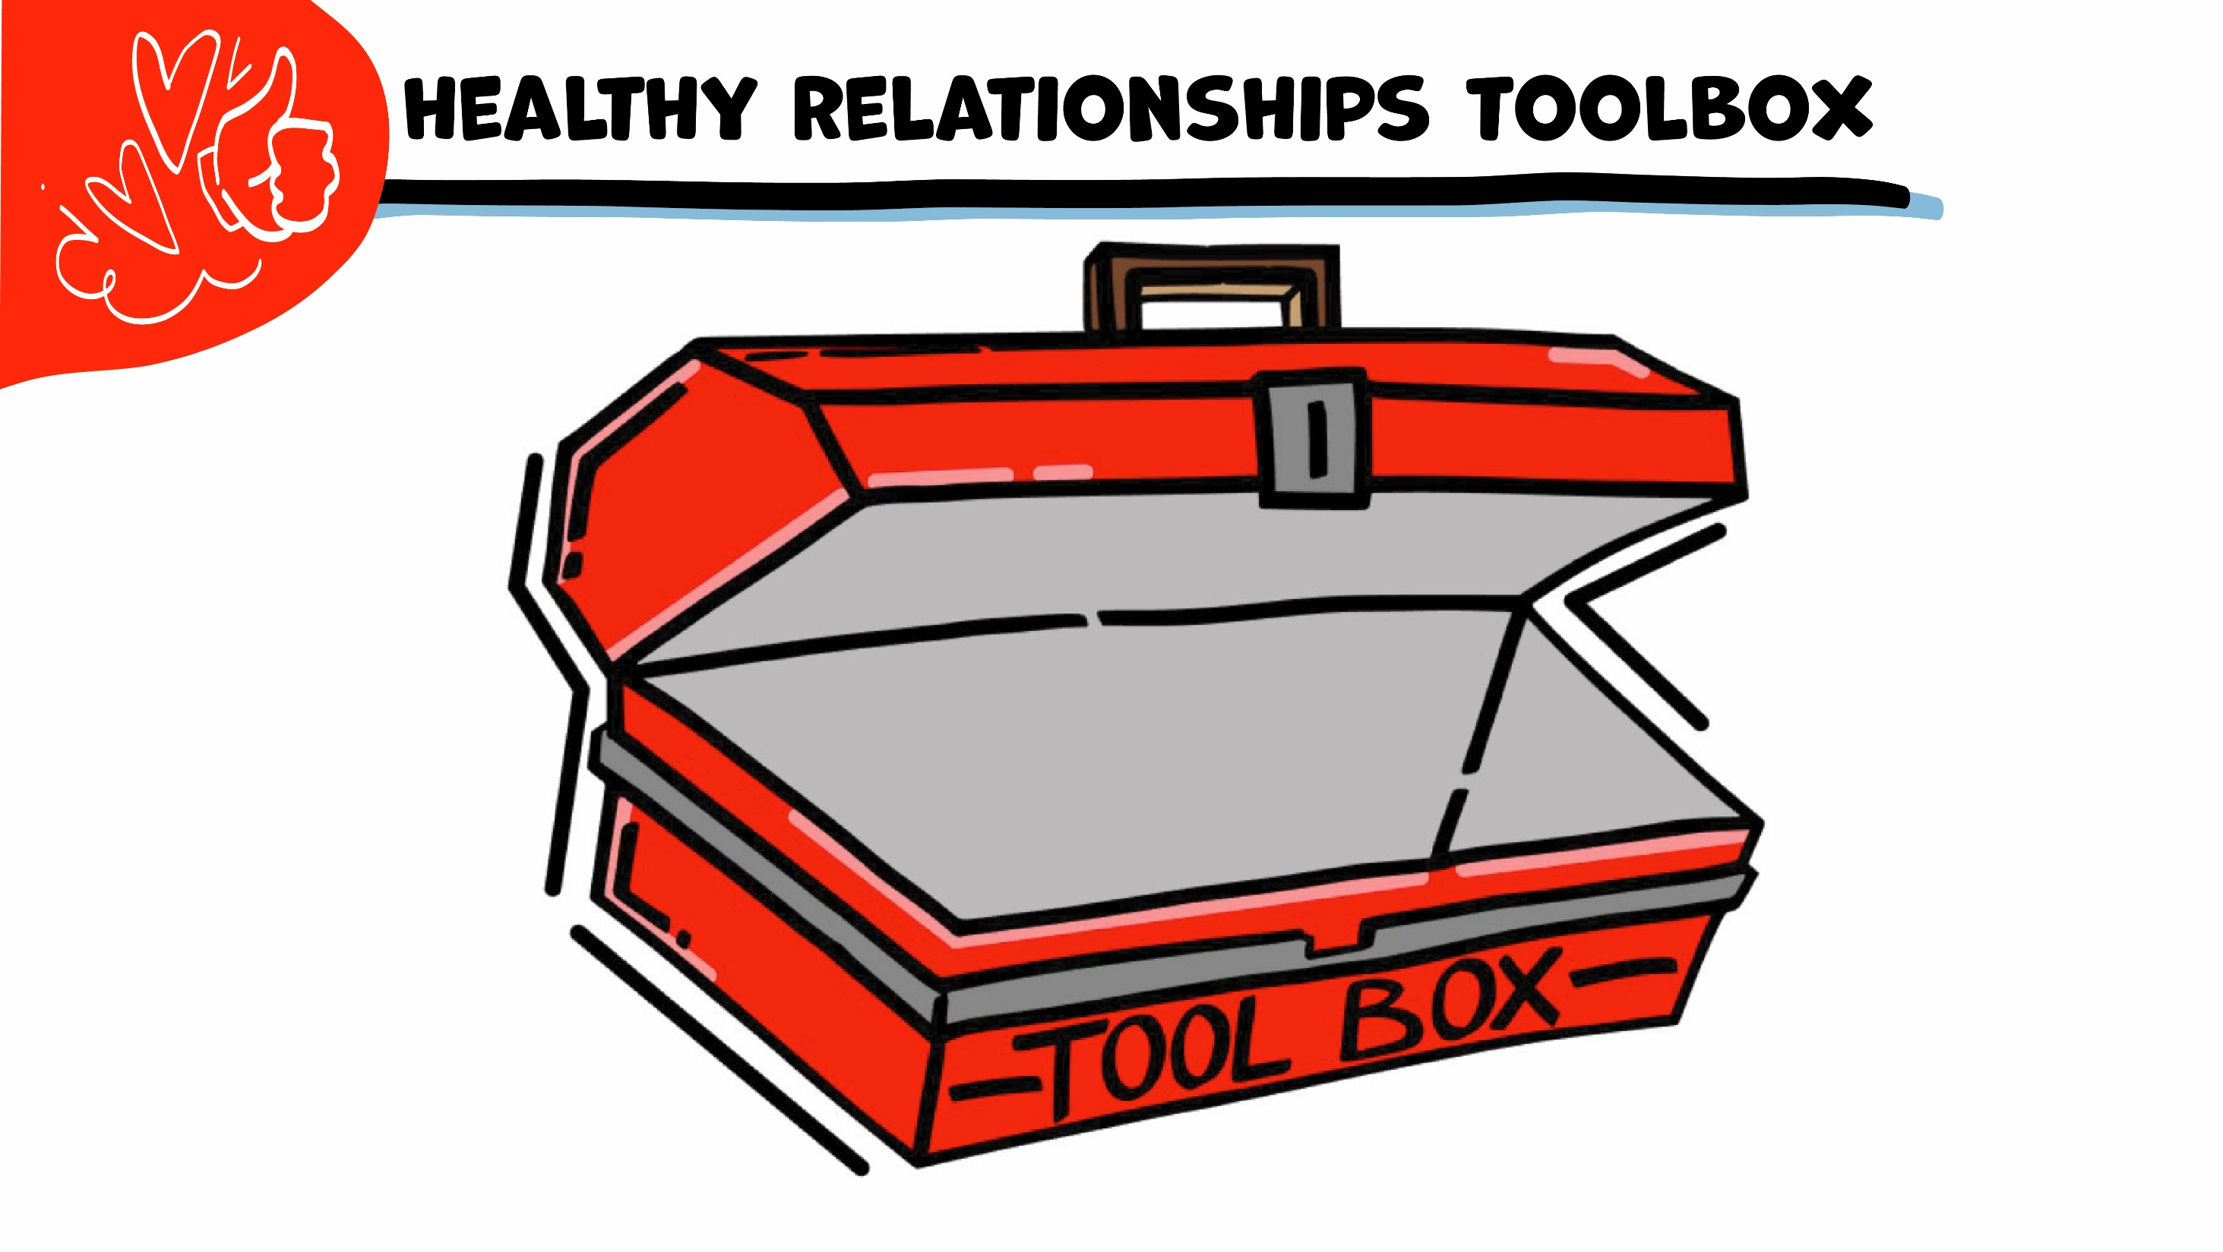
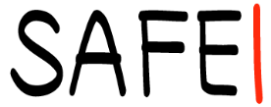
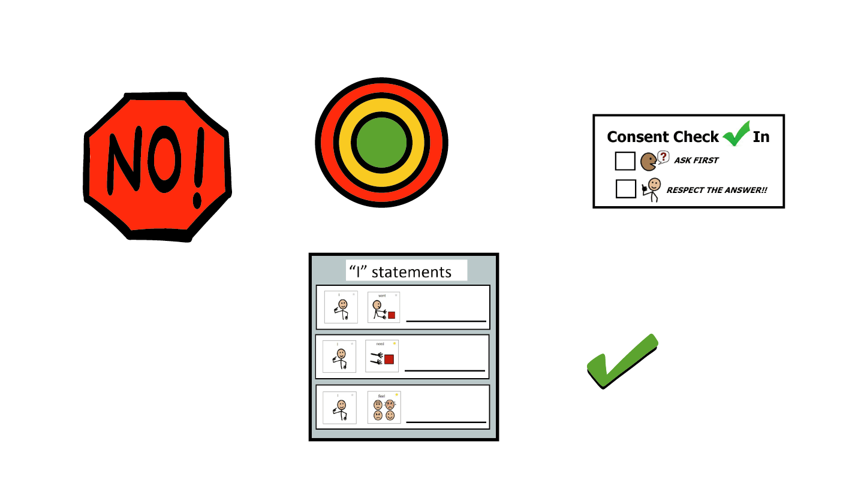
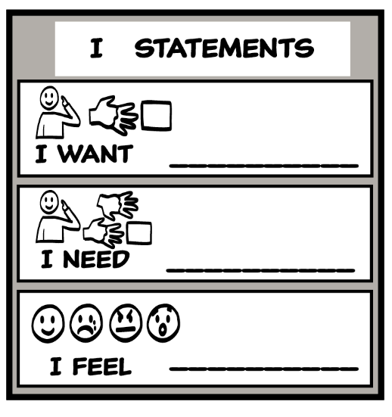
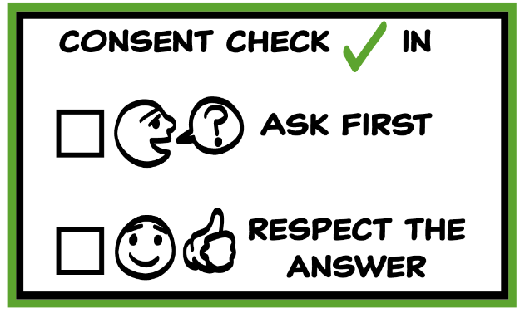
© 2026 SAFE Disability Services Program
Notes:
Use the large class Healthy Relationship Toolbox to review the Healthy Relationship Tools (I Statement, Relationship Map, NO!, and Consent Check-In). You can ask students to pull off one tool at a time and discuss what it is and how it is used. It can be particularly helpful for this review if you give students specific scenarios to think through. For example, you might ask, “If your friend lies to you, what is one I Statement you could use to tell your friend how you feel?” You may even consider using examples of situations that have recently occurred in your classroom, as long as doing so does not break student confidentiality. You can also ask students to connect the toolbox tools to their current relationships. You might say, “Can anyone volunteer and tell me about something going on in your life right now that the toolbox could help you with?”
If you invite the discussion, remind students about mandatory reporting should a student decide to talk about abuse happening to them in a current relationship.
Instructions for how to use each Healthy Relationship Tool can be found in the following classes:
I Statements: Classes 2 and 3
Relationship Map: Class 4
NO!: Class 5
Consent Check-In: Class 6

Slide 3
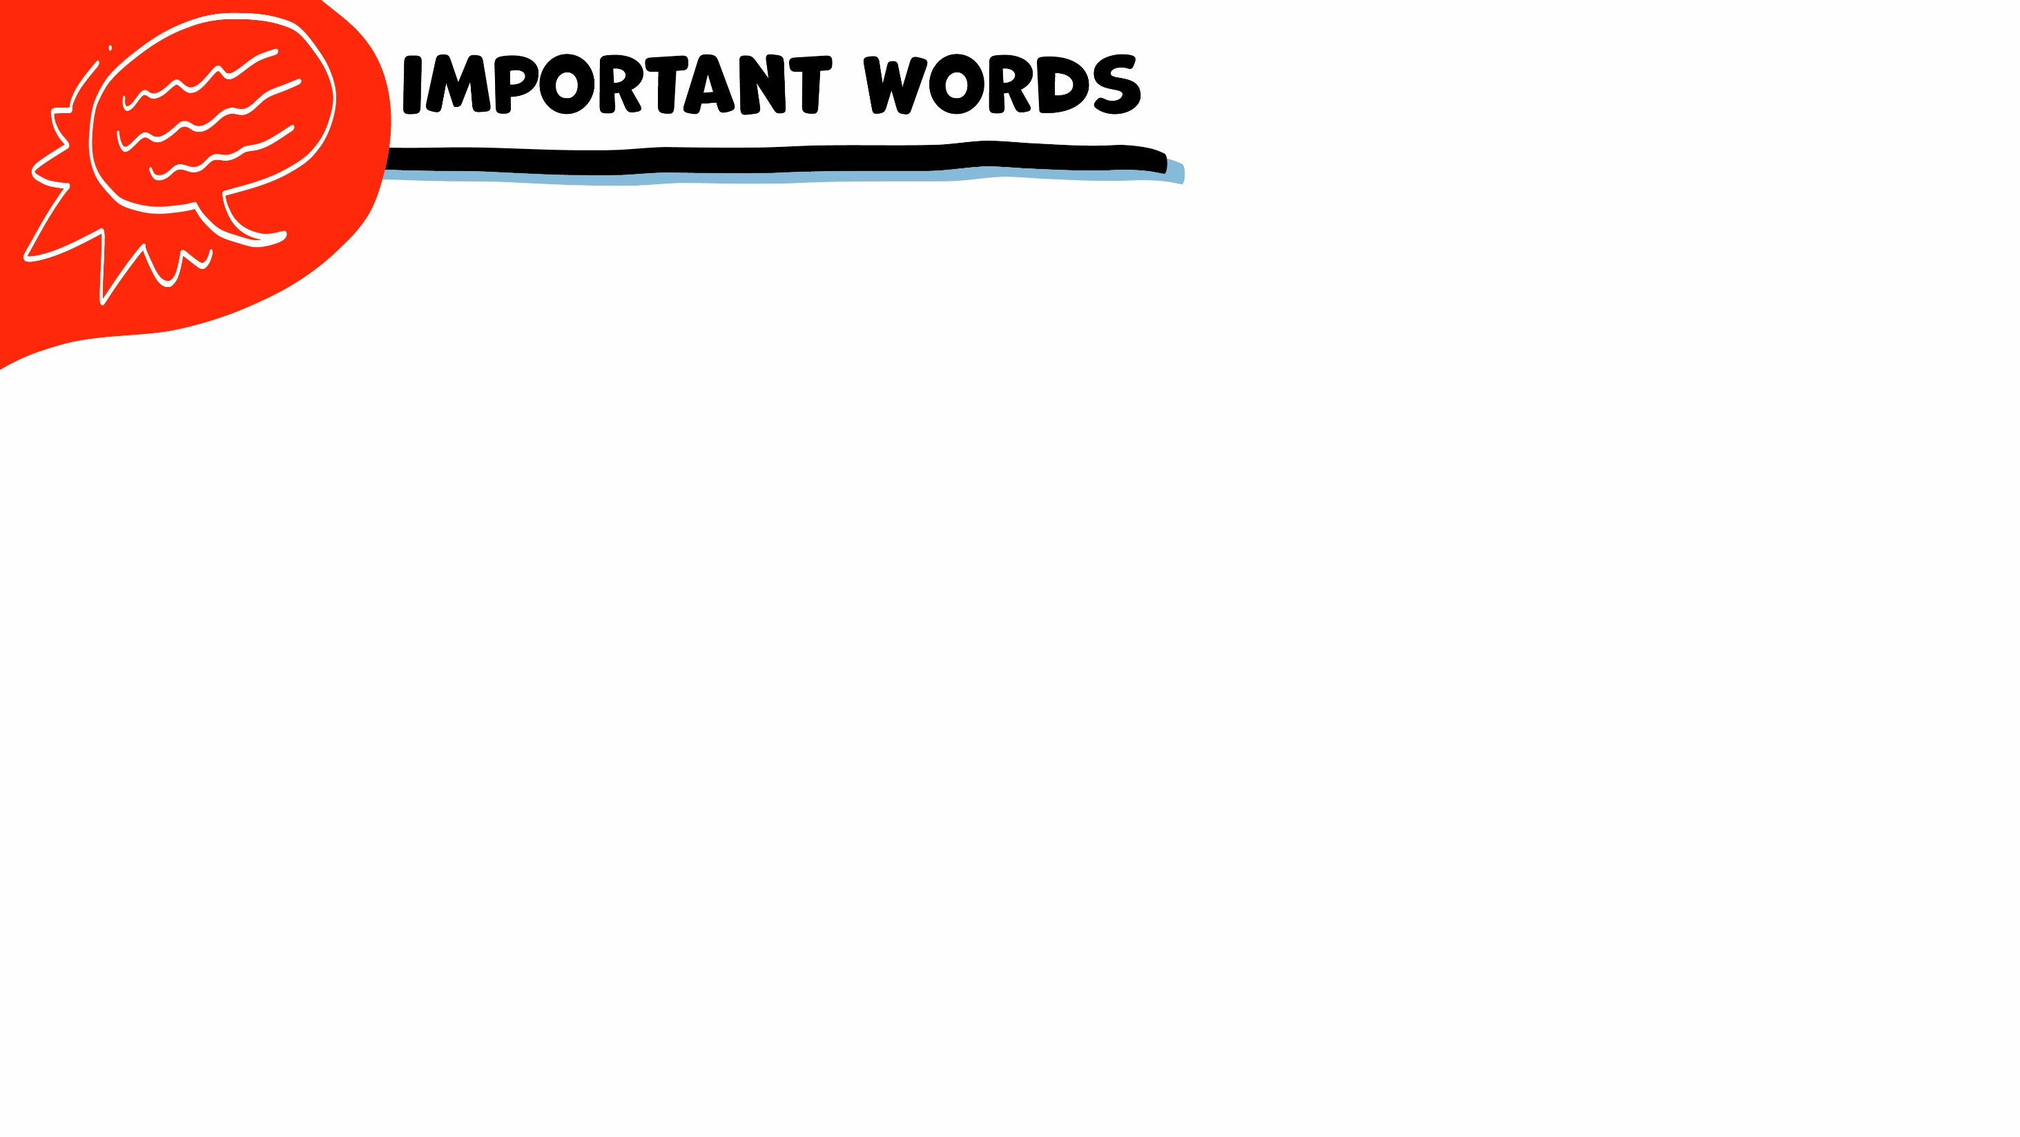
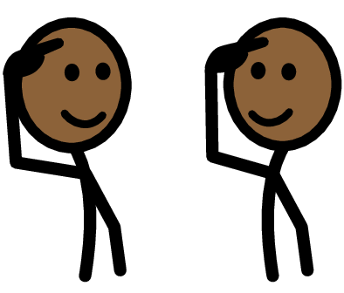
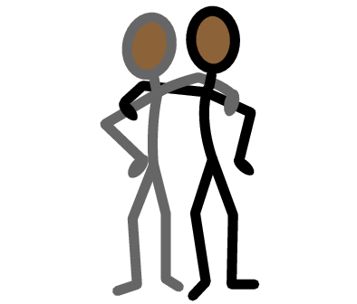
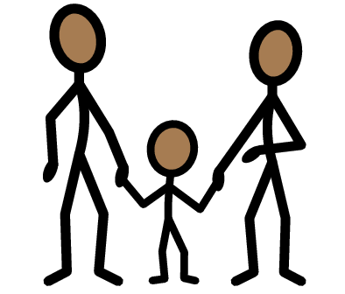
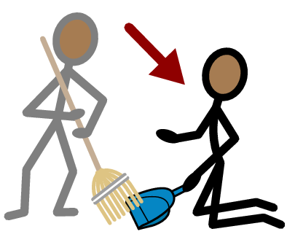
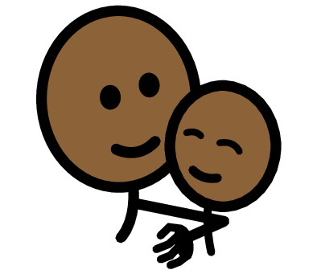


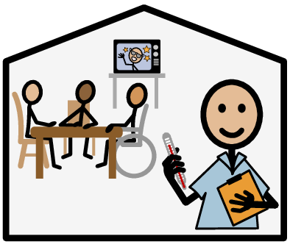
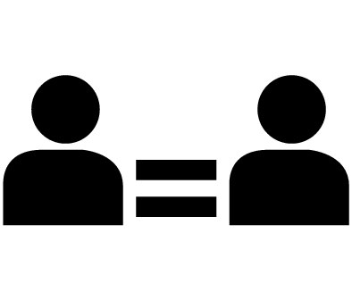
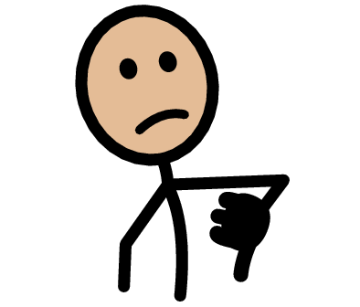


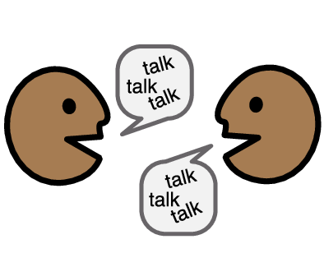

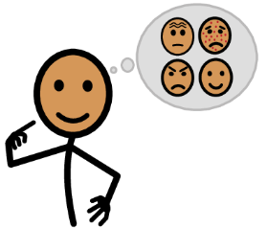



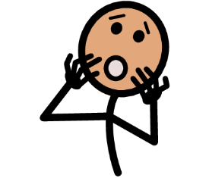
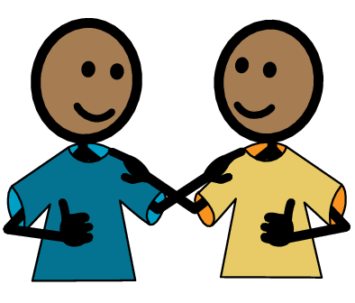
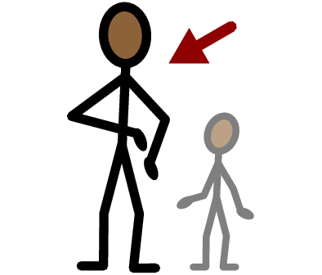
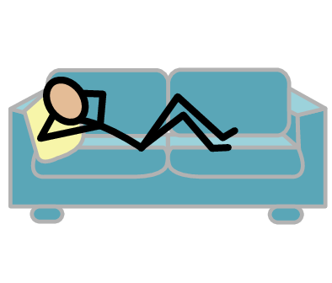
Respect
Friend
Family
Coworker
Safety
Yes
No
Support staff
Communication
Equality
Unhealthy
Healthy
I need help
I have a question
Trust
Adult
Take a break
I feel
Happy
Sad
Mad
Scared
Copyright © 2021 SymbolStix, LLC. All rights reserved. Used with Permission.
Notes:
You can print this slide separately so each student can use the Important Words Sheet as a communication board throughout class. Review the words using the suggested definitions below. To enhance understanding, you can ask students to come up with their own definitions for vocabulary words or to provide a sentence or scenario using the new word.
Safety: When you feel physically and emotionally okay
Respect: When people listen to your boundaries, and when you can be exactly who you are, and no one makes fun of you for it
Equality: When both people in a relationship make choices together, and both people give and get things
Communication: When people talk and listen to each other
Healthy: When a relationship feels good to both people
Unhealthy: When a relationship does not feel good to both people
Friend: Someone you like to spend time with
Coworker: Someone who works where you work
Support staff: Someone who gets money to help you do things (like getting dressed or taking a bath)
Family: The people you are related to, such as mom, dad, brother, or sister

Slide 4
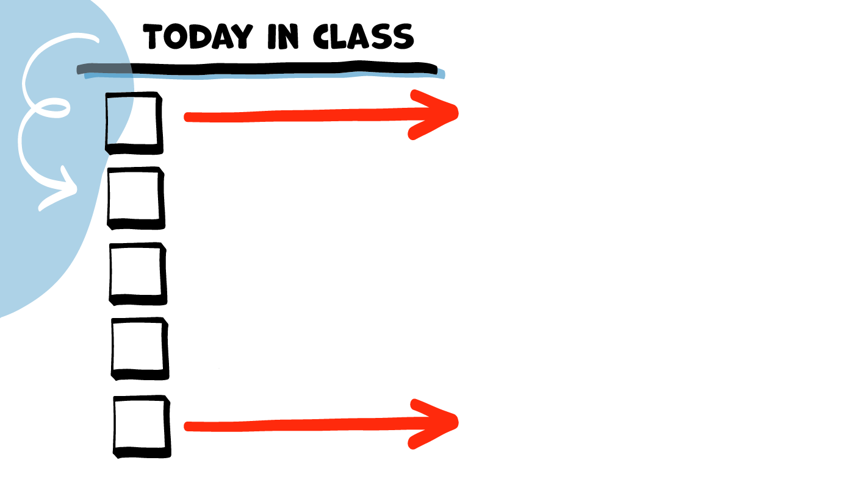
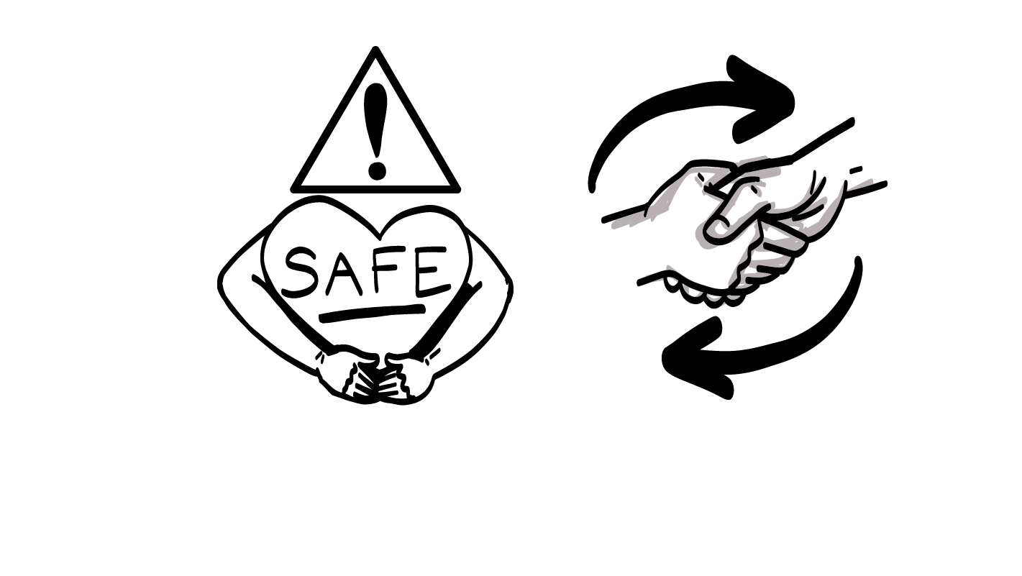
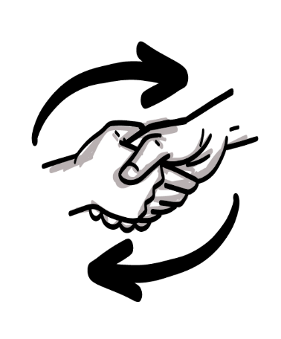
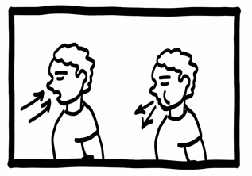
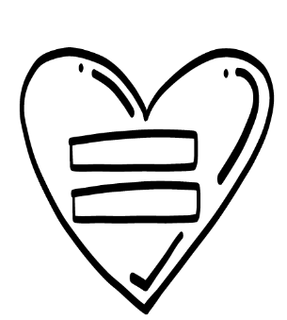
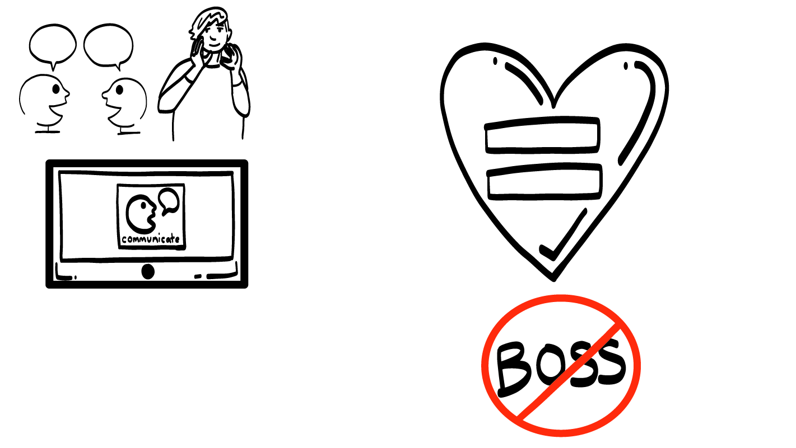
Safety
Respect
Brain break
Equality
Communication
© 2026 SAFE Disability Services Program
Notes:
Read the agenda. Alternatively, you can ask for a student volunteer to read the agenda.

Slide 5
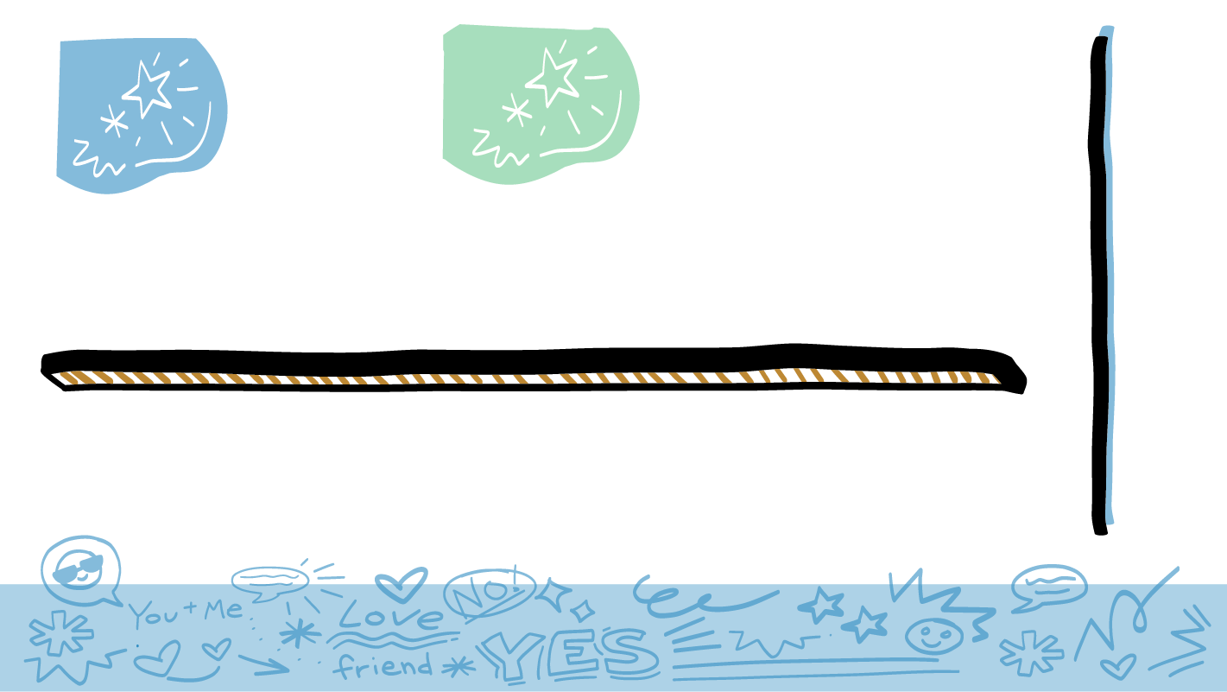
Parts of a
Healthy Relationship
Safety
Respect
Communication
Equality
© 2026 SAFE Disability Services Program
Notes:
Say: Today we are going to talk about four things you need to have a healthy relationship—safety, respect, equality, and communication. You’ll get to practice thinking about each one.

Slide 6
Safety
You should feel like your body and your feelings are safe.
© 2026 SAFE Disability Services Program
Notes:
Say: The first thing you need for a healthy relationship is safety. In every relationship, you should be physically safe. That means no one is hurting your body. You should also be emotionally safe. This means that people say nice things to you, and they are kind to you.

Slide 7
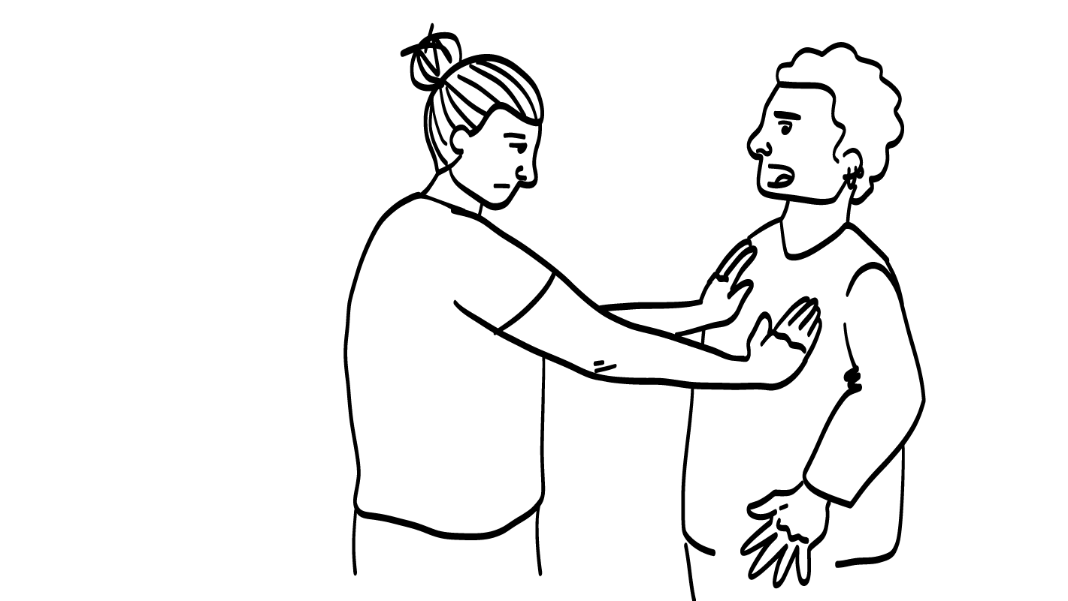


Your friend gets mad
and pushes you.
Is this safe?
YES
NO
© 2026 SAFE Disability Services Program
Notes:
Say: Let’s practice. You all are going to decide if what’s on the screen is safe or unsafe.
While you are arguing, your friend gets mad and pushes you. Is this safe? Give a thumbs up for yes and a thumbs down for no.
Give students enough time to process the question and make their decisions.
Say: This is not safe. It is never okay for anyone to hurt your body. No one should ever push, hit, kick, slap, or do anything else to hurt your body.

Slide 8
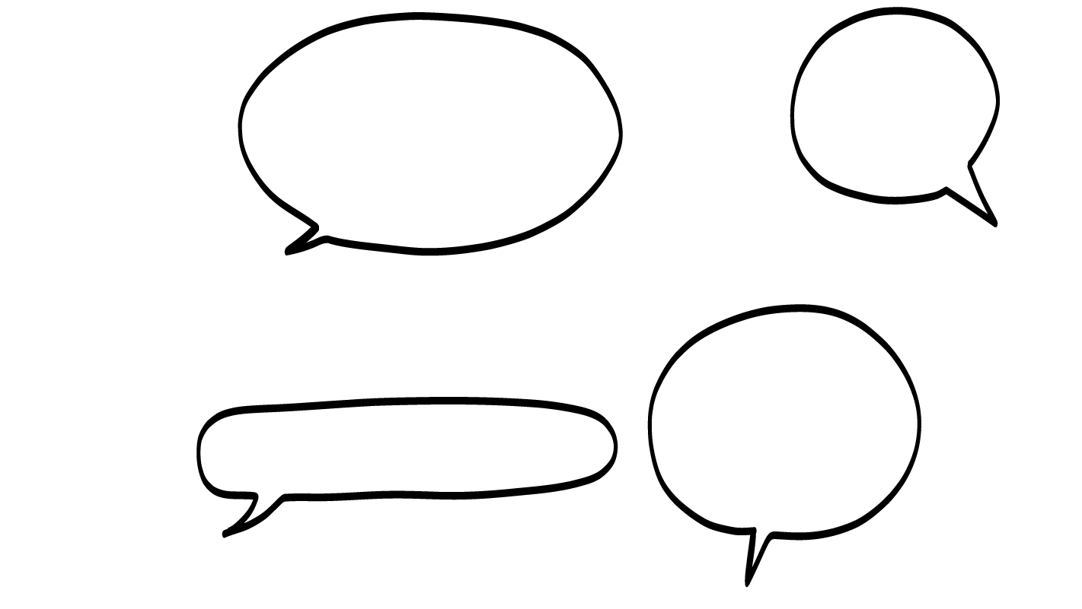
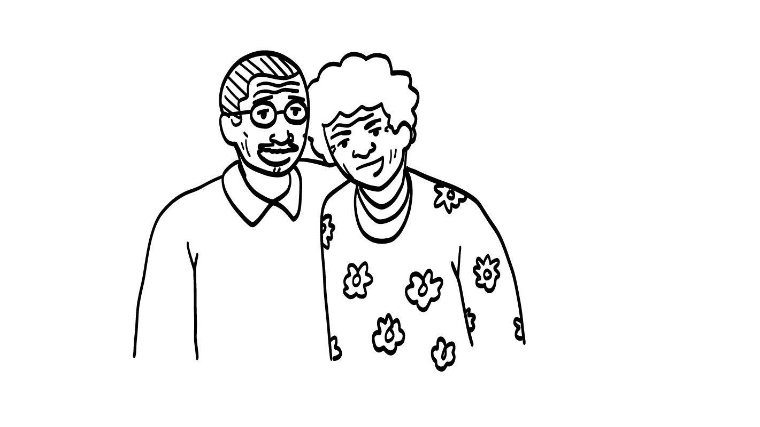
Your parent tells you
they are proud of you.
Is this safe?
YES
NO
© 2026 SAFE Disability Services Program
Notes:
Say: Your parent tells you they are proud of you. Is this safe? Give a thumbs up for yes and a thumbs down for no.
Give students enough time to process the question and make their decisions.
Say: Yes, this is safe. In every relationship, you should feel both physically and emotionally safe. Emotional safety means that the other person is kind to you and respects your feelings.

Slide 9
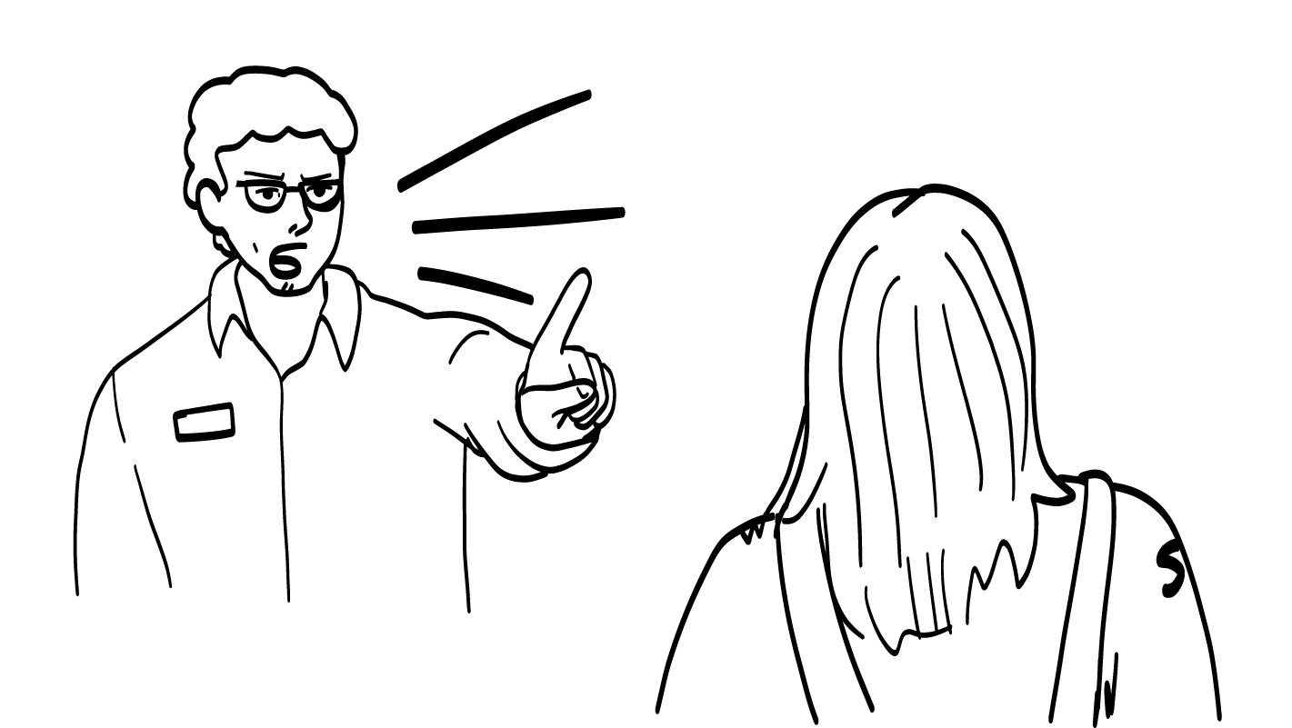
Your coworker yells at
you and says you are
bad at your job.
Is this safe?
YES
NO
© 2026 SAFE Disability Services Program
Notes:
Say: Your coworker yells at you and says you are bad at your job. Is this safe? Give a thumbs up for yes and a thumbs down for no.
Give students enough time to process the question and make their decisions.
Say: No, this is not safe. It is never okay for someone to yell at you, say mean things to you or make you feel bad about yourself. You shouldn’t say mean things to or about other people either.

Slide 10
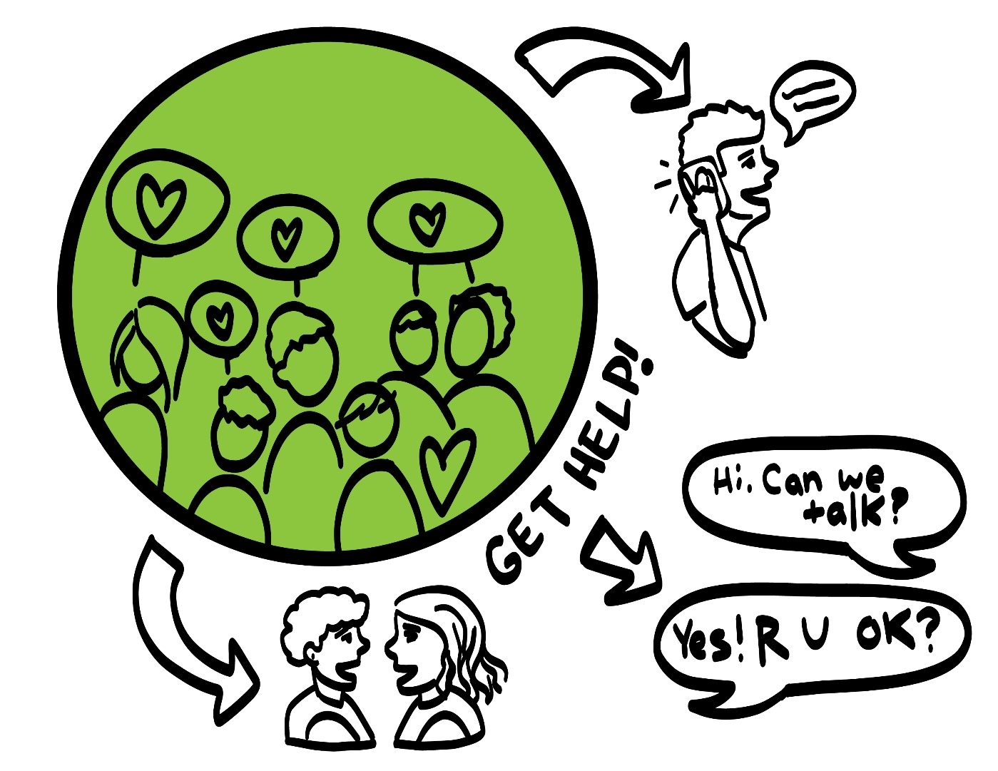
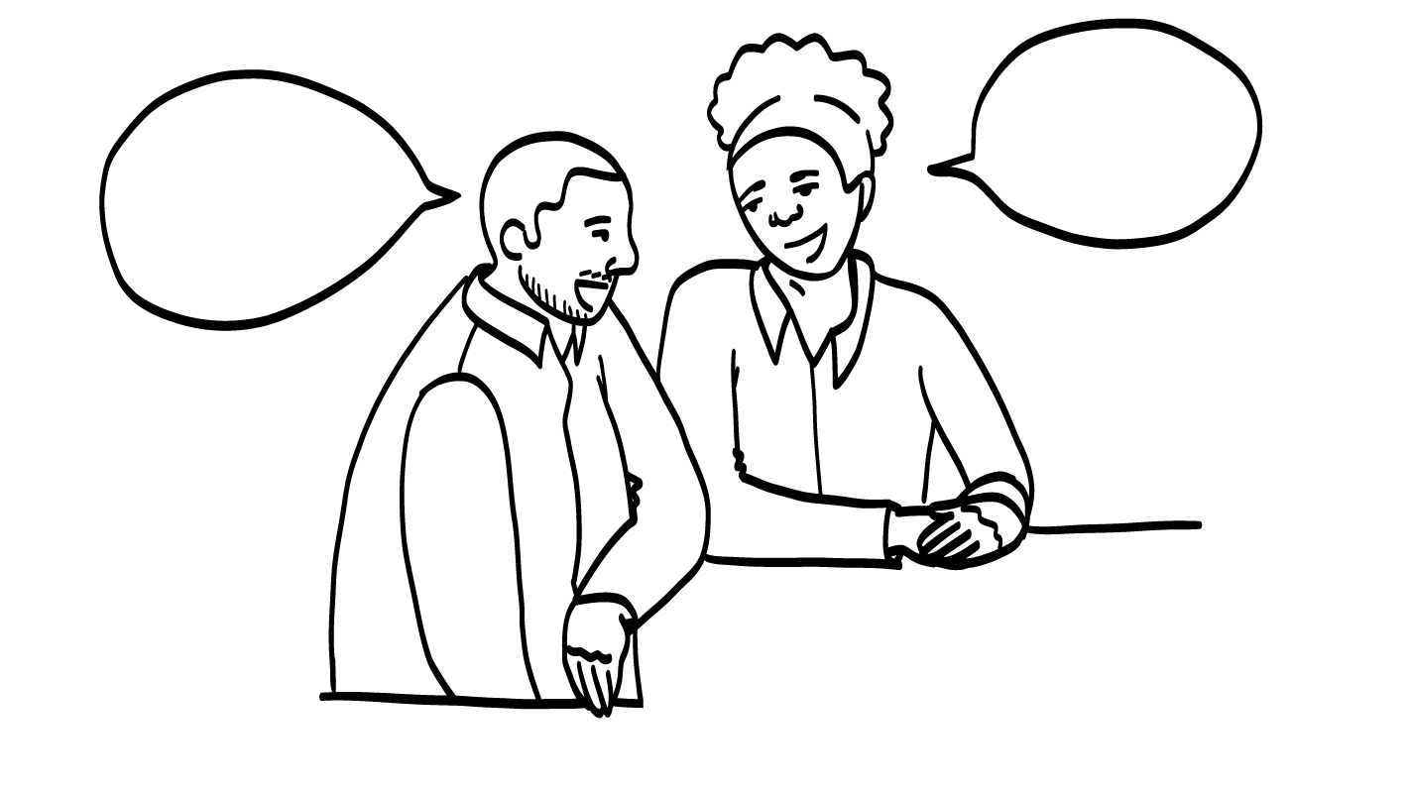
Getting Help
© 2026 SAFE Disability Services Program
Notes:
Say: If you ever feel physically or emotionally unsafe in your relationships, it is not your fault. You did not do anything wrong, and you can get help. You can get help by talking to an adult from your inner green circle of trust. Who is one adult you could talk to if you feel unsafe in your relationships?
Give students enough time to process the question and make their decisions. Go around and ask each student to share the name of one adult they trust who could help if they feel unsafe.

Slide 11
Safety
Respect
Brain break
Equality
Communication
© 2026 SAFE Disability Services Program
Notes:
Say: Now let’s talk about the second part of a healthy relationship.

Slide 12
Respect
People listen to you and respects your boundaries, and don’t make you feel bad about who you are.
© 2026 SAFE Disability Services Program
Notes:
Say: The second thing you need for a healthy relationship is respect. Respect means that you can be exactly who you are, and people will not make fun of you for it. Respect also means that other people listen to you and will follow the boundaries you set. If you tell them no, what should they do?
Give students enough time to process the question and make their decisions.
Say: They should stop right away and back off.

Slide 13
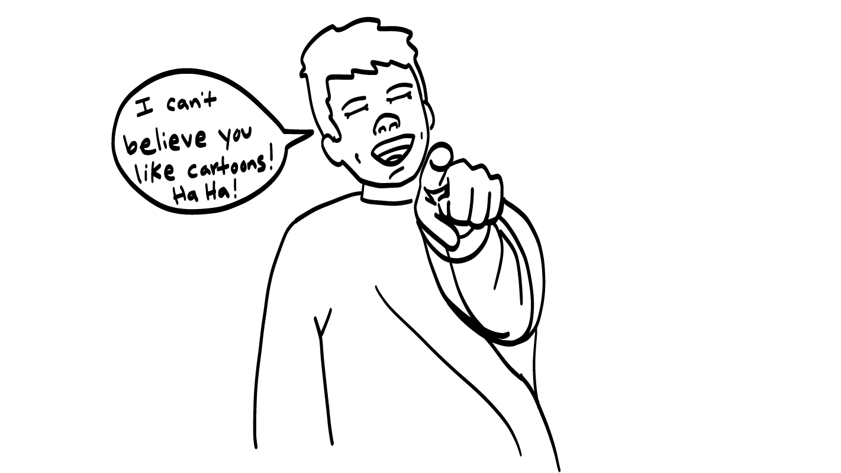
Your friend makes fun of you for watching cartoons.
Is this respect?
YES
NO
© 2026 SAFE Disability Services Program
Notes:
Say: Your friend makes fun of you for watching cartoons. Is this respect? Give a thumbs up for yes and a thumbs down for no.
Give students enough time to process the question and make their decisions.
Say: No, this is not respect. The people you have relationships with should like you for who you are. If you like cartoons, that’s awesome! It’s not cool to make people feel bad about what they like or who they are.

Slide 14
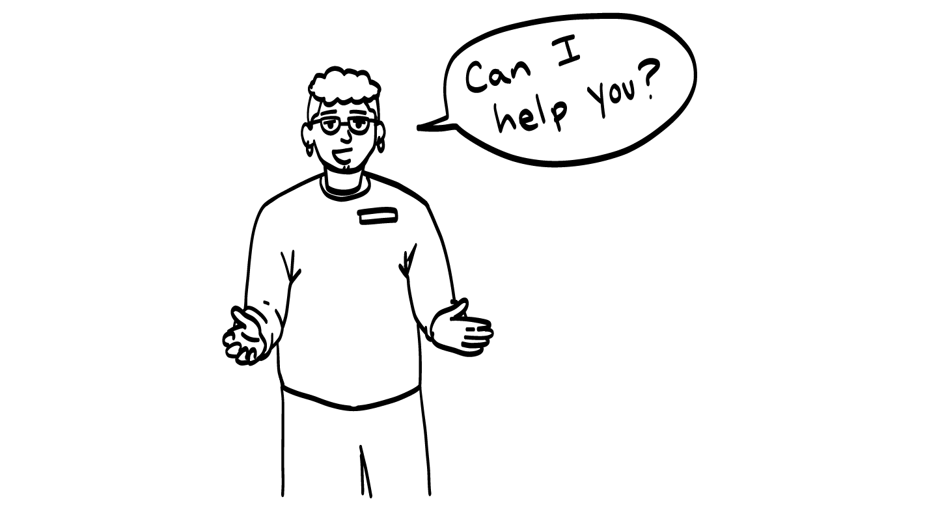
Your support staff asks for your consent before helping you.
Is this respect?
YES
NO
© 2026 SAFE Disability Services Program
Notes:
Say: Your support staff asks for your consent before helping you get dressed in the morning. Is this respect? Give a thumbs up for yes and a thumbs down for no.
Give students enough time to process the question and make their decisions.
Say: Yes, this is respect. They are using the Consent Check-In Tool! Even if it is someone’s job to help you, they still need to respect your boundaries.
They should still ask you how you want to be helped. They should get your consent any time they are going to touch your body.
If anyone touches your body in a way you don’t like, it’s not your fault. You can get help. If you have a support staff who helps you get bathed and dressed, or if they help you use the bathroom, they still shouldn’t touch you in a way you don’t like. If they touch you in a way you don’t like, tell an adult in your inner green circle of trust right away.

Slide 15
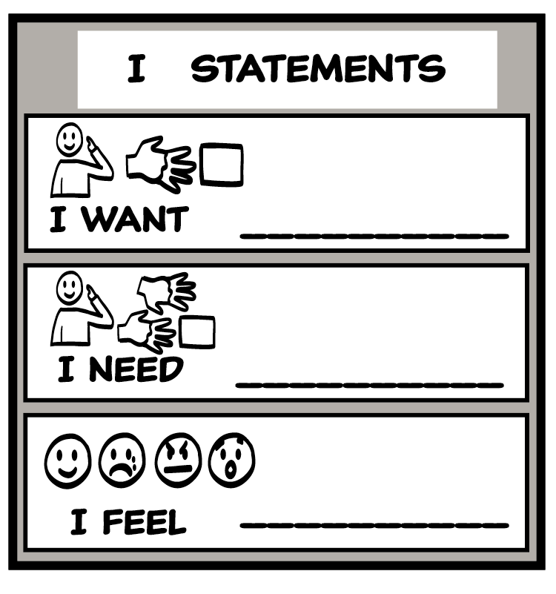
Setting Boundaries
© 2026 SAFE Disability Services Program
Notes:
Say: Let’s review what you can do if someone is being disrespectful. If someone is not respecting you, that’s not cool. That’s a boundary crossing. Remember, any time someone does something that crosses your boundaries, you have the right to say NO! Can you all show me how you can say no with your voice, signs, and body?
Give students enough time to process the question and make their decisions. Encourage students to practice saying no assertively, showing no with their signs, or doing things like turning or walking away.
Say: Another way to set your boundaries is to use the I Statement Tool. Let’s think about an example from earlier. If your friend is making fun of you for watching cartoons, what is an I statement you could use to talk to them about it?
Give students enough time to process the question and make their decisions. Sample I statements are included below:
I feel sad when you make fun of me.
I want you to respect me.
I need you to be nice to me.
Say: If you have said no or used an I statement, and the person keeps crossing your boundaries, talk to an adult in your inner green circle of trust for help.

Slide 16
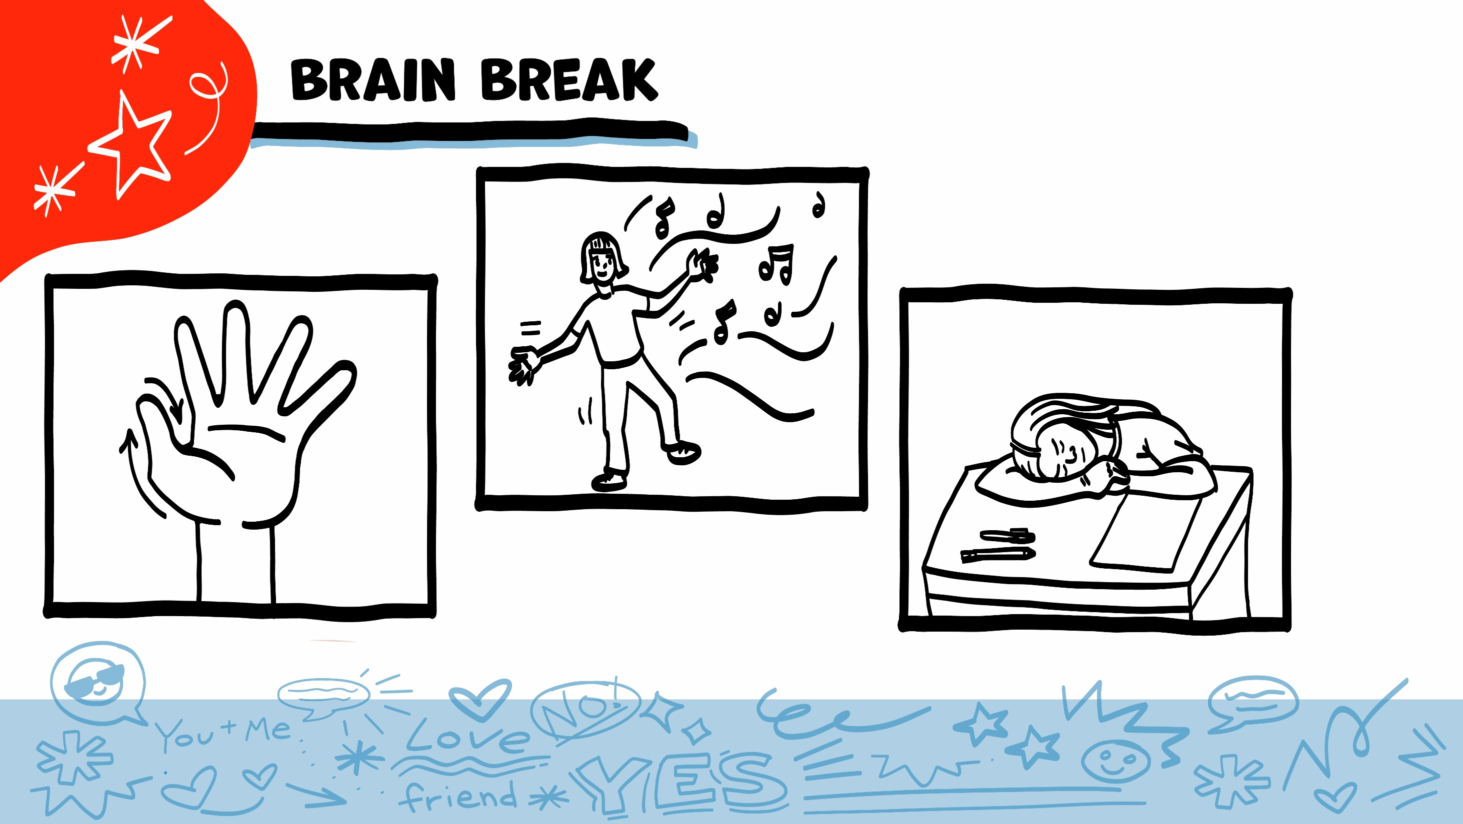
© 2026 SAFE Disability Services Program
Notes:
Say: That was a lot of information, and you all are doing an amazing job! Every week in class we will take a brain break in the middle. This is a chance to move a little and take a break from thinking!
Below are three ideas to give students a quick opportunity for a brain break. You are also welcome to come up with your own ideas for brain breaks that work best for your class.
Five finger breathing
For this exercise, have all students place their hand in front of their chest with their five fingers spread out. Next, use the pointer finger of the other hand to trace up and down each of the five fingers, beginning with the thumb. As students trace up a finger, they will breathe in. As they trace down a finger, they will breathe out. When students breathe out on the pinky finger, you can tell them to shake out their hands and arms. As the school year goes on, you can ask students to lead this exercise for their peers.
If this exercise is physically inaccessible for your class, you can also model the hand tracing for students while they breathe in and out.
Stretch break
Lead students through a series of basic stretches. These can be completed in a chair, or while standing up, depending on the accommodation needs of your class. Some ideas include reaching toward the ceiling, stretching one arm at a time across the chest, reaching toward toes, turning head from side to side, etc. Ask students to hold a pose while you count to ten. As the school year goes on, you can ask students to lead stretches for their peers.
Dance party
If your class likes to dance, you can put on a short song for them to dance to. This is especially effective if you are able to find a song that relates to the theme for that week’s class.

Slide 17
Safety
Respect
Brain break
Equality
Communication
© 2026 SAFE Disability Services Program
Notes:
Say: Let’s move on to the third part of healthy relationships: equality.

Slide 18
Equality
You make choices together and no one is the boss.
© 2026 SAFE Disability Services Program
Notes:
Say: The next part of a healthy relationship is equality. Equality means that both people give things and get things in the relationship. You and the other person will make choices together.

Slide 19
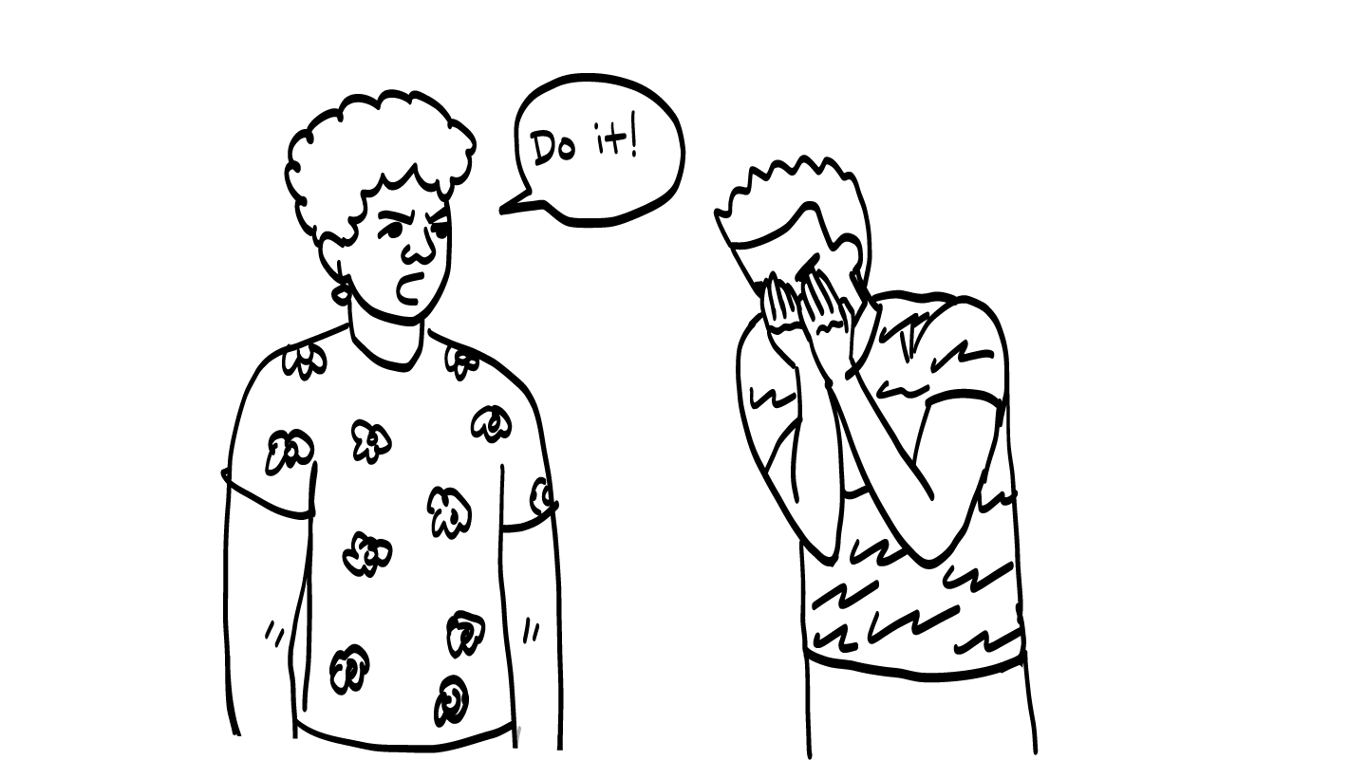
Your brother bosses you around.
Is this equality?
YES
NO
© 2026 SAFE Disability Services Program
Notes:
Say: Your brother bosses you around, always telling you what to do. Is this equal? Give a thumbs up for yes and a thumbs down for no.
Give students enough time to process the question and make their decisions.
Say: No, this is not equal. Your brother is not the boss of you. He should not tell you what to do.

Slide 20
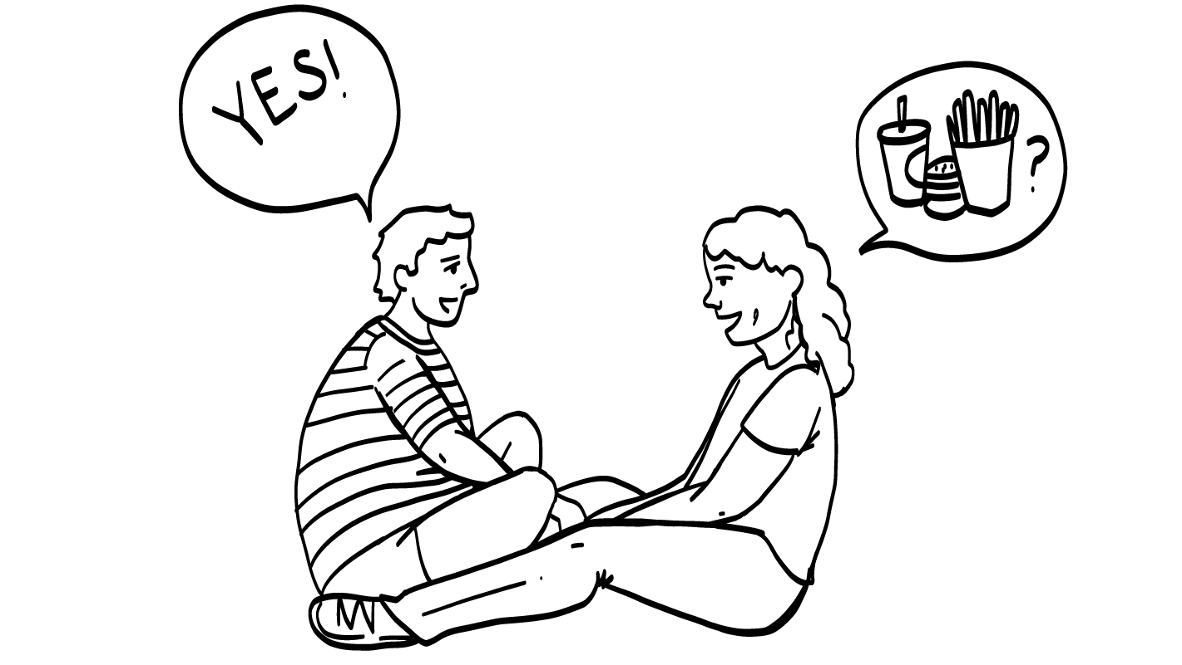
You and your friend
take turns choosing
where to eat.
Is this equality?
YES
NO
© 2026 SAFE Disability Services Program
Notes:
Say: You and your friend take turns choosing where you are going to eat for lunch. Is this equal? Give a thumbs up for yes and a thumbs down for no.
Give students enough time to process the question and make their decisions.
Say: Yes, this is equal. You and your friend should both get to make choices, or you should take turns making choices. Neither of you is the boss of the other one.

Slide 21
Safety
Respect
Brain break
Equality
Communication
© 2026 SAFE Disability Services Program
Notes:
Say: Finally, let’s talk about communication.

Slide 22
Communication
You share your feelings, wants, and needs, and both people listen to each other.
© 2026 SAFE Disability Services Program
Notes:
Say: The last part of a healthy relationship is communication. Good communication means that you use I statements to tell the other person how you feel, what you want, and what you need. It also means that you and the other person really listen to each other.

Slide 23
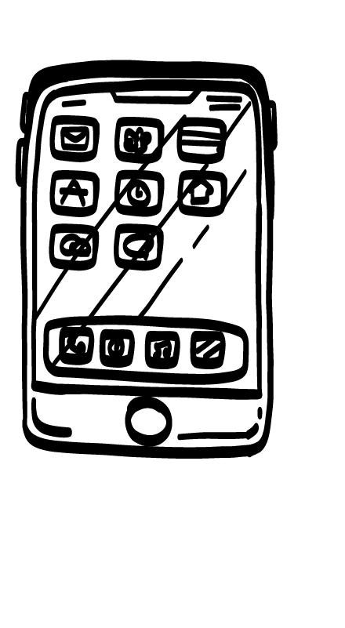
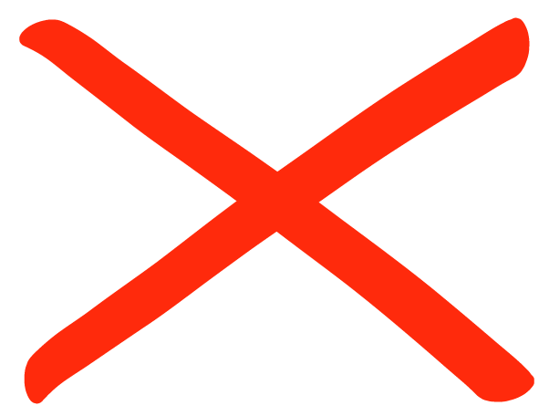
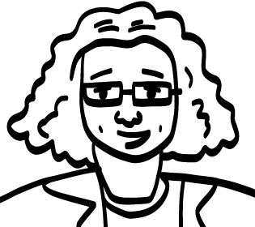
How to Show You
are Listening
?
?
© 2026 SAFE Disability Services Program
Notes:
Say: One way to let the other person know you are listening is to make eye contact. Not everyone likes to make eye contact though. What are other ways you can show someone that you’re listening?
Give students enough time to process the question and make their decisions. As students make suggestions, write their ideas on a piece of chart paper. Some sample ideas are included below:
Putting down your phone
Paying attention
Nodding your head
Asking questions about the thing the other person is talking about

Slide 24
Listening Practice
© 2026 SAFE Disability Services Program
Notes:
Say: Let’s practice! In just a minute, you are going to find a partner. You and your partner are going to practice healthy communication skills. Pick one person to go first. When I say “start,” that person is going to talk about their favorite thing to do for fun, such as bowling or making art. The other person is going to be an active listener. You can look at the list we just made if you need ideas for how to show your partner that you are listening. At the end of the minute, you will switch roles. The other person will get to talk about their favorite thing to do for fun while their partner listens.
It might help students understand these directions if you and another staff member first role play in front of the class, with one person talking and the other person using active listening skills. Ask if students have any questions about the directions, and once all questions are answered, tell students to find a partner and start. Give each person one minute to talk about their favorite thing to do for fun. Walk around during the minute supporting students. You may also want to remind the listening partner to do things such as asking the sharing partner a question. At the end of one minute, tell the partners to switch roles. If students need additional time, you can extend the sharing period to two or three minutes per person.

Slide 25
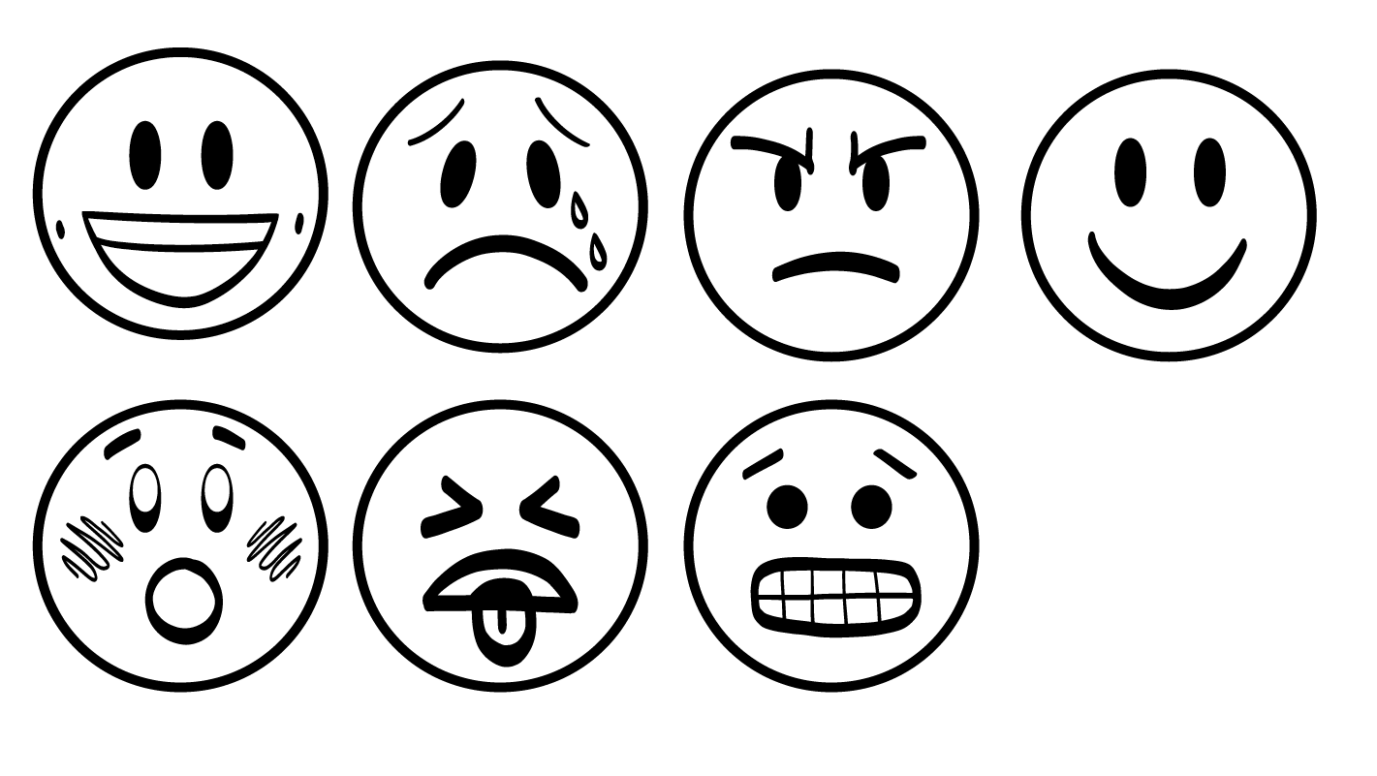
Grossed out
Nervous
Sad
Mad
Scared
© 2026 SAFE Disability Services Program
Notes:
Say: Another thing you need for healthy communication is to be able to disagree in healthy ways. We are all different, and we all have different likes and dislikes and opinions. In a healthy relationship, you can disagree in a respectful way. One thing you can use to have healthy disagreements is our I Statements Tool. We are going to practice this next.

Slide 26
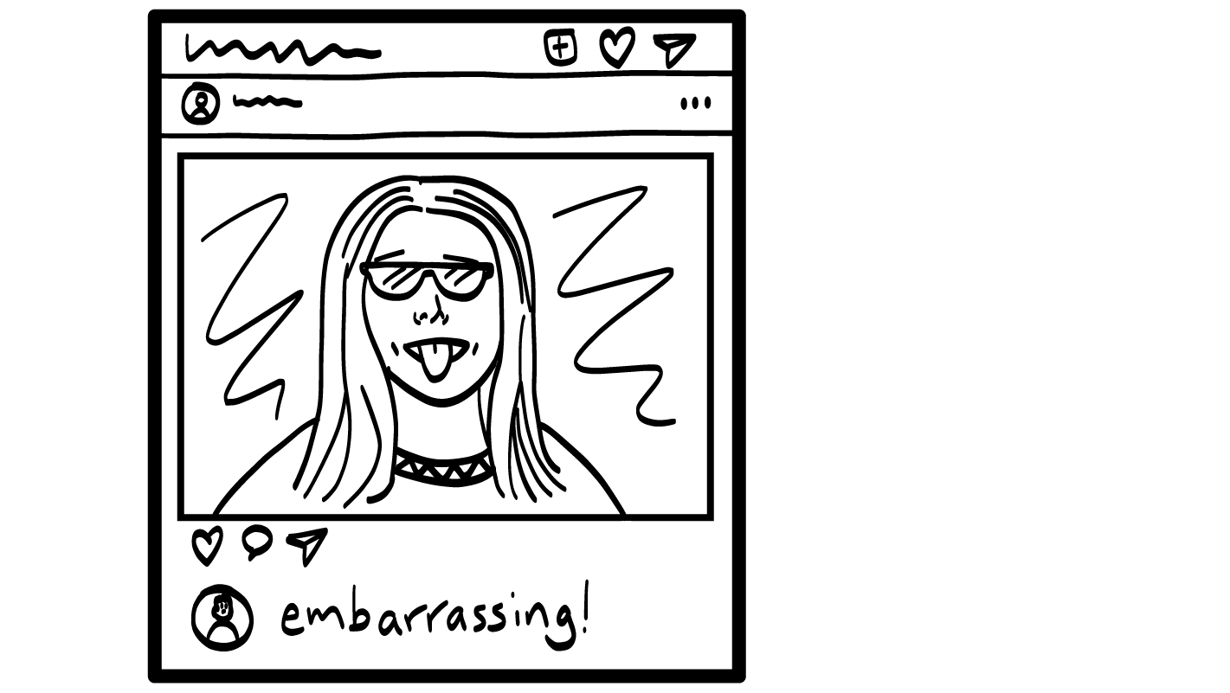
Your friend posts pictures of you online that you don’t like.
© 2026 SAFE Disability Services Program
Notes:
Say: Imagine that your friend posted a bunch of pictures of you online that you don’t like. What’s an I statement you could use to talk to them about it?
Give students enough time to process the question and make their decisions. Some sample I statements are included below:
I feel mad that you post pictures I don’t like.
I want you to ask me before putting my pictures online.
I need you to take the pictures down.

Slide 27
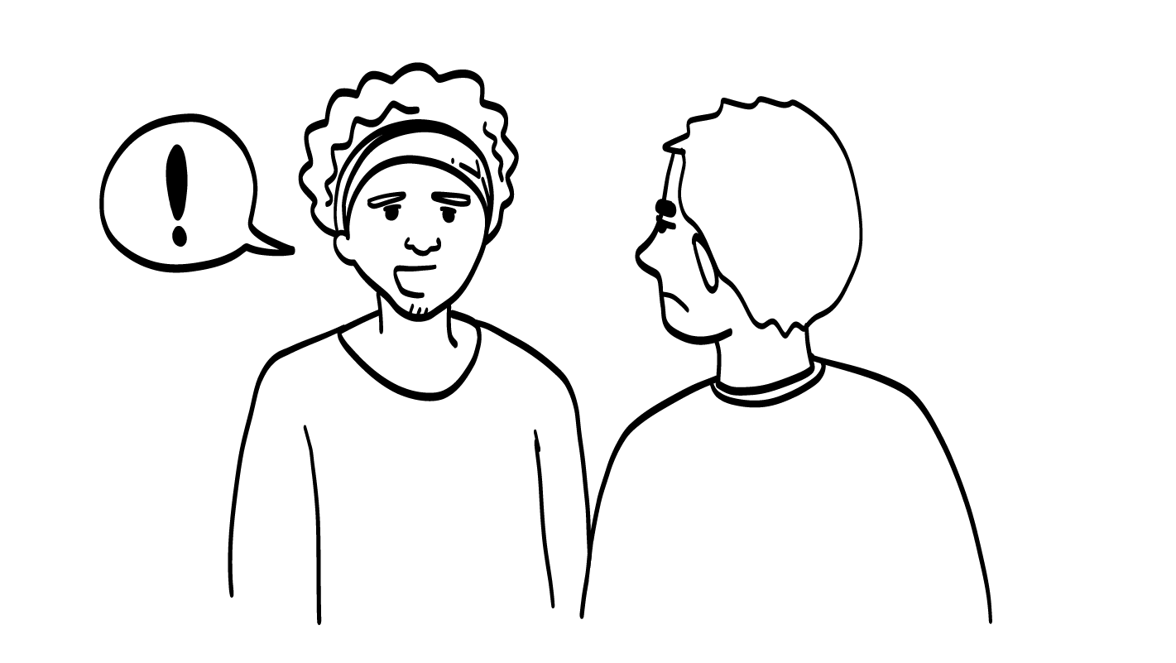
Your parent shared your private story.
© 2026 SAFE Disability Services Program
Notes:
Say: Let’s do another example. Imagine that your parent shared a private story about you with several of your friends. What’s an I statement you could use to talk to them about it?
Give students enough time to process the question and make their decisions. Some sample I statements are included below:
I feel embarrassed that you told that story to my friends.
I want you to ask me before telling my private stories.
I need you to get my consent before telling my stories.

Slide 28
Respect
Safety
Equality
Communication
© 2026 SAFE Disability Services Program
Notes:
Say: Excellent work in class today everyone. Remember, in healthy relationships, most of the time the other person will make you feel safe, respected, and equal. They will use good communication skills to talk to you. Both of you will feel good most of the time!

Slide 29
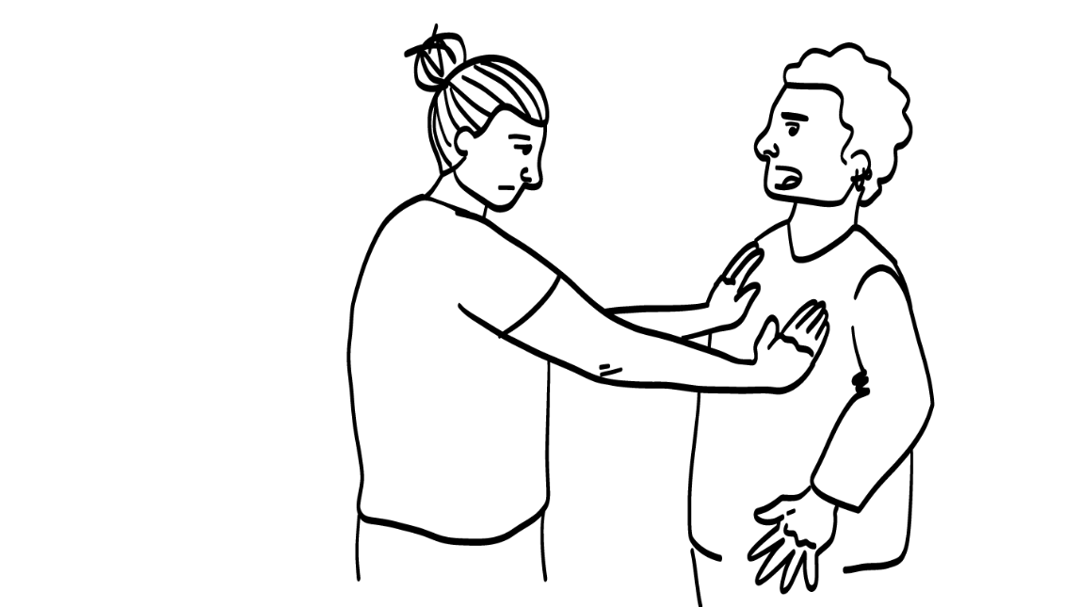
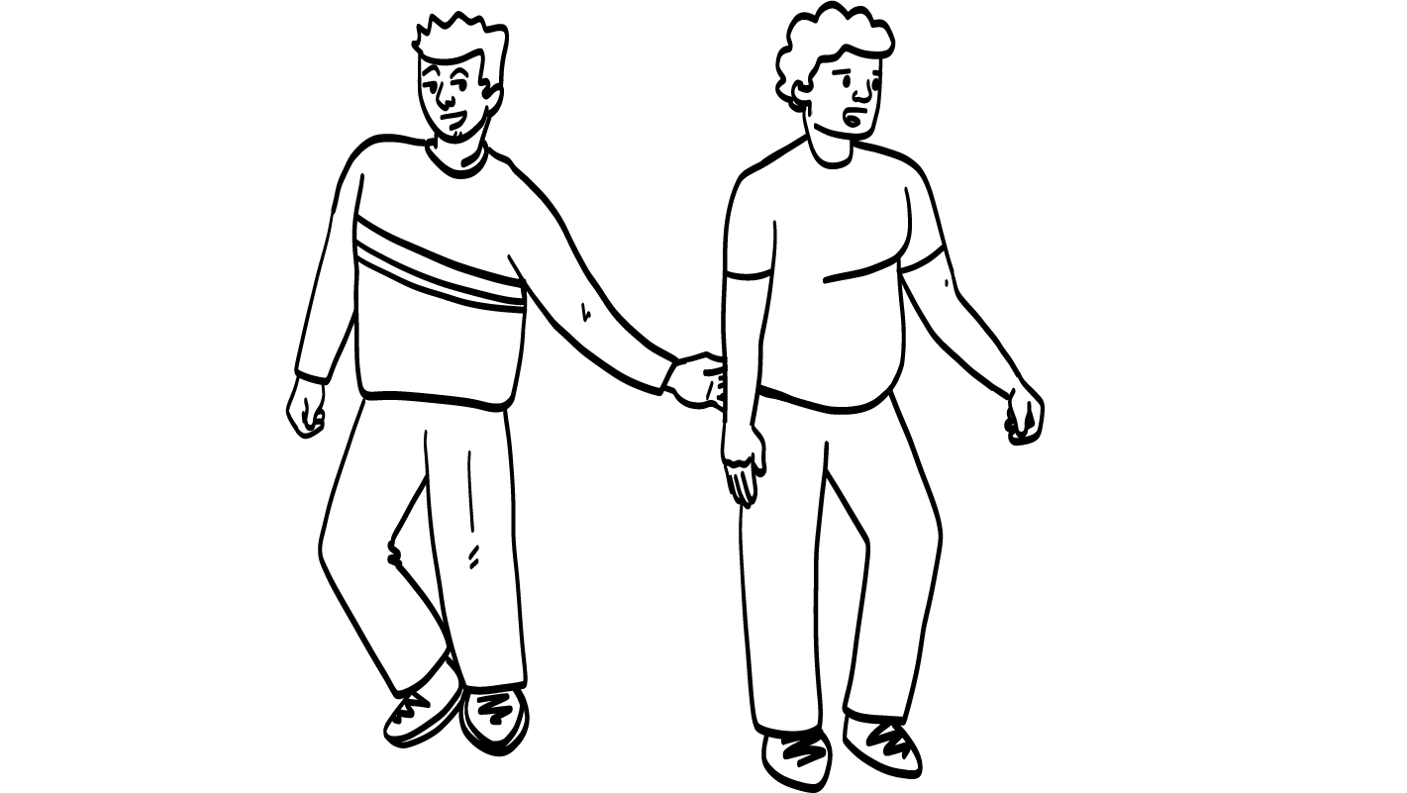
Abuse is Never Okay
Verbal Abuse
Physical Abuse
Sexual Abuse
© 2026 SAFE Disability Services Program
Notes:
Say: Sometimes when people do unhealthy things, you can talk to them about it. You can say NO! or use I statements to try to make things better.
Other times, people do things that are so unhealthy, the relationship needs to end right away for the safety of both people. These super unhealthy things are called abuse. There are three types of abuse.
Verbal abuse is when someone uses their words to say mean things to you, or makes you feel bad about who you are.
Physical abuse is when someone hurts your body.
Sexual abuse is when someone touches your private parts, your butt, or your breasts without your consent or in a way you do not like.
Abuse is never okay.

Slide 30
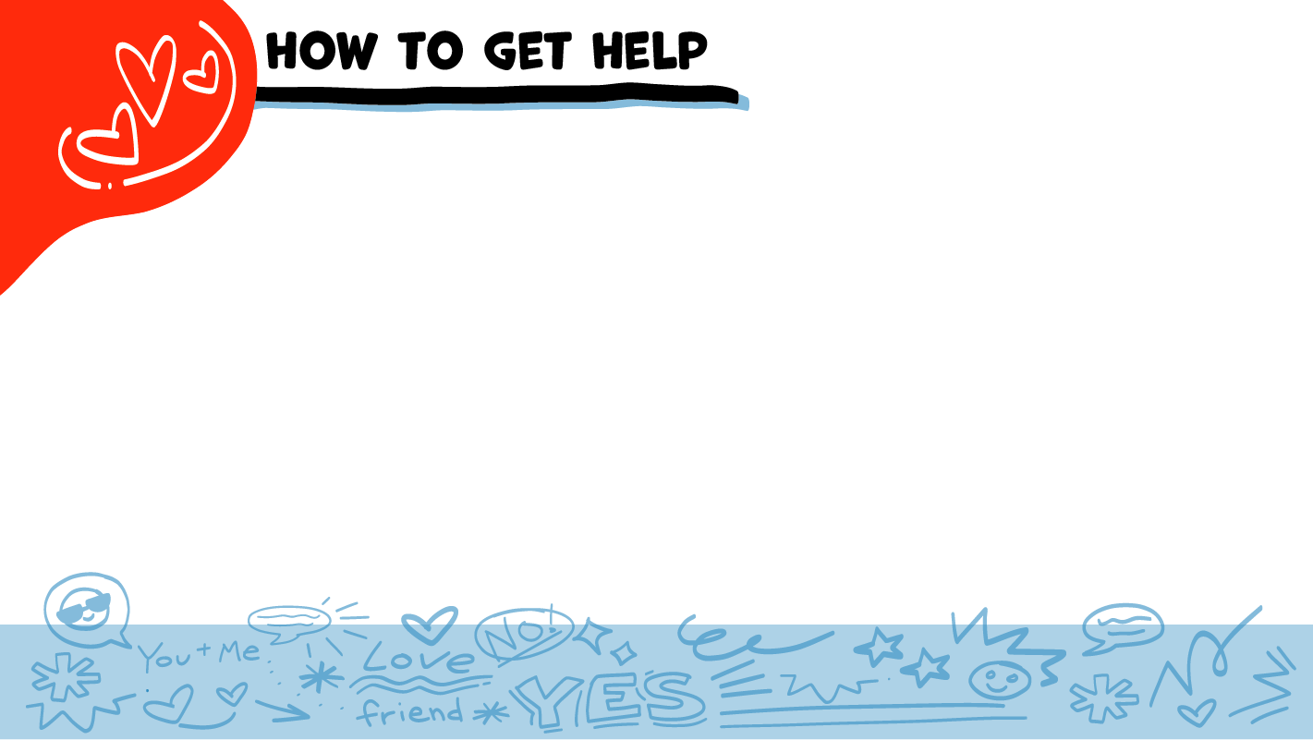

© 2026 SAFE Disability Services Program
Notes:
Say: If you are being hurt, or if someone ever touches your body in a way that you don’t like, you can get help. You did not cause that to happen or do anything wrong. And you are not alone. You can get help by talking to an adult from your inner green circle of trust. If someone you care about is being hurt, you can also get help by talking to an adult from your inner green circle of trust. If an emergency is happening, you can always call 911. If you call 911 for help, a police officer or an ambulance might come.
If the first person you tell doesn’t believe you or doesn’t get you help, keep telling adults you trust what is going on until you get the help you need.

Slide 31


© 2026 SAFE Disability Services Program
Notes:
Say: Does anyone have any questions about today’s class? Remember, if you don’t want to ask your question out loud, you can write it on a notecard and leave it on your desk. You can also ask someone you trust to help you write your question on the notecard. I will pick up the note cards and will answer the questions the next time we meet. When I answer a question, I won’t tell anyone who asked it.

Slide 32




For a healthy relationship, you need safety, respect, equality, and what?
Tacos
Boundary crossings
Communication
1
2
3
© 2026 SAFE Disability Services Program
Notes:
Say: For a healthy relationship, you need safety, respect, equality, and what? Hold up one finger for “tacos,” two fingers for “boundary crossings,” and three fingers for “communication.”
Give students enough time to process the question and make their decisions.
Say: The fourth thing you need is good communication. Today you practiced active listening, and I statements, two very important parts of healthy communication.

Slide 33


Is using the I Statement Tool a healthy way to disagree with someone?
YES
NO
© 2026 SAFE Disability Services Program
Notes:
Say: Is using the I Statement Tool a healthy way to disagree with someone? Give a thumbs up for yes and a thumbs down for no.
Give students enough time to process the question and make their decisions.
Say: Yes, the I Statement Tool is a great way to let someone know how you feel, what you want, or what you need. You can use this tool to disagree in healthy ways.

Slide 34
If you have been hurt in a relationship, can you get help?
YES
NO
© 2026 SAFE Disability Services Program
Notes:
Say: If you have been hurt in a relationship, can you get help? Give a thumbs up for yes and a thumbs down for no.
Give students enough time to process the question and make their decisions.
Say: Yes, you can always get help if you are being hurt. It is never your fault. You can get help from an adult in your inner green circle of trust.

Slide 35

© 2026 SAFE Disability Services Program
Notes:
Say: Does anyone remember what our power statement is? Our power statement is “I know me best.” This means that each of you knows yourself better than anyone else does. Today you learned the things you can look for to make sure your relationships are healthy. You also learned how to get help if your relationships are not healthy. Let’s gather together and then on the count of three, say our power statement.
Have each interested student put one hand in the middle of the circle. Ask for a student volunteer to count to three. After three, all participants say the power statement while lifting their hands into the air. Students can also stand in the circle without touching hands if they prefer.

Slide 36

This work is supported by the Texas Council for Developmental Disabilities through a grant from the U.S. Administration for Community Living (ACL), Department of Health and Human Services (HHS), Washington, D.C. 20201 with a 100% federal funding award totaling $6,161,072. Council efforts are those of the grantee and do not necessarily represent the official views of nor are endorsed by ACL, HHS, or the U.S. government.
© 2026 SAFE Disability Services Program
Notes:
SAFE would like to thank the Texas Council for Developmental Disabilities for the funding for this curriculum.

Slide 37

This curriculum is offered online at no cost. You are free to use the resources in the original format for educational purposes only. Please reference The SAFE Alliance appropriately (citations at bottom of page).
We ask that you do not alter curriculum images/art, slides, or lesson plan materials. You may not use My Rights My Life (18+ or High School) curriculum for commercial purposes (i.e., selling workshops you facilitate based on MRML curriculum; and/or creating links/websites to re-distribute any materials associated SAFE’s My Rights My Life).
This resource, My Rights My Life: A curriculum for healthier relationships for high school students (grades 9-12) is based on the original My Rights My Life: A curriculum for safer relationships (age 18+) written by Megan Westmore, Heidi Lersch, and edited by Schwartz, M. (2026). Selling materials from MRML is a copyright violation.
Burleson, Anna Belle & Benitez, Sophie (2026) provided light modification and abbreviated the original curriculum
(Westmore & Lersch, 2026) to offer an age appropriate resource for High School Students (grades 9-12).
Schwartz, M. (Ed.). The SAFE Alliance, Austin, Texas.
Westmore, M. & Lersch, H. (2026). My rights my life: A curriculum for safer relationships.
Schwartz, M. (Ed.). The SAFE Alliance: Austin, TX.
© 2026 SAFE Disability Services Program

