Slide 1
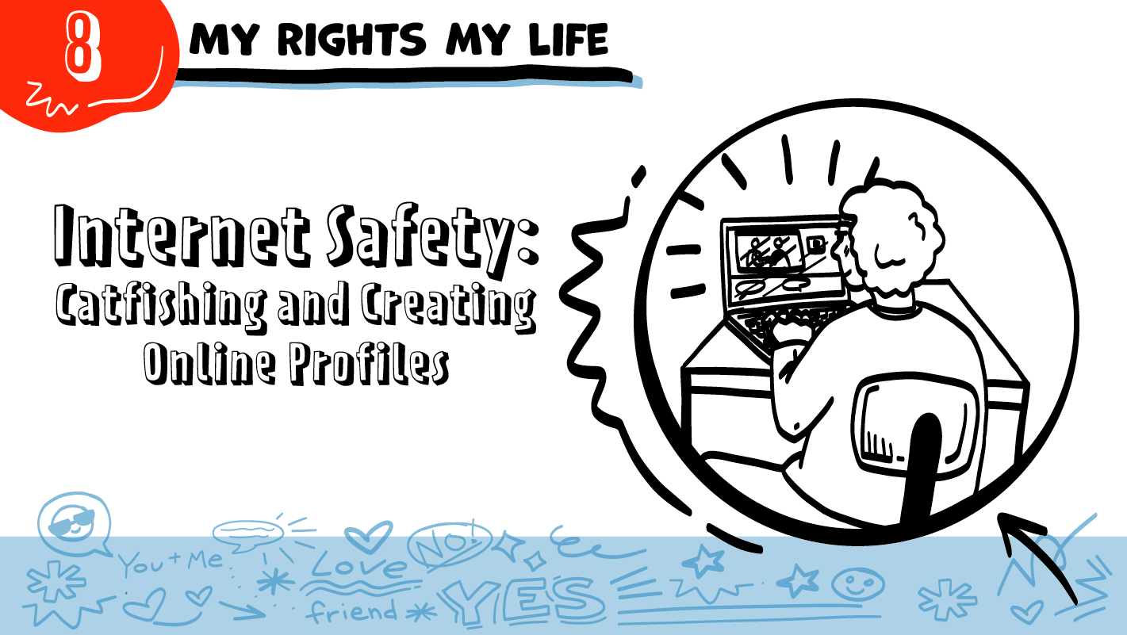

for High School Students
© 2026 SAFE Disability Services Program
Notes:
Repetition is beneficial for learning. Take time to review the last My Rights My Life class you taught prior to beginning this session. You can also answer any private questions students submitted on notecards during your previous class session.
Say: Today is the first of two classes where we are going to talk about how to be safer online. Today we are going to talk about something called catfishing. You’ll also have a chance to practice thinking about what is and is not safe to share online.

Slide 2
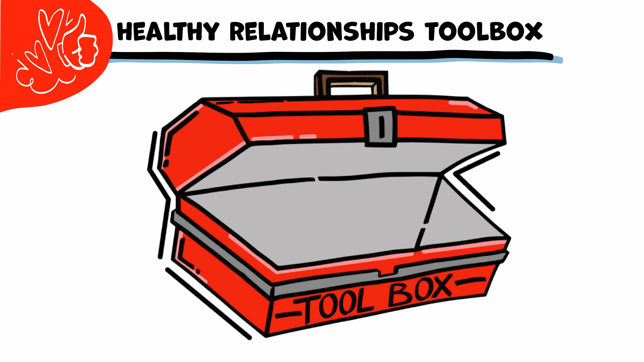

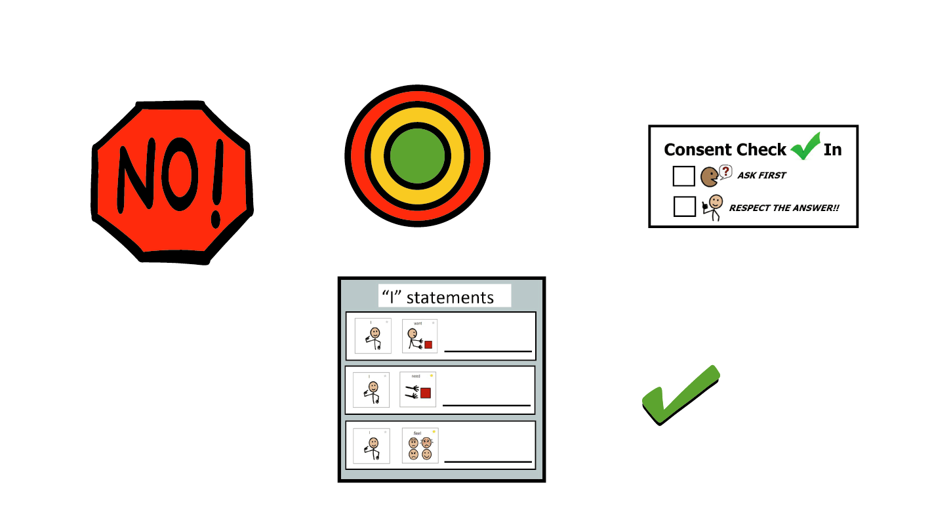
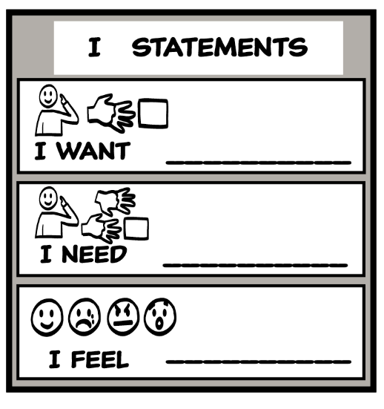
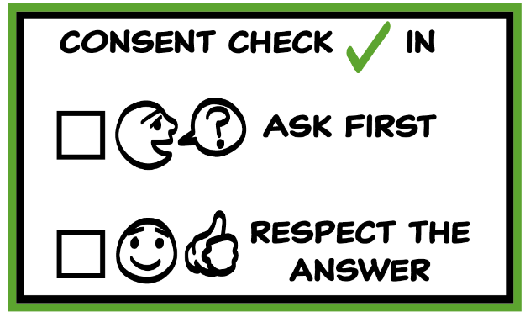
© 2026 SAFE Disability Services Program
Notes:
Use the large class Healthy Relationships Toolbox to review the Healthy Relationships Tools (I Statement, Relationship Map, NO!, and Consent Check-In). You can ask students to pull off one tool at a time and discuss what it is and how it is used. It can be particularly helpful for this review if you give students specific scenarios to think through. For example, you might ask, “If your friend lies to you, what is one I Statement you could use to tell your friend how you feel?” You may even consider using examples of situations that have recently occurred in your classroom, as long as doing so does not break student confidentiality. You can also ask students to connect the toolbox tools to their current relationships. You might say, “Can anyone volunteer and tell me about something going on in your life right now that the toolbox could help you with?”
Instructions for how to use each Healthy Relationship Tool can be found in the following classes:
I Statements: Classes 2 and 3
Relationship Map: Class 4
NO!: Class 5
Consent Check-In: Class 6

Slide 3


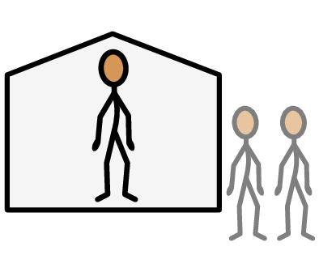

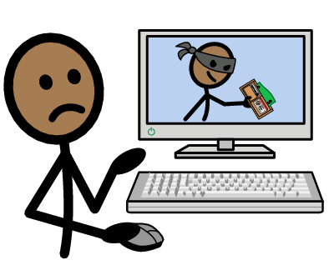


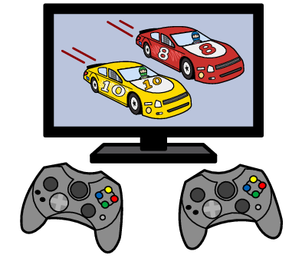

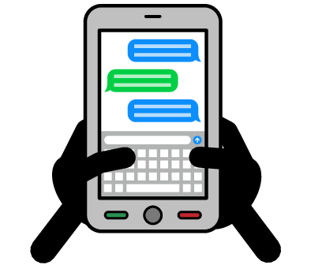



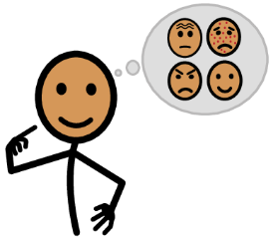




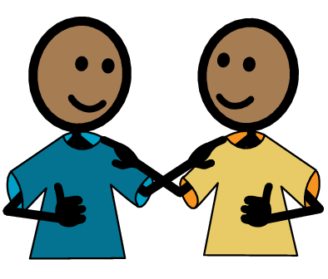
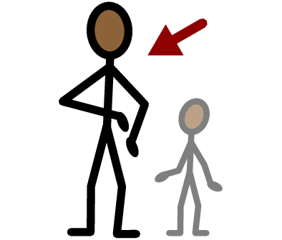
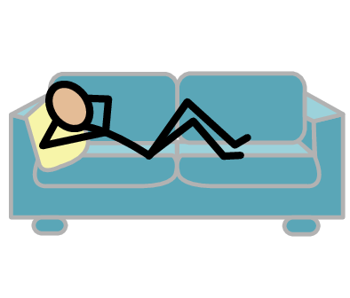
Public
Private
Watch videos
Catfishing
Yes
No
Videogame
Email
Texting
Social media
I need help
I have a question
Trust
Adult
Take a break
I feel
Happy
Sad
Mad
Scared
Copyright © 2021 SymbolStix, LLC. All rights reserved. Used with Permission.
Notes:
You can print this slide separately so each student can use the Important Words Sheet as a communication board throughout class. Review the words using the suggested definitions below. To enhance understanding, you can ask students to come up with their own definitions for vocabulary words or to provide a sentence or scenario using the new word.
Catfishing: When someone pretends to be someone else online in order to trick people
Public: Places where other people can come in and out and there are sometimes a lot of people, like a mall; or places online that other people can see
Private: Places where other people need your consent to come in and out, like your bedroom; or places online that only you can see
Video game: Something you play online, often with other people
Social media: Websites and phone apps where you can talk to other people and share things like photos and videos; examples include Instagram, Facebook, and TikTok
Email: Sending mail online; examples of email accounts are Gmail, Hotmail, and Yahoo
Texting: Sending messages on a phone
Watch videos: Going to YouTube or social media sites to watch short video clips

Slide 4
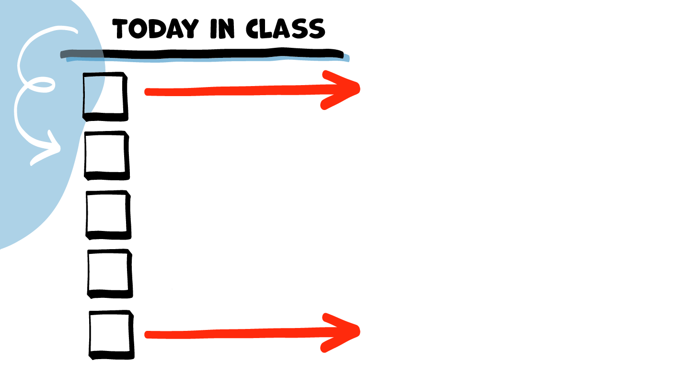
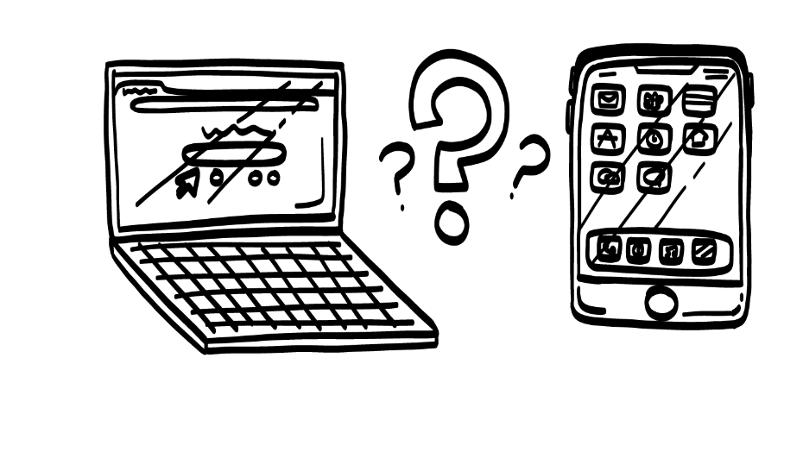
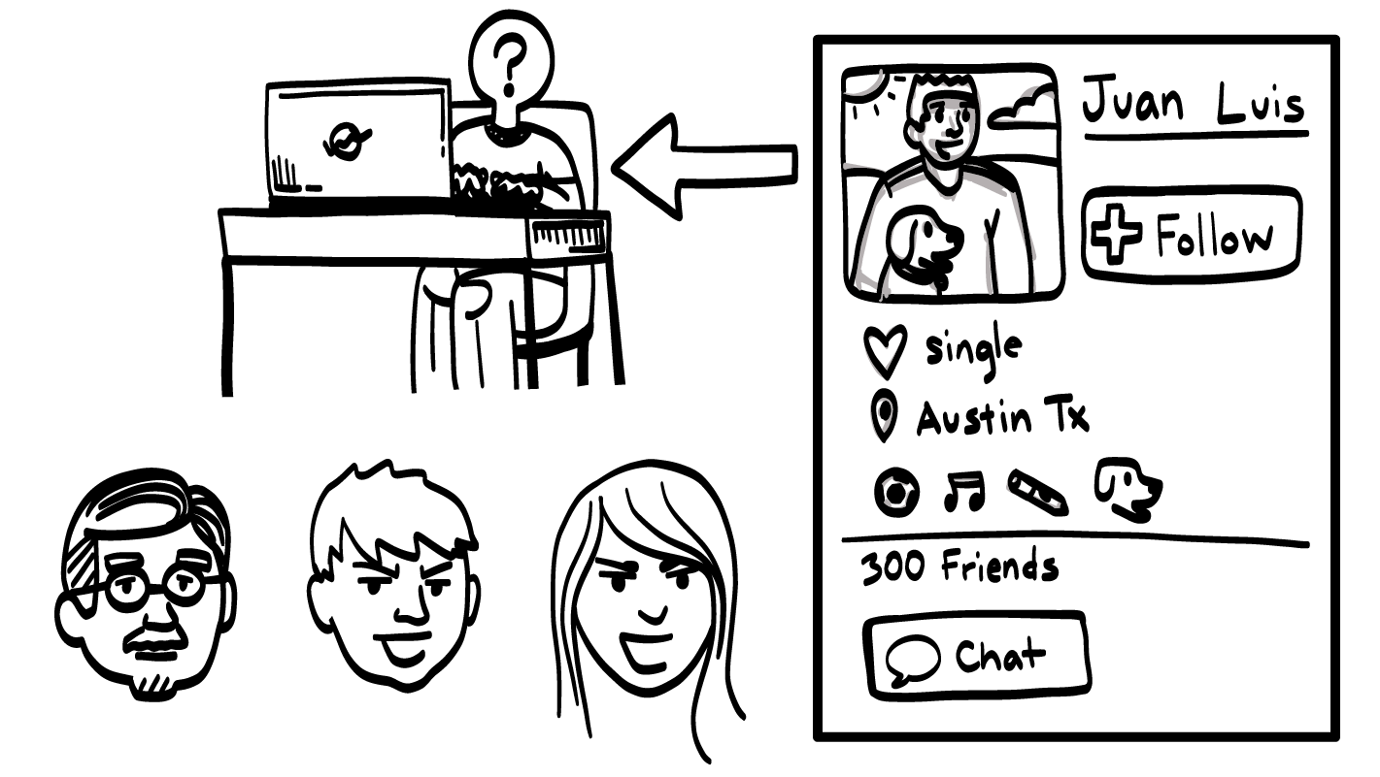
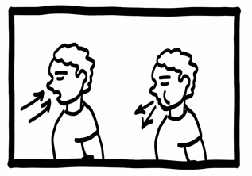
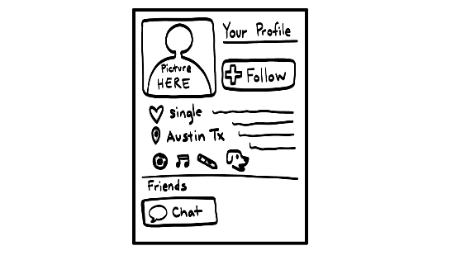
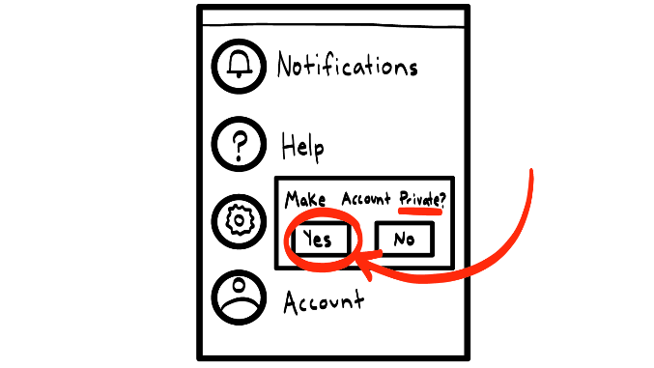
What do you
do online?
Catfishing
Brain break
Creating an online profile
Social media
privacy settings
© 2026 SAFE Disability Services Program
Notes:
Read the agenda. Alternatively, you can ask for a student volunteer to read the agenda.

Slide 5
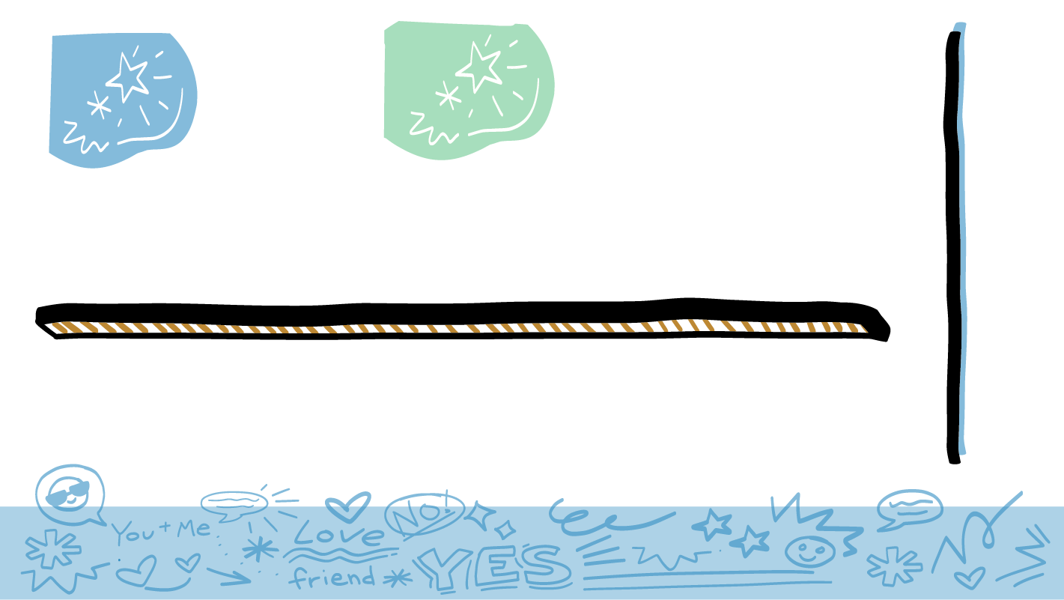
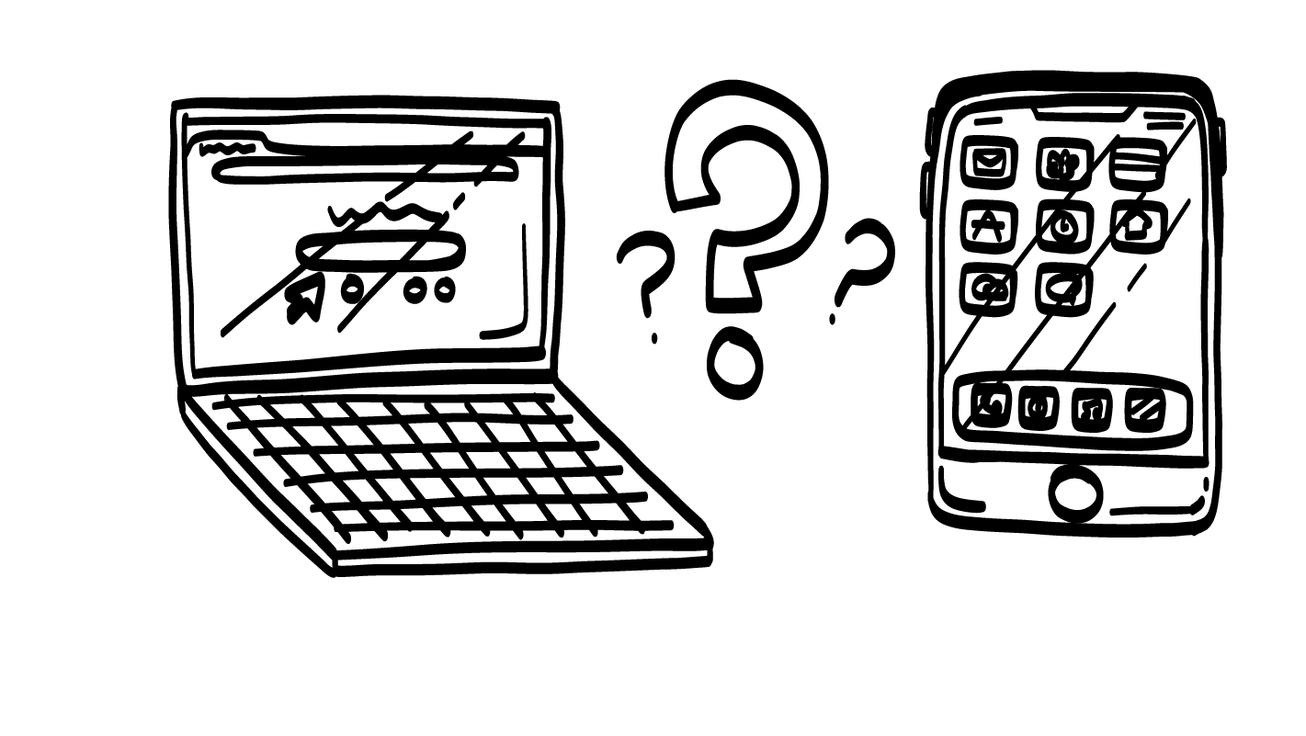
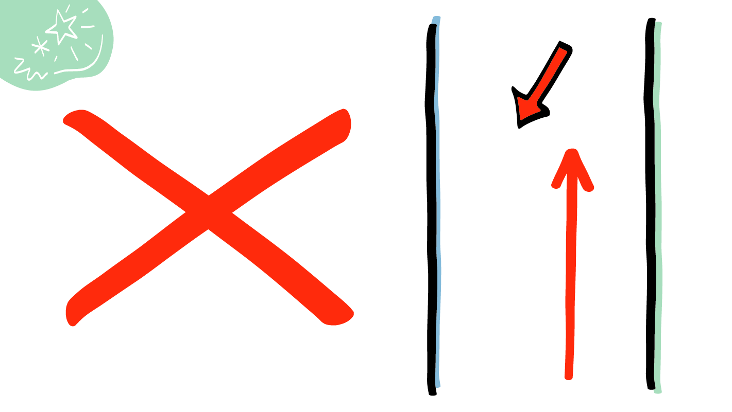


What Do You Do Online?
YES
NO
© 2026 SAFE Disability Services Program
Notes:
Say: Let’s get moving! We are going to do an activity to think about all the things you do online. I am going to read a statement, and if it is true for you, please move to the left side of the room. If it is not true for you, please move to the right side of the room. For example, if I read, “I am a student at [name of school/program],” what would happen?
Give students enough time to process the question and make their decisions.
Say: All of you would move to the left side of the room.

Slide 6



Google
YES
NO
© 2026 SAFE Disability Services Program
Notes:
For each slide, read the online activity out loud. Give plenty of time for students to process the statement and move to the corresponding side of the room. Support students as needed to make their choices.
Say: I use Google to learn new things.

Slide 7

YouTube
YES
NO
© 2026 SAFE Disability Services Program
Notes:
For each slide, read the online activity out loud. Give plenty of time for students to process the statement and choose the corresponding side of the room. Support students as needed to make their choices.
Say: I watch videos on YouTube.

Slide 8
Email
YES
NO
© 2026 SAFE Disability Services Program
Notes:
For each slide, read the online activity out loud. Give plenty of time for students to process the statement and choose the corresponding side of the room. Support students as needed to make their choices.
Say: I use email.

Slide 9

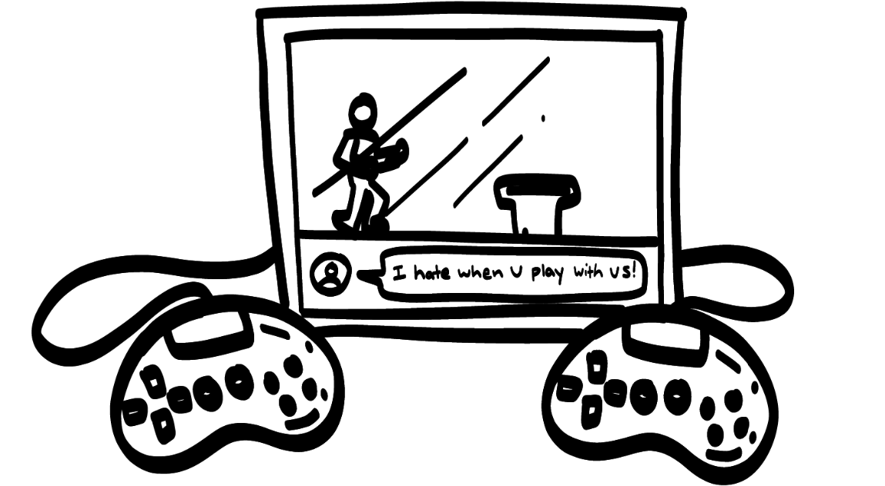
Video Games
YES
NO
© 2026 SAFE Disability Services Program
Notes:
For each slide, read the online activity out loud. Give plenty of time for students to process the statement and choose the corresponding side of the room. Support students as needed to make their choices.
Say: I play video games online with friends.

Slide 10
Instagram
NO
YES
© 2026 SAFE Disability Services Program
Notes:
For each slide, read the online activity out loud. Give plenty of time for students to process the statement and choose the corresponding side of the room. Support students as needed to make their choices.
Say: I post pictures on Instagram.

Slide 11


TikTok
YES
NO
© 2026 SAFE Disability Services Program
Notes:
For each slide, read the online activity out loud. Give plenty of time for students to process the statement and choose the corresponding side of the room. Support students as needed to make their choices.
Say: I have a TikTok account.

Slide 12


Shopping
YES
NO
© 2026 SAFE Disability Services Program
Notes:
For each slide, read the online activity out loud. Give plenty of time for students to process the statement and choose the corresponding side of the room. Support students as needed to make their choices.
Say: I shop online.

Slide 13


Meet New People
YES
NO
© 2026 SAFE Disability Services Program
Notes:
For each slide, read the online activity out loud. Give plenty of time for students to process the statement and choose the corresponding side of the room. Support students as needed to make their choices.
Say: I meet new people online.

Slide 14
What Else Do You Do Online?
YES
NO
© 2026 SAFE Disability Services Program
Notes:
Say: Does anyone have any other examples of things you do online?
Repeat the activity with a few student examples.
Say: As you just saw, you do a lot online! The internet can be a really fun place to watch videos, meet people, play games, or share photos and news with your family and friends. But even though the internet is an amazing place, you can all take some steps to stay safer while you’re online. We are going to talk about this today.

Slide 15
What do you
do online?
Catfishing
Brain break
Creating an online profile
Social media
privacy settings
© 2026 SAFE Disability Services Program
Notes:
Say: We’ll start thinking about internet safety by talking about something called catfishing.

Slide 16
Catfishing
© 2026 SAFE Disability Services Program
Notes:
Say: You use the internet for a lot of things. Sometimes, people will go online to make friends. This is okay, but there are some things you need to know to be safer when you are meeting new people online.
Does anyone know what catfishing is?
Give students enough time to process the question and make their decisions.
Say: Catfishing is when someone pretends to be someone online that they are not. Many people take pictures of celebrities or pictures of people they don’t know and use them to pretend to be someone else online. Sometimes people online will make up information about themselves to try to trick you. They can try to trick you into giving them money or starting a relationship with them. For example, take a careful look at Juan Luis’s profile on the right side of the screen. Juan seems cool, right? But the truth is, they could be any of the people on the bottom of the screen pretending to be Juan Luis!
If you have only ever talked to someone online, do you know who they really are?
Give students enough time to process the question and make their decisions.
Say: No. They could be pretending to be someone else. The only way to know for sure who someone you’ve met online is, is to meet them in-person. We are going to talk in a minute about safer ways to meet in-person with someone you’ve only met online.

Slide 17
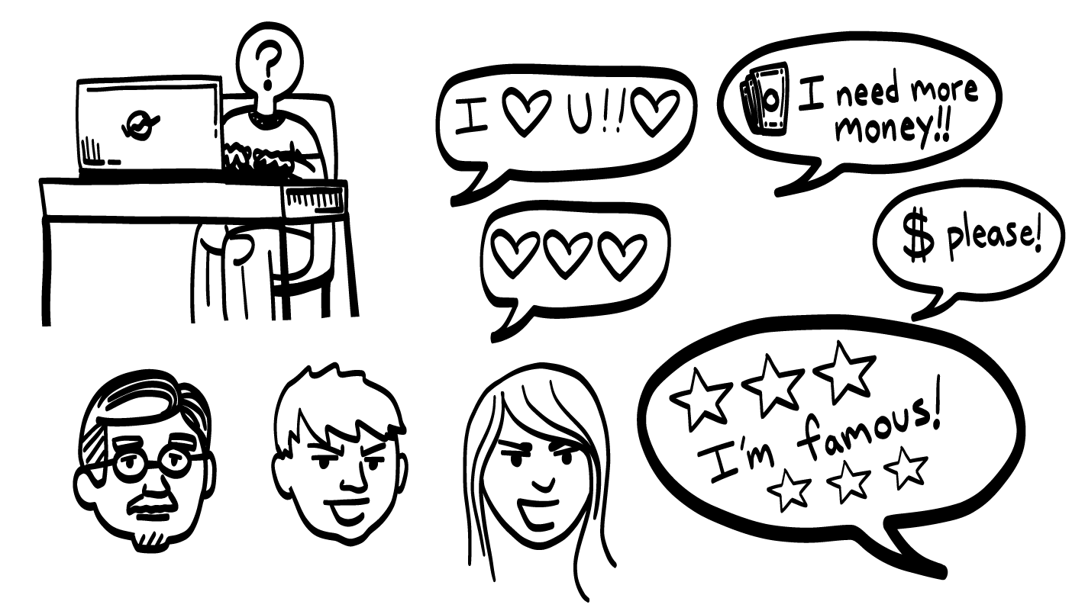
Catfishing Signs
© 2026 SAFE Disability Services Program
Notes:
Say: There are some things to look out for when you are talking to someone online. If a person does one of these things, there’s a good chance that they are a catfish. Let’s look at the examples now.
If someone you’ve only ever talked to online starts saying, “I love you,” or saying they want to date you, or sending you a bunch of heart emojis, this is something called love bombing. Remember, if you’ve only ever talked to someone online, they are in your outer red circle of people you don’t know. They should not say that they love you or they want to date you. If someone keeps talking about being in love with you, they might be a catfish trying to trick you into being in a relationship with them.
Another warning sign that someone is a catfish is if they ask you for money. They might even say something really sad, like that their house burned down and they need help. If someone you’ve only talked to online asks you for money, say no and get help from an adult in your inner green circle of trust..
What about if a famous person like <name a current popular celebrity> messages you? Do you think that <celebrity’s name> would talk to you online?
Give students enough time to process the question and make their decisions.
Say: No, celebrities don’t talk to people who aren’t also celebrities online. If a celebrity talks to you online, that’s a warning sign that they are a catfish pretending to be a celebrity to try to trick you.

Slide 18
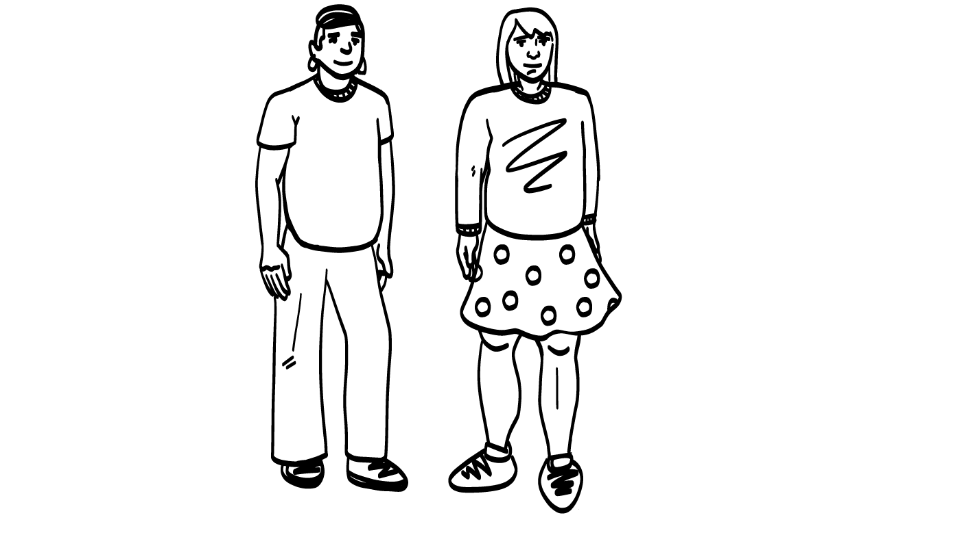
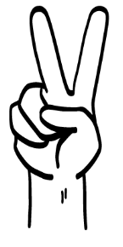
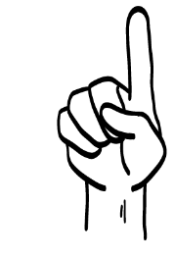
Alone
Bring another adult you trust
© 2026 SAFE Disability Services Program
Notes:
Say: If you are going to meet in-person with someone you met online, is it safer to go alone or to bring an adult you trust with you? Hold up one finger for “alone” and two fingers for “bring an adult you trust.”
Give students enough time to process the question and make their decisions.
Say: You should bring an adult from your inner green circle of trust with you to the meeting.

Slide 19
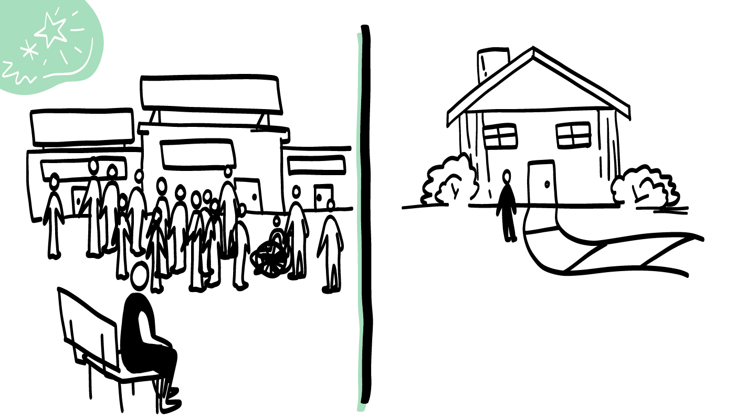
Public
Private
© 2026 SAFE Disability Services Program
Notes:
Say: Even though you are bringing an adult from your inner green circle of trust to meet in-person with someone you met online, is it safer to meet in a public place where there are lots of other people around, or a private place where it is just the three of you? Hold up one finger for “public” and two fingers for “private.”
Give students enough time to process the question and make their decisions.
Say: It is safer to meet in a public place where there are lots of other people around. You want there to be other people who you can go to if you need help. For example, if you meet at a coffee shop and things start to feel weird or unsafe, you could go to someone who works there and ask for help.
You should never invite someone you have only talked to online to your house. It is also never safe to go to their house. Do not get in a car with someone you’ve only ever talked to online. Remember, they are in your outer red circle of people you don’t know, so you cannot trust them.

Slide 20

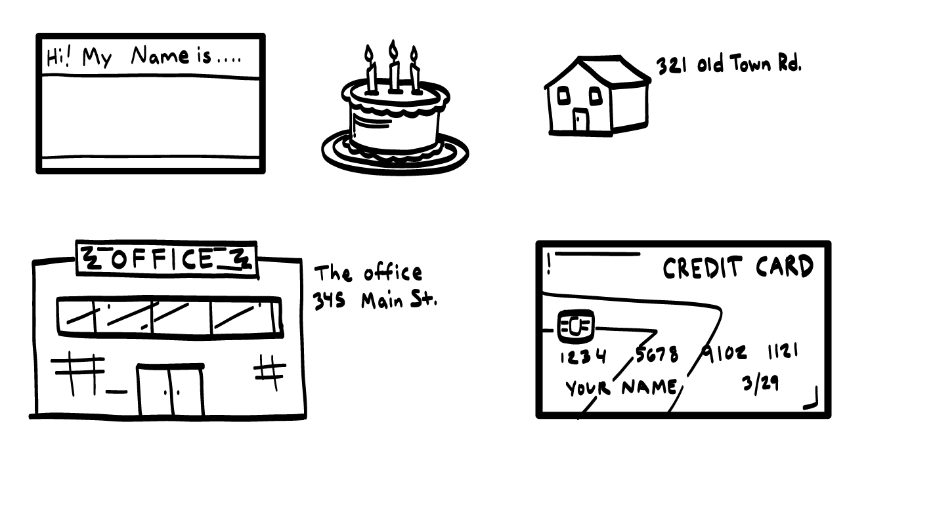
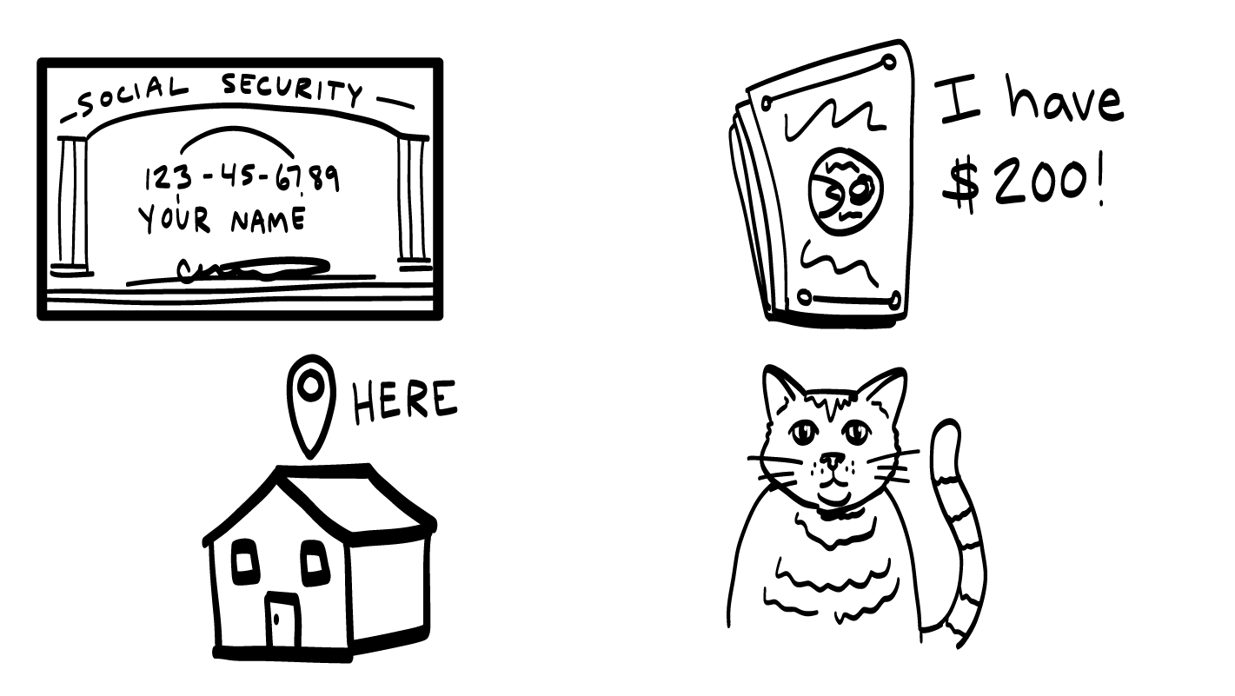
Is it Okay to Share Private Information with Someone You Met Online?
© 2026 SAFE Disability Services Program
Notes:
Say: Is it okay to share private information like your last name, address, or phone number with someone you have only talked to online?
Give students enough time to process the question and make their decisions.
Say: No. You don’t know who this person really is. You should not share any private information with this person until you’ve met in public, with an adult you trust, many times. Remember, a person who you have only talked to online is in your outer red circle of people you don’t know or can’t trust. It will take many times meeting with them in public AND with an adult you trust, over several months, for them to move into your middle yellow circle of people you know or are getting to know.

Slide 21
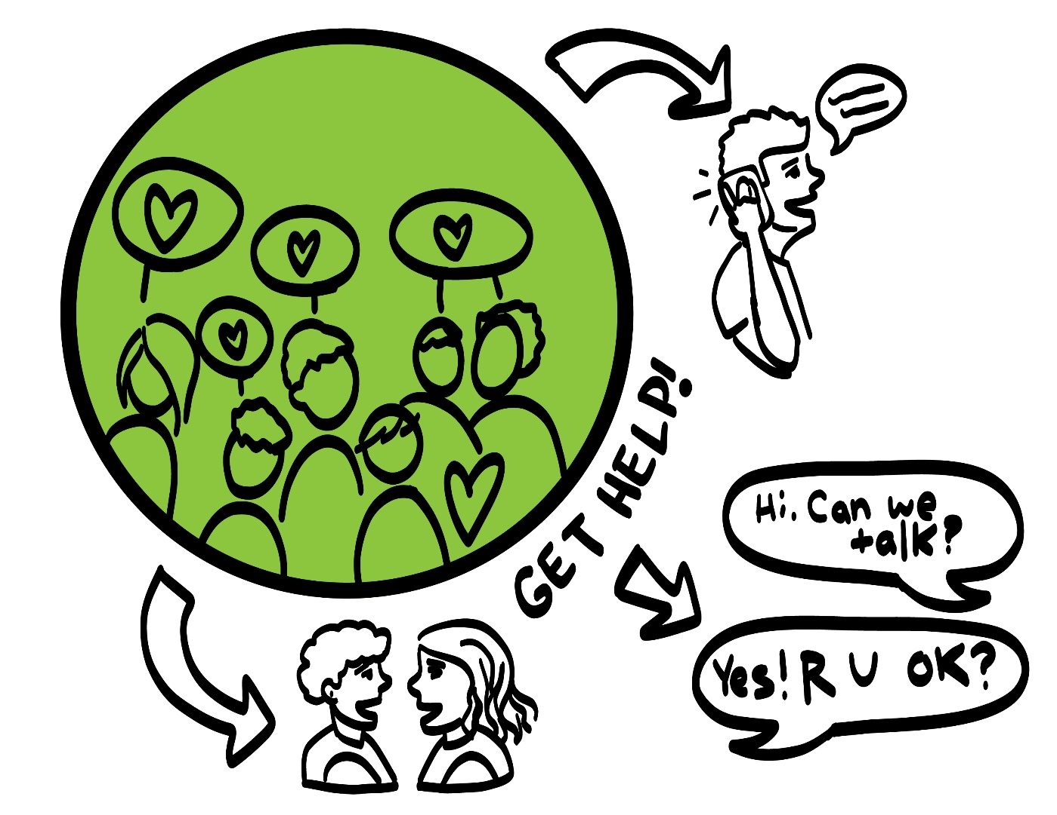
Getting Help
© 2026 SAFE Disability Services Program
Notes:
Say: If someone is doing something online that makes you uncomfortable, or if you’re not sure if they’re a safe person to talk to, what can you do?
Give students enough time to process the question and make their decisions.
Say: Talk to a trusted adult in your inner green circle of most trust people. If you aren’t sure if it is safe to share information with a person you are talking to online, you can also ask an adult in your inner green circle of trust for help making that decision.

Slide 22
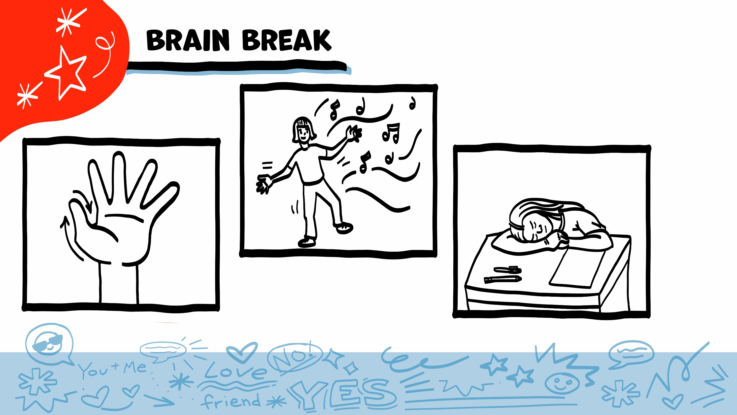
© 2026 SAFE Disability Services Program
Notes:
Say: That was a lot of information, and you all are doing an amazing job! Every week in class we will take a brain break in the middle. This is a chance to move a little and take a break from thinking!
Below are three ideas to give students a quick opportunity for a brain break. You are also welcome to come up with your own ideas for brain breaks that work best for your class.
Five finger breathing
For this exercise, have all students place their hand in front of their chest with their five fingers spread out. Next, use the pointer finger of the other hand to trace up and down each of the five fingers, beginning with the thumb. As students trace up a finger, they will breathe in. As they trace down a finger, they will breathe out. When students breathe out on the pinky finger, you can tell them to shake out their hands and arms. As the school year goes on, you can ask students to lead this exercise for their peers.
If this exercise is physically inaccessible for your class, you can also model the hand tracing for students while they breathe in and out.
Stretch break
Lead students through a series of basic stretches. These can be completed in a chair, or while standing up, depending on the accommodation needs of your class. Some ideas include reaching toward the ceiling, stretching one arm at a time across the chest, reaching toward toes, turning head from side to side, etc. Ask students to hold a pose while you count to ten. As the school year goes on, you can ask students to lead stretches for their peers.
Dance party
If your class likes to dance, you can put on a short song for them to dance to. This is especially effective if you are able to find a song that relates to the theme for that week’s class.

Slide 23
What do you
do online?
Catfishing
Brain break
Creating an online profile
Social media
privacy settings
© 2026 SAFE Disability Services Program
Notes:
Say: Now that we’ve learned what catfishing is, let’s talk about how to make safer online profiles.

Slide 24
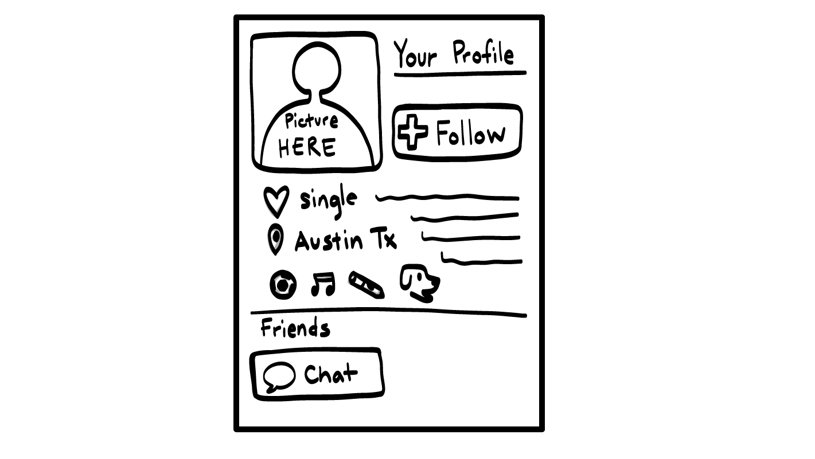
© 2026 SAFE Disability Services Program
Notes:
For this game, you will use the Poster-sized Social Media Profile, Poster-Sized Don’t Share Online List, and Creating an Online Profile Activity Cards. See the Materials section at the end of the Lesson Plan for more information. Tape the profile and the poster at the front of the room.
Say: You are going to work together to create an online profile. This could be for anything you do online—social media or video gaming You’ll see we have a blank profile right now. Next to it is a poster that says, “Don’t share online.” In just a minute, I am going to give you and a partner a card that has something written on it. You and your partner are going to decide together if the thing on your card is safe to share on your online profile, or if it should go on the “Don’t share online” poster. Think about what is safe to share publically with people online, and what is private.
Give each 2-partner team an activity card and ask them to tape it on the correct poster. Support students as needed to decide if it should go on the online profile or on the “Don’t share online” poster. As partners complete a card, give them a new card until all cards have been distributed. After all cards have been sorted onto the two posters, use the next slides to go through each one with the class. You probably will not have time to go through every one of the examples, but you can come back to the ones you did not get to later, to reinforce online safety.

Slide 25


Name
Add to profile?
YES
NO
© 2026 SAFE Disability Services Program
Notes:
After you display each PowerPoint slide, look to see whether student groups taped the corresponding card on the Social Media Profile or the Don’t Share Online list. Ask students to give a “thumbs up” if they agree with the placement of the card, or a “thumbs down” if they don’t. Ask students to explain their thoughts if there is disagreement. Then use the space bar to display on the slide whether the card is okay to share or should not be shared online.
Not everyone will agree on where to place the activity cards, and that’s okay. For example, you can talk about potential risks of sharing where you work online but also acknowledge that many people still choose to share where they work on social media. The point of this activity is for students to practice weighing the pros and cons of online behaviors so they can make informed decisions and can think through potential risks of what they do online. Some activity cards will not have a clear-cut answer.
Sample talking points include:
Most online profiles will ask you to include your name.
Which do you think is safer to share: just your first name or your full name?
It’s safer to include just your first name. You might also put a nickname on your profile instead of your real name.
Some people will choose to put their first and last name on the profile.
If you are trying to decide if it is safe to include something on your profile, who could you ask?
An adult from your inner green circle of trust.

Slide 26
Address
Add to profile?
NO
© 2026 SAFE Disability Services Program
Notes:
After you display each PowerPoint slide, look to see whether student groups taped the corresponding card on the Social Media Profile or the Don’t Share Online list. Ask students to give a “thumbs up” if they agree with the placement of the card, or a “thumbs down” if they don’t. Ask students to explain their thoughts if there is disagreement. Then use the space bar to display on the slide whether the information on the card is okay to share or should not be shared online.
Not everyone will agree on where to place the activity cards, and that’s okay. For example, you can talk about potential risks of sharing where you work online, but also acknowledge that many people still choose to share where they work on social media. The point of this activity is for students to practice weighing the pros and cons of online behaviors so they can make informed decisions and be able to think through potential risks of what they do online. Some activity cards will not have a clear-cut answer.
Sample talking points include:
It is not safe to put your address on your profile. Why do you think it’s not safe?
The internet is a public place. That means that lots of people, including people you don’t know, might be able to see what you put online.
Would you want a stranger showing up at your house?
NO!

Slide 27
Where You Work
Add to profile?
NO
© 2026 SAFE Disability Services Program
Notes:
After you display each PowerPoint slide, look to see whether student groups taped the corresponding card on the Social Media Profile or the Don’t Share Online list. Ask students to give a “thumbs up” if they agree with the placement of the card, or a “thumbs down” if they don’t. Ask students to explain their thoughts if there is disagreement. Then use the space bar to display on the slide whether the information on the card is okay to share or should not be shared online.
Not everyone will agree on where to place the activity cards, and that’s okay. For example, you can talk about potential risks of sharing where you work online, but also acknowledge that many people still choose to share where they work on social media. The point of this activity is for students to practice weighing the pros and cons of online behaviors so they can make informed decisions and learn to think through potential risks of what they do online. Some activity cards will not have a clear cut answer.
Sample talking points include:
If you put where you work on your profile, what might happen?
Someone could show up at your work without telling you first.
Your boss might find out what you post online.
Some people put where they work on their profile.
Other people think it is not safe to share that information online.
If you aren’t sure, talk to an adult from your inner green circle of trust.

Slide 28
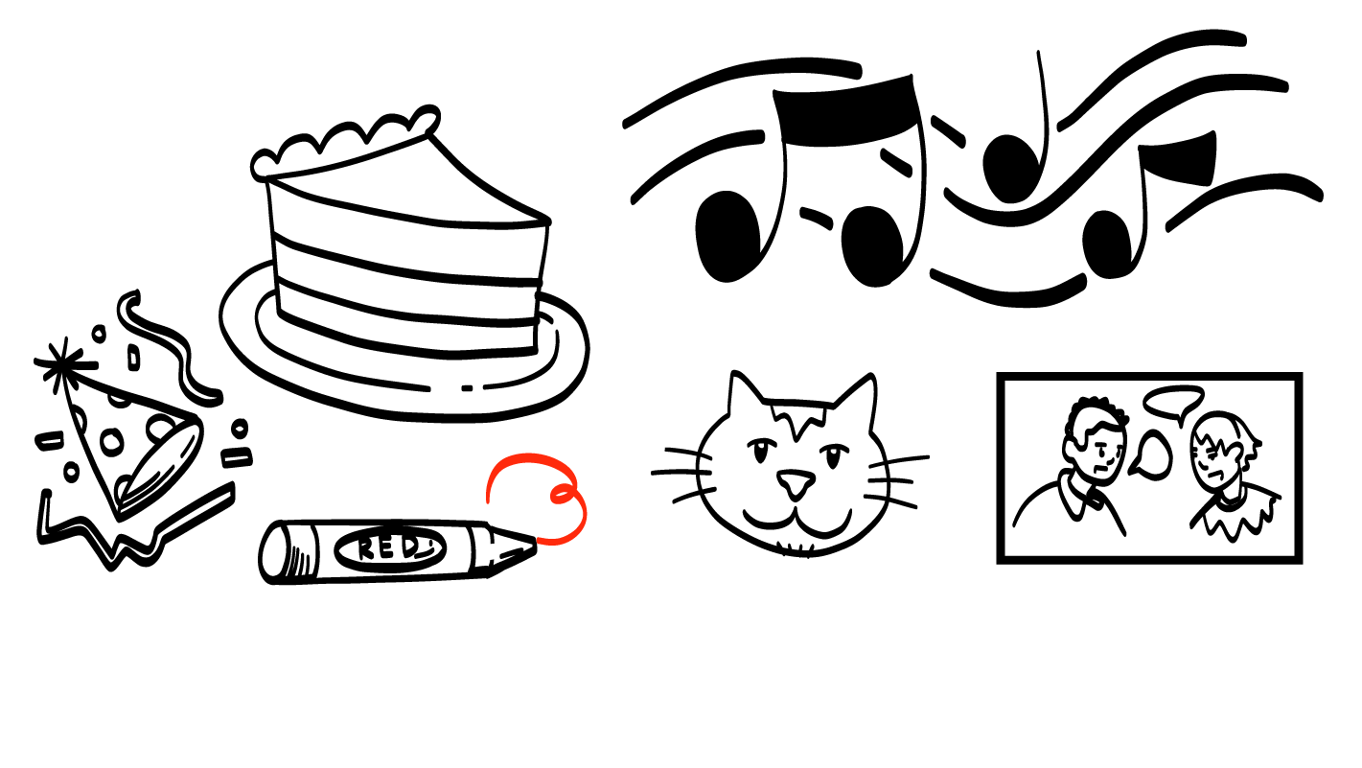
Your Favorite Color
Add to profile?
YES
© 2026 SAFE Disability Services Program
Notes:
After you display each PowerPoint slide, look to see whether student groups taped the corresponding card on the Social Media Profile or the Don’t Share Online list. Ask students to give a “thumbs up” if they agree with the placement of the card, or a “thumbs down” if they don’t. Ask students to explain their thoughts if there is disagreement. Then use the space bar to display on the slide whether the card is okay to share or should not be shared online.
Not everyone will agree on where to place the activity cards, and that’s okay. For example, you can talk about potential risks of sharing where you work online, but also acknowledge that many people still choose to share where they work on social media. The point of this activity is for students to practice weighing the pros and cons of online behaviors so they can make informed decisions and to practice thinking through potential risks of what they do online. Some activity cards will not have a clear-cut answer.
Sample talking points include:
This is a safe thing to share online.
Your favorite color is not too private to share with others.

Slide 29
Phone Number
Add to profile?
NO
© 2026 SAFE Disability Services Program
Notes:
After you display each PowerPoint slide, look to see whether student groups taped the corresponding card on the Social Media Profile or the Don’t Share Online list. Ask students to give a “thumbs up” if they agree with the placement of the card, or a “thumbs down” if they don’t. Ask students to explain their thoughts if there is disagreement. Then use the space bar to display on the slide whether the information on the card is okay to share or is not okay to share online.
Not everyone will agree on where to place the activity cards, and that’s okay. For example, you can talk about potential risks of sharing where you work online, but also acknowledge that many people still choose to share where they work on social media. The point of this activity is for students to practice weighing the pros and cons of online behaviors so they can make informed decision and to practice thinking through potential risks of what they do online. Some activity cards will not have a clear-cut answer.
Sample talking points include:
It is not safe to put your phone number online where other people can see it.
Why do you think that is? Do you want a stranger calling you?
NO!

Slide 30
Credit Card Number
Add to profile?
NO
© 2026 SAFE Disability Services Program
Notes:
After you display each PowerPoint slide, look to see whether student groups taped the corresponding card on the Social Media Profile or the Don’t Share Online list. Ask students to give a “thumbs up” if they agree with the placement of the card, or a “thumbs down” if they don’t. Ask students to explain their thoughts if there is disagreement. Then use the space bar to display on the slide whether the information on the card is okay to share or should not be shared online.
Not everyone will agree on where to place the activity cards, and that’s okay. For example, you can talk about potential risks of sharing where you work online, but also acknowledge that many people still choose to share where they work on social media. The point of this activity is for students to practice weighing the pros and cons of online behaviors so they can make informed decisions and to be able to think through potential risks of what they do online. Some activity cards will not have a clear-cut answer.
Sample talking points include:
It’s never safe to put a credit card number on an online social media profile, or to give it someone you met online.
Someone might take your parents’ credit card number and steal their money.
Some websites, such as shopping sites, might ask for a credit card number.
Always ask for your parents’ permission before using their credit card number, even if you have used it before.

Slide 31
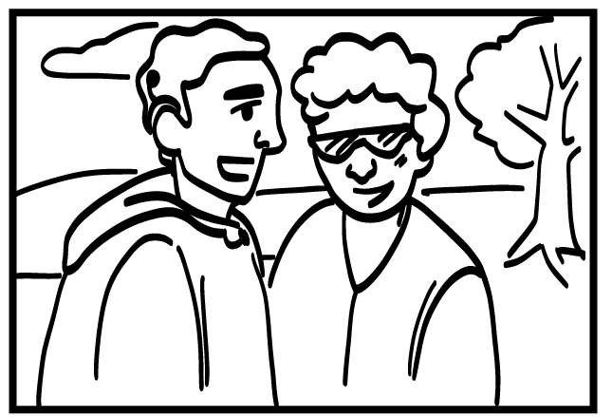
Picture of a Person Smiling at the Camera
Add to profile?
YES
© 2026 SAFE Disability Services Program
Notes:
After you display each PowerPoint slide, look to see whether student groups taped the corresponding card on the Social Media Profile or the Don’t Share Online list. Ask students to give a “thumbs up” if they agree with the placement of the card, or a “thumbs down” if they don’t. Ask students to explain their thoughts if there is disagreement. Then use the space bar to display on the slide whether the information on the card is okay to share or should not be shared online.
Not everyone will agree on where to place the activity cards, and that’s okay. For example, you can talk about potential risks of sharing where you work online, but also acknowledge that many people still choose to share where they work on social media. The point of this activity is for students to practice weighing the pros and cons of online behaviors so they can make informed decisions and be able to think through potential risks of what they do online. Some activity cards will not have a clear-cut answer.
Sample talking points include:
Some people don’t want to put any pictures of themselves online. Some people do.
Always ask for consent before putting pictures of someone else online.
What could you say to ask for permission?
If you choose to share pictures of yourself online, think about what would make the picture safer. It is a good idea to look closely at the picture to make sure it is not showing any private information like your address, your ID card, or any other personal information.

Slide 32
Social Security Number
Add to profile?
NO
© 2026 SAFE Disability Services Program
Notes:
After you display each PowerPoint slide, look to see whether student groups taped the corresponding card on the Social Media Profile or the Don’t Share Online list. Ask students to give a “thumbs up” if they agree with the placement of the card, or a “thumbs down” if they don’t. Ask students to explain their thoughts if there is disagreement. Then use the space bar to display on the slide whether the information on the card is okay to share or should not be shared online.
Not everyone will agree on where to place the activity cards, and that’s okay. For example, you can talk about potential risks of sharing where you work online, but also acknowledge that many people still choose to share where they work on social media. The point of this activity is for students to practice weighing the pros and cons of online behaviors so they can make informed decisions and be able to think through potential risks of what they do online. Some activity cards will not have a clear-cut answer.
Sample talking points include:
NEVER share your social security number online.
Someone might take your social security number and pretend to be you. This could cause lots of problems for you and your family.

Slide 33
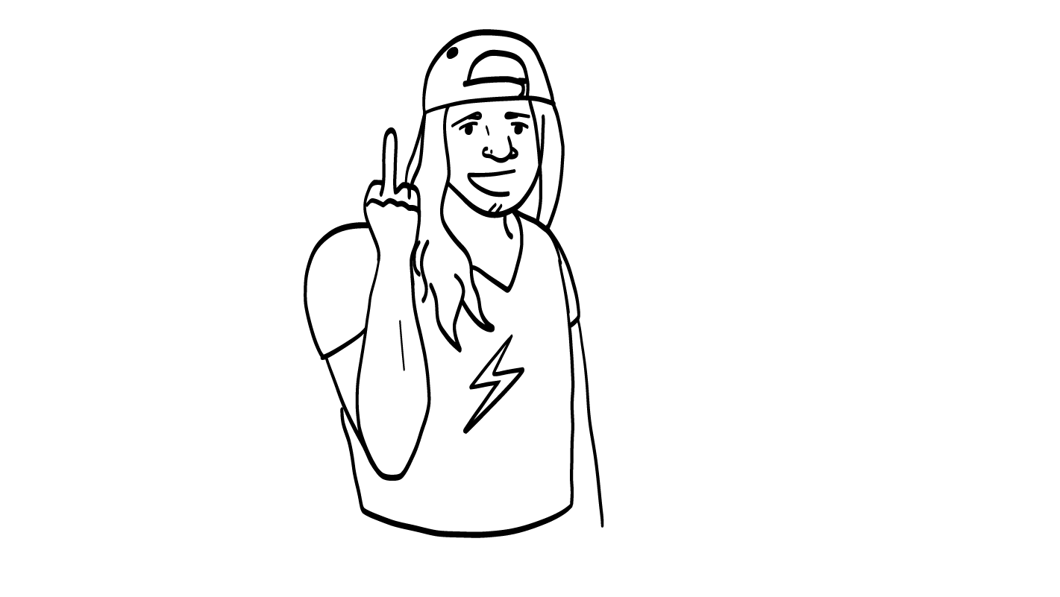
Picture of a Person Flipping Off the Camera
Add to profile?
NO
© 2026 SAFE Disability Services Program
Notes:
After you display each PowerPoint slide, look to see whether student groups taped the corresponding card on the Social Media Profile or the Don’t Share Online list. Ask students to give a “thumbs up” if they agree with the placement of the card, or a “thumbs down” if they don’t. Ask students to explain their thoughts if there is disagreement. Then use the space bar to display on the slide whether the information on the card is okay to share or should not be shared online.
Not everyone will agree on where to place the activity cards, and that’s okay. For example, you can talk about potential risks of sharing where you work online, but also acknowledge that many people still choose to share where they work on social media. The point of this activity is for students to practice weighing the pros and cons of online behaviors so they can make informed decisions and be able to think through potential risks of what they do online. Some activity cards will not have a clear-cut answer.
Sample talking points include:
Why do you think this is not a safe thing to post online?
If you post this picture, who might see it?
Your parents or your teacher at school. It might even be harder to get a job if you have this type of picture on your online profile.

Slide 34
How Much Money You Have
Add to profile?
NO
© 2026 SAFE Disability Services Program
Notes:
After you display each PowerPoint slide, look to see whether student groups taped the corresponding card on the Social Media Profile or the Don’t Share Online list. Ask students to give a “thumbs up” if they agree with the placement of the card, or a “thumbs down” if they don’t. Ask students to explain their thoughts if there is disagreement. Then use the space bar to display on the slide whether the information on the card is okay to share or should not be shared online.
Not everyone will agree on where to place the activity cards, and that’s okay. For example, you can talk about potential risks of sharing where you work online, but also acknowledge that many people still choose to share where they work on social media. The point of this activity is for students to practice weighing the pros and cons of online behaviors so they can make informed decisions and be able to think through potential risks of what they do online. Some activity cards will not have a clear-cut answer.
Sample talking points include:
It is not safe to share how much money you have online.
How much money you have is private information. Remember, the internet is a public place. Someone might want to steal your money if you talk about it online.

Slide 35
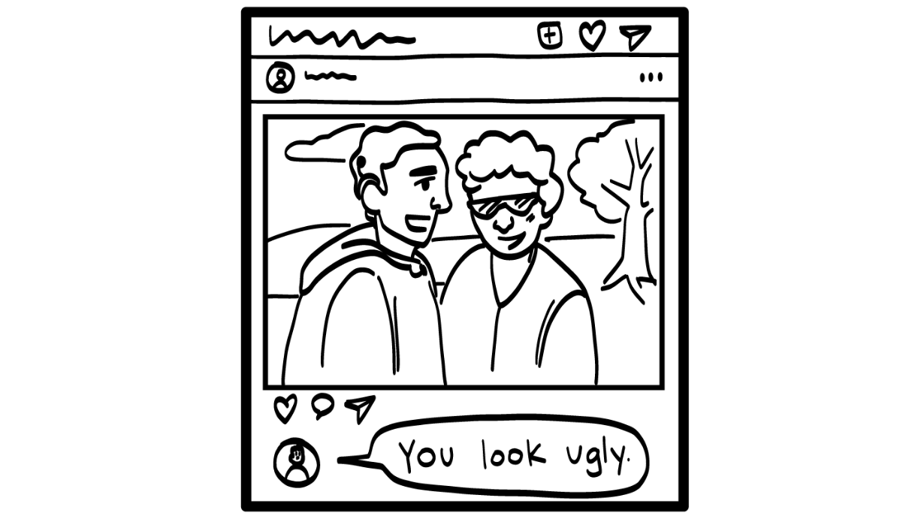
Comment Making Fun of Someone
Add to profile?
NO
© 2026 SAFE Disability Services Program
Notes:
After you display each PowerPoint slide, look to see whether student groups taped the corresponding card on the Social Media Profile or the Don’t Share Online list. Ask students to give a “thumbs up” if they agree with the placement of the card, or a “thumbs down” if they don’t. Ask students to explain their thoughts if there is disagreement. Then use the space bar to display on the slide whether the information on the card is okay to share or should not be shared online.
Not everyone will agree on where to place the activity cards, and that’s okay. For example, you can talk about potential risks of sharing where you work online, but also acknowledge that many people still choose to share where they work on social media. The point of this activity is for students to practice weighing the pros and cons of online behaviors so they can make informed decisions and be able to think through potential risks of what they do online. Some activity cards will not have a clear-cut answer.
Sample talking points include:
It is not cool to make fun of people online. This is something called cyberbullying, which we will talk about next week.
You can get in trouble at your school or work for making fun of people online.

Slide 36
Birthday
Add to profile?
YES
NO
© 2026 SAFE Disability Services Program
Notes:
After you display each PowerPoint slide, look to see whether student groups taped the corresponding card on the Social Media Profile or the Don’t Share Online list. Ask students to give a “thumbs up” if they agree with the placement of the card, or a “thumbs down” if they don’t. Ask students to explain their thoughts if there is disagreement. Then use the space bar to display on the slide whether the information on the card is okay to share or should not be shared online.
Not everyone will agree on where to place the activity cards, and that’s okay. For example, you can talk about potential risks of sharing where you work online, but also acknowledge that many people still choose to share where they work on social media. The point of this activity is for students to practice weighing the pros and cons of online behaviors so they can make informed decisions and be able to think through potential risks of what they do online. Some activity cards will not have a clear-cut answer.
Sample talking points include:
A lot of people put their birthdays on their online profiles, but other people don’t feel safe sharing that information online.
Do you think it is safer to put just your birth month and day, or to include your whole birthday with the year?
It’s safer to just put your birth month and day. If you put all of your birthday information someone may be able to use it to find out other private information about you.

Slide 37
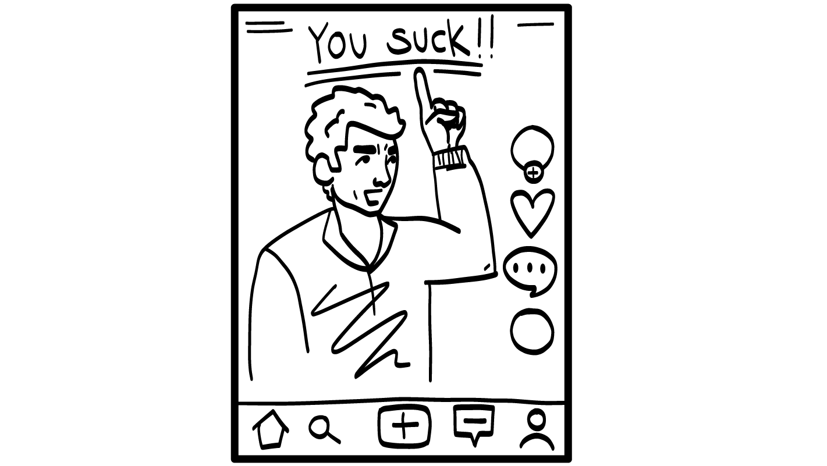
A Complaint About Your Teacher
Add to profile?
NO
© 2026 SAFE Disability Services Program
Notes:
After you display each PowerPoint slide, look to see whether student groups taped the corresponding card on the Social Media Profile or the Don’t Share Online list. Ask students to give a “thumbs up” if they agree with the placement of the card, or a “thumbs down” if they don’t. Ask students to explain their thoughts if there is disagreement. Then use the space bar to display on the slide whether the information on the card is okay to share or should not be shared online.
Not everyone will agree on where to place the activity cards, and that’s okay. For example, you can talk about potential risks of sharing where you work online, but also acknowledge that many people still choose to share where they work on social media. The point of this activity is for students to practice weighing the pros and cons of online behaviors so they can make informed decisions and be able to think through potential risks of what they do online. Some activity cards will not have a clear-cut answer.
Sample talking points include:
It is never a good idea to complain about your school or your teacher online.
What could happen if you complained about your teacher online?
You could get in trouble with your parents and/or your school.

Slide 38
Your Favorite Song
Add to profile?
YES
© 2026 SAFE Disability Services Program
Notes:
After you display each PowerPoint slide, look to see whether student groups taped the corresponding card on the Social Media Profile or the Don’t Share Online list. Ask students to give a “thumbs up” if they agree with the placement of the card, or a “thumbs down” if they don’t. Ask students to explain their thoughts if there is disagreement. Then use the space bar to display on the slide whether the information on the card is okay to share or should not be shared online.
Not everyone will agree on where to place the activity cards, and that’s okay. For example, you can talk about potential risks of sharing where you work online, but also acknowledge that many people still choose to share where they work on social media. The point of this activity is for students to practice weighing the pros and cons of online behaviors so they can make informed decisions and be able to think through potential risks of what they do online. Some activity cards will not have a clear-cut answer.
Sample talking points include:
This is a safe thing to share online.
Your favorite song is not too private to share with others.

Slide 39
Check-in At Your House
Add to profile?
NO
© 2026 SAFE Disability Services Program
Notes:
After you display each PowerPoint slide, look to see whether student groups taped the corresponding card on the Social Media Profile or the Don’t Share Online list. Ask students to give a “thumbs up” if they agree with the placement of the card, or a “thumbs down” if they don’t. Ask students to explain their thoughts if there is disagreement. Then use the space bar to display on the slide whether the information on the card is okay to share or should not be shared online.
Not everyone will agree on where to place the activity cards, and that’s okay. For example, you can talk about potential risks of sharing where you work online, but also acknowledge that many people still choose to share where they work on social media. The point of this activity is for students to practice weighing the pros and cons of online behaviors so they can make informed decisions and be able to think through potential risks of what they do online. Some activity cards will not have a clear-cut answer.
Sample talking points include:
It is not safe to check-in online. When you check in at your house, it shows anybody who sees your profile what your address is.
Would you want a stranger coming to your house? NO!
So, it’s not a good idea to check in at your house.
It’s actually not safe for you to check in anywhere that you are. When you check-in somewhere, you are letting someone know exactly where you are, and someone you do not know, or trust could find you. If you want to talk about a cool place that you go, you can post about it later, when you are no longer at the place.

Slide 40
Picture of a Cute Animal
Add to profile?
YES
© 2026 SAFE Disability Services Program
Notes:
After you display each PowerPoint slide, look to see whether student groups taped the corresponding card on the Social Media Profile or the Don’t Share Online list. Ask students to give a “thumbs up” if they agree with the placement of the card, or a “thumbs down” if they don’t. Ask students to explain their thoughts if there is disagreement. Then use the space bar to display on the slide whether the information on the card is okay to share or should not be shared online.
Not everyone will agree on where to place the activity cards, and that’s okay. For example, you can talk about potential risks of sharing where you work online, but also acknowledge that many people still choose to share where they work on social media. The point of this activity is for students to practice weighing the pros and cons of online behaviors so they can make informed decisions and be able to think through potential risks of what they do online. Some activity cards will not have a clear-cut answer.
Sample talking points include:
This is a safe thing to post online, because it is not too private.

Slide 41
What do you
do online?
Catfishing
Brain break
Creating an online profile
Social media
privacy settings
© 2026 SAFE Disability Services Program
Notes:
Say: The last thing we are going to talk about today is social media privacy settings.

Slide 42
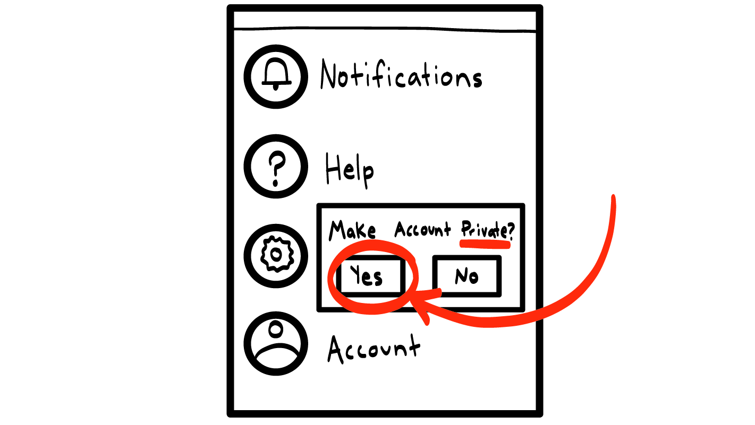
Social Media Privacy Settings
© 2026 SAFE Disability Services Program
Notes:
Say: Thanks for helping to create our online profile! It’s important to think about what you share online. To be safer online, you should also look at your privacy settings on things like social media and video games. Privacy settings are where you tell the online site who should be able to see what you post. For example, on some sites, you can say that only your friends should be able to see what you post. But even if you have privacy settings turned on, people you don’t know still might be able to figure out ways to see what you post online.
Who could you ask to help you figure out how to change your privacy settings on social media sites?
Give students enough time to process the question and make their decisions.
Say: You can ask for help from an adult in your inner green circle of trust.

Slide 43
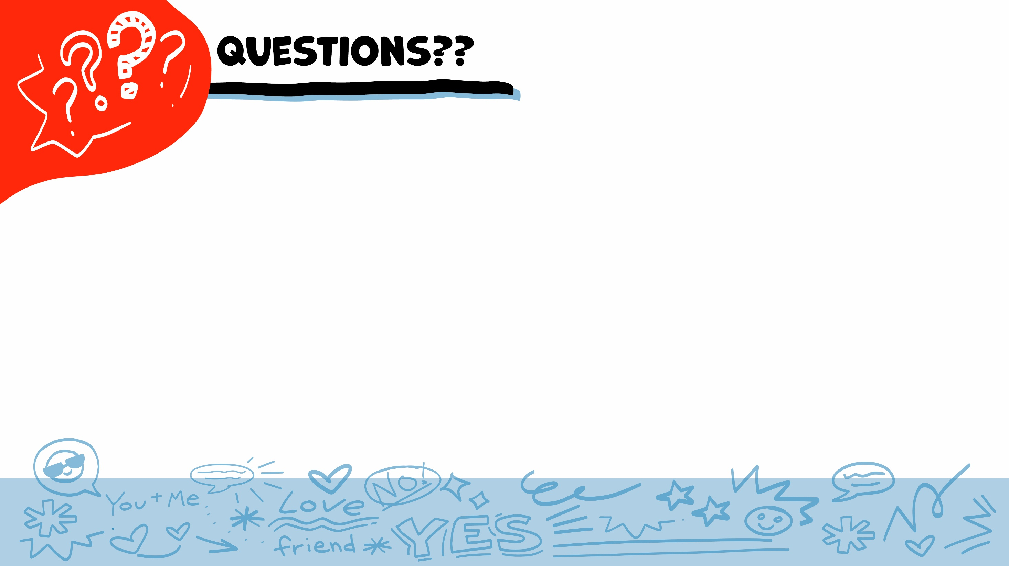
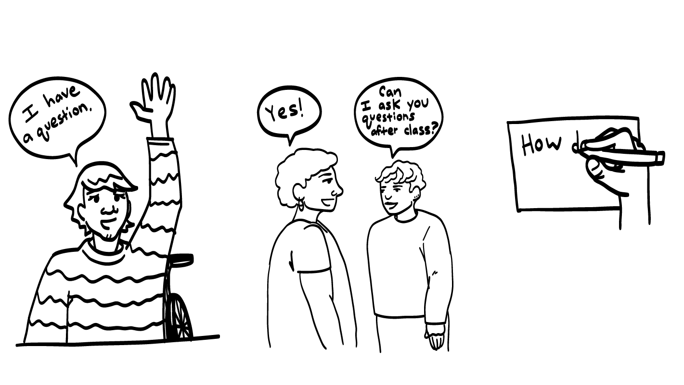
© 2026 SAFE Disability Services Program
Notes:
Say: Does anyone have any questions about today’s class? Remember, if you don’t want to ask your question out loud, you can write it on a notecard and leave it on your desk. You can also ask someone you trust to help you write your question on the notecard. I will pick up the notecards and will answer the questions the next time we meet. When I answer a question, I won’t tell anyone who asked it.

Slide 44
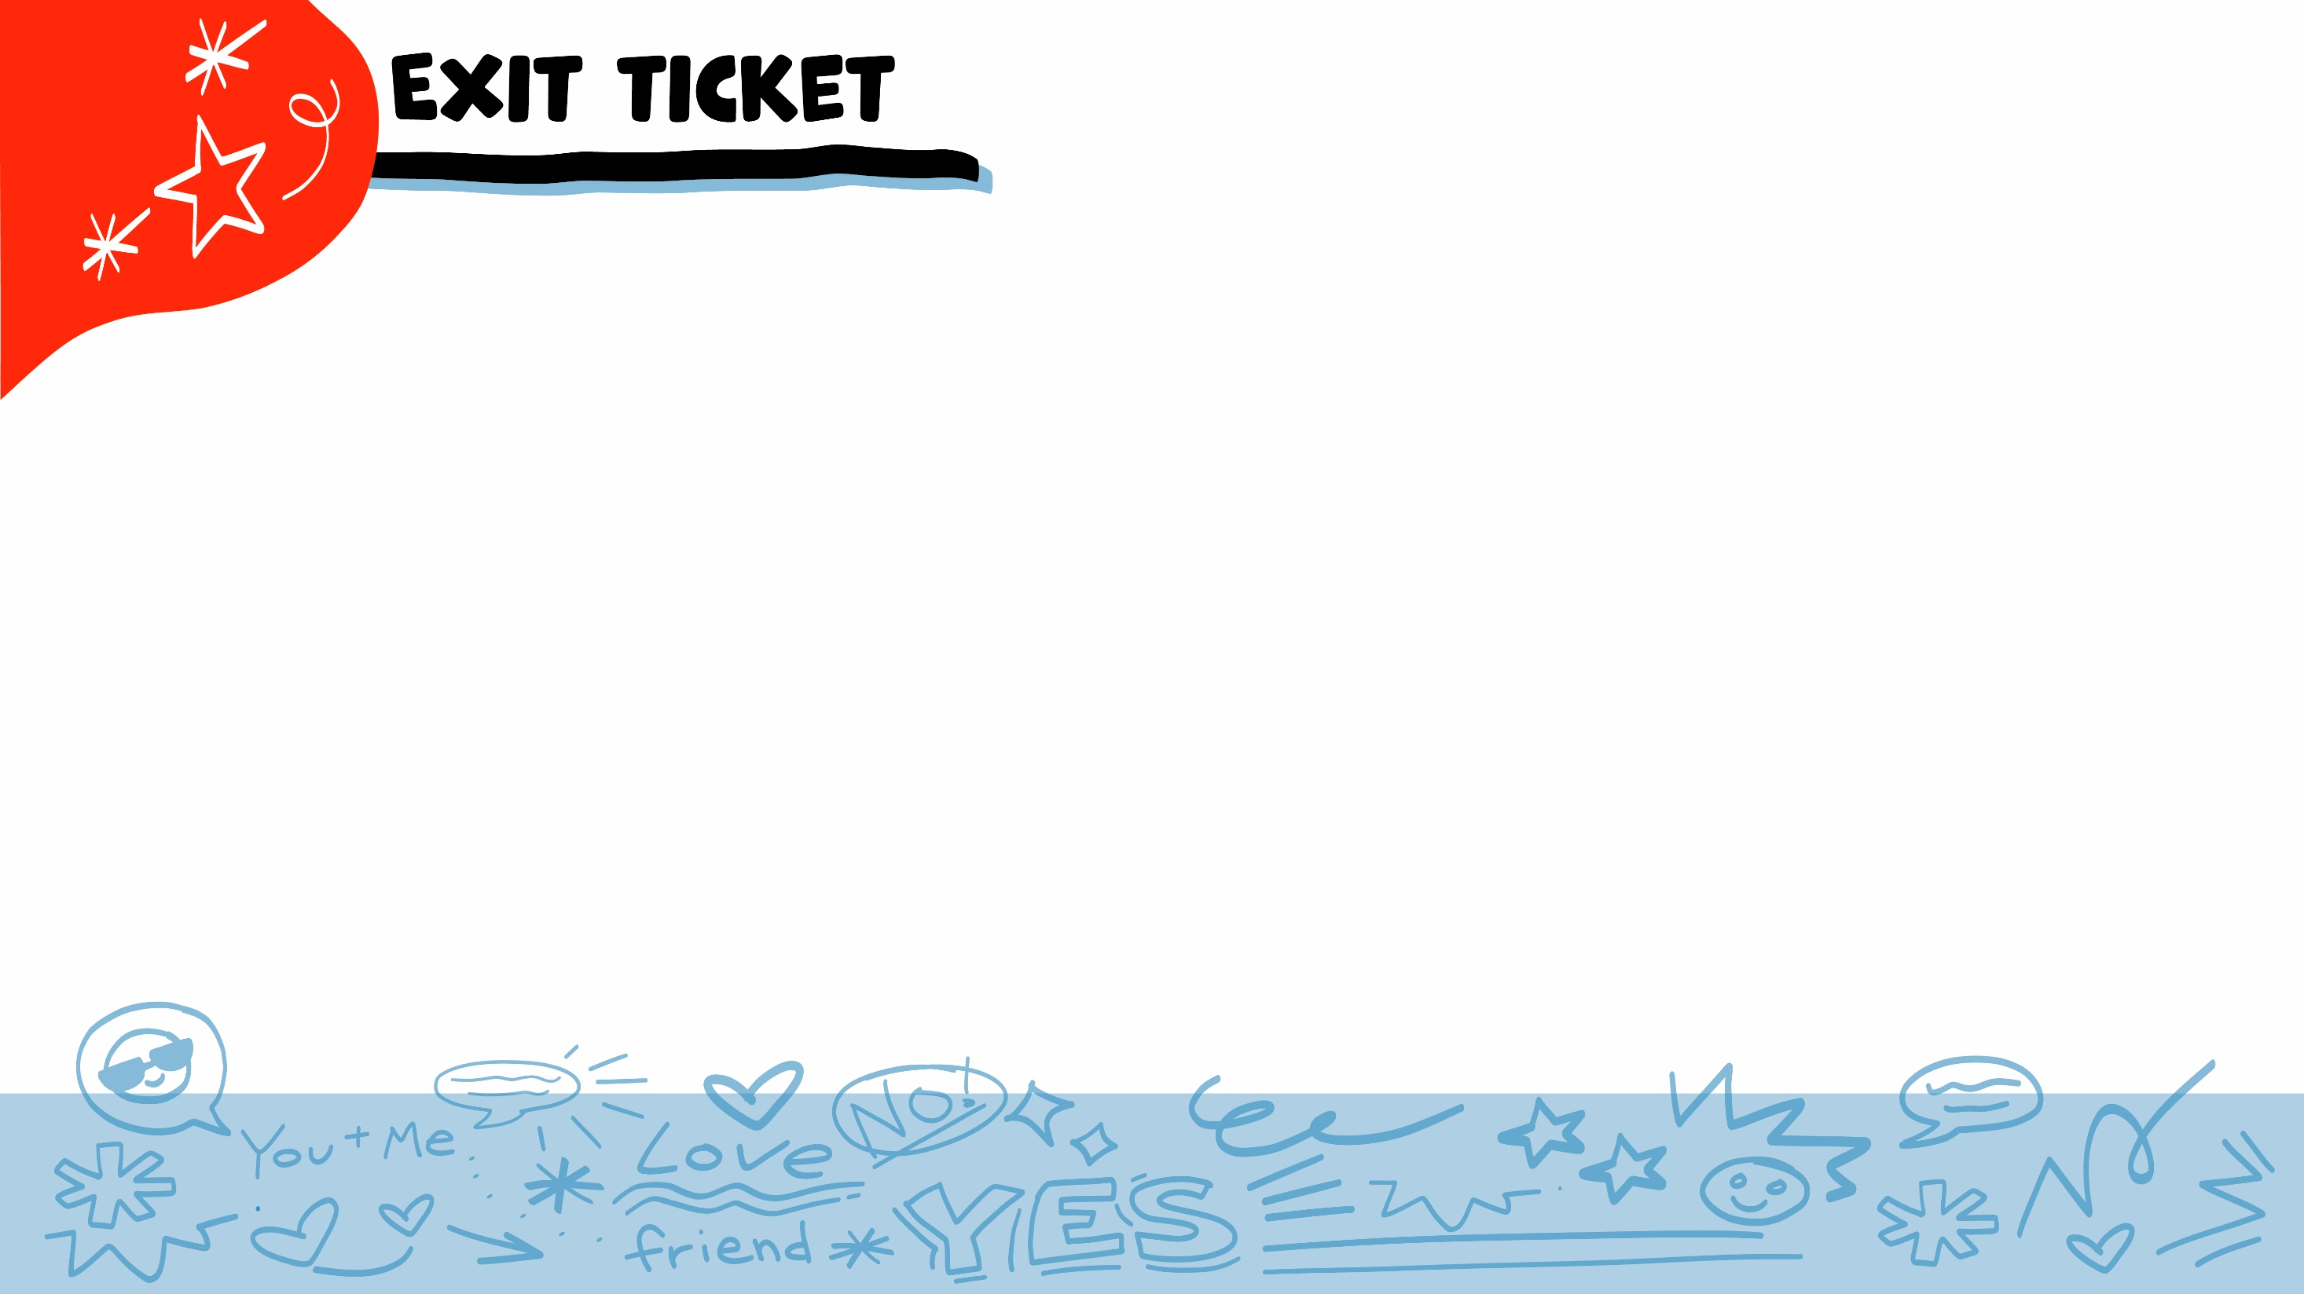
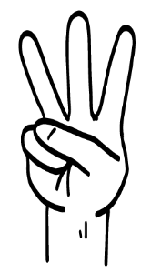
If you have only ever talked to someone online, what circle are they in?
Inner green circle
Middle yellow circle
Outer red circle
1
2
3
© 2026 SAFE Disability Services Program
Notes:
Say: If you have only ever talked to someone online, what circle are they in? Hold up one finger for your “inner green circle of trust” , two fingers for your “middle yellow getting to know you circle”, and three fingers for your “outer red circle of people you don’t know, just met, or don’t trust”.
Give students enough time to process the question and make their decisions.
Say: If you have only ever talked to someone online, you don’t know who they really are. You cannot trust them, and they are in your outer red circle of trust. Even if they seem to be really cool, they are still in your outer red circle of people you don’t know and can’t trust until you meet them in-person and get to know them in-person for several months or even longer. And remember, if you are going to meet in-person with someone you met online, you need to meet in a public place and bring an adult you trust with you.

Slide 45
Which of the following is NOT safe to share on social media?
Your favorite song
A picture of a cute cat
Your home address
1
2
3
© 2026 SAFE Disability Services Program
Notes:
Say: Which of the following is NOT safe to share on social media? Hold up one finger for “your favorite song,” two fingers for “a picture of a cute cat,” and three fingers for “your home address.”
Give students enough time to process the question and make their decisions.
Say: It is not safe to share your home address on social media. Social media sites are public—this means a lot of people can see what you share on them. People in your outer red circle of people you don’t know or don’t trust might even be able to see what you share. It is never safe to share private information like your home address on social media.

Slide 46
Are there ways to make your social media profiles more private?
YES
NO
© 2026 SAFE Disability Services Program
Notes:
Say: Are there ways to make your social media profiles more private? Give a thumbs up for yes and a thumbs down for no.
Give students enough time to process the question and make their decisions.
Say: Yes, every social media site has something called privacy settings. You can change these to make your profiles more private. Even if you have privacy settings turned on, people you don’t know still might be able to see what you post online. If you need help making your profiles more private, you can ask for help from an adult in your inner green circle of trust. And take a look at your privacy settings every once in awhile to be sure they have not been changed.

Slide 47
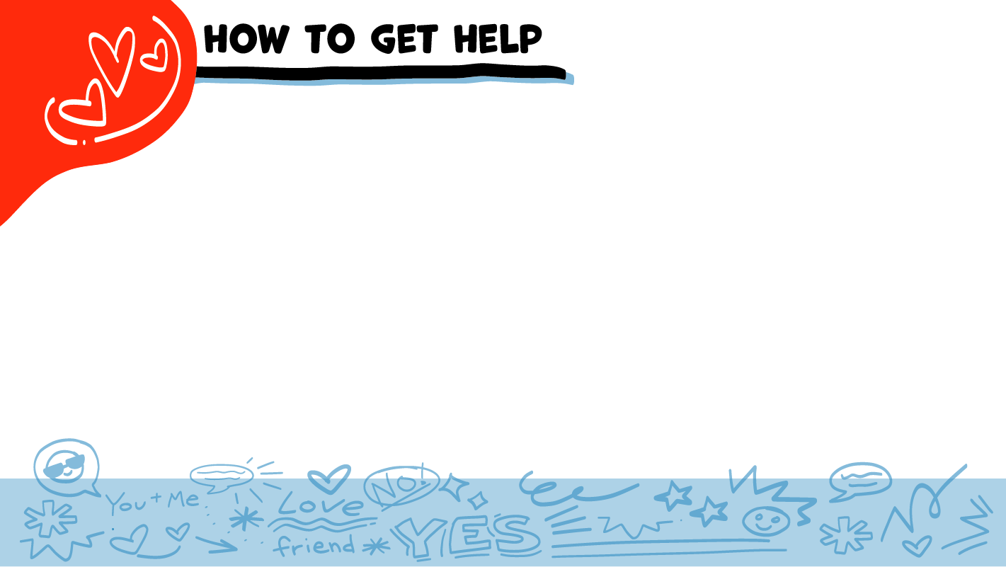
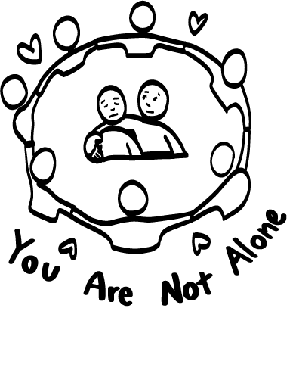
© 2026 SAFE Disability Services Program
Notes:
Say: If you are being hurt, or if someone ever touches your body in a way that you don’t like, you can get help. You did not do anything wrong, and you are not alone. You can get help by talking to an adult from your green circle of trust. If someone you care about is being hurt, you can also get help by talking to an adult from your inner green circle of trust. If an emergency is happening, you can always call 911. If you call 911 for help, a police officer or an ambulance might come.
If the first person you tell doesn’t believe you or doesn’t get you help, keep telling adults you trust what is going on until you get the help you need.

Slide 48
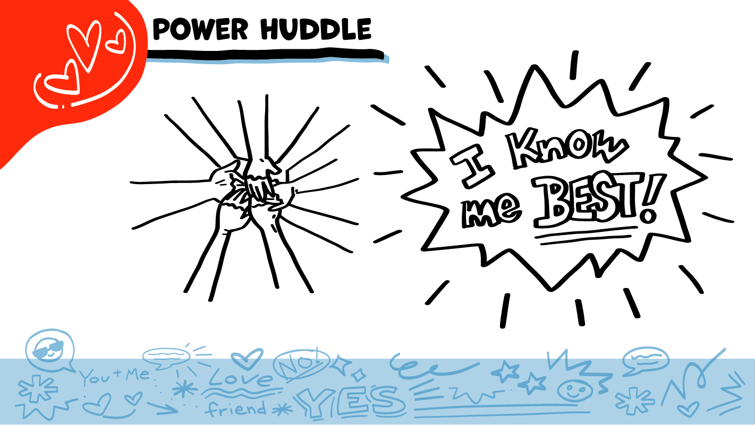
© 2026 SAFE Disability Services Program
Notes:
Say: Does anyone remember what our power statement is? Our power statement is “I know me best.” This means that each of you knows yourself better than anyone else does. Today you learned all about what is safe and not safe to share online. Let’s gather together and on the count of three, say our power statement.
Have each interested student put one hand in the middle of the circle. Ask for a student volunteer to count to three. After three, all participants say the power statement while lifting their hands into the air. Students can also stand in the circle without touching hands if they prefer.

Slide 49

This work is supported by the Texas Council for Developmental Disabilities through a grant from the U.S. Administration for Community Living (ACL), Department of Health and Human Services (HHS), Washington, D.C. 20201 with a 100% federal funding award totaling $6,161,072. Council efforts are those of the grantee and do not necessarily represent the official views of nor are endorsed by ACL, HHS, or the U.S. government.
© SAFE Disability Services Program
Notes:
SAFE would like to thank the Texas Council for Developmental Disabilities for the funding for this curriculum.

Slide 50

This curriculum is offered online at no cost. You are free to use the resources in the original format for educational purposes only. Please reference The SAFE Alliance appropriately (citations at bottom of page).
We ask that you do not alter curriculum images/art, slides, or lesson plan materials. You may not use My Rights My Life (18+ or High School) curriculum for commercial purposes (i.e., selling workshops you facilitate based on MRML curriculum; and/or creating links/websites to re-distribute any materials associated SAFE’s My Rights My Life).
This resource, My Rights My Life: A curriculum for healthier relationships for high school students (grades 9-12) is based on the original My Rights My Life: A curriculum for safer relationships (age 18+) written by Megan Westmore, Heidi Lersch, and edited by Schwartz, M. (2026). Selling materials from MRML is a copyright violation.
Burleson, Anna Belle & Benitez, Sophie (2026) provided light modification and abbreviated the original curriculum
(Westmore & Lersch, 2022) to offer an age appropriate resource for High School Students (grades 9-12).
Schwartz, M. (Ed.). The SAFE Alliance, Austin, Texas.
Westmore, M. & Lersch, H. (2022). My rights my life: A curriculum for safer relationships.
Schwartz, M. (Ed.). The SAFE Alliance: Austin, TX.
© SAFE Disability Services Program

