Slide 1
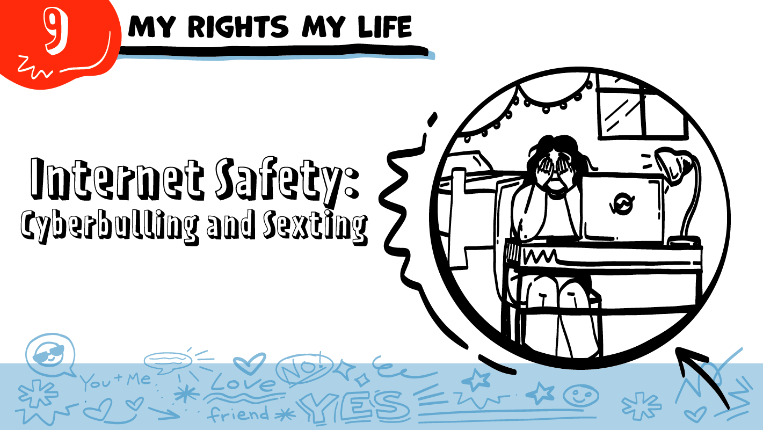

for High School Students
Cyberbullying and Sexting
© 2026 SAFE Disability Services Program
Notes:
Repetition is beneficial for learning. Take time to review the last My Rights My Life class you taught prior to beginning this session. You can also answer any private questions students submitted on notecards during your previous class session.
Say: Today is our second class about internet safety. We will be talking about cyberbullying and sexting.

Slide 2
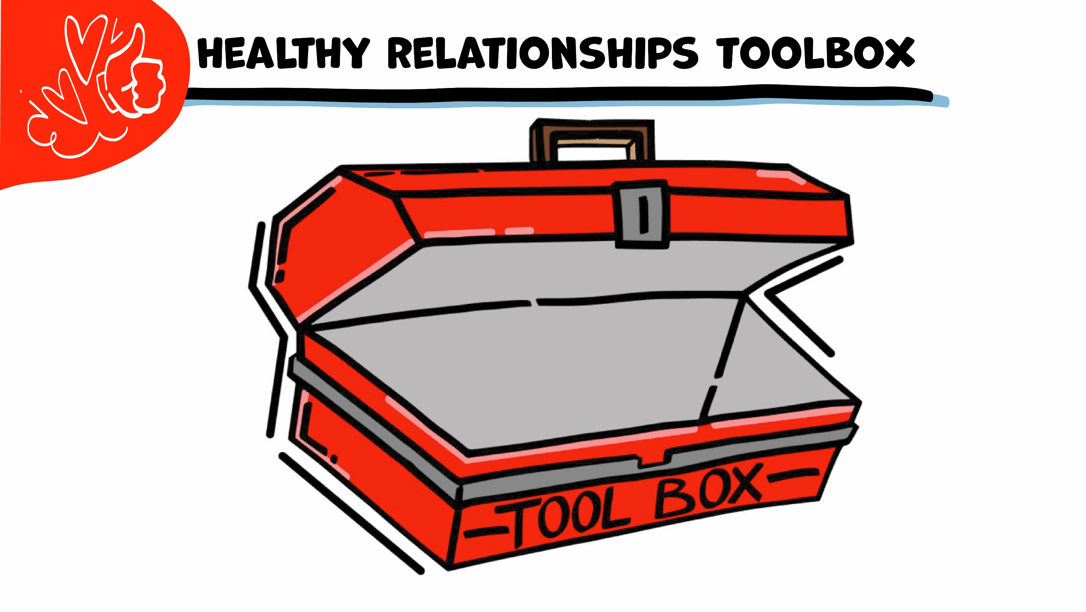

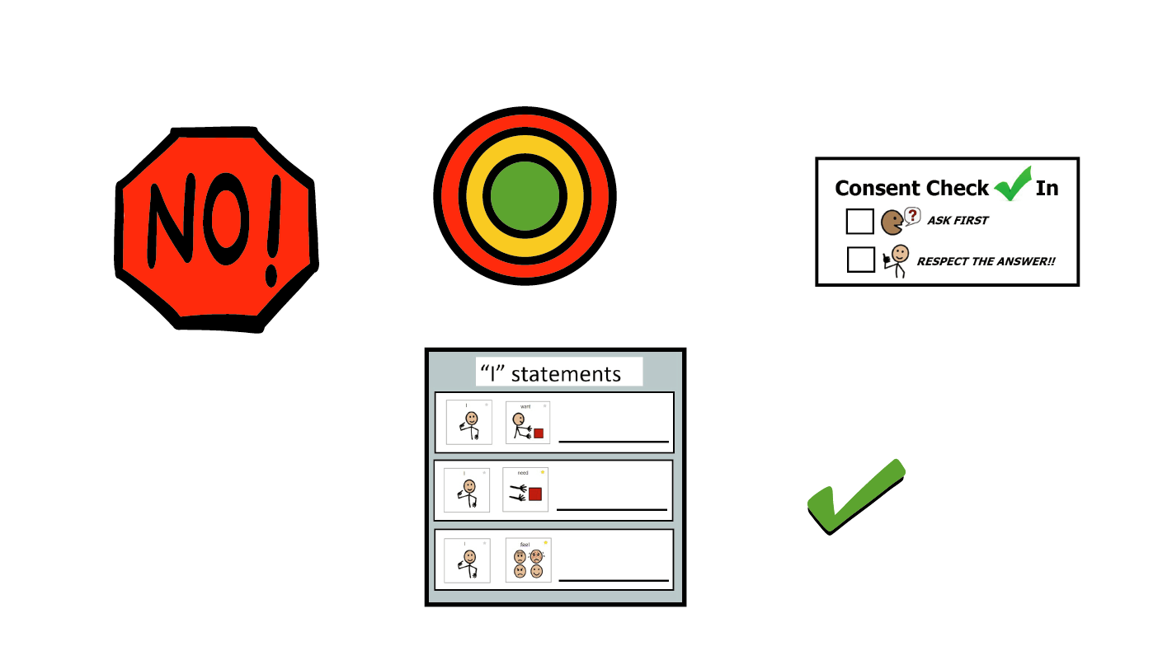
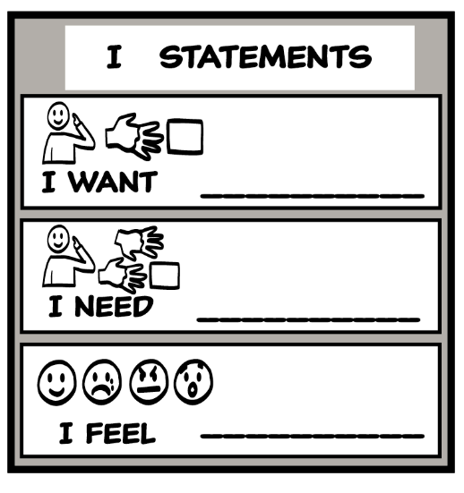
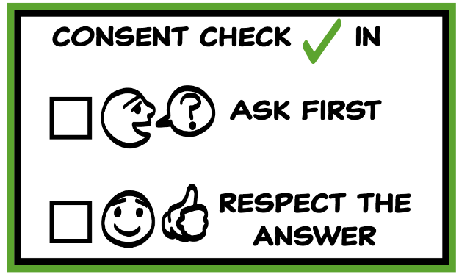
© 2026 SAFE Disability Services Program
Notes:
Use the large class Healthy Relationship Toolbox to review the Healthy Relationship Tools (I Statement, Relationship Map, NO!, and Consent Check-In). You can ask students to pull off one tool at a time and discuss what it is and how it is used. It can be particularly helpful for this review if you give students specific scenarios to think through. For example, you might ask, “If your friend lies to you, what is one I Statement you could use to tell your friend how you feel?” You may even consider using examples of situations that have recently occurred in your classroom, as long as doing so does not break student confidentiality. You can also ask students to connect the toolbox tools to their current relationships. You might say, “Can anyone volunteer and tell me about something going on in your life right now that the toolbox could help you with?”
Instructions for how to use each Healthy Relationship Tool can be found in the following classes:
I Statements: Classes 2 and 3
Relationship Map: Class 4
NO!: Class 5
Consent Check-In: Class 6

Slide 3


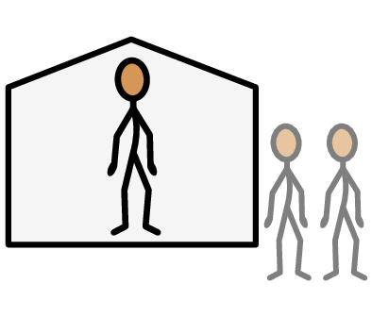
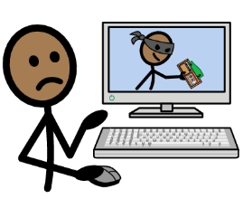



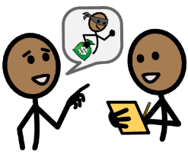

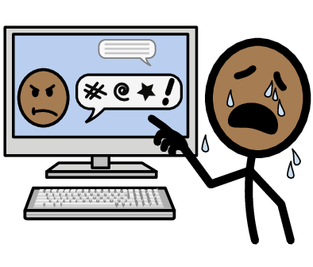



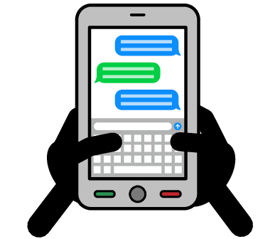
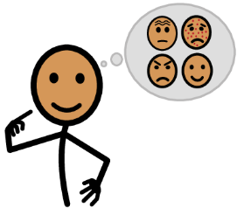





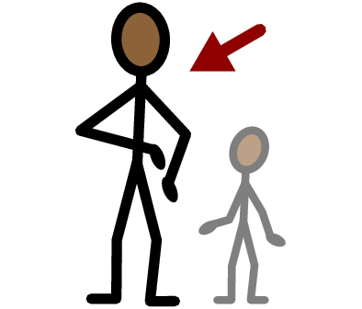
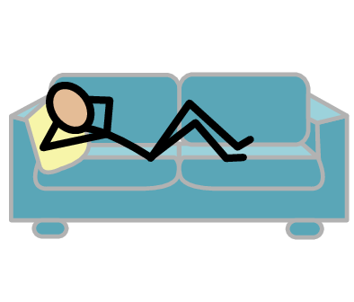
Public
Private
Report
Screenshot
Yes
No
Sexting
Cyberbullying
Block
I need help
I have a question
Trust
Adult
Take a break
I feel
Happy
Sad
Mad
Scared
Copyright © 2021 SymbolStix, LLC. All rights reserved. Used with Permission.
Notes:
You can print this slide separately so each student can use the Important Words Sheet as a communication board throughout class. Review the words using the suggested definitions below. To enhance understanding, you can ask students to come up with their own definitions for vocabulary words or to provide a sentence or scenario using the new word.
Public: Places where other people can come in and out and there are sometimes a lot of people, like a mall; or places online that other people can see
Private: Places where other people need your consent to come in and out, like your bedroom; or places online that only you can see
Cyberbullying: When people say or do mean things to you online
Sexting: Sending sexy texts to someone
Block: Make it so someone can’t talk to you online or see your pictures or videos
Report: When you tell someone that you are being cyberbullied
Screenshot: A picture of something on your computer or phone

Slide 4
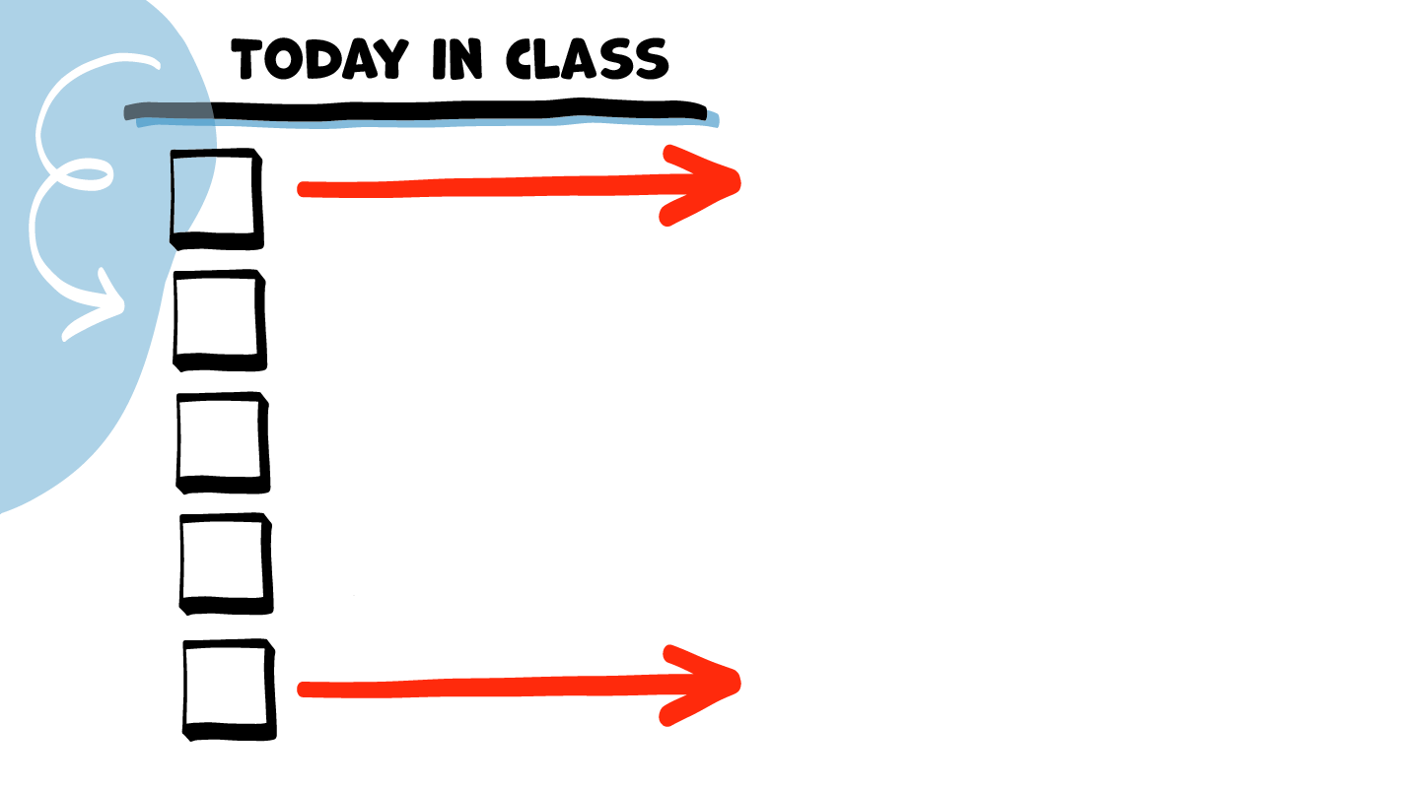
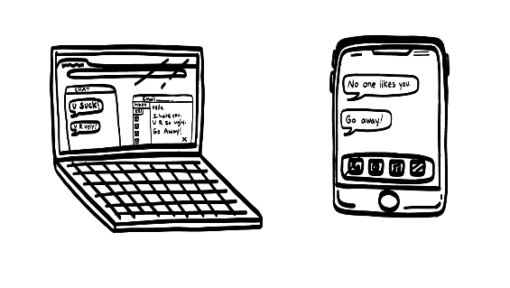

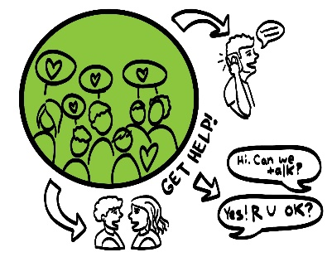
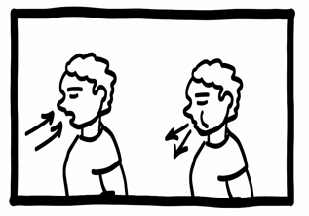
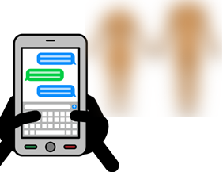


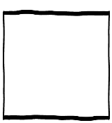
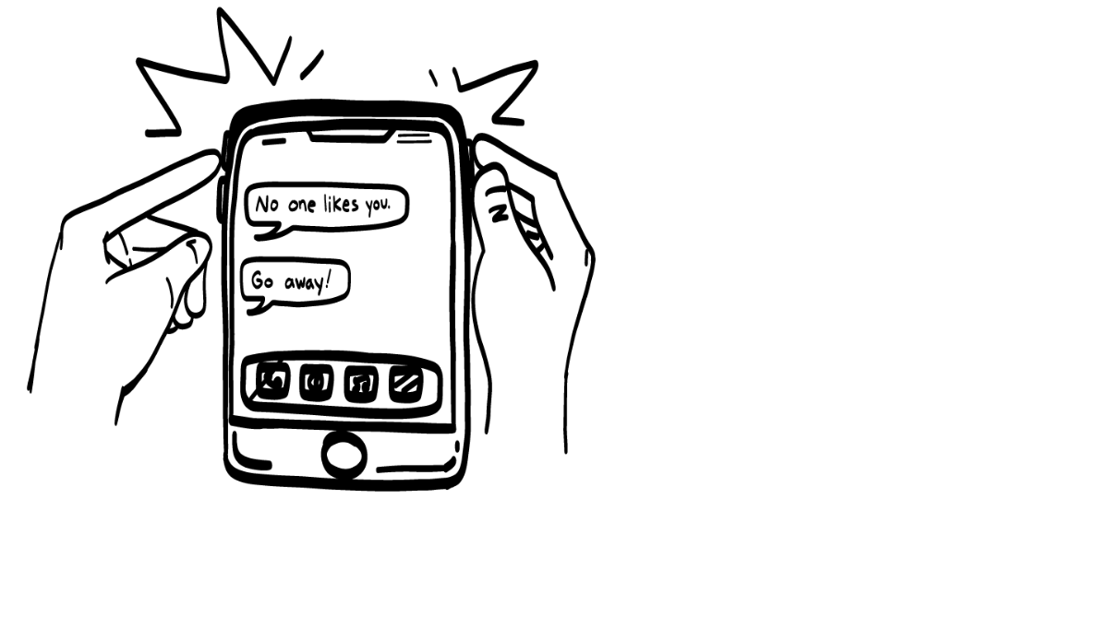




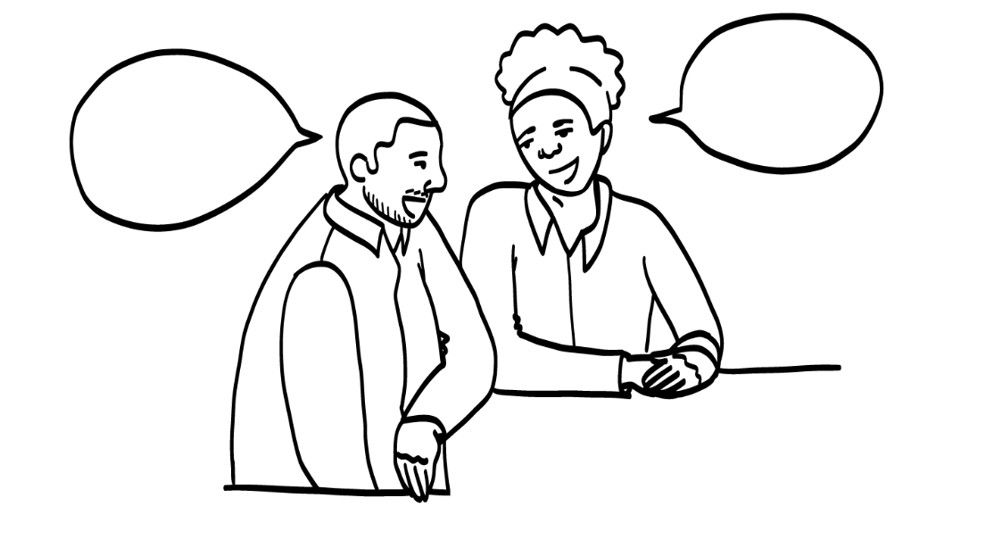
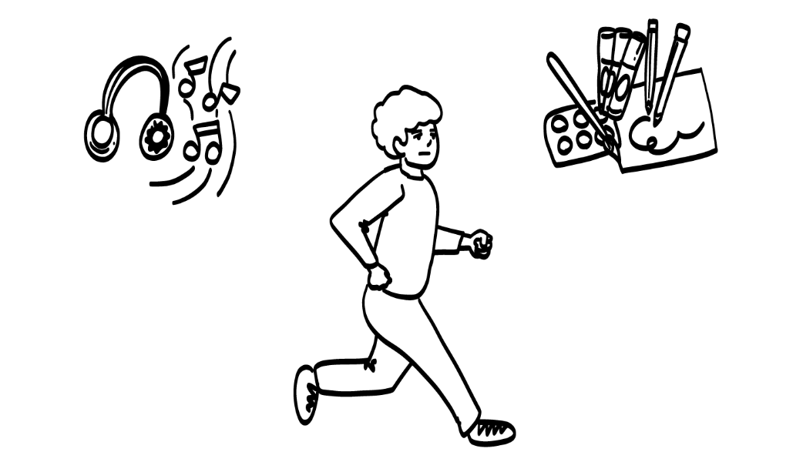
Cyberbullying
Getting Help Game
Brain break
Online Safety Plan
© 2026 SAFE Disability Services Program
Notes:
Read the agenda. Alternatively, you can ask for a student volunteer to read the agenda.

Slide 5
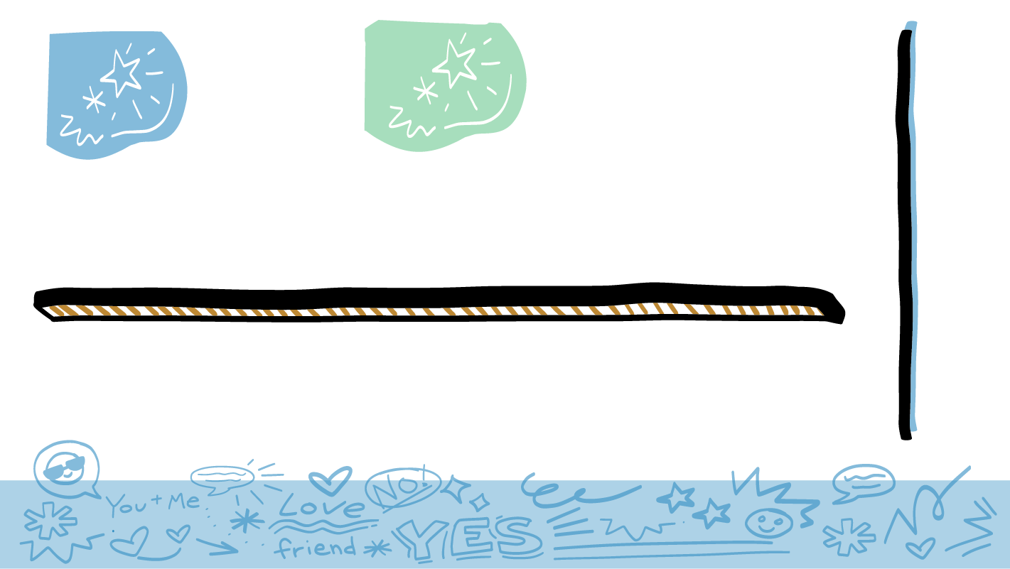
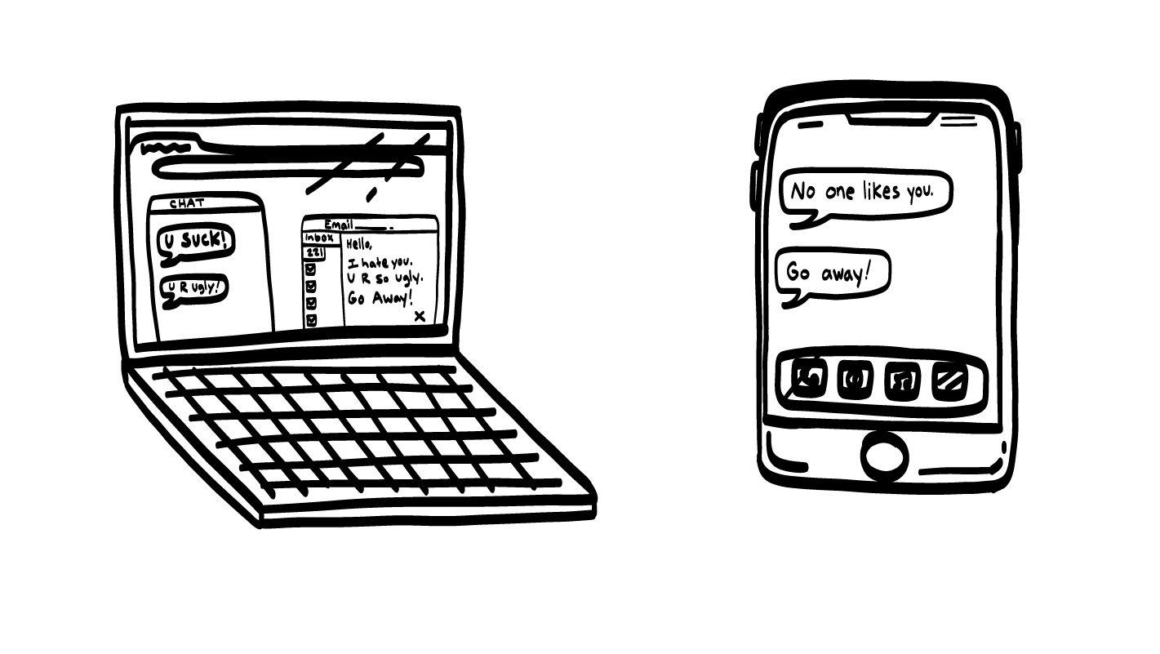
Cyberbullying
© 2026 SAFE Disability Services Program
Notes:
Say: Does anyone know what cyberbullying is?
Give students enough time to process the question and make their decisions.
Say: Cyberbullying is when people say or do mean things to you online. For example, someone might make mean comments on your pictures or posts. This can happen on social media, while gaming, in text messages, or any other place online.

Slide 6
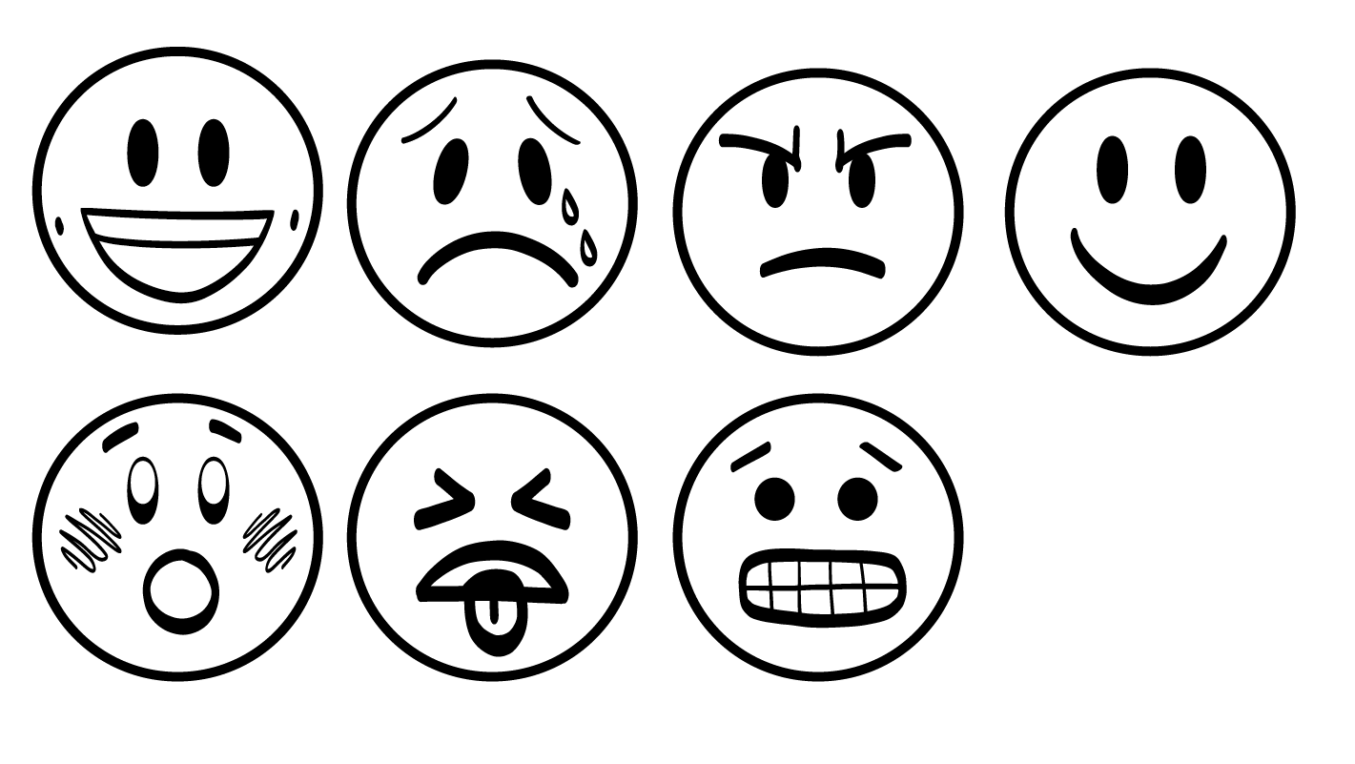
How Does Cyberbullying Make You Feel?
Grossed out or sick
Nervous
Sad
Mad
Scared
© 2026 SAFE Disability Services Program
Notes:
Say: How does cyberbullying make people feel?
Give students enough time to process the question and make their decisions.
Say: Cyberbullying can make people feel grossed out or sick, nervous, sad, mad, or scared. It is not okay for someone to cyberbully. It makes people feel really awful.

Slide 7

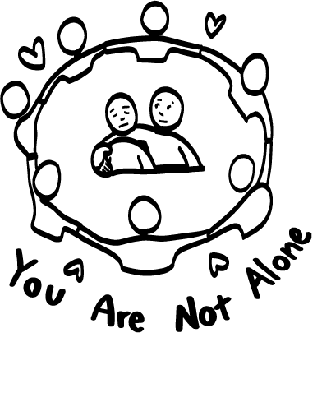
It is Not Your Fault. You Can Get Help!
© 2026 SAFE Disability Services Program
Notes:
Say: If you have been cyberbullied, does that mean something is wrong with you? Give a thumbs up for yes and a thumbs down for no.
Give students enough time to process the question and make their decisions.
Say: No! If you have been cyberbullied, it is not your fault. You did not do anything wrong. You are awesome and you can get help from an adult in your inner green circle of trust.
Say: If your friend is being cyberbullied, does that mean something is wrong with them? Give a thumbs up for yes and a thumbs down for no.
Give students enough time to process the question and make their decisions.
Say: No! If your friend has been cyberbullied, it is not their fault. They did not do anything wrong. You can help them get help from an adult in their inner green circle of trust. This is called being an ally for your friend.

Slide 8

Take a Break
© 2026 SAFE Disability Services Program
Notes:
Say: Today we are going to talk about five things you can do that might help if you have been cyberbullied. Your first option is to take a break from being online. What does this mean? What could you do instead of spending time online?
Give students enough time to process the question and make their decisions. Ask a few students to share ideas of things they could do while taking a break from being online.
Say: It is not a good idea to respond to a cyberbully. Responding to a cyberbully probably will not make you feel better. It can also lead the person to say more mean things because they are getting attention. Responding usually doesn’t help.

Slide 9
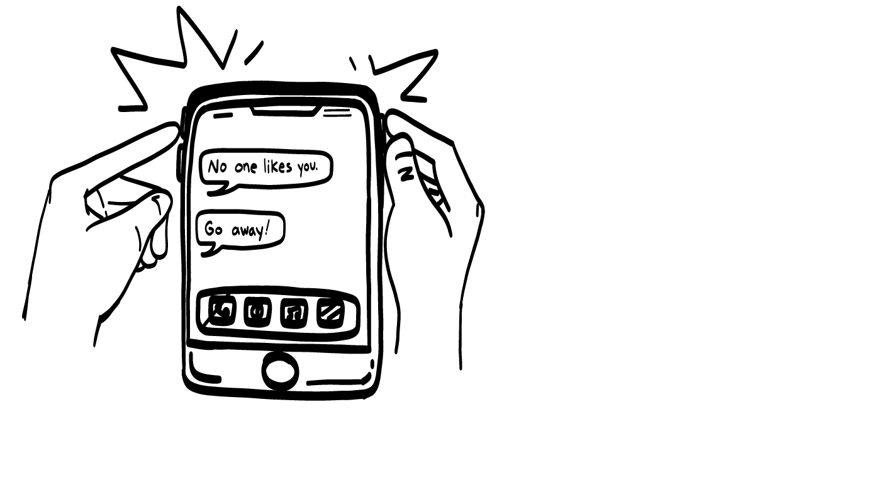
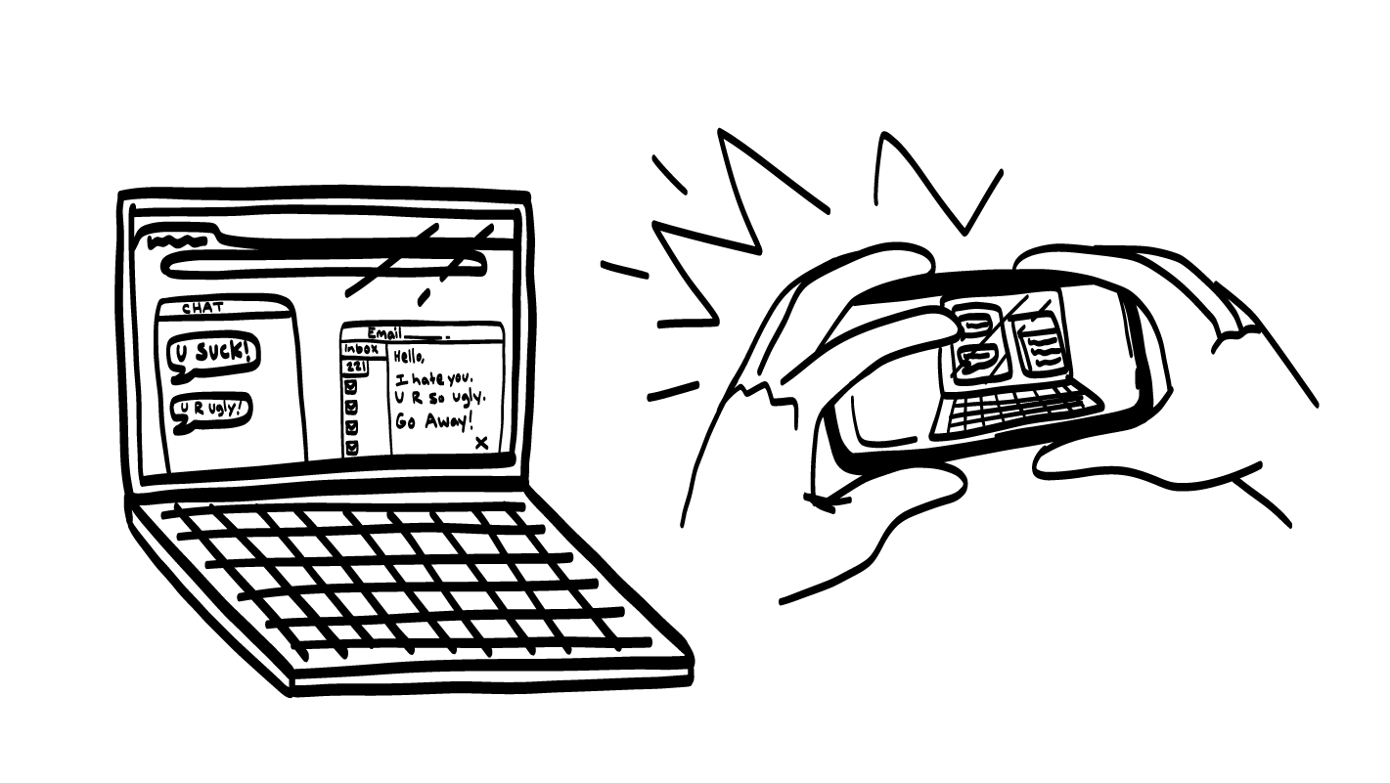
Report It
© 2026 SAFE Disability Services Program
Notes:
Say: Another option is to report the person. A lot of websites and apps will let you report abusive behavior like cyberbullying. This means that you tell someone who works for the website or app what the other person is doing.
You can also report cyberbullying at school. Who can help you with cyberbullying at school?
Give students enough time to process the question and make their decisions.
Say: You could report the cyberbullying to a teacher, a teacher’s aide, or an administrator like a principal.
When making a report, it helps if you have a screenshot of the cyberbullying. A screenshot is a picture of what the cyberbully said. You can take a screenshot from your phone, tablet, or computer. If the cyberbully deletes their comments later, you will still have a picture of what they said. You can use the screenshots to make the report. Who knows how to take a screenshot?
In some cases, cyberbullying is a crime that can be reported to the police. For example, if someone is saying they are going to hurt you, this is a crime. You could call 911 for help.
You can talk to an adult from your inner green circle of trust about whether the cyberbullying can be reported to police and decide together if this is what you want to do.

Slide 10

Block People
© 2026 SAFE Disability Services Program
Notes:
Say: Your third option is to block the person. Does anyone know what it means to block someone online?
Give students enough time to process the question and make their decisions.
Say: Blocking someone means that they can’t talk to you anymore. You can always block someone on your phone or on social media. Sometimes this is called “unfollow” or “unfriend.”
If you can’t figure out how to block someone online, you can ask an adult from your inner green circle of trust for help.

Slide 11

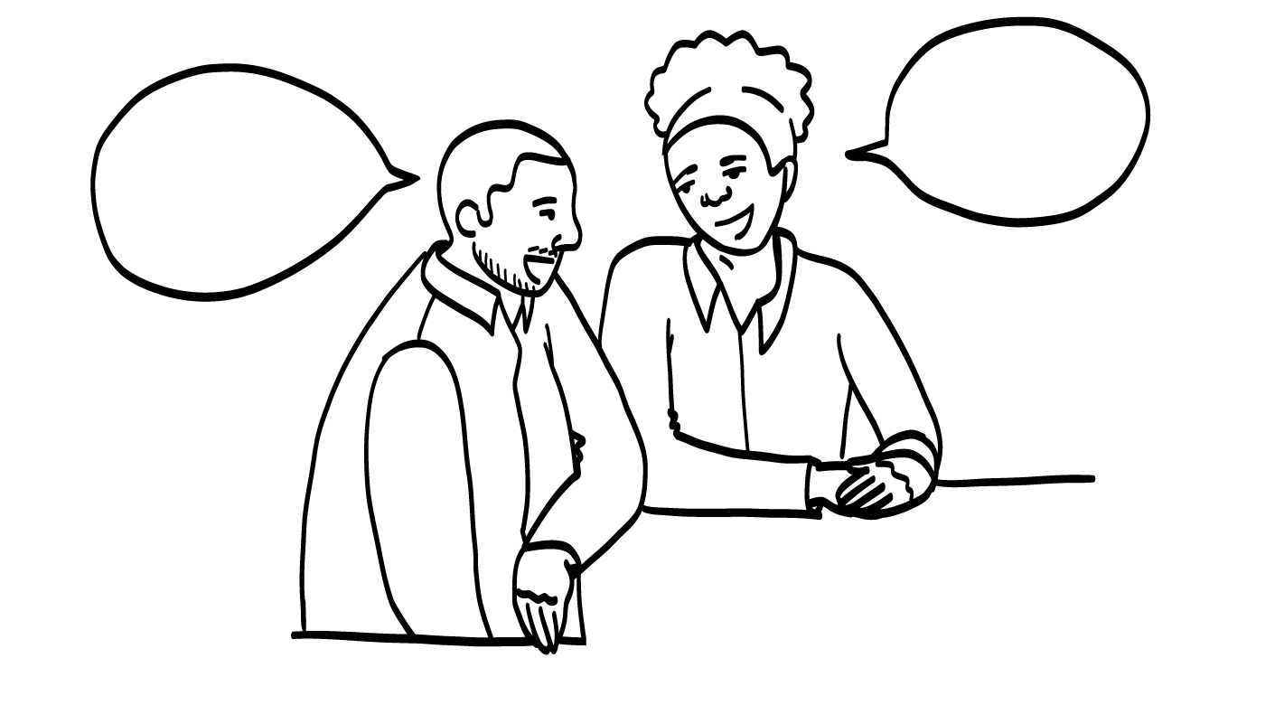
Talk to An Adult You Trust
© 2026 SAFE Disability Services Program
Notes:
Say: A fourth option for getting help when you’ve been cyberbullied is to talk to an adult you trust. What circle on your relationship map is for people you trust the most?
Give students enough time to process the question and make their decisions.
Say: The inner green circle of trust. Who is one adult from your inner green circle of trust who could help?
Give students enough time to process the question and make their decisions. Go around the room and ask each student to name one adult they trust who could help if they are being cyberbullied.
Say: If you have a job, who might be able to help you if you are being cyberbullied by someone at work?
Give students enough time to process the question and make their decisions.
Say: You could talk to a manager or your boss for help at work.

Slide 12
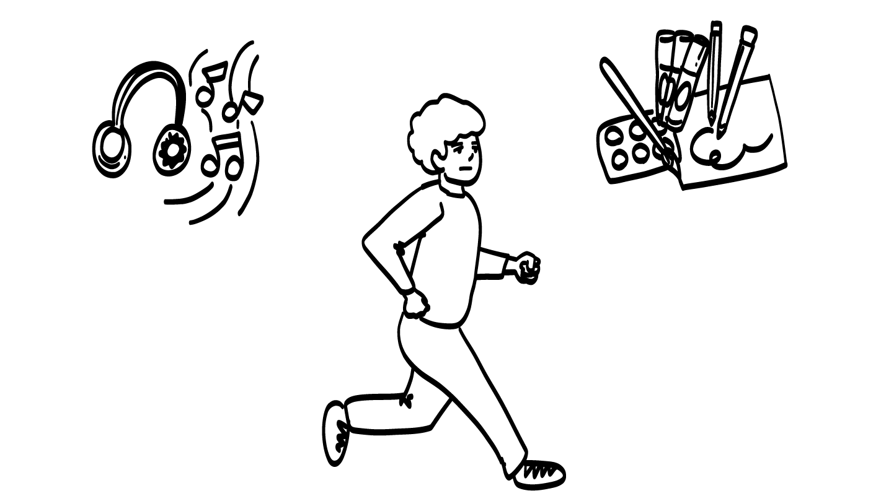
Do Self-Care
© 2026 SAFE Disability Services Program
Notes:
Say: Finally, our last option for getting help when you have been cyberbullied is to do some self-care. Self-care is about doing things that make you feel happy and good about yourself. For example, some people love to listen to music, and others like to run or draw.
What do you like to do for self-care?
Give students enough time to process the question and make their decisions. Go around the room and ask each student to share one thing they do for self-care.

Slide 13


2. Report it
1. Block
3. Take a break
5. Talk to an adult you trust
4. Do self-care
© 2026 SAFE Disability Services Program
Notes:
Say: If your friend is being cyberbullied, can you help them follow one or more of these five steps that we just talked about?
Give students enough time to process the question and make their decisions.
Say: Yes, you can be an ally, or supporter, to your friend. You can help them follow any of these steps. They can take a break, report the cyberbully, block the cyberbully, or talk to an adult they trust. You can also help your friend do some self-care and maybe spend some time with you. Being an ally is an important part of a healthy friendship.

Slide 14
Cyberbullying
Getting Help Game
Brain break
Sexting
Online Safety Plan
© 2026 SAFE Disability Services Program
Notes:
Read the agenda. Alternatively, you can ask for a student volunteer to read the agenda.

Slide 15
2. Report it
1. Block
3. Take a break
5. Talk to another adult you trust
4. Do self-care
© 2026 SAFE Disability Services Program
Notes:
Say: We are going to play a game about what you can do to get help if you or someone you know is being cyberbullied. In just a minute, I will give you a story about something that happened online. You’ll decide which of the five things we’ve talked about could help the person in that story.
Ask for a student volunteer. They can either read the story aloud or you can read the story out loud yourself if the student prefers.
Ask the student to choose one of the five getting help strategies and explain how the strategy would help in that story. The student can pick more than one getting help strategy.
For these scenarios, there is no right or wrong answer. The purpose of this game is for students to practice applying the getting help strategies previously discussed to real-world situations, and to think through which strategies they are most likely to use. All of the strategies can be applied to any scenario.
You will probably not be able to get through all these scenarios in one class, but you can return to them to reinforce cybersafety.

Slide 16
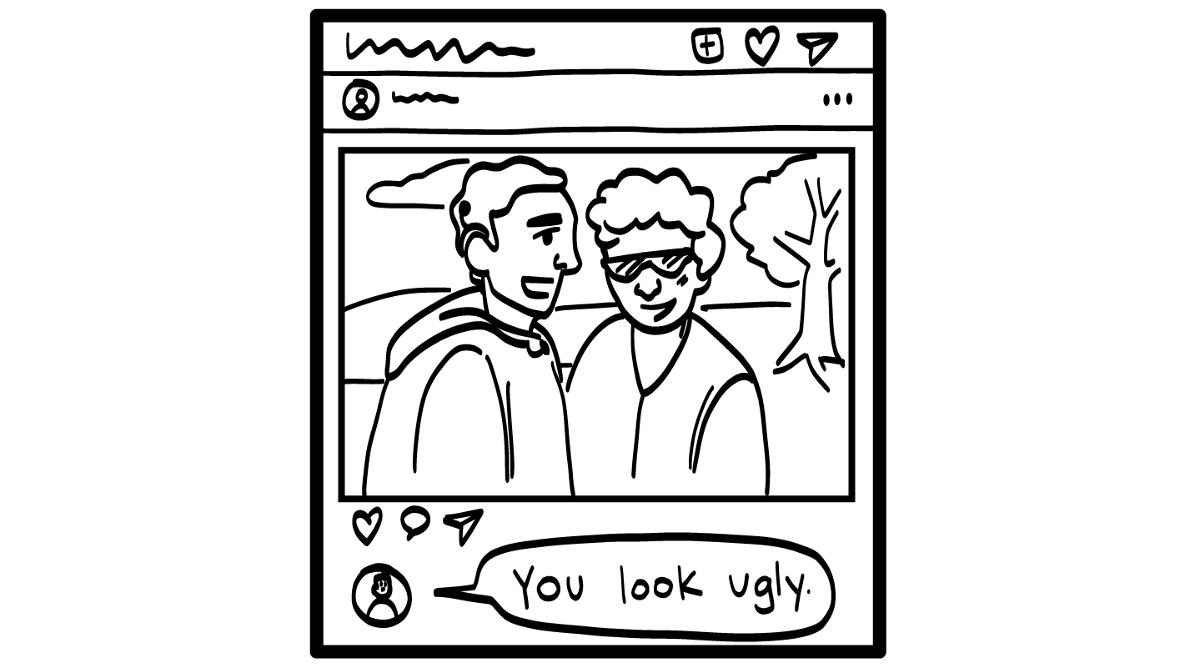

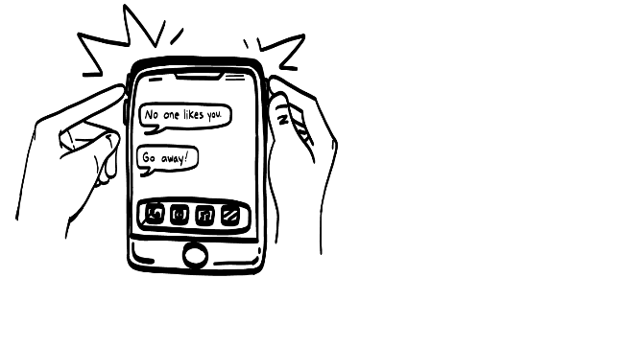

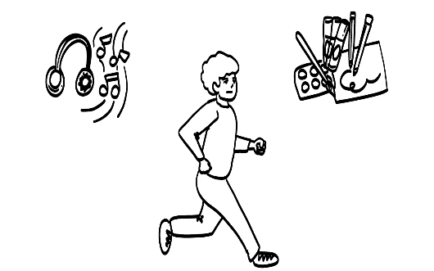
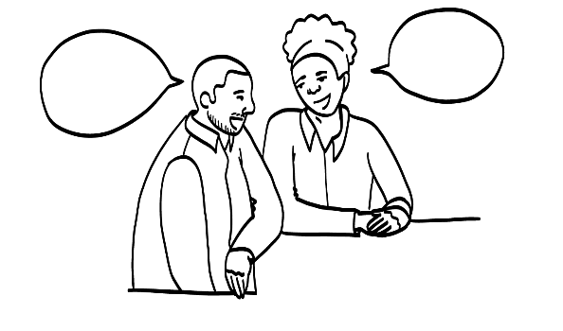
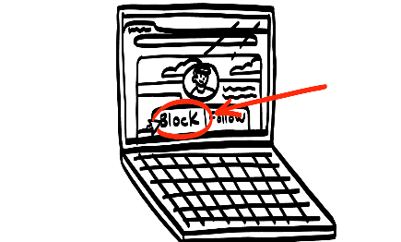
Someone says you look ugly on your photo.
1. Block
2. Report it
3. Take a break
5. Talk to another adult you trust
4. Do self-care
© 2026 SAFE Disability Services Program
5. Talk to an adult you trust
4. Do self-care
Notes:
Say: Is there a volunteer who wants to go first?
Ask the volunteer to read the story out loud and say that you can also read the story yourself if the student prefers. Ask the student to choose one of the five getting help strategies and then explain how that strategy would help. Students can also choose more than one strategy. Students can say the strategy name out loud or hold up a finger for the one they choose. (Example: one finger for blocking the person, 2 fingers for reporting the person, and so on).
Sample prompting questions:
What getting help strategy do you choose?
How would that help?
What would you do?
Who could help you with this?
Does anyone else have a suggestion of what someone could do in this story?

Slide 17
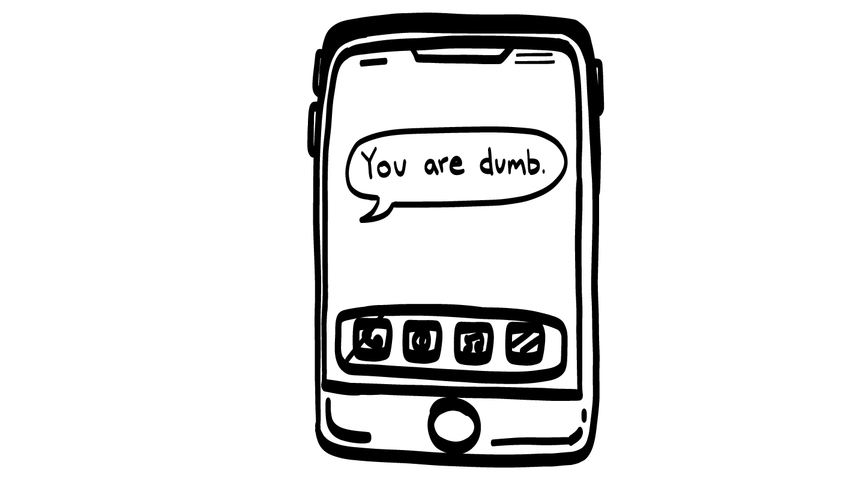
Someone texts you saying you are dumb.
1. Block
2. Report it
3. Take a break
4. Do self-care
5. Talk to an adult you trust
© 2026 SAFE Disability Services Program
Notes:
Say: Who would like to go next?
Ask the volunteer to read the story out loud and say that you can also read the story yourself if the student prefers. Ask the student to choose one of the five getting help strategies and then explain how that strategy would help. Students can also choose more than one strategy. Students can say the strategy name out loud or hold up a finger for the one they choose. (Example: one finger for blocking the person, 2 fingers for reporting the person, and so on).
Sample prompting questions:
What getting help strategy do you choose?
How would that help?
What would you do?
Who could help you with this?
Does anyone else have a suggestion of what someone could do in this story?

Slide 18
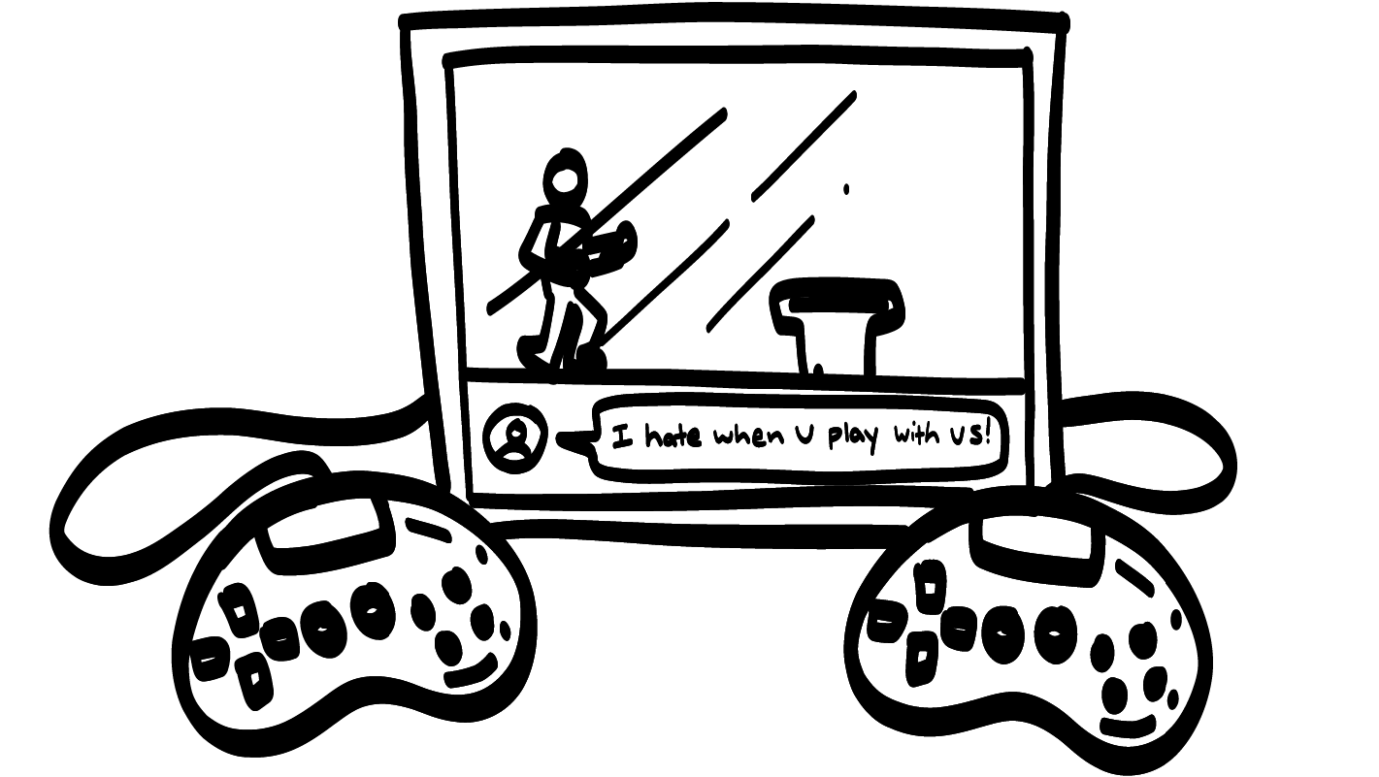
Someone you are playing video games with sends a chat saying, “I hate when you play with us.”
1. Block
2. Report it
3. Take a break
4. Do self-care
5. Talk to an adult you trust
© 2026 SAFE Disability Services Program
Notes:
Say: Who would like to go next?
Ask the volunteer to read the story out loud and say that you can also read the story yourself if the student prefers. Ask the student to choose one of the five getting help strategies and then explain how that strategy would help. Students can also choose more than one strategy. Students can say the strategy name out loud or hold up a finger for the one they choose. (Example: one finger for blocking the person, 2 fingers for reporting the person, and so on).
Sample prompting questions:
What getting help strategy do you choose?
How would that help?
What would you do?
Who could help you with this?
Does anyone else have a suggestion of what someone could do in this story?

Slide 19
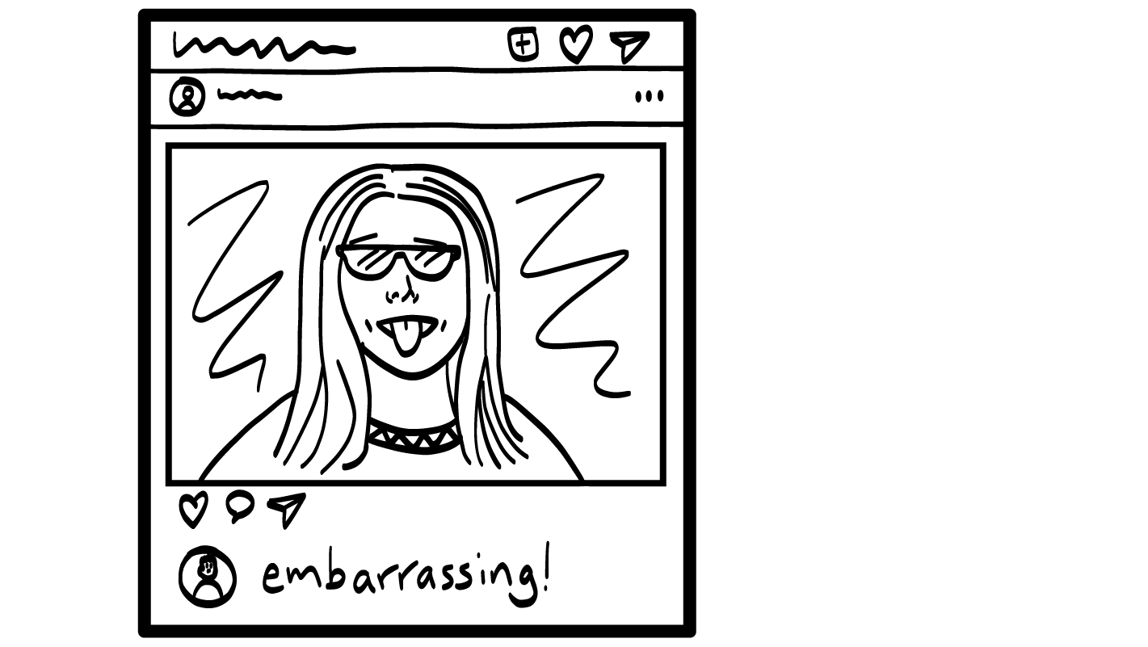
Your classmate takes an embarrassing picture of you and posts it online.
1. Block
2. Report it
3. Take a break
4. Do self-care
5. Talk to an adult you trust
© 2026 SAFE Disability Services Program
Notes:
Say: Who would like to go next?
Ask the volunteer to read the story out loud and say that you can also read the story yourself if the student prefers. Ask the student to choose one of the five getting help strategies and then explain how that strategy would help. Students can also choose more than one strategy. Students can say the strategy name out loud or hold up a finger for the one they choose. (Example: one finger for blocking the person, 2 fingers for reporting the person, and so on).
Sample prompting questions:
What getting help strategy do you choose?
How would that help?
What would you do?
Who could help you with this?
Does anyone else have a suggestion of what someone could do in this story?

Slide 20
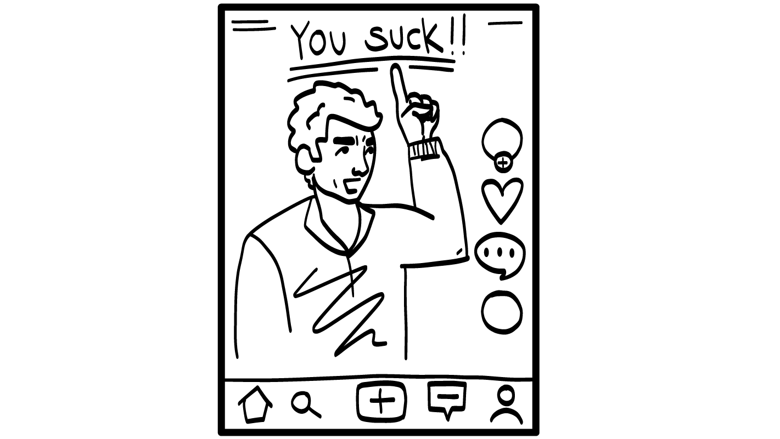
Someone posts a video making fun of you.
1. Block
2. Report it
3. Take a break
4. Do self-care
5. Talk to an adult you trust
© 2026 SAFE Disability Services Program
Notes:
Say: Who would like to go next?
Ask the volunteer to read the story out loud and say that you can also read the story yourself if the student prefers. Ask the student to choose one of the five getting help strategies and then explain how that strategy would help. Students can also choose more than one strategy. Students can say the strategy name out loud or hold up a finger for the one they choose. (Example: one finger for blocking the person, 2 fingers for reporting the person, and so on).
Sample prompting questions:
What getting help strategy do you choose?
How would that help?
What would you do?
Who could help you with this?
Does anyone else have a suggestion of what someone could do in this story?

Slide 21
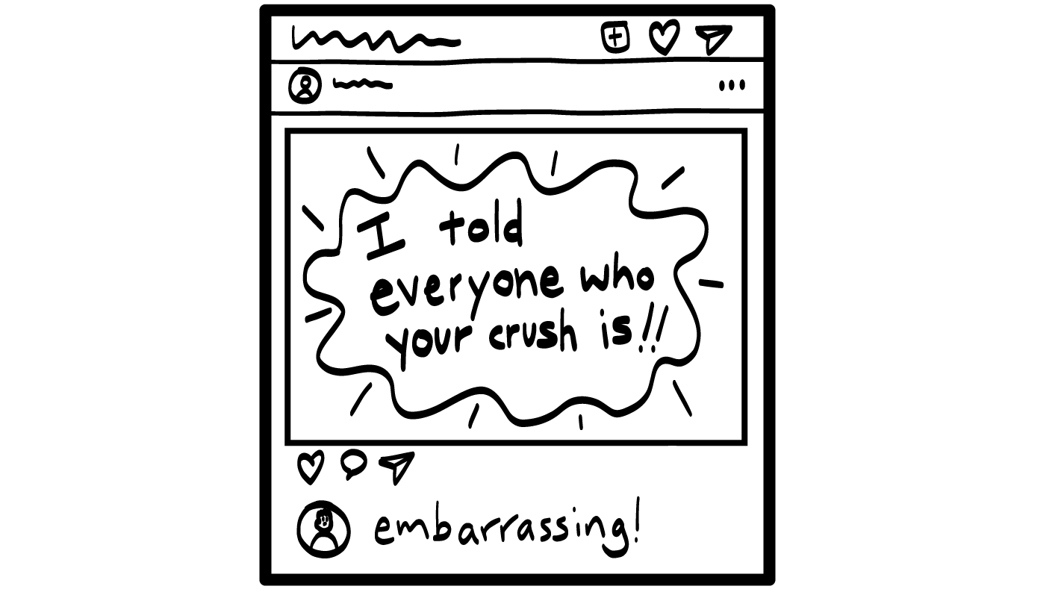
Your classmate shares one of your secrets online where everyone can see it.
1. Block
2. Report it
3. Take a break
4. Do self-care
5. Talk to an adult you trust
© 2026 SAFE Disability Services Program
Notes:
Say: Who would like to go next?
Ask the volunteer to read the story out loud and say that you can also read the story yourself if the student prefers. Ask the student to choose one of the five getting help strategies and then explain how that strategy would help. Students can also choose more than one strategy. Students can say the strategy name out loud or hold up a finger for the one they choose. (Example: one finger for blocking the person, 2 fingers for reporting the person, and so on).
Sample prompting questions:
What getting help strategy do you choose?
How would that help?
What would you do?
Who could help you with this?
Does anyone else have a suggestion of what someone could do in this story?

Slide 22
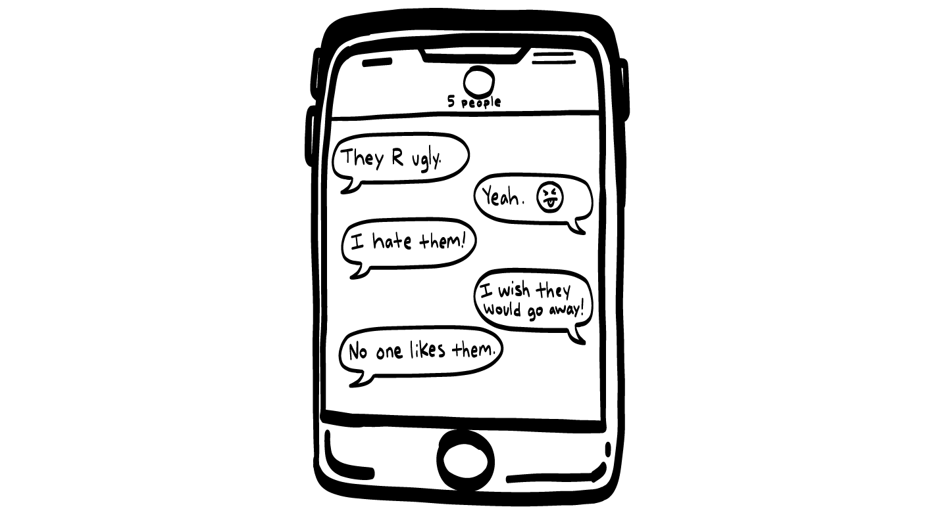
Someone starts a group text to talk about you behind your back.
1. Block
2. Report it
3. Take a break
4. Do self-care
5. Talk to an adult you trust
© 2026 SAFE Disability Services Program
Notes:
Say: Who would like to go next?
Ask the volunteer to read the story out loud and say that you can also read the story yourself if the student prefers. Ask the student to choose one of the five getting help strategies and then explain how that strategy would help. Students can also choose more than one strategy. Students can say the strategy name out loud or hold up a finger for the one they choose. (Example: one finger for blocking the person, 2 fingers for reporting the person, and so on).
Sample prompting questions:
What getting help strategy do you choose?
How would that help?
What would you do?
Who could help you with this?
Does anyone else have a suggestion of what someone could do in this story?

Slide 23
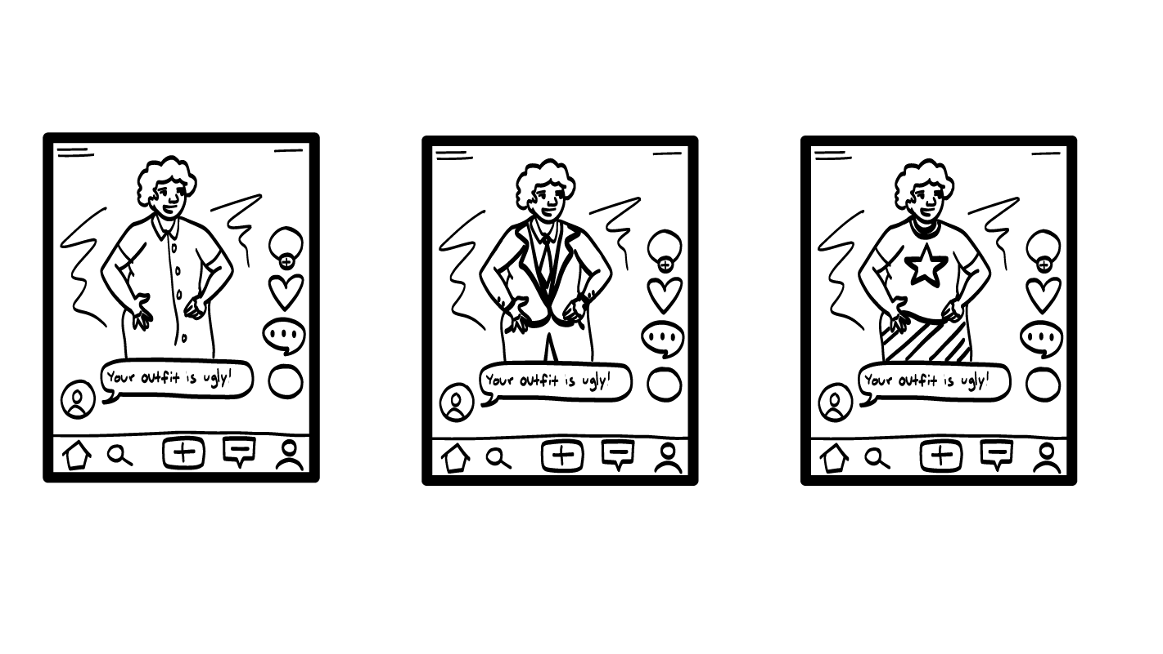
A stranger comments on your photos saying your outfits are ugly.
1. Block
2. Report it
3. Take a break
4. Do self-care
5. Talk to an adult you trust
© 2026 SAFE Disability Services Program
Notes:
Say: Who would like to go next?
Ask the volunteer to read the story out loud and say that you can also read the story yourself if the student prefers. Ask the student to choose one of the five getting help strategies and then explain how that strategy would help. Students can also choose more than one strategy. Students can say the strategy name out loud or hold up a finger for the one they choose. (Example: one finger for blocking the person, 2 fingers for reporting the person, and so on).
Sample prompting questions:
What getting help strategy do you choose?
How would that help?
What would you do?
Who could help you with this?
Does anyone else have a suggestion of what someone could do in this story?

Slide 24
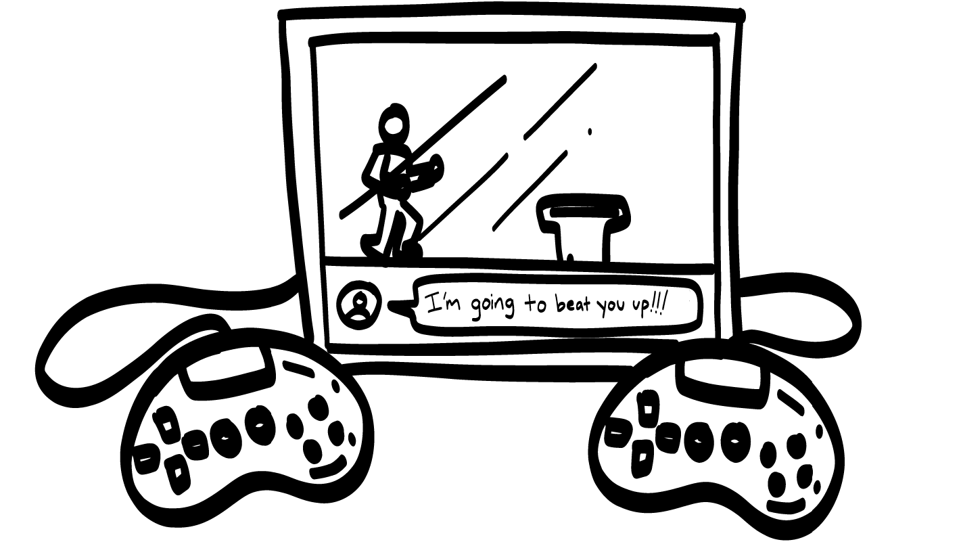
Someone you are playing video games with says they are going to hurt you.
1. Block
2. Report it
3. Take a break
4. Do self-care
5. Talk to an adult you trust
© 2026 SAFE Disability Services Program
Notes:
Say: Who would like to go next?
Ask the volunteer to read the story out loud and say that you can also read the story yourself if the student prefers. Ask the student to choose one of the five getting help strategies and then explain how that strategy would help. Students can also choose more than one strategy. Students can say the strategy name out loud or hold up a finger for the one they choose. (Example: one finger for blocking the person, 2 fingers for reporting the person, and so on).
Because in this scenario, someone is threatening physical harm, make sure to cover 5, talk to another adult you trust.
Sample prompting questions:
It is important to get help as soon as possible any time someone threatens to hurt you. Who are people in your green circle of trust who could help right away with something serious like this?
What else would you do?
Does anyone else have a suggestion of what someone could do in this story?

Slide 25

A classmate sends your friend a lot of emails saying you are a loser.
1. Block
2. Report it
3. Take a break
4. Do self-care
5. Talk to an adult you trust
© 2026 SAFE Disability Services Program
Notes:
Say: Who would like to do the final story?
Ask the volunteer to read the story out loud and say that you can also read the story yourself if the student prefers. Ask the student to choose one of the five getting help strategies and then explain how that strategy would help. Students can also choose more than one strategy. Students can say the strategy name out loud or hold up a finger for the one they choose. (Example: one finger for blocking the person, 2 fingers for reporting the person, and so on).
Sample prompting questions:
What getting help strategy do you choose?
How would that help?
What would you do?
Who could help you with this?
Does anyone else have a suggestion of what someone could do in this story?
Say: Great job with the Getting Help Game everyone!

Slide 26
Cyberbullying
Getting Help Game
Brain break
Sexting
Online Safety Plan
© 2026 SAFE Disability Services Program
Notes:
Read the agenda. Alternatively, you can ask for a student volunteer to read the agenda.

Slide 27
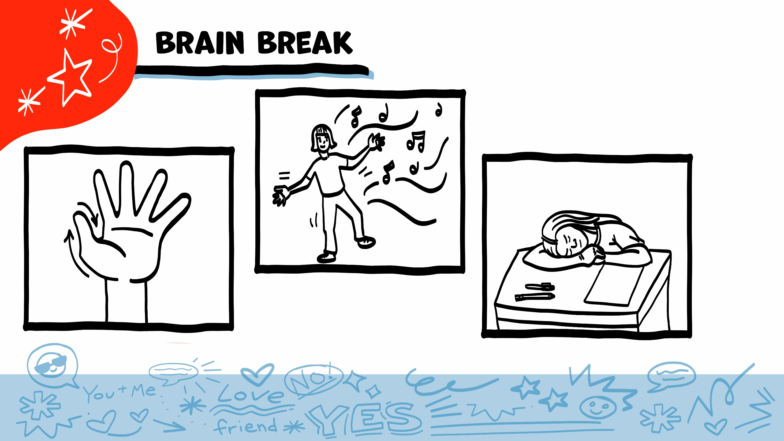
© 2026 SAFE Disability Services Program
Notes:
Say: That was a lot of information, and you all are doing an amazing job! Every week in class we will take a brain break in the middle. This is a chance to move a little and take a break from thinking!
Below are three ideas to give students a quick opportunity for a brain break. You are also welcome to come up with your own ideas for brain breaks that work best for your class.
Five finger breathing
For this exercise, have all students place their hand in front of their chest with their five fingers spread out. Next, use the pointer finger of the other hand to trace up and down each of the five fingers, beginning with the thumb. As students trace up a finger, they will breathe in. As they trace down a finger, they will breathe out. When students breathe out on the pinky finger, you can tell them to shake out their hands and arms. As the school year goes on, you can ask students to lead this exercise for their peers.
If this exercise is physically inaccessible for your class, you can also model the hand tracing for students while they breathe in and out.
Stretch break
Lead students through a series of basic stretches. These can be completed in a chair, or while standing up, depending on the accommodation needs of your class. Some ideas include reaching toward the ceiling, stretching one arm at a time across the chest, reaching toward toes, turning head from side to side, etc. Ask students to hold a pose while you count to ten. As the school year goes on, you can ask students to lead stretches for their peers.
Dance party
If your class likes to dance, you can put on a short song for them to dance to. This is especially effective if you are able to find a song that relates to the theme for that week’s class.

Slide 28
Cyberbullying
Getting Help Game
Brain break
Sexting
Online Safety Plan
© 2026 SAFE Disability Services Program
Notes:
Read the agenda. Alternatively, you can ask for a student volunteer to read the agenda.

Slide 29
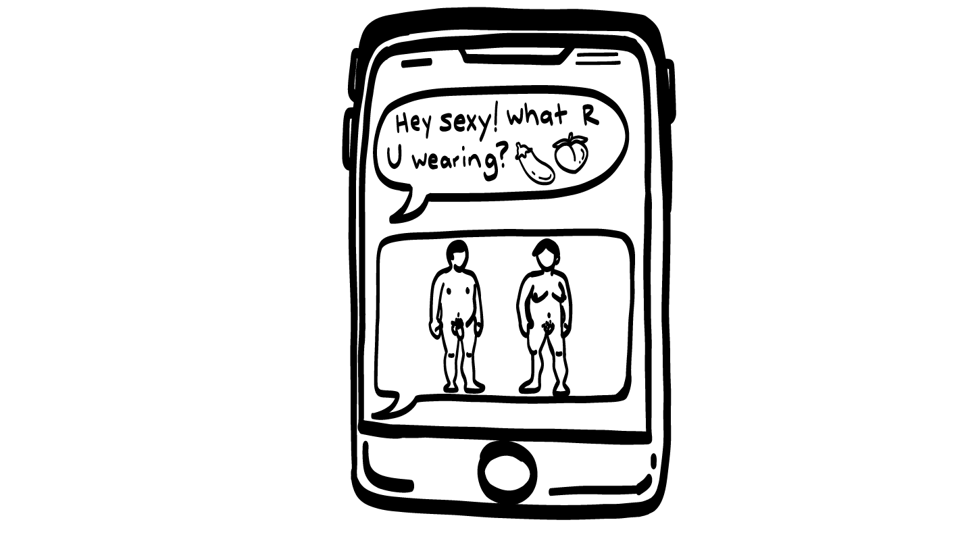
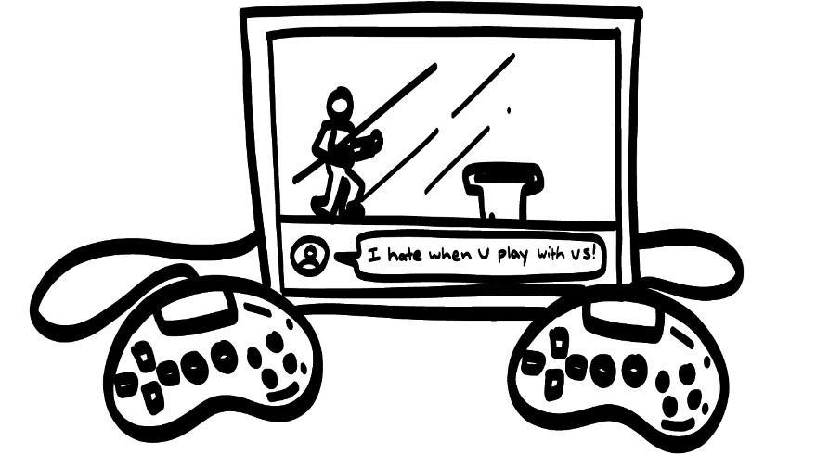
!?!?!?
© 2026 SAFE Disability Services Program
Notes:
Say: Does anyone know what sexting is?
Give students enough time to process the question and make their decisions.
Say: Sexting means sending sexy texts to someone, and it can be naked pictures. This can happen through a cell phone but could also happen through messenger apps or video games.
What can or should you do if someone sends you a sext?
Give students enough time to process the question and make their decisions.
You should talk to an adult from your inner green circle of trust. They can help you decide what to do about the message.
Say: What can or should you do if your friend says that someone sent them a sext?
Give students enough time to process the question and make their decisions.
You can also be an ally to your friend and encourage them to talk to an adult from their inner green circle of trust. They can help your friend decide what to do about the message.
Note: In Texas, it is against the law to send sexually explicit photos to someone without their prior consent. It is a class C misdemeanor that can lead to up to a fine. You can talk with your students about how serious it is to send a naked picture without someone’s consent, and how someone who does so could get in trouble with the police. If you are not in Texas, check your local statutes regarding .

Slide 30
Cyberbullying
Getting Help Game
Brain break
Sexting
Online Safety Plan
© 2026 SAFE Disability Services Program
Notes:
Read the agenda. Alternatively, you can ask for a student volunteer to read the agenda.

Slide 31

Online Safety Plan
2. Report it
1. Block
3. Take a break
5. Talk to an adult you trust
4. Do self-care
© 2026 SAFE Disability Services Program
Notes:
Say: The first part of the safety plan is all about cyberbullying. Remember, if you have been cyberbullied it is not your fault. That means you didn’t do anything wrong. You can get help. On your safety plan, you’ll write the name of another adult you trust who can help if you are being cyberbullied.
You can also use the other strategies we talked about today, like screenshotting the comments, making a report, or blocking the person. It’s not a good idea to respond to the mean comments, but you can take a break from being online.

Slide 32

Getting Help
© 2026 SAFE Disability Services Program
Notes:
Say: The second part of the safety plan is about sexting. If you feel weird or scared about a sext someone sends you, you can get help.
On your safety plan, you’ll write the name of an adult from your inner green circle of trust you could talk to if you are worried about a sext. You should only show the sext to the adult you trust, and not to anyone else.
If you get a sext, an adult can help you delete the sext and block the person who was sexting you.
Finally, If you have been cyberbullied, you can practice self-care. Self-care is when you do things that you love and that make you feel really good.
At the bottom of your safety plan, you will write or draw some things that you can do to help you feel better.
Walk around and provide support to students as needed as they fill out their Online Safety Plan.

Slide 33
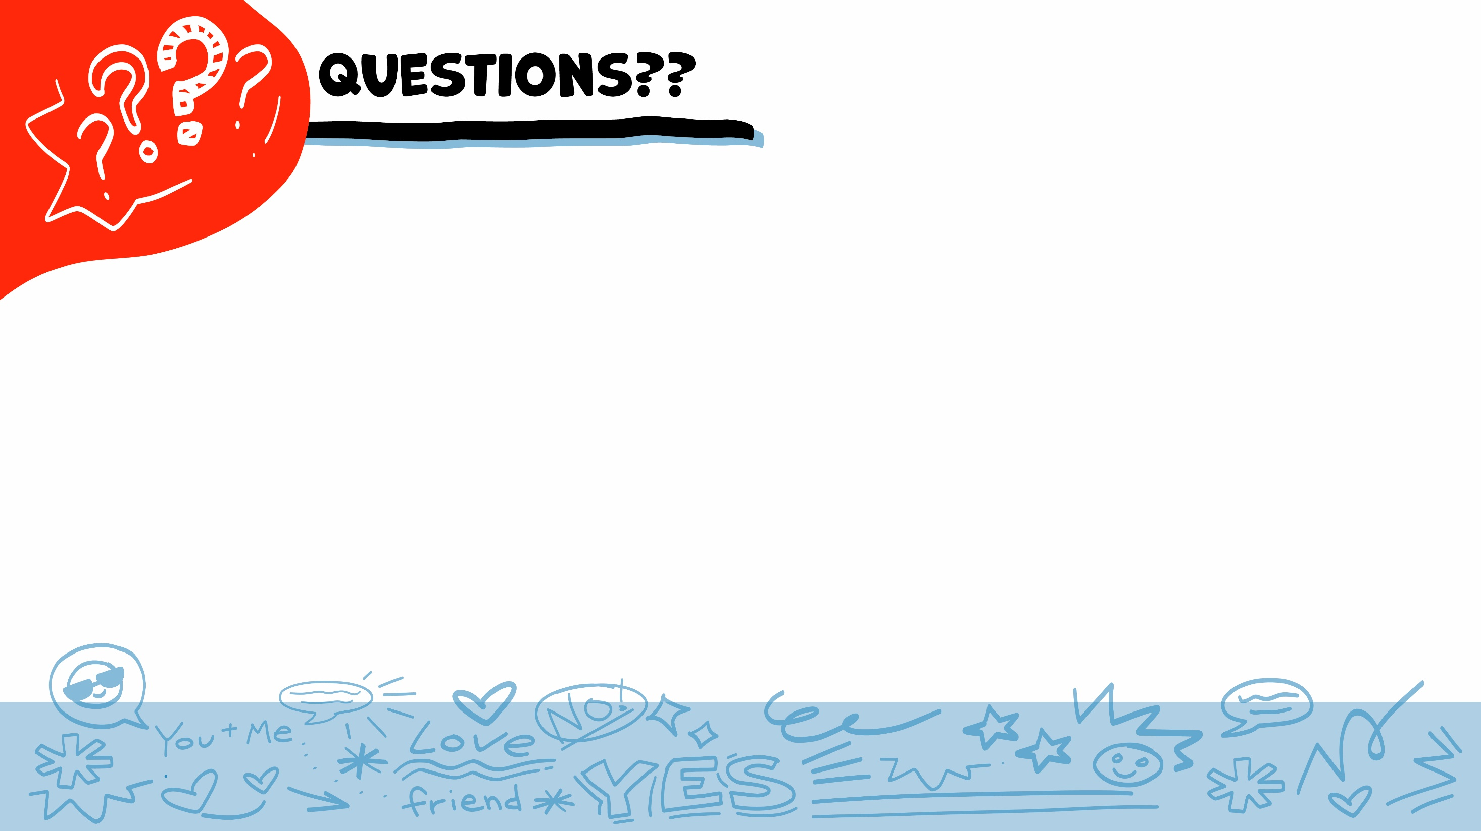
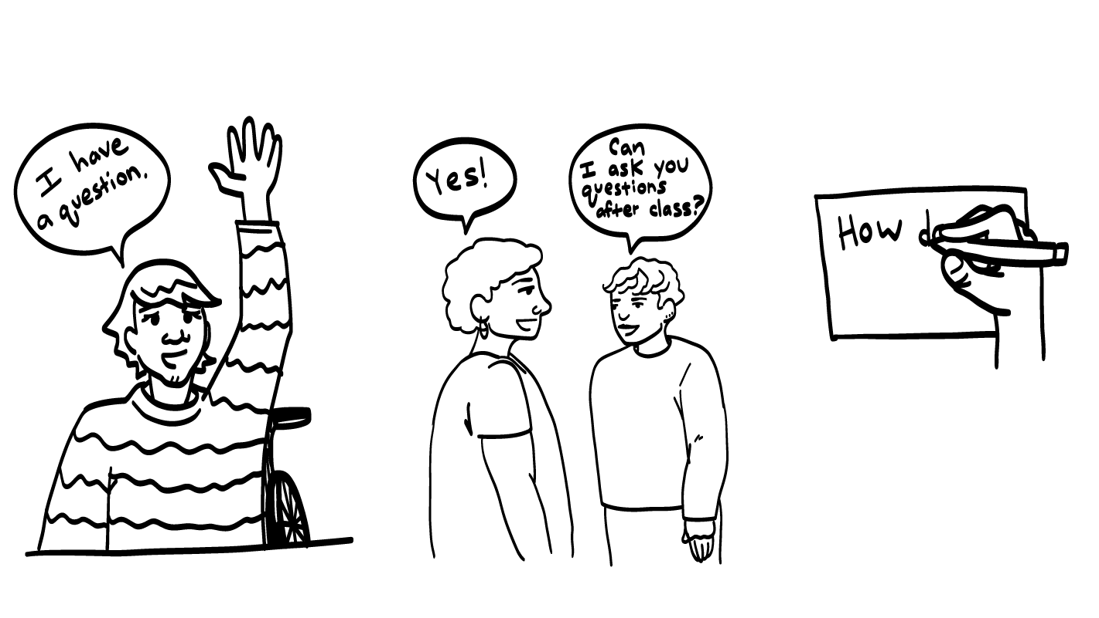
© 2026 SAFE Disability Services Program
Notes:
Say: Does anyone have any questions about today’s class? Remember, if you don’t want to ask your question out loud, you can write it on a notecard and leave it on your desk. You can also ask someone you trust to help you write your question on the notecard. I will pick up the notecards and will answer the questions the next time we meet. When I answer a question, I won’t tell anyone who asked it.

Slide 34
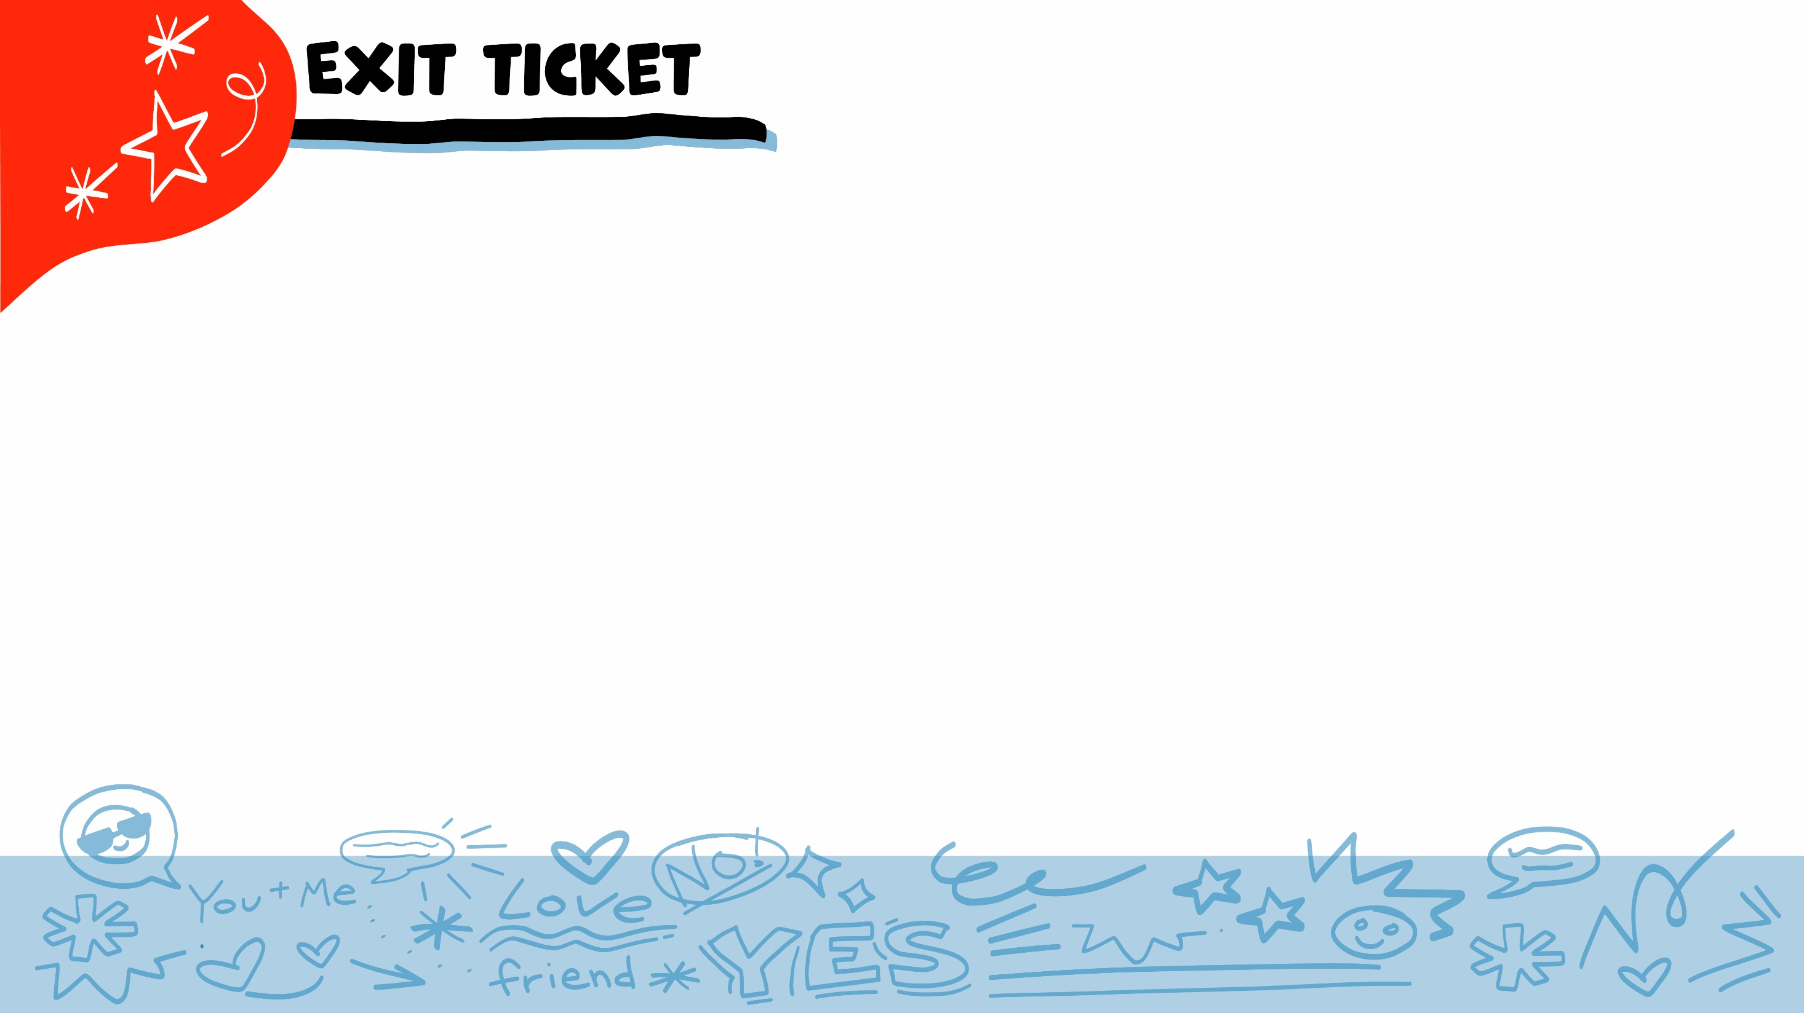


If you are being cyberbullied, can you get help?
YES
NO
© 2026 SAFE Disability Services Program
Notes:
Say: If you are being cyberbullied, can you get help? Give a thumbs up for yes and a thumbs down for no.
Give students enough time to process the question and make their decisions.
Say: Yes! You can always get help from an adult in your inner green circle of trust.

Slide 35
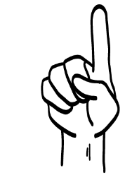



If someone cyberbullies you, what can you do?
Talk to an adult you trust
Block them
Take a break from being online
1
2
3
All of the above
4
© 2026 SAFE Disability Services Program
Notes:
Say: If someone cyberbullies you, what can you do? Hold up one finger for “talk to an adult you trust,” two fingers for “block them,” three fingers for “take a break from being online,” and four fingers for “all of the above.”
Give students enough time to process the question and make their decisions.
Say: You can do all of the things on this screen to get help if you have been cyberbullied. You can also report the person or do some self-care.

Slide 36
If you send someone a picture online, can you get it back?
YES
NO
© 2026 SAFE Disability Services Program
Notes:
Say: If you send someone a picture online, can you get it back? Hold a thumbs up for yes and a thumbs down for no.
Give students enough time to process the question and make their decisions.
Say: No, once you have sent a picture, there is no way to get it back. You also have no control over what the person will do with that picture.

Slide 37

© 2026 SAFE Disability Services Program
Notes:
Say: If you are being hurt, or if someone ever touches your body in a way that you don’t like, you can get help. You did not do anything wrong, and you are not alone. You can get help by talking to another adult from your circle of trust. If someone you care about is being hurt, you can also get help by talking to another adult from your circle of trust (green circle). If an emergency is happening, you can always call 911. If you call 911 for help, a police officer or an ambulance might come.
If the first person you tell doesn’t believe you or doesn’t get you help, keep telling adults you trust what is going on until you get the help you need.

Slide 38

© 2026 SAFE Disability Services Program
Notes:
Say: Does anyone remember what our power statement is? Our power statement is “I know me best.” This means that each of you knows yourself better than anyone else does. Today you learned more about being safer online. Let’s gather together and on the count of three, say our power statement.
Have each interested student put one hand in the middle of the circle. Ask for a student volunteer to count to three. After three, all participants say the power statement while lifting their hands into the air. Students can also stand in the circle without touching hands if they prefer.

Slide 39

This work is supported by the Texas Council for Developmental Disabilities through a grant from the U.S. Administration for Community Living (ACL), Department of Health and Human Services (HHS), Washington, D.C. 20201 with a 100% federal funding award totaling $6,161,072. Council efforts are those of the grantee and do not necessarily represent the official views of nor are endorsed by ACL, HHS, or the U.S. government.
© 2026 SAFE Disability Services Program
Notes:
SAFE would like to thank the Texas Council for Developmental Disabilities for the funding for this curriculum.

Slide 40

This curriculum is offered online at no cost. You are free to use the resources in the original format for educational purposes only. Please reference The SAFE Alliance appropriately (citations at bottom of page).
We ask that you do not alter curriculum images/art, slides, or lesson plan materials. You may not use My Rights My Life (18+ or High School) curriculum for commercial purposes (i.e., selling workshops you facilitate based on MRML curriculum; and/or creating links/websites to re-distribute any materials associated SAFE’s My Rights My Life).
This resource, My Rights My Life: A curriculum for healthier relationships for high school students (grades 9-12) is based on the original My Rights My Life: A curriculum for safer relationships (age 18+) written by Megan Westmore, Heidi Lersch, and edited by Schwartz, M. (2022). Selling materials from MRML is a copyright violation.
Burleson, Anna Belle & Benitez, Sophie (2026) provided light modification and abbreviated the original curriculum
(Westmore & Lersch, 2022) to offer an age appropriate resource for High School Students (grades 9-12).
Schwartz, M. (Ed.). The SAFE Alliance, Austin, Texas.
Westmore, M. & Lersch, H. (2022). My rights my life: A curriculum for safer relationships.
Schwartz, M. (Ed.). The SAFE Alliance: Austin, TX.
© 2026 SAFE Disability Services Program

